Slide 1

ACP Advocacy in Challenging Times: Embrace the Process and Celebrate Progress State Health Policy Networking Webinar November 5, 2025
Shari M. Erickson, MPH Chief Advocacy Officer and Senior Vice President, Governmental Affairs and Public Policy

Slide 2
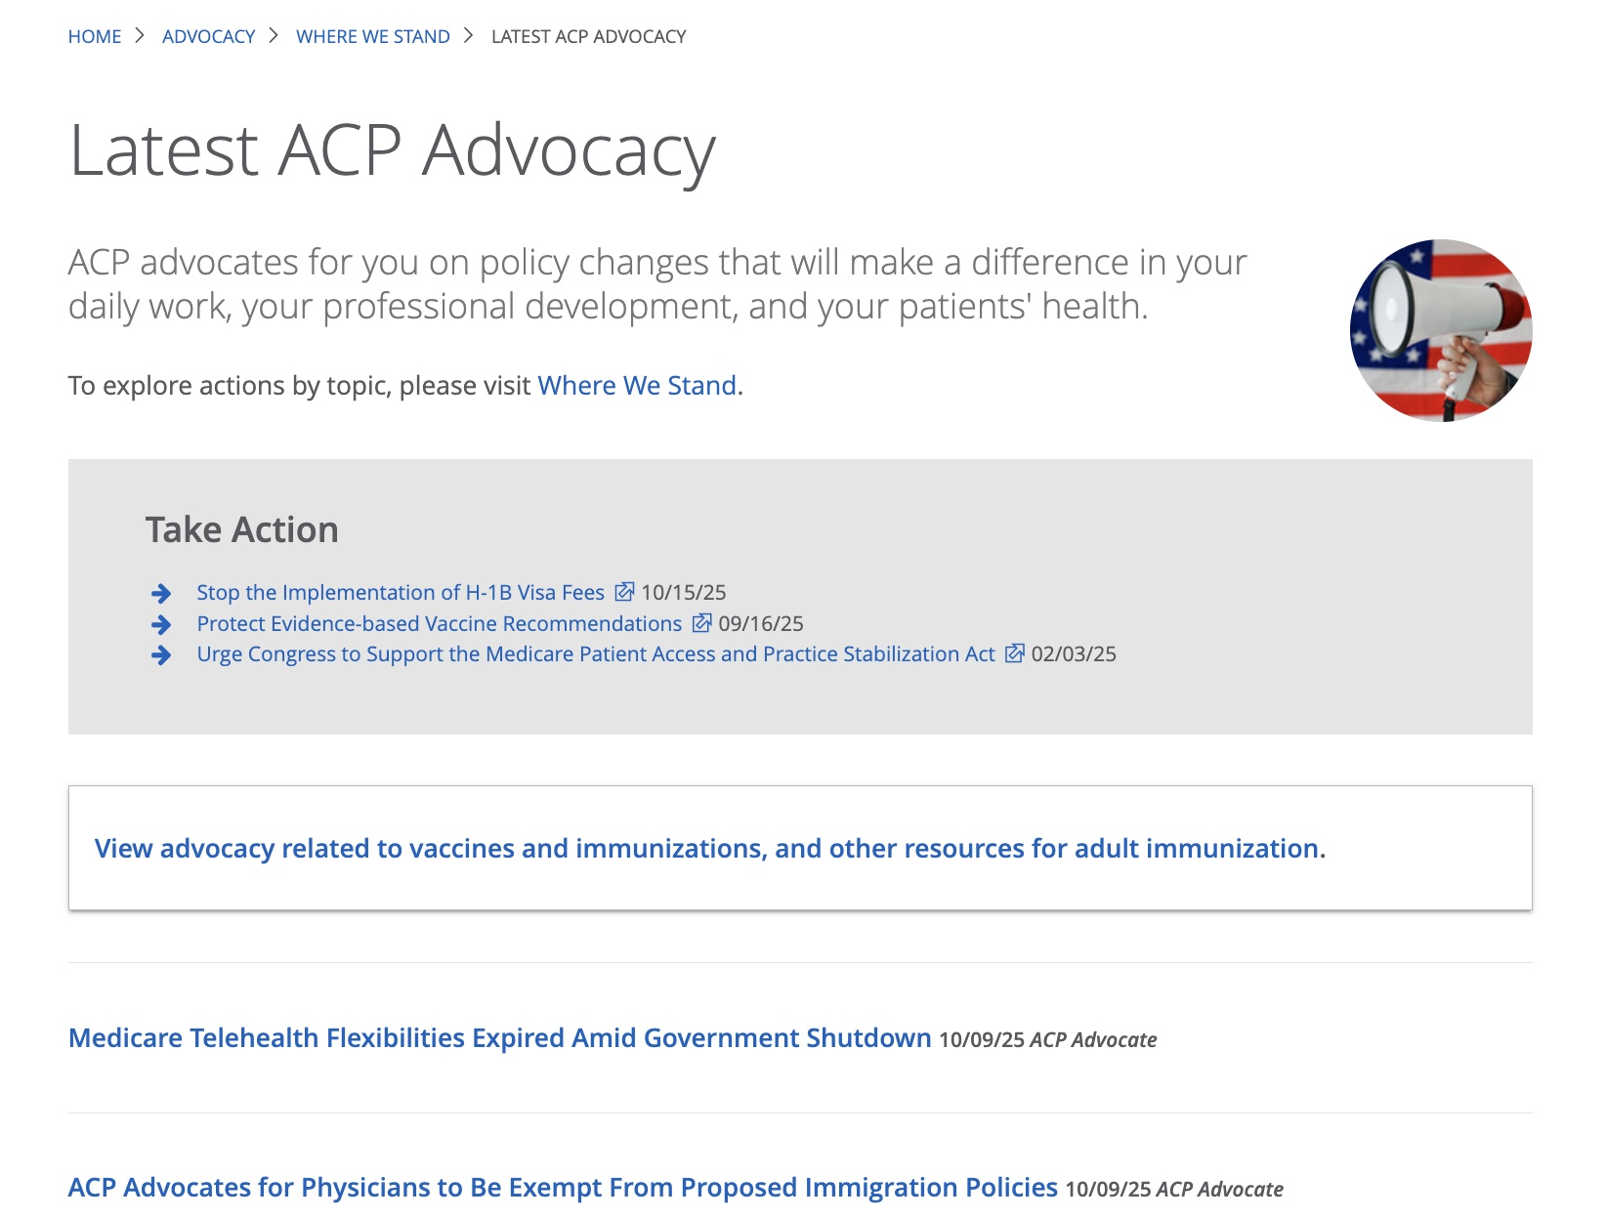


Slide 3

2025 Elections

Slide 4
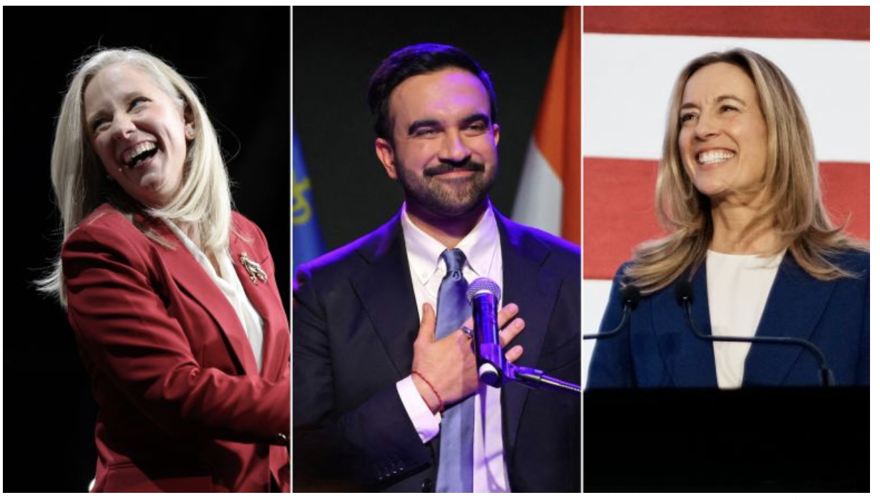
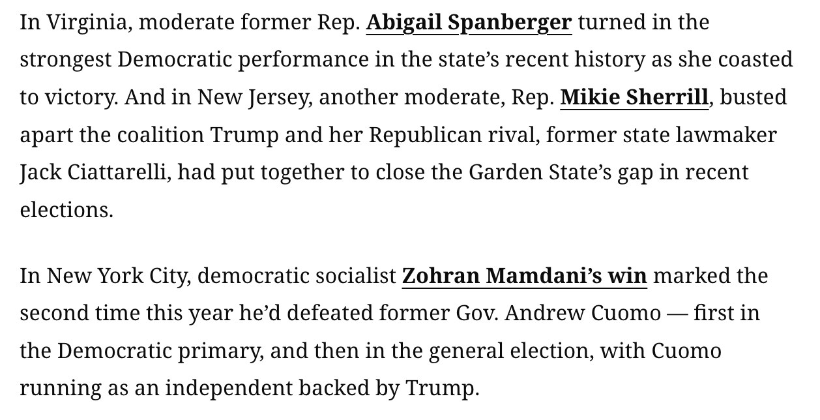
Democratic Sweep on the East Coast

Slide 5
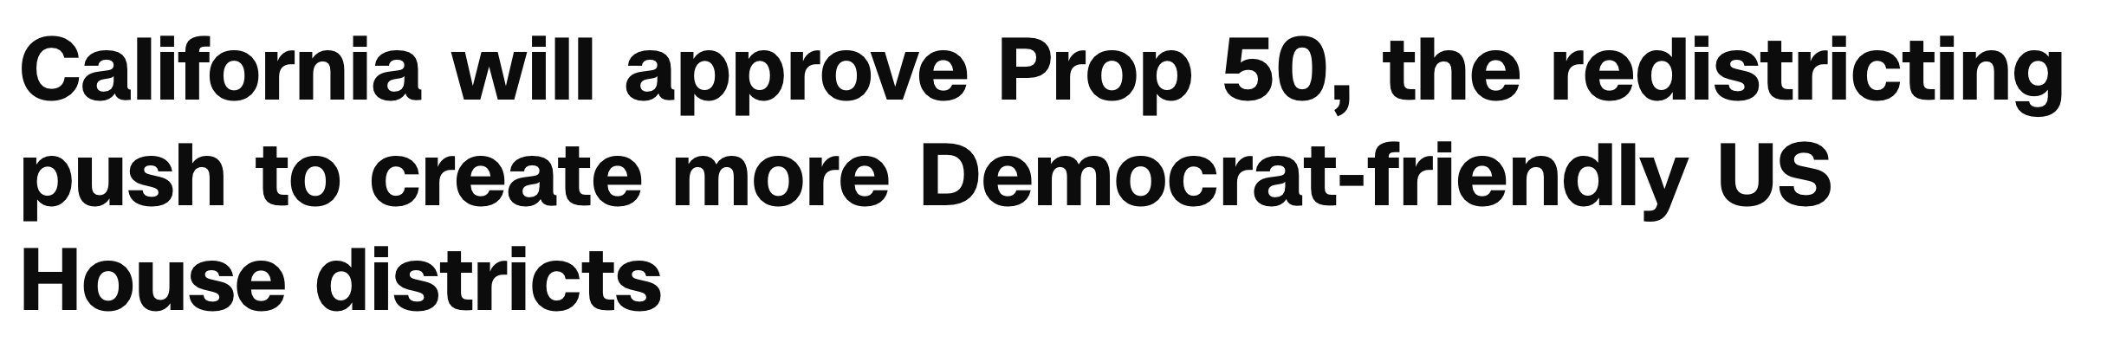
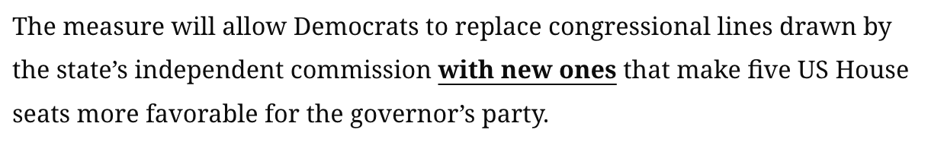

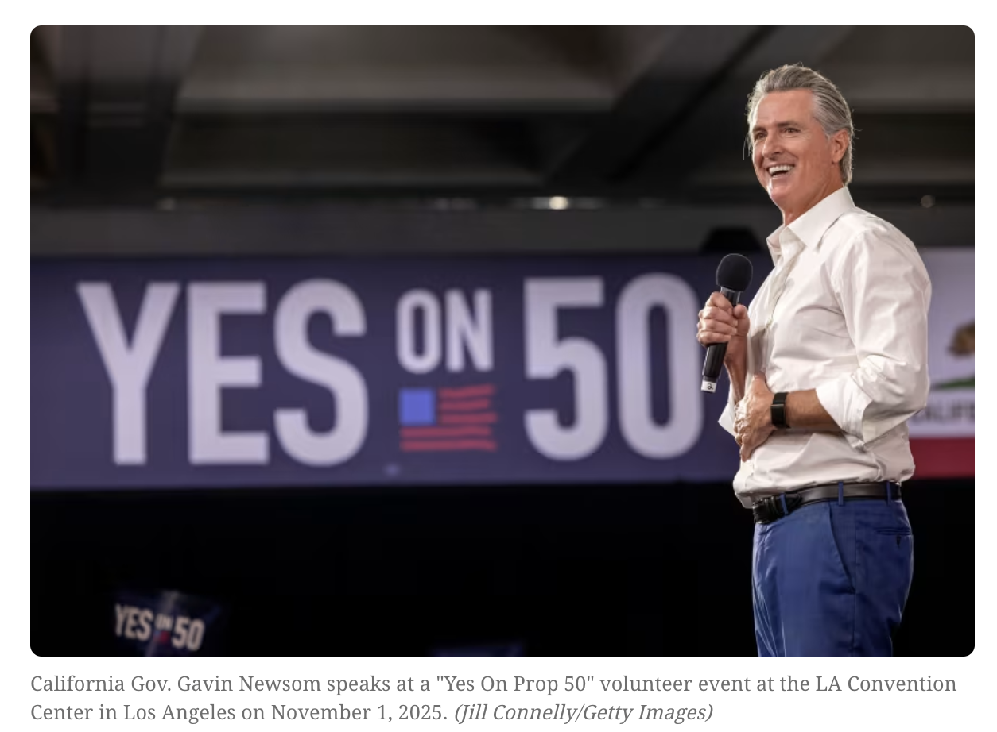
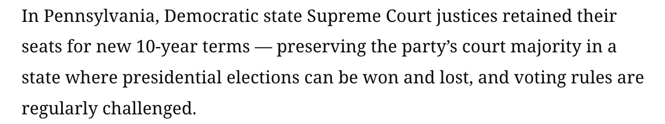
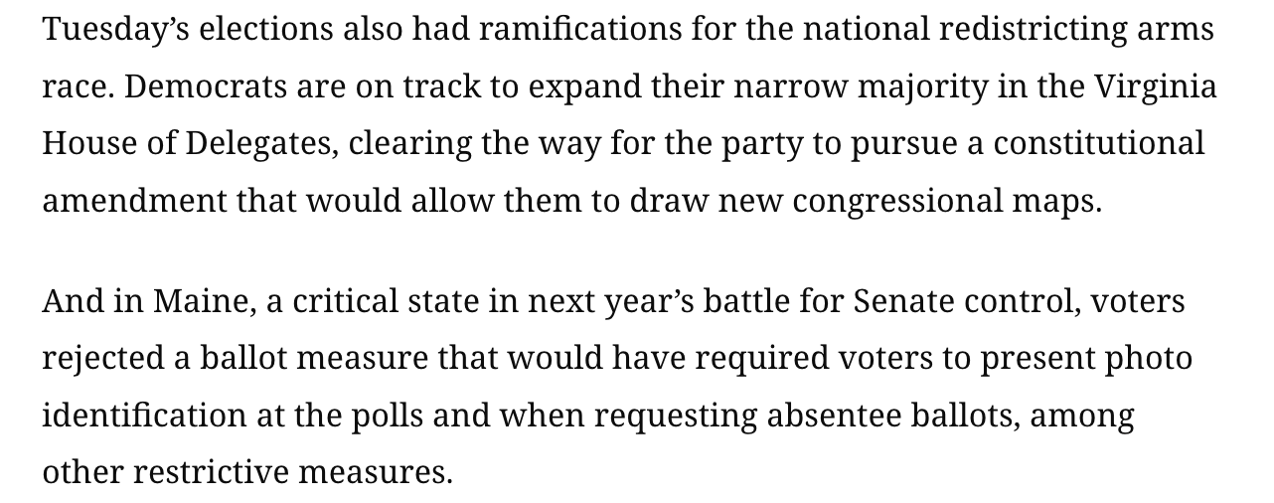

Slide 6
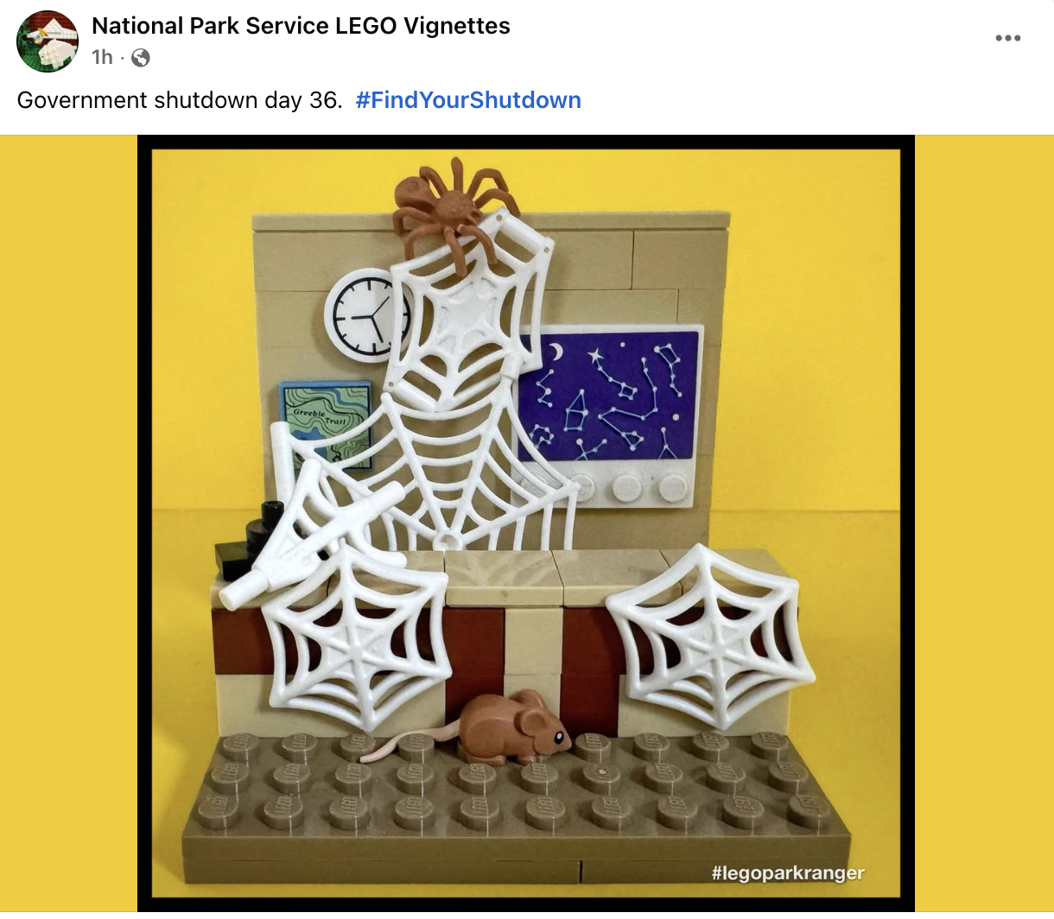
Congressional Activity …. None 😢

Slide 7
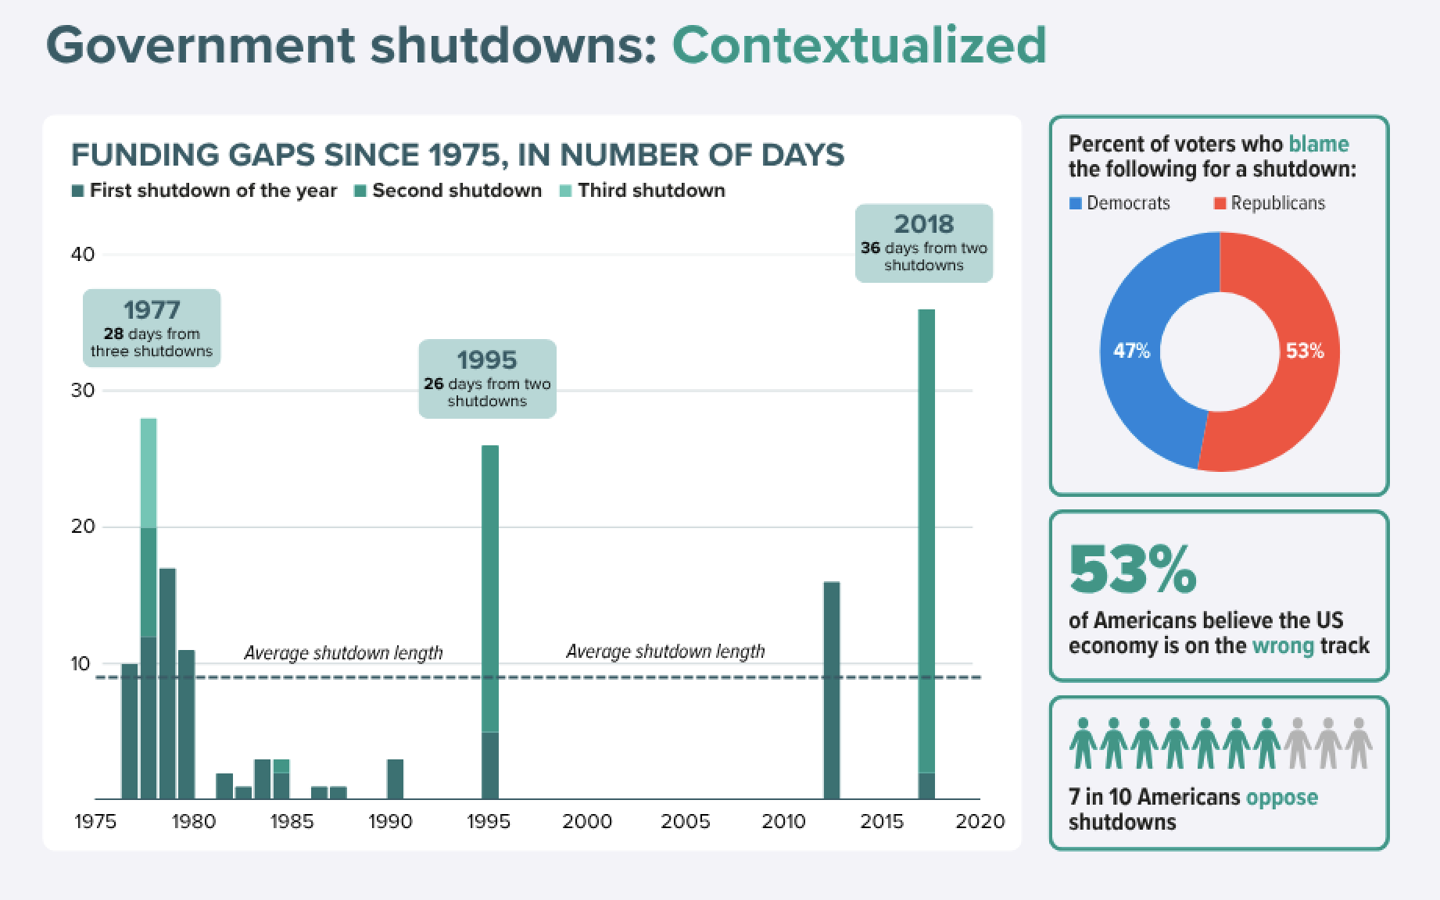


Slide 8

2025 government shutdown dashboard
Who will be missing paychecks?
At least 700,000+ federal employees have been furloughed
3 million active-duty and over 750,000 National Guard and reserve personnel facing payment uncertainties for November 1
-$15B
potential shrink in GDP each week the shutdown extends
LAYOFF TRACKER
Updated: October 15
More than 4,000 total workers at seven major federal agencies have been laid off
AGENCY | FURLOUGHS | SHARE
EPA | 13,432 | 89%
EDUCATION | 2,117 | 87%
COMMERCE | 34,711 | 81%
LABOR | 9,792 | 76%
HUD | 4,359 | 71%
STATE | 16,651 | 62%
ENERGY | 8,105 | 59%
INTERIOR | 30,995 | 53%
AGRICULTURE | 42,256 | 49%
DEFENSE | 334,904 | 45%
HHS | 32,460 | 41%
SBA | 1,456 | 23%
TRANSPORTATION | 12,213 | 23%
SSA | 6,197 | 12%
JUSTICE | 12,840 | 11%
PERSONNEL MANAGEMENT | 210 | 10%
DHS | 14,184 | 5%
VETERANS AFFAIRS | 14,874 | 3%
TREASURY | 1,736 | 2%
ENERGY
DHS
EPA
HUD
TREASURY
EDUCATION
COMMERCE
HHS
SOURCE NYT, Politico, Bipartisan Policy Center
PRESENTATION CENTER 10/24/25
Notes:
Sources:
“US to lose $15B in GDP each week of a shutdown, White House memo says,” Politico, October 1, 2025, https://www.politico.com/news/2025/10/01/us-gdp-loss-shutdown-00590927
“Who Is Missing Paychecks in the 2025 Shutdown—When and Where?,” Bipartisan Policy Center, October 14, 2025, https://bipartisanpolicy.org/explainer/who-is-missing-paychecks-in-the-2025-shutdown-when-and-where/
“How the Shutdown Is Affecting Federal Services and Workers,” New York Times, October 15, 2025, https://www.nytimes.com/interactive/2025/09/30/us/politics/government-shutdown-furloughs.html

Slide 9
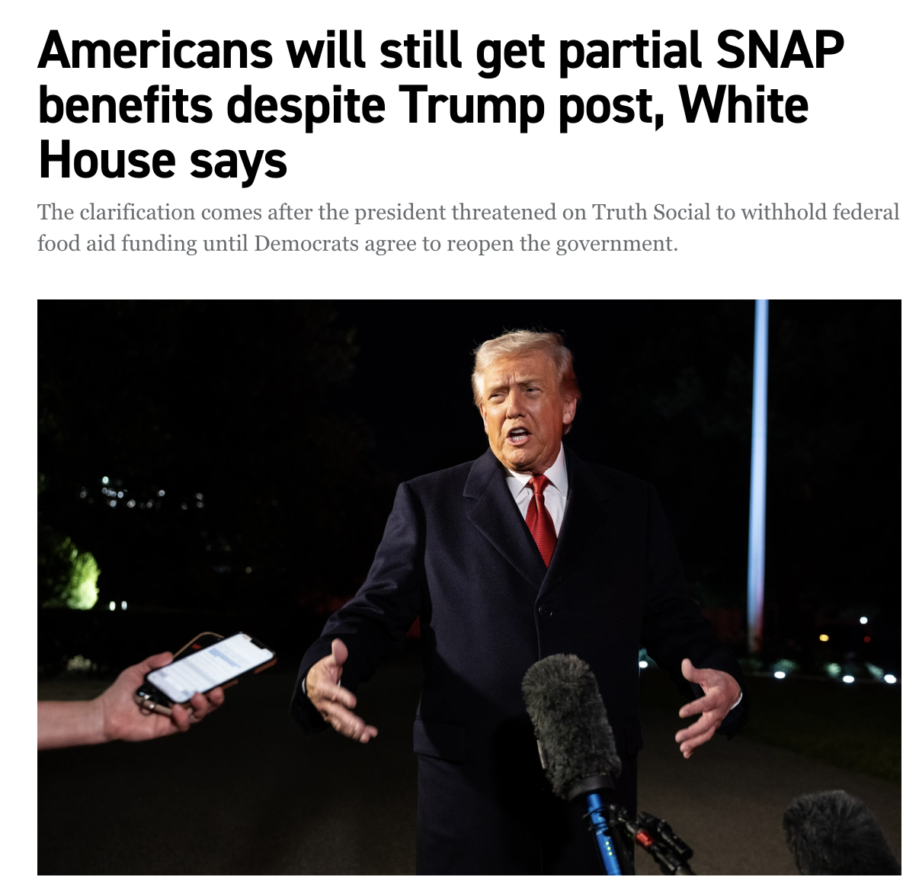
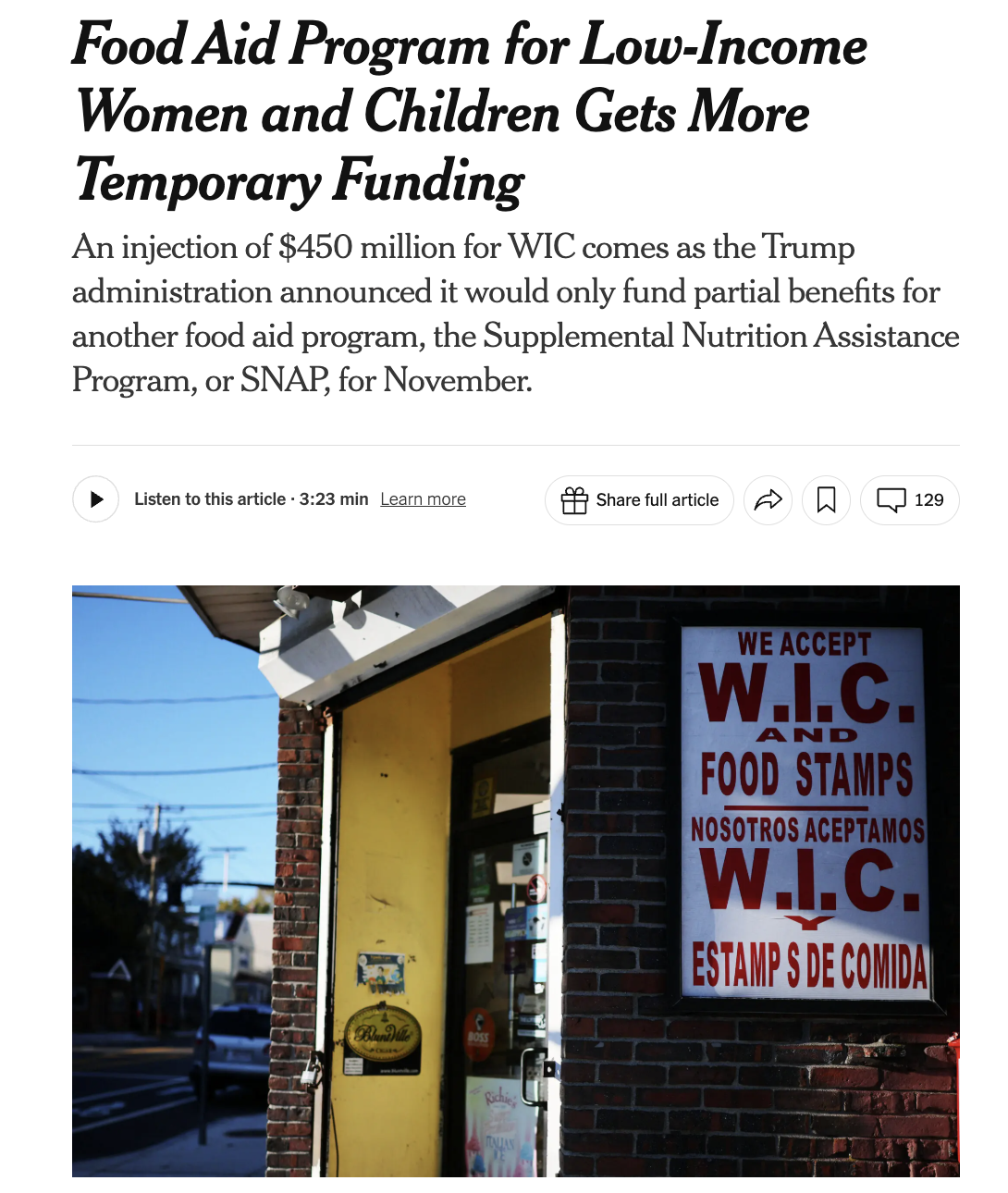
2025 government shutdown key dates
■ Both chambers in session ■ House only in session ■ Senate only in session ■ Federal holiday
October 2025
OCTOBER KEY DATES
October 1: Shutdown begins
October 3: Senate vote fails (54-44)
October 6: Two Senate votes fails (52-42 & 50-45)
October 8: Two Senate vote fails (54-45 & 52-47)
October 9: Senate vote fails (54-45)
October 10: Federal employees receive partial paychecks
October 14: Senate vote fails (49-45)
October 15: Senate vote fails (51-44); Medicare open enrollment begins; missed pay day for some federal employees
October 16: Senate vote fails (51-45)
October 17: Federal courts reduce operation
October 20: Senate vote fails (50-43)
October 22: Senate vote fails (54-46)
October 23: Senate vote fails (54-45)
October 31: Day 31 and possible funding lapse for WIC
 |  |  | 1 | 2 | 3 | 4
5 | 6 | 7 | 8 | 9 | 10 | 11
12 | 13 | 14 | 15 | 16 | 17 | 18
19 | 20 | 21 | 22 | 23 | 24 | 25
26 | 27 | 28 | 29 | 30 | 31
November 2025
 |  |  |  |  |  | 1
2 | 3 | 4 | 5 | 6 | 7 | 8
9 | 10 | 11 | 12 | 13 | 14 | 15
16 | 17 | 18 | 19 | 20 | 21 | 22
23 | 24 | 25 | 26 | 27 | 28 | 29
30
NOVEMBER KEY DATES
November 1: 2026 ACA open enrollment begins; possible disruption to SNAP benefits
November 4: Election day; government shutdown becomes the longest in US history
SOURCE NBC News, Forbes
PRESENTATION CENTER 10/24/25
Notes:
Sources:
“Government shutdown key dates: What could happen, day by day,” NBC News, October 20, 2025, https://www.nbcnews.com/data-graphics/government-shutdown-key-dates-social-security-wic-smithsonian-museums-rcna235198
“Government Shutdown Day 16: Funding Bill Fails 10th Vote,” Forbes, October 20, 2025, https://www.forbes.com/sites/saradorn/2025/10/16/government-shutdown-day-16-funding-bill-fails-10th-vote/

Slide 10
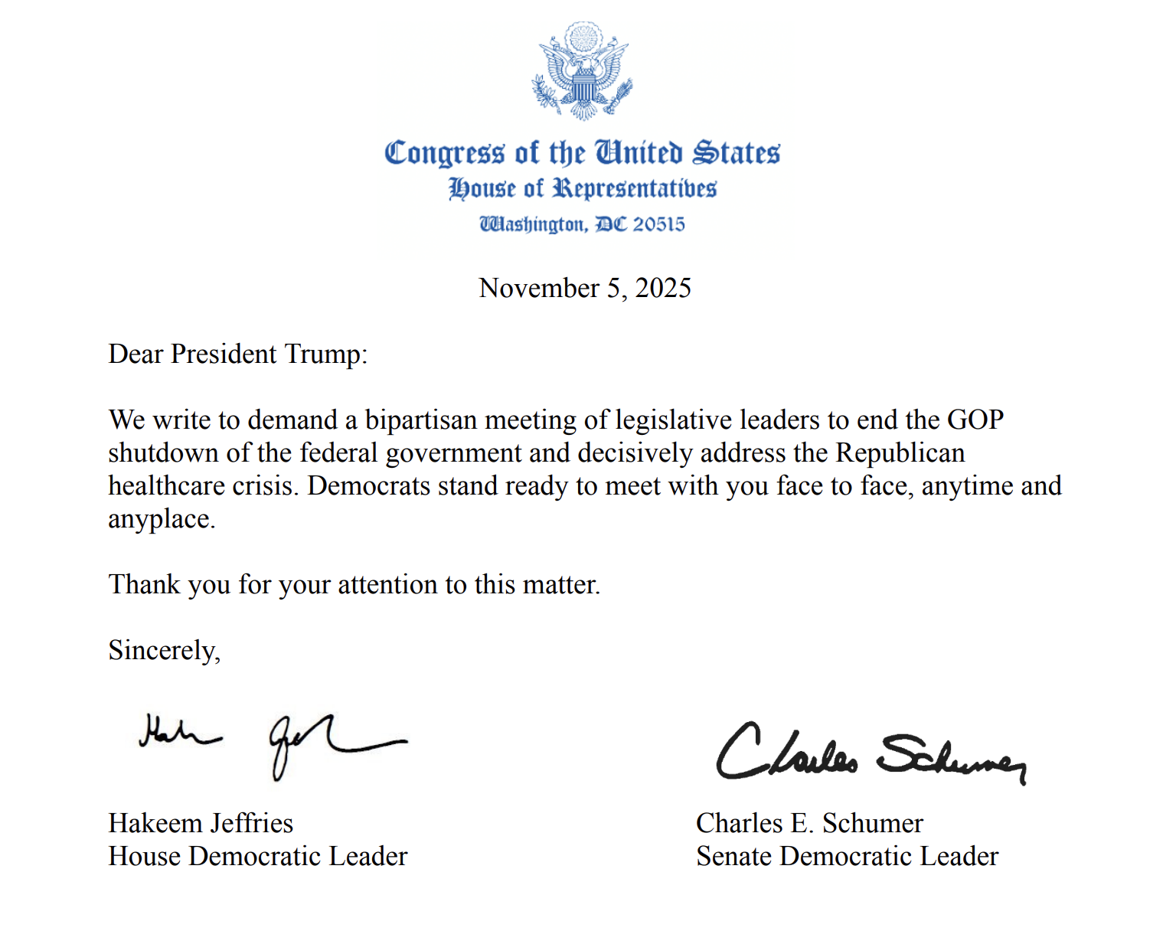

Slide 11

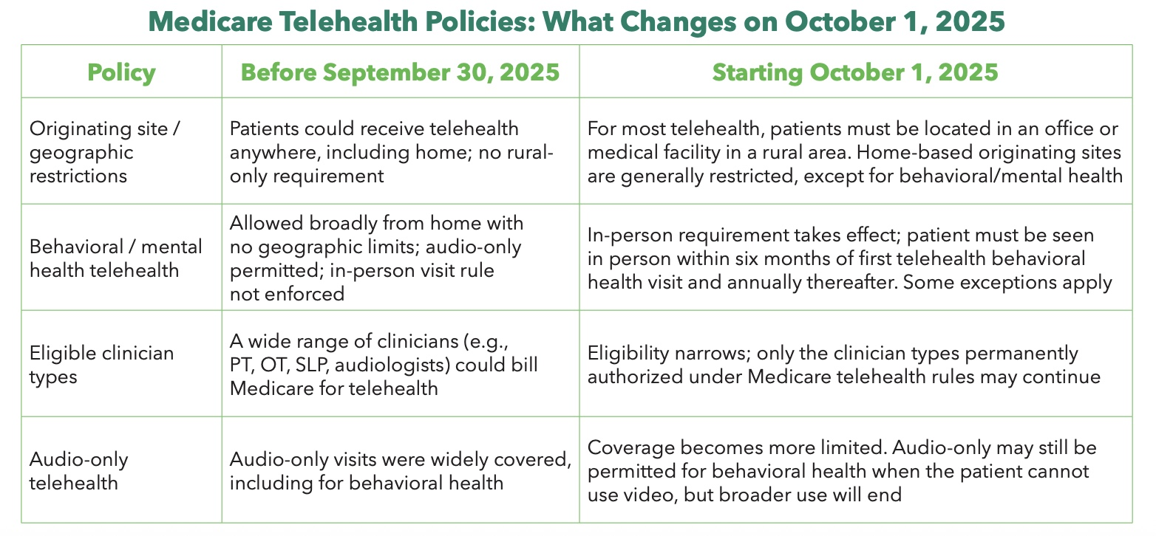
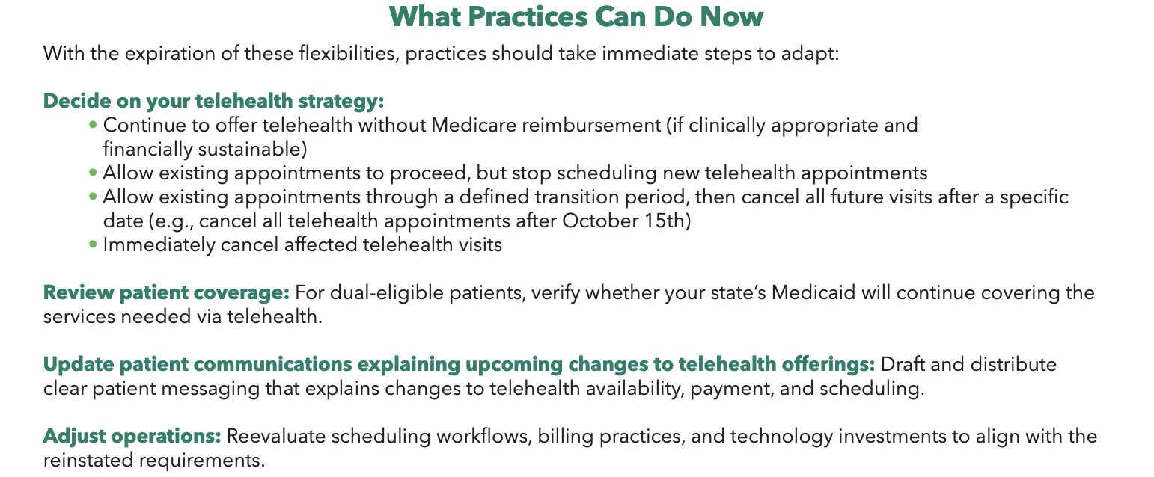
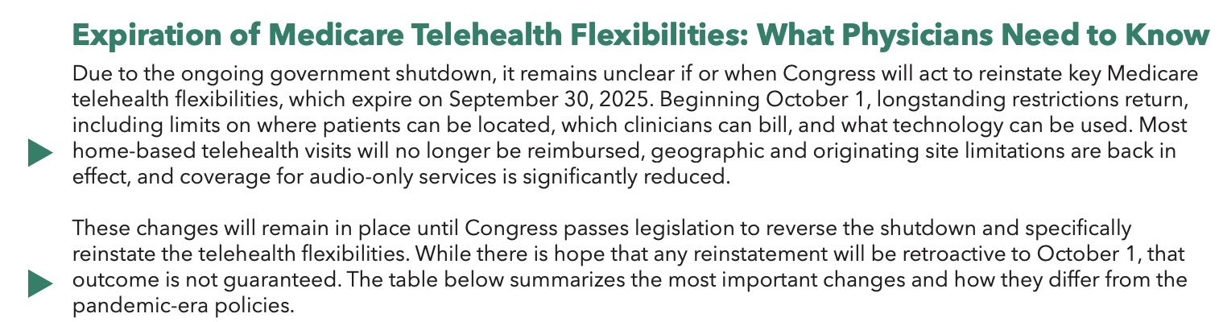

Slide 12
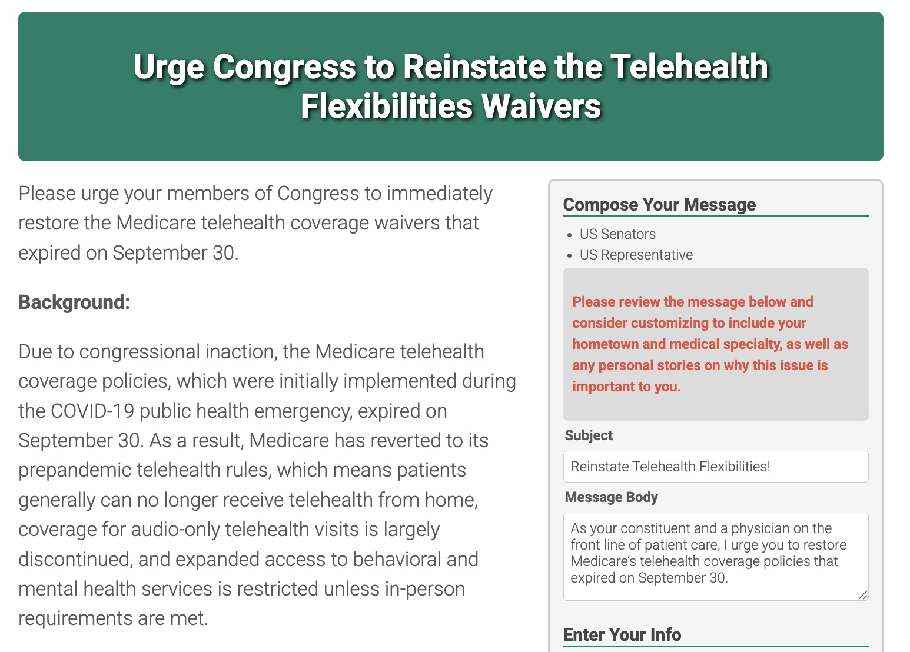

ACP Invites You To Take Action to Restore Telehealth Flexibilities

Slide 13
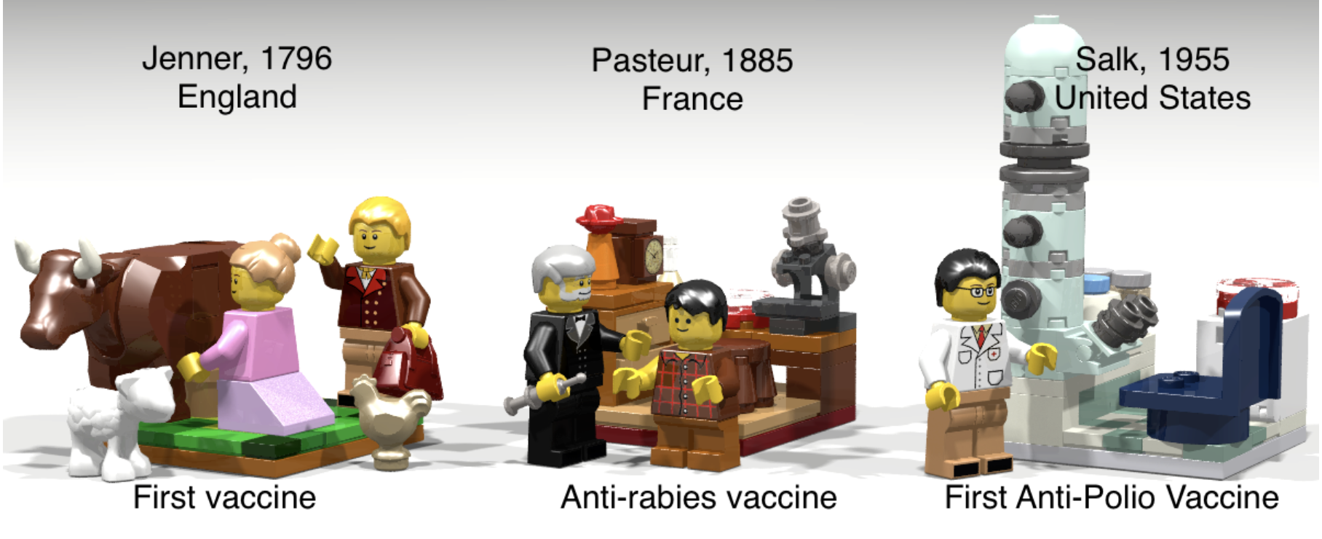
Vaccine and Public Health Related Advocacy

Slide 14
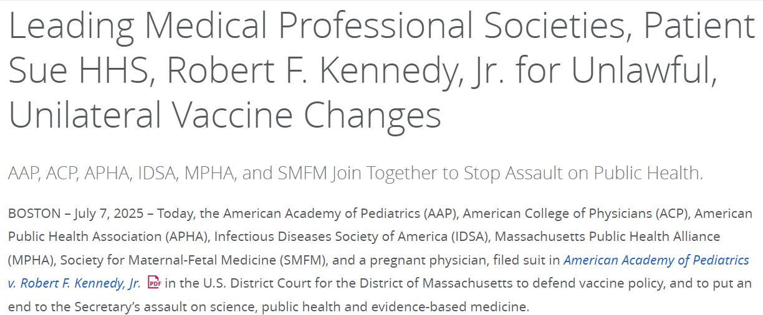




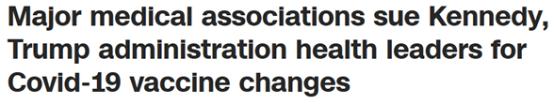

ACP Files Lawsuit with Other Medical Societies against HHS, Secretary Kennedy for Unlawful, Unilateral Vaccine Changes
On July 7, 2025, ACP and other medical societies defend vaccine policies and call to put an end to the assault on science, public health, and evidence-based medicine.
Medical societies part of the lawsuit:
The American Academy of Pediatrics
The American Public Health Association
The Infectious Diseases Society of America
The Massachusetts Public Health Alliance
The Society for Maternal-Fetal Medicine
ACP received extensive coverage media coverage

Slide 15
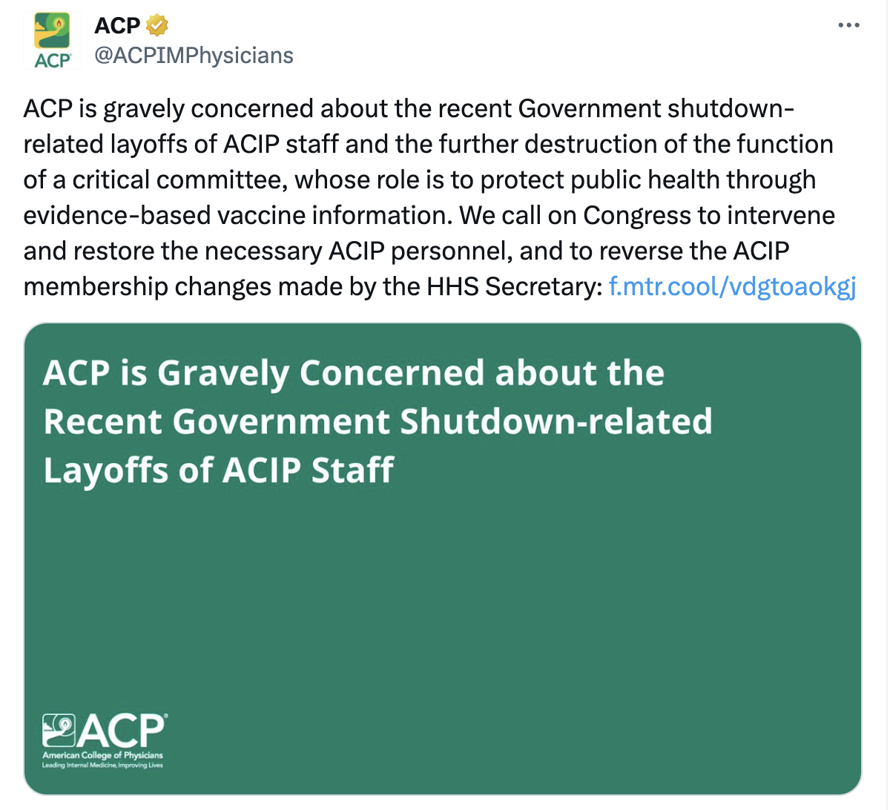
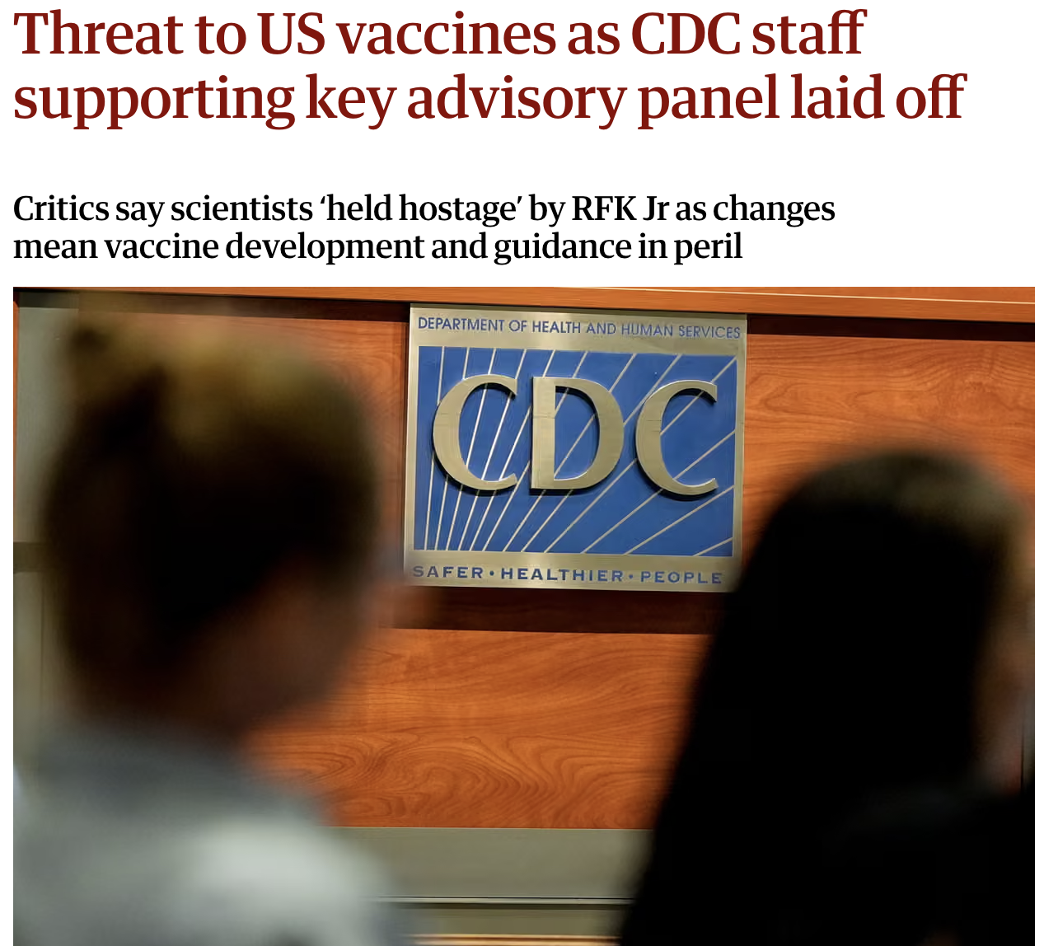

Slide 16
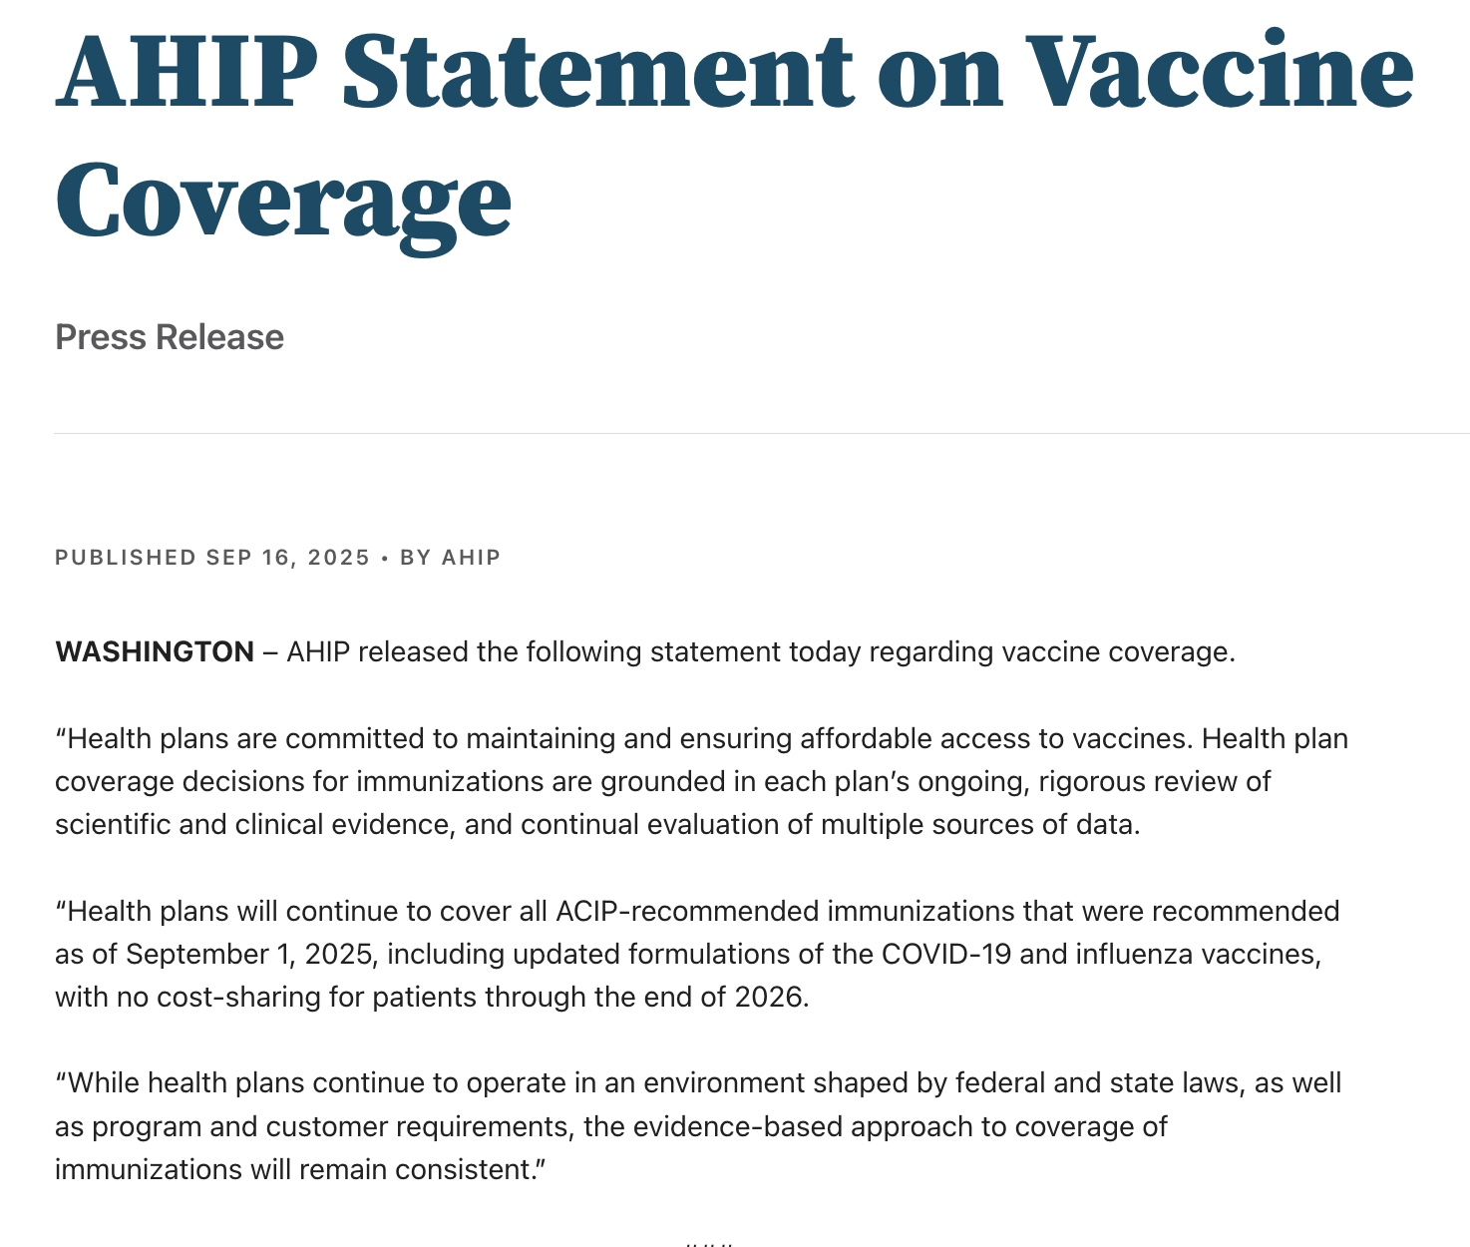
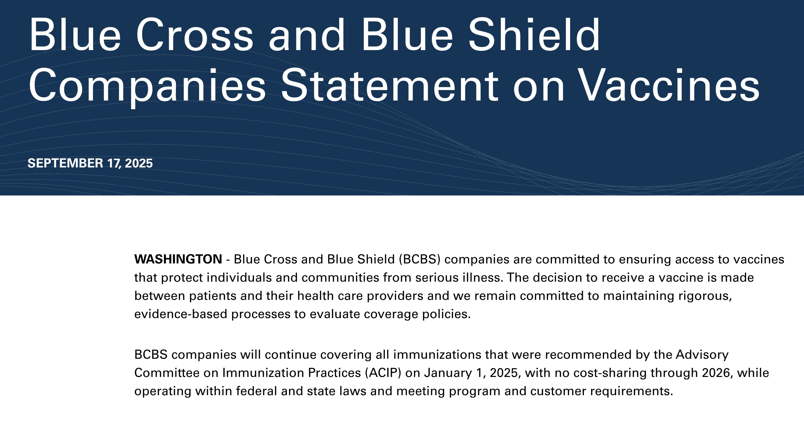
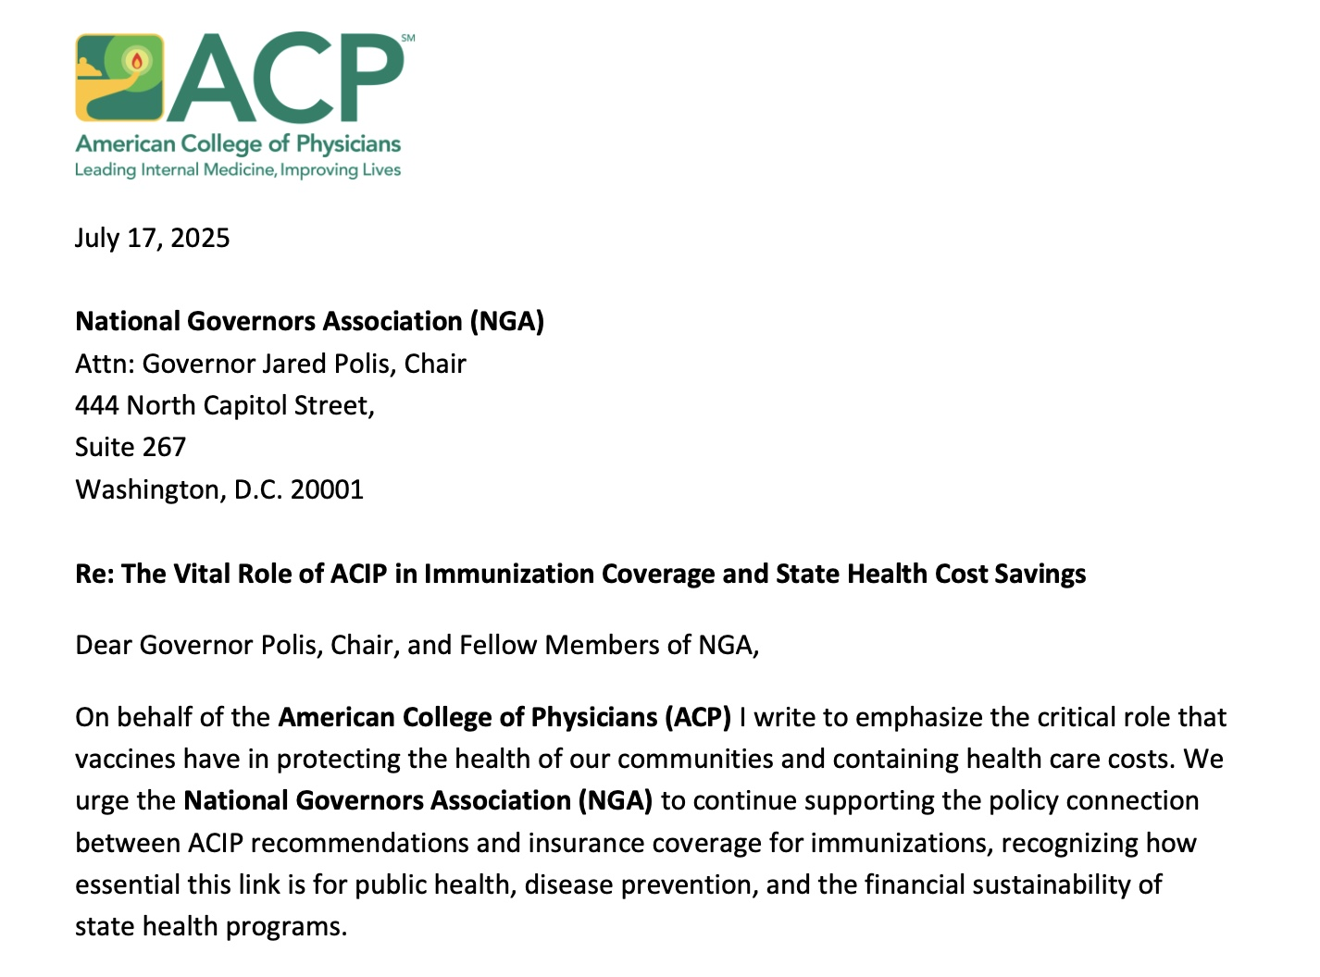
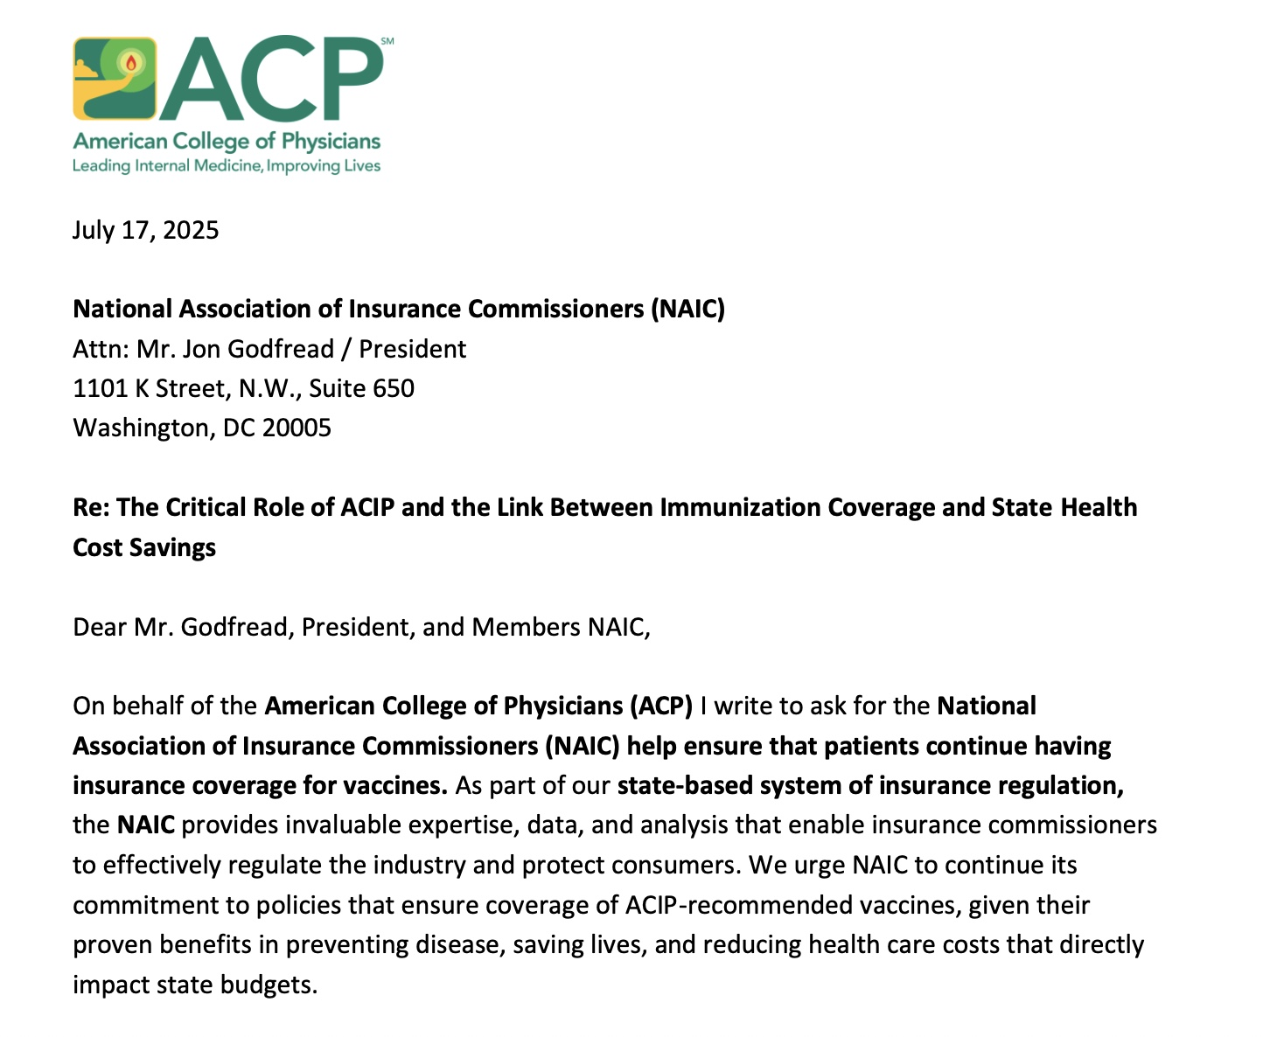
Advocacy for Vaccine Insurance Coverage

Slide 17
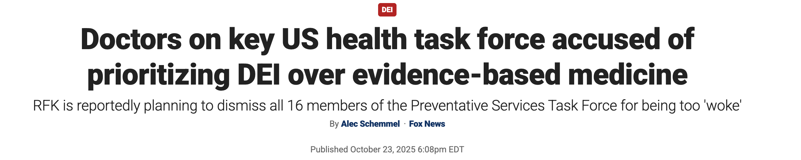
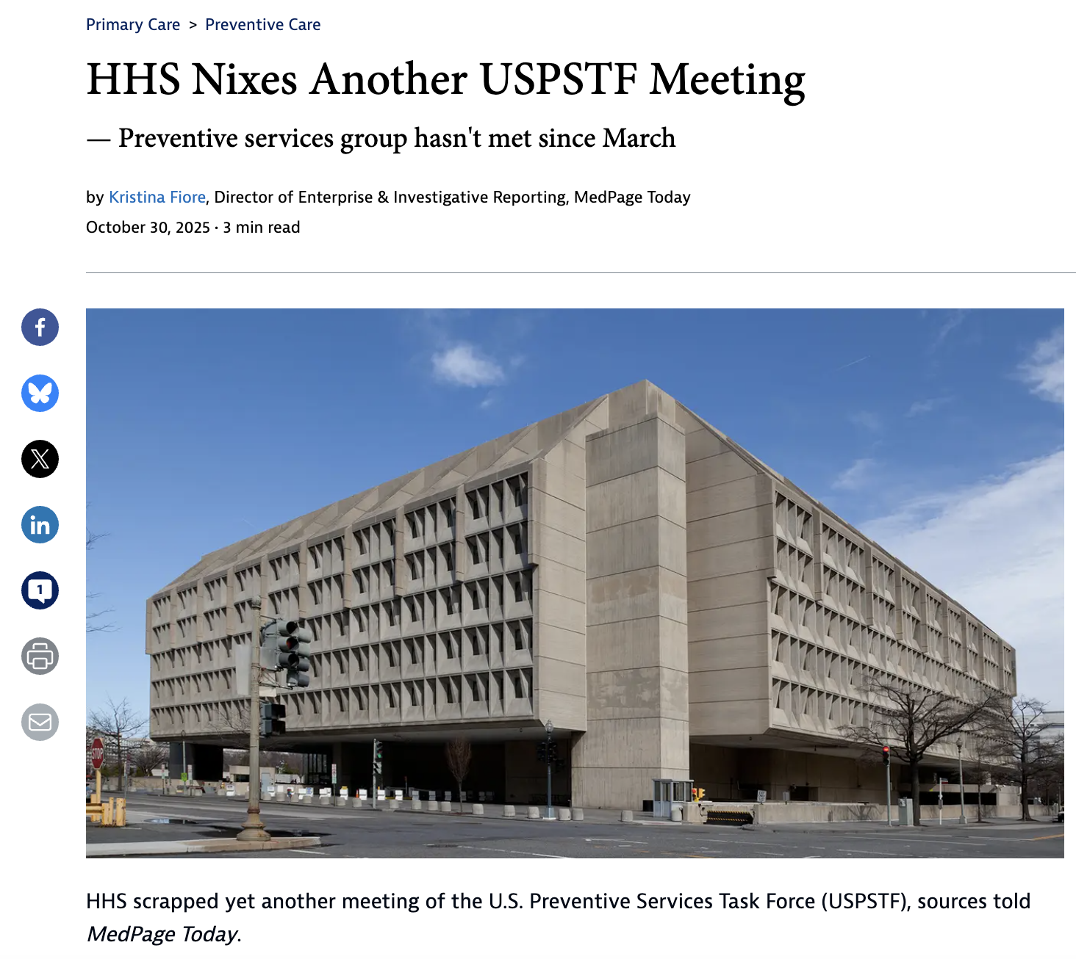

Slide 18

Make America Healthy Again (MAHA) Movement

Slide 19






The MAHA Report assigns blame to processed food, chemical exposure, and overmedication
40%
of US children have at least one chronic illness, according to the MAHA report
IDENTIFIED CAUSES
The report identifies four primary contributors to rising chronic disease in children:
Ultra-processed foods (UPFs)
Finds that approximately 70% of the caloric intake of US children comes from UPFs, which it associates with obesity and nutrient deficiencies
Chemical exposure
Raises concerns over youth exposure to synthetic chemicals (e.g., pesticides, plastics) and suggests these may be linked to developmental and chronic health risks
Sedentary, tech-driven lifestyles
Reports that teens average ~9 hours of non-school screen time daily; 4/5 don’t meet physical activity or sleep guidelines
Overmedicalization
Claims that increased prescription rates for ADHD medications, antidepressants, and antipsychotics have not produced long-term health benefits and contribute to overmedication
"There is something wrong and we will not stop until we defeat the chronic disease epidemic…”
President Trump, 5/22
SOURCE The White House, Federal Register, HHS, NPR
PRESENTATION CENTER 8/23/25
Notes:
Sources:
“Make Our Children Healthy Again: Assessment,” White House, accessed May 25, 2025, https://www.whitehouse.gov/wp-content/uploads/2025/05/WH-The-MAHA-Report-Assessment.pdf
Willy Stone, “MAHA Commission report paints a dark picture of U.S. children's health,” NPR, May 22, 2025, https://www.npr.org/sections/shots-health-news/2025/05/22/nx-s1-5406772/rfk-maha-commission-report-childrens-health

Slide 21
State-level policy activity breakdown
41 States have introduced MAHA related bills
MAHA BILLS INTRODUCED BY STATE
SOURCE: BILL TRACK 50
■ At least one bill ■ 5 or more bills ■ 10 or more bills ■ 15 or more bills
In total, 260 state-level bills have been introduced advancing MAHA-aligned food and beverage priorities, spanning a broad range of policy areas
WA
MT
ND
VT
ME
OR
MN
NH
Top of the leaderboard
ID
SD
WI
NY
WY
MI
New Jersey leads the states with 45 bills introduced
New York is second with 35 bills
Oklahoma is third with 15 bills
NE
IA
PA
MA
NV
UT
IL
IN
OH
CA
CO
WV
VA
RI
KS
MO
KY
CT
AZ
TN
NC
NJ
NM
OK
AR
SC
Common issues by region
DE
MS
AL
GA
MD
Northeast: Hunger, labeling, and nutrition equity
Midwest/South: Program modernization and food assistance
West: Sustainability, packaging, and environmental framing
AK
TX
LA
HI
FL
SOURCE Bill Track 50
PRESENTATION CENTER 10/30/25
Notes:
“Billsheet | BillTrack50,” Accessed October 23, 2025, https://www.billtrack50.com/account/billsheet/60294.

Slide 22
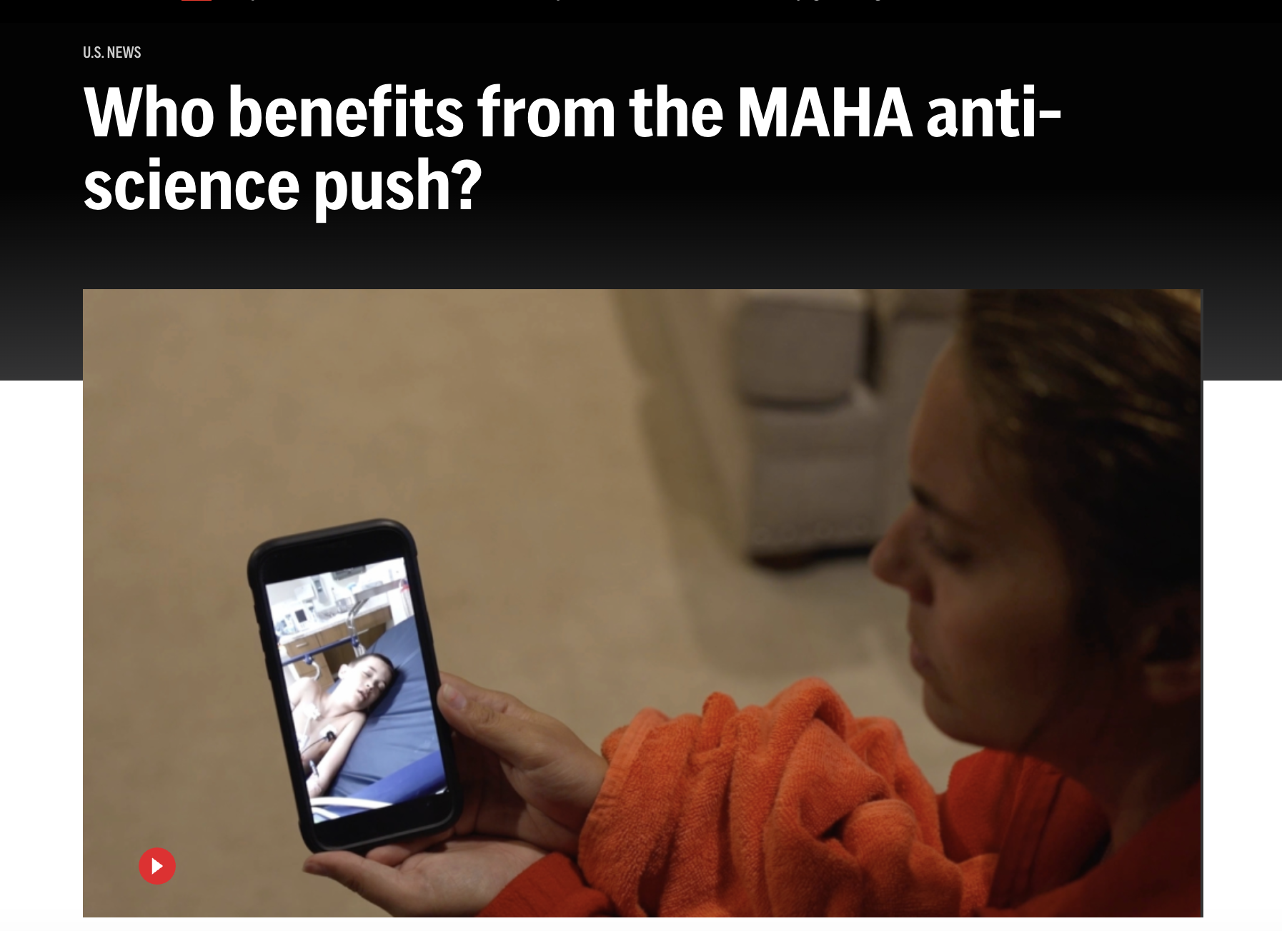
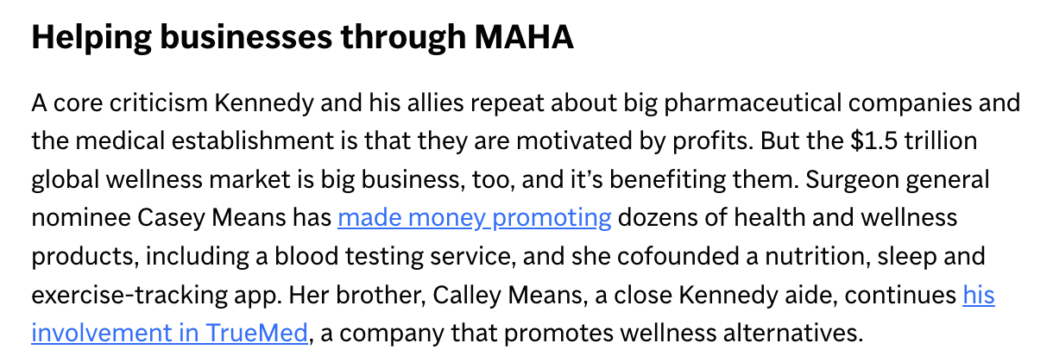

Slide 23
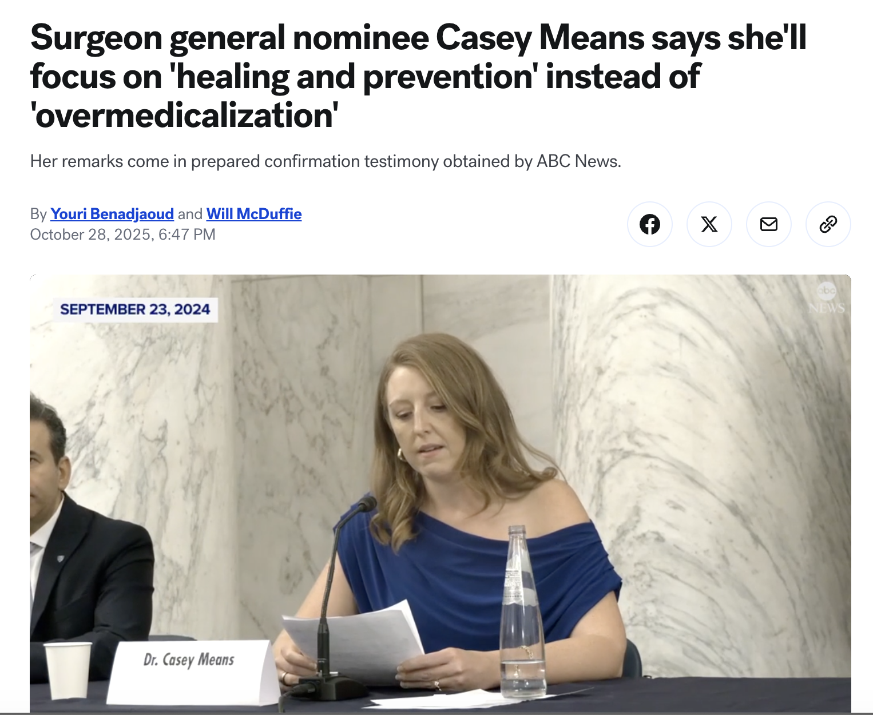
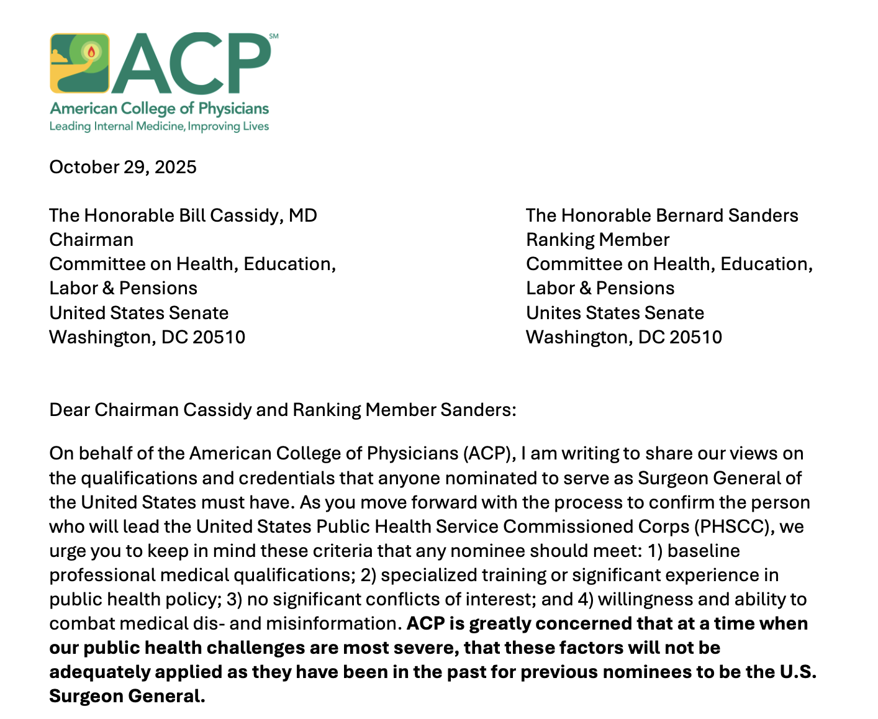
Surgeon General Hearing - TBD

Slide 24
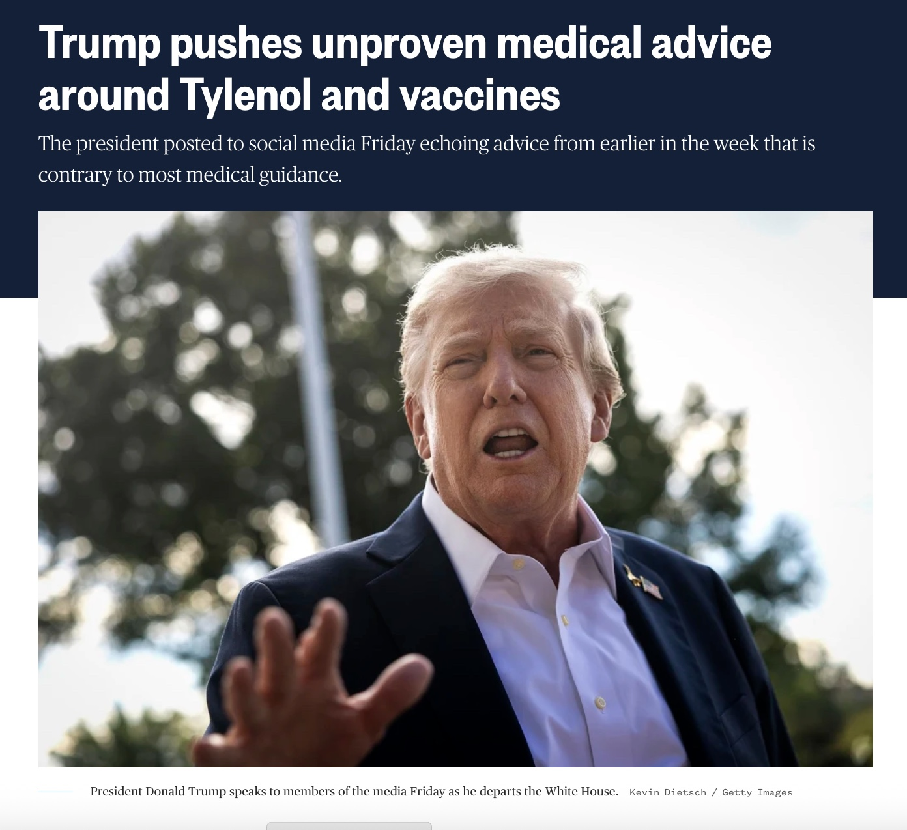

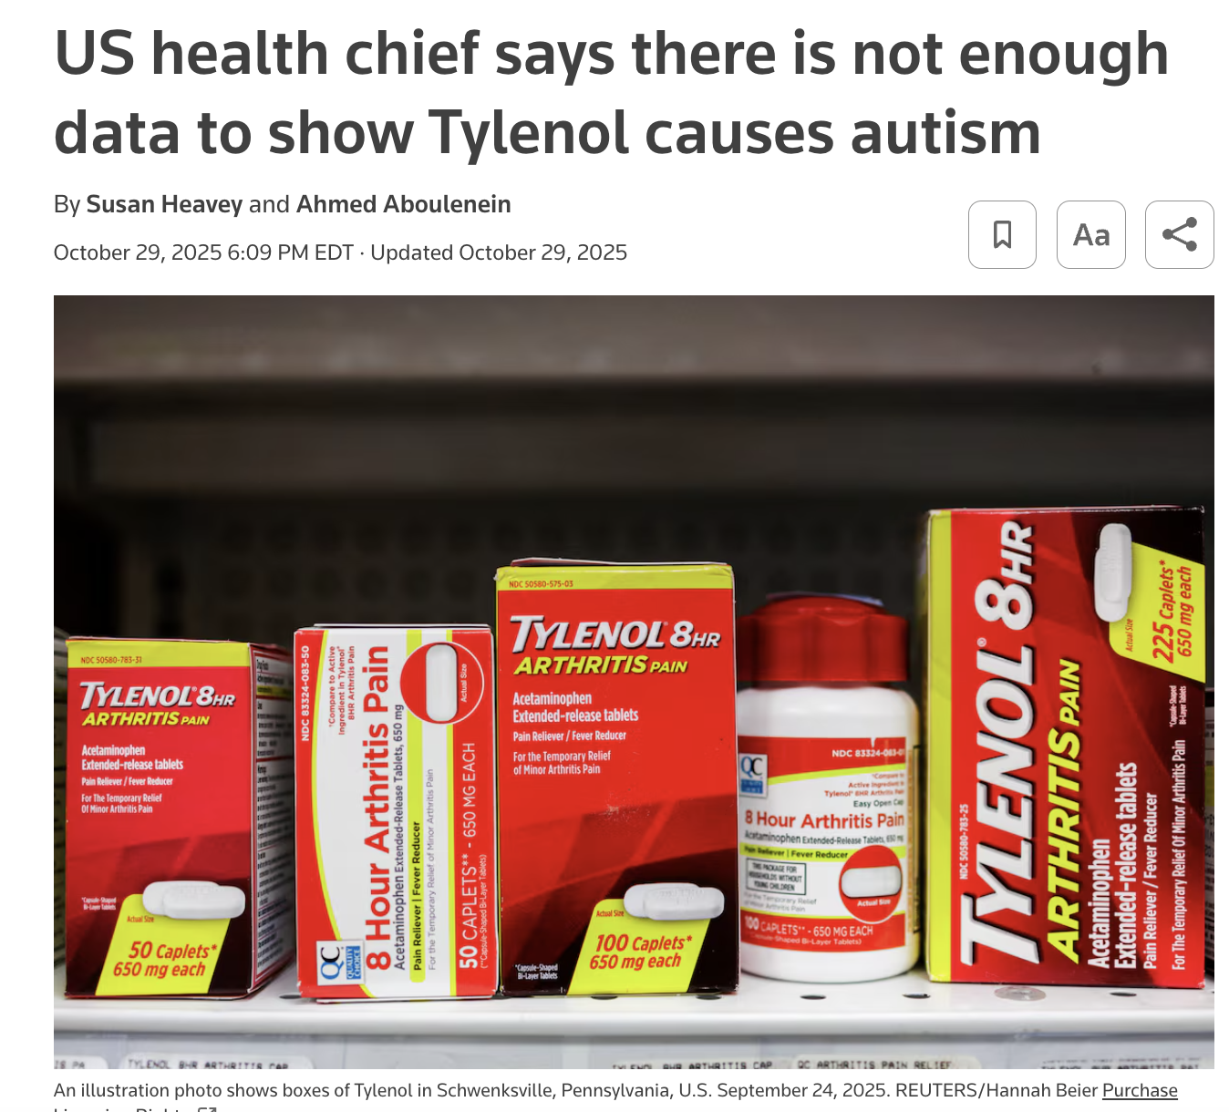
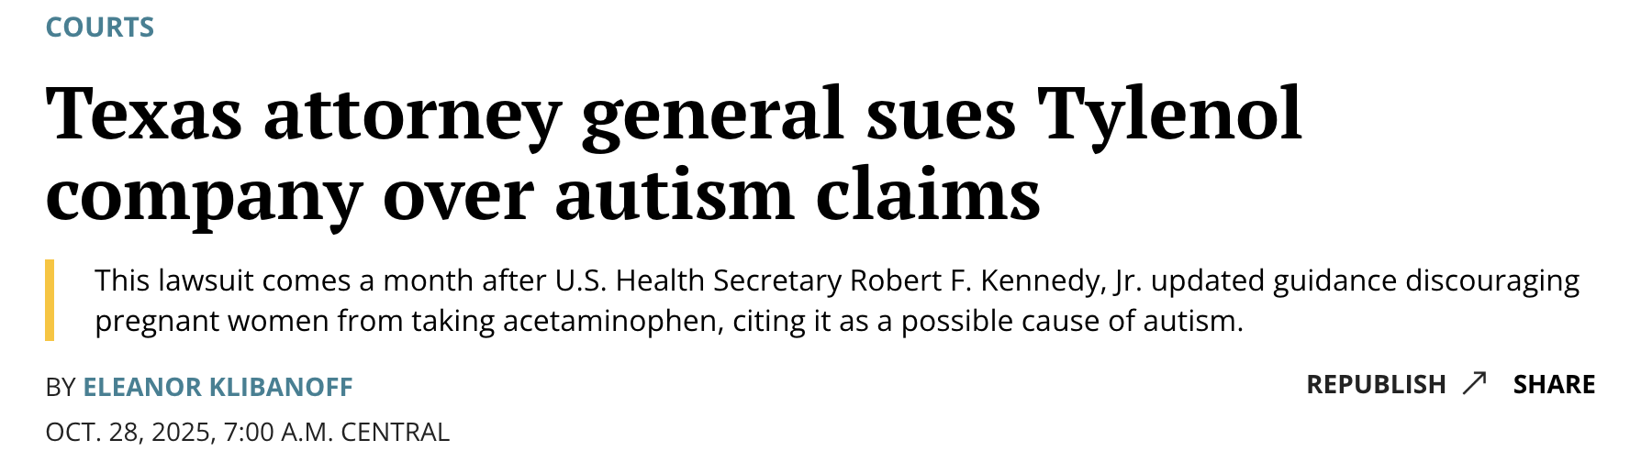

Slide 25

2026 Physician Fee Schedule

Slide 26
2026 Physician Fee Schedule Timeline
On July 14, 2025, CMS issued a proposed rule on changes to Medicare physician payments under the Medicare Physician Fee Schedule (PFS) for Calendar Year (CY) 2026.
CMS accepted comments on the proposed rule through September 12, 2025.
On October 31, 2025, CMS issued the CY 2026 Medicare PFS Final Rule.
Except as otherwise specified, provisions from the final rule generally take effect on January 1, 2026.

Slide 27
2026 Physician Fee Schedule Final Rule: Two Conversion Factors due to MACRA
Beginning in CY 2026, there will be two separate conversion factors for: (1) clinicians who are qualifying participants (QPs) in alternative payment models (APMs) and (2) clinicians who are not QPs in APMs.
The finalized conversion factor for clinicians who are QPs in APMs for CY 2026 is $33.57, slightly less than the $33.59 amount proposed in the Medicare PFS proposed rule.
This is an increase of 3.77% compared to the current conversion factor ($32.35), which reflects a 0.75% annual statutory update, plus a 0.49% budget neutrality adjustment, plus a one-time 2.5% increase for 2026 required under the One Big Beautiful Bill Act.
The finalized conversion factor for clinicians who are not QPs in APMs for CY 2026 is $33.40, slightly less than the $33.42 amount proposed in the Medicare PFS proposed rule.
This is an increase of 3.26% compared to the current conversion factor ($32.35), which reflects a 0.25% annual statutory update, plus a 0.49% budget neutrality adjustment, plus a one-time 2.5% increase for 2026 required under the One Big Beautiful Bill Act.

Slide 28
Efficiency Adjustment – Finalized with Minor Changes
In the proposed rule, CMS raised a variety of concerns with the utilization of the American Medical Association (AMA) Relative Value Scale Update Committee (“RUC”) for determining physician work RVU values in the Medicare PFS, which CMS indicated tends to benefit specialty practices more than primary care.
To address this, for CY 2026, CMS finalized a negative 2.5% “efficiency adjustment” to all physician work RVUs that are not timed-based codes (e.g. excluding time-based codes such as evaluation and management visits from the negative adjustment).
The negative 2.5% adjustment is derived from the CMS Actuary’s Medicare Economic Index (MEI) productivity adjustment, aggregated over the past five years.
In the final rule, CMS finalized a list of Healthcare Common Procedure Coding System (HCPCS) codes that would be exempted from the efficiency adjustment. The list of exempted HCPCS codes in the final rule is broader than the scope of exempted codes from the proposed rule.
Specifically, in the final rule, CMS indicated that, in addition to exempting time-based codes, the agency would also exempt new HCPCS codes from the efficiency adjustment, as well as services on CMS’ telehealth list. For 2026, CMS will also exempt time-based drug administration codes from the efficiency adjustment.
This efficiency adjustment policy is the primary driver of a positive 0.49% budget neutrality adjustment to the Medicare PFS conversion factor. As a result, CMS estimates that for almost all specialties, the efficiency adjustment would result in payment changes within the range of plus 1% to minus 1%

Slide 29
Practice Expense Changes
CMS also finalized changes to the calculation of practice expense (PE) RVUs, after raising concerns about:
Sample sizes, representativeness, completeness of data, and measurement error related to the AMA’s 2024 Physician Practice Information (PPI) survey; and
Degree to which facility PE RVUs accurately reflect indirect PE costs, given the shift to hospital employment of physicians.
Specifically, based on these concerns, CMS finalized a policy NOT to utilize the 2024 PPI Survey or the Clinical Practice Information (CPI) survey to determine PE values for CY 2026.
CMS also finalized a policy to reduce the portion of facility PE RVU values that is allocated based on physician work RVUs to equal half the amount allocated to nonfacility PE RVUs, beginning in 2026. CMS also finalized a policy to utilize OPPS data to determine PE RVUs for certain radiation therapy and remote monitoring services.
CMS indicates that the change to facility PE RVU values will result in decreases in total RVU valuation for specialties primarily practicing in facility settings and increases in RVU valuation for specialties primarily practicing in nonfacility settings.

Slide 30
Chronic Disease Management, Primary Care, and Behavioral Health Care Services
CMS finalized a proposal to add three new add-on codes for BHI services that can be billed on a monthly basis conjunctively with APCM codes, without having to document the number of minutes that the practice spent on the BHI services (which is required for standalone billing of BHI codes).
CMS sought comment on options for waiving Medicare cost-sharing for APCM services, as a preventive service—and the agency indicated that it would examine this issue in additional detail in future rulemaking.
CMS finalized a policy to allow for Medicare’s Evaluation & Management (E&M) Visit Complexity Add-on code to be billed by clinicians furnishing home-based primary care visits (in addition to in-office/outpatient settings).
Finally, CMS discussed comments the agency received on a wide range of questions related to chronic illness and the Medicare PFS. CMS indicated it could address issues discussed in the comments in future rulemaking.

Slide 31

2026 Physician Fee Schedule Final Rule
Proposals to explore how AI and other technologies can improve efficiencies and transform physician practices
Streamlining how services are added to the Medicare telehealth list by removing the distinction between provisional and permanent. Finalized a policy to make permanent the current virtual supervision flexibilities for several additional service types.
Proposing to remove coverage of the screening for Social Determinants of Health.
Proposing a new Ambulatory Specialty Model (ASM), a mandatory payment model focused on specialty care for beneficiaries with heart failure and low back pain

Slide 32
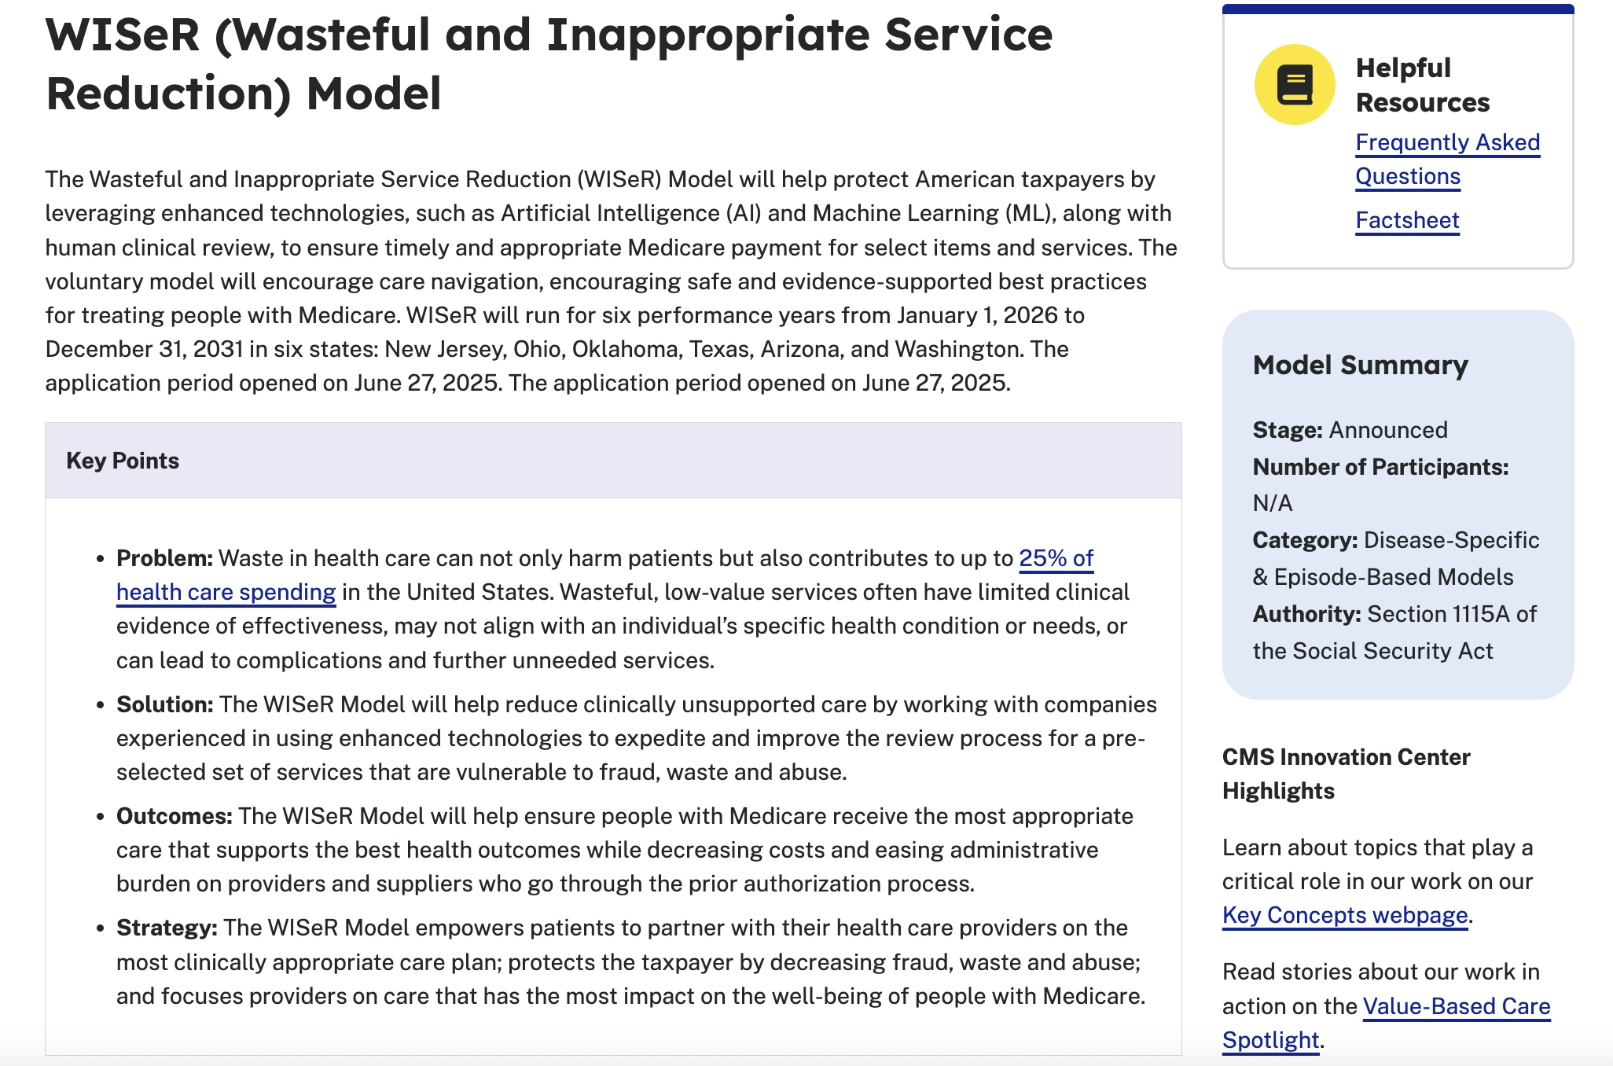
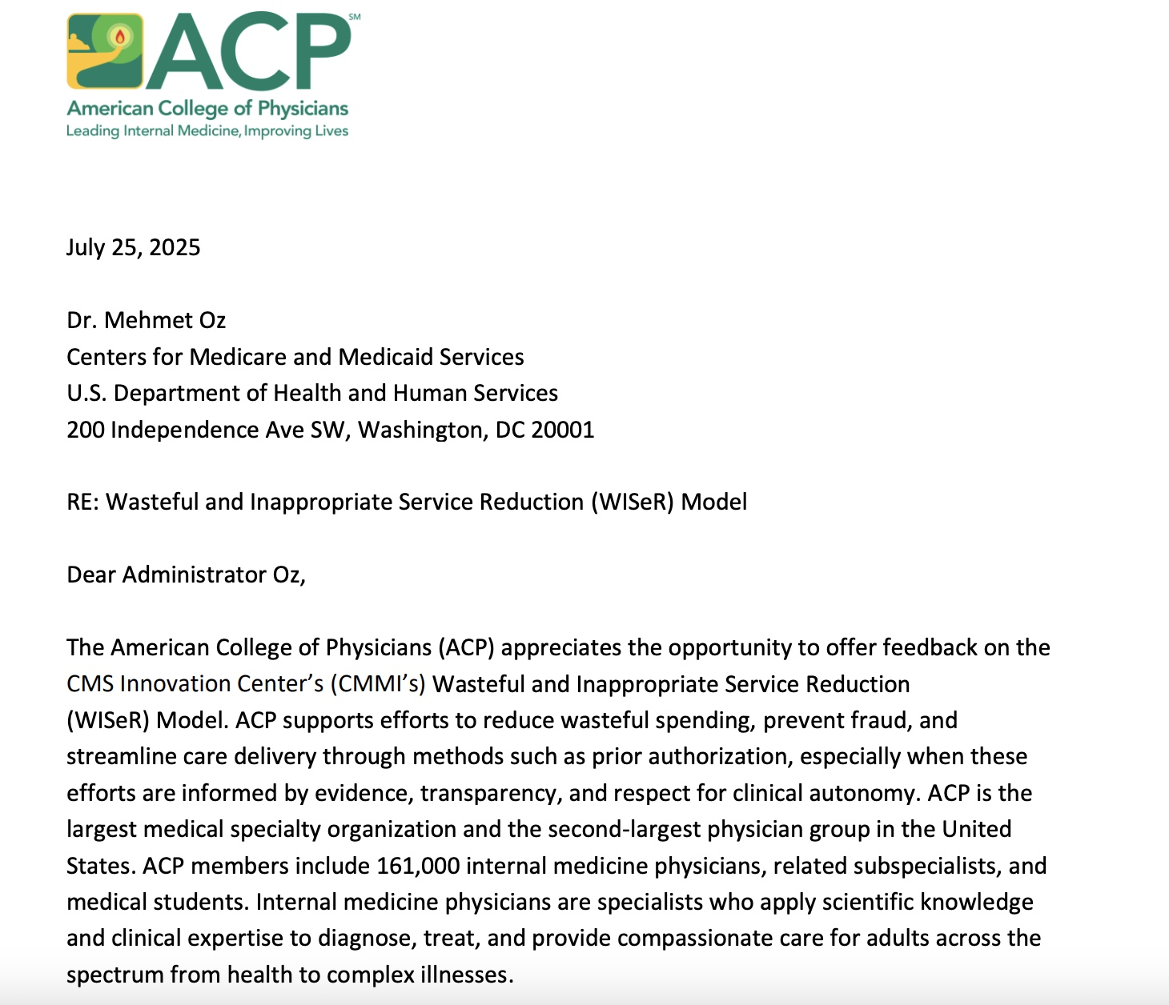
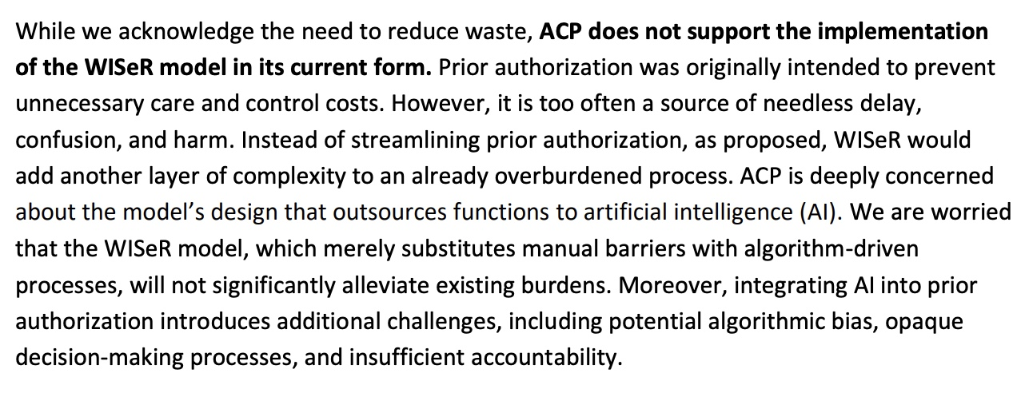

Slide 33
Private Payer Activity

Slide 34
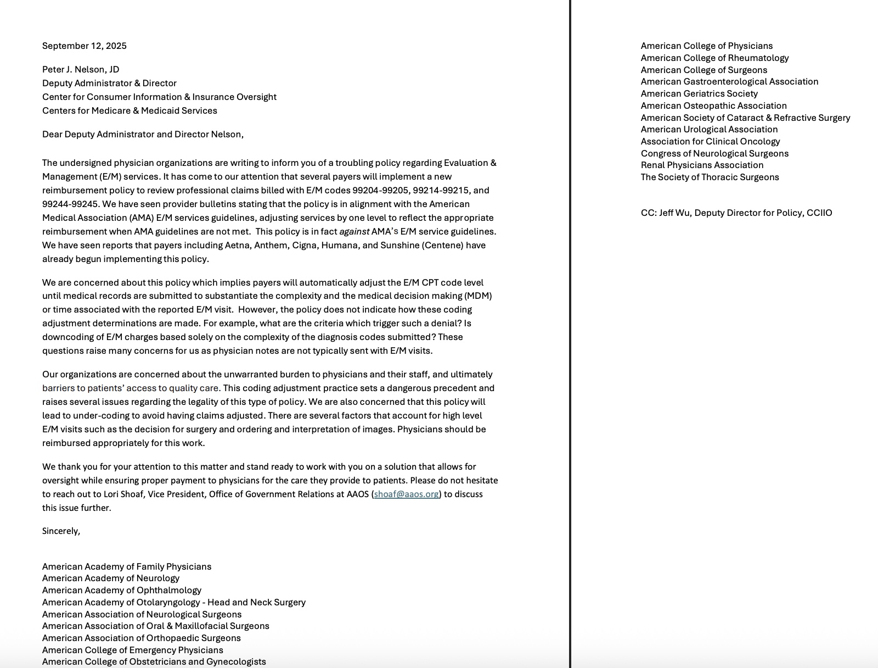
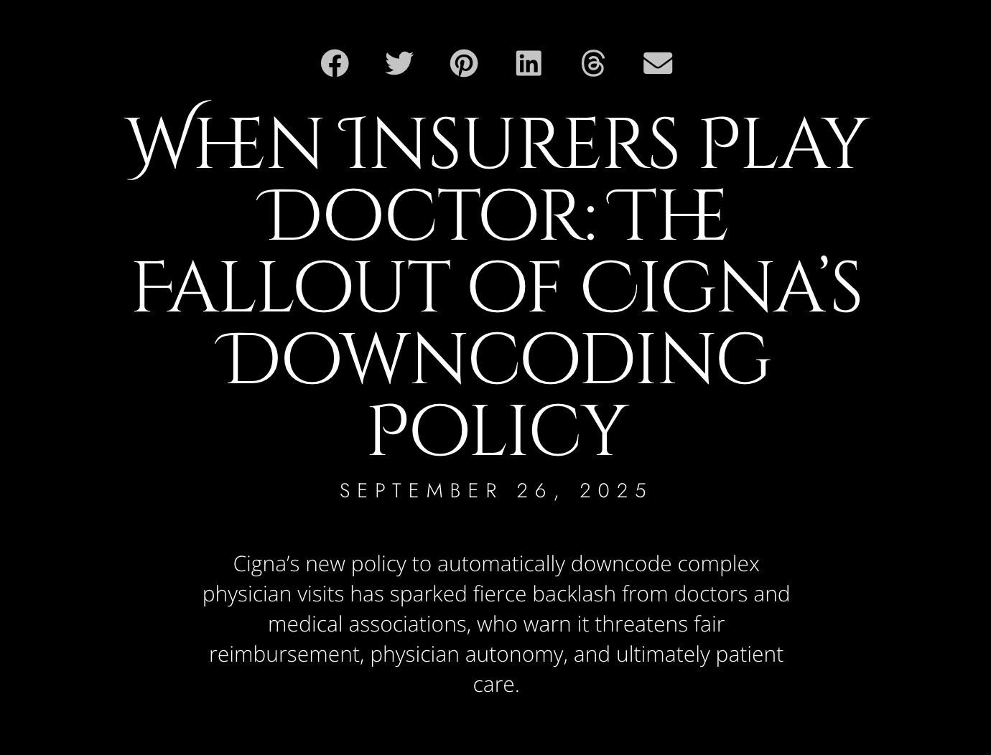
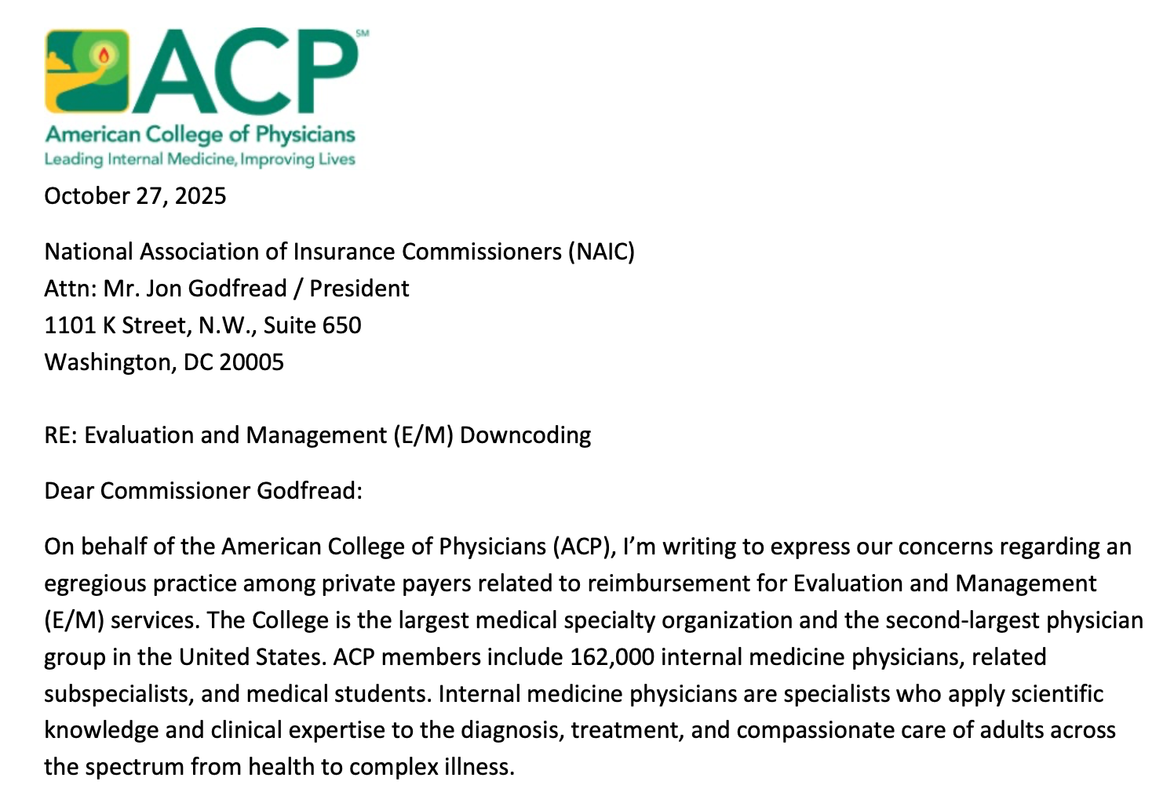
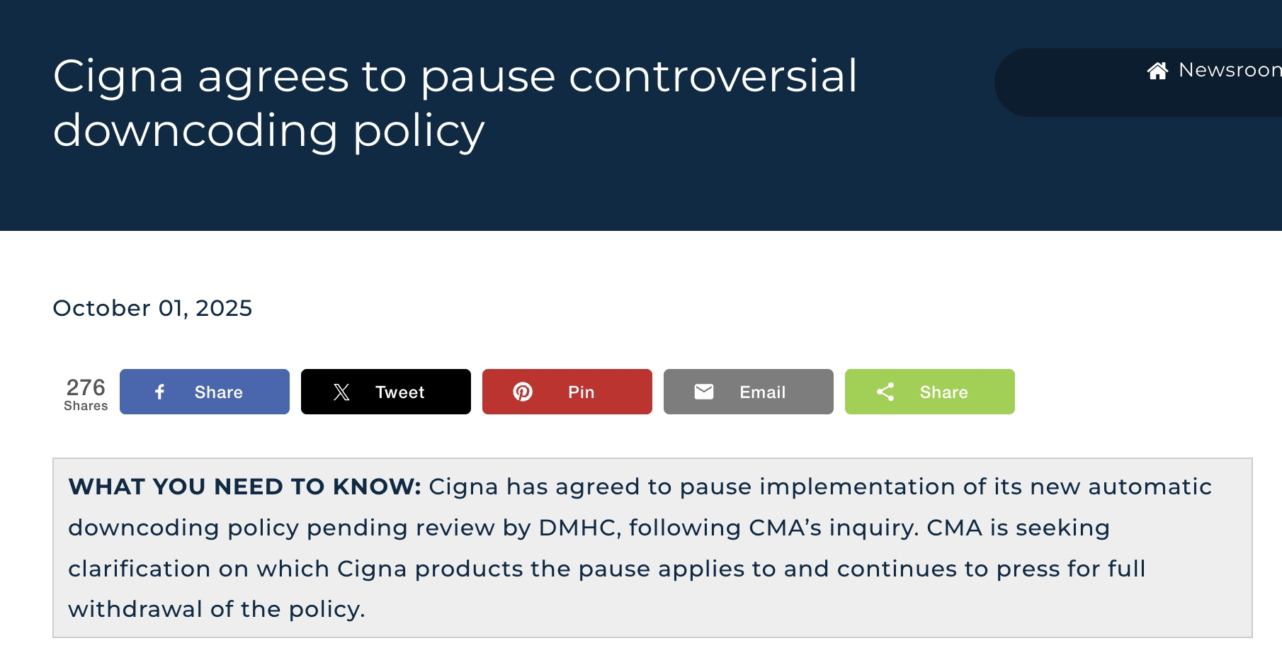
Downcoding by Private Payers

Slide 35

Questions

