Slide 1
Kansas Chapter Pilot:
Prior Authorization Reform
Benjamin Quick, MD, MPH, FACP
KS ACP Health & Public Policy Chair

Slide 2
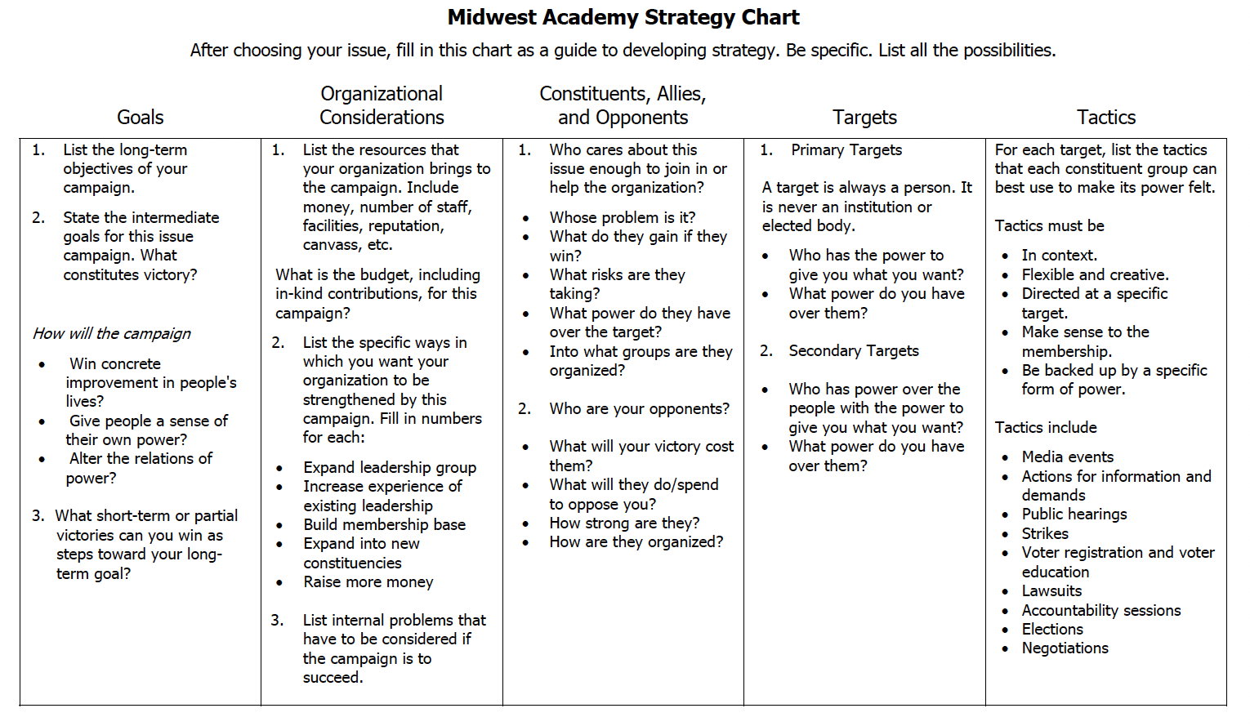

Slide 3
Topic selection
Why we chose prior authorization reform?
  Popular with membership
  Other states have passed reform
  KS had bill from 2023
Met with advocacy leaders from 2023 bill
Created KS ACP policy recommendations

Slide 4
KS ACP Policy Recommendations
Prohibit retroactive denial
Prescription medications valid for twelve months or until plan ends
Time requirements for PA determination
Require electronic transmission of requests
Right to appeal
Require same specialty review
Require public reporting on PA denial and approval rates
Require reporting of guidelines used in cases of denial

Slide 5
Partnerships
Main partners:
  Kansas Academy of Family Physicians (KAFP)
  Kansas American Academy of Pediatrics (KAAP)
Introduced legislation to KS Senate Insurance Committee
Notified additional medical specialty organizations

Slide 6
Tactics
Outreach to members, especially those of geographic interest
Made sample emails/letters/talking points for members
Story gathering
Inviting legislators to clinics
Kansas Medical Society advocacy day
Exploring avenues to involve press/social media
Preparing for hearing

Slide 7
Questions?

