Slide 1
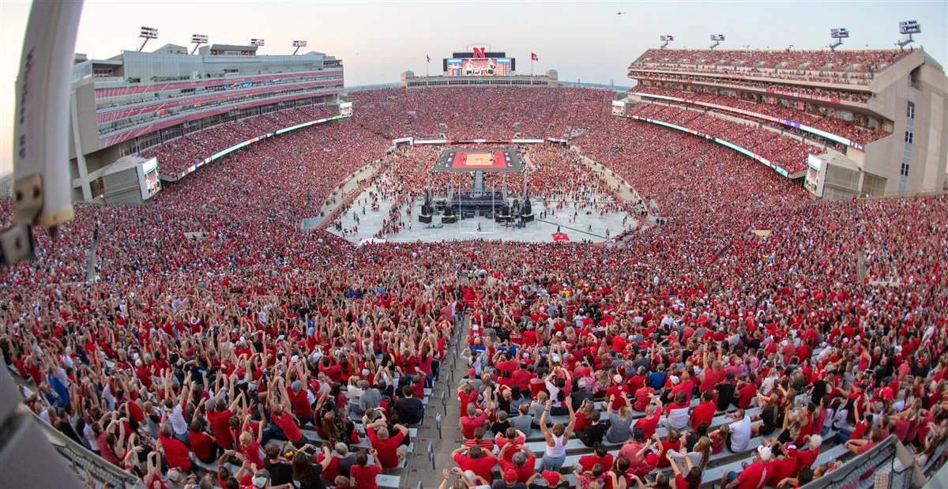
Nebraska
First in women’s volleyball attendance and Medicaid work requirements
-Population 2.02 million
-70,000 Nebraskans impacted by Medicaid work requirements
-92,003 people in Memorial stadium to support Husker volleyball

Slide 2
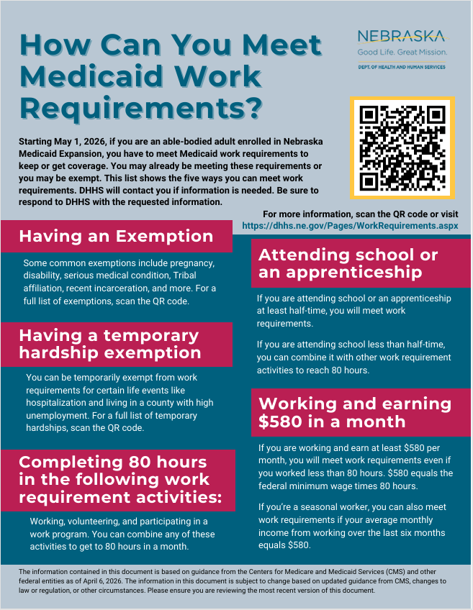
Thank you to the smart people doing the work
Tiffany Joekel, VP of Governmental Affairs at Nebraska Medicine
Anna McCaslin, VP of Finance at Boys Town National Research Hospital

Slide 3
Confusing Timelines and Exemptions
(what we know so far)
Medical Frailty
  New enrollees, use the Individual Declaration form (no medical records required)
  Reenrollment, Medicaid will determine based on 8k+ ICD10 codes
  Only reviewing primary diagnosis codes
  Yikes!
Temporary hardships
  Hospitalizations, dependent receiving medical care outside of community, county with federal emergency or low employment rate
  No definitions – “outside of community”, “extended period of time,” “serious medical condition”
  No duration of time for inpatient hospitalization
  By individual declaration, except unemployment & disaster/emergency
Timelines of Eligibility Determination
  Renewal vs newly eligible
  Temporary hardship vs medically frail

Slide 4
A tale of health 2 system responses
Boys Town National Research Hospital
  Small, pediatric specialty hospital system, with a few adult physicians
  750 Medicaid Expansion patients
  Max $1M in annual loss
  Increasing financial counselor positions from 1 to 3
Nebraska medicine
  Quaternary academic health system
  Approximately 8,300 Medicaid Expansion patients
  $13-21M predicted annual loss in reimbursement
  Extensive team approach…

Slide 5
Nebraska Medicine
Multidisciplinary Team
  Government Affairs
  Revenue cycle
  Community Engagement
  Inpatient
  Ambulatory
  Pharmacy
  Social work

Slide 6
Nebraska Medicine Strategy and Response
Identify Medicaid Expansion Patients
  MCOs- Gather the data. Who is on expansion? When are the redetermination dates?
Identify Who is Eligible for Medical Exemption
  Use medical frailty codes for those likely eligible, reach out
  Connect to navigator if not eligible
Navigating Financial Assistance
  Exemption identification and support
  Connect with volunteer and work resources
  Connect with internal resources and community partners
Targeted Engagement and Education
  Proactive patient outreach (MyChart, patient encounters)
  Redetermination dates entered in Epic
  Cards, fliers- updated patient contact info is key
  Support the frontline of safety net care

Slide 7
Nebraska Medicine Lessons Learned
Early connection with MCOs
  Data is the first bottleneck
Medical frailty exemption, engage early
Data and infrastructure
  Right patients, right info, right time.
  Big IT lift to address EHR fields, registries, referral work flows.

Slide 8
Resources
  Nebraska Hospital Association Stay Covered Nebraska
Nebraska Medicaid Guide | Benefits | Eligibility | Apply | Nebraska Medicaid
  Nebraska Medicine information
  New Medicaid work requirements | Nebraska Medicine Omaha, NE
  Nebraska Dept of Health and Human Services Work Requirements
  Work Requirements
  Individual Declaration Form
  Medicaid Work Requirements Declaration Form.pdf
  Nelson.lauren08@gmail.com

