Slide 1
Medicaid Work and Community Engagement Requirements
Ryan Crowley
Manager, Health Policy
American College of Physicians

Slide 2
Medicaid Community Engagement Requirements
The OBBBA requires certain adults to be working, participating in a workforce training program, or volunteering for at least 80 hours a month, or enrolled in an educational program at least part time, to enroll in or remain eligible for Medicaid benefits.
Generally, the community engagement requirements apply to non-pregnant adults age 19 to 64 enrolled through the ACA Medicaid expansion or certain section 1115 demonstrations but there are exceptions.
Most states will implement CE starting January 1, 2027.
CBO estimates work requirements will reduce Medicaid spending by $326 billion over ten years and increase uninsured by 5.3 million in 2034.
ACP opposes Medicaid work/community engagement requirements.

Slide 3
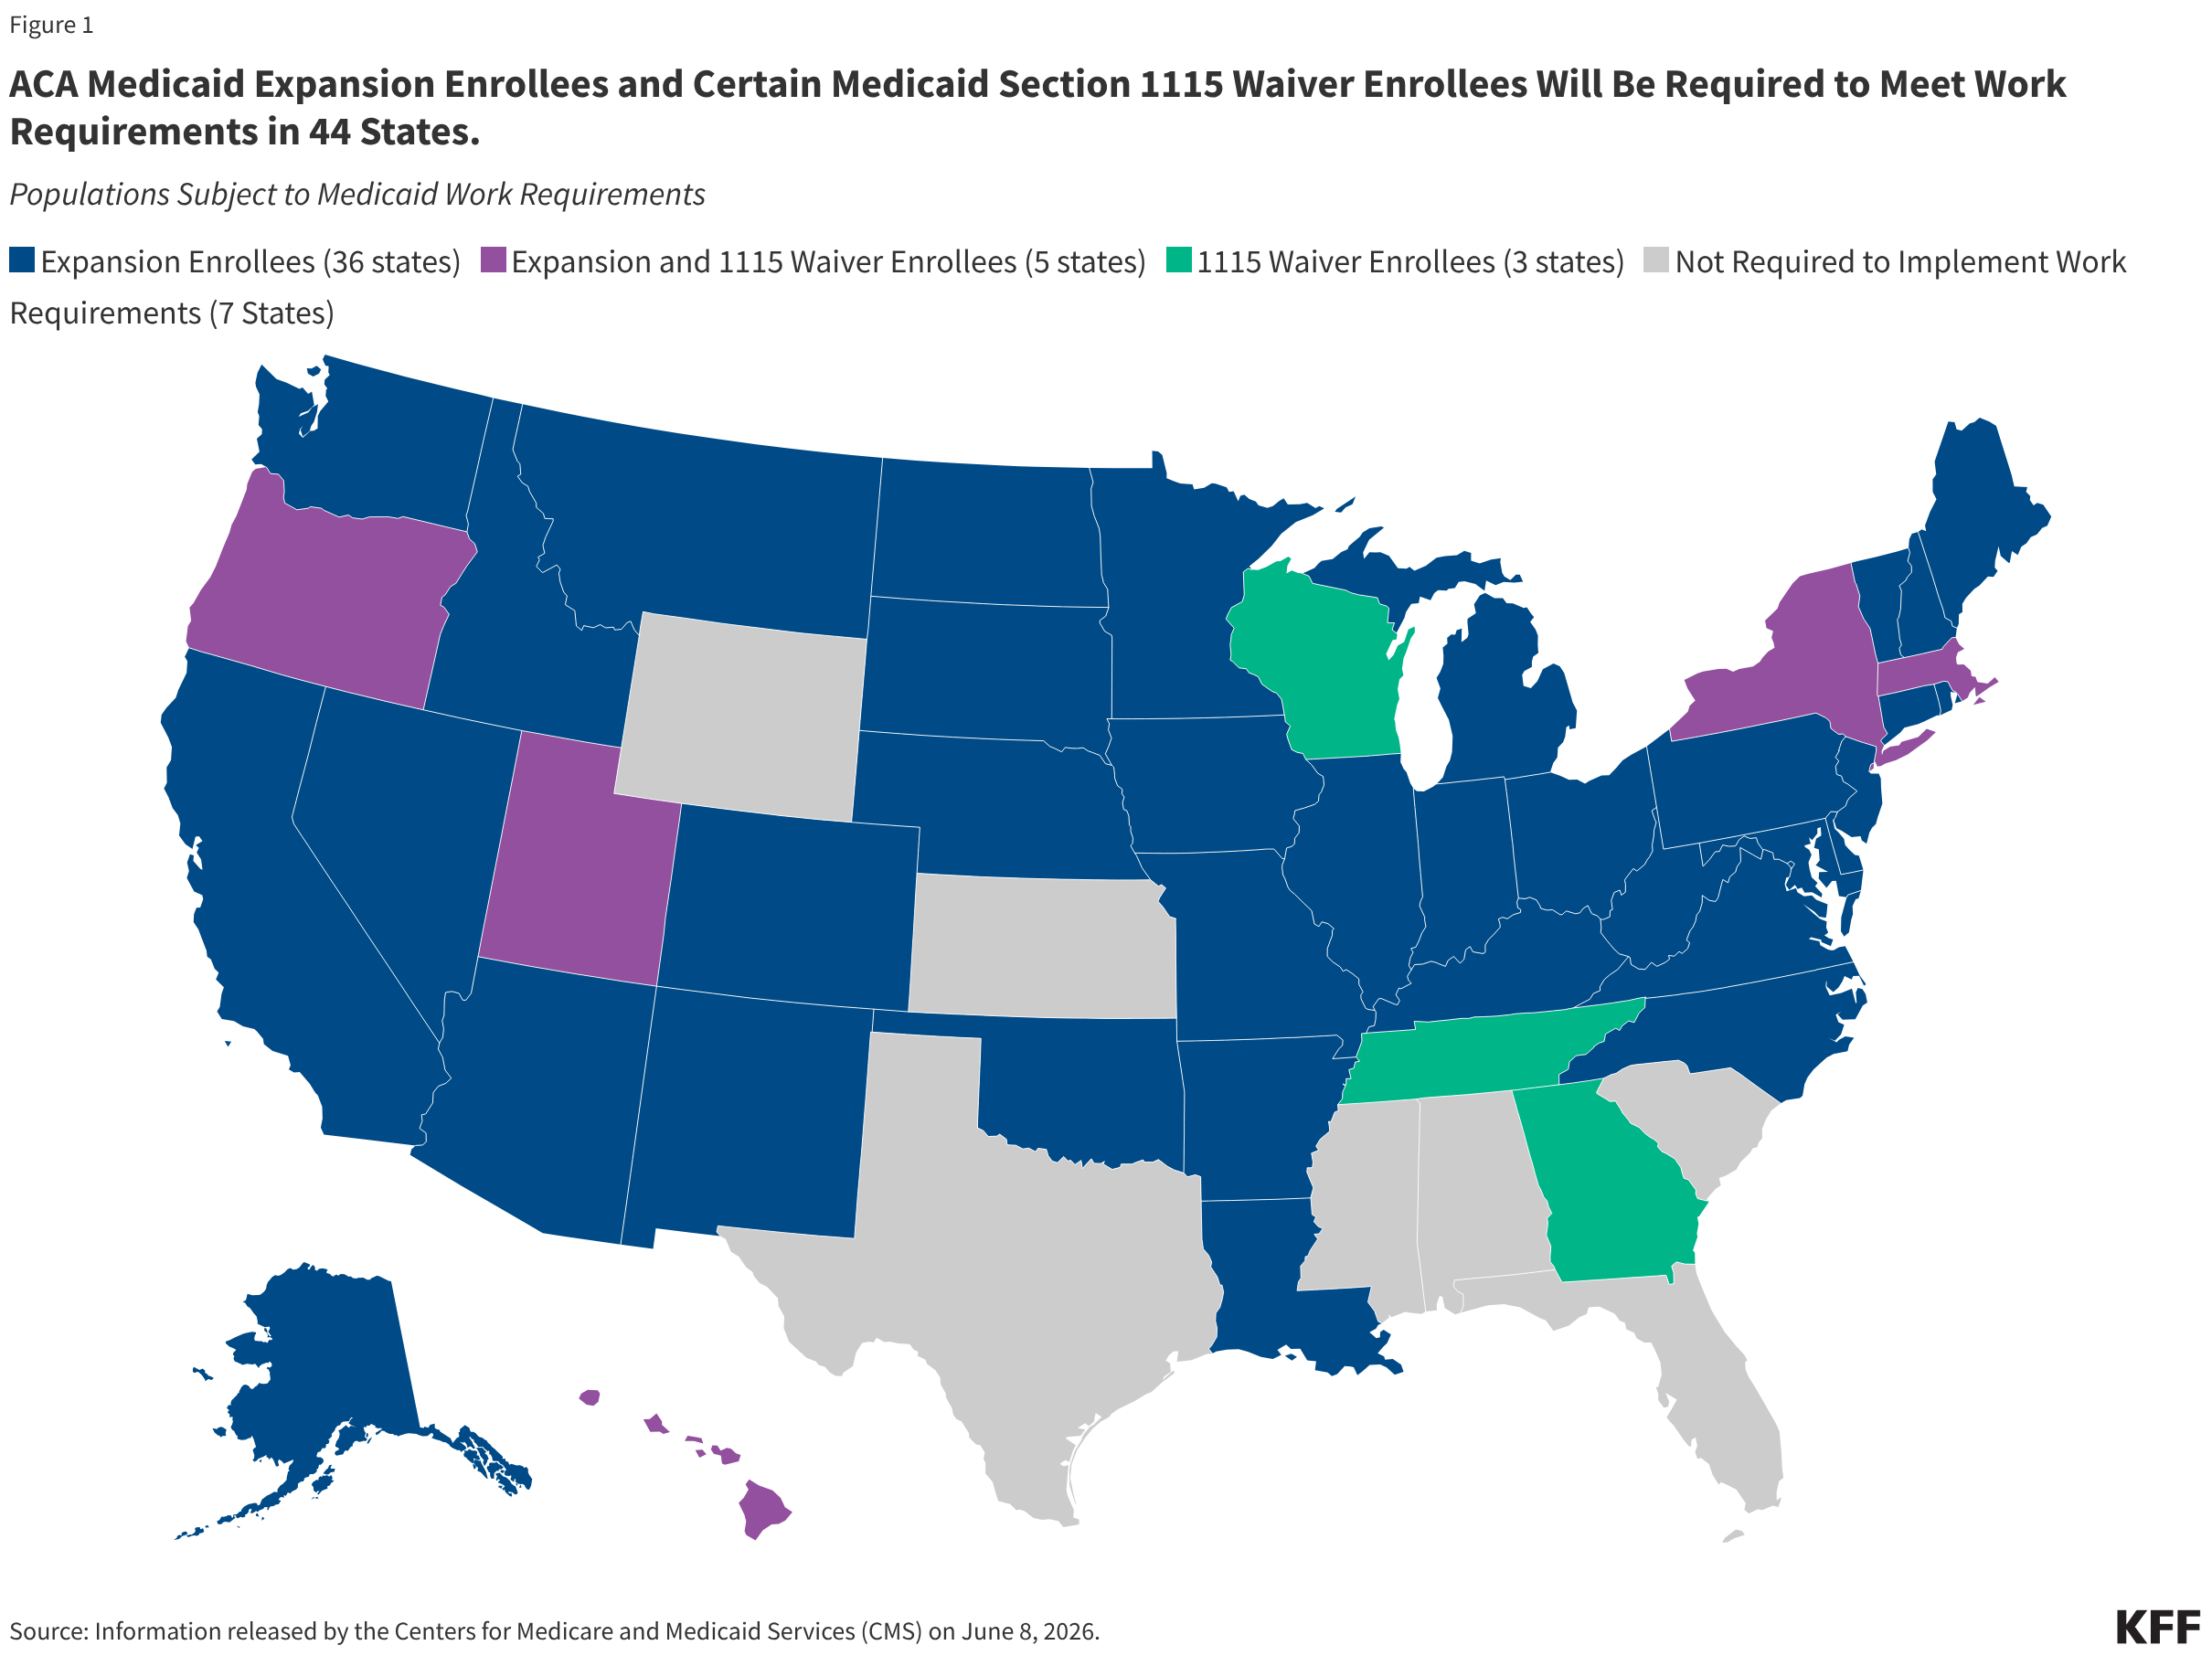
CE Requirements Apply in 44 States

Slide 4
Some populations are exempt from the CE requirement
Certain groups are exempt from the CE requirement:
  Parents, guardians, caretaker relatives, or family caregivers of a dependent child 13 years of age and under, or a disabled individual;
  Veterans with a total disability rating;
  Participants in a drug or alcohol rehabilitation or treatment program
  Medically frail or otherwise have special medical needs that significantly impair their ability to comply with the requirement
States may adopt short-term hardship exceptions for meeting the CE requirement if:
  an individual is receiving certain medical services,
  residing in an area where an emergency/disaster has been declared,
  residing in a county with a high unemployment rate, or
  traveling outside of area to receive care for serious illness.

Slide 5
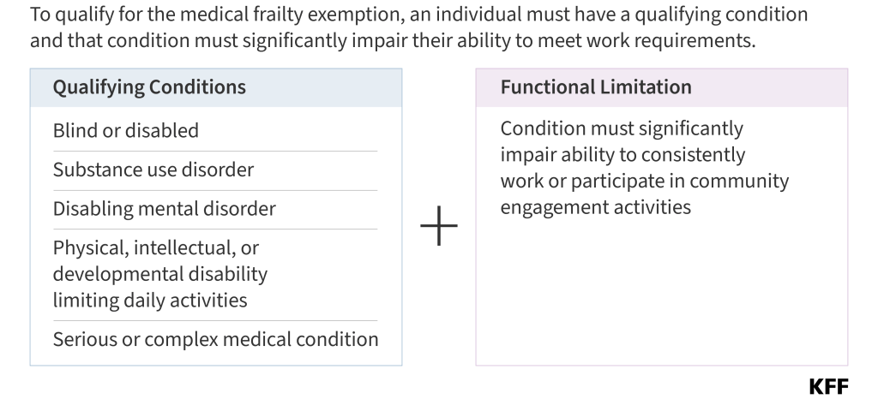
Medical Frailty Exemption: CMS Rule Adds Complexity

Slide 6
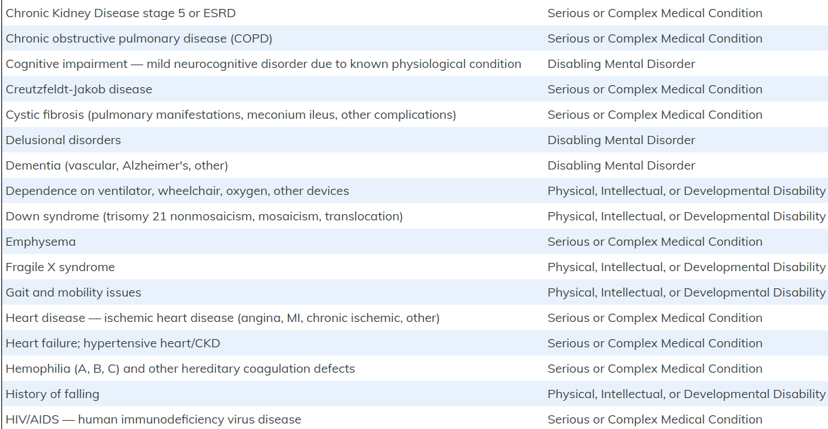
Defining Medical Frailty: It's Up to the States
CMS did not provide a comprehensive list of conditions that would qualify for a frailty exemption, so states will have to create their own lists.
States verify CE compliance at least every 6 months.
To verify medical frailty, states will use claims and encounter data from previous 12 months, but other resources like screeners may be implemented.

Slide 7
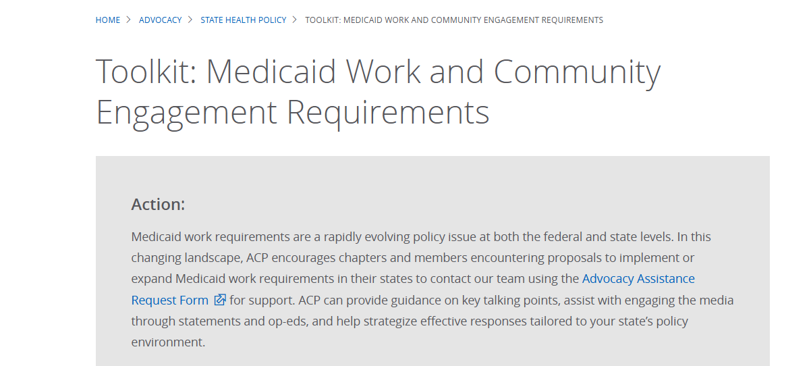
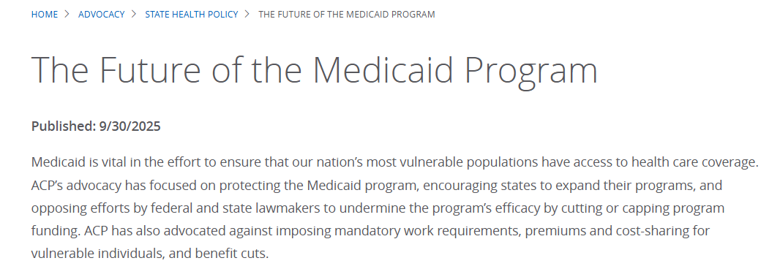
ACP Resources
ACP Toolkit on Medicaid Community Engagement Requirements
ACP Backgrounder on Medicaid State and Federal Activity

