Slide 1
State Health Policy Networking Webinar Leadership Day Updates
Shuan Tomlinson
Senior Analyst, State Health Policy and Grassroots Advocacy
November 1, 2023

Slide 2
Leadership Day: May 14-15, 2024

Slide 3
New Chapter Advocacy Resources

Slide 4
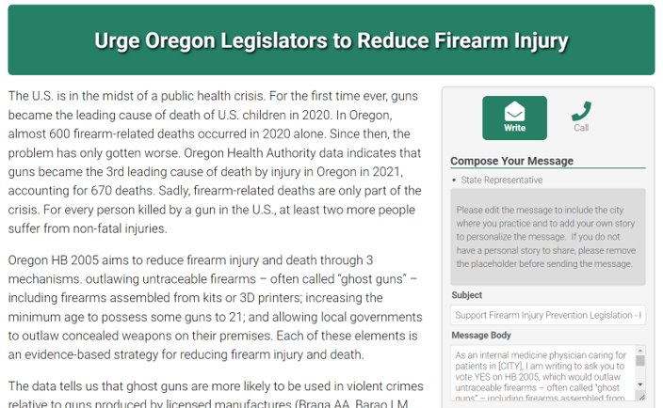
Request State-level Grassroots Alerts via ACP Legislative Action Center
Chapter leaders can now request to use ACP's grassroots software to facilitate their members contacting elected officials about health policy issues in their state
More information on LeaderNet:

Slide 5
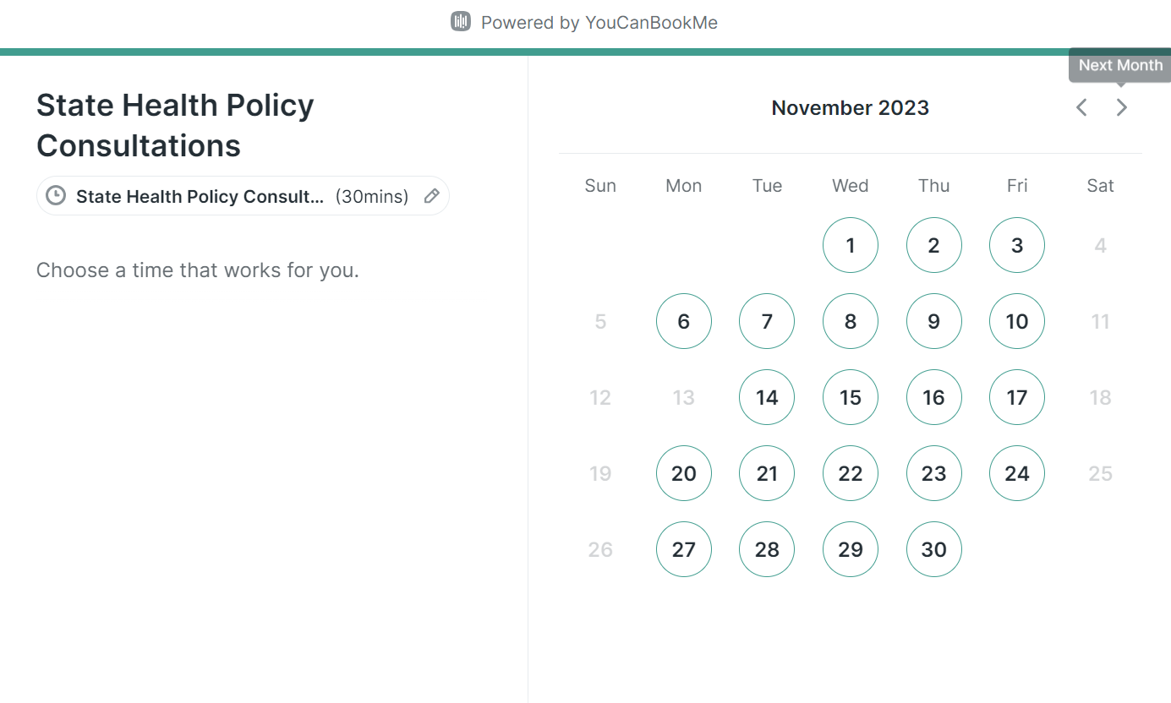
State Health Policy Staff Available for Consultations
ACP National's state health policy team is now available to be booked for consultations to discuss policy issues in your state, advocacy strategies, and more!
More information on LeaderNet:

