Slide 1
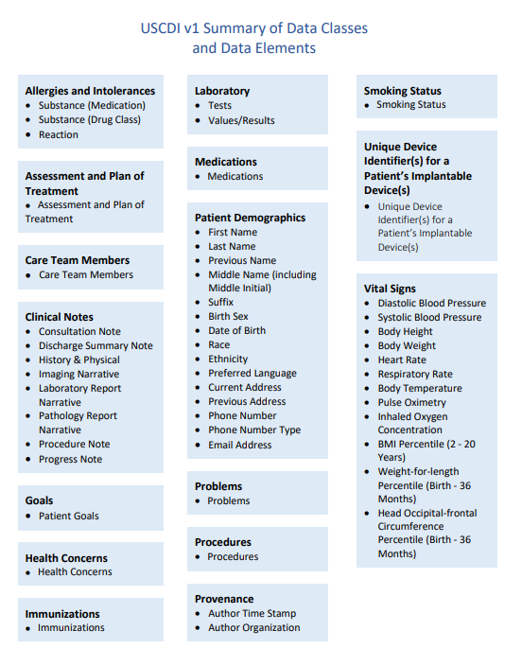
New Health Information Sharing Requirements – APRIL 5, 2021
Information Blocking Provisions of the 21st Century Cures Act go into effect April 5, 2021
All actors (independent physician practices, large health systems, EHR vendors, HIEs) will be required to share a subset of electronic health information
This subset of data is called US Core Data for Interoperability version 1 (USCDI v1)

Slide 2
New Health Information Sharing Requirements – APRIL 5, 2021
Required to share unless one of the 8 info blocking exceptions apply
E.g., promoting privacy, preventing harm, infeasibility, etc.
Concerns We’re Hearing:
Embargos on lab results (cannot establish "blanket" hold on lab results until physician reviews, could be considered info blocking)
Nuance around clinical documentation practices and where to document sensitive information
How do you appropriately document to meet one of the 8 info blocking exceptions
Questions? Email Brooke at brockwern@acponline.org

Slide 3
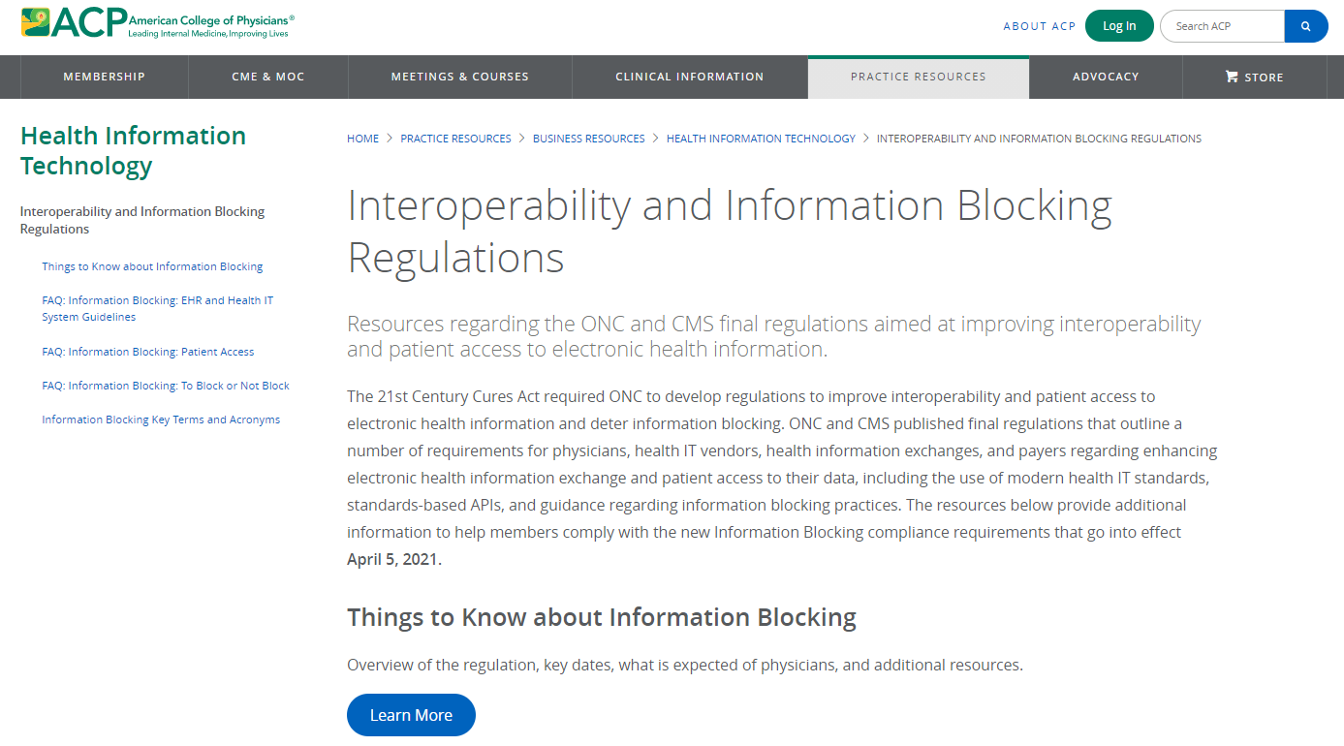
ACP Interoperability and Info Blocking Resources:
www.acponline.org/infoblocking

Slide 4
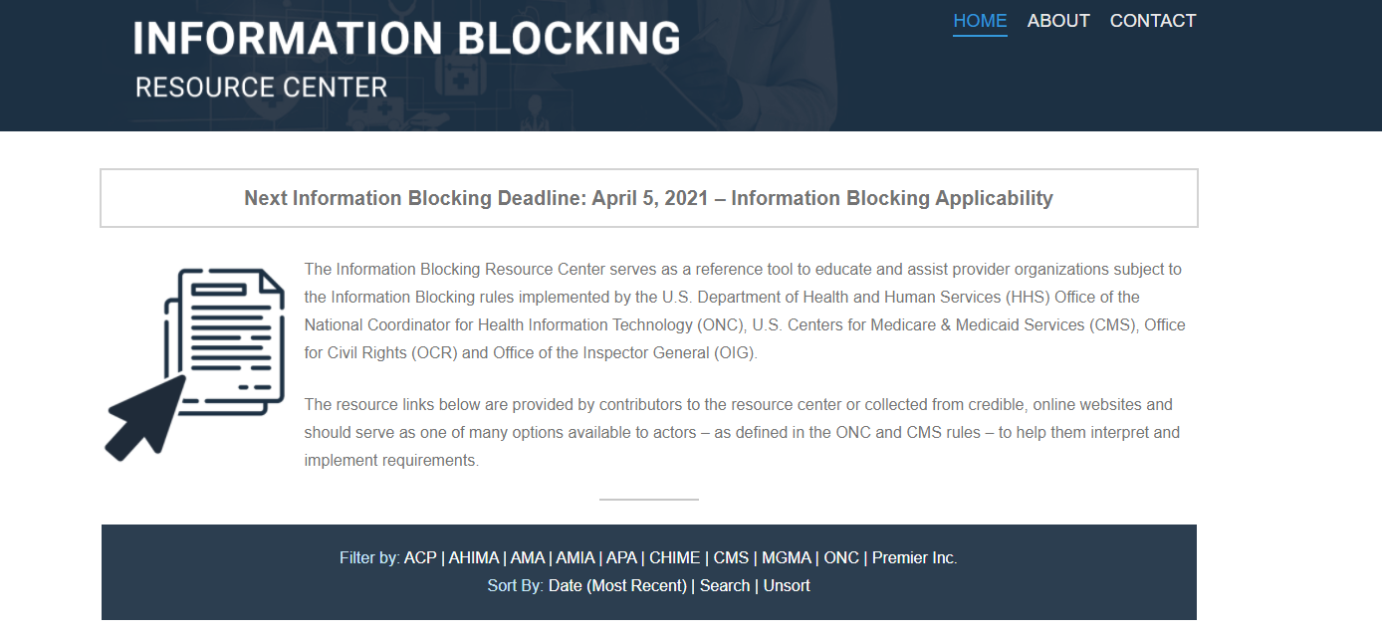
CHIME hosted Info Blocking Resource Center:
https://infoblockingcenter.org/

