Slide 1
Washington Update
2024 Priorities and Regulatory Update
ACP State Health Policy Networking Webinar
Shari M. Erickson, MPH
Chief Advocacy Officer and
Senior Vice President, Governmental Affairs and Public Policy
March 12, 2024

Slide 2
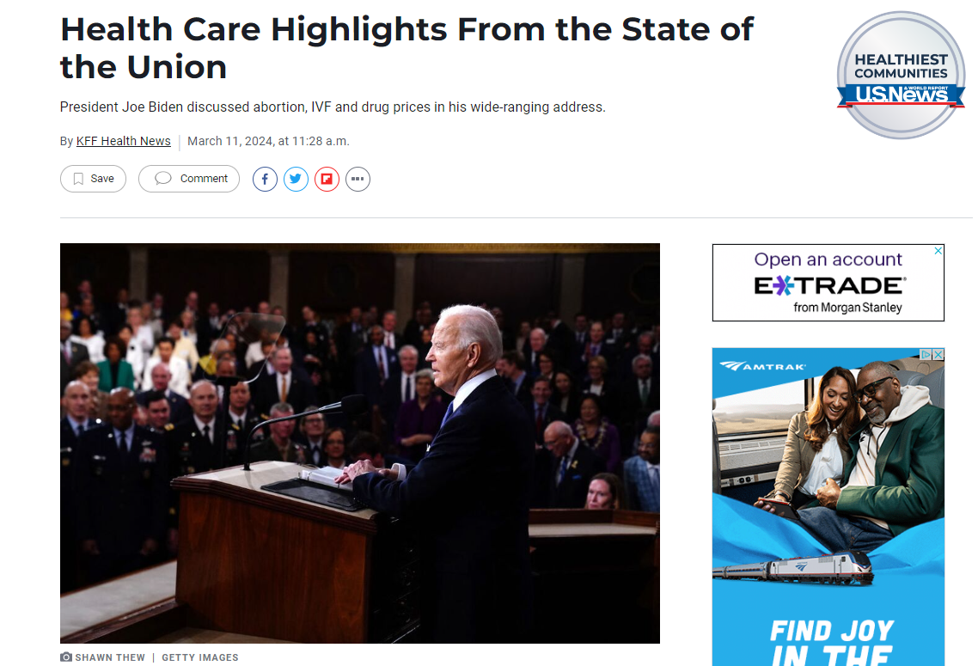
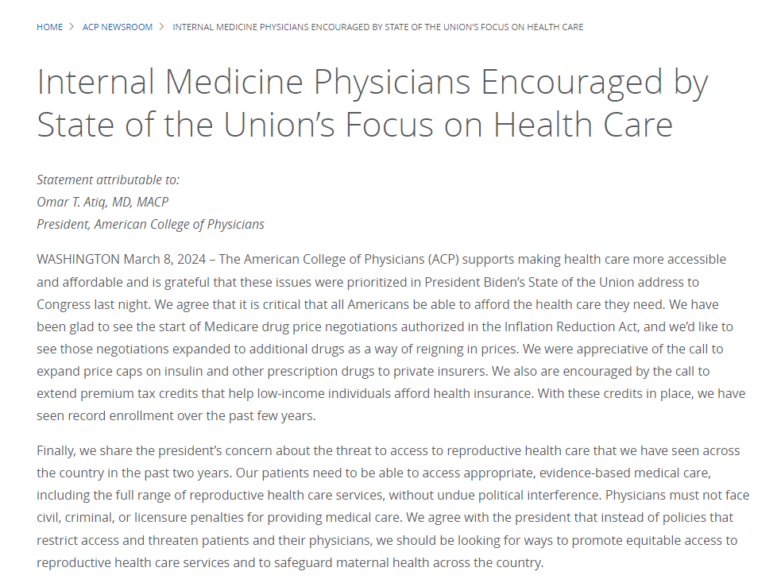
State of the Union

Slide 3
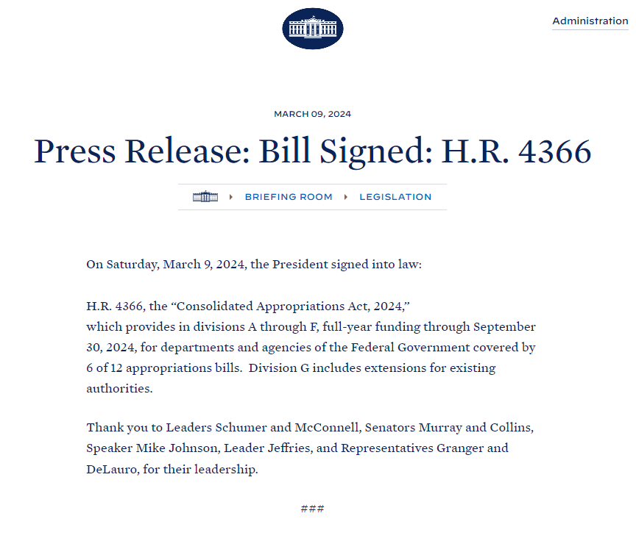
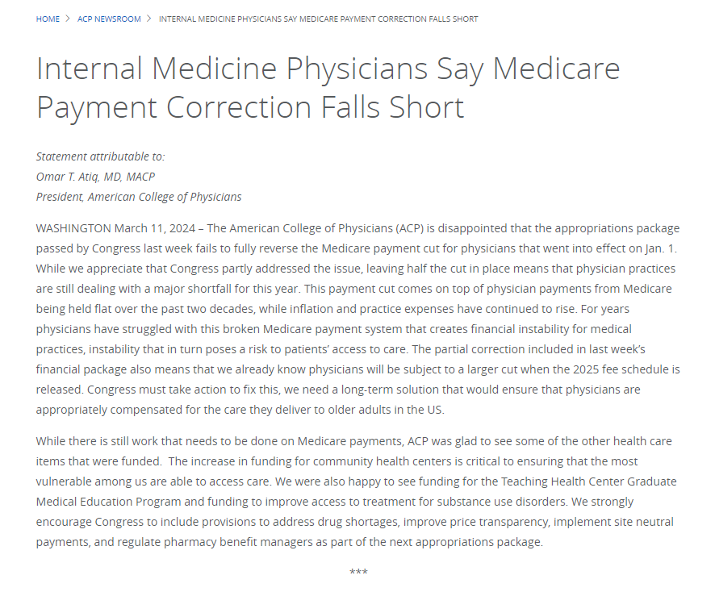
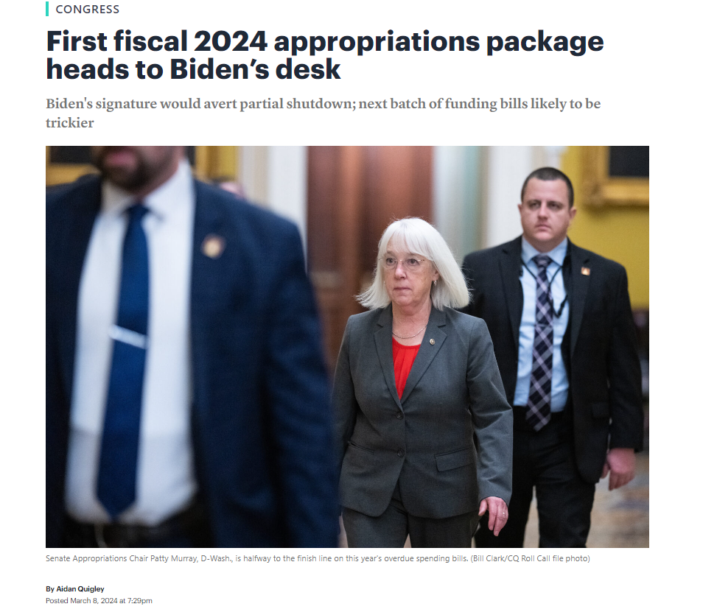
Appropriations – First 6 of 12 bills signed, March 9, 2024

Slide 4
2024 Policy and Advocacy Priorities
Promoting patient access to care
Protecting the patient-physician relationship
Addressing prescription drug access and affordability
Reducing administrative burden/“Patients before Paperwork”
Compensating physicians, particularly for the value of care they provide
Supporting programs that strengthen the physician workforce
Health information technology
Preventing Firearms-related Deaths and Injuries

Slide 5
How do we decide on what priorities to consider?
Needs of the Internal Medicine profession/ ACP members
Environmental Feasibility/ Opportunities for Action – Can we get some wins?
ACP Strategic Priorities:
Valued Professional Identity;
DEI;
Innovation
Membership Growth and Engagement;

Slide 6
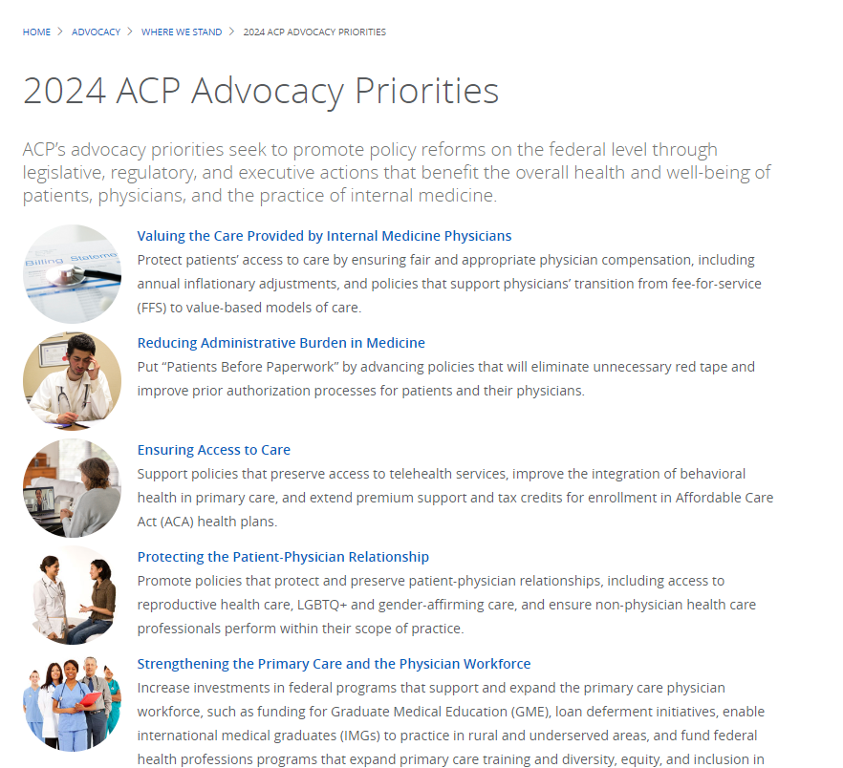


Slide 7

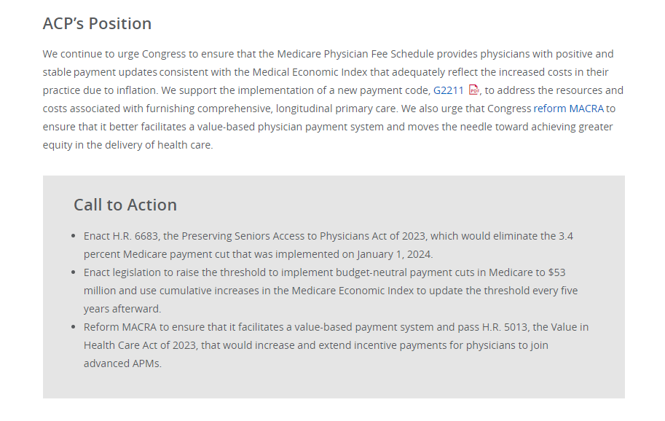
Valuing the Care Provided by IM Physicians
Inflationary updates to Medicare payment rates
Addressing budget neutrality/Medicare physician fee schedule
Policies that facilitate physicians transitioning to value-based models of care/ MACRA reform

Slide 8

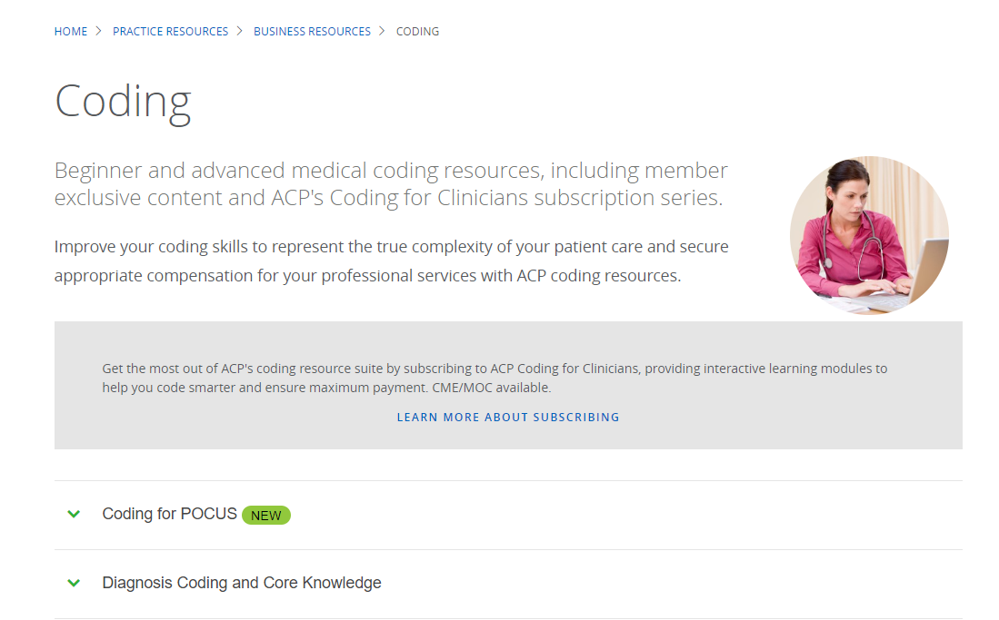
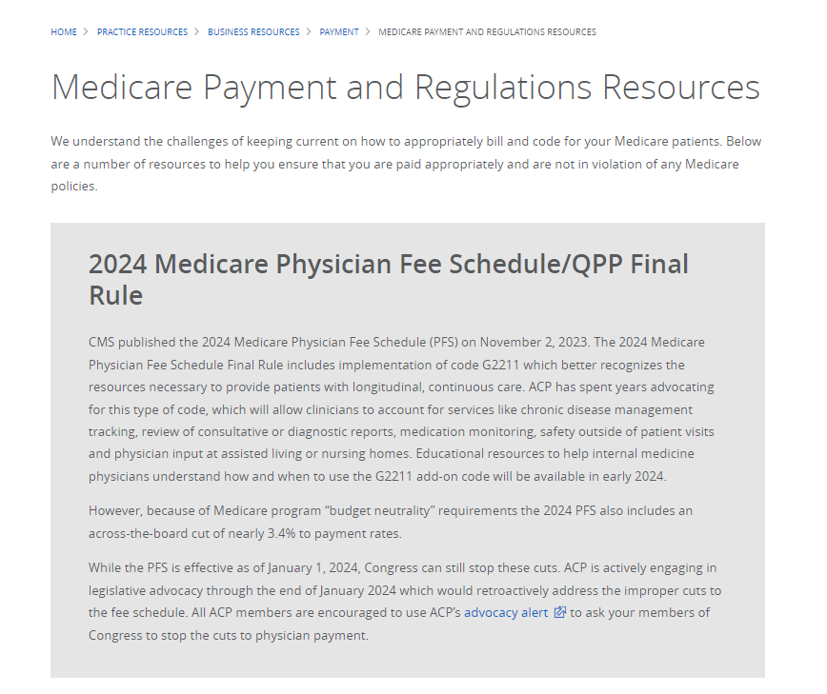

G2211 – Have you used it yet?
G2211 is appropriate in the context of a longitudinal relationship and characterizes the base E/M service based on the kind of care being furnished.
The relationship between the patient and the clinician is the determining factor and the add-on code should only be billed when the E/M office visit (CPT codes 99202-99215) serves as the focal point for all needed services.
The 2024 national Medicare payment amount is $16.04.
You should not use G2211 in the context of an annual wellness visit, a “Welcome to Medicare” visit, or when modifier 25 is used with the E/M service on the same day.
G2211 is active for additional payment from Medicare starting January 1, 2024. You should educate your administration and coding professionals about the importance of G2211 and offer ACP’s resource hub for support.

Slide 9
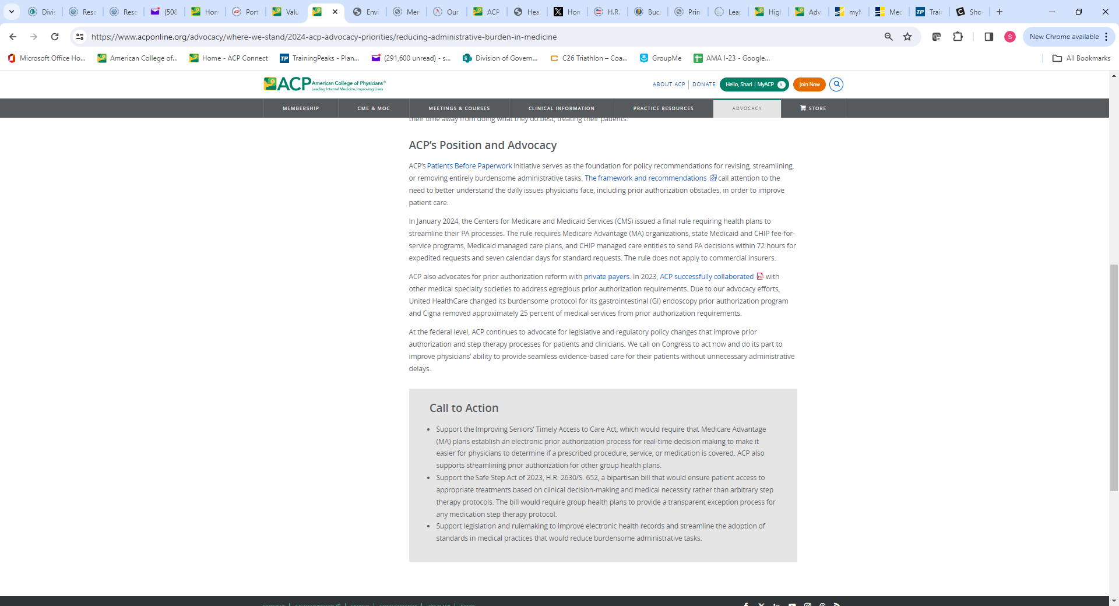

Reducing Administrative Burden in Medicine (Patients Before Paperwork)
Prior Authorization/ Medicare Advantage utilization management
Step therapy
Inbox management
Improving EHRs/Quality reporting issues

Slide 10

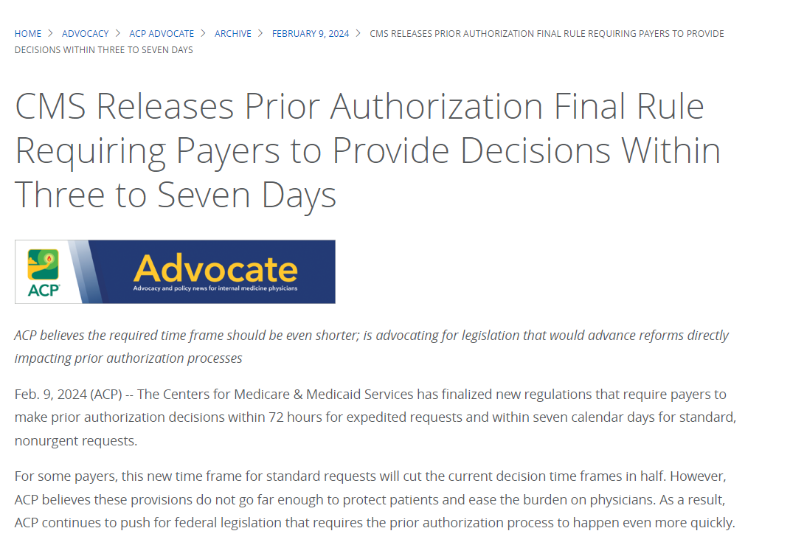

CMS – Advancing Interoperability and Improving Prior
Authorization Processes Rule (finally released in Jan. 2024)
These changes apply to government-regulated health plans:
  Medicare Advantage
  Medicaid
  Children’s Health Insurance Programs
  Medicaid Managed Care Plans
  All health plans on Federally-Facilitated Exchanges
This is helpful, but not sufficient:
  Congress should pass the Improving Seniors Timely Access to Care Act

Slide 11
CMS Prior Authorization Rule: What do physicians and patients need to know?
Transparency - To begin in 2026:
  Health plans will be required to provide very specific denial reasons and public reporting metrics, including:
    How often do they approve requests?
    How often do they deny requests?
    How long does it take the process to give a result/decision?
Shortened Decision Timeframes to Reduce Care Delays - To begin in 2026:
  Require health plans to have a decision within 72 hours for expedited or urgent request
  Or seven (7) calendar days for standard request
Require Health Plans to Support Electronic Prior Authorizations through the EHR - To begin in 2027:
  Embed the prior-authorization processes into the HER
These changes have teeth – enforcement could potentially include sanctions from CMS

Slide 12
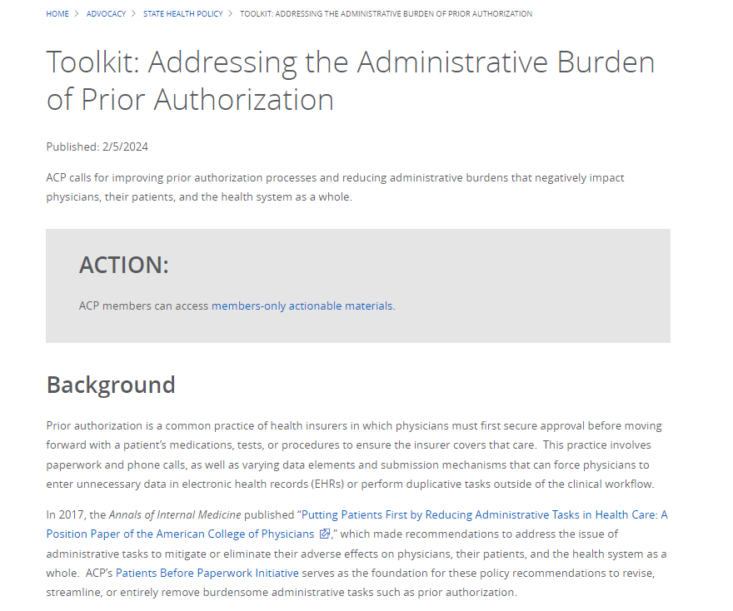

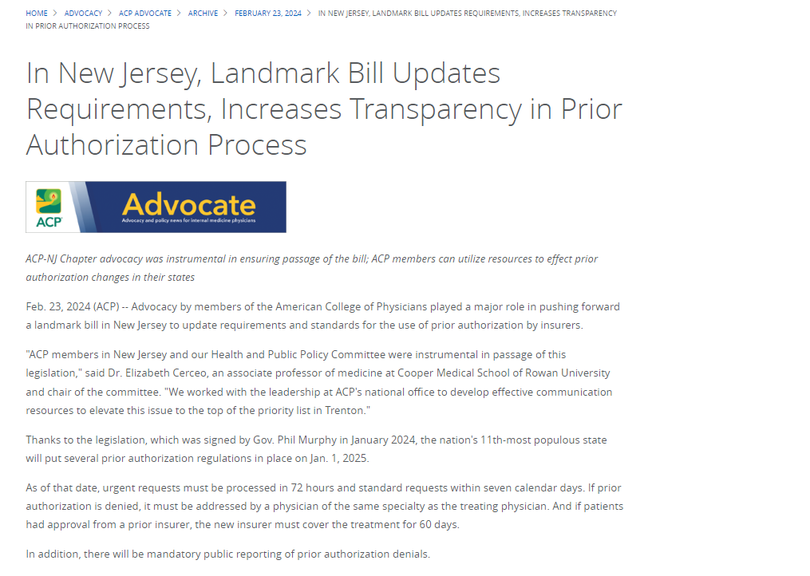
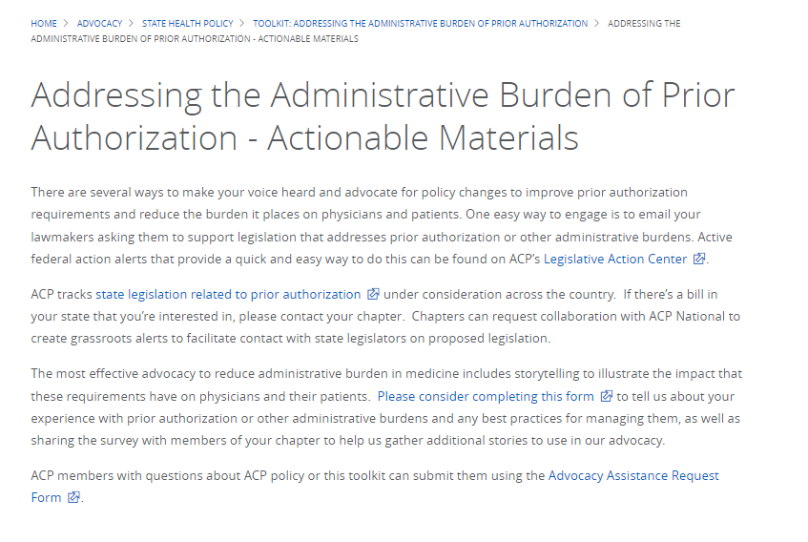

Slide 13

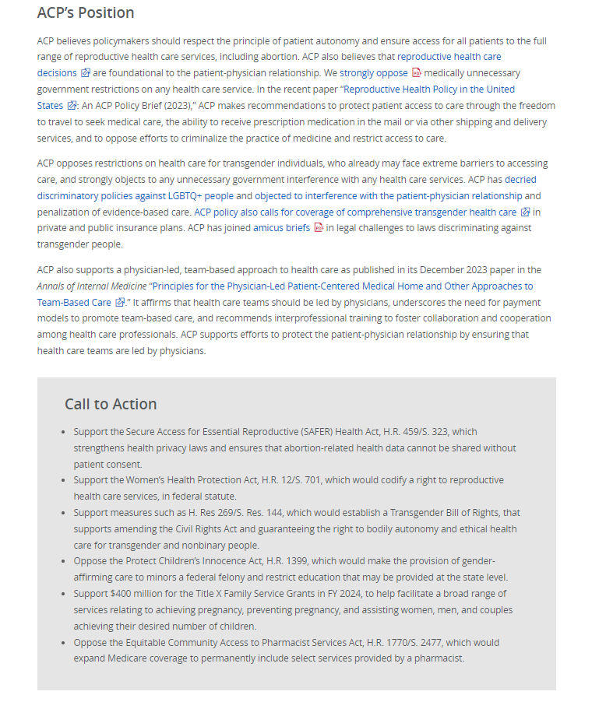
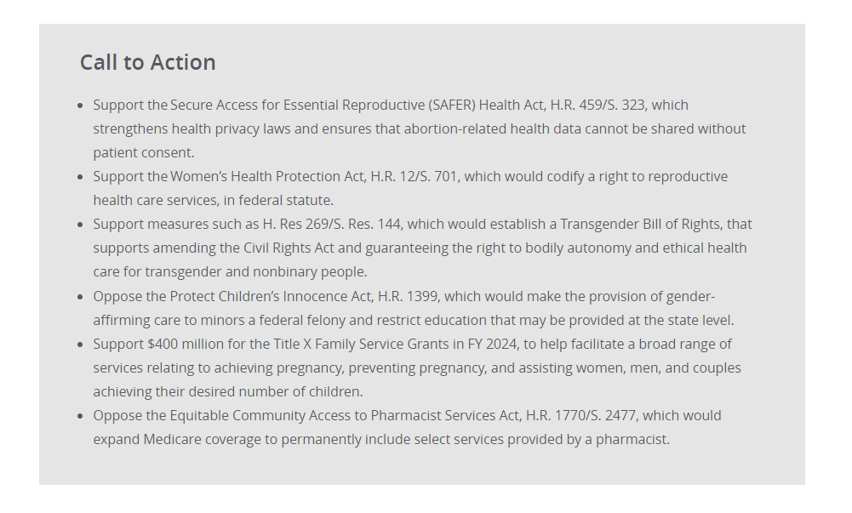
Protecting the Patient-Physician Relationship
Reproductive health care
LGBTQ+/gender affirming care
Scope of practice

Slide 14

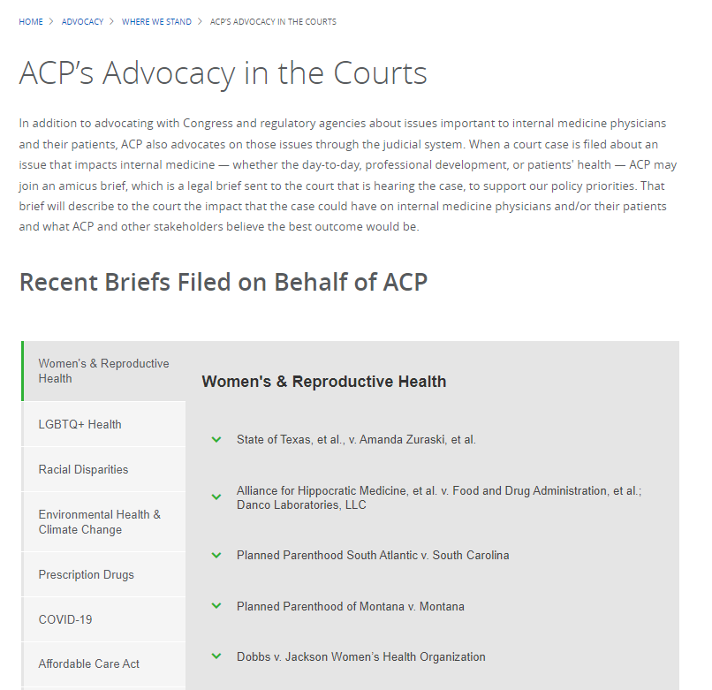
Amicus Briefs
Participated in or led 35 briefs on 7 issues, including:
    19 on LGBTQIA+ issues
    8 on prescription drugs
    3 on women’s health
    2 on climate change
    ACA
    COVID-19/medical misinformation
    Firearms

Slide 15
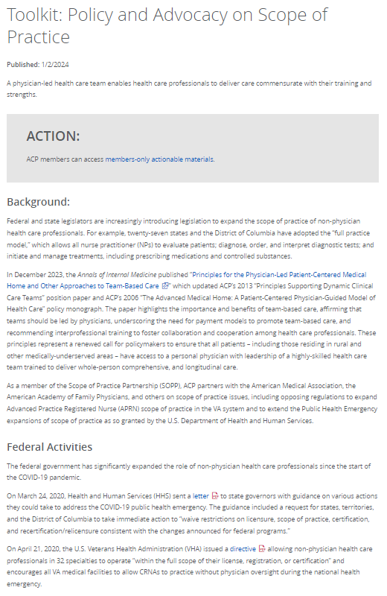
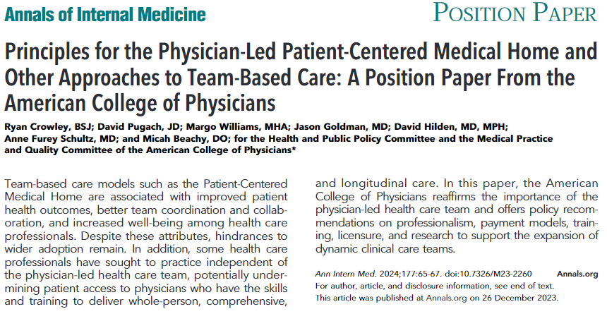

Team-Based Care

Slide 16

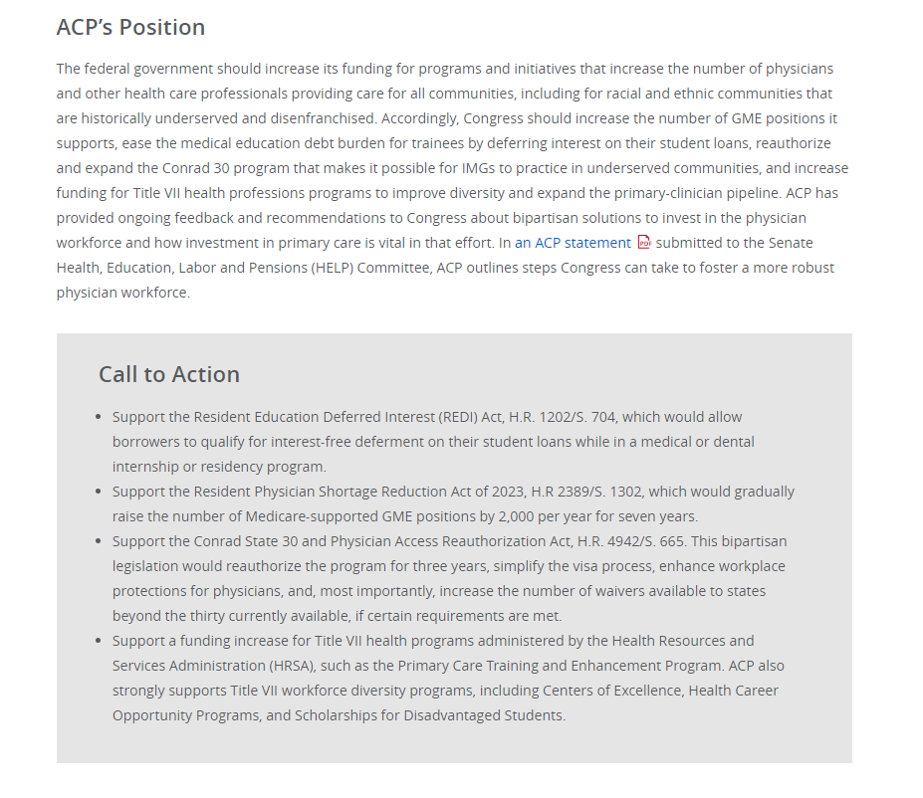
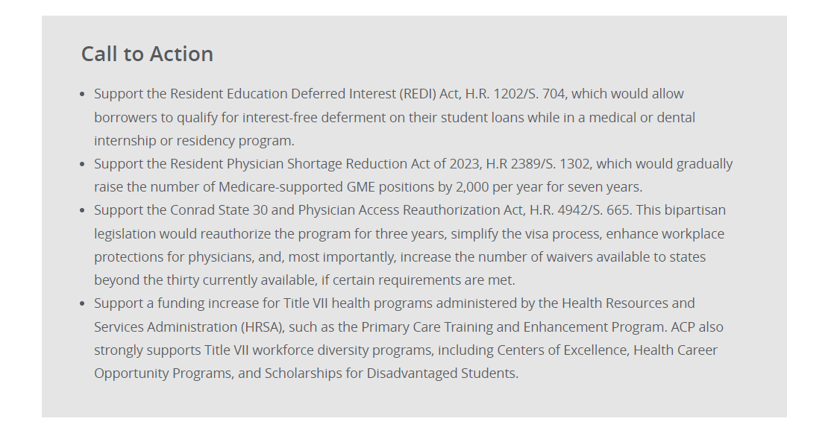
Strengthening Primary Care and the Physician Workforce
Increase GME slots to improve access to primary care/ Residency slots
Support Conrad 30 program
HRSA funding – title VII programs that support DEI and primary care

Slide 17

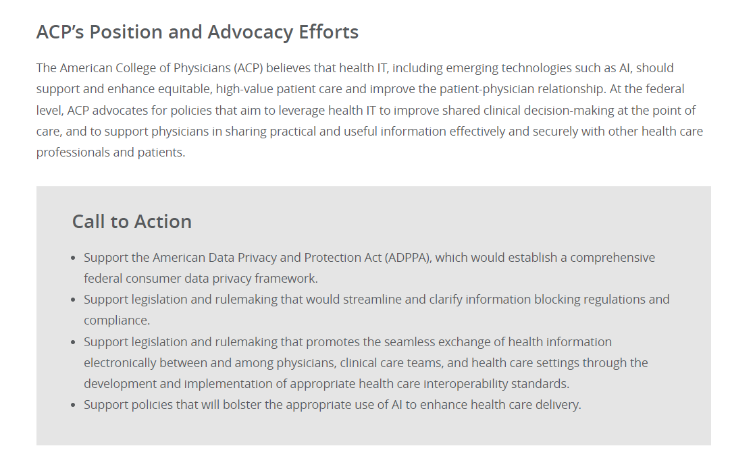
Supporting and Enhancing Health Information Technology
Policies that support the appropriate use of artificial intelligence to support health care delivery
Data privacy/ Information blocking
Interoperability

Slide 18

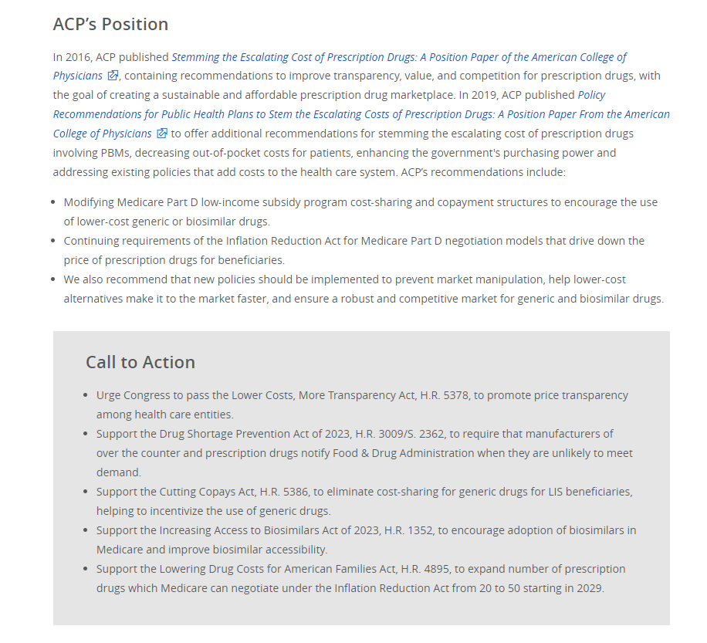
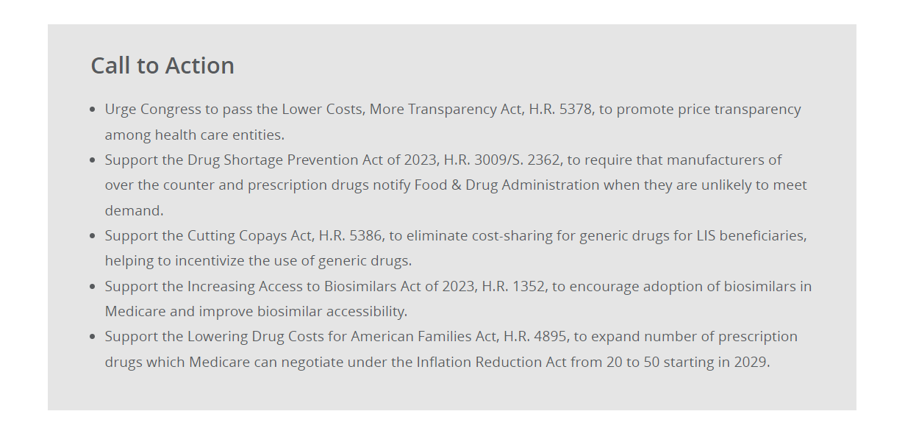
Increasing Prescription Drug Access and Affordability
PBM reform/ pricing transparency
Inflation Reduction Act implementation/ next steps/ additional drugs for negotiation
Drug shortages

Slide 19

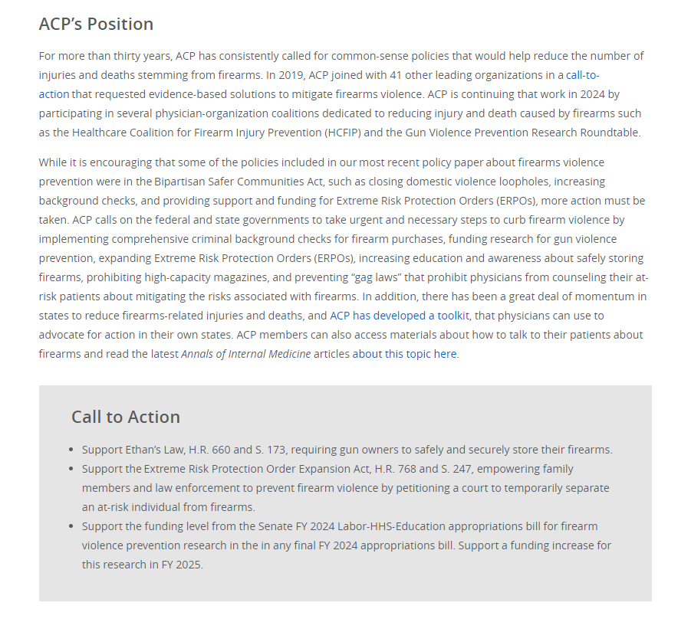
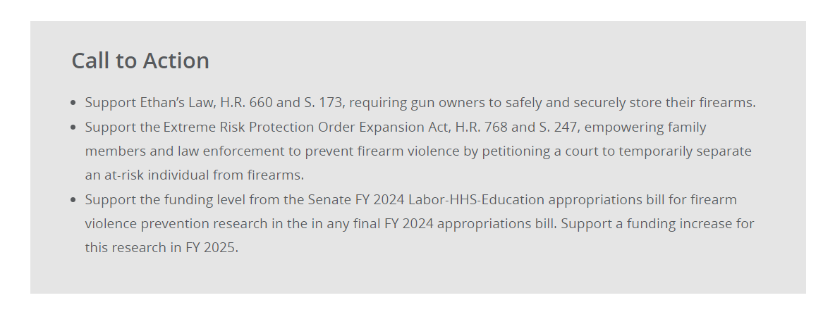
Preventing Firearms-Related Injuries and Deaths
Collaborations with AMA, ACS, others and state-level efforts
Investment in research and funding, as well as policy implementation
Taking action within health systems and practices

Slide 20
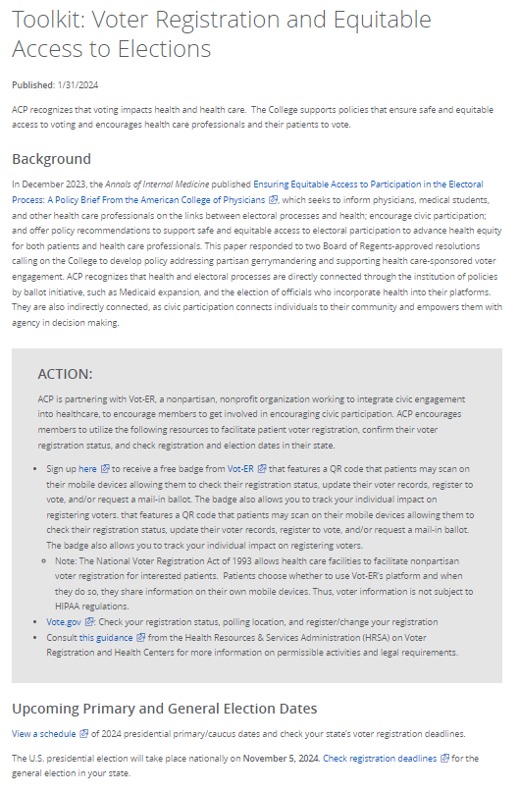
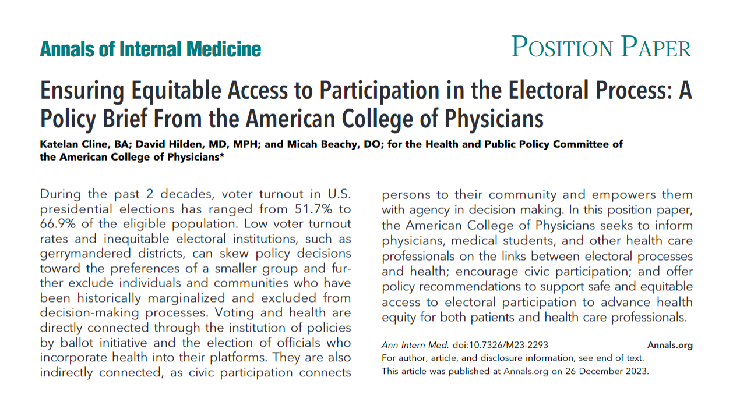

Equitable Access to Electoral Process

Slide 21
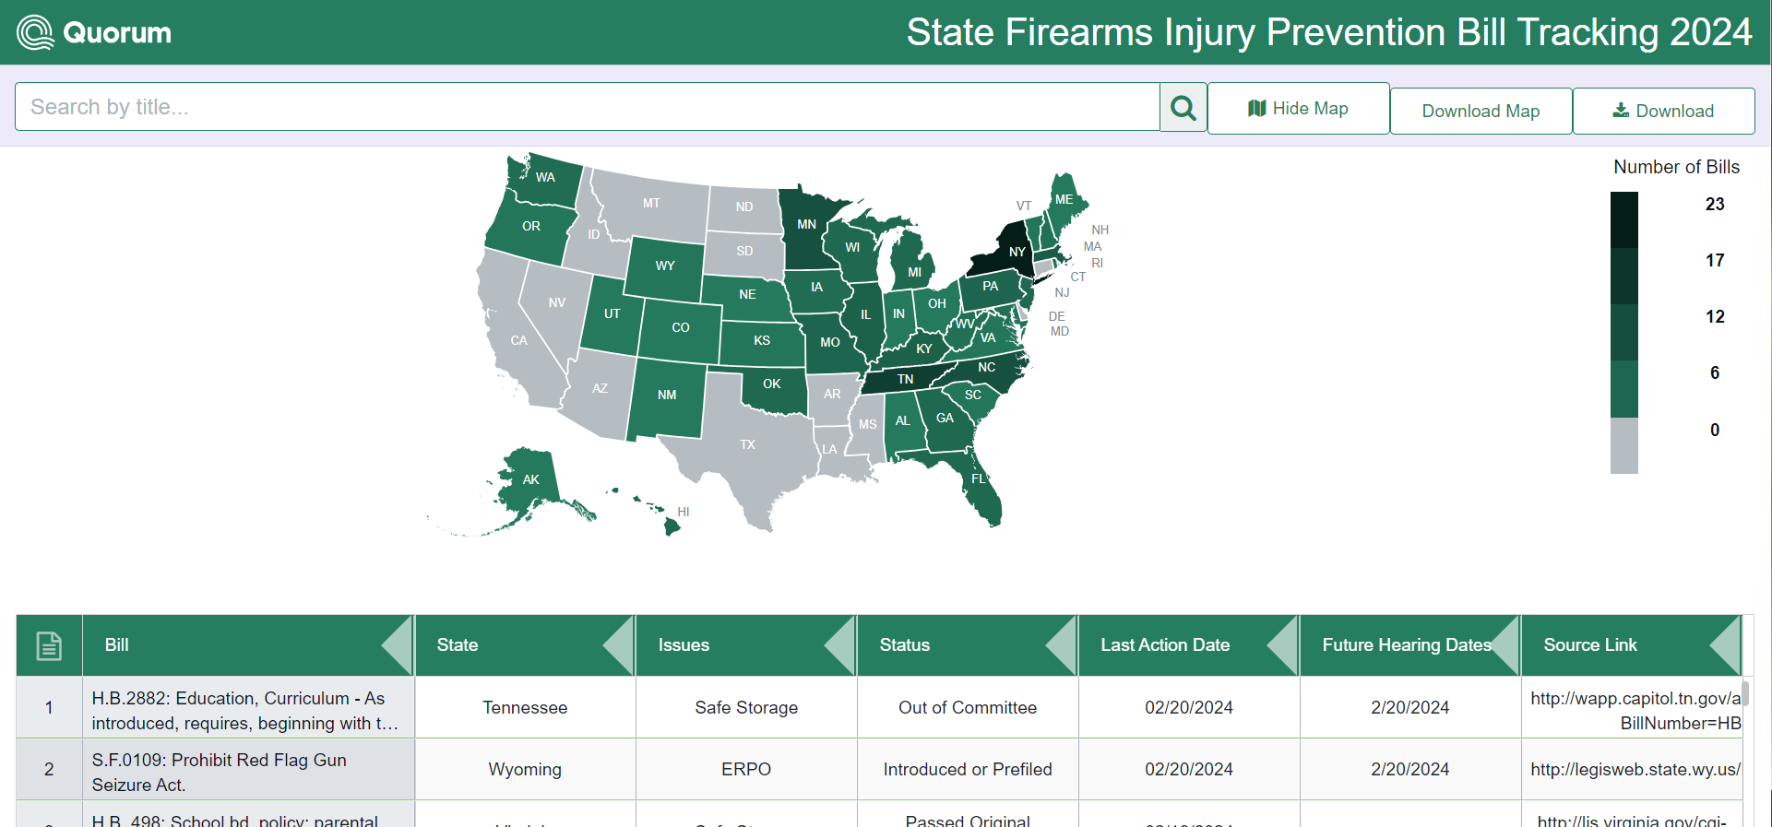

State Legislative Tracking
State Leg Tracking on LeaderNet:
ACP tracking state legislation on:
Reproductive health
Scope of Practice
Prior Authorization
Firearm Injury Prevention
Gender-affirming Care

Slide 22
2023 Chapter Inquiry Highlights
23 chapters submitted 92 requests
For requests (62) received through online forms:
53% marked urgent vs 47% marked normal
Average response time of 1.51 business days, with 0.66 business days for urgent requests and 2.27 business days for normal requests
97% of requests completed on goal timeline, including 100% of urgent requests
Requests on 23 health policy issues, including:
  Reproductive health
  Prescription drugs and health equity
  Followed by: environmental health/climate change and public health, then by physician payment, LGBTQ+ issues, scope of practice, and electoral inquiries

Slide 23
2023 ACP Grassroots Advocacy Data
14 federal campaigns covering:
  physician payment (x5),
  Medicare/Medicaid pay parity (x2),
  step therapy (x2),
  non-compete agreements,
  student loans,
  GME slots, telehealth,
  prior authorization,
  price transparency
4 state campaigns covering: firearms safety (x2), maternal health/Medicaid, prior authorization
Total # of messages to lawmakers: 5,119 from 1,196 advocates
  4,478 federal messages, including 498 grassroots regulatory comments
    G2211: 2,454 messages, include 265 individual comment letters to CMS

Slide 24
Questions?

