Slide 1
The Latest on ACP’s 2023 Policy Priorities ACP State Health Policy Networking Webinar
Shari M. Erickson, MPH Chief Advocacy Officer and Senior Vice President, Governmental Affairs and Public Policy
November 1, 2023

Slide 2
2023 ACP Public Policy Priorities

Slide 3
ACP Policy Priorities for 2023
Behavioral Health
Health Care Access and Coverage – focus on Medicaid and Telehealth
Physician Payment and Delivery System Reform
Patients Before Paperwork – focus on prior authorization reform
Health and Workforce Equity
COVID-19 and Public Health Preparedness
Prescription Drug Affordability
Firearm Violence Prevention
Reproductive Health Care
Climate Change

Slide 5
2023 Public Policy Priorities: A Closer Look

Slide 6
Addressing Prescription Drug Costs

Slide 7
Addressing Prescription Drug Access and Affordability
Supporting S. 652/H.R. 2630, the Safe Step Act of 2023, to address arbitrary step therapy protocols by providing an exceptions process.
Ensuring CMS implements regulations to fully reflect the requirements contained in the Inflation Reduction Act, including prescription drug price negotiations under Medicare Part D beginning in 2026.
CMS has issued guidance for drug price negotiations
CMS has announced the first 10 drugs selected for negotiations
White House report: Medicare beneficiaries are projected to save approximately $400 per year on average in prescription drug costs because of the IRA out-of-pocket spending cap of $4000/year.
Advocating for requiring greater transparency in prescription drug price increases
Monitoring legislation focused on pandemic preparedness that will address drug pricing

Slide 9
Judicial Branch Activity

Slide 10
Compensate Physicians for the Value of Care Provided

Slide 12
Compensate Physicians for the Value of Care Provided
Supporting H.R. 2474, the Strengthening Medicare for Patients and Providers Act, preserves access to care for Medicare beneficiaries by providing an annual inflation update equal to the Medicare Economic Index (MEI) for Medicare physician payments.
Supporting H.R. 2829, the Chronic Care Management Improvement Act of 2023, would waive the beneficiary coinsurance to manage chronic care conditions.
Advocating for Congressional hearings to gain the input needed from all stakeholders to ensure that MACRA provides opportunities for physicians to deliver high quality care to patients based upon value-based payment models
Submitted a coalition letter to House and Senate leadership on the importance of value-based care.
Multiple ACP grassroots alerts in supporting payment issues.

Slide 13
Strengthening Primary Care: Making Care Primary
CMMI recently announced a new model that will be tested in 8 states:
CO, MA, MN, NJ, NM, NY, NC, and WA
Structured to facilitate and promote care coordination between primary care physicians and other specialists.
Will provide primary care clinicians with enhanced payments, tools, and supports to improve the health outcomes of their patients
Outstanding questions about attribution of care
Incorporates key elements that ACP proposed in the Medical Home Neighborhood model
Aligns with recommendations in ACP paper, Beyond the Referral: Principles of Effective, Ongoing Primary and Specialty Care Collaboration
Notes:
Webinar on September 29-ACP Calls with CMMI leadership
Questions re: impact on health equity and attribution of care
-ACP Statement
- ACP Letter to CMS
- Informational resources for physicians in process

Slide 14
Reduce Administrative Burden in Medicine

Slide 15
Reduce Administrative Burden in Medicine
Reintroducing and passing the Improving Seniors’ Timely Access to Care Act, which would simplify the prior authorization process to determine if a prescribed procedure, service, or medication is covered by a health plan in Medicare Advantage (MA).
Support S. 652/H.R. 2630, the Safe Step Act of 2023, to address arbitrary step therapy protocols by providing an exceptions process.
Advocacy with CMS:
Comments on Advancing Interoperability and Improving Prior Authorization Processes for Medicare Advantage Organizations proposed rule.
Comments on Contract Year (CY) 2024 policy and technical revisions to regulations governing Medicare Advantage proposed rule.
Private payer advocacy:
Opposed United Healthcare’s gastrointestinal endoscopy prior authorization program – this led directly to UHC halting this policy!
Opposed Cigna’s modifier 25 policy – this led directly to Cigna delaying the implementation of this policy!

Slide 16
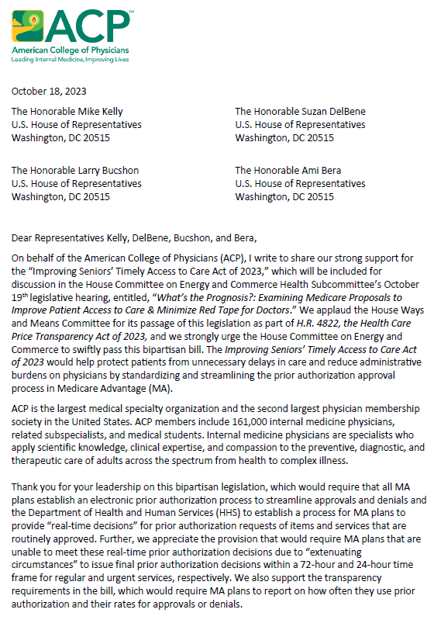
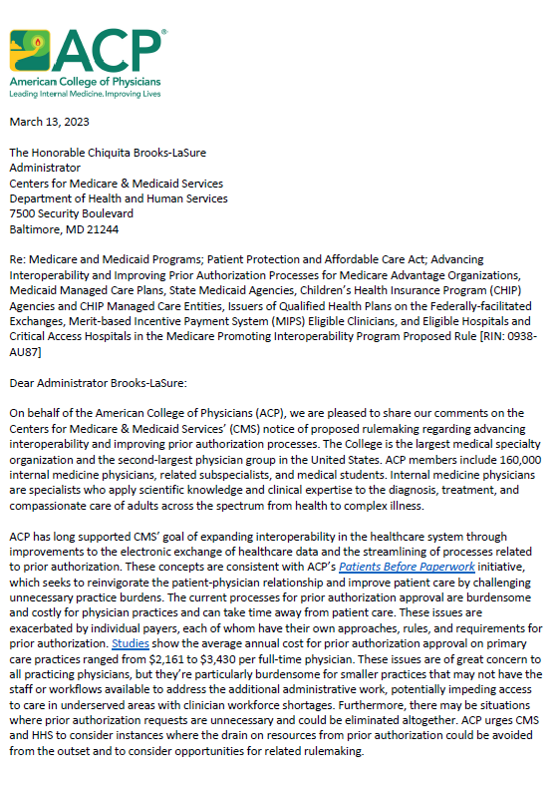
Prior Authorization
Legislation
Rulemaking

Slide 17
Forecasting Fall 2023 Advocacy

Slide 18
Health Care Legislation on Horizon
H.R. 5378: Lower Costs, More Transparency Act – combines portions of H.R. 4822, Health Care Price Transparency Act of 2023, H.R. 3561, Promoting Access to Treatments and Increasing Extremely Needed Transparency Act of 2023 (PATIENT Act of 2023), and other related bills.
H.R. 4895: Lowering Drug Costs for American Families Act - would build on drug pricing provisions in the Inflation Reduction Act of 2022 and expand the annual number of prescription drugs selected for negotiation in the Drug Pricing Program from 20 to 50, starting in 2029.
H.R. 3305/S. 1606: Black Maternal Health Momnibus Act – would authorize or expand a comprehensive set of grants and programs to address social determinants of health, expand and diversify the perinatal health workforce, expand access to maternal mental health care, and addresses the effects of climate change on maternal and infant care.
Notes:
HR 5378: Would require disclosure of changes in hospital or health facility ownership to reveal when private equity firms acquire them, promote price transparency among hospitals, health plans and pharmacy benefit managers and promote site neutrality for Medicare and Medicare beneficiaries.
- Reauthorizes and funds Teaching Health Center Graduate Medical Education program, Community Health Center program and National Health Service Corps.
- Missing prior authorization and step therapy legislation.

Slide 19
Shutdown Averted (for now), but U.S. House WAS in Chaos
Notes:
November 17th deadline

Slide 20
But work has still been happening!
GOP Doctors Caucus Co-Chairs released a discussion draft of legislation seeking to reform the Medicare Physician Fee Schedule (MPFS).
1. Updates Budget Neutrality Threshold: Increases the budget neutrality threshold, which has not changed since 1992, from $20 million to $53 million (for 2025-2029). After 2030, the budget neutrality threshold would be determined by the cumulative increase in Medicare Economic Index (MEI) every 5 years.
2. Supports Budget Neutrality Corrections: Establishes a lookback period to reconcile overestimates and underestimates of pricing adjustments for individual services, allowing the Medicare conversion factor to be calculated with more accuracy based on actual utilization data and claims.
3. Updates to Direct Cost Inputs for Practice Expenses: Requires the HHS Secretary to update prices and rates for direct cost inputs for practice expense (PE) relative value units (RVUs), including clinical wage rates, prices of medical supplies, and prices of equipment no less than every 5 years.
4. Limits Conversion Factor Variance: Starting in 2025, the HHS Secretary would be required to limit positive or negative increases in the conversion factor to no greater than 2.5% each year.

Slide 21
House Energy & Commerce Subcommittee on Health Hearing – Thursday, October 19th
Numerous bills to be discussed, including:
Provider Reimbursement Stability Act of 2023
Improving Seniors Timely Access to Care Act of 2023
Telehealth Privacy Act of 2023
Fewer Burdens for Better Care Act of 2023
Allow for the use of alternative measures of performance under the Merit-based Incentive Payment System under the Medicare program
Exempt certain practitioners from MIPS payment adjustments under the Medicare program based on participation in certain payment arrangements under Medicare Advantage
Extend incentive payments for participation in eligible alternative payment models
And more…

Slide 22
Thank you! serickson@acponline.org

