Slide 1
ACP State Health Policy Networking Webinar
July 15, 2026
Shari M. Erickson, MPH, Chief Advocacy Officer and
Senior Vice President, Governmental Affairs and Public Policy

Slide 2
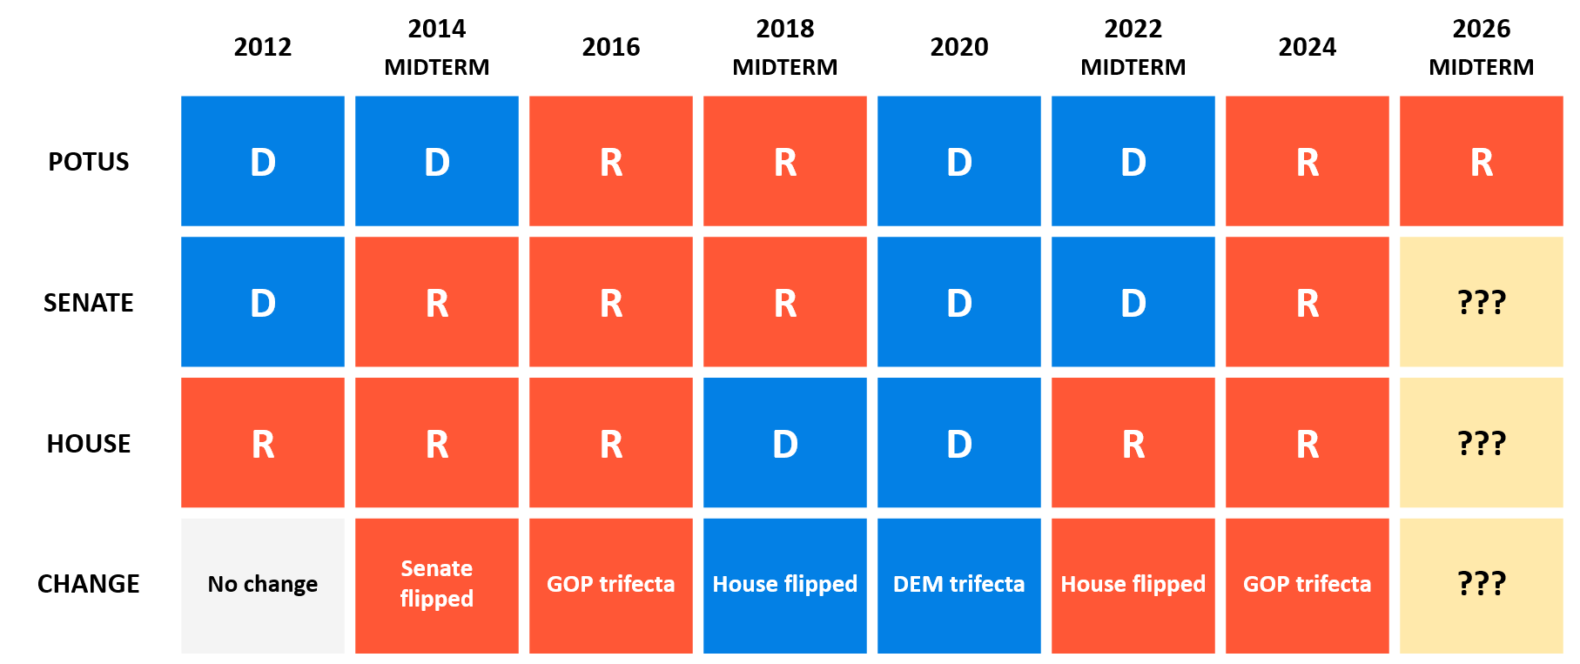
In each of the last three midterm election cycles, a chamber of Congress has flipped

Slide 3
POTUS | SENATE | HOUSE | LIKELIHOOD | LIKELIHOOD ANALYSIS
R | R | D | High ••••• | The president’s party has lost ground in midterm elections in each of the last three midterms, and Democrats would need to flip just five seats to secure a majority in the House
R | D | D | Medium ••••• | Democrats have recruited their ideal Senate candidate in several swing states, including Sherrod Brown in Ohio and Mary Peltola in Alaska, and have strong funding numbers in Texas
R | R | R | Low ••••• | The Senate map is favorable for Republicans, and redistricting efforts across several Republican-led states could help the GOP maintain control if President Trump remains popular with his base
R | D | R | Very Low ••••• | It is highly unlikely that Democrats will perform well enough in states such as Texas, Ohio, or Iowa to flip the Senate, and not secure a House majority as well

Slide 4
2026 ACP Advocacy Priorities

Slide 5
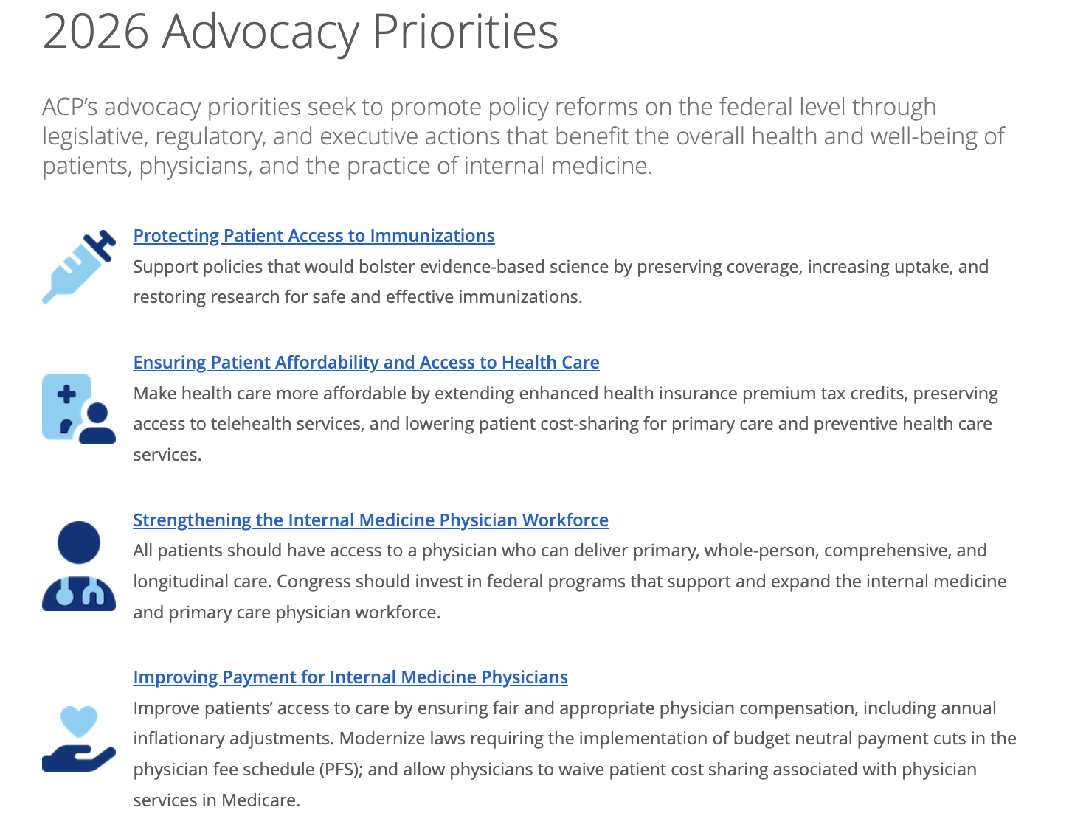


Slide 6
Priority 1: Protecting Patient Access to Vaccines

Slide 7
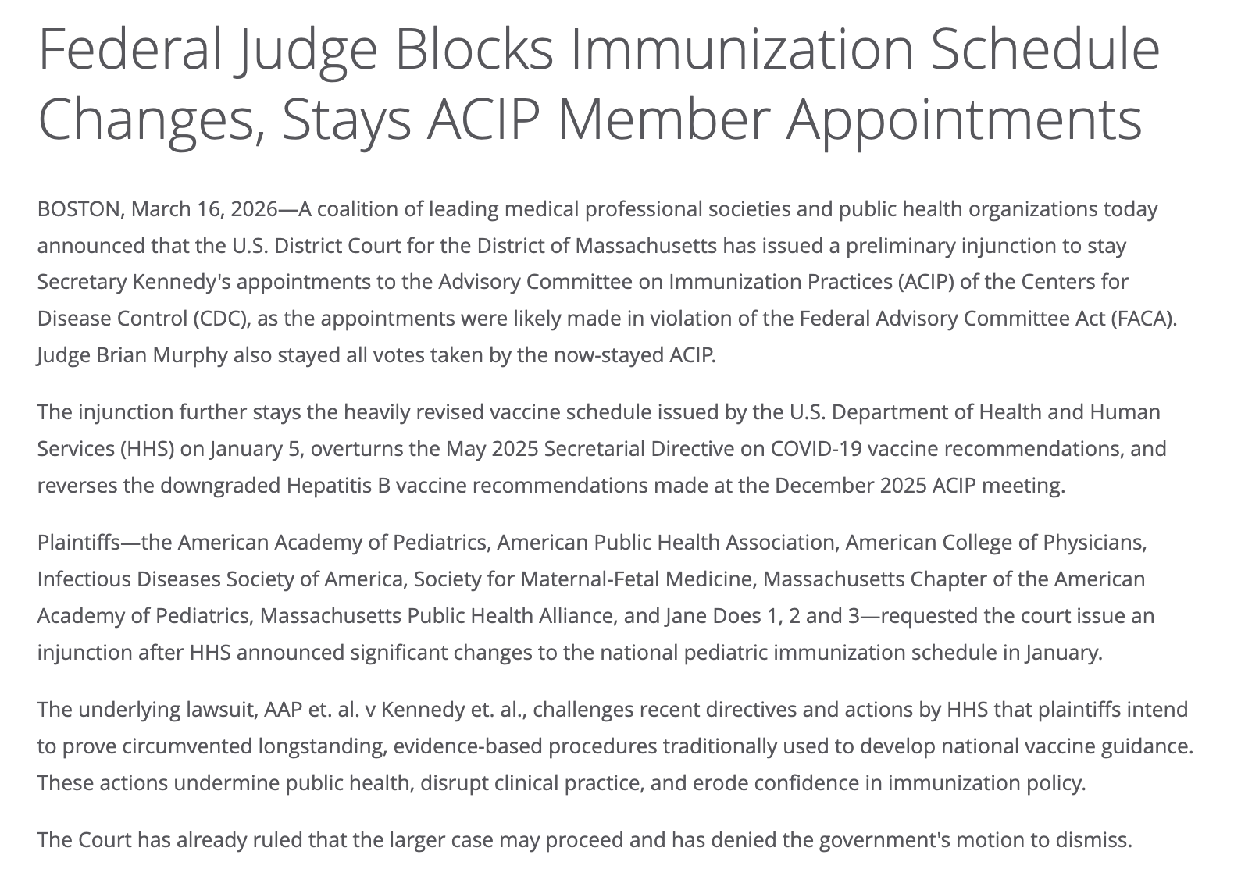

Slide 8
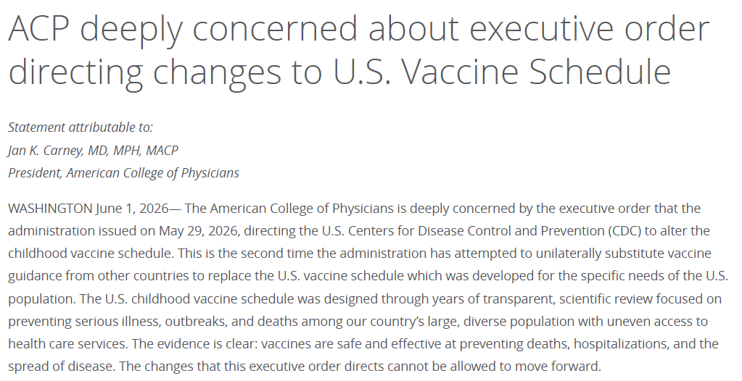
Additional Vaccine News
New ACIP Charter: HHS and the CDC recently issued an updated ACIP charter. Critics warn the updated framework—which grants more control to the CDC director, broadens criteria to include non-vaccine experts, and omits previous mandates for regular public meetings—could open the door for further politicization and delays in vaccine access.
Presidential Directive: In late May, an Executive Order directed the CDC and ACIP to review and align U.S. childhood vaccination schedules with peer developed countries to ensure "maximum flexibility to parents and doctors"

Slide 9
Priority 2: Ensuring Patient Affordability and Access to Health Care

Slide 10
Updated Asks re: Ensuring Patient Affordability and Access to Health Care
Enact legislation that would lower out-of-pocket costs and cost-sharing for primary care and preventive health services, such as:
Enact H.R, 8261, the Chronic Care Management Improvement Act, which would remove cost sharing responsibilities for chronic care management services under the Medicare program.
Support legislation and efforts by CMS to waive cost sharing for Advanced Primary Care Management services.
Oppose CMS proposal to impose the more burdensome interim final rule on Medicaid community engagement or work requirements.
H.R. 919, Chronic Disease Flexible Coverage Act. This bill would provide employers with the option of offering first dollar coverage of certain chronic disease treatments for employees with high-deductible health plans.

Slide 11
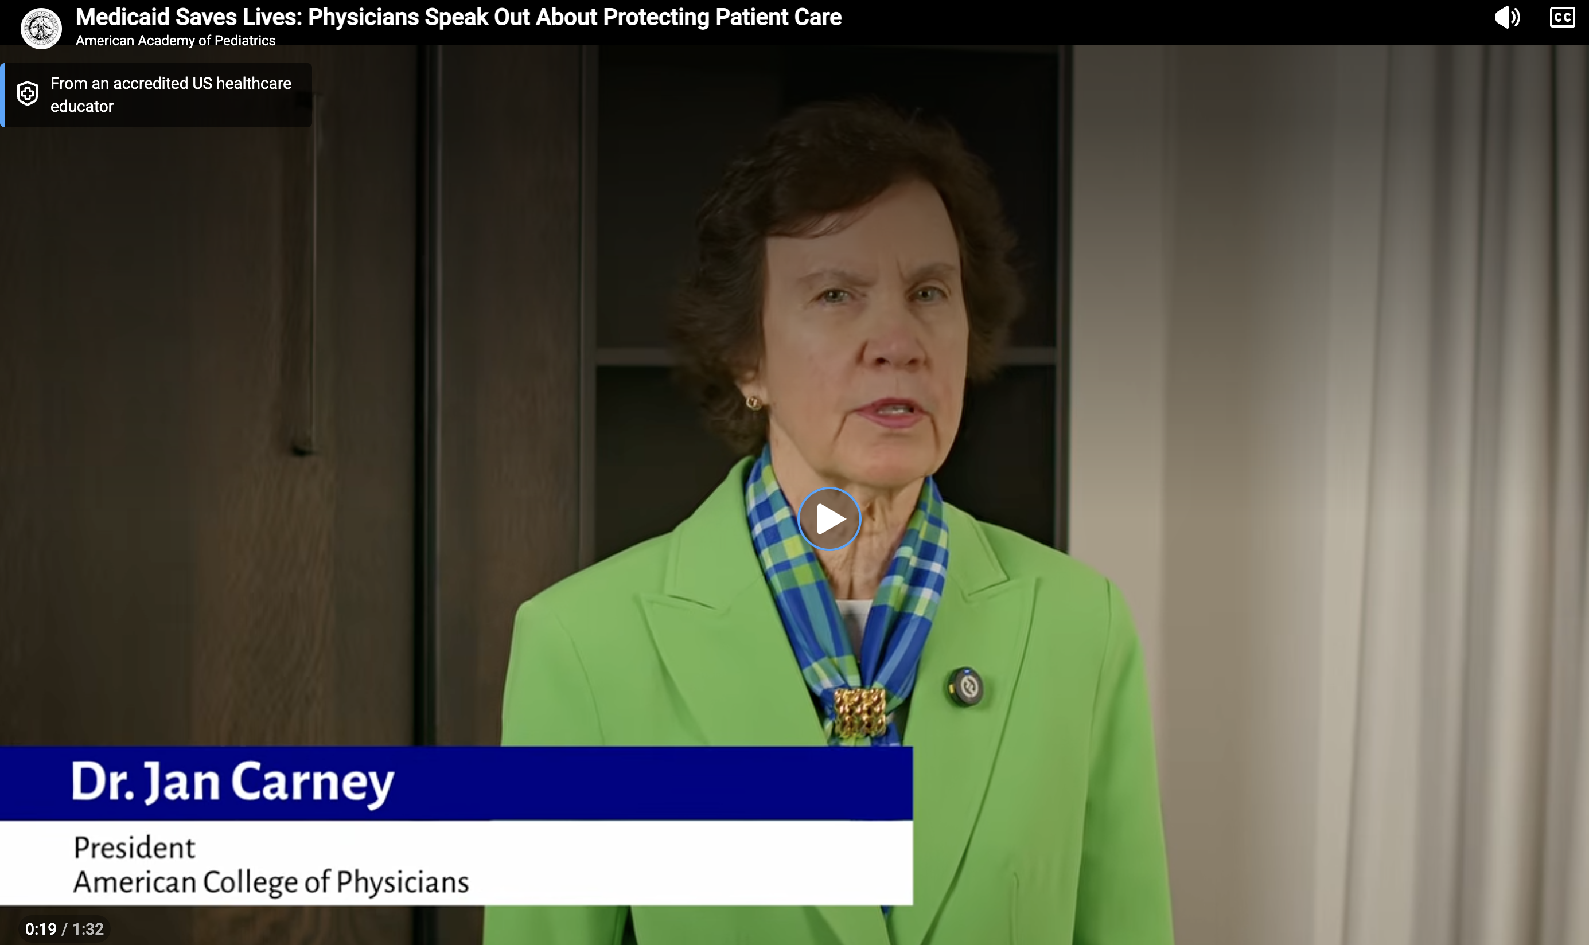
https://www.youtube.com/watch?v=vjL-0BZnrv0

Slide 12
Priority 3: Strengthening the Internal Medicine Physician Workforce

Slide 13
Updated Asks re: Strengthening the Internal Medicine Physician Workforce
Easing Medical Student Debt: Co-sponsor and pass the REDI (Resident Education Deferred Interest) Act (H.R. 2028/S. 942), which would allow borrowers to qualify for interest-free deferment on their federal student loans while in a medical or dental internship or residency program. Currently, interest on student loans accrues during medical residency, which adds a significant cost to student borrowing.
Public Service Loan Forgiveness (PSLF) Program: Congress should make clear that any authorized federal repayment plan is eligible for PSLF. As of July 1, 2026, the Tiered Standard Repayment Plan will not count toward PSLF.
H-1B Visas: Cosponsor and pass the H–1Bs for Physicians and the Healthcare Workforce Act, H.R. 7961. This bill would exempt physicians as well as other health care professionals from the H-1B visa fee of $100,000.

Slide 14
Priority 4: Improving Payment for Internal Medicine Physicians

Slide 15
Updated Asks re: Improving Payment for Internal Medicine Physicians
The Patients First Act of 2026, which supports patient access to primary care by strengthening Medicare payment for primary care and all physician services. This bill provides positive, predictable, and stable annual updates to the PFS that are tied to the Medicare Economic Index.
Pass H.R. 8163, the Provider Reimbursement Stability Act, that modernizes Medicare’s budget neutrality requirements, including increasing the statutory threshold that triggers budget-neutral adjustments within the PFS from $20 million to $54.5 million.
Allow physicians to waive patient cost-sharing associated with primary services.

Slide 16
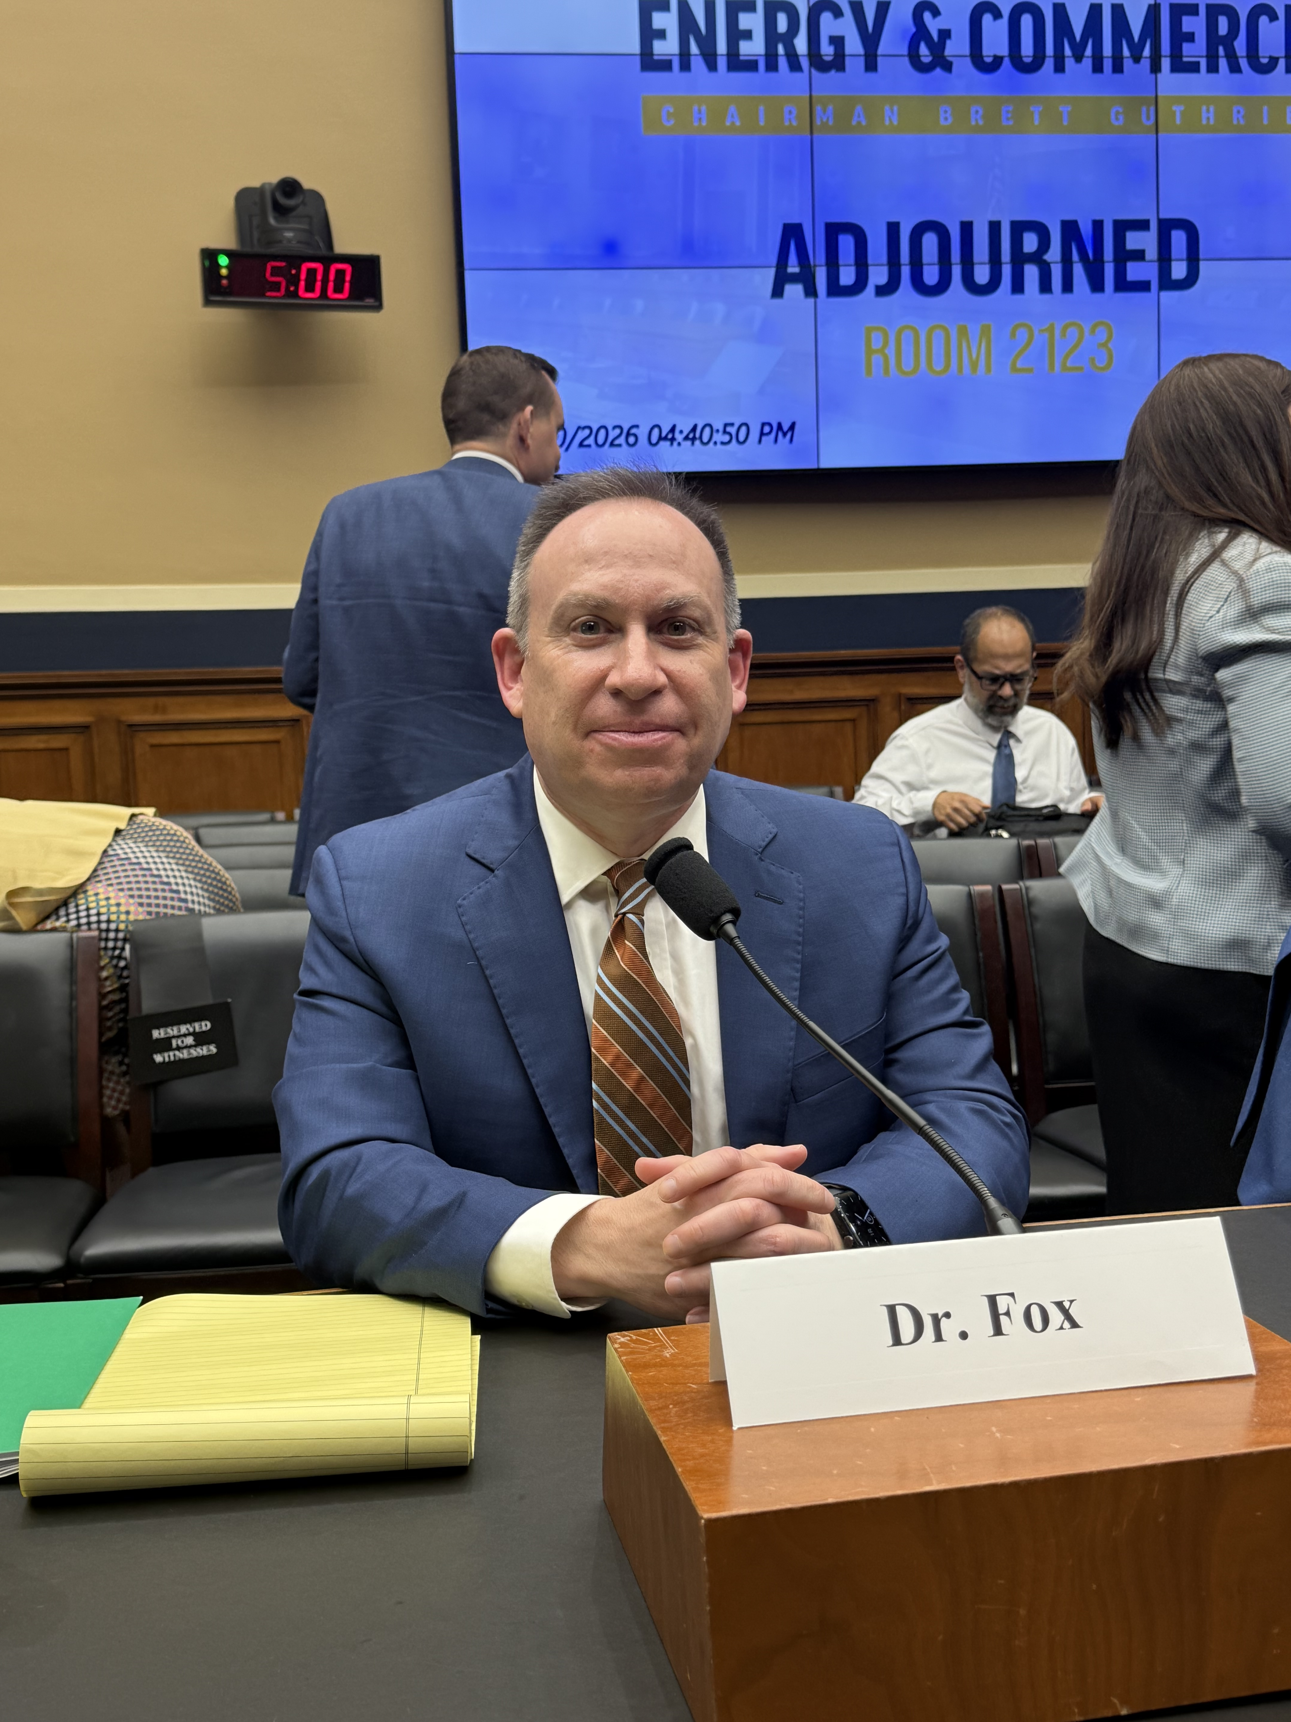
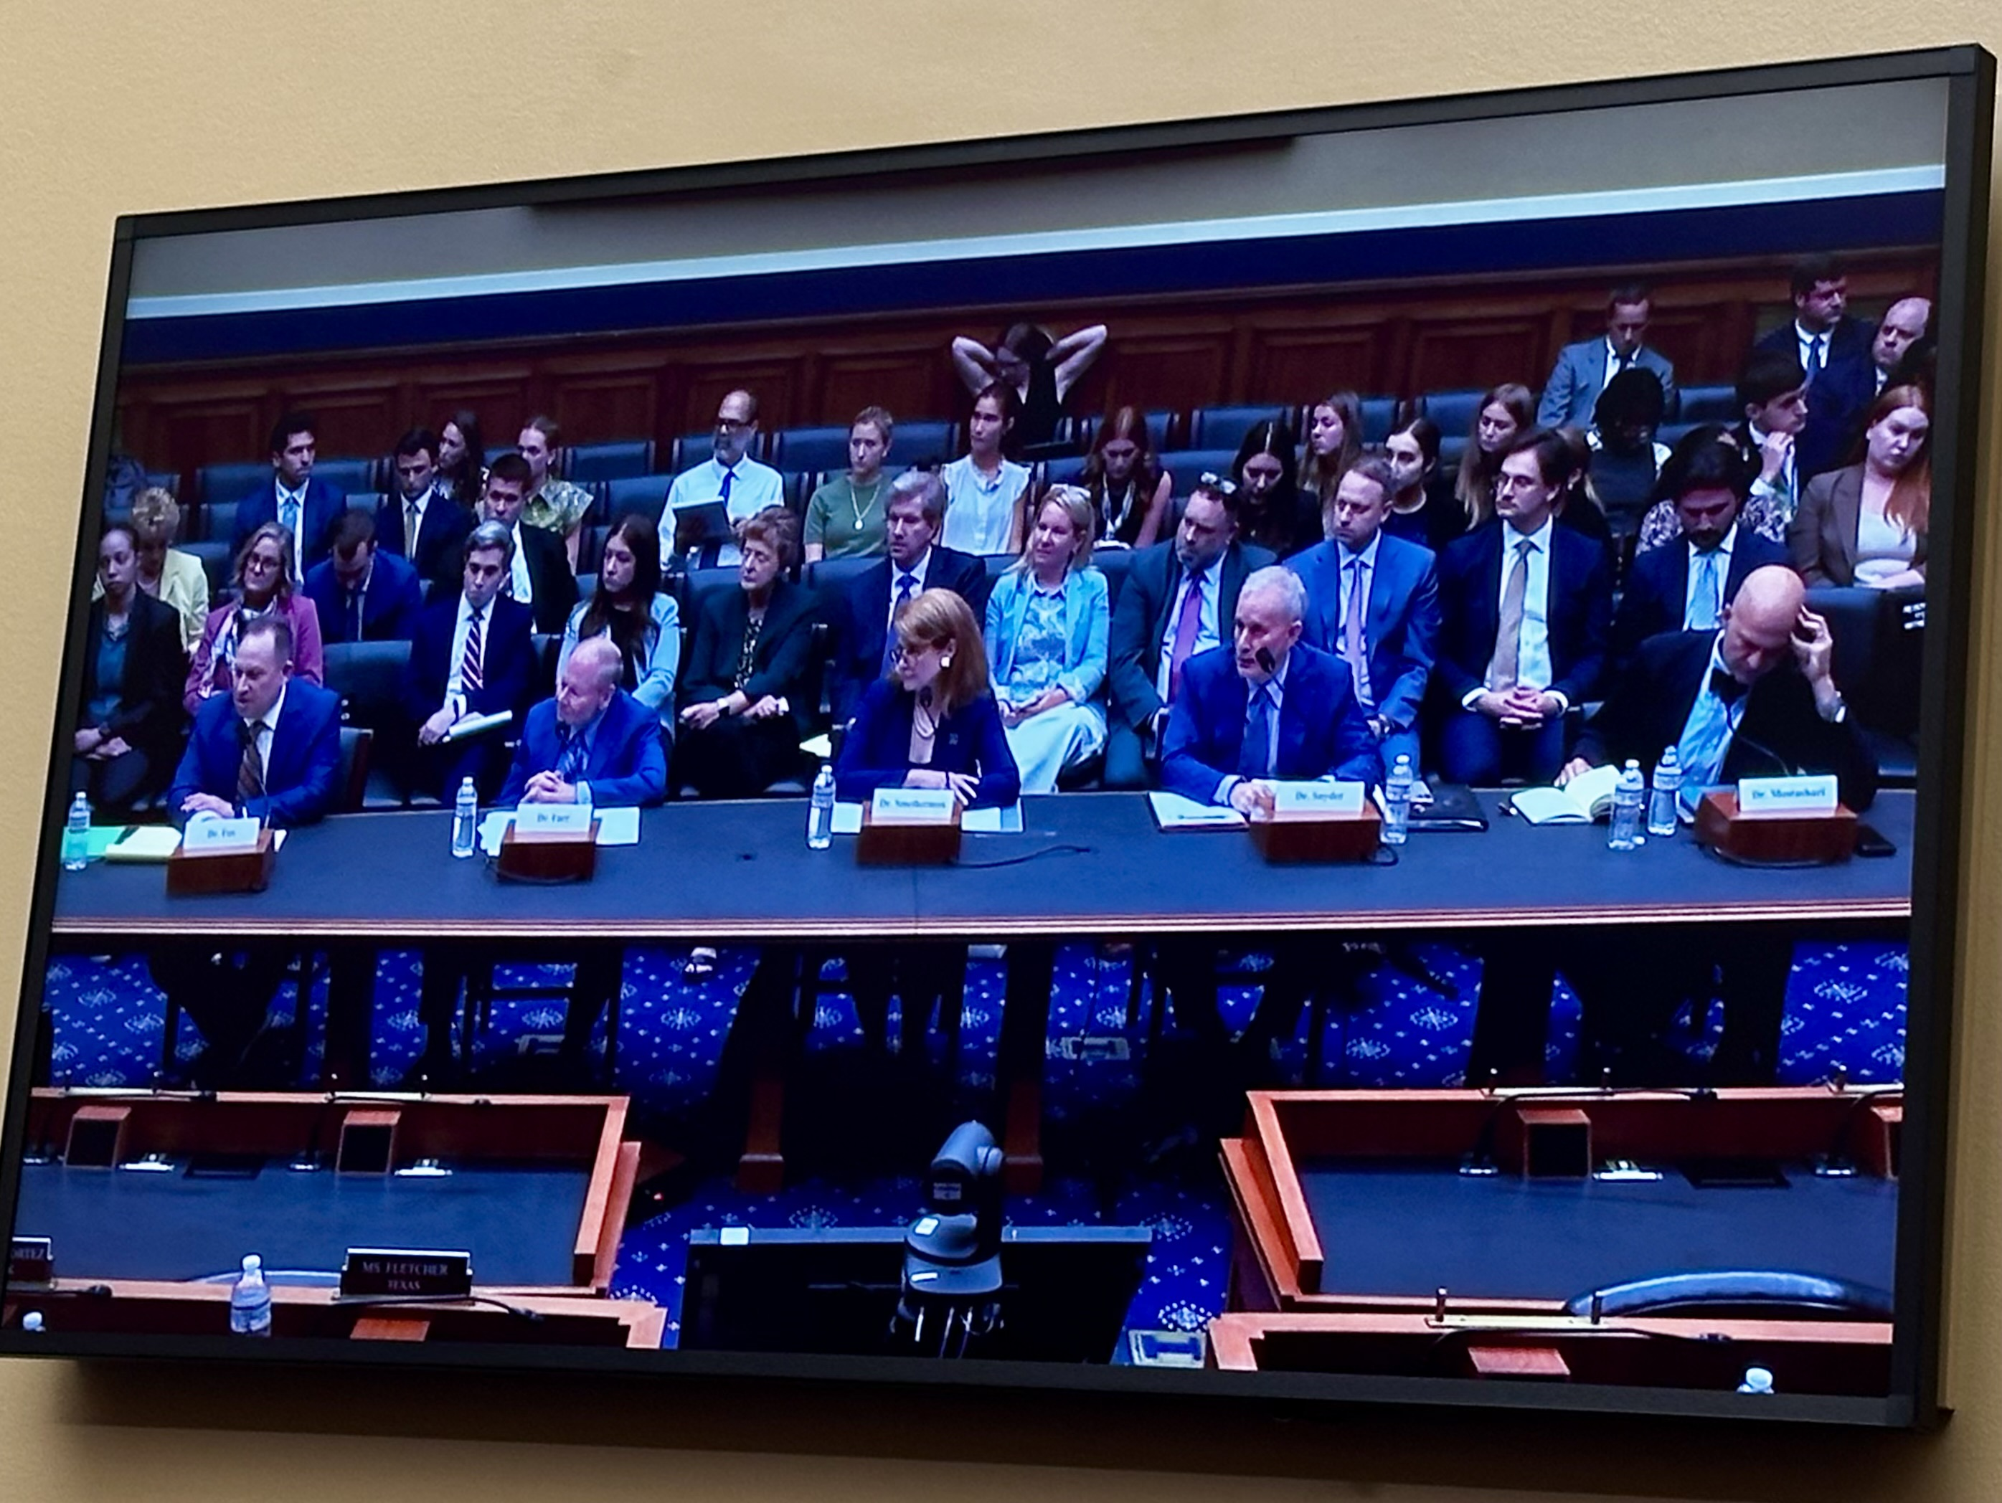
Bill Fox, MD, MACP, ACP BOR Chair Emeritus
Testimony before the House Energy and Commerce Health Subcommittee on May 20, 2026

Slide 17
The Patients First Act of 2026 – Introduced on July 15!
MEI minus 1 update with additional .5% for APM participants. There is also a floor and ceiling for MEI update.
Five-year hybrid payment model for primary care – and only open to independent practices. Hybrid payment mode is outside of budget neutrality and does not have a cost sharing requirement!
The definition of independent practice is modeled on the Oregon corporate practice of medicine definition
Hybrid payment would be a monthly payment in lieu of payment for any ‘designated primary care services’ and equal to one-twelfth of the national average amount that the Secretary estimates would be payable for those services:
(A) care management services
(B) behavioral health integration services
(C) office-based evaluation and management services (whether furnished in person or via telehealth)

Slide 18
The Patients First Act of 2026
Sunsets MIPS and replaces it with POINTS, starting 5 years out
POINTS will have Quality, Resource Use, and Care Efficiency measures
There will be a new Task Force within CMS that must approve all POINTS measures
Quality – 65% weight
Resource Use – 20% weight
Care Efficiency – 15% weight
Bonuses/Penalties phased to 2% starting in 2032, then back up to 3% in 2032, 4% in 2033, and 5% in 2034 and future years
Value provisions: Includes three-year freeze on APMs, locking in current payments; Provides pathway to specialty participation in value-based care
Raises the budget neutrality threshold from $20 million to $54.5 million

Slide 19
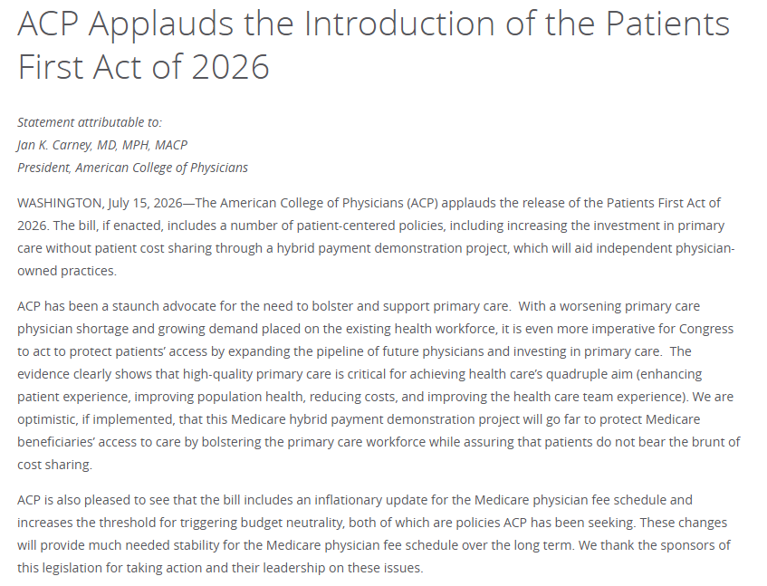

Slide 20
2028 Physician Fee Schedule Proposed Rule – released July 14!
Medicare Conversion Factor
For APM QPs | For non-APM QPs
$33.1693 (-1.19%) | $32.8409 (-1.68%)
Includes an RFI on how to redesigning primary care payment, including reconsidering primary care valuation, the role of technology-enabled primary care, and prospective payment within MSSP.
This may better recognize the variation in work across visit levels, provide greater payment for more complex longitudinal care, streamline billing by eliminating a separate claim line, and provide an enhanced adjustment for physicians participating in MSSP ACOs and the LEAD model (32%)
Increase payment for several CoCM and APCM Behavioral Health Integration add-on codes, which should better reflect the work involved.
Require RPM and RTM services to be furnished only to established patients and requiring an initial visit before these services begin.
Replace G2211 with a modifier that would increase payment by 16% of the base E/M service rather than as a flat payment.

Slide 21
2028 Physician Fee Schedule Proposed Rule
As part of the MAHA initiative, smoking and tobacco sensation codes will get a 19% bump in value (CPT codes 99406 and 99407)
Medicare had been asking physicians to document their postop visits but are now proposing to pause the data collection.
Data indicates that only 4% of 10-day globals and 67% of 90-day globals had one or more postop visits. Yet physicians are still being paid for the visits that are not occurring.
CMS departs from many RUC recommendations by reducing values where procedure time has decreased without sufficient justification for maintaining higher wRVUs.
CMS also proposes reducing payment when an E/M visit is furnished on the same day as a 0-, 10-, or 90-day global, citing potential duplication of payment.
CMS includes an RFI on the CPT/RUC process, including discussion of conflicts of interest, whether the current process has contributed to underinvestment in prevention and primary care, and questions regarding the AMA's role in the CPT process.

Slide 22
2028 Physician Fee Schedule Proposed Rule – QPP Changes
Sunsetting traditional MIPS after 2028: To reduce long-term complexity by moving clinicians away from the older “report everything” structure and toward more focused pathways, which may be easier for primary care practices to manage.
New MVPs for diabetes, hypertension, and hospitalists: The diabetes and hypertension MVPs they feel are especially relevant to primary care because they center on common chronic conditions primary care physicians manage every day, making performance measurement more clinically aligned.
Replacing the outcome/high-priority measure requirement with a MIPS core measure requirement: CMS feels a core measure requirement can create clearer, more standardized expectations and reduce the need to hunt for specialty-specific measure combinations, which may simplify quality reporting.
Make changes to how Qualifying APM Participant (QP) and Partial QP determinations are made

Slide 23
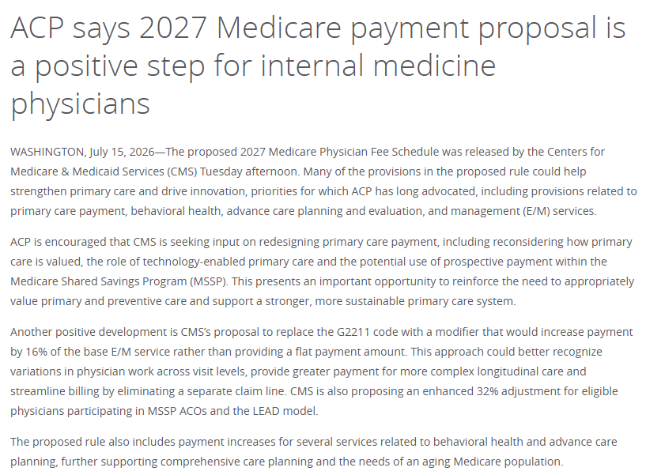

Slide 24

Questions?

