Slide 1
State Health Policy Networking Webinar Call-to-Action
David Pugach, JD Vice President, Governmental Affairs and Public Policy
November 1, 2023

Slide 2
Advocacy Success Can Take Time Legislation Moves Slowly Through Congress
Bills and resolutions by status
Only ~5% of bills make it to the House or Senate floor
Notes:
Sources:
Bills and resolutions. GovTrack.us. (n.d.). Retrieved November 30, 2022, from https://www.govtrack.us/congress/bills/#bystatus

Slide 3
What Could Go Wrong? A Maze of Obstacles Before Congress Passes Legislation
Bill is ignored by full committee
Bill fails passage in subcommittee vote
Bill fails passage in full committee vote
Introduced in House/Senate
Sent to committee
Sent to subcommittee
Full committee vote
Process repeats
in other chamber
Full House/Senate vote
Amended
Floor debate
Placed on legislative calendar
Bill fails final vote in full chamber
“Poison pill” amendments can sabotage final passage
In the Senate, bills can be filibustered during debate
Senate majority leader/
House speaker declines to put bill on calendar
Note
The Senate relies on unanimous consent to operate efficiently; therefore, individual senators have the power to delay or prevent a bill’s passage by creating additional procedural hurdles, including filibusters.
Notes:
SOURCE National Journal research, “The Legislative Process,” U.S. House of Representatives.

Slide 4
Congressional Decision-making Influenced by Constituent Views and Personalized Outreach
Influence of Advocacy Strategies Directed at a Member’s Washington Office
Notes:
Citizen-Centric Advocacy: The Untapped Power of Constituent Engagement,” Congressional Management Foundation, 2017
http://www.congressfoundation.org/storage/documents/CMF_Pubs/cmf-citizen-centric-advocacy.pdf

Slide 5
Importance of Contacting Legislators Throughout the Process

Slide 6
How a Bill Becomes Law
House of Representatives
Senate
Introduction
A representative or senator introduces a bill by filing it with the House/Senate clerk
Committee consideration
Bills are referred to committees for debate, analysis, and amendments
Simple majorities are needed to pass committees in both the House and Senate
Bills are often sent to subcommittees for extra analysis, especially on niche issues
Floor debate
House
Bill is debated and amended
Simple majority needed to pass
Senate
Bill is debated and amended
3/5 majority needed to end debate
Simple majority needed to pass
Final votes/
conference
committee
If both chambers pass an identical bill, it is sent directly to the president
If they pass different bills, a conference committee is formed of representatives and senators who try and find a compromise
Bills that pass conference committee must then pass both the House and Senate
President’s
signature or veto
A bill becomes law after a president signs it or after 10 days if they take no action
The president can reject a bill with a veto
Congress can override the veto by with a 2/3 majority vote in each chamber

Slide 7
Maintaining Momentum
Ideal continuous engagement
Advocate activity level
Loss of engagement
Start of campaign
End of campaign
Tip
At the start of an advocacy campaign, momentum typically increases steadily, but many campaigns lose advocacy momentum and drop to previous engagement levels after the campaign ends. Ideally, an organization would ensure continuous engagement with advocacy efforts.
Notes:
SOURCE National Journal research

Slide 8
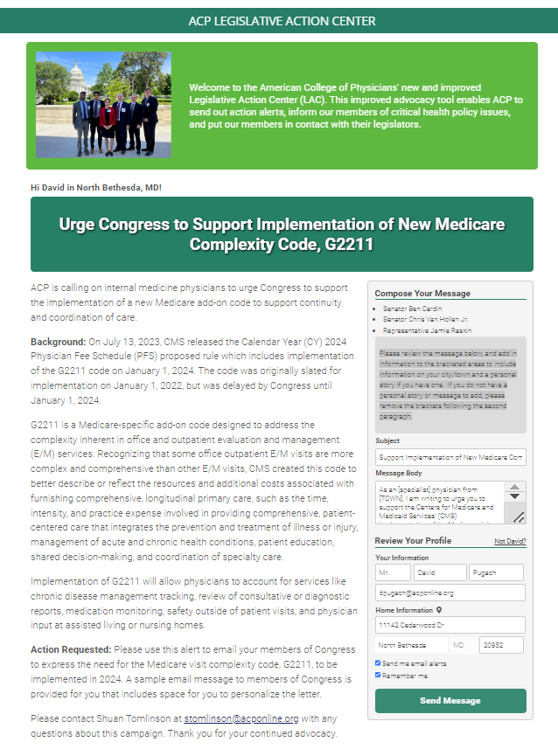
ACP Grassroots Advocacy – Take Action Early and Often

Slide 9
Discussion/Questions

Slide 10
Thank you! dpugach@acponline.org

