Slide 1
Chapter Spotlight: Massachusetts Primary Care Taskforce
American College of Physicians State Health Policy Webinar
July 31, 2025
Judith A. Melin, M.A., M.D., FACP Governor, MA Chapter, ACP JMelinMD@gmail.com

Slide 2
Massachusetts Primary Care Access, Delivery & Payment Task Force (PCTF) Goals and deliverables mandated under Chapter 343 of the Acts of 2024
The PCTF—formally known as the Primary Care Access, Delivery, and Payment Task Force—is convened by the Massachusetts Health Policy Commission. Its mission is to tackle critical challenges in primary care access, workforce sustainability, care delivery models, and payment reform across the Commonwealth

Slide 3
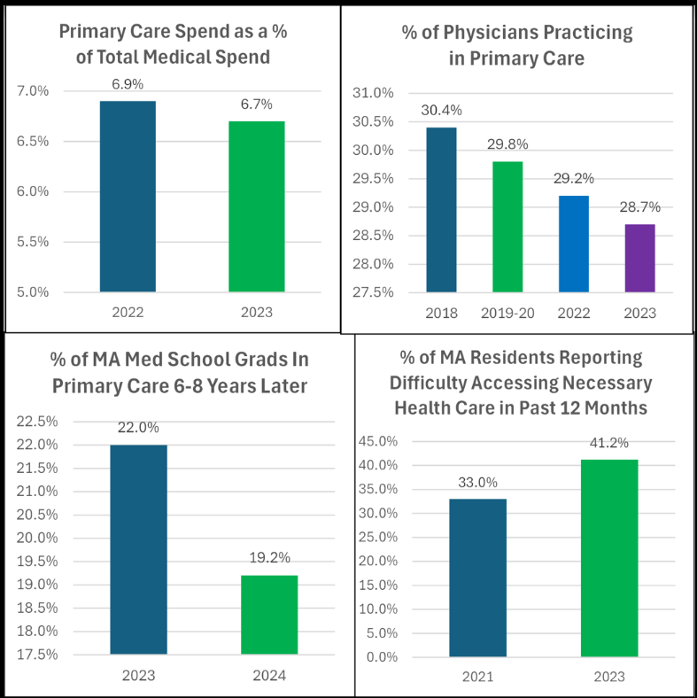
The Primary Care Dashboard Paints a Troubling Picture for Massachusetts Healthcare - Massachusetts Health Quality Partners

Slide 4
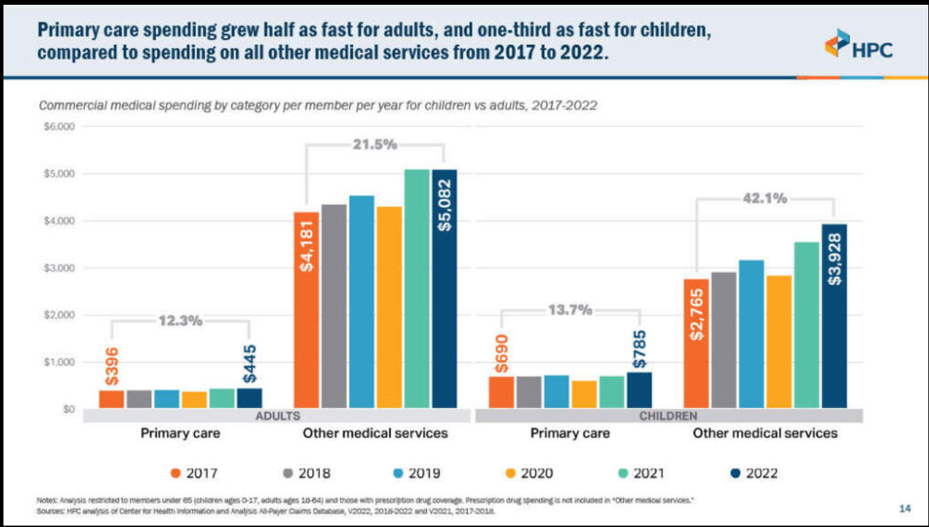
MA Health Policy Commission

Slide 5
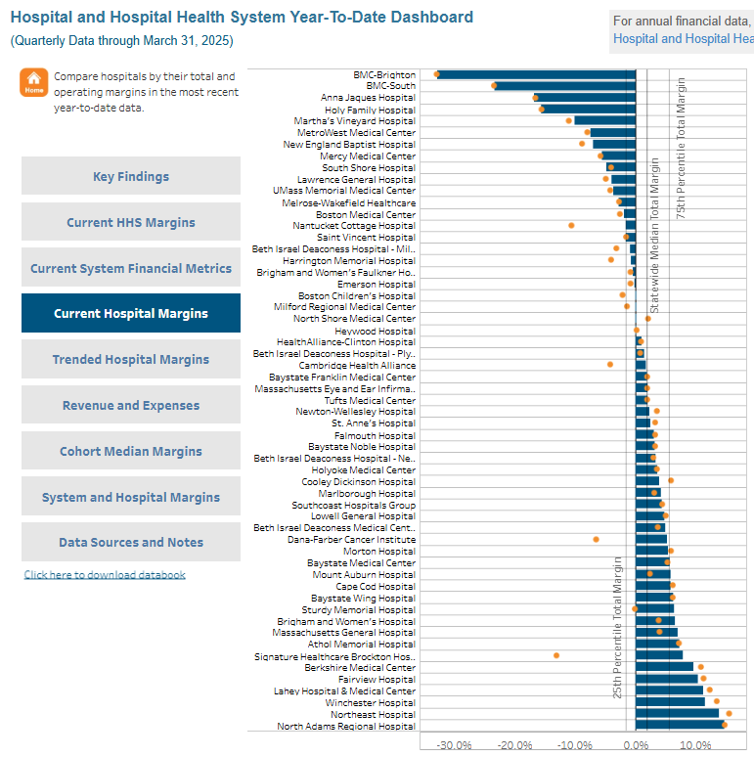
Of the 23 hospital health systems (HHS) reporting during this period, 15 (65%) reported positive total margins, though only 7 (30%) reported positive operating margins. The HHS median total margin was 1.6% The median operating margin was -1.0%. Hospital and Hospital System Year-To-Date Financial Data CHIA

Slide 6
Annual Report on the Performance of the Massachusetts Health Care System (March 2025)
Key Findings from the Annual Report (Released March 2025)
Total Health Care Expenditures (THCE) in Massachusetts totaled $78.1 billion in 2023. From 2022 to 2023, THCE per capita increased 8.6% to $11,153 per resident.
Pharmacy spending, along with new MassHealth supplemental payments, drove THCE growth in 2023. Pharmacy spending net of rebates increased by $1.0 billion (10.0%), while MassHealth administered $1.5 billion in new payments to hospitals to support key initiatives in quality and health equity.
Between 2021 and 2023, premiums (12.1%) and member cost-sharing (12.9%) outpaced growth in Massachusetts wages and salaries (9.7%).
While affordability was a pervasive issue in Massachusetts with 41.3% of residents overall having issues paying for health care, the burden was greater for Hispanic residents (58.2%) and non-Hispanic Black residents (48.7%).
In HFY 2023, the statewide acute hospital median total margin increased by 6.4 percentage points, from -4.2% to 2.2%, while the statewide median operating margin was 0.2% with just over 50% of hospitals (32 of 60 hospitals) reporting a positive operating margin.

Slide 7
Massachusetts health care landscape factors
Selected examples:
HPC health care cost growth benchmark
Steward hospitals
Referral care / Subspecialists
Research funding changes

Slide 8
Ongoing development of policy recommendations addressing:
Workforce shortages and retention strategies
Payment and delivery innovations
Data infrastructure for tracking impact

Slide 9
Key Goals
Improve Access to Primary Care Identify barriers and propose actionable solutions to ensure equitable and timely access for all residents.
Enhance Delivery Models & Workforce Capacity Explore sustainable staffing models, integrate team-based care, and better align resources to meet demand.
Advance Payment Reform Recommend innovative payment structures that reward value, outcomes, and expanded services rather than volume.
Data & Research Integration Support decision-making with robust data, metrics monitoring, and evidence-based policy recommendations by the Data & Research Workgroup Council on Teacher Quality+3Massachusetts Budget Tool+3Mass.gov+3Massachusetts Health Policy Commission+1National Council on Teacher Quality

Slide 10
Data and Research Workgroup
Key Deliverables:
Confirming a methodology for measuring primary care spending and setting future spending goals by defining primary care services, codes, and providers.
Developing a framework for standardized data and reporting requirements for private and public payers, providers, and provider organizations to track and evaluate primary care spending.
Developing an analytic approach to assess the impact of health plan design on health equity and patient access to primary care services.

Slide 11
Impacts to consider re: policy development
Selected examples:
Policy development: Data considerations
The math: numerator or denominator
Equations: static or evolving?
Pharmacy costs

Slide 12
Workforce Workgroup
Key Deliverables:
Developing short-term and long-term workforce development plans to increase the supply and distribution of, and improve working conditions for, primary care clinicians and other primary care workers.
Developing recommendations on advancing patient-centered, team-based primary care.
Developing recommendations to improve the working conditions of primary care clinicians and other primary care workers.

Slide 13
Full Task Force
Key Deliverables: Developing a series of recommendations to stabilize and strengthen the primary care system across Massachusetts, including:
Defining primary care services
Developing standardized data reporting requirements
Establishing a primary care spending target
Proposing payment models to increase primary care reimbursements
Assessing the impact of health plan design on health equity and patient access to primary care services
Monitoring and tracking the needs of and service delivery to Massachusetts residents
Creating workforce development plans.

Slide 14
Impacts to consider re: policy development
Selected examples:
Funds Flow to whom? for what?
Payment models
Variation in patient populations (e.g, age of patients)

Slide 15
Chapter Spotlight: Massachusetts Primary Care Taskforce
American College of Physicians State Health Policy Webinar
July 31, 2025
Judith A. Melin, M.A., M.D., FACP Governor, MA Chapter, ACP JMelinMD@gmail.com

