Slide 1
August Recess Challenge:
ACP CA Southern III Experience
Tammy Lin, MD, MPH, FACP (Governor, 2021-2025)
Vineet Gupta, MD, SFHM, FACP (Governor, 2025-2029)
State Health Policy Webinar
July 31, 2025

Slide 2
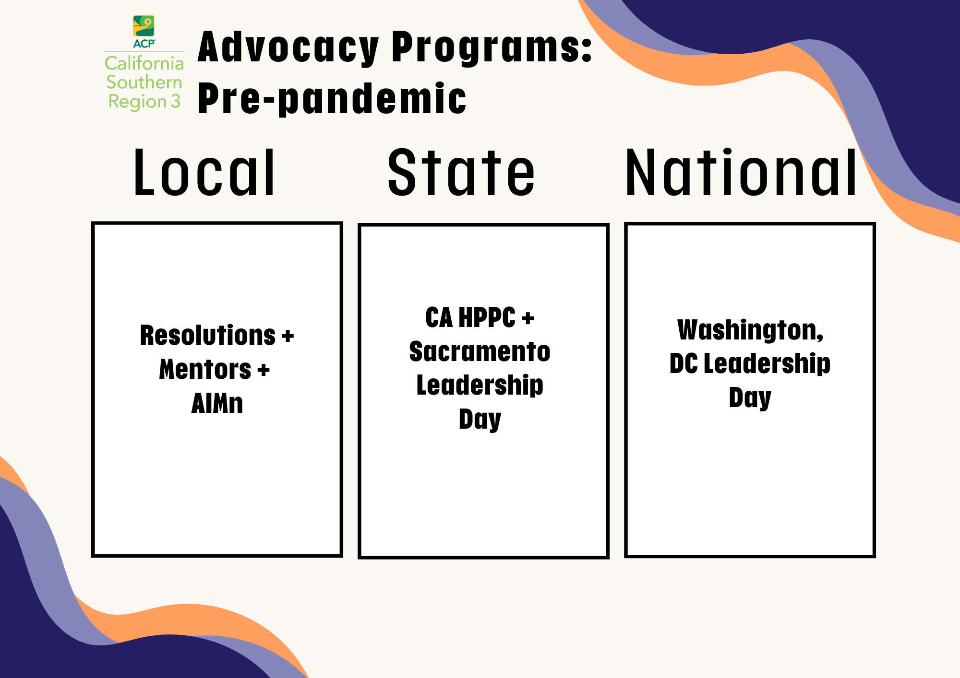

Slide 3
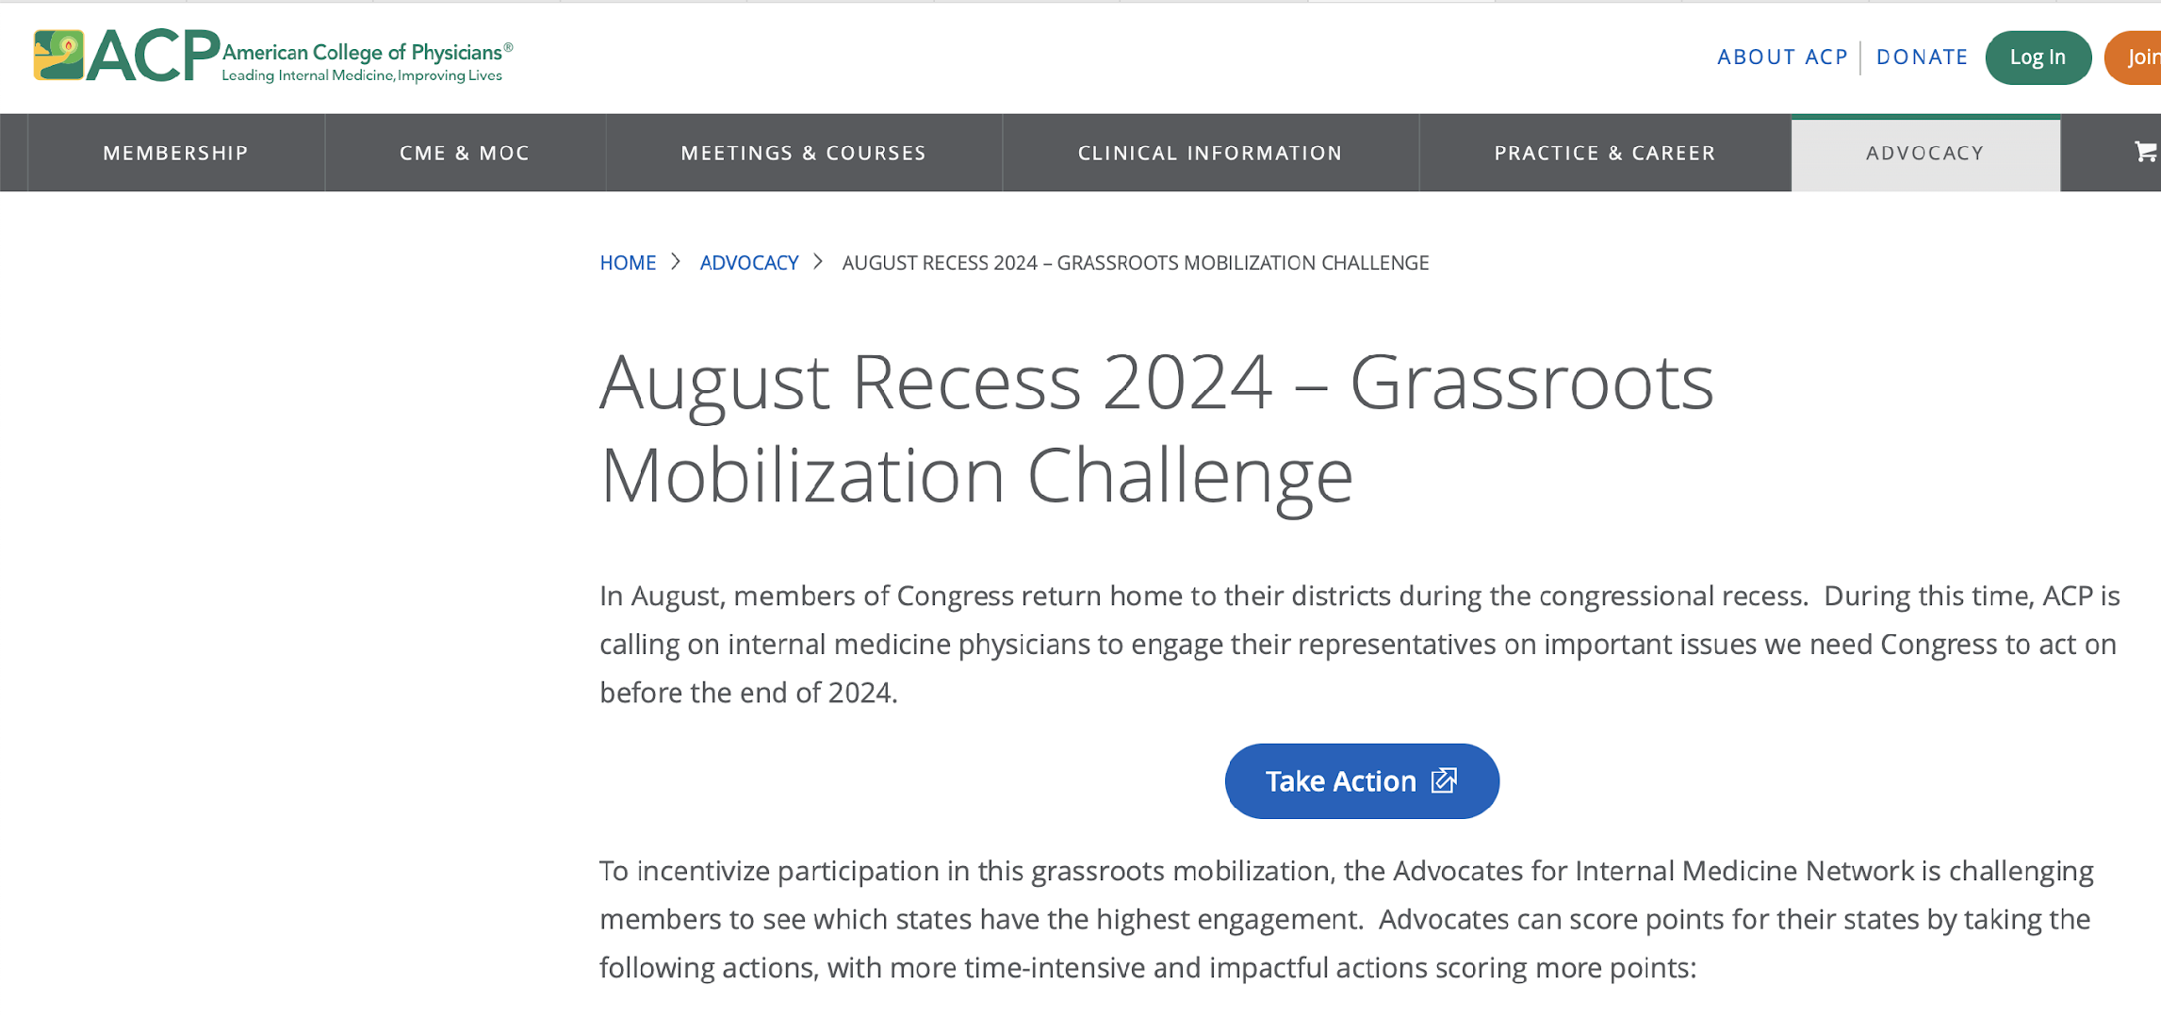
August’24 Recess Challenge

Slide 4
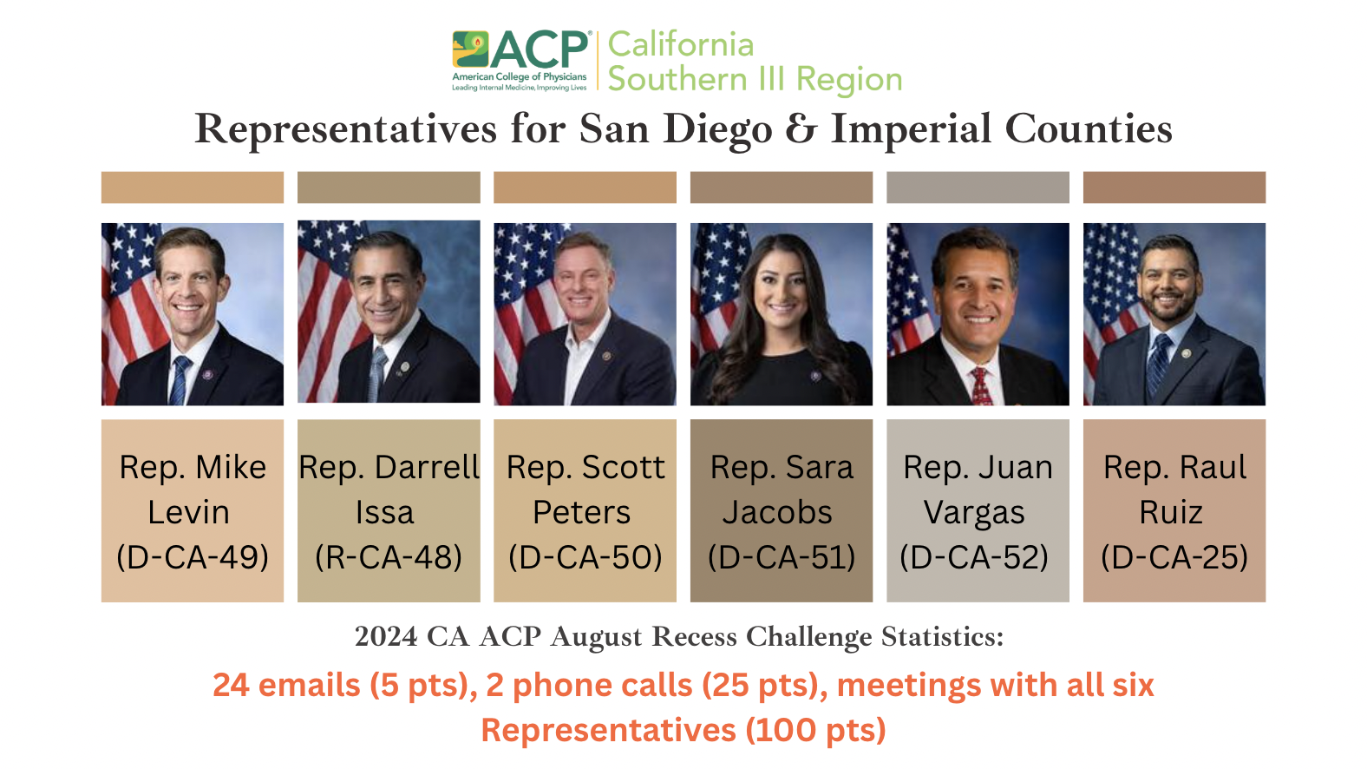

Slide 5
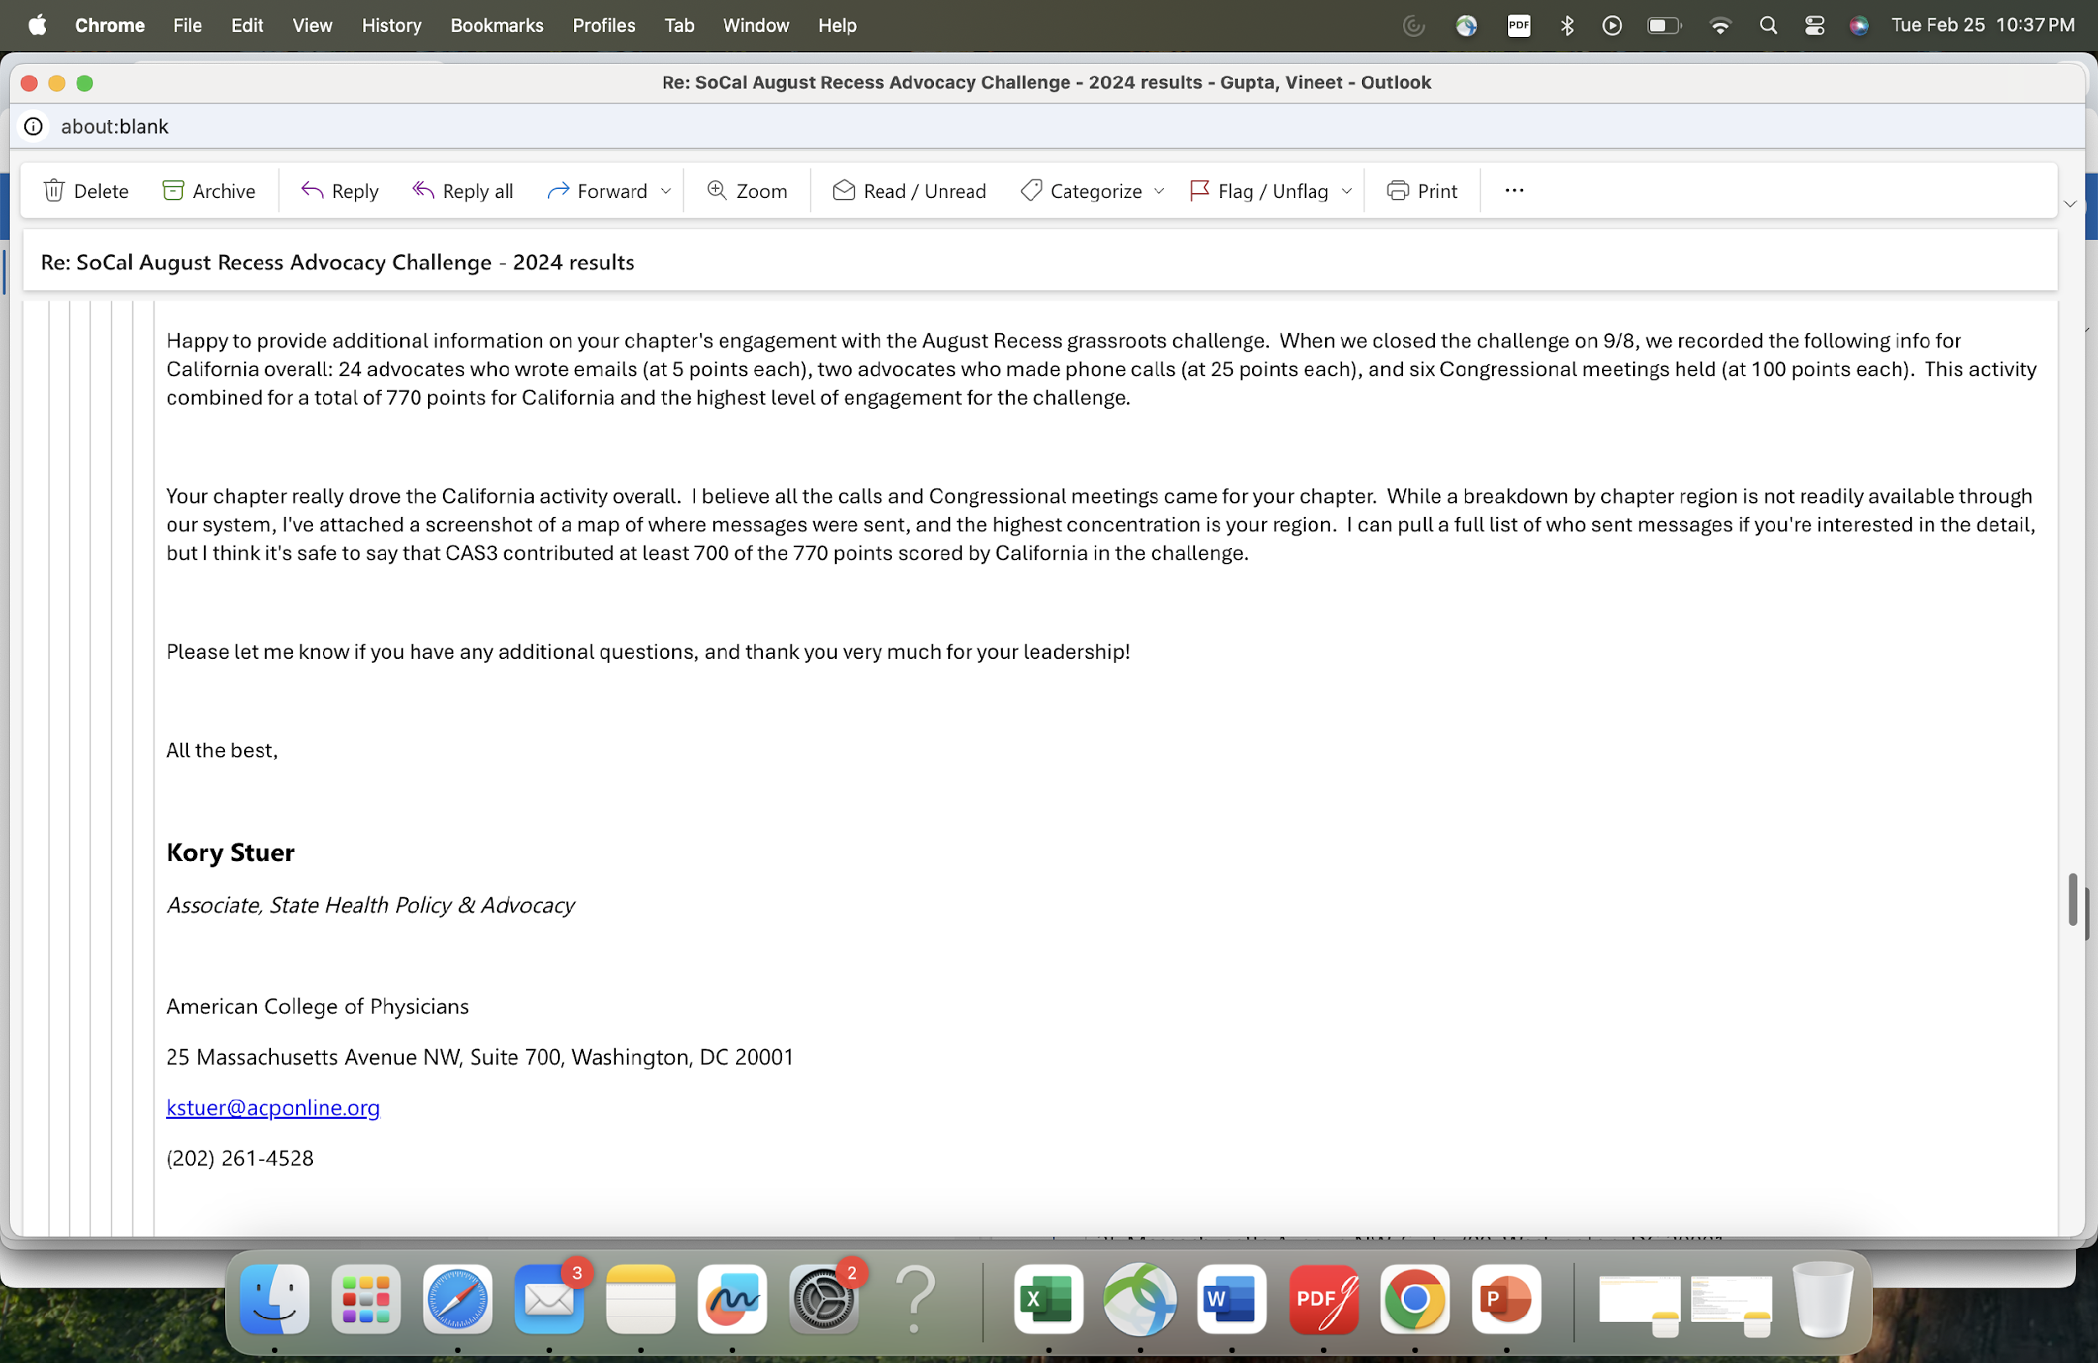
August’24 Recess Challenge
Aligned with ACP National’s focus on Telemedicine and Physician Payments

Slide 6
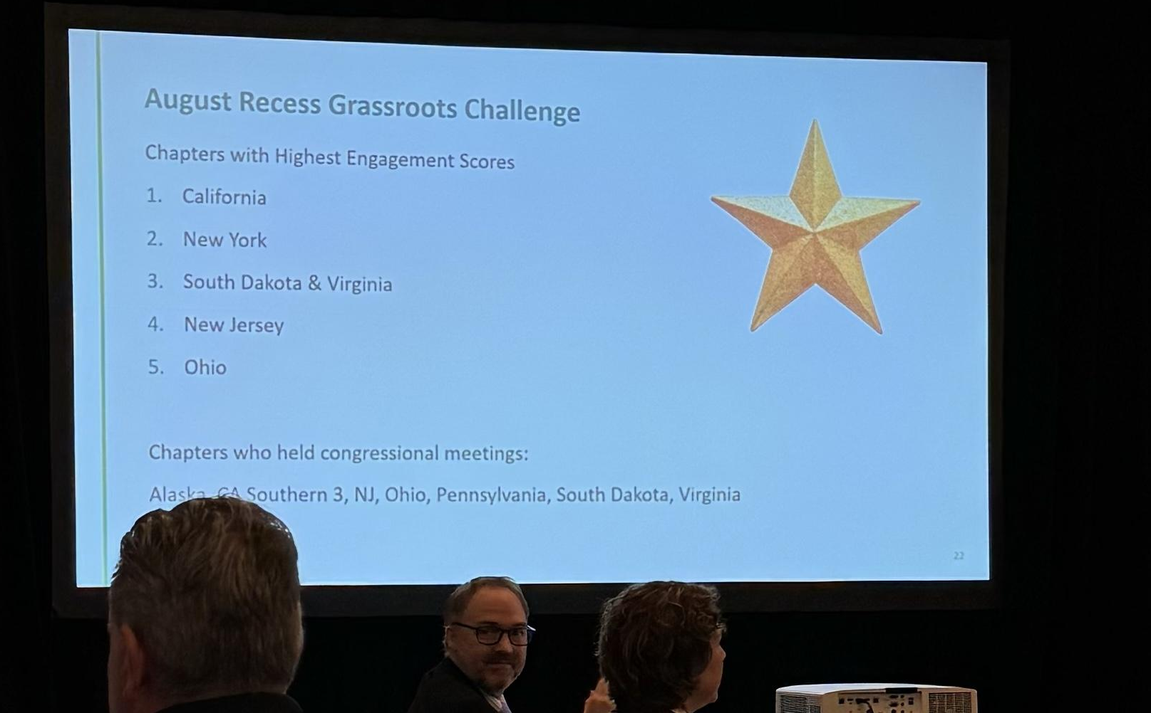
August’24 Recess Challenge

Slide 7
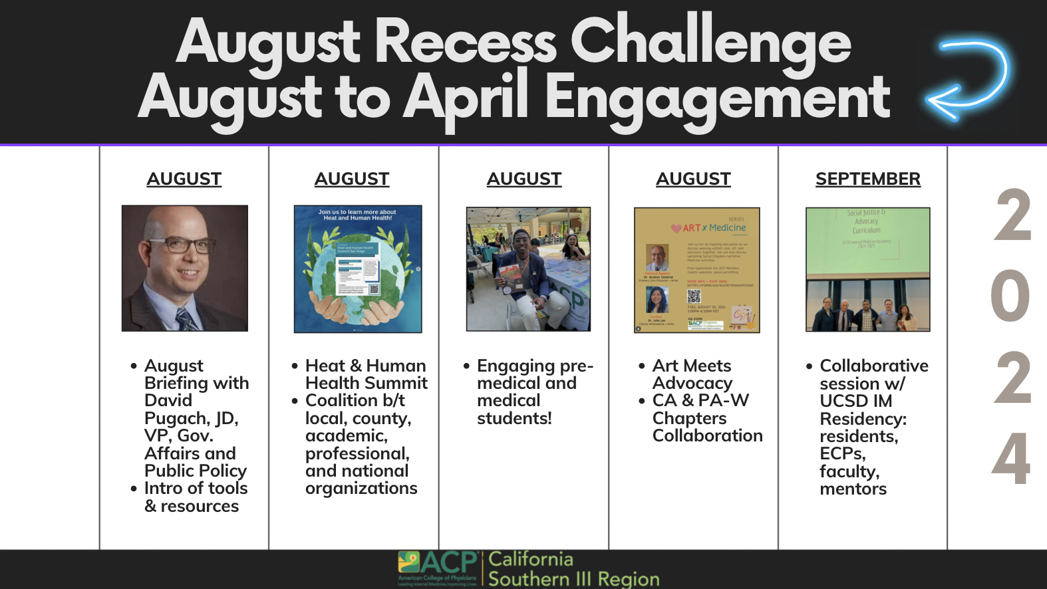

Slide 8
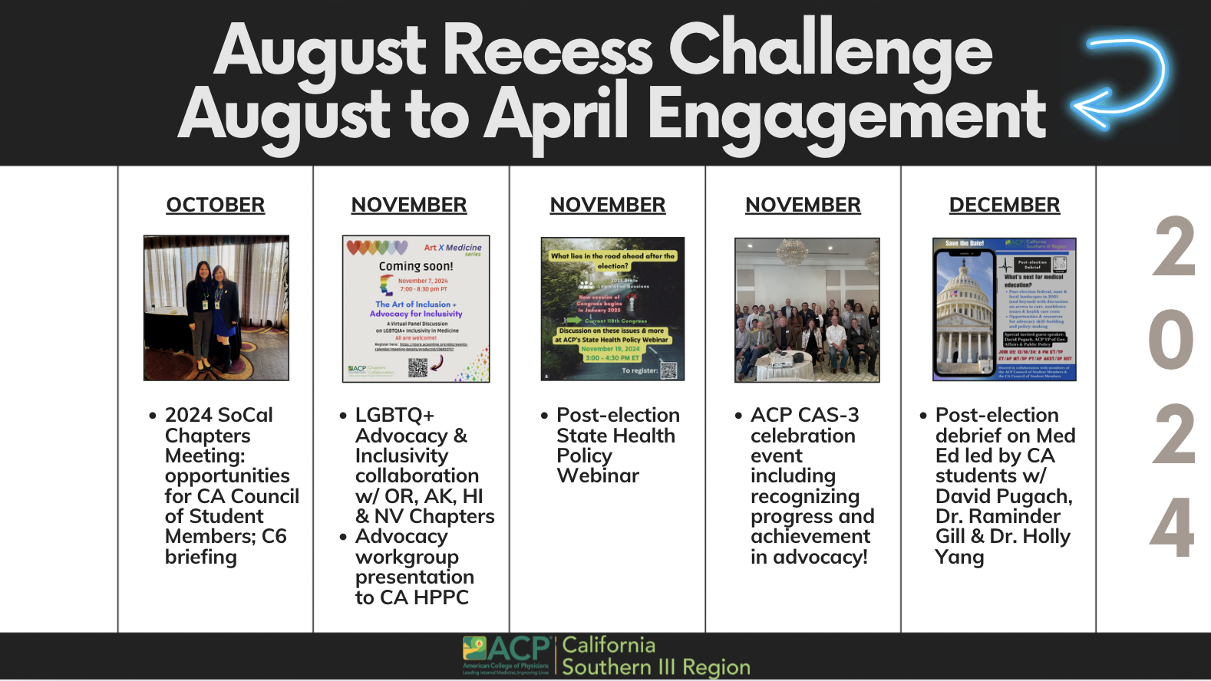

Slide 9
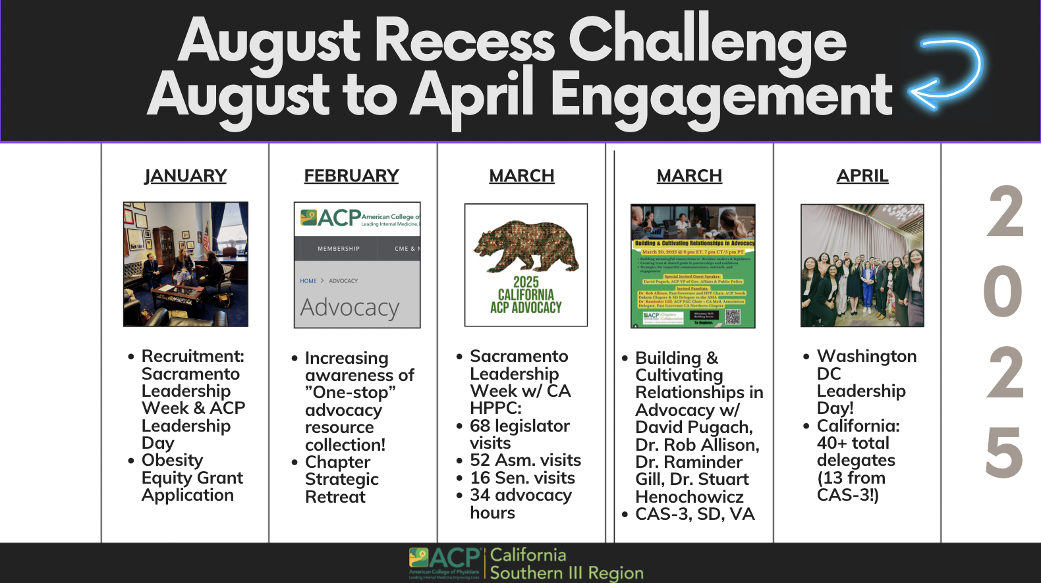

Slide 10
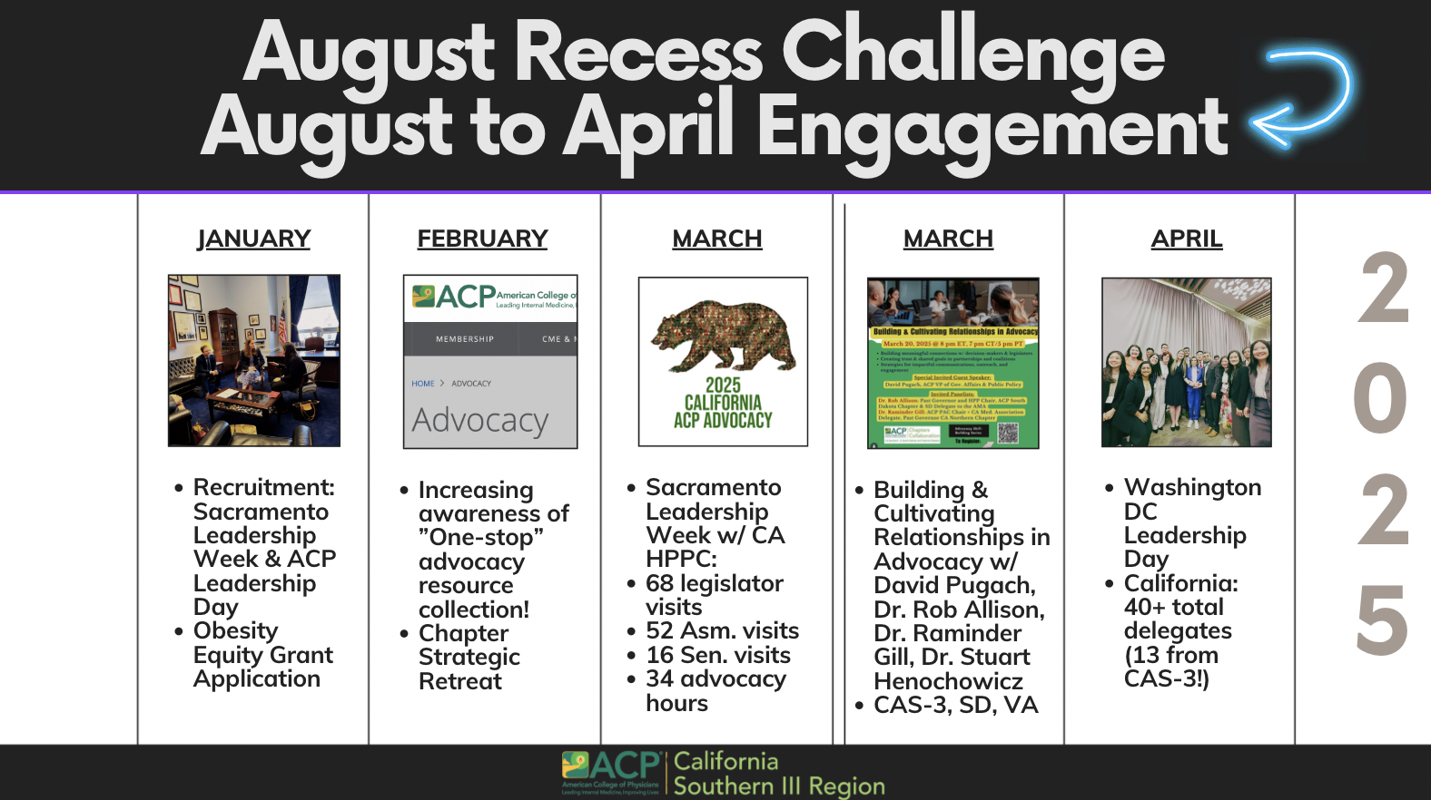

Slide 11
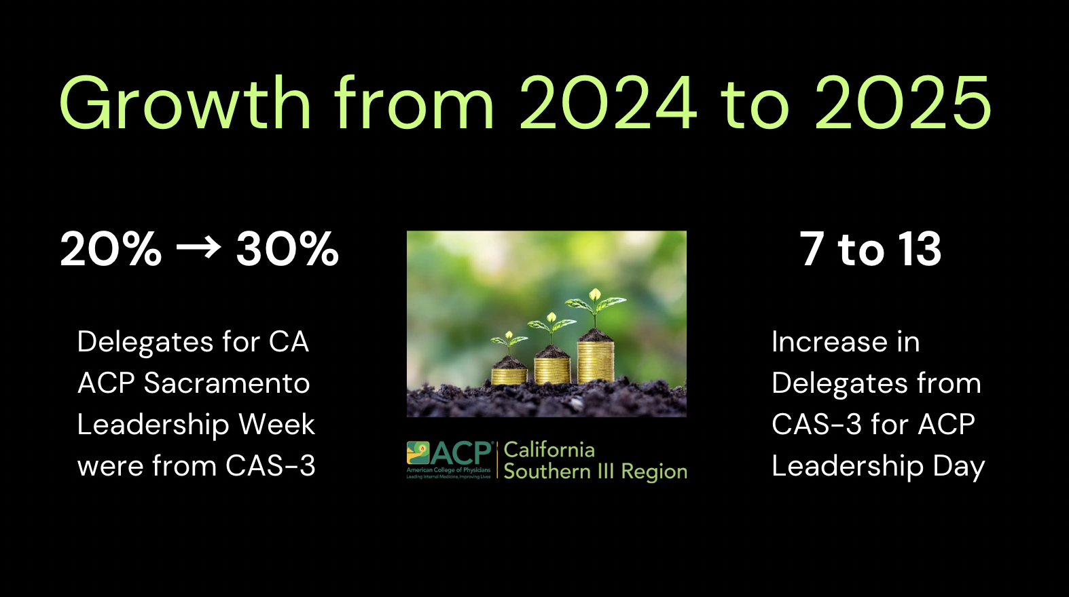

Slide 12
SoCal 3 August-to-April Advocacy Challenge Summary
Personal recruitment + dedicated staff
Briefings (local, national)
Cultivating relationships in August & beyond
Springboard to year-round advocacy activities
Easy access to tools, resources, and opportunities
Commitment to advocacy: leadership, resources, collaboration, celebrating wins!

Slide 13
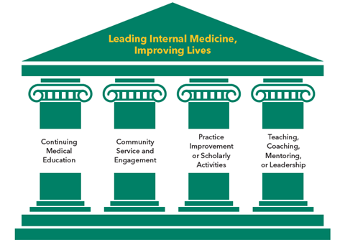

Pillars of Advocacy Success
Strong Stakeholder Engagement & Coalition Building
Policy Knowledge & Legislative Expertise
Effective Communication & Public Awareness
Persistence
& Adaptability

Slide 14

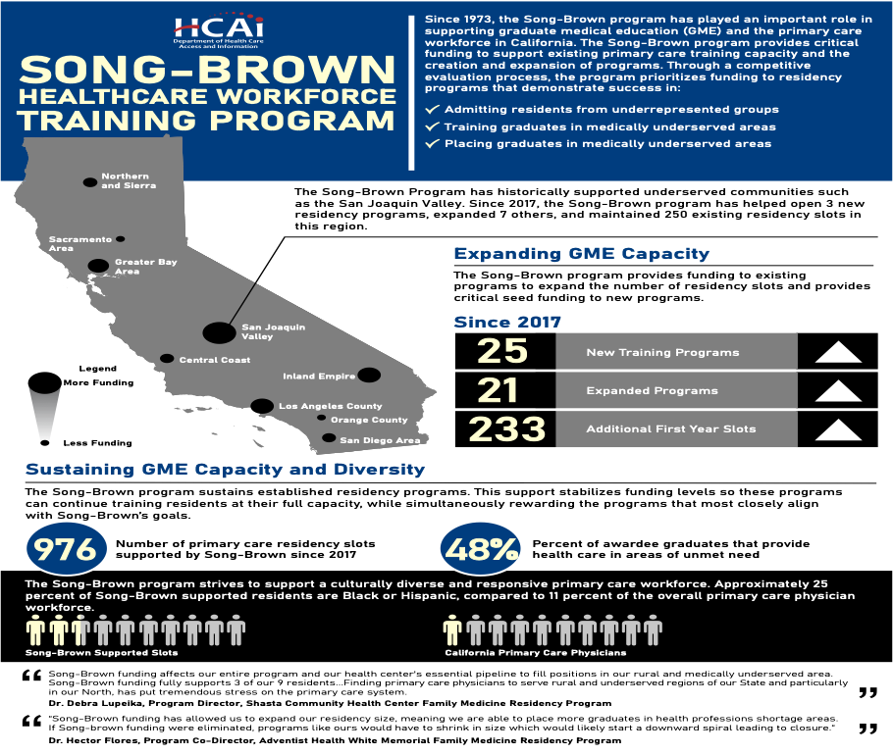
Case Study: Song-Brown Program

Slide 15

Case Study: Song-Brown Program
Truly a Collaborative Effort!
Fam Med Advocacy
CANO
SoCal1
SoCal3
SoCal2

Slide 16
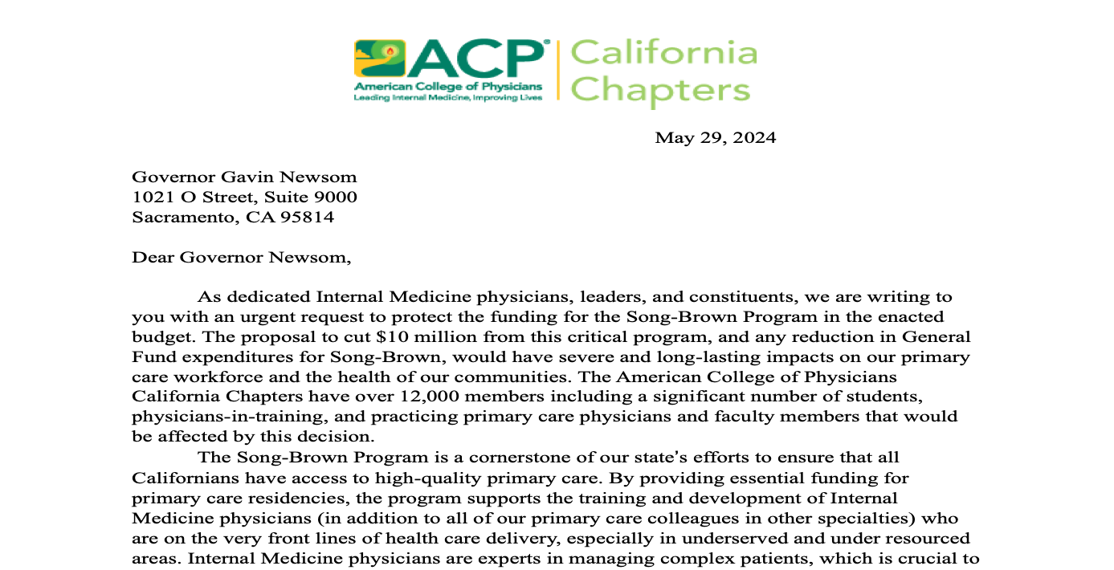
Case Study: Song-Brown Program

Slide 17

Case Study: Song-Brown Program

Slide 18

Climate Change and Health Advocacy

Slide 19
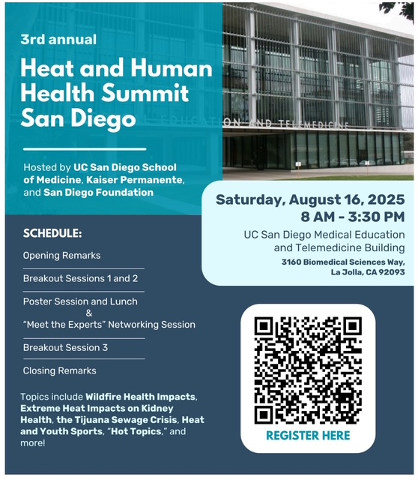
Climate Change and Health Advocacy

Slide 20
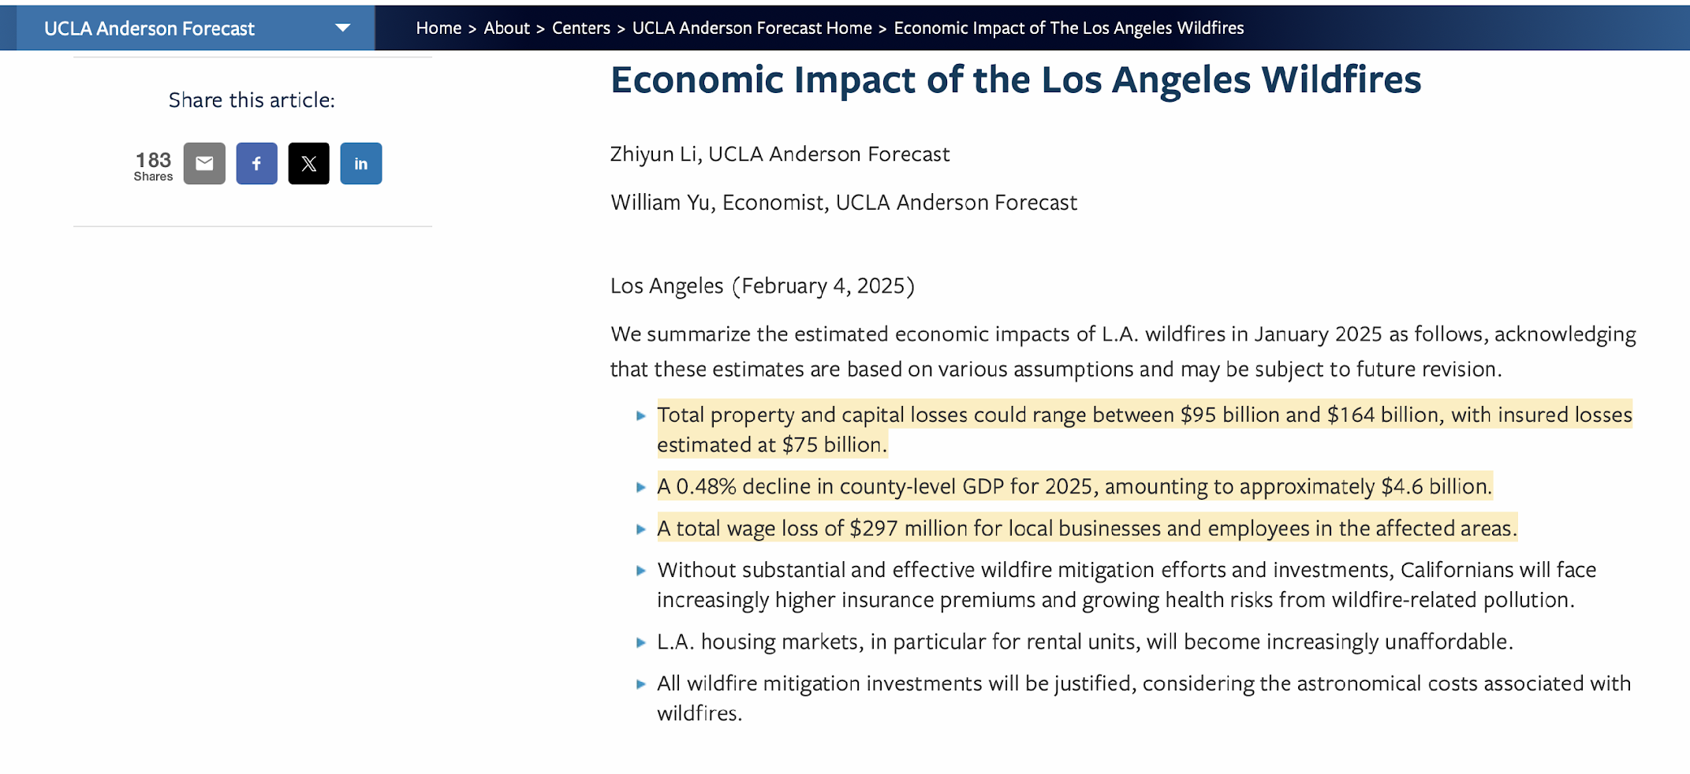

Slide 21
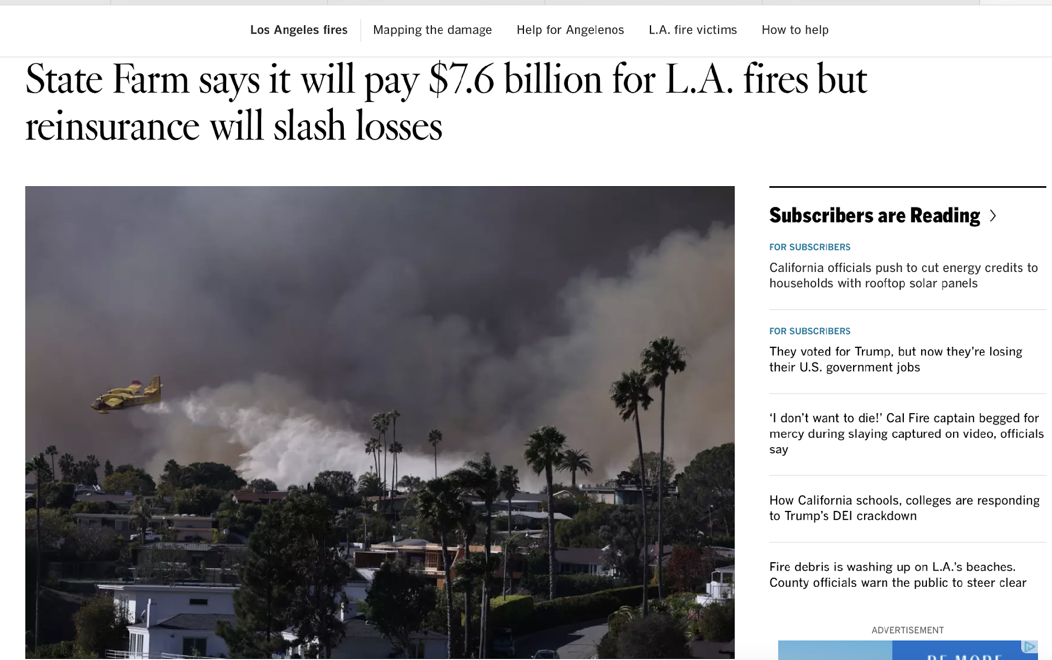

Slide 22


Slide 23
Future Directions in Advocacy SoCal3
Advancing digital health policies and telemedicine
Strengthening collaborations between advocacy groups (including other chapters) and policymakers
Engaging communities in healthcare decision-making
Advancing health Equity (previously DEI) in healthcare advocacy
Expanding mentorship and leadership programs for future healthcare advocates
Overcoming misinformation and public skepticism

Slide 24

United
We
Stand
Divided
We
Fall

Slide 25


Slide 26
Pillars of Advocacy Success
Song Brown Program
Local grassroots Advocacy Challenge
H3SD summit
Opportunities
Local Efforts
Sacramento Advocacy Day(~March)
Washington Leadership Day (Apr/May)
Strong Stakeholder Engagement & Coalition Building
Policy Knowledge & Legislative Expertise
Effective Communication & Public Awareness
Persistence
& Adaptability

Slide 27


