Slide 1
Visa Policy Changes and Impacts on International Medical Graduates
Tracy Wallowicz, MLS
SVP, Regulatory Affairs & Chief Communications Officer
November 2025

Slide 2
Overview
The U.S. healthcare system currently cannot function without international medical graduates (IMGs)
1 in 4 physicians in practicing in the United States is an IMG (this includes U.S. IMGs)
Nearly a third (1 in 3) of practicing physicians in the United States came from abroad to train in the US (17%) or they are the child of an immigrant (13%)

Slide 3
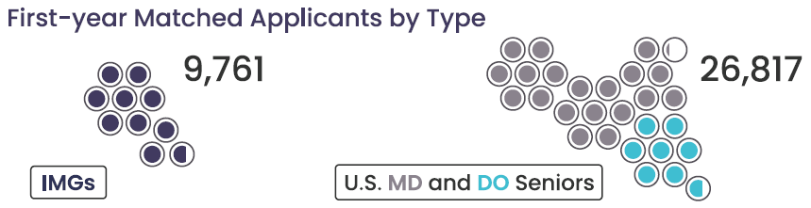
2025 Match
Internal Medicine
10,941 positions offered (758 programs)
US MD grads: 3,782 (34.6%)
US DO grads: 1,882 (17.2%)
US IMGs: 1,145 (10.5%)
Non-US IMGs: 3,573 (32.7%)

Slide 4
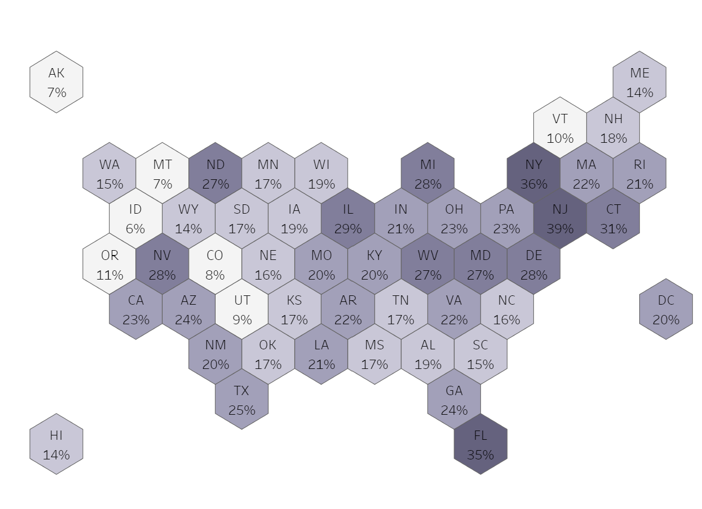
IMGs in Active Practice by State
 | % IMG
All Active Physicians | 24%
Idaho (min) | 6%
New Jersey (max) | 39%

Slide 5
Active Physicians by Specialty & IMG Status
Internal Medicine Subspecialties
55%
Internal Medicine (IM) residencies and IM subspecialty fellowships highly dependent on IMGs

Slide 6
RECENT ISSUES

Slide 7
Context: Visa vs. Visa Status
Understanding this distinction is critical as we navigate recent and expected immigration actions.
Visa = permits entry to the U.S.; can expire while still lawfully present
Visa Status = allows an individual to live, train, or work in the U.S.; must stay valid the entire time
This difference matters — especially amid increased vetting, shifting policies, and visa appointment delays.

Slide 8
May 2025 Appointment Pause: Social Media Vetting
What Happened
On May 27, 2025, the U.S. Department of State initiated a pause in visa processing while implementing new security review procedures.
The pause primarily impacted nonimmigrant visa applicants, including J-1 physicians in the Exchange Visitor Program.
Applicants were unable to schedule new appointments; some experienced unexpected cancellations and reschedulings.
IMPORTANT: Appointments resumed on June 18, 2025, with a directive
to consular posts to prioritize J-1 physicians.

Slide 9
Best Practices for Social Media Activities
Immigration agencies request information regarding personal social media accounts
This includes all accounts used in the last 5 years
Ask.FM, Douban, Facebook, Flickr, Google+, Instagram, LinkedIn, MySpace, Pinterest, QZone (QQ), Reddit, Sina Weibo, Tencent Weibo, Tumblr, Twitter, Twoo, Vine, VKontakte (VK), Youku, YouTube
Advise trainees to be conscious and thoughtful of information they post on social media, particularly regarding their political views
Immigration officials are likely able to view their full profile and contacts regardless of access to password

Slide 10
June 2025 Presidential Proclamation: Travel Ban / Restrictions
Tier 1 Full suspension of entry: all citizens barred from entering the United States | Tier 2 Partial suspension of entry: citizens seeking certain visa classifications, including J-1, barred from entering the United States
Afghanistan, Burma (Myanmar), Chad, Republic of the Congo, Equatorial Guinea, Eritrea, Haiti, Iran, Libya, Somalia, Sudan, and Yemen | Burundi, Cuba, Laos, Sierra Leone, Togo, Turkmenistan, and Venezuela
Exemptions:
U.S. lawful permanent residents (green card holders)
Individuals with valid visas issued prior to the proclamation
Dual nationals traveling on a passport from a non-designated country
Certain individuals traveling on diplomatic or humanitarian grounds
Intealth sponsoring 117 initial applicants from “travel ban” countries this year.
More than half had their visas before the ban took effect on June 9.

Slide 11
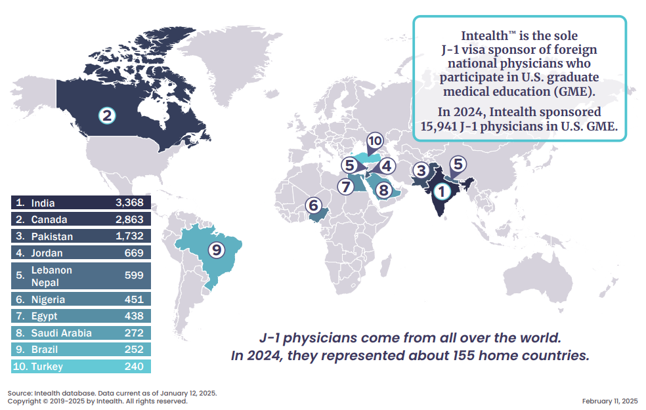
J-1 Physicians’ Top Nations of Origin
None are “travel ban” countries.

Slide 12
Duration of Status
Reemergence of an issue first introduced by the previous Trump administration in 2020
Would significantly modify admission and extension procedures for nonimmigrant students, exchange visitors, and foreign media representatives
Goal is to replace Duration of Status (D/S) with fixed time periods for admission
Comment period closed September 29, 2025
“Establishing a Fixed Time Period of Admission and an Extension of Stay Procedure for Nonimmigrant Academic Students, Exchange Visitors, and Representatives of Foreign Information Media”

Slide 13
H-1B Presidential Proclamation
Proclamation issued Sept. 19, 2025
Imposes new $100,000 fee for certain H-1B petitions filed on/after Sept. 21, 2025
Does not apply to:
Physicians already in the United States seeking extensions, amendments, or change-of-employer cases
Does apply to:
Physicians seeking to enter the United States in H-1B status
Employers must cover fee; cannot shift to physicians
Physicians already in the United States seeking a change of status from another visa classification (e.g., J-1 to H-1B)

Slide 14
INTEALTH APPROACH
TO ADVOCACY

Slide 15
Washington Outreach Goals
Educate
Educate Policymakers about the Problem(s) and the Value of IMGs
Identify
Identify Champions
Build
Build Long-term Bipartisan Support

Slide 16
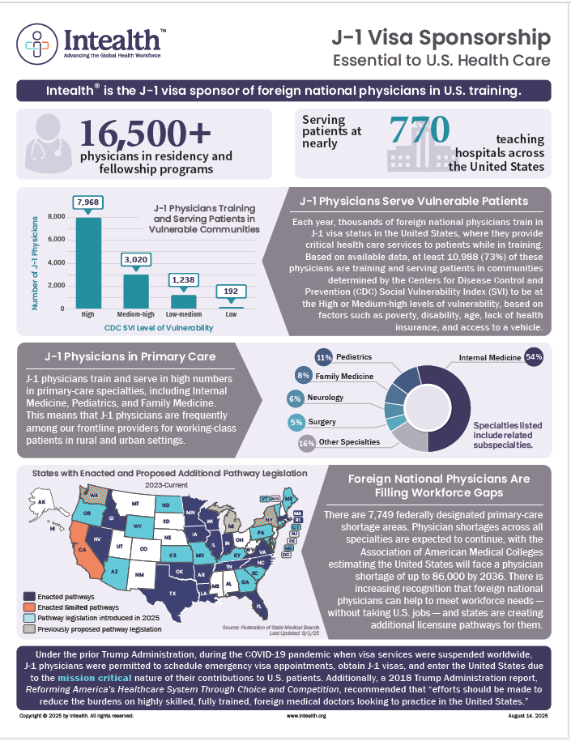
Outreach Key Tenets
Like the Administration, Intealth believes in the importance of screening and vetting visitors to the United States
Intealth has a robust process in place for physicians
Issues that we addressing are HEALTH CARE, not immigration, issues.
IMGs do not take positions / jobs away from U.S. citizens; there is significant projected workforce shortage in the United States.
Many states have passed or are considering laws that would make it easier for IMGs to contribute in those states.

