Slide 1
ACP’s Advocacy in the Courts
Shari M. Erickson, MPH
Chief Advocacy Officer and SVP, Governmental Affairs and Public Policy

Slide 2

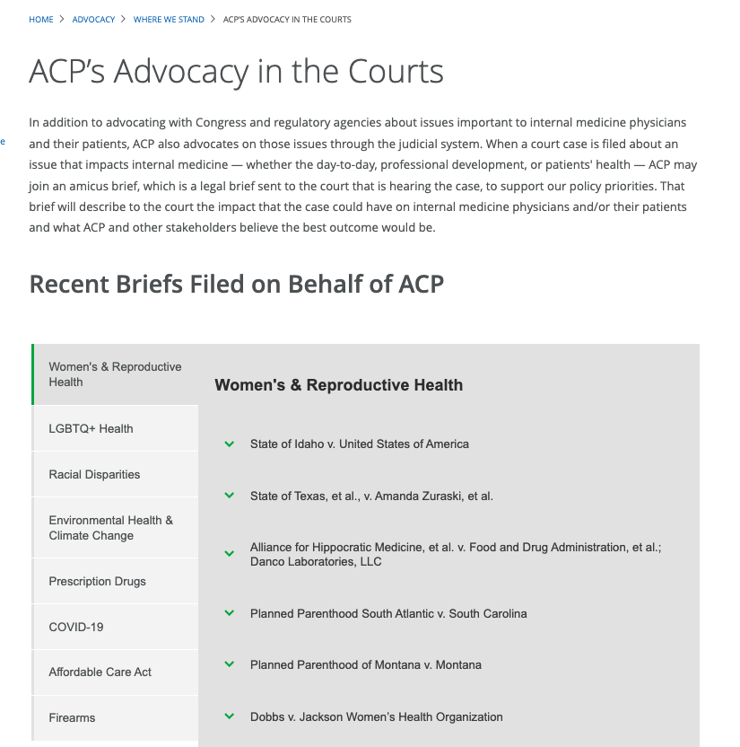
Amicus Briefs – ACP’s Advocacy in the Courts
In 2024 to date, ACP is participating in or leading 8 amicus briefs

Slide 3
Major SCOTUS Decisions in 2024 Relevant to ACP
WIN: Abortion Pills (i.e., mifepristone): 9-0 ruling on 6/13
Amicus Brief (FDA v. Alliance for Hippocratic Medicine) and Statement
PARTIAL/TEMPORARY WIN: Emergency Abortion Care: Dismissed on 6/27
Amicus Brief (Moyle v. United States) and Statement
LOSS: Bump Stocks for Guns: 6-3 ruling on 6/21
Amicus Brief (Garland v. Cargill) and Statement
WIN: Gun Rights: 8-1 ruling on 6/21
ACP was not involved in an amicus brief, but this decision is aligned with our policy
WIN: Disinformation on Social Media: 6-3 ruling on 6/26
Amicus Brief (Murthy v. Missouri) and Statement

Slide 4
Introducing Jessica Morton
Senior Counsel
Democracy Forward Foundation

