Slide 1
2024 State Legislative Session Preview State Health Policy Networking Webinar
Kory Stuer
Associate, State Health Policy and Advocacy
November 1, 2023

Slide 2
Preparing for the 2024 Session

Slide 3
General Tips for State Legislative Advocacy
46 states + DC have regular session in 2024
Most sessions 30-90 days
Over 161k bills filed in 2023
Demands on state legislators & limited support
Personalize your advocacy & the power of stories

Slide 4
Before January, all chapters should think about if they
Have a legislative session in 2024
Know key dates for the session
Know your legislative priorities
Can identify your threshold for action
Have defined what a successful legislative session means to you

Slide 5
Chapters with more capacity for legislative advocacy may want to consider
Identifying key officials, like chairs of finance or health committees
Consider engaging before session starts, especially if you want something introduced
Planning advocacy events
Lining up your advocates
Who has capacity for what kinds of advocacy?
Who lives in whose district?
Is training needed?
Aligning with coalitions and partners
Determining what issues you're expecting to be priorities for the legislature and what may impact your chapter or its advocacy

Slide 6
State Health Policy Hot Topics

Slide 7
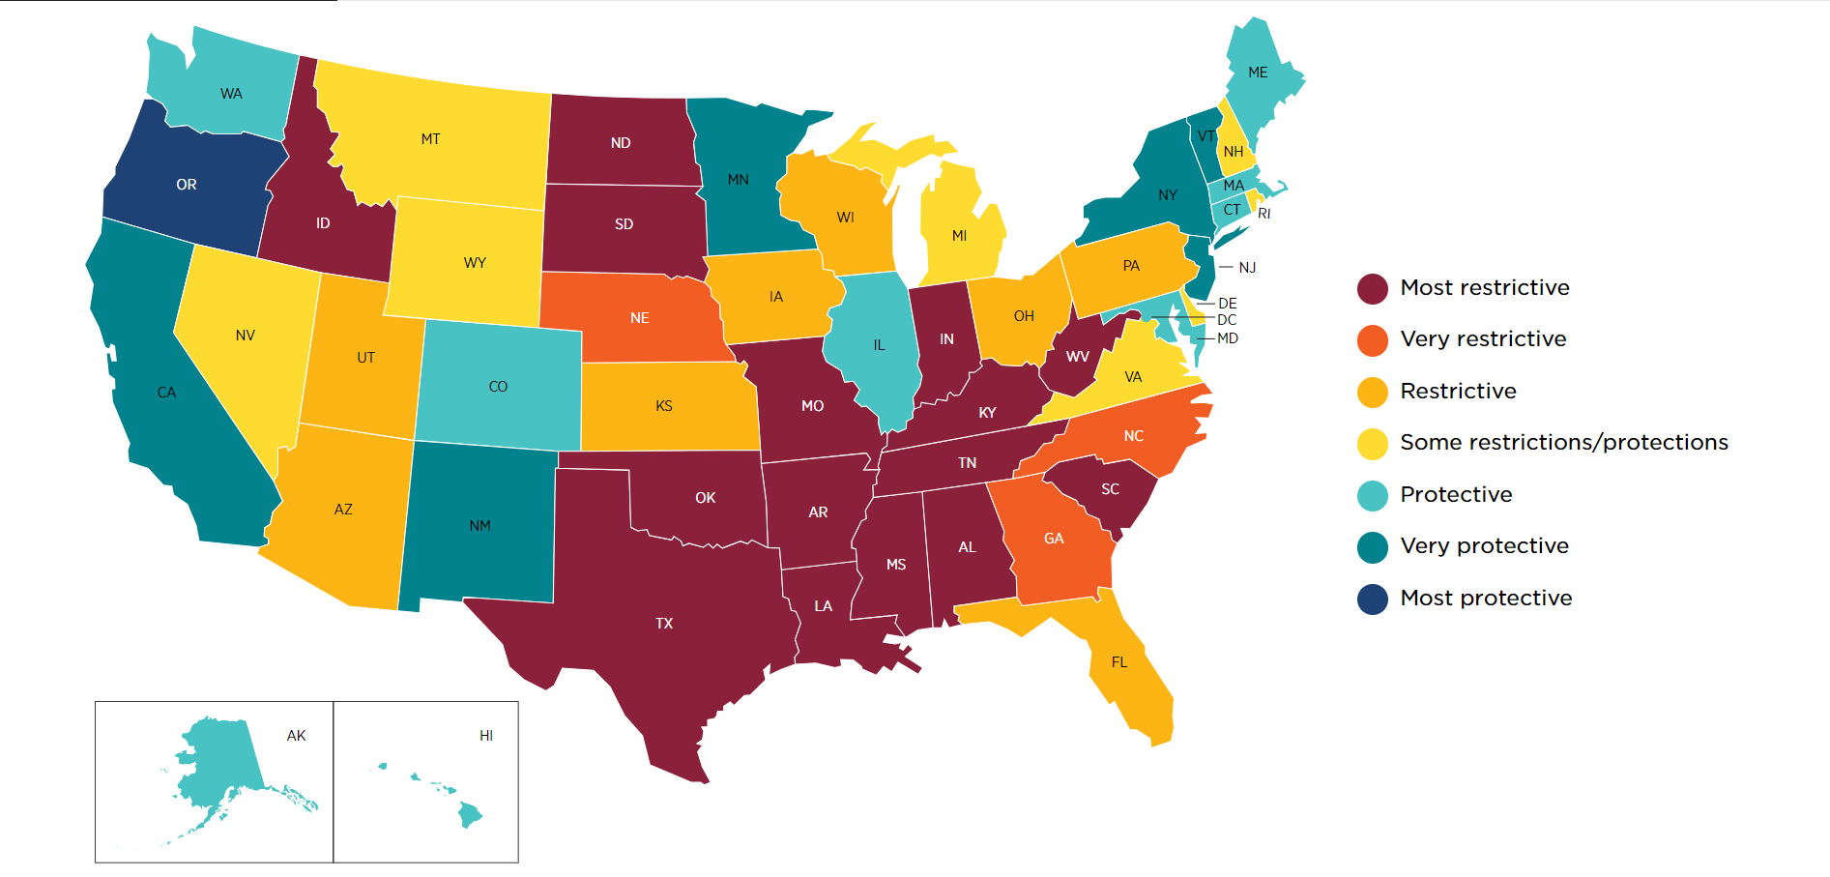
Reproductive Health
Toolkit on ACPOnline:
2023 Legislation
Over 3,300 provisions introduced 58 restrictive provisions, 295 protective provisions enacted
Trends: shield laws, "abortion trafficking" legislation, focus on criminalization/decriminalization
Active Litigation
Medical/health exceptions
Mifepristone
Ballot measures
Abortion restrictions exacerbating maternal maternal health crisis
Impact on physicians
Source: Guttmacher Institute

Slide 8
Scope of Practice
2023: Over 400 bills introduced
Growing trend around pharmacist scope bills, 59 in 2023
Physician assistant bills were in 10 states in 2022, 20 states in 2023
"Zombie" bills
AMA Scope of Practice Partnership
Look out for updated policy toolkit in early 2024
State policy brief on ACPOnline:

Slide 9
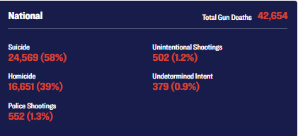
Firearms Safety
2023: nearly 2,000 bills introduced, more than 80 enacted
Growing investments in violence prevention/interruption
Key role of suicide prevention
ACPOnline Firearms Safety Hub:
Source: Giffords, CDC

Slide 10
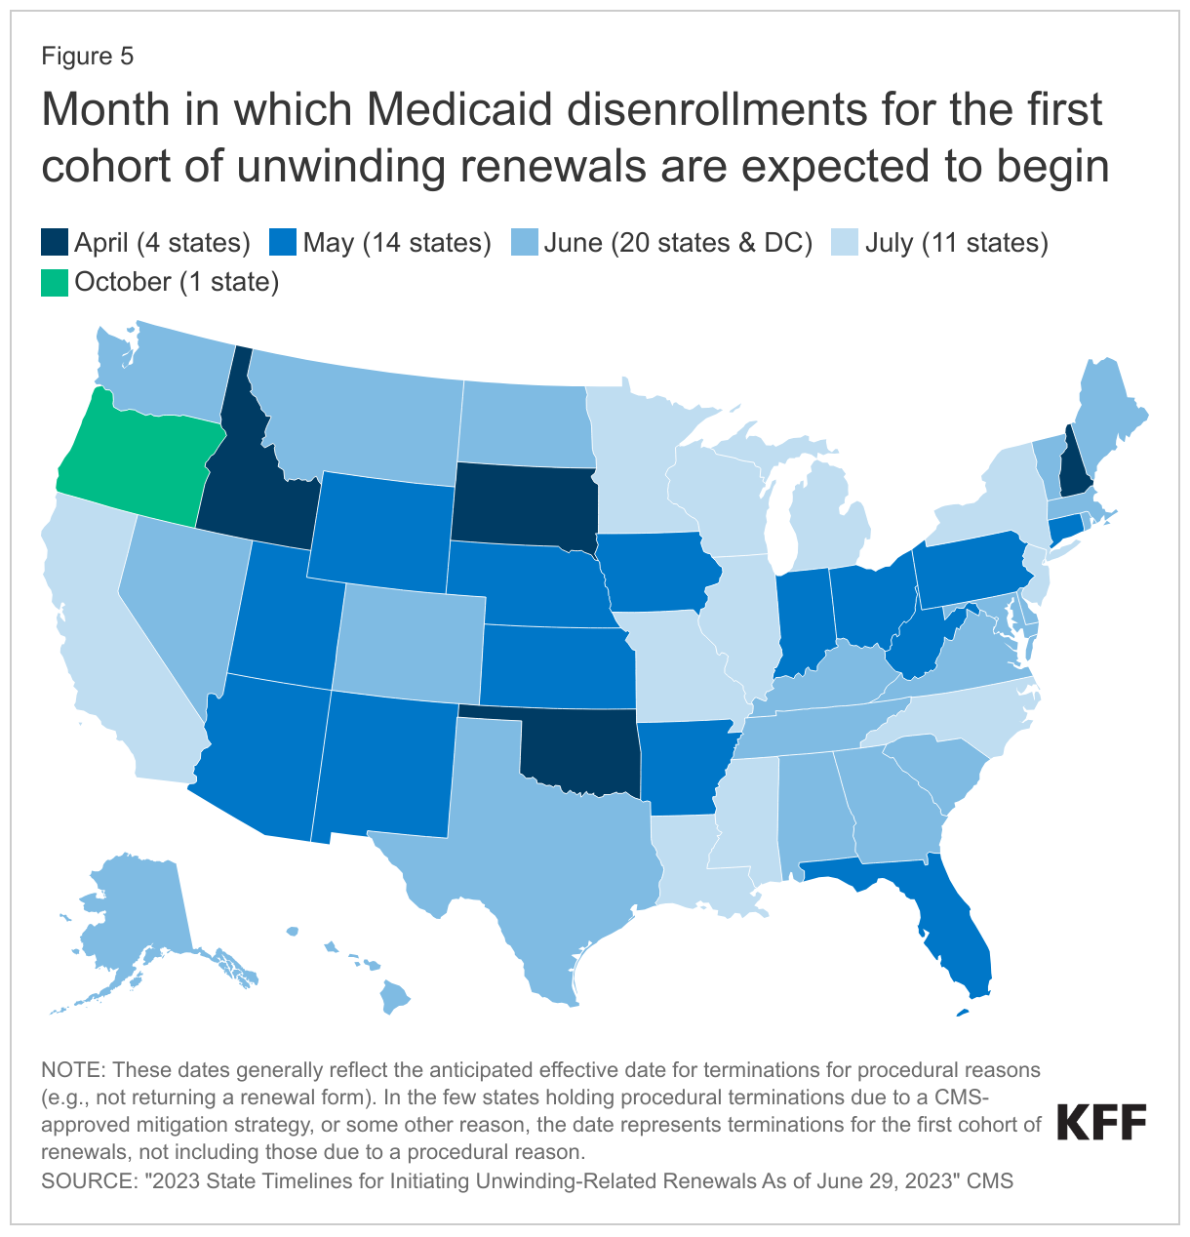
Medicaid
Continuous coverage unwinding
Since April, at least 9.5 million Medicaid enrollees have been disenrolled
Across states with available data, 72% of coverage terminations have been for procedural reasons
Varied state approaches
1115 Waiver innovations on covering social needs, ACP papers on Nutrition and Housing
12-month Postpartum Expansion
Fight Continues in Non-expansion states
Toolkit on ACPOnline:

Slide 11
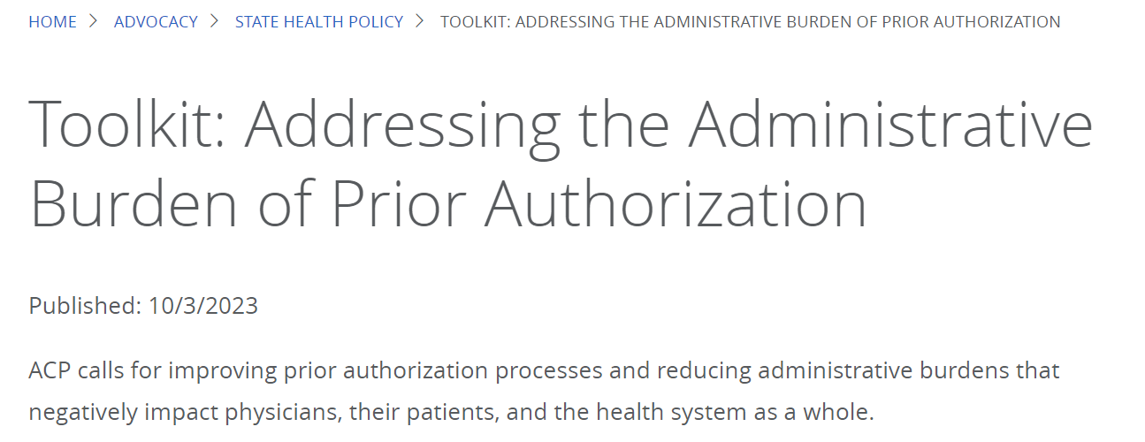
Prior Authorization
2023 Legislation
Approximately 90 bills in 30 states
Potential area for bipartisan collaboration, at both federal and state levels
Private sector advocacy
New Toolkit on ACPOnline:

Slide 12
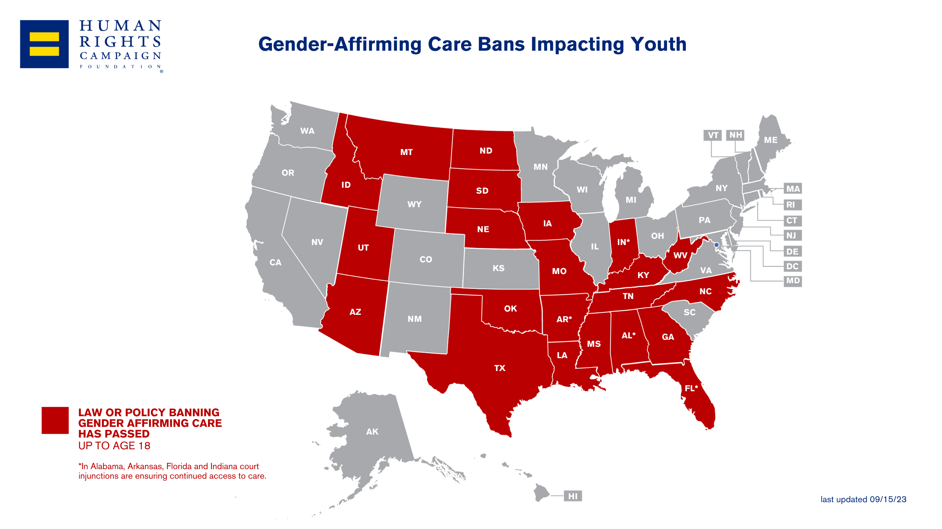
Gender-Affirming Care & LGBTQ+ Health Equity
2023: Over 500 anti-LGBTQ+ bills, another record for the most in a single year
Gender affirming care: legal status and active litigation
Impacts on transgender people, their families, and physicians
Restrictive activity at federal level starting to follow state trend
State policy brief on ACPOnline:

Slide 13
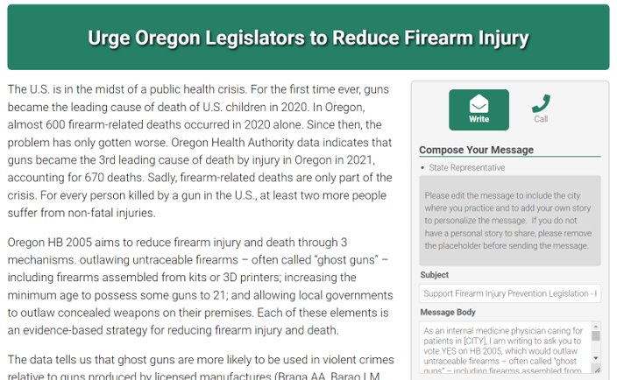
Request State-level Grassroots Alerts via ACP Legislative Action Center
Chapter leaders can now request to use ACP's grassroots software to facilitate their members contacting elected officials about health policy issues in their state
More information on LeaderNet:

Slide 14
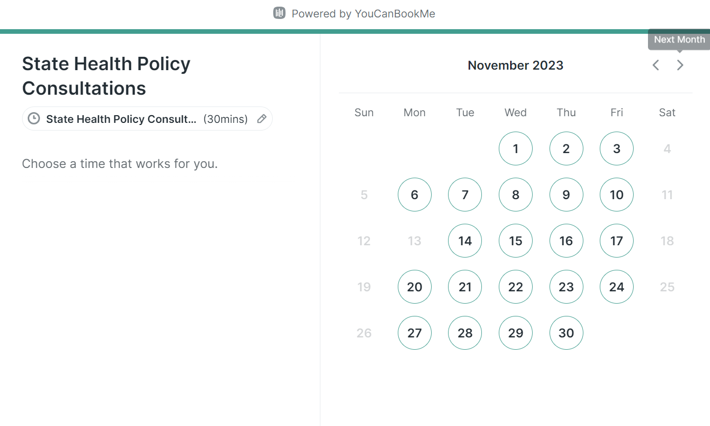
State Health Policy Staff Available for Consultations
ACP National's state health policy team is now available to be booked for consultations to discuss policy issues in your state, advocacy strategies, and more!
More information on LeaderNet:

