Slide 1
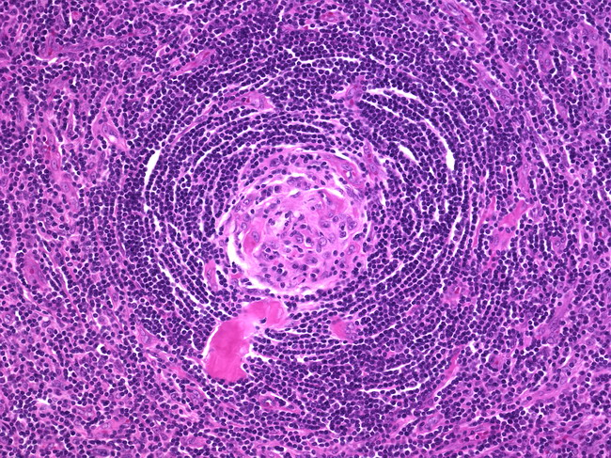
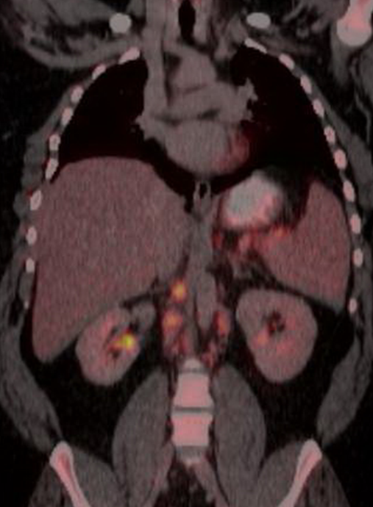
HHV-8-negative, idiopathic multicentric Castleman’s disease
Amanda Breviu¹, Peter Hale², Santosh Reddy¹
¹ Department of Internal Medicine, University of Utah, Salt Lake City, Utah
² University of Utah Medical School, Salt Lake City, Utah
Introduction
Hospital Course and Further Work-Up
Castleman’s disease is a rare lymphoproliferative disorder associated elevated levels of cytokines, previously typically identified in the setting of HIV or human herpes virus 8 (HHV-8).
While unicentric Castleman’s disease is uncommon, the multicentric variant is extraordinarily rare. This case highlights a rare instance in a young, relatively healthy male.
When daily fevers persisted, CT imaging was performed and showed splenomegaly and multiple enlarged lymph nodes.
Eventual PET CT imaging revealed diffuse uptake within the spleen and periaortic lymph nodes (see Figure 1). FNA biopsies of periaortic lymph nodes were unremarkable. Lymph node excisional biopsy was consistent with a diagnosis of multicentric Castleman’s disease (see Figure 2).
When diagnosis was confirmed, he was treated with rituximab weekly for four weeks as well as a prednisone taper. With this treatment, he had resolution of his fevers and normalization of his inflammatory markers and IL-6 levels.
Of note, HIV and HHV-8 serologies were negative and IL-6 was elevated.
Case Description
History of Present Illness:
A 30-year-old male with type two diabetes mellitus and morbid obesity presented with one month of generalized weakness, fatigue and fever. This was his third hospitalization with the same symptoms; no definitive diagnosis was identified the previous two. He also complained of headache, a dry cough, and upper abdominal pain.
Exam:
Vitals were unremarkable other than daily fevers, as high at 40° C. Pertinent exam findings included morbid obesity as well as abdominal tenderness to palpation in the upper quadrants with pain radiating to the back, without palpable organomegaly or lymphadenopathy.
Figure 2. Pathology appearance of a lymph node in Castleman’s disease.
Discussion
This patient’s eventual diagnosis required a prolonged work-up for a fever of unknown origin – with biopsy leading to the eventual diagnosis.
While Castleman’s has historically been associated with HHV-8 or HIV positivity, a growing number of cases are negative for both viruses.
Despite identification of this group, the pathophysiology and treatment options remain poorly understood. This patient was treated with rituximab and prednisone followed by localized radiation.
Interestingly, this patient still did have elevated IL-6 levels which point to a similar pathway of inflammation despite negative viral studies.
Diagnostic Data
Initial Labs/Imaging:
Given initial concern for infection, chest x-ray, blood and urine cultures were evaluated and all were unremarkable.
CBC revealed a normal WBC count and normocytic anemia.
Chemistry and liver function tests were normal.
ESR and CRP were elevated at 123 and 28 respectively.
CSF cell count notable for a pertinent for a mildly elevated WBC count.
With the above work-up complete, he was initially treated for aseptic meningitis thought to be secondary to NSAID usage.
Conclusion
This case highlights a diagnostic dilemma in a case of fever of unknown origin; excisional lymph node biopsy finally confirmed the diagnosis.
Despite historical association with HHV-8 or HIV, there are a growing number of cases which are negative for these viruses but may also be mediated by IL-6 signaling.
Contact Information
References
Amanda Breviu, MD Email Amanda.Breviu@hsc.utah.edu
Peter Hale, MS4 Email Peter.Hale@hsc.utah.edu
Santosh Reddy, MD Email Santosh.Reddy@hsc.utah.edu
Fajgenbaum DC, van Rhee F, Nabel CS. HHV-8 negative, idiopathic multicentric Castleman disease: novel insights into biology, pathogenesis, and therapy. Blood. 2014 May 8;123(19):2924 - 33.
Robey RC, Mletzko S, Colley C, Balachandran K, Bower M. The use of monoclonal antibodies to treat Castleman’s disease. Immunotherapy. 2014;6(2):211-9.
Figure 1. PET scan showing uptake in periaortic lymph nodes.
Notes:
Figure 1: add MHC data?
Png for graphs

