Slide 1
Texas Chapter
April 6-October 5, 2023
Ethics and Professionalism
Webinar Series​
Session 5: HIPAA/Patient Privacy Issues

Slide 2
Disclosure information – Planning Committee
None of the planning committee members for this educational activity have relevant financial relationship(s) to disclose with ineligible companies whose primary business is producing, marketing, selling, re-selling, or distributing healthcare products used by or on patients.

Slide 3
Disclosure information – Faculty
None of the faculty for this educational activity have relevant financial relationship(s) to disclose with ineligible companies whose primary business is producing, marketing, selling, re-selling, or distributing healthcare products used by or on patients.

Slide 4
Disclosure: Members of the College’s Education Content Validation Committee provide oversight of chapter education programs
Kati Avila, MD, ACP Member Eileen Barrett, MD MPH, SFHM, MACP Marvin Bittner, MD, FACP Consultant: Sanofi Pasteur, Merck Sharp & Dohme Sarah Burns, DO, MS, FACP, FHM William Davis, MD, MACP Consultant: AbbVie, Amgen, Janssen, Mitsubishi Tanabe Jessica Favreau, MD, FACP Tatyana Gavrilova, MD, FACP Sonali Iyer, MD, ACP Member Stock: Moderna, Pfizer Alain Olivier Lerebours, MD, ACP Member Consultant: Italki | Anuj Maheshwari, MD, FACP Consultant: Novo Nordisk, OMRON Health Care India Pvt Ltd, Sanofi India Ltd, Abbott Healthcare Private Limited Cynthia Miller, MD, MPH, FACP Stock: Centene Gregory Rouan, MD, MACP Dalia Saha, MD, ACP Member Amit Sharma, MD, ACP Member Shmuel Shoham, MD, FACP Consultant: Acidophil, Adagio, Adamis, Amplyx, Celltrion Healthcare, Immunome, Karyopharm Therapeutics, Reviral Grant: Whiscon, F2G, Cidara Therapeutics, Ansun, Emergent Biosolutions, Shionogi, Zeteo Tech. Ky Stoltzfus, MD, FACP
Relevant financial relationships appear in italics below each individual’s name. All others have nothing to disclose. All relevant relationships have been mitigated.

Slide 5
Go to the Texas chapter webpage and follow the prompts to claim credit.
The American College of Physicians (ACP) is accredited by the Accreditation Council for Continuing Medical Education (ACCME) to provide continuing medical education for physicians.
The ACP designates this other (live component and enduring component) activity for a maximum 1 AMA PRA Category 1 Credit(s)TM. Physicians should claim only the credit commensurate with the extent of their participation in the activity.

Slide 6
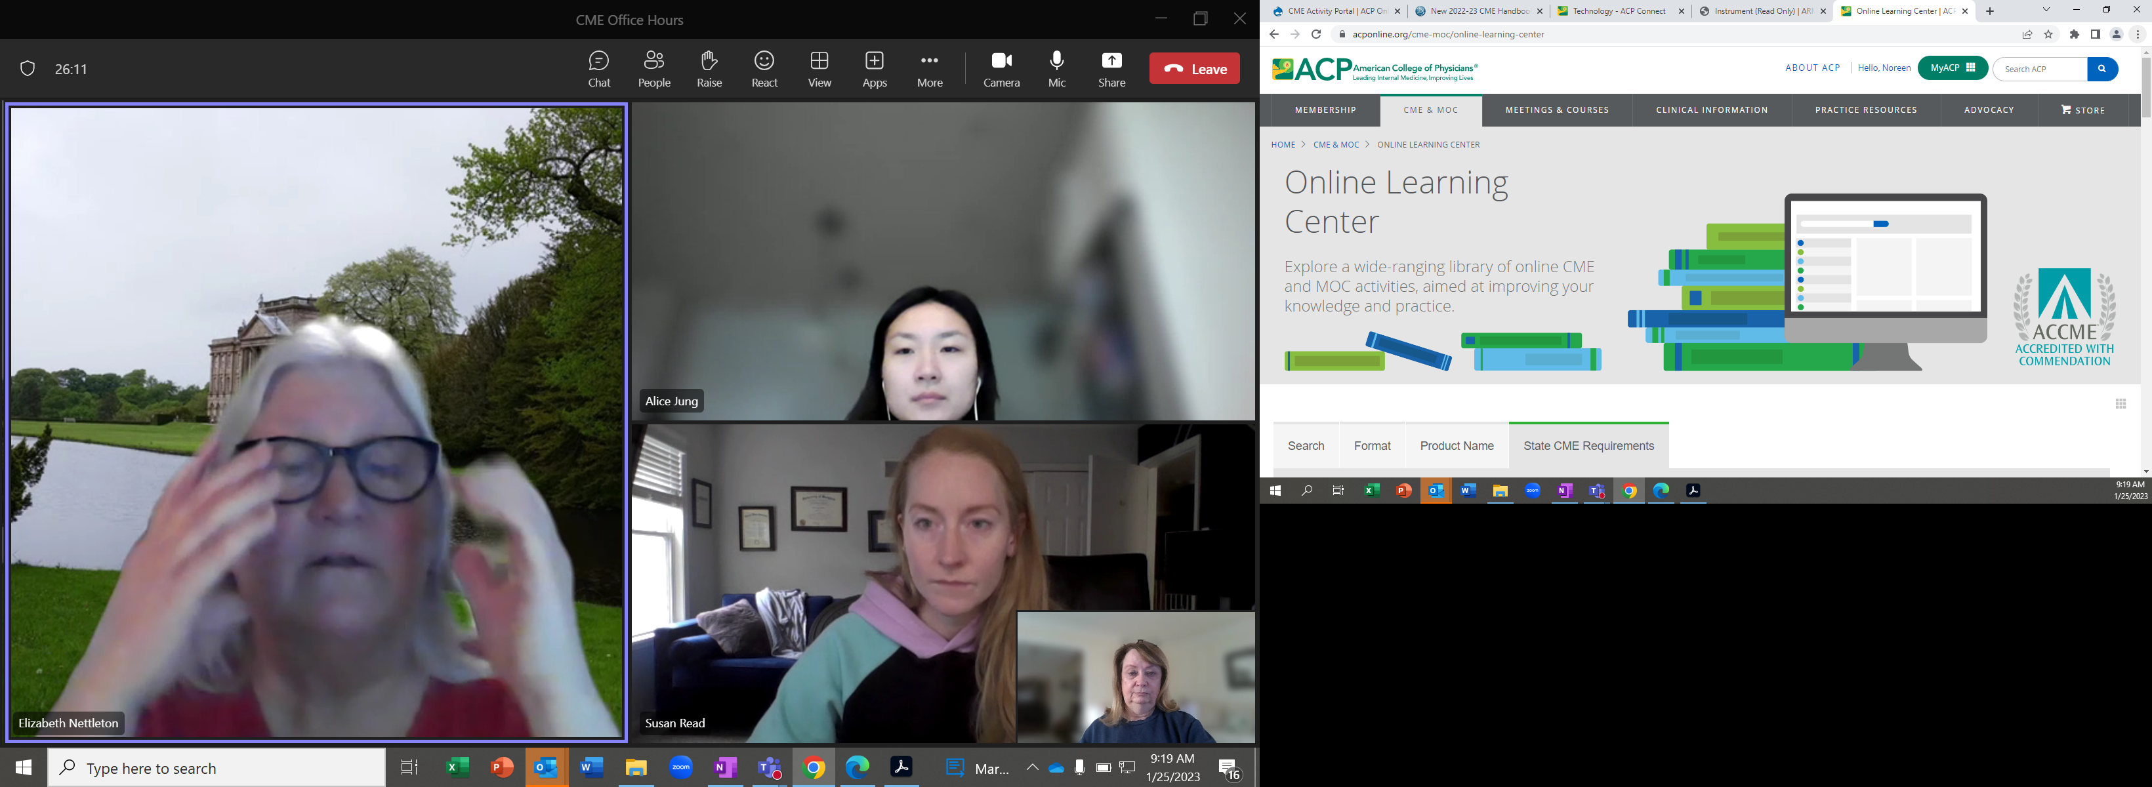
Thanks for joining us!
For more information
about topics covered
at our meeting, and more, visit
ACP’s Online Learning Center

