Slide 1
Preoperative Evaluation and the 2014 ACC/AHA Guidelines
Stephen D. Sisson MD FACP

Slide 2
Objectives
To review preoperative evaluation
To review issues in perioperative medication adjustment
To review preoperative testing
To review clinical risk assessment and risk assessment tools
To review the role of functional assessment
To determine who needs further cardiac testing
To determine who might benefit from perioperative beta blockers

Slide 3
Disclosures
None

Slide 4
Preoperative
Evaluation

Slide 5
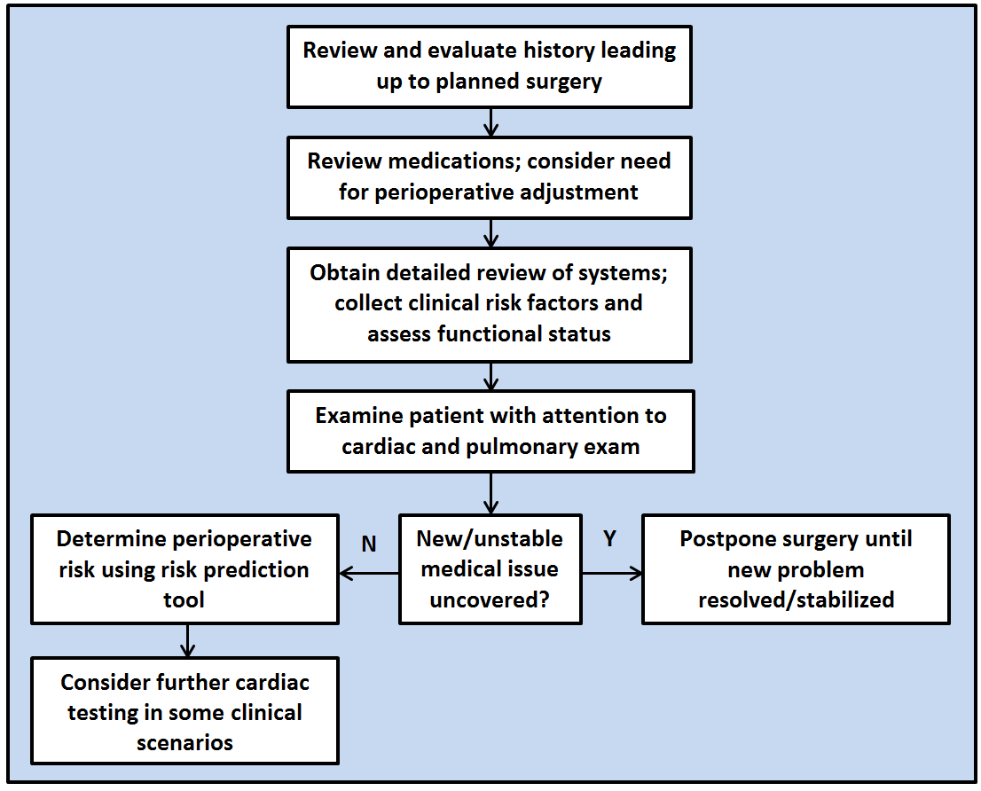

Slide 6
64F, PMH: DM, HTN, elevated cholesterol, tobacco; preop for femoral/popliteal bypass. Meds: Metformin 500mg, lisinopril 20mg, HCTZ 25mg daily. Labs, EKG normal.
What medication adjustments would you recommend for this patient?
Notes:
Day of surgery, hold metformin and probably HCTZ. New guidelines suggest adding statin. She has only 1 clinical risk factor, so beta blocker not indicated

Slide 7
2014 ACC/AHA Guidelines
Continue ACEI/ARB, or restart as soon as clinically feasible postoperatively
Continue statins if taking statin
Consider initiating statin if undergoing vascular surgery or with clinical indications and undergoing elevated-risk procedures

Slide 8
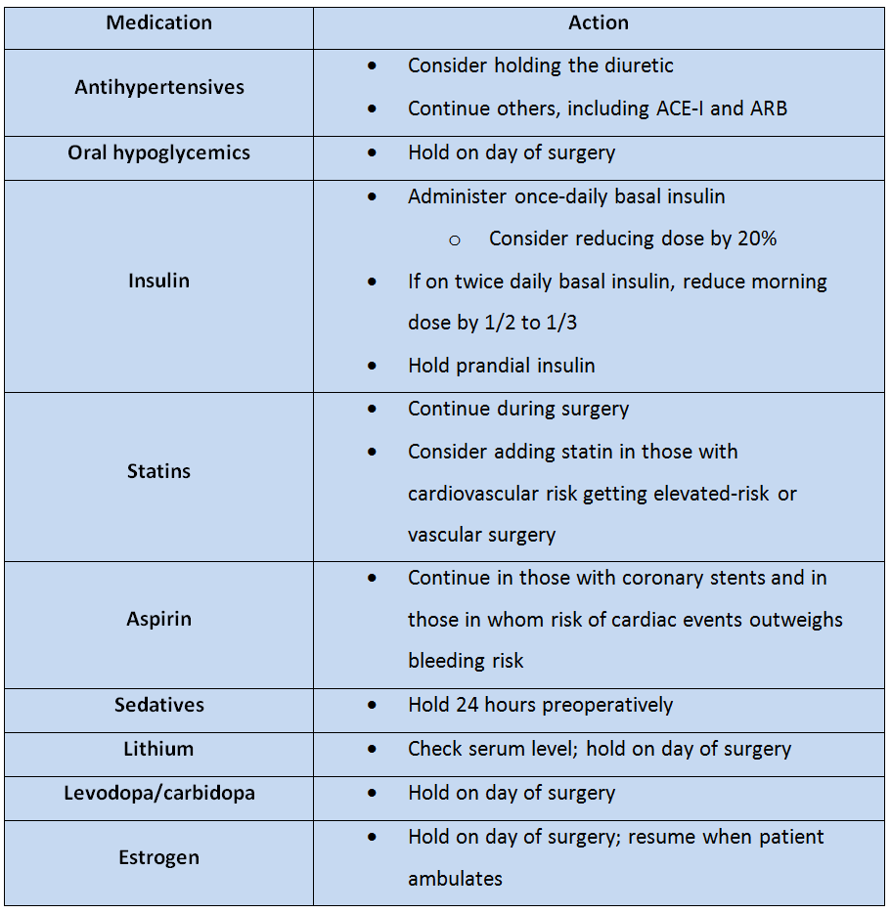

Slide 9
A 57-year-old during preop for THR mentions increasing angina. Stress test is positive; he then undergoes placement of a drug-eluting stent in his RCA. When should his elective total hip replacement be rescheduled?
In 4-6 weeks
In 3 months
In 6 months
In 1 year
Notes:
Could consider elective surgery in 6 months.

Slide 10
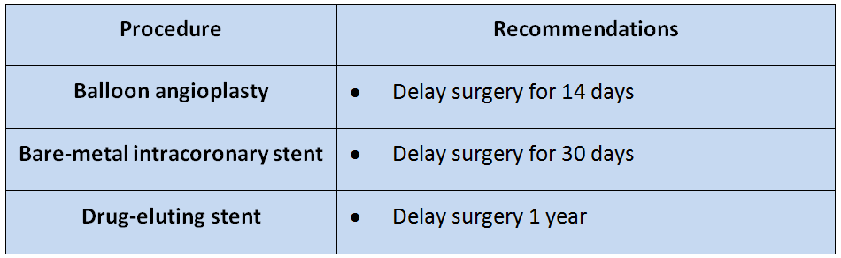
Antiplatelet therapy
Always try to continue DAPT; if not, at least continue aspirin. Discuss with cardiology and surgery to balance risks.
Notes:
With new DES, can consider elective surgery after 6 months. Try to continue aspirin. In each case, discussion with cardiologist, surgeon and internist should take place.

Slide 11
Additional caveats about meds
Look for steroid use >2 wks in prior year
Ask specifically about OTC NSAIDs
Ask about alcohol and other drugs of abuse

Slide 12
Preoperative cardiac testing
Candidate tests:
  EKG
  Echocardiogram
  Cardiac catheterization
  Stress testing

Slide 13
Preoperative EKG
Not useful for low-risk surgical procedures
May be considered in those without known CAD*
Reasonable for patients with CAD, significant arrhythmia, peripheral arterial disease, CVD, or other significant heart disease*
(*except undergoing low risk surgery)
Notes:
No evidence of specific age or procedure when obtaining an EKG alters outcome. Guideline authors did note that the value of a preoperative EKG likely increased as the patient's cardiovascular risk increased and/or the complexity of the surgical procedure increased.

Slide 14
Preoperative Echocardiography
Routine preoperative evaluation of LV function is not recommended
Reassessment of LV function in clinically stable patients with previously documented LV dysfunction may be considered if there has been no assessment within a year
Notes:
Systolic dysfunction worse than diastolic dysfunction

Slide 15
Preoperative cardiac catheterization
Coronary angiography in the asymptomatic patient has no value in preoperative evaluation

Slide 16
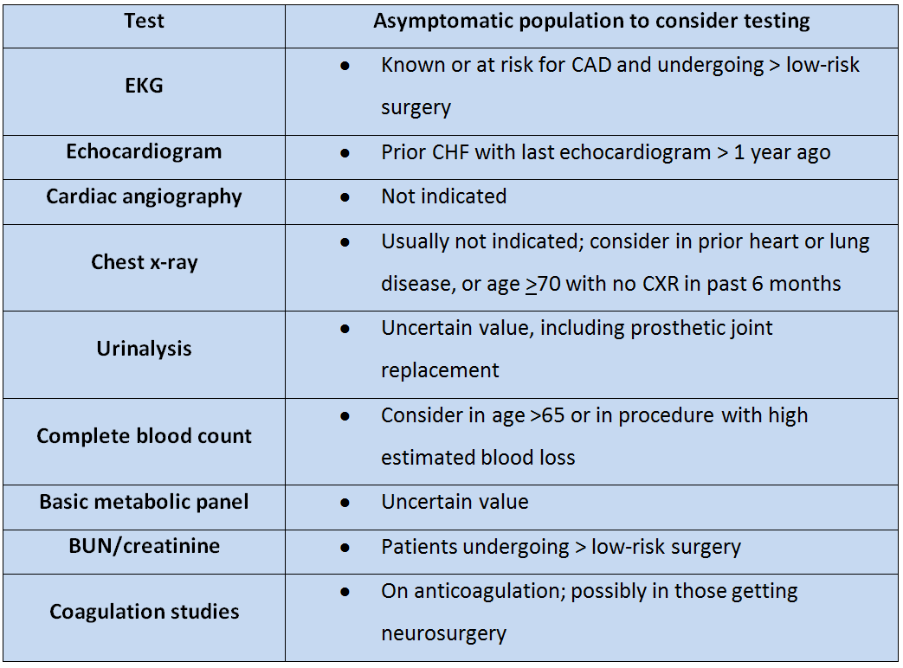

Slide 17
Clinical Risk Assessment

Slide 18
Clinical risk assessment
Occurs throughout preoperative evaluation
Review of systems used to gather information on clinical risk factors not already uncovered in HPI or PMH
Combined with functional status and type of surgery to predict perioperative risk

Slide 19
Of the following patients with cardiac conditions, which one may proceed with elective surgery?
Patient with aortic stenosis with valve area 0.9cm² and chest pain
Patient with mitral stenosis with dyspnea on exertion
Patient with angina that is present at rest
Patient with myocardial infarction 3 months ago
Notes:
Correct is D

Slide 20
Cardiovascular risks
Ischemic cardiovascular disease
  Angina
  Intracoronary stent
  Myocardial infarction
Congestive heart failure
Valvular heart disease
  (AS>MS>AR/MR)
Hypertension
Arrhythmias

Slide 21
Ischemic cardiovascular disease
The presence of the following should postpone surgery:
  Unstable angina
  Class III or IV angina
  Myocardial infarction < 60 days ago

Slide 22
Additional cardiac considerations
Cardiac catheterization does not have a role in preoperative risk assessment.
Coronary revascularization should not be performed solely to reduce operative risk for another procedure.*
*If indicated on its own, revascularize before elective procedure
Notes:
If left main, triple vessel CAD, or 2vv disease incl prox LAD and either EF<50% or + noninvasive testing, revascularization should be performed prior to elective surgery

Slide 23
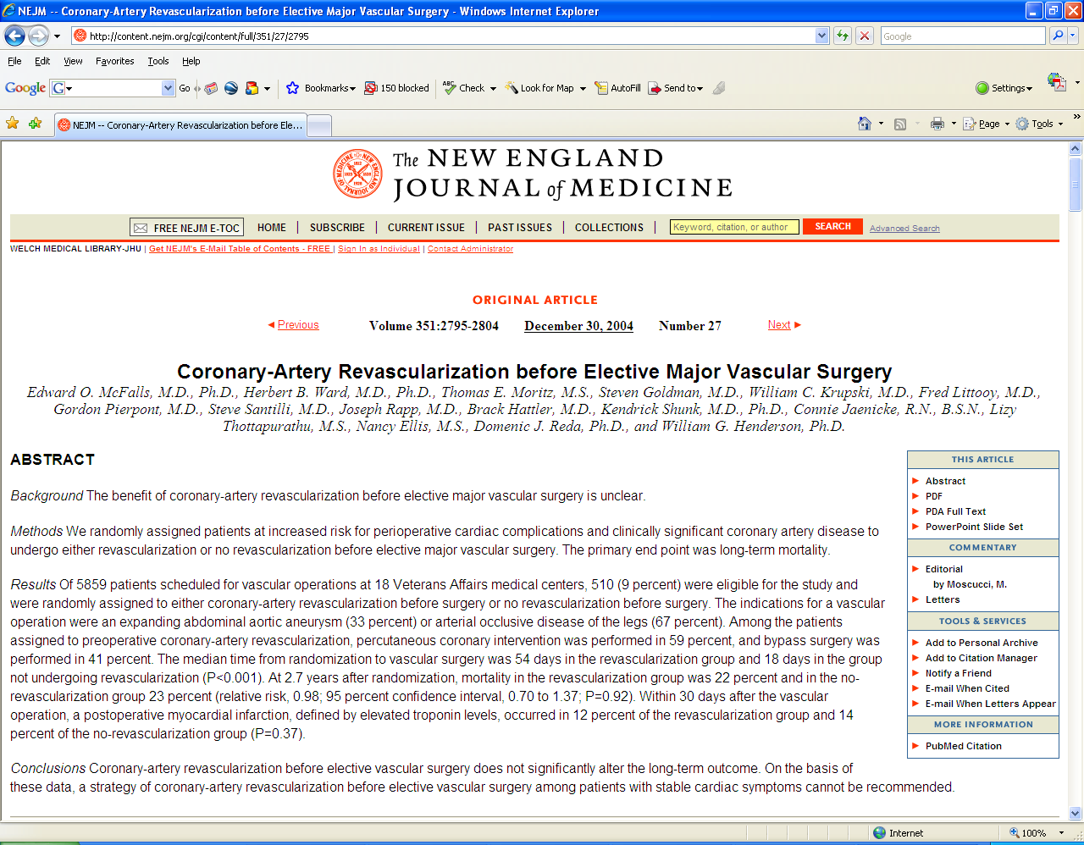

Slide 24
Congestive heart failure
Decompensated congestive heart failure is a contraindication to elective surgery

Slide 25
Valvular heart disease
Obtain echo if clinically suspected moderate or severe valvular heart disease if no echo in past year, or clinically changed.
Asymptomatic patients may undergo elective noncardiac surgery, even with severe valvular disease, with monitoring
  Consider mitral valve commisurotomy preoperatively in severe mitral stenosis
Notes:
Patients with indication for valve replacement based on symptoms and/or severity of valve lesion should have the valve taken care of before elective surgery

Slide 26
Hypertension
(no specific recommendations)

Slide 27
Arrhythmias
Atrial fibrillation: no adjustments (other than anticoagulation) if clinically stable
Ventricular arrhythmias do not require special therapy if clinically stable
Communicate with Cardiology and surgeon if pacemaker/AICD present
Lack of data limits more specific recommendations

Slide 28
Pulmonary Risks
Pulmonary risk assessment poorly defined
  FEV1<1.5 = increased pulmonary complications
  FEV1<1.0 = likely prolonged intubation
Serum albumin <3.5g/dl best predictor of perioperative pulmonary complications
(Consider ABG if CO₂ retention, COPD, restrictive lung disease)

Slide 29
Other systems
Hematologic: h/o bleeding/thrombosis risk, h/o transfusion reaction
Endocrine: DM, thyroid, adrenal disease
  If >2wks. steroids in past year, give stress dose steroids (HC 100mg IV q8H)
ID: cancel elective surgery when acute infectious illness present
Renal: creatinine > 2.0mg/dl associated with increased risk
Neurologic: cerebrovascular disease associated with increased risk

Slide 30
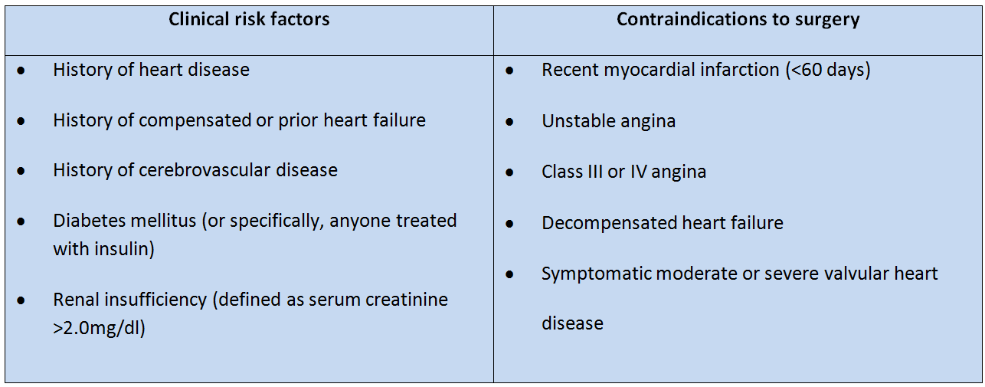
Data gathered thus far
Clinical risk factors = Revised Cardiac Risk Index (which also includes high-risk surgery)

Slide 31
Surgery Specific Risk

Slide 32
Surgical Risk
Overall perioperative mortality: 0.3%
Cardiac etiologies most common cause of death
  POD#3 most common day for perioperative MI
Pulmonary etiologies most common cause of complications
  Extubation is time of risk for flare of reactive airways

Slide 33
Of the operations listed, which one has the lowest operative risk?
Simple mastectomy
Prostatectomy
Carotid endarterectomy
Total knee replacement
Notes:
Correct is A

Slide 34
Low Risk Surgery
(<1% risk MI/death)
Endoscopic procedures
Superficial procedures
Cataract surgery
Breast surgery
Ambulatory surgery

Slide 35
Intermediate and high-risk surgery
Carotid endarterectomy
Endovascular AAA repair
Head and neck surgery
Intraperitoneal/intrathoracic surgery
Orthopedic surgery
Prostate surgery
Aortic/major vascular surgery
Peripheral vascular surgery

Slide 36
Functional assessment

Slide 37
A 73-year-old woman is to undergo left TKR for DJD. PMH: HTN
Meds: HCTZ
She has been limited in physical activity because of her knee, but she can walk up 1 flight of stairs without difficulty. How many metabolic equivalents (METs) is she demonstrating?
0 METs
1 MET
4 METs
10 METs
Notes:
Correct answer is C

Slide 38
Functional Assessment
ACC/AHA: poor exercise tolerance is the inability to perform 4 METs of activity without symptoms

Slide 39
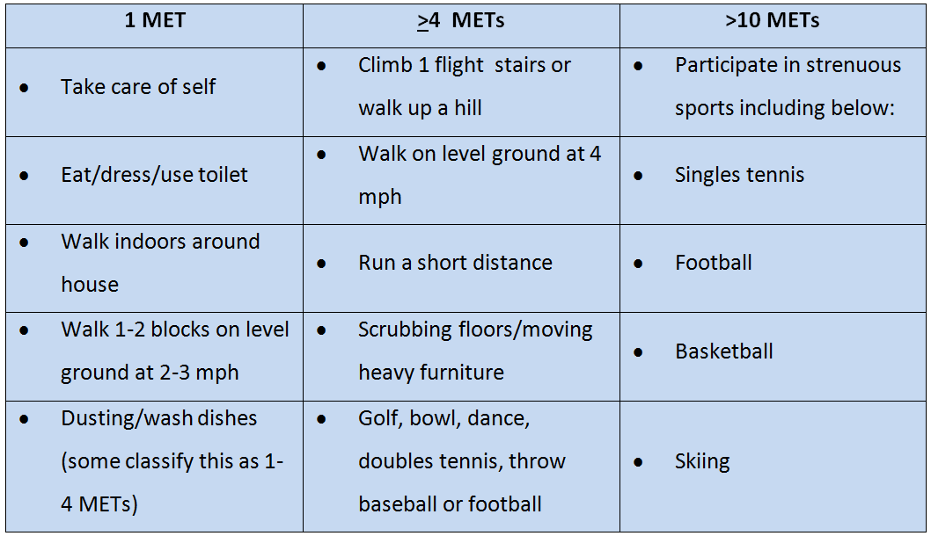

Slide 40
64M preop. for AAA repair.
PMH: HTN, DM, CKD, prior CVA, tobacco use.
Meds: lisinopril, HCTZ, atorvastatin and metformin.
ROS: Walks 3 flights of stairs regularly
Physical examination: Normal.
The surgeon requests an EKG and blood work, which are baseline. Of the options listed, correct management at this point would be:
Add metoprolol
Obtain a dobutamine echocardiogram
Both A and B
Proceed with surgery with no changes
Notes:
Correct is A

Slide 41
Perioperative beta blockers
Proven to reduce risk of perioperative MI in certain populations
Also increases risk of death and stroke in other populations
If used, long-acting beta blockers preferable over short-acting

Slide 42
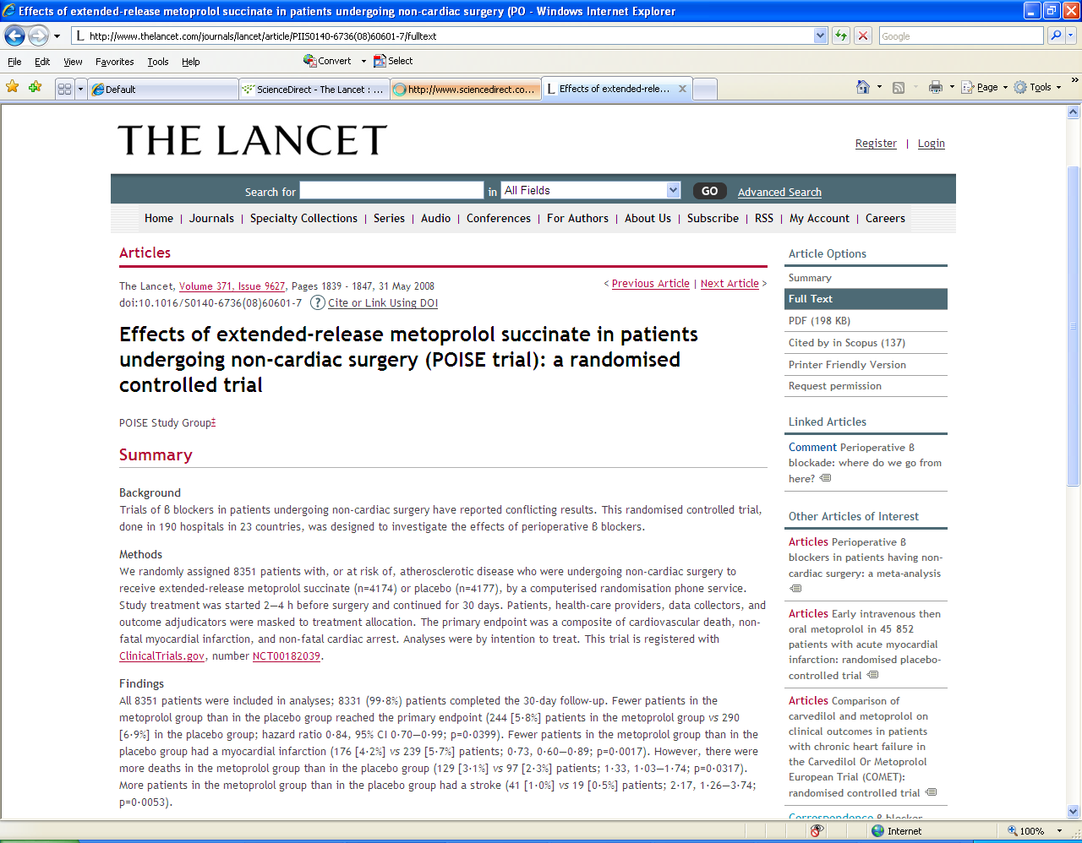
Notes:
RCT 8300 patients undergoing non-cardiac surgery. Rx with 100mg metop XL 2-4H preop and in first 6H post op if HR>80 or SBP>100, then metop XL 200mg daily for 30 days. MI/CV death decreased, but CVA/non-cardiac death increased. For every 1000 patients; prevents 15 MI but causes 8 deaths and 5 CVAs

Slide 43
Perioperative beta blockers
Continue if already on them
Consider starting them if 3 or more Revised Cardiac Risk Index factors
Consider if intermediate or high-risk preoperative testing seen
Start at least 1 day preoperatively; no proven value in titrating to HR<60

Slide 44
Putting it all together

Slide 45
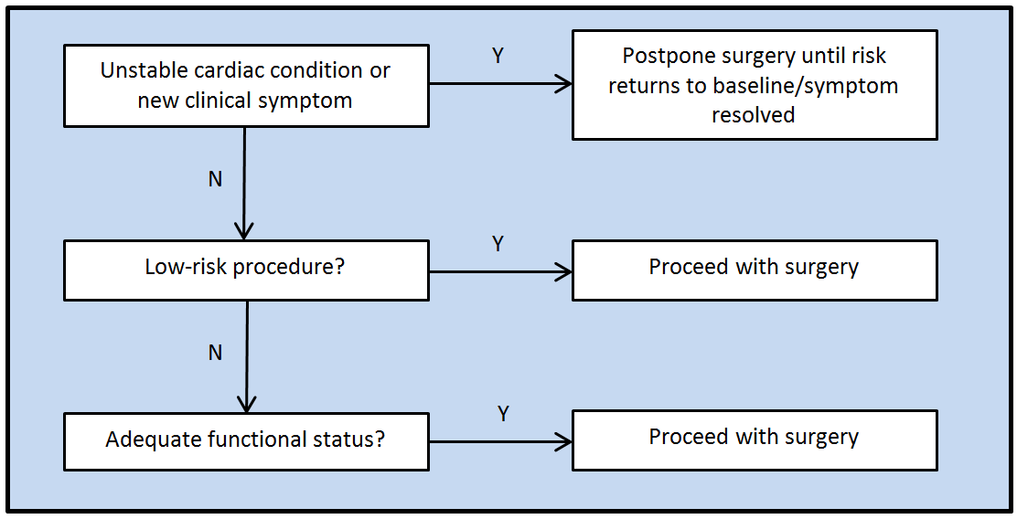
What we know so far:

Slide 46
Management in other scenarios
NSQIP:
  Multicenter study of >200,000 patients at >250 hospitals
  Clinical outcomes tracked and compared with clinical risk factors and operative procedure
  Better predictor of perioperative risk than the RCRI
  Variables included type or surgery, functional status, abnormal creatinine, ASA class, age
Notes:
National Surgical Quality Improvement Program. Study done in 2011

Slide 47
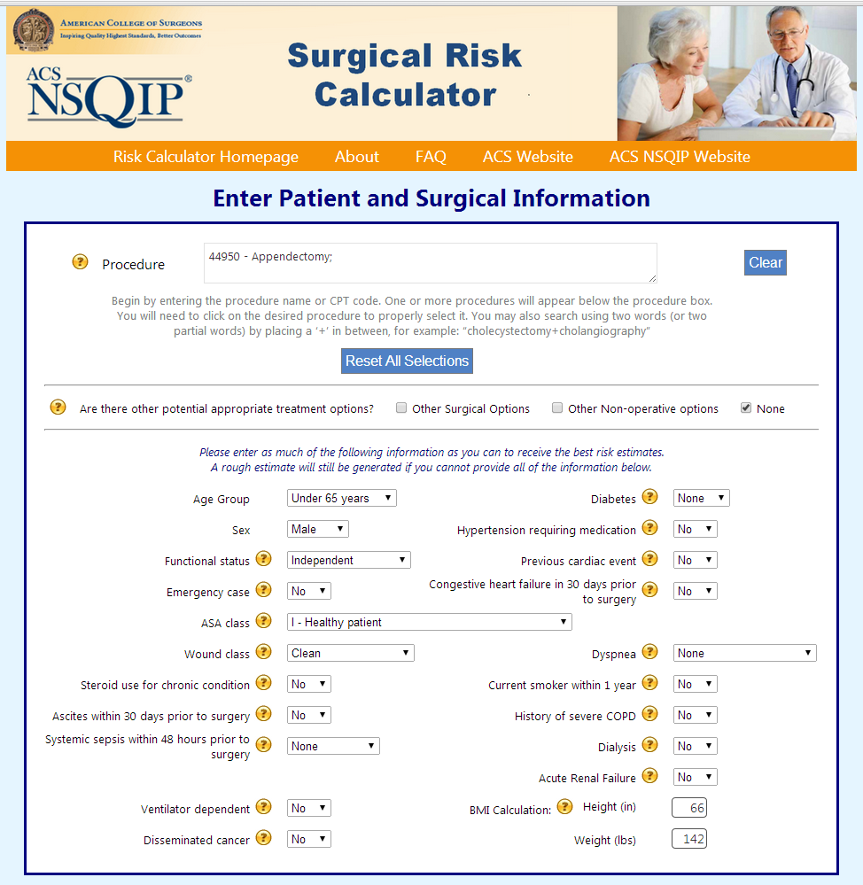

Slide 48
NSQIP-guided management
If surgical risk <1%, proceed with surgery
If surgical risk >1% and functional status <4 METS, obtain pharmacologic stress if it would affect management

Slide 49
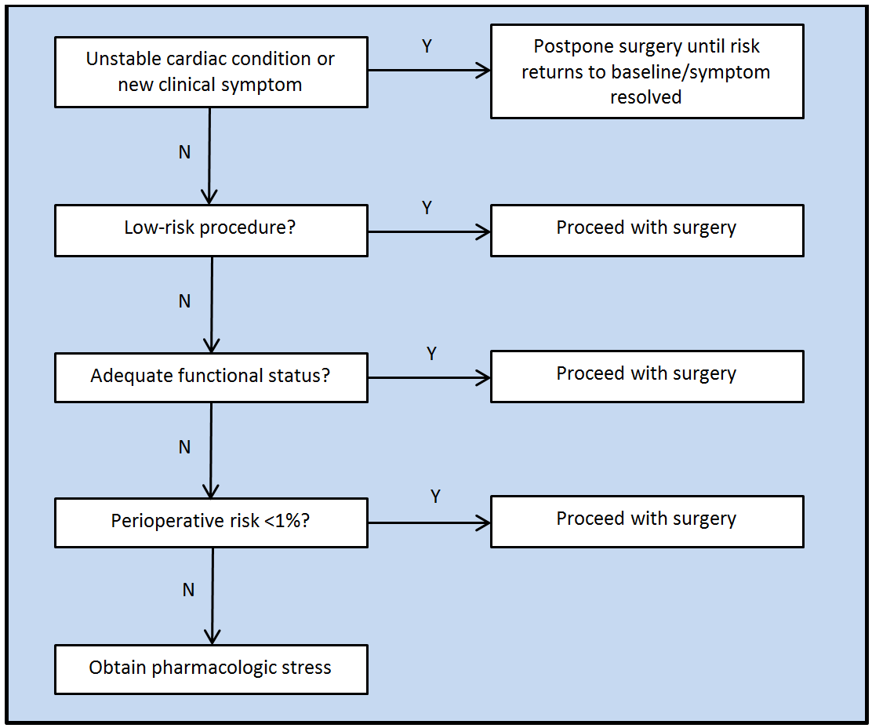

Slide 50
73F preop for mastectomy for breast cancer.
PMH: HTN, DM
Meds: Lisinopril, HCTZ, insulin, aspirin
She lives on a 1-level apartment, and cooks for herself without any dyspnea. The surgeon has already obtained blood work. Of the options listed, appropriate management at this point would be:
Obtain dobutamine echocardiogram
Add metoprolol prior to surgery
Both A and B
Proceed with surgery
Notes:
Correct is D; low risk surgery

Slide 51
44M preoperative for bunion surgery.
PMH: Dilated cardiomyopathy from viral myocarditis three years ago.
Meds: lisinopril and furosemide.
PE: BP 118/68; P66.
You note bibasilar rales and mild pedal edema, and the patient admits he's been a little bit more dyspneic recently, and a little less compliant with salt restriction. Appropriate management at this point would be:
Double his furosemide and proceed with surgery
Add metoprolol then proceed with surgery
Both A and B
Postpone surgery
Notes:
D. postpone

Slide 52
57M preop for total knee replacement surgery.
PMH: heavy smoker, hypertension, diabetes and chronic kidney disease
Meds: Lisinopril, HCTZ, insulin, rosuvastatin, aspirin
ROS: He is sedentary, lives on a single floor in an elevator building, but is compliant with his medications.
Data: A1C 6.5%; creatinine 2.6mg/dl. CXR and EKG done in anticipation of surgery are normal.
After instructing the patient about medication adjustments, the next step in preparing this patient for surgery should be:
Add metoprolol and proceed with surgery
Assess perioperative risk with risk calculator
Obtain dobutamine echocardiogram
Proceed with surgery
Notes:
Correct is B

