Slide 1
Mycobacterium Avium Complex Associated Spondylitis
Sunjeet SiDhu, MD
February 1, 2014

Slide 2
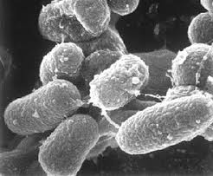
MAC
Combination of two genetically related species
Mycobacterium Avium
Mycobacterium Intercellulare
Aerobic non-spore forming bacteria
Commonly found in air and water
Acquired through inhalation or ingestion
Mandell, et al. Mandell, Douglas, and Bennett's Principles and Practice of Infectious Diseases. 2009

Slide 3
Pulmonary
Immunocompetent host
Due to direct innoculation rather than reactivation
Past history of smoking or chronic lung disease
Symtpoms
Productive Cough (>80%)
Weight loss (~50%)
Fever and night sweaths (10-20%)
Typically presents as a fibronodular/cavitary lung disease
Can also present as a hypersensitivity pneumonitis
Mandell, et al. Mandell, Douglas, and Bennett's Principles and Practice of Infectious Diseases. 2009

Slide 4
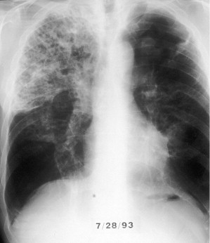
Radiographic findings
Mandell, et al. Mandell, Douglas, and Bennett's Principles and Practice of Infectious Diseases. 2009

Slide 5
Disseminated MAC
Typically occurs in patients with AIDS
Median CD4 count of 13
Symptoms: high fevers, weight loss, severe anemia and diarrhea
Affected Organs: spleen, lymph nodes, liver, GI tract, and bone marrow
Lung parenchymal involvement less common (<10%)
Immune reconstitution syndrome can be seen 1 – 12 weeks after initiating anti-retroviral therapy
Mandell, et al. Mandell, Douglas, and Bennett's Principles and Practice of Infectious Diseases. 2009

Slide 6
Treatment
Macrolides have drastically improved cure rates but development of resistance is high (46%) when used as single therapy
Ethambutol and rifamycins are also used in combination with macrolides as first line agents
Other anitbiotics with varying activity against MAC include: fluroquinolones, clofazamine and aminoglycosides
Novel agent: Bedaquilline – active against mycobacterial ATP Synthase – approved for MDR TB
Course of therapy 1-2 years for pulmonary disease
Disseminated MAC treatment course dependent on CD4
Mandell, et al. Mandell, Douglas, and Bennett's Principles and Practice of Infectious Diseases. 2009

Slide 7
Our Case
52 year old male who presented with multiple joint complaints
Left wrist effusion with purulent drainage as well as right knee effusion and mid back pain
PMHX: Diabetes Mellitus, Gout, Atrial Fibrillation, Hypertension, and end stage renal disease status post two cadaveric renal transplants
Immunosuppressive regimen included mycophenolate mofetil, tacrolimus, cylcosporine and prednisone at various points

Slide 8
Our Case Cont.
Pertinent Physical Exam: T 36.8 HR 92 BP 141/92 RR 14
tender erythematous -2x3cm palmar lesion on left wrist and 2x2 cm lesion on dorsal surface with purulent drainage
Right knee effusion with pain on passive ROM
Neuro exam revealed weakness of left hip extension and plantar flexion
HIV Ag/Ab aswell as viral load negative, CD4 ~200
Right knee effusion: 12,000 WBC 76% polys and 24% lymphs

Slide 9
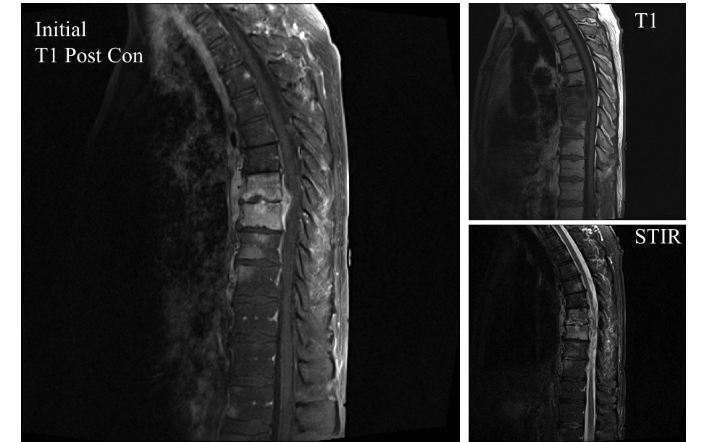
MRI

Slide 10
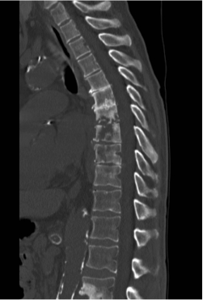
Ct scan

Slide 11
Diagnosis
Right knee effusion, left wrist lesion and epidural abscess: AFB culture showed MAC

Slide 12
Clinical Course
Initially treated with broad spectrum antibiotics until MAC isolated
Started on Azithromycin, Ethambutol and rifampin
Rifampin changed to moxifloxacin due to resistance on DNA probe
6 week MRI showed progression of spinal disease
T7-8 corpectomy and washout with cage placement
Antibiotics changed to azithromycin, linezolid and amikacin due to progression

Slide 13
Clinical Course Cont.
12 weeks: Tacrolimus and Mycophenolate stopped due to recurrent wrist abscesses
Developed severe thrombocytopenia and anemia on linezolid
Linezolid stopped and patient placed back on moxifloxacin
Bilateral deafness on amikacin – amikacin stopped
Currently on Azithromycin and moxifloxacin
Significant improvement on stopping immunosuppressants

Slide 14
Discussion
22 cases of non-HIV MAC spinal infections – most due to trauma or long term steroid use – none reported in solid organ transplant recipients
Time to diagnosis 4-12 weeks with resulting neurologic deficits
Case reports exist for the use of PCR to speed time to diagnosis – not yet universally available
Treatment – often required surgical intervention and long term anitbiotics (>12 months)
In vitro susceptibility data poorly correlated with in vivo efficacy (except macrolides and rifamycins)
Mandell, et al. Mandell, Douglas, and Bennett's Principles and Practice of Infectious Diseases. 2009
Shimizu H, et. al.,Vertebral osteomyelitis caused by non-tuberculous mycobacteria: case reports and review. J Infect Chemother. 2013

Slide 15
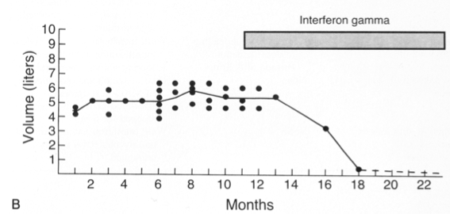
IFN- Gamma
Deficits in the IFN-gamma pathway have been attributed to mechanism of disease
IFN- gamma receptor mutation and IFN-gamma auto antibodies have been reported with recurrent disseminated MAC osteomyelitis
Ishii T, et. al., J Infect Chemother. 2013
Holland SM, et. al., N Engl J Med. 1994 May12;330(19):1348-55.

Slide 16
Questions?
Thank You

