Slide 1
Maryland ACP Meeting January 30, 2015 Update in Pulmonary Medicine
Albert J. Polito, M.D.
The Lung Center at Mercy

Slide 2
Disclosures
I have no relevant financial relationships with any commercial interest related to the manufacturer of any commercial product and/or provider of commercial services discussed in this presentation.

Slide 3
Topics
Lung cancer screening
Prevention of COPD exacerbations
Treatment of obstructive sleep apnea
Emergence of electronic cigarettes
Treatment of IPF

Slide 4
Lung Cancer Screening

Slide 5
Cancer Screening
Identification of unrecognized cancer through physical exam, laboratory testing, or procedure
Screening should sort out “apparently well” persons who have cancer from those who do not
Goal of cancer screening
Early detection to improve survival

Slide 6
Guidelines for Screening American Cancer Society
Breast cancer
Annual mammogram and clinical breast exam in women ≥ 40
Colorectal cancer
Colonoscopy every 10 yrs starting at age 50
Other approaches acceptable
Cervical cancer
Pap smear in women every 3 years starting at age 21
Prostate cancer
Annual PSA level and digital rectal exam in men ≥ 50
Talk to your doctor

Slide 7
Guidelines for Screening American Cancer Society
Breast cancer
Annual mammogram and clinical breast exam in women ≥ 40
Colorectal cancer
Colonoscopy every 10 yrs starting at age 50
Other approaches acceptable
Cervical cancer
Pap smear in women every 3 years starting at age 21
Prostate cancer
Annual PSA level and digital rectal exam in men ≥ 50
What about lung cancer?!
Talk to your doctor

Slide 8
American Cancer Society
U.S. Preventive Services Task Force
American College of Physicians
American College of Chest Physicians
American Academy of Family Physicians
American College of Radiology
American Thoracic Society
Until 2012, no group ever had recommended screening for lung cancer.

Slide 9
Lung Cancer Screening Traditional Approaches
Regular screening with periodic chest X-rays
Mayo Lung Project (10,993 male smokers)
Czechoslovakia screening study (6364 male smokers)
No benefit in either study
Number of lung cancer deaths was unchanged by screening

Slide 10
Lung Cancer Screening Traditional Approaches
Periodic chest X-rays + induced sputum cytology
Memorial Sloan-Kettering Lung Project (10,040 smokers)
Johns Hopkins Lung Project (10,387 male smokers)
No benefit in either study
Number of lung cancer deaths was unchanged by screening

Slide 11
I-ELCAP Study

Slide 12
I-ELCAP Study
Case-control observational study
31,567 asymptomatic persons at risk for lung cancer had chest CT scans every 12 months from 1993-2005
Lung cancer identified in 484 persons
412 (85%) had stage I disease
Estimated 10 year survival rate = 88%
Traditionally reported 5 year survival rate = 70%
Conclusion: Annual spiral CT screening can detect early stage lung cancer that is curable.
Weaknesses
No control group (everyone was screened)
Statistical model (not hard data) used to determine 10-year survival rate

Slide 13
National Lung Screening Trial
Started in 2002, sponsored by NIH
53,454 current or former smokers randomly assigned to screening with CT scans or with chest X-rays
Study was stopped in November 2010 because of clear benefit for patients getting CT scans
20% drop in death rate
354 deaths in CT scan group, 442 deaths in X-ray group

Slide 15
Should everyone be screened with CT scans?
No
Issues
Potential for overdiagnosis (false positives)
26,722 screened with CT scan; 6413 had a suspicious lesion requiring F/U; of those, 6182 were false positives; 75 had major complication
Number needed to screen to avoid one lung cancer death = 320
Cost!

Slide 16
American Cancer Society
U.S. Preventive Services Task Force
American College of Physicians
American College of Chest Physicians
American Academy of Family Physicians
American College of Radiology
American Thoracic Society
“…evidence is insufficient to recommend for or against screening.”
Between 2012 and 2014, all made formal recommendations for lung cancer screening.

Slide 17
American Cancer Society
U.S. Preventive Services Task Force
American College of Physicians
American College of Chest Physicians
American Academy of Family Physicians
American College of Radiology
American Thoracic Society
What about CMS?
“…evidence is insufficient to recommend for or against screening.”
Between 2012 and 2014, all made formal recommendations for lung cancer screening.

Slide 18
CMS and Lung Cancer Screening
04/30/2014
MEDCAC (Medicare Evidence Development and Coverage Advisory Committee) recommends against lung cancer screening
11/10/2014
CMS releases proposal in favor of lung cancer screening
Patients must meet eligibility criteria
55-74 years old
30 pack-year or greater smoking history
Current smoker or ex-smoker within last 15 years
February 2015 (anticipated)
CMS releases final rule on lung cancer screening

Slide 19
A Few More Caveats from CMS…
A shared decision-making visit between physician and patient must take place
Imaging center must:
Perform low-dose CT scans (1.5 mSv)
Collect and submit data to a CMS-approved national registry for each lung cancer screening performed

Slide 20
Prevention of COPD Exacerbations

Slide 21
COPD Exacerbations
Significant and persistent worsening of breathing in a patient with COPD, requiring a change in medications
Treatment may include
Systemic corticosteroids
Antibiotics
Nebulized bronchodilators
Oxygen

Slide 22
COPD Exacerbations What’s so bad about them?
May signal or cause more rapid progression of disease
Reduce quality of life
Associated with increased mortality
If hospitalized, mortality rate similar to acute coronary syndrome
8% die in hospital, 25% die in subsequent 6 months
Account for 50% of the healthcare costs associated with COPD
Total cost for COPD in 2010 = $50 billion
Criner GJ, et al. Chest 2014 (Oct. 16); epub:14-1676.

Slide 23
Medications That Reduce Frequency of COPD Exacerbations
Drug Class | Examples | Brand names | %Reduction
Long-acting β-agonist (LABA) | Salmeterol Formoterol | Serevent Foradil | 15-20%
LABA + inhaled corticosteroid (ICS)* | Salmeterol/fluticasone Formoterol/budesonide Formoterol/mometasone | Advair Symbicort Dulera | 25%
Long-acting anticholinergic | Tiotropium | Spiriva | 14-25%
Phosphodiesterase inhibitor | Roflumilast | Daliresp | 17%
Marchetti N, et al. Chest 2013; 143:1444-54.

Slide 24
Medications That Reduce Frequency of COPD Exacerbations
Drug Class | Examples | Brand names | %Reduction
Long-acting β-agonist (LABA) | Salmeterol Formoterol | Serevent Foradil | 15-20%
LABA + inhaled corticosteroid (ICS)* | Salmeterol/fluticasone Formoterol/budesonide Formoterol/mometasone | Advair Symbicort Dulera | 25%
Long-acting anticholinergic | Tiotropium | Spiriva | 14-25%
Phosphodiesterase inhibitor | Roflumilast | Daliresp | 17%
Marchetti N, et al. Chest 2013; 143:1444-54.

Slide 25
Medications That Reduce Frequency of COPD Exacerbations
Drug Class | Examples | Brand names | %Reduction
Long-acting β-agonist (LABA) | Salmeterol Formoterol | Serevent Foradil | 15-20%
LABA + inhaled corticosteroid (ICS)* | Salmeterol/fluticasone Formoterol/budesonide Formoterol/mometasone | Advair Symbicort Dulera | 25%
Long-acting anticholinergic | Tiotropium | Spiriva | 14-25%
Phosphodiesterase inhibitor | Roflumilast | Daliresp | 17%
*ICS alone are not proven to reduce COPD exacerbation rates.
Marchetti N, et al. Chest 2013; 143:1444-54.

Slide 26
Medications That Reduce Frequency of COPD Exacerbations
Drug Class | Examples | Brand names | %Reduction
Long-acting β-agonist (LABA) | Salmeterol Formoterol | Serevent Foradil | 15-20%
LABA + inhaled corticosteroid (ICS)* | Salmeterol/fluticasone Formoterol/budesonide Formoterol/mometasone | Advair Symbicort Dulera | 25%
Long-acting anticholinergic | Tiotropium | Spiriva | 14-25%
Phosphodiesterase inhibitor | Roflumilast | Daliresp | 17%
*ICS alone are not proven to reduce COPD exacerbation rates.
Marchetti N, et al. Chest 2013; 143:1444-54.

Slide 27
Medications That Reduce Frequency of COPD Exacerbations
Drug Class | Examples | Brand names | %Reduction
Long-acting β-agonist (LABA) | Salmeterol Formoterol | Serevent Foradil | 15-20%
LABA + inhaled corticosteroid (ICS)* | Salmeterol/fluticasone Formoterol/budesonide Formoterol/mometasone | Advair Symbicort Dulera | 25%
Long-acting anticholinergic | Tiotropium | Spiriva | 14-25%
Phosphodiesterase inhibitor | Roflumilast | Daliresp | 17%
*ICS alone are not proven to reduce COPD exacerbation rates.
Marchetti N, et al. Chest 2013; 143:1444-54.

Slide 28
Macrolide Antibiotics Another Drug Class to Prevent COPD Exacerbations
Index study
1142 patients with COPD randomized to receive daily azithromycin vs. placebo
Median time to first exacerbation
266 days (azithro) vs. 174 days (placebo), p<0.001
Frequency of exacerbations
1.48/patient-year (azithro) vs. 1.83/patient-year (placebo), p=0.01
Albert RK, et al. N Engl J Med 2011; 365:689-698.

Slide 29
Macrolide Antibiotics for COPD
Cochrane analysis (and JAMA clinical review) published in 2013-2014
Conclusions
Continuous macrolide antibiotic use is associated with a clinically significant reduction in COPD exacerbations.
Thrice weekly administration is equal to daily administration.
Intermittent administration is of no benefit.
Other antibiotic classes show no similar benefit.
Herath SC, et al. Cochrane Database Syst Rev 2013; 11:9764.
Herath SC, et al. JAMA 2014; 311:2225.

Slide 30
Medications That Reduce Frequency of COPD Exacerbations
Drug Class | Examples | Brand names | %Reduction
Long-acting β-agonist (LABA) | Salmeterol Formoterol | Serevent Foradil | 15-20%
LABA + inhaled corticosteroid (ICS)* | Salmeterol/fluticasone Formoterol/budesonide Formoterol/mometasone | Advair Symbicort Dulera | 25%
Long-acting anticholinergic | Tiotropium | Spiriva | 14-25%
Phosphodiesterase inhibitor | Roflumilast | Daliresp | 17%
Marchetti N, et al. Chest 2013; 143:1444-54.

Slide 31
Medications That Reduce Frequency of COPD Exacerbations
Drug Class | Examples | Brand names | %Reduction
Long-acting β-agonist (LABA) | Salmeterol Formoterol | Serevent Foradil | 15-20%
LABA + inhaled corticosteroid (ICS)* | Salmeterol/fluticasone Formoterol/budesonide Formoterol/mometasone | Advair Symbicort Dulera | 25%
Long-acting anticholinergic | Tiotropium | Spiriva | 14-25%
Phosphodiesterase inhibitor | Roflumilast | Daliresp | 17%
Macrolide antibiotic | Azithromycin | Zithromax | 17%
Marchetti N, et al. Chest 2013; 143:1444-54.

Slide 32
What is it about macrolides?
Anti-inflammatory effects
Inhibition of neutrophil migration into airways
Inhibition of neutrophil survival (↑apoptosis)
Reduction in mucous secretion
Maintenance of integrity of airway epithelial cells

Slide 33
Macrolides Adverse Effects
Risk of QT prolongation leading to fatal arrhythmias
Calculated risk of cardiac death associated with long term azithromycin prophylaxis in COPD ≈ 1 in 20,000
Hearing loss
Absolute 5% excess of hearing loss in azithromycin arm of index study (p=0.04)
Development of resistant bacterial strains?

Slide 34
Treatment of Obstructive Sleep Apnea

Slide 35
Obstructive Sleep Apnea (OSA)
Recurrent decreases in airflow during sleep, associated with respiratory efforts
Pharyngeal structures cause the obstruction
Occurs in 2-4% of middle-aged adults
Usually more prominent during REM sleep

Slide 36
Clinical Presentation of OSA The Sleep History
Middle-aged overweight/obese men and women
Loud snoring (“wakes the dead”)
Witnessed apneas
Daytime hypersomnolence
Gasping or choking sensations during sleep
Unrefreshing sleep
Morning headaches
Automobile accidents

Slide 37
Clinical Presentation of OSA The Sleep History
Middle-aged overweight men and women
Loud snoring (“wakes the dead”)
Witnessed apneas
Daytime hypersomnolence
Gasping or choking sensations during sleep
Unrefreshing sleep
Morning headaches
Automobile accidents
Highest positive
predictive value

Slide 38
Clinical Presentation of OSA The Sleep History
Middle-aged overweight men and women
Loud snoring (“wakes the dead”)
Witnessed apneas
Daytime hypersomnolence
Gasping or choking sensations during sleep
Unrefreshing sleep
Morning headaches
Automobile accidents
**Reported history of snoring
with any of these findings
warrants a sleep study

Slide 39
Medical Consequences of OSA
Cardiovascular Effects
Systemic and pulmonary hypertension
Right- and left-sided CHF
Coronary artery disease
Nocturnal arrhythmias
Stroke
Non-Cardiovascular Effects
Cognitive impairment
Sexual dysfunction
Motor vehicle accidents
Impaired quality of life

Slide 40
Treatment of OSA
Behavioral*
Weight loss
Avoidance of alcohol, sedatives, and hypnotics
Change in sleep position
Lateral decubitus position helps alleviate symptoms
*Frequently the only intervention recommended for patients with mild OSA

Slide 41
CPAP Therapy
Treatment of choice for moderate to severe OSA
“Pneumatic splint”
Reduces apneic episodes, snoring, daytime sleepiness, hypertension, right heart failure, pulmonary hypertension

Slide 42
CPAP works well, but…
Noncompliance is a major issue
Nasal dryness
Nasal congestion
Conjunctivitis
Pressure on the face
Abrasions on nasal bridge
Claustrophobia
Adherence rates ≈ 30-70%

Slide 43
Surgical Treatment of OSA
Nasal surgery (septoplasty; sinus surgery)
Tonsillectomy/adenoidectomy
Uvulopalatopharyngoplasty (UPPP)
Laser-assisted uvuloplasty

Slide 44
Surgical Treatment of OSA
Nasal surgery (septoplasty; sinus surgery)
Tonsillectomy/adenoidectomy
Uvulopalatopharyngoplasty (UPPP)
Laser-assisted uvuloplasty
May alleviate snoring, but not consistently
effective in treating OSA

Slide 45
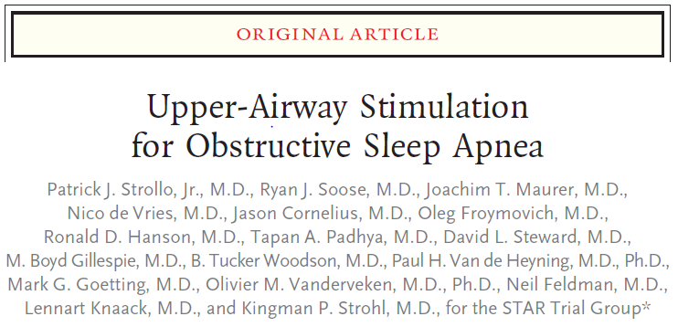
N Engl J Med 2014; 370:139-49.

Slide 46
Hypoglossal Nerve Stimulator Concept
OSA patients lose upper airway muscle tone
Genioglossus muscle
Largest upper airway dilator muscle
Contraction → tongue protrusion and stiffening of anterior pharyngeal wall
Stimulation of the muscle via the hypoglossal nerve may increase airway patency

Slide 47
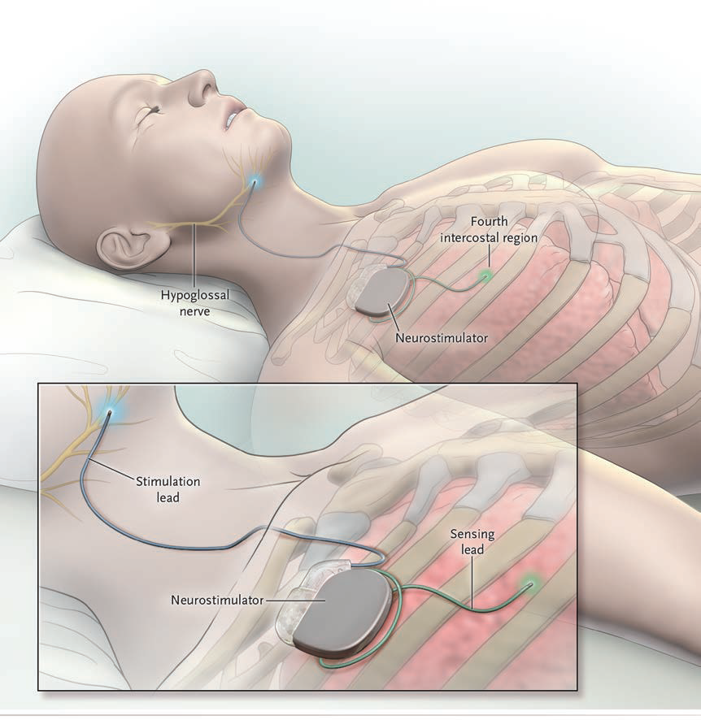
Strollo PJ Jr, et al. N Engl J Med 2014; 370:139-49.

Slide 48
Study Design/Results
Uncontrolled cohort study of 126 patients
83% men; mean age 54.5; mean BMI 28.4
Apnea-hypopnea index (AHI)
Decreased by 68% (29 → 9 events/hour)
Oxygen desaturations
Decreased by 70% (25 → 7 events/hour)
Adverse effects
Discomfort, tongue soreness, transient tongue weakness

Slide 49
Current Status
Device approved by FDA in May 2014
Advantages
May provide an option for those unable to tolerate CPAP
Addresses the major site of obstruction in the upper airway
Drawbacks
Surgery (akin to pacemaker implantation)
Usefulness in more obese patients?
Cost

Slide 50
Emergence of Electronic Cigarettes

Slide 51
E-Cigarettes
Battery-operated devices that heat a liquid to produce a vapor that is inhaled
Prevalence dramatically increased between 2010 and 2013
Ever use, 3.3% → 8.5% of all adults
Ever use, 3.3% → 6.8% of all students in grades 6-12
2014 survey of 12th grade students
Current use of e-cigarettes, 17%
Current use of conventional cigarettes, 14%
CDC. MMWR Morb Mortal Wkly Rep 2013; 62:279.
Arrazola RA, et al. MMWR Morb Mortal Wkly Rep 2014; 63:1021.

Slide 52
E-Cigarette Design

Slide 53
Role in Smoking Cessation
May decrease cigarette cravings and reduce nicotine withdrawal
Little data exist
To date, only one published randomized trial
657 smokers placed in 3 groups and followed for 6 mos
Nicotine-containing e-cigs – 7.3% quit rate
Nicotine-free e-cigs – 4.1% quit rate
Nicotine patches – 5.8% quit rate
Quit rates were similar
Bullen C, et al. Lancet 2013; 382:1629.

Slide 54
Adverse Health Effects
Nicotine exposure
Vapor exposure
Components vary, so levels of toxic and carcinogenic compounds are not known
Propylene glycol
Glycerol
Long-term effects not known
Formaldehyde and acetaldehyde
– both known carcinogens
Kosminder L, et al. Nicotine Tob Res 2014; 16:1319.
Jensen RP, et al. N Engl J Med 2015; 372:392-3.

Slide 55
Public Health Concerns
Effect of smoking initiation among youth
Gateway to nicotine dependence?
Accidental nicotine poisoning
Accidental ingestion by children
Typical 5 mL vial of e-cig liquid contains 100 mg
Lethal dose in children = 10 mg
Calls to U.S. Poison Control Centers:
1 call/month in 2010 → 215 calls/month in 2014
Cameron JM, et al. Tob Control 2014; 23:77.
Chatham-Stephens K, et al. MMWR Morb Mortal Wkly Rep 2014; 63:292.

Slide 56
E-Cigarettes The Present and The Future
The Present
FDA currently does not regulate e-cigs
Some states have no minimum age for purchase
Available over the internet
No restrictions on advertising
The Future
Extension of the FDA’s authority to regulate e-cigarettes (as well as cigars) is expected in 2015

Slide 57
Treatment of Idiopathic Pulmonary Fibrosis

Slide 58
Interstitial Lung Diseases
“Primary”
disorders
Collagen
vascular
disease
IPF
Env’mental/
occupational
disease
Drug-
induced
disease

Slide 59
Idiopathic Pulmonary Fibrosis Prevalence
Old estimates: 3 to 6 per 100,000
Newer estimates: 14-43 per 100,000 (~125,000 - 150,000 cases)
Increases with age: >75 years → 225 per 100,000
Raghu G, et al. Am J Respir Crit Care Med 2006; 174:810.
Fernandez Perez ER, et al. Chest 2010; 137:29.

Slide 60
Idiopathic Pulmonary Fibrosis Clinical Presentation
Onset: 50 - 70 yrs
Exertional dyspnea and/or dry cough for > 1 yr
“Velcro” crackles in 80% of patients
Clubbing in 25% of patients
Progressive decline, culminating in death
3-year survival = 50%
Vancheri C, et al. Eur Respir J 2010; 35:496-504.

Slide 61
Treatment for IPF
Prednisone
Cyclophosphamide
Azathioprine
Mycophenolate mofetil
How about a different approach?
Oxidant-antioxidant imbalance had been observed in IPF lungs
Contrary to long-held
beliefs, IPF is not
caused by inflammation.

Slide 62
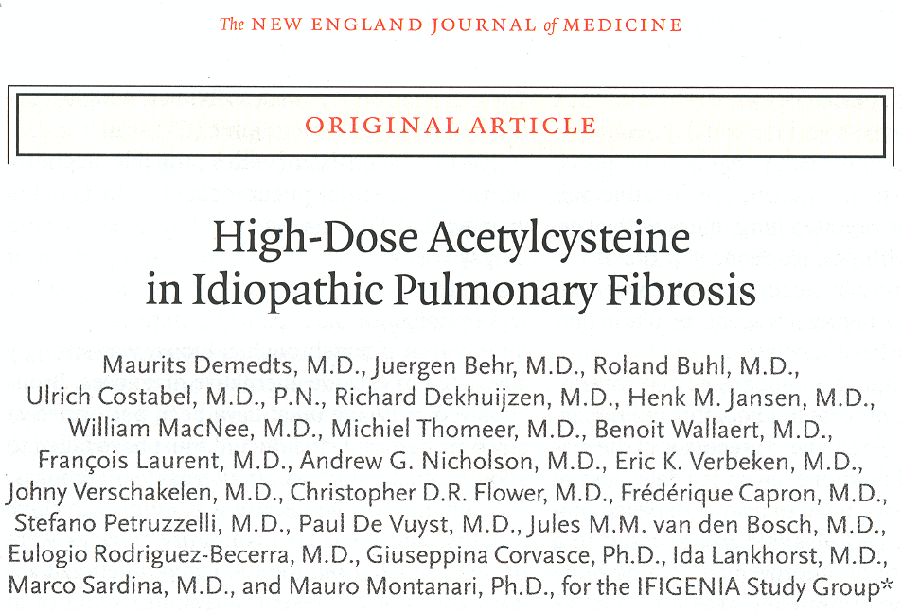
Idiopathic Pulmonary Fibrosis International Group Exploring N-Acetylcysteine I Annual (IFIGENIA trial)
November 24, 2005

Slide 63
IFIGENIA Trial Study Design
All patients were on prednisone and azathioprine at baseline and remained on it throughout the study
80 assigned to N-acetylcysteine 600 mg p.o. t.i.d.
75 assigned to placebo
Primary endpoints
Absolute changes in VC and DLCO

Slide 64
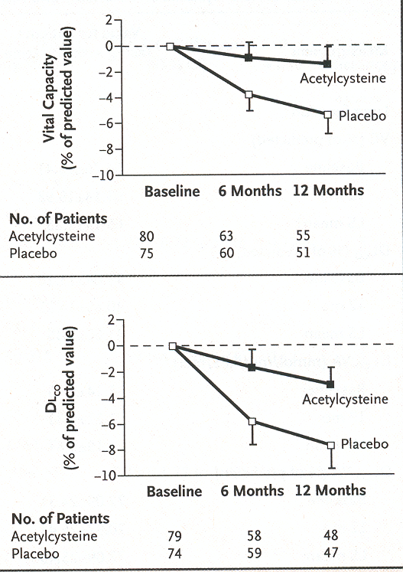
p < 0.02
Conclusion:
Addition of N-acetylcysteine
to prednisone and
azathioprine slows the rate of progression of disease in patients with IPF.
p < 0.003

Slide 65
Criticism of the IFIGENIA Trial
Absence of a “no treatment” arm
Is the azathioprine/prednisone/NAC combination any better than no treatment?
U.S.-based follow-up trial: PANTHER-IPF
Prednisone, Azathioprine, NAC: A Trial That Evaluates Response in IPF
390 patients randomized to aza/pred/NAC vs. NAC alone vs. placebo
Primary endpoint: Change in FVC at 60 weeks

Slide 66
Update on PANTHER-IPF
November 2011
238 of the 390 expected patients were enrolled
DSMB recommends discontinuation of the aza/pred/NAC arm because of ↑mortality, ↑serious adverse events, and ↑drug discontinuations, without evidence of benefit
NAC and placebo arms of the study continued
May 2014
Final results of PANTHER-IPF published
No difference between NAC and placebo
IPF Clin Res Network. N Engl J Med 2014; 370:2093-101.

Slide 67
Same issue of NEJM…
Positive trials for two other agents in IPF
Pirfenidone
Nintedanib

Slide 68
Pirfenidone
Antifibrotic agent
Inhibits TGF-β-stimulated collagen synthesis
Blocks fibroblast proliferation in vitro
Decreases extracellular matrix

Slide 69
Pirfenidone Trial The ASCEND Trial
555 patients with mild to moderate IPF randomized to pirfenidone vs. placebo
Outcome: Proportion of patients with a 10% or more decline in FVC
46 patients (16.5%) in pirfenidone group
88 patients (31.8%) in placebo group
p<0.001
King TE Jr, et al. N Engl J Med 2014; 370:2083-92.

Slide 70
Pirfenidone Adverse Effects
Photosensitivity/rash
28% (pirfenidone) vs. 9% (placebo)
Nausea
36% (pirfenidone) vs. 13% (placebo)
King TE Jr, et al. N Engl J Med 2014; 370:2083-92.

Slide 71
Nintedanib
Tyrosine kinase receptor blocker
Inhibitory effects on:
Platelet-derived growth factor
Vascular endothelial growth factor
Fibroblast growth factor

Slide 72
Nintedanib Trial The INPULSIS Trials
1066 patients with mild to moderate IPD randomized to nintedanib vs. placebo
Outcome: Annual rate of decline of FVC
125.3 mL/year less decline in FVC in nintedanib group vs. placebo group
p<0.001
Richeldi L, et al. N Engl J Med 2014; 370:2071-82.

Slide 73
Nintedanib Adverse Effects
Diarrhea
61% (nintedanib) vs. 18% (placebo)
Elevated liver function enzymes
5% (nintedanib) vs. 0.5% (placebo)
Richeldi L, et al. N Engl J Med 2014; 370:2071-82.

Slide 74
Current Status
October 2014
FDA approves both pirfenidone and nintedanib for treatment of IPF
The first drugs ever approved for this indication!
Downside – cost!
Both drugs priced at ~$95,000/year

