Slide 1
Diagnosis and Management of Hyperthyroidism, A Rational Approach
Kashif Munir, M.D. Assistant Professor of Medicine
Division of Endocrinology, Diabetes & Nutrition
University of Maryland School of Medicine

Slide 2
Definitions
Thyrotoxicosis - clinical state that results from inappropriately high thyroid hormone action in tissues generally due to inappropriately high tissue thyroid hormone levels
Hyperthyroidism – a form of thyrotoxicosis due to inappropriately high synthesis and secretion of thyroid hormone(s) by the thyroid
Bahn et al. Hyperthyroidism and Other Causes of Thyrotoxicosis: Management Guidelines of the American Thyroid Association and American Association of Clinical Endocrinologists. Thyroid, 2011 Jun;21(6):593-646 & Endocr Pract, 2011 May-Jun;17(3):456-520

Slide 3
Epidemiology/etiology
Prevalence 1.2% (0.5% overt, 0.7% subclinical)
Graves’ disease
Toxic nodule/s
Subacute thyroiditis

Slide 4
Low TSH, High RAIU
Grave’s disease
Toxic MNG
Toxic Adenoma
Chorionic gonadotropin-induced
Inherited non-immune hyperthyroidism (TSH receptor or G protein mutations)
Low TSH, Low RAIU
Iodine-induced hyperthyroidism
Amiodarone-associated hyperthyroidism (due to excess iodine release)
Thyroiditis:
Autoimmune
Lymphocytic thyroiditis (silent, painless, postpartum)
Acute exacerbation of Hashimoto’s
Viral or post viral
Subacute (granulomatous, painful, post viral)
Drug-induced
Amiodarone
Lithium, interferon-α, IL-2, GM-CSF
Infectious (acute)
Post-partum
Iatrogenic over-replacement
Thyrotoxicosis factitia
Ingestion of natural products containing thyroid hormone
“Hamburger” thyrotoxicosis
Natural foodstuffs
Thyromimetic compounds (e.g. Tiracol)
Occupational exposure to thyroid hormone
Pill manufacturing
Veterinary occupations
Struma Ovarii
Metastatic functioning thyroid carcinoma
Normal/Elevated TSH
TSH-secreting pituitary tumors
Thyroid hormone resistance

Slide 5
Is low TSH enough to diagnose thyrotoxicosis?

Slide 6
Biochemical evaluation
TSH has highest sensitivity and specificity
Diagnostic accuracy improves with measurement of free T4
Free T4 gives baseline measurement of degree of thyrotoxicosis
Important for monitoring success of initial treatment
Though not always related to severity of symptoms
T3 toxicosis
Can be sign of early disease

Slide 7
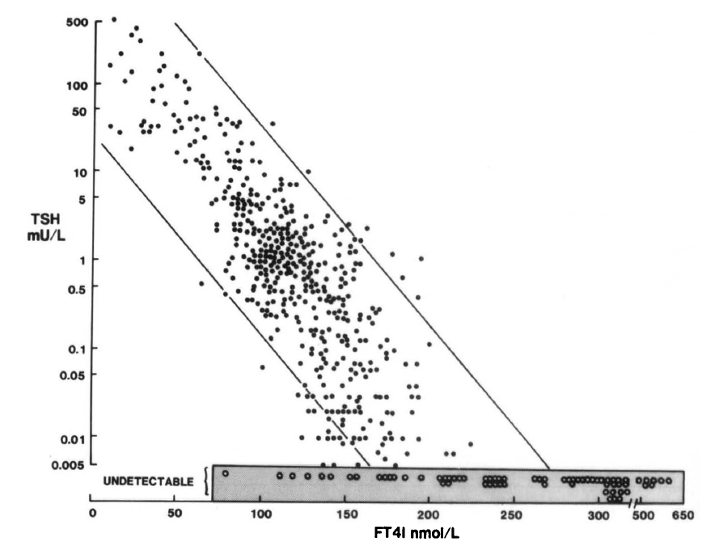
TSH and free T4 have inverse log-linear relationship
Spencer et al. J Clin Endocrinol Metab. 1990 Feb;70(2):453-60.

Slide 8
Thyrotoxicosis/Hyperthyroidism:
Low or suppressed TSH (< 0.1 mIU/L)
Elevated T4, elevated T3 or both
Subclinical Hyperthyroidism
Low or suppressed TSH (< 0.4 mIU/L)
Normal T4 & T3

Slide 9
Subclinical hyperthyroidism
Document by repeating TSH in 3-6 months
Can spontaneously resolve
Increased rates of atrial fibrillation in the elderly
Increased risk of osteoporosis/fracture
Possible increased risk of mortality

Slide 10
Subclinical hyperthyroidism
Treat if TSH persistently < 0.1 mU/L in persons 65 years or older, postmenopausal women, patients with cardiac risk factors, osteoporosis, or symptoms of thyrotoxicosis
Consider treating younger patients with symptoms and TSH < 0.1 mU/L
Consider treating older patients with TSH ≥ 0.1 mU/L with cardiac disease or symptoms

Slide 11
Is ultrasound indicated in the work-up of thyrotoxicosis?

Slide 12
Thyroid Ultrasound
Color Doppler Flow helpful in AIT 1 vs. AIT 2.
May reveal nodular disease or increased vascularity (seen in Grave’s)
Thyroid Uptake & Scan
High uptake:
Graves’, toxic MNG, toxic adenoma
Low uptake:
Thyroiditis, iodine-induced hyperthyroidism

Slide 13
ATA/AACE guidelines
“Ultrasonography does not generally contribute to the differential diagnosis of thyrotoxicosis”
Radioiodine uptake should be done when clinical presentation not diagnostic of Graves’
Scan added in presence of nodularity

Slide 14
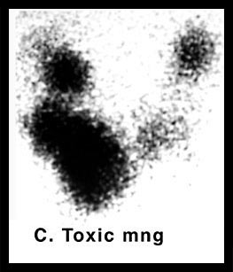
Toxic adenoma

Slide 15
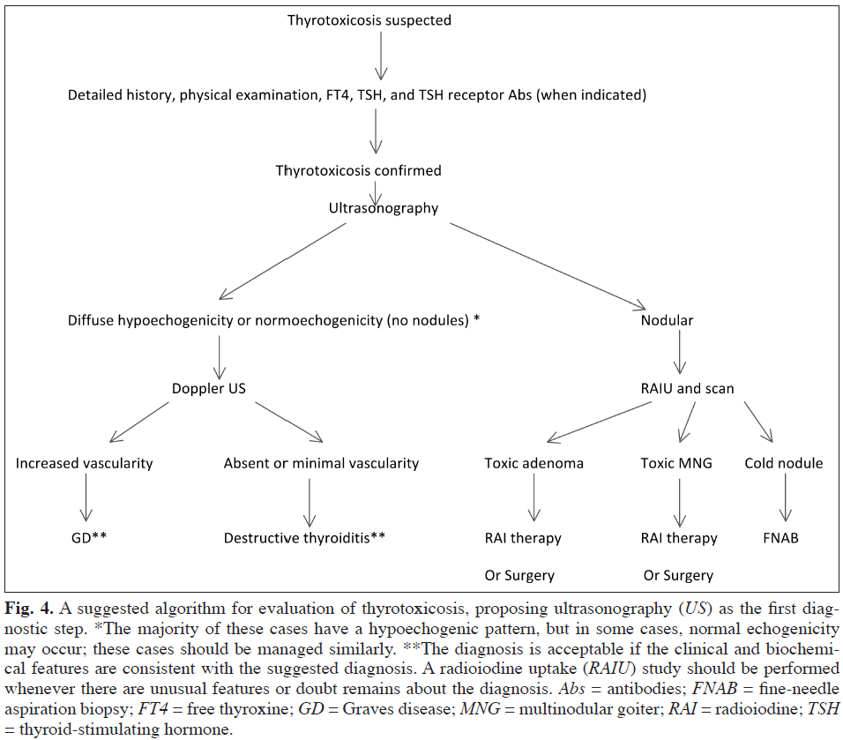
Suggestion to add US to diagnostic algorithm for thyrotoxicosis
Cost effectiveness
Non-invasive
Detection of nodules
Avoidance of radiation exposure
Alzahrani et al. Endocrine Practice. 18(4): 567-578
Notes:
Suggested algorithm for w/u thyrotoxicosis

Slide 16
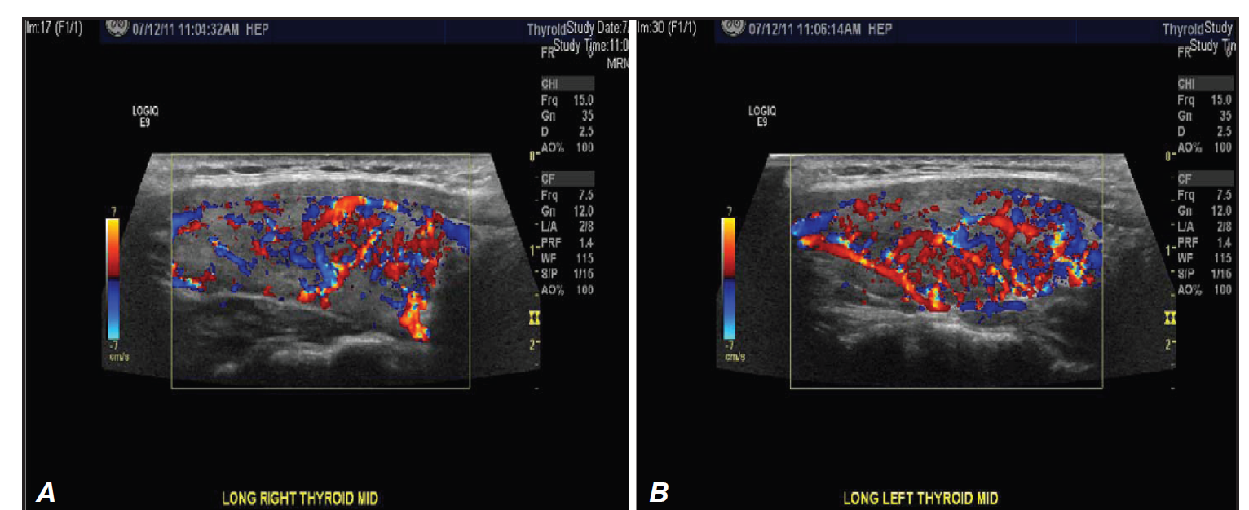
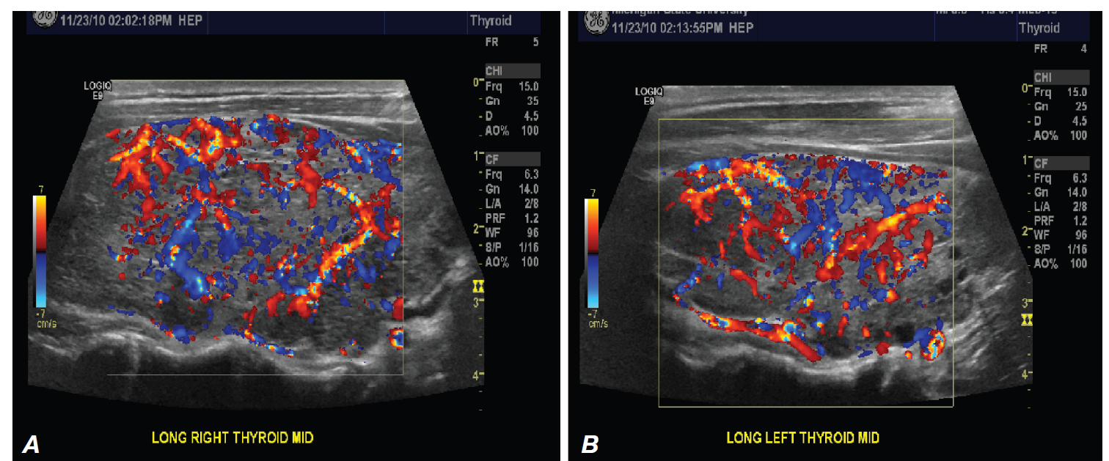
“Thyroid inferno” – seen in Graves’ disease (color doppler US)

Slide 17
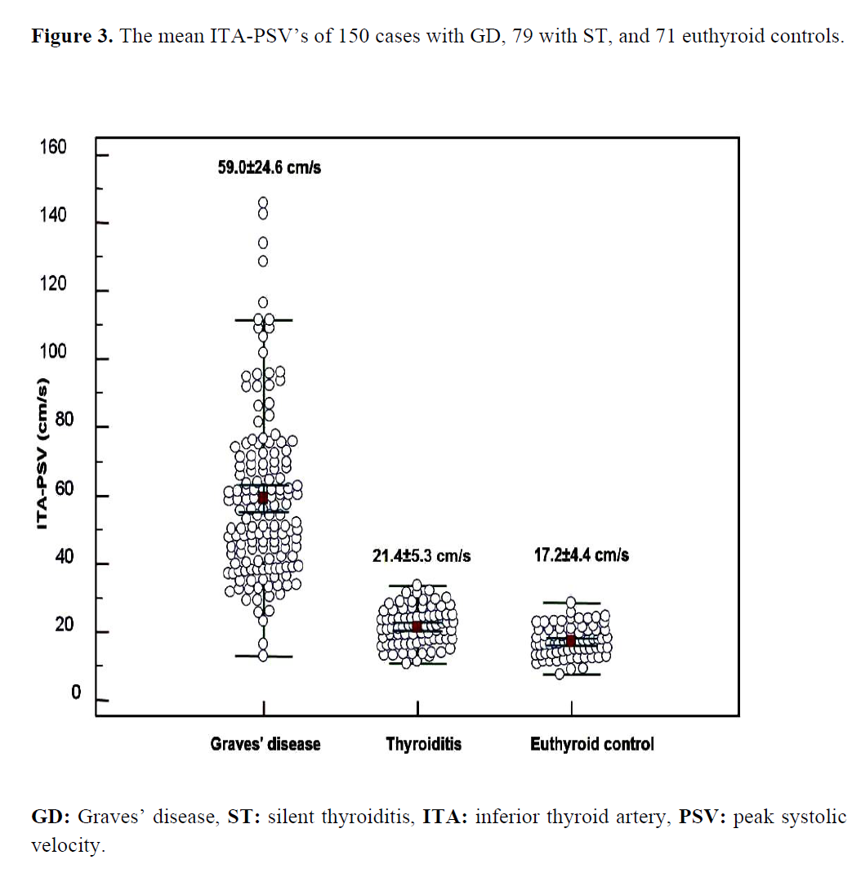
Zuhur et al. Endocr Pract. 2013 Nov 18:1-36.
Notes:
Objective: The differential diagnosis between Graves’ disease (GD) and silent thyroiditis (ST) is important for the selection of appropriate treatment. To date, no study has compared the diagnostic utility of color Doppler ultrasonography (CDUSG), Tc-99m pertechnetate uptake and TSH receptor antibody (TRAb) for the differential diagnosis of these two conditions. In the present study, we aimed to compare the diagnostic utility of inferior thyroid artery (ITA) peak systolic and end-diastolic velocities (PSV and EDV) measured by CDUSG, Tc-99m pertechnetate uptake and TRAb for differential diagnosis between GD and ST.
Methods: One hundred fifty subjects with GD, 79 with ST and 71 healthy euthyroid
controls were included in the study. The diagnosis of GD and ST were made according
to the patient’s signs and symptoms, physical examination findings, the results of TRAb and Tc-99m pertechnetate uptake and follow-up findings. All subjects underwent CDUSG for the quantitative measurement of ITA blood-flow velocities. Results: The mean ITA-PSV and EDV in patients with GD were significantly higher than those with ST. In ROC analysis, the sensitivity/specificity of the 30 and 13.2 cm/sn
cutoff values of the mean ITA-PSV and EDV for discrimination of GD from ST were 95.3/94.9% and 89.3/88.6%, respectively. The sensitivity/specificity of the 1.0 IU/L and 3% cut-off values of the TRAb and Tc-99m pertechnetate uptake were 93.0/91.0% and 90.7/89.9%, respectively.
DOI:10.4158/ EP13300.OR
© 2013 AACE.
Conclusion: The measurement of ITA-PSV by CDUSG is a usefull diagnostic tool and is a complementary method to the TRAb and Tc-99m pertechnetate uptake for
differential diagnosis between GD and ST.

Slide 18
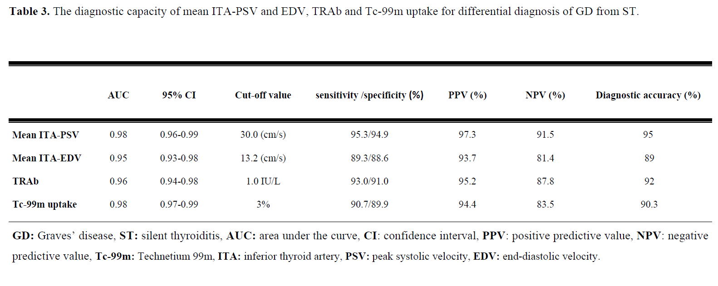
Zuhur et al. Endocr Pract. 2013 Nov 18:1-36.

Slide 19
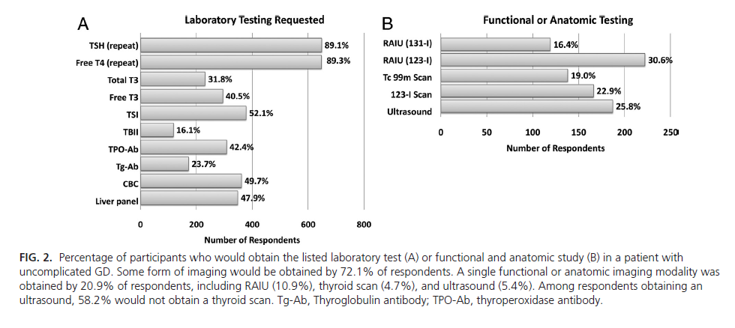
Burch et al. J Clin Endocrinol Metab. 2012 Dec;97(12):4549-58
Notes:
More than two decades have passed since members from the American Thyroid Association (ATA), European Thyroid Association, and Japan Thyroid Association were surveyed on management practices for patients with hyperthyroidism due to Graves' disease (GD).
OBJECTIVE:
We sought to document current practices in the management of GD and compare these results both to those documented in earlier surveys and to practice recommendations made in the 2011 ATA/American Association of Clinical Endocrinologists (AACE) hyperthyroidism practice guidelines. Lastly, we sought to examine differences in GD management among international members of U.S.-based endocrine societies.
METHODS:
Members of The Endocrine Society (TES), ATA, and AACE were invited to participate in a web-based survey dealing with testing, treatment preference, and modulating factors in patients with GD.
RESULTS:
A total of 730 respondents participated in the survey, 696 of whom completed all sections. Respondents included 641 TES members, 330 AACE members, and 157 ATA members. The preferred mode of therapy in uncomplicated GD was antithyroid drugs (ATDs) by 53.9% of respondents, radioactive iodine (RAI) therapy by 45.0%, and thyroid surgery in 0.7%. Compared with 1991, fewer U.S. (59.7 vs. 69%) and European (13.3% vs. 25%) respondents would use RAI therapy. Methimazole and carbimazole were the preferred ATDs, with only 2.7% of respondents selecting propylthiouracil. Patients with Graves' ophthalmopathy were treated with ATDs (62.9%) or surgery (18.5%) and less frequently with RAI plus corticosteroids (16.9%) or RAI alone (1.9%).
CONCLUSIONS:
Striking changes have occurred in the management of GD over the past two decades, with a shift away from RAI and toward ATDs in patients with uncomplicated GD. Apparent international differences persist but should be interpreted with caution. Current practices diverge in some areas from recently published guidelines; these differences should be assessed serially to determine the impact of the guidelines on future clinical practice.

Slide 20
How is hyperthyroidism best treated?

Slide 21
Treatment
Goals:
Normalize serum TSH levels
Reverse\correct clinical signs & symptoms and metabolic derangements.
Beta-blockers
Antithyroid medication
I-131
Surgery

Slide 22
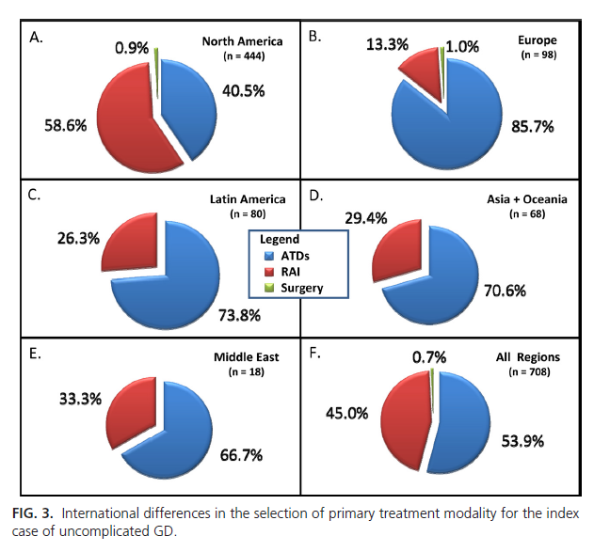
Burch et al. J Clin Endocrinol Metab. 2012 Dec;97(12):4549-58
Notes:
More than two decades have passed since members from the American Thyroid Association (ATA), European Thyroid Association, and Japan Thyroid Association were surveyed on management practices for patients with hyperthyroidism due to Graves' disease (GD).
OBJECTIVE:
We sought to document current practices in the management of GD and compare these results both to those documented in earlier surveys and to practice recommendations made in the 2011 ATA/American Association of Clinical Endocrinologists (AACE) hyperthyroidism practice guidelines. Lastly, we sought to examine differences in GD management among international members of U.S.-based endocrine societies.
METHODS:
Members of The Endocrine Society (TES), ATA, and AACE were invited to participate in a web-based survey dealing with testing, treatment preference, and modulating factors in patients with GD.
RESULTS:
A total of 730 respondents participated in the survey, 696 of whom completed all sections. Respondents included 641 TES members, 330 AACE members, and 157 ATA members. The preferred mode of therapy in uncomplicated GD was antithyroid drugs (ATDs) by 53.9% of respondents, radioactive iodine (RAI) therapy by 45.0%, and thyroid surgery in 0.7%. Compared with 1991, fewer U.S. (59.7 vs. 69%) and European (13.3% vs. 25%) respondents would use RAI therapy. Methimazole and carbimazole were the preferred ATDs, with only 2.7% of respondents selecting propylthiouracil. Patients with Graves' ophthalmopathy were treated with ATDs (62.9%) or surgery (18.5%) and less frequently with RAI plus corticosteroids (16.9%) or RAI alone (1.9%).
CONCLUSIONS:
Striking changes have occurred in the management of GD over the past two decades, with a shift away from RAI and toward ATDs in patients with uncomplicated GD. Apparent international differences persist but should be interpreted with caution. Current practices diverge in some areas from recently published guidelines; these differences should be assessed serially to determine the impact of the guidelines on future clinical practice.

Slide 23
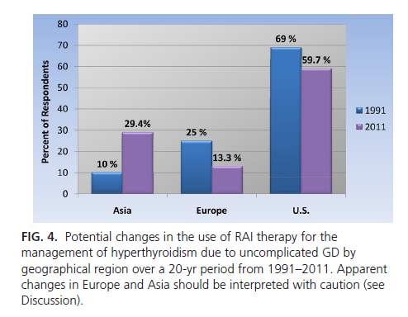
Burch et al. J Clin Endocrinol Metab. 2012 Dec;97(12):4549-58
Notes:
More than two decades have passed since members from the American Thyroid Association (ATA), European Thyroid Association, and Japan Thyroid Association were surveyed on management practices for patients with hyperthyroidism due to Graves' disease (GD).
OBJECTIVE:
We sought to document current practices in the management of GD and compare these results both to those documented in earlier surveys and to practice recommendations made in the 2011 ATA/American Association of Clinical Endocrinologists (AACE) hyperthyroidism practice guidelines. Lastly, we sought to examine differences in GD management among international members of U.S.-based endocrine societies.
METHODS:
Members of The Endocrine Society (TES), ATA, and AACE were invited to participate in a web-based survey dealing with testing, treatment preference, and modulating factors in patients with GD.
RESULTS:
A total of 730 respondents participated in the survey, 696 of whom completed all sections. Respondents included 641 TES members, 330 AACE members, and 157 ATA members. The preferred mode of therapy in uncomplicated GD was antithyroid drugs (ATDs) by 53.9% of respondents, radioactive iodine (RAI) therapy by 45.0%, and thyroid surgery in 0.7%. Compared with 1991, fewer U.S. (59.7 vs. 69%) and European (13.3% vs. 25%) respondents would use RAI therapy. Methimazole and carbimazole were the preferred ATDs, with only 2.7% of respondents selecting propylthiouracil. Patients with Graves' ophthalmopathy were treated with ATDs (62.9%) or surgery (18.5%) and less frequently with RAI plus corticosteroids (16.9%) or RAI alone (1.9%).
CONCLUSIONS:
Striking changes have occurred in the management of GD over the past two decades, with a shift away from RAI and toward ATDs in patients with uncomplicated GD. Apparent international differences persist but should be interpreted with caution. Current practices diverge in some areas from recently published guidelines; these differences should be assessed serially to determine the impact of the guidelines on future clinical practice.

Slide 24
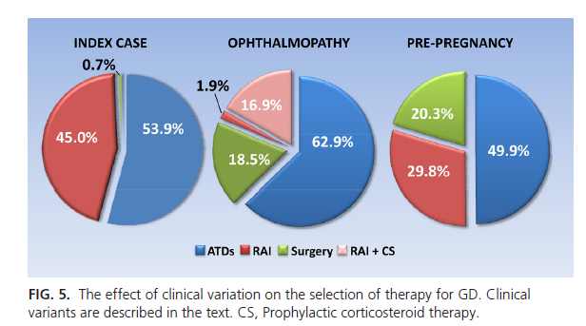
Burch et al. J Clin Endocrinol Metab. 2012 Dec;97(12):4549-58

Slide 25
Medical therapy
Methimazole (MMI) – 5-30 mg daily
Propylthiouracil (PTU) – 100-300 mg per day divided BID/TID
Inhibit the synthesis of thyroid hormones
Interfere with iodination of tyrosine residues
Effects seen 1-2 weeks after initiation of therapy.
Side effects:
Rash, arthralgias, nausea
Vasculitis
Liver function tests abnormalities (liver failure with PTU)
Agranulocytosis
Embryopathy
Check baseline CBC/diff and LFT’s

Slide 26
PTU black box
Reserved for early pregnancy; thyroid storm; mild intolerance to methimazole in patients not wanting RAI or surgery

Slide 27
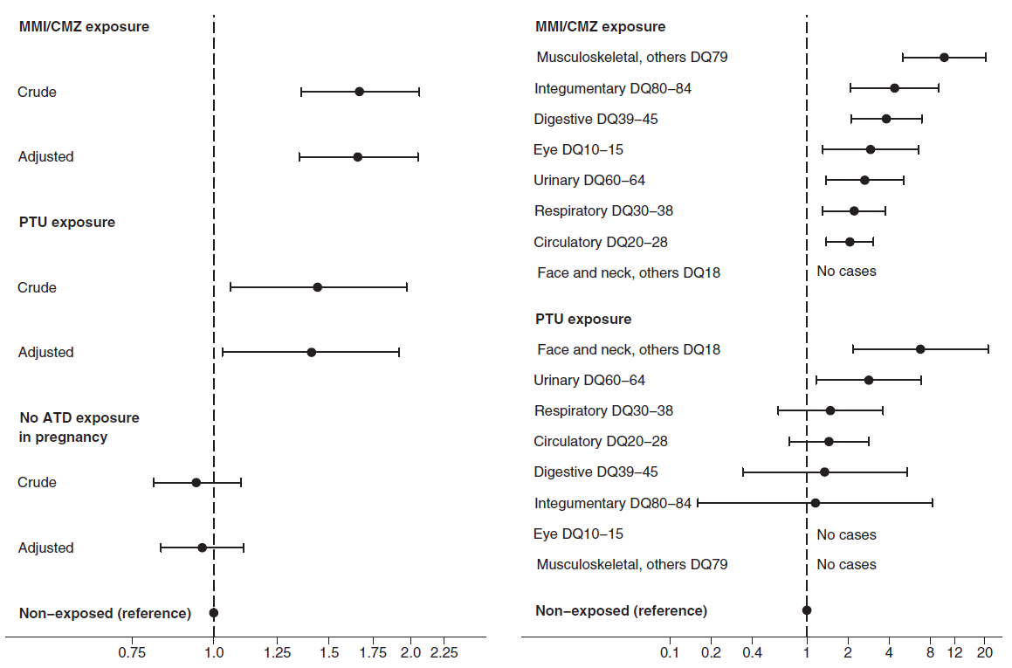
Andersen et al. J Clin Endocrinol Metab. 2013 Nov;98(11):4373-81
Notes:
Introduction:
Hyperthyroidism in pregnant women should be adequately treated to prevent maternal and fetal complications, but teratogenic effects of antithyroid drug (ATD) treatment have been described. Evidence is still lacking in regard to the safety and choice of ATD in early pregnancy.
Objective:
Our objective was to determine to which degree the use of methimazole (MMI)/carbimazole (CMZ) and propylthiouracil (PTU) in early pregnancy is associated with an increased prevalence of birth defects.
Methods:
This Danish nationwide register-based cohort study included 817 093 children live-born from 1996 to 2008. Exposure groups were assigned according to maternal ATD use in early pregnancy: PTU (n = 564); MMI/CMZ (n = 1097); MMI/CMZ and PTU (shifted in early pregnancy [n = 159]); no ATD (ATD use, but not in pregnancy [n = 3543]); and nonexposed (never ATD use [n = 811 730]). Multivariate logistic regression was used to estimate adjusted odds ratio (OR) with 95% confidence interval (95% CI) for diagnosis of a birth defect before 2 years of age in exposed versus nonexposed children.
Results:
The prevalence of birth defects was high in children exposed to ATD in early pregnancy (PTU, 8.0%; MMI/CMZ, 9.1%; MMI/CMZ and PTU, 10.1%; no ATD, 5.4%; nonexposed, 5.7%; P < .001). Both maternal use of MMI/CMZ (adjusted OR = 1.66 [95% CI 1.35–2.04]) and PTU (1.41 [1.03–1.92]) and maternal shift between MMI/CMZ and PTU in early pregnancy (1.82 [1.08–3.07]) were associated with an increased OR of birth defects. MMI/CMZ and PTU were associated with urinary system malformation, and PTU with malformations in the face and neck region. Choanal atresia, esophageal atresia, omphalocele, omphalomesenteric duct anomalies, and aplasia cutis were common in MMI/CMZ-exposed children (combined, adjusted OR = 21.8 [13.4–35.4]).
Conclusions:
Both MMI/CMZ and PTU were associated with birth defects, but the spectrum of malformations differed. More studies are needed to corroborate results in regard to early pregnancy shift from MMI/CMZ to PTU. New ATD with fewer side effects should be developed.
Figure 1.Crude and adjusted odds ratio (AOR) with 95% CI for
having one or more birth defects diagnosed before 2 years of age in
children exposed to methimazole/carbimazole (MMI/CMZ),
propylthiouracil (PTU) and children born to mothers with previously or
later antithyroid drug (ATD) use (no ATD exposure in pregnancy) vs
nonexposed (never ATD use). Adjusted model included birth year of
the child (1996–1997, 1998–2000, 2001–2003, 2004–2006, 2007–
2008), gender of the child (boy/girl), singleton/multiple pregnancy and
the following maternal variables obtained at the time of the child’s
birth: age ( 25, 25–29, 30–34, 35–39, 40 years), parity (1, 2, 3,
4), cohabitation (married/not married), income (first, second, third,
fourth quartile), origin (born in Denmark/not born in Denmark) and
residence (East/West Denmark).
Figure 2. Subgroups of birth defects with significant association to
antithyroid drug (ATD) therapy (Table 2). Adjusted OR, ranked for each
drug, with 95% CI for birth defects in children exposed to
methimazole/carbimazole (MMI/CMZ) or propylthiouracil (PTU) vs
nonexposed (never ATD use). Adjusted model included the same
variables as in Figure 1.

Slide 28
Methimazole
Primarily used first line in Graves’
Not generally considered first line therapy for toxic nodular goiter
Chance for ‘remission’ (euthyroid 1 year after treatment ceased)
More likely in smaller goiter, milder disease, lower antibody titer
Pretreatment of patients awaiting RAI or surgery – stop 3-5 days prior to RAI
Once daily dosing – 5 to 30 mg/day
Monitor labs every 4-6 weeks initially – free T4/T3
TSH suppression can lag for months
Treat for 12-18 months

Slide 29
Methimazole
Once daily dosing – 5 to 30 mg/day
Monitor labs every 4-6 weeks initially – free T4/T3
TSH suppression can lag for months
Treat for 12-18 months
Consider measuring thyroid receptor antibodies to predict remission

Slide 30
Radioactive Iodine
Beta-blockers often peri-therapy
Pregnancy- absolute contraindication
Graves’ disease – goal is hypothyroidism after treatment
Fixed dose or calculation (weight [g] x 150 µCi/g x 1/24 hour uptake %)
Toxic MNG and Toxic Adenoma – can be eu-thyroid following treatment
May repeat in 6 months if initial dose not effective

Slide 31
Surgery
May need pre-op preparation with super-saturated potassium iodine (SSKI) to decrease vascularity of gland (Graves’ disease, large goiters).
Continue anti-thyroid meds and beta blockers.
Levothyroxine replacement following surgery.
Total thyroidectomy for Graves’, partial possible for toxic nodular goiter

Slide 32
Graves’ ophthalmopathy
Up to 50% may have eye involvement
Can be euthyroid or hypothyroid in small minority (< 10 %)
High dose steroids
Radiation
Surgery – orbital decompression
Selenium
Supportive therapies (lubricants, prisms, etc.)
Alternative therapies (e.g. rituximab, botox)

Slide 33
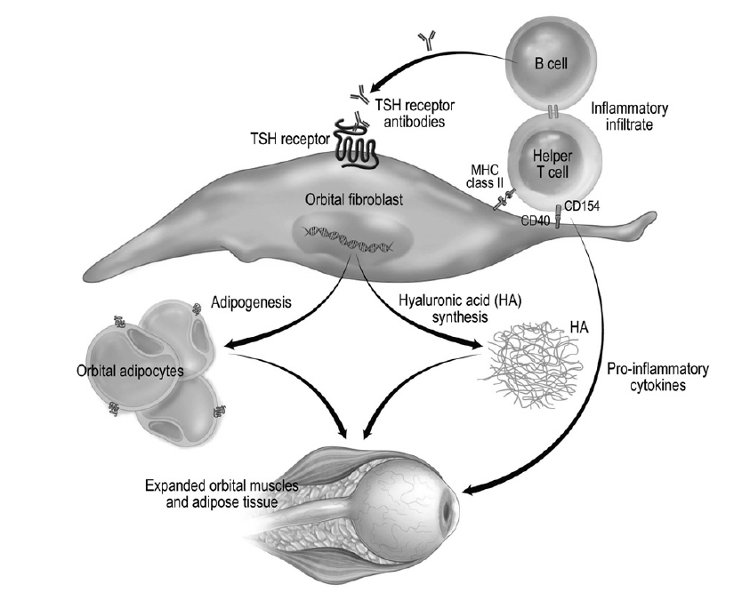
Stan et al. Med Clin N Am 96 (2012) 311–328
Notes:
Fig. 1. Immunopathogenesis of Graves ophthalmopathy. Circulating autoantibodies directed
against the thyrotropin receptor activate this receptor on orbital fibroblasts; this
results in their increased secretion of hyaluronic acid, and the differentiation of a subset
into mature adipocytes. In addition, activated T cells infiltrate the orbit, interact with autoreactive
B cells, and secrete proinflammatory cytokines. These cellular changes lead to the
extraocular muscle enlargement, orbital adipose tissue expansion, and orbital inflammation
characteristic of the disease. XRT, radiotherapy.

Slide 34
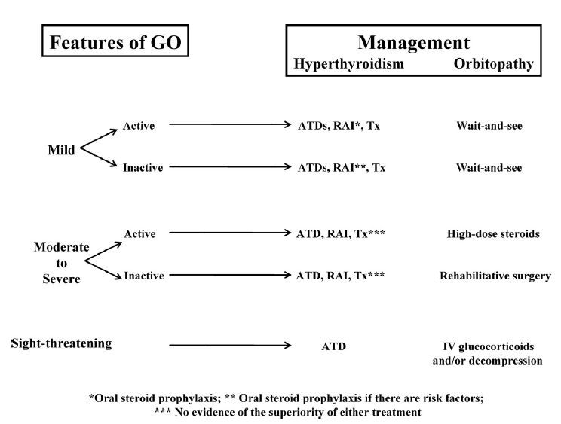
Bartalena L. J Clin Endocrinol Metab, March 2011, 96(3):592–599
Notes:
Context: Graves’ orbitopathy (GO) is present in about 50% of patients with Graves’ hyperthyroidism.
It may range from mild to moderately severe and (rarely) to sight-threatening. Whether
antithyroid drugs (ATDs), radioactive iodine (RAI), or thyroidectomy should be the treatment of
choice in the presence of overt and active GO is a matter of debate.
Evidence Acquisition: The major source of data acquisition included PubMed search strategies.
Articles published in the last 30 yr were screened. Furthermore, the bibliographies of relevant citations
and chapters of major textbooks were evaluated for any additional appropriate citation.
Evidence Synthesis: Prompt restoration and stable maintenance of euthyroidism is important for
the course of GO. ATDs and thyroidectomy per se do not influence the natural history of GO. RAI
can cause progression or de novo development of GO, particularly in smokers. This effect can be
prevented by oral steroid prophylaxis. In patients with mild orbitopathy, the choice of thyroid
treatment is largely independent of GO. Moderate-to-severe and active GO should be treated
without delay. Whether in these patients, concomitant treatment of hyperthyroidism should be
conservative (ATDs) or ablative (RAI, thyroidectomy, or both) is presently based on expert opinion
rather than evidence. Emerging and potentially interesting biological agents, such as rituximab,
counteracting pathogenic mechanisms of both hyperthyroidism and GO, need to be evaluated in
randomized clinical trials.
Conclusions: The choice of the optimal treatment for hyperthyroidism in patients with moderateto-
severe and active GO remains unsettled and is mainly based on personal experience. Randomized
clinical trials in this field are eagerly needed. (J Clin Endocrinol Metab 96: 592–599, 2011)
FIG. 1. Management of hyperthyroidism and orbitopathy of Graves’ disease in different
clinical settings. Tx, Thyroidectomy.

Slide 35
Summary
Thyrotoxicosis is a common condition encountered in practice
Subclinical disease is more common than overt thyrotoxicosis
TSH best for screening and free T4 for confirmation and monitoring treatment
Radioiodine uptake and scan preferred imaging modality
Treatment with methimazole or I-131 usually preferred

