Slide 1
Management of Behavioral Challenges in Dementia
Agitation
Dr. Abhay Moghekar, M.B.,B.S.
Director – Center for CSF Disorders,
Clinical Core Co-Leader Johns Hopkins ADRC
Johns Hopkins University – School of Medicine
Notes:
Resident – Syncope/Dizziness and Delirium in a patient with dementia – ROCKS – restraints – sitters - antipsychotics

Slide 2

P. Sherman,
42 Wallaby Way,
Sydney, Australia
Notes:
We often do not realize how much we need something until it is gone ….
Marlin father, Nemo, Dory
When Dory finally encounters Nemo, she has of course forgotten all about him. When she asks his name, he replies "Nemo", and she comments that "That's a nice name".

Slide 3
70 yo woman with h/o of multiple strokes and dementia brought to clinic by her daughter who states she has been more agitated lately. She has been combative and has been verbally abusive to her daughter and the daytime caregiver. She often gets dressed up at night and wants to leave the house to “run errands”. She does not report pain or recent illness and denies depressive thoughts. Her medications have not changed. On exam her MMSE is 14/30. In particular, she does not have a fever, fingerstick glucose is 96 mg/dl and her urine dipstick is normal. Her BP is 130/84 mm Hg. She takes Aspirin 81 mg daily and Lisinopril 20 mg daily as her only medications. The rest of her general exam and neurologic exam is normal.

Slide 4
What is the optimal next step in the management of behavior issues in dementia?
Start a SSRI like citalopram
Institute psychosocial interventions and facilitate caregiver education
Start an anticholinesterase inhibitor like donepezil or rivastigmine
Start a low dose of an atypical antipsychotic like olanzapine
Start a mood stabilizer like lamotrigine

Slide 5
Range of behaviors in dementia
Underlying causes
Nonpharmacological methods
Judicious use of Meds – short term vs long term

Slide 6
Prevalence
80-90% of patients develop at least 1 distressing symptom
60% of community dwelling patients with dementia
80% of dementia patients in nursing homes

Slide 7
Range of behaviors
Apathy – 36%
Depression – 32%
Agitation/aggression – 30%
Sleep disturbances – 27.4%
Irritability – 27%
Anxiety – 21.5%
Delusions – 18%

Slide 8
Affects everyone…..
Patient – big reason for institutionalization
Caregiver – stress; can deal with memory issues but agitation is a huge challenge
Health care providers in nursing homes – disruptive, work within guidelines

Slide 9
Increased mortality
Increased ER visits
Prolonged hospital stays
Increased use of medications
Placement in LTC
Decreased quality of life for patient and caregiver

Slide 10
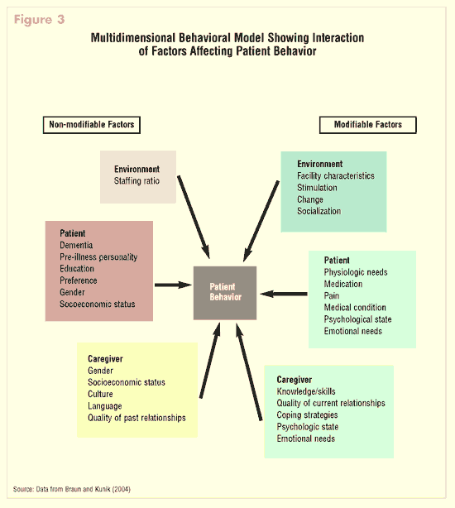
The same behavior may have different antecedents and underlying causes; hence management will differ accordingly

Slide 11
Cohen Mansfield
Unmet needs model
Learning/behavioral model
Environmental vulnerability/reduced stress-threshold model

Slide 12
Cohen-Mansfield “unmet needs” model
There is an underlying unmet need that is causing the inappropriate behavior.
This need is frequently not apparent to the observer or the caregiver, or caregivers do not feel able to fulfill this need (example -sensory deprivation, boredom, and loneliness)
Possible responses:
  Providing sensory stimulation, activities, and social contacts -The provision of hearing aids, corrective lenses may decrease isolation due to sensory deprivation
  Easily accessible outdoor area
  Reduced levels of restraints
  Sufficient levels of light
  Appropriate treatment of pain
Eg: Pacers - activity

Slide 13
Learning/behavioral models
Behavior is a learned connection between antecedents, behavior, reinforcement
Many problem behaviors are learned through reinforcement by staff members, who provide attention when problem behavior is displayed.
ABC approach
  A = antecedent or triggering event that precedes the problem behavior
  B= the behavior of concern
  C= the consequence of that behavior
Changing either the antecedent or the consequence may change the behavior

Slide 14
Environmental vulnerability/reduced stress-threshold model
Dementia results in greater vulnerability to surroundings and a greater chance that an event will affect behavior.
Persons with dementia progressively lose their coping abilities and therefore perceive their environment as threatening their survival
An environment of reduced stimulation is supposed to limit the stress experienced and thereby reduce the level of inappropriate behavior
Relaxation will reduce the stress and thereby decrease the undesirable behavior.
Challenge – Too much and too little stimulation, both make things worse; what is optimal varies in the course of the illness

Slide 15
Types of Aggressive Behaviors
Physically aggressive behaviors
  - hitting, kicking, biting, throwing, grabbing, spitting,
  pushing, physical sexual advances
Verbally aggressive behaviors -
  cursing, screaming, verbal sexual advances
Notes:
Feeding Bears

Slide 16
Assessment
History:
  Acute/evolving/sudden – usually a precipitant
  Progression of underlying dementia – generally more insidious and persistent
  clear description of problem behavior, temporal onset, course, circumstances
Review Meds:
  New meds or recent change in dose
  Anticholinergics, antihistaminics, sedative/hypnotics

Slide 17
Environmental Precipitants
Change in routine, roommate, caregiver
Overstimulation/understimulation
Other disruptive patients, family illness

Slide 18
If acute screen for usual suspects
Dehydration
UTI or urinary retention
Pneumonia
Constipation
Pain

Slide 19
Management
Acute life-threatening – Antipsychotics with rapid medical assessment
Otherwise –
“Four D” Method
    Define and Describe
    Decode
    Design and Implement
    Determine

Slide 21
Interventions
Tx underlying medical illness
Correct sensory deficits
Remove offending medications
Keep environment comfortable, calm, homelike
Regular daily activities and structure
Assess sleep and eating patterns
Educate and support caregiver

Slide 22
Medications for Agitation
No FDA approved Medications
Black Box Warnings -
WARNING: INCREASED MORTALITY FOR ELDERLY PATIENTS WITH DEMENTIA RELATED PSYCHOSES. Elderly patients with dementia related psychoses are at increased risk for death compared to placebo. This drug is not approved for the treatment of dementia related psychoses.

Slide 23
Black Box Warning
Meta-analysis of 17 double blind RCT’s in elderly dementia patients, April 2005. Atypicals associated with a 1.6-1.7 times greater risk of mortality compared to placebo. Most deaths from cardiac or infectious etiology, in some studies – strokes.
Extended to all antipsychotics in June 2008

Slide 24
Even short term therapy is deleterious
Older adults with dementia: 20,682 in community, 20,559 in LTC
Control: No antipsychotics
Outcomes: serious events in first 30 days
Community dwellers:
  Atypicals: 13.9% had a serious event (3.2 times higher than control)
  Typicals: 3.8 times higher serious event
LTC
  Atypicals: 1.9 times higher serious events than control
  Typicals: 2.4 times higher serious event
Rochon PA. Antipsychotic therapy and short-term serious events in older adults with dementia. Arch Intern Med. 2008;168:1090-1096.

Slide 25
Common S/E of all antipsychotics
Extrapyramidal symptoms (akathisia, dystonia, psuedoparkinsonism, and dyskinesia)
Sedation
Tardive dyskinesia – should screen regularly
Gait disturbances
Falls
Meta-analysis shows a significant increase in respiratory tract and urinary tract infections and peripheral edema in patients treated with risperidone versus placebo (Ballard et al. 2006)

Slide 26
CATIE-AD trial
421 AD patients with psychosis and aggression assigned to olanzapine, quetiapine, risperidone, or placebo or “watchful waiting” over 9 months
No statistical differences between groups, although placebo most often superior in net health benefit analysis
Olanzapine group – more impaired on ADL testing - sedation, gait disturbance
Placebo group – best ADL score, lower dependence score, lower total health care costs
Schneider LS, Tariot PN, Dagerman KS, Davis SM, Hsiao JK, Ismail MS, Lebowitz BD, Lyketsos CG, Ryan JM, Stroup TS, Sultzer DL, Weintraub D, Lieberman JA; CATIE-AD Study Group. N Engl J Med 2006; 355:1525-1538

Slide 27
CATIE-AD Methodologic drawbacks
  Subjects were outpatients, less impaired than some BPSD trials
  High dropout rate compared to other RCTs (likely a design feature)
  No washout period
  Dosage likely too low for quetiapine (mean 56.5mg/day)
  Nevertheless adverse events offset advantages in efficacy
Clinical Antipsychotic Trial of Intervention Effectiveness – Alzheimer’s Disease. Rosenheck, Cost-benefit analysis…., Arch Gen. Psychiatry 2007; 64(11):1259-1268.

Slide 28
Are atypicals safer or more effective?
Atypicals block excessive dopamine transmission, which is beneficial in schizophrenics.
Elderly patients (especially dementia) have accelerated dopamine loss and tend to experience more severe motor side effects than younger patients.
Less likely to trigger extrapyramidal symptoms/tardive dyskinesia
No difference in safety, efficacy

Slide 29
Recommendations for use of anti-psychotics
Need shared decision making – staff, families, patients
Identify target signs and symptoms, and set a limited time frame (many patients improve without treatment over 2-4 weeks)
Treat only severe symptoms, emotional distress, physical safety
Use the lowest dosages for shortest time
Possible doses used:
  Risperidone (Risperdal) 0.5-1.5 mg/day
  Olanzapine (Zyprexa) 5-10 mg/day
  Quetiapine (Seroquel) 50-200 mg/day
  Aripiprazole (Abilify) 7-12 mg/day
Monitor, assess regularly
Taper and trial discontinuation regularly

Slide 30
Are SSRIs safe and effective for agitation?
Well tolerated
Beneficial for depression
No definitive efficacy for agitation
Pharmacological treatment of Neuropsychiatric symptoms of dementia: A review of the evidence. JAMA 2005;293(5); 596-608

Slide 31
Citalopram vs risperidone study
To alleviate severe agitation and psychotic symptoms associated with dementia in nondepressed elderly (aggression, agitation, hostility, suspiciousness, hallucinations, or delusions)
Efficacy:
  Citalopram overall 32% reduction of symptoms
  Risperidone - 35% reduction
Total adverse-event scores
  Increased 19% with risperidone
  Decreased by 4% with citalopram
Citalopram worked on psychotic symptoms like hallucinations and delusions
A double-blind comparison of citalopram and risperidone for the treatment of behavioral and psychotic symptoms associated with dementia. Am J Geriatr Psychiatry. 2007 Nov;15(11):942-52. Epub 2007 Sep 10.

Slide 32
Citalopram in AD - agitation
Participants (n = 186) were randomized to receive a psychosocial intervention plus either citalopram (n = 94) or placebo (n = 92) for 9 weeks.
Dosage began at 10 mg per day with planned titration to 30 mg per day over 3 weeks based on response and tolerability.
40% of citalopram participants had moderate or marked improvement from baseline severity vs 26% of placebo participants, with an estimated treatment effect from the proportional odds model including participants with week-9 data (odds ratio [OR] of being at or better than a given CGIC category) of 2.13 (95% CI, 1.23-3.69; P = .007).
Effect of citalopram on agitation in Alzheimer disease: the CitAD randomized clinical trial. JAMA. 2014 Feb 19;311(7):682-91.

Slide 33
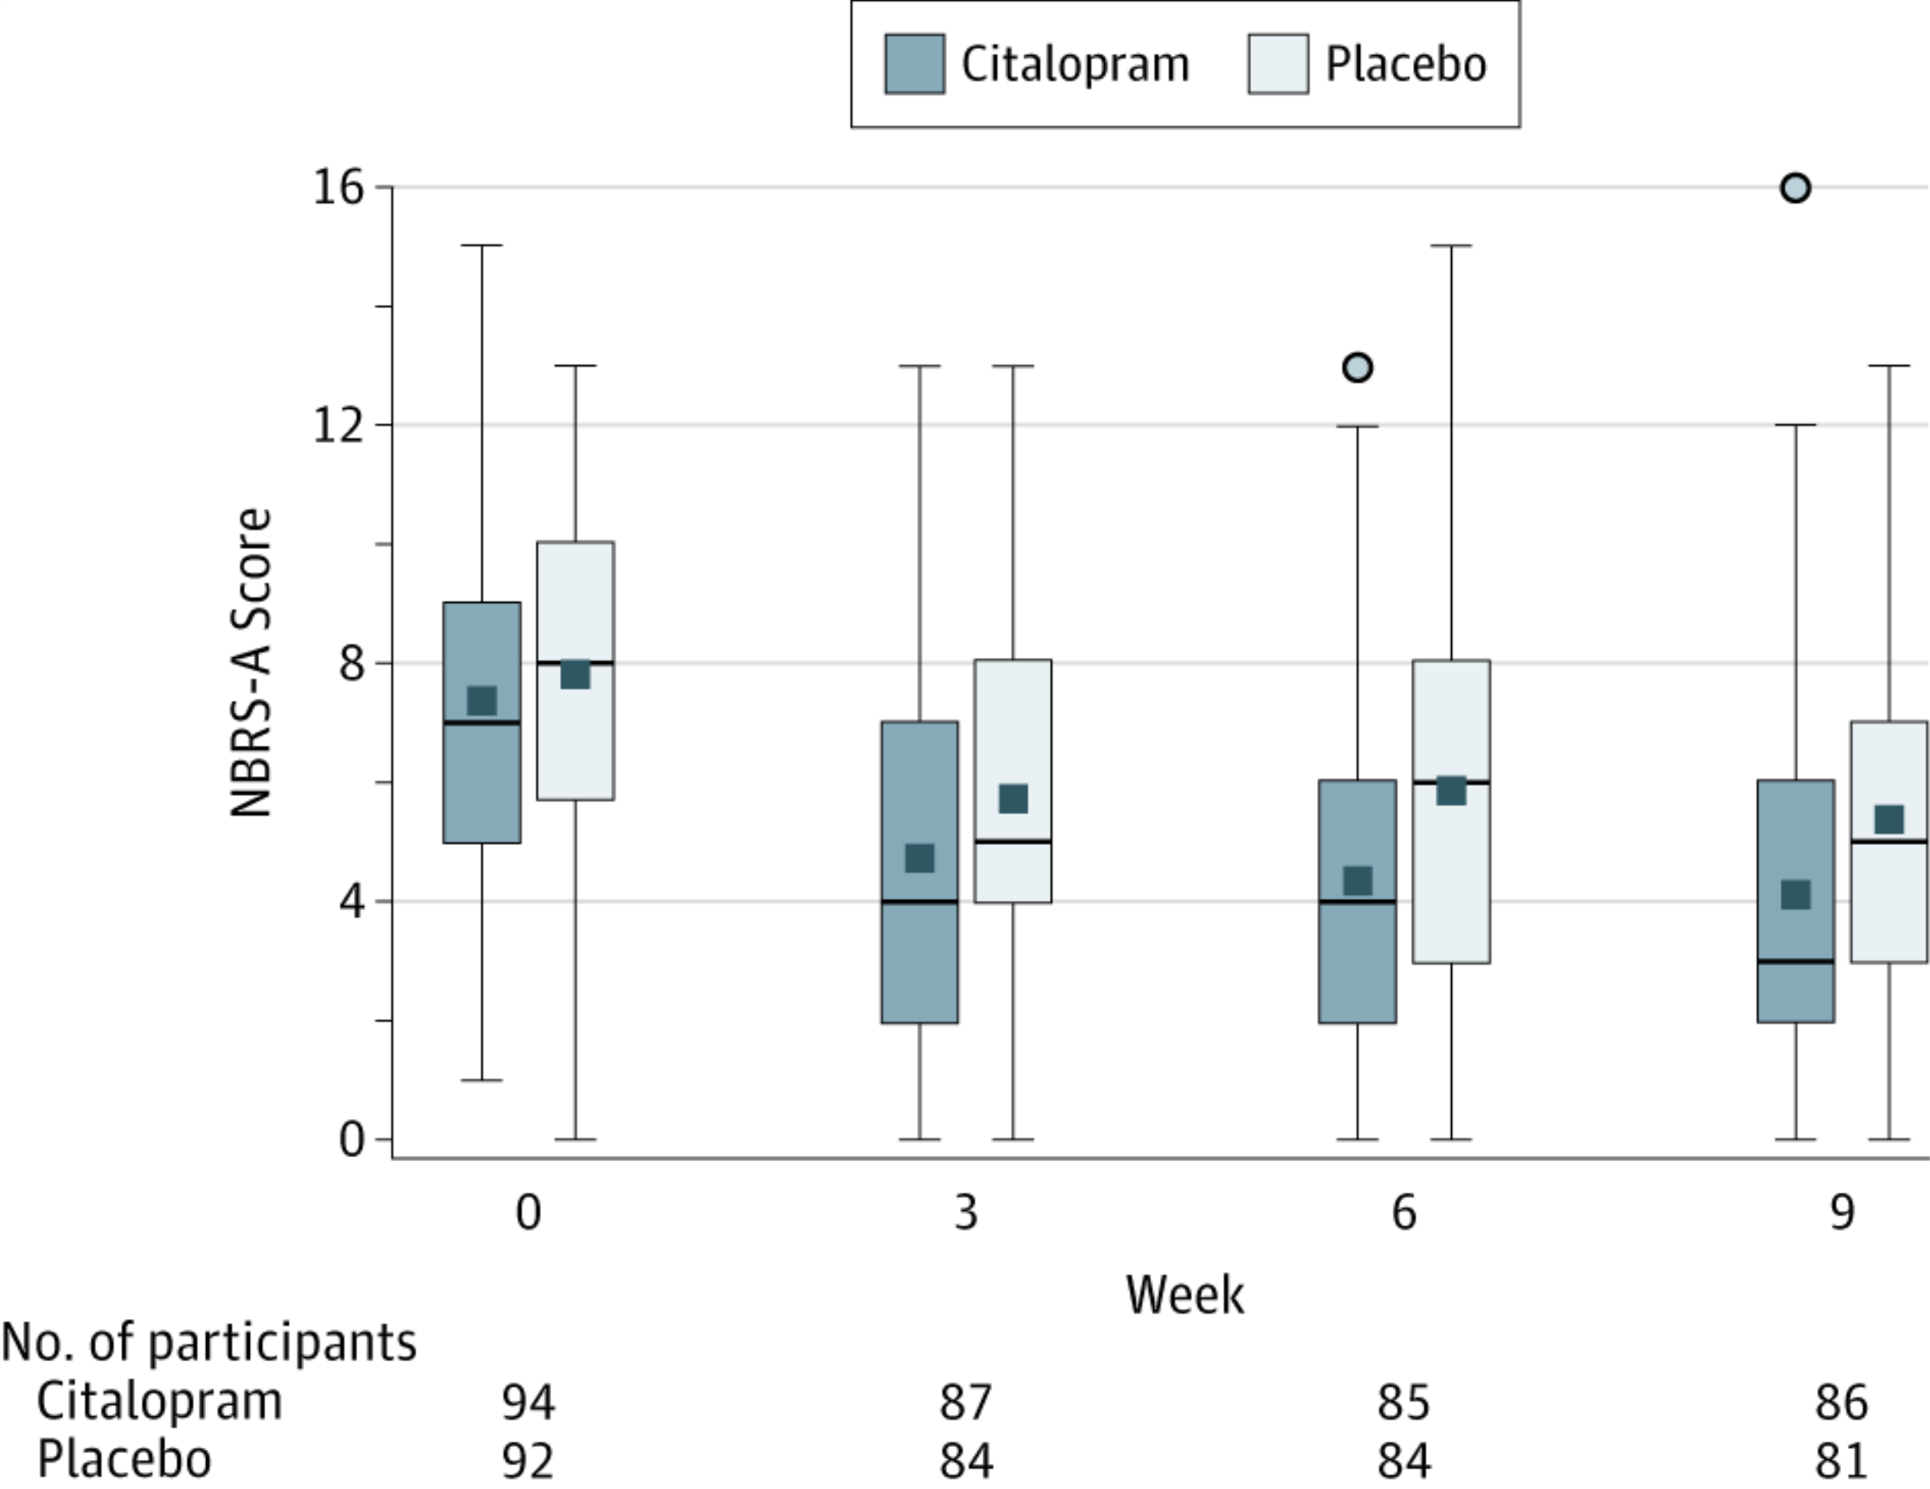
BUT prolongs QTc!
FDA max 20 mg daily
Neurobehavioral Rating Scale (NBRS)-Agitation SubscaleHigher NBRS scores indicate more severe symptoms.

Slide 34
Efficacy of cholinesterase inhibitors
  Initial studies focused on cognition, yet there is increasing evidence of a possible behavioral benefit as well
  Meta-analysis of ChEI studies - Modest but significant behavioral benefit compared with placebo Trinh et al. (2005)
  Several post-hoc analyses of studies with galantamine and donepezil suggest beneficial effects on psychosis, agitation, mood, apathy, and aberrant motor behaviors

Slide 35
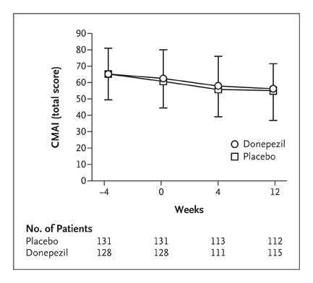
CALM – AD trial
Mean Total Scores on CMAI from Trial Entry through Follow-up for Treatment and Placebo Groups.
Howard RJ et al. N Engl J Med 2007;357:1382-1392.

Slide 36
Memantine
3 studies have examined the effect of memantine on BPSD in moderate-severe AD
Post-hoc analysis suggests benefits, particularly for aggressive, agitated behaviors (Gauthier S et al 2005; Cummings et al. 2006)
Memantine also appears to delay emergence of agitation and reduce caregiver distress (Cummings et al 2006)
Other reviewers question the clinical significance of the benefit

Slide 37
Carbamazepine
4 RCTs demonstrate benefit for aggression and agitation (Tariot el al. 1994; Cooney et al. 1996; Tariot et al. 1998; Olin et al. 2001)
Tariot et al. (1998) completed a nursing home study where 72% of patients improved versus only 21% placebo
One of the largest effect sizes of all BPSD trials
S/E limit use: tolerability, drug-drug interactions, hyponatremia

Slide 38
Benzodiazepines
Several studies support efficacy
Main concern is high rate of adverse events in the elderly
Excessive sedation, falls, cognitive impairment, paradoxical agitation
Guidelines support only short-term as-needed use

Slide 39
Is withdrawal of antipsychotics safe?
3 placebo controlled withdrawal studies indicated no worsening of behavior when long-term administration of neuroleptics were stopped
Gradual dose reduction every 3-6 months
(Cohen-Mansfield et al. 1999; Bridge-Parlet. 1997; Ballard et al. 2004)

Slide 40
Non Pharmacologic Interventions
Caregiver Education and Support
Training in Problem Solving
Exercise
Cognitive Behavioral Therapy
Music
Aroma and Massage Therapy
Simulated Presence
Validation Therapy
Light therapy
Limited RCTs but advantage of minimal side-effects

Slide 41
Novel Treatments
Lack of clear definition for agitation – newer criteria
Phase 3 trial - AVP-923, combination of cough syrup ingredient dextromethorphan & quinidine
Phase 2 study of a small molecule scyllo inositol
Phase 3 study of the dopamine agonist brexpiprazole.
Phase 2 trial - oral cannabonoid Namisol
Agitation in cognitive disorders: International Psychogeriatric Association provisional consensus clinical and research definition. Int Psychogeriatr. 2015 Jan;27(1):7-17

Slide 42
Resources
Alzheimer’s Association: www.alz.org
“The 36-Hour Day” – Nancy Mace and Dr. Peter Rabbins
NIA – Alzheimer’s Disease Education and Referral Center –
800-438-4380 Mon-Fri, 8:30 am-5:00 pm

Slide 43
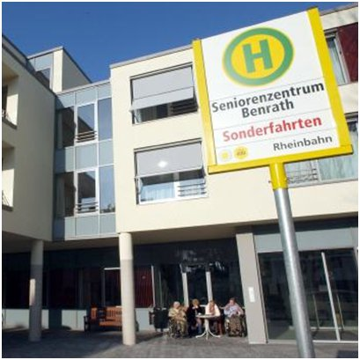
Think outside the Building !

