Slide 1
Update on Screening of Gastrointestinal Diseases
Niraj Jani, M.D.
Greater Baltimore Medical Center
1/30/15

Slide 2
Helicobacter Pylori
ACG Recommendations on when to test:
In pts with MALT lymphoma, active PUD, or past history of documented peptic ulcer.
Patients under the age of 55 years who have dyspepsia and no alarm features (test-and –treat strategy).
H. Pylori is a common cause of gastric and duodenal ulcers.

Slide 3
Testing for H. Pylori
Non-invasive Testing:
Urea Breath Tests (UBT)
Stool Antigen Test
Serology
Invasive Testing:
Endoscopic biopsy- biopsy urease test, rapid urease test or histology

Slide 4
Non-Invasive Testing
Urea Breath Test: non-radioactive 13C Test and the radioactive 14C Test. Take 15 min to administer. Sensitivity is 88-95%, Specificity of 95-100%. Pts should be off antibiotics, bismuth and PPIs.
Stool Ag Assay: enzyme immunoassay. Sensitivity of 94% and specificity of 86%.

Slide 5
Non-Invasive Testing
Serology: Uses ELISA to detect IgG antibodies. Easiest primary screening tool. Sensitivity is 90-100% but specificity is 76-96%.
Local prevalence affects PPV of Ab testing. Therefore, in areas where the prevalence is less than 20%, a positive result on serologic testing represents active infection only 50% of the time.
In low prevalence populations, much of the U.S., UBT or stool testing is recommended.

Slide 6
Invasive Testing
Urease Test on antral biopsy. Preferred test. Sensitivity is 90-95% and specificity is 95-100%.
False positive tests occur if patient is on a PPI, H2 antagonist, antibiotics, bismuth, or recent GI bleed.
Histology: expensive, but likely is the most accurate method of detection. Also provides information on gastritis, metaplasia, and MALT.

Slide 7
Confirmation of Eradication
ACG Recommendations:
Any pt with an H. Pylori ulcer.
Pts with persistent dyspepsia despite treatment.
Pts with H. Pylori MALT lymphoma.
Pts with resection of early gastric cancer.
UBT 4 weeks after treatment is the test of choice to confirm eradication. If not available, stool Ag testing.

Slide 8
Colorectal Cancer Screening

Slide 9
Epidemiology
Colon cancer is the second leading cause of cancer death in US - approx 132,000 cases/yr and 52,000 deaths. Only 63% of the population has undergone screening .
Equal lifetime risk between men and women.
93% of cases dx over age 50. Five-year survival of 60%.
Treatment costs over $6.5 billion per year
Among malignancies, second only to breast cancer at $6.6 billion per year

Slide 10
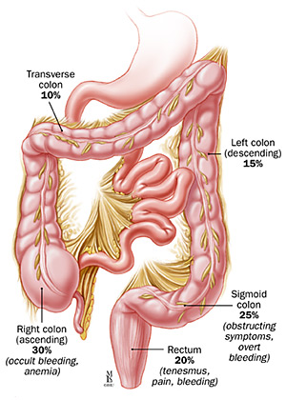
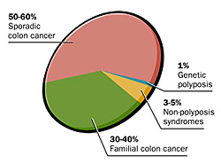
Colon Cancer
Polyp/Cancer locations

Slide 11
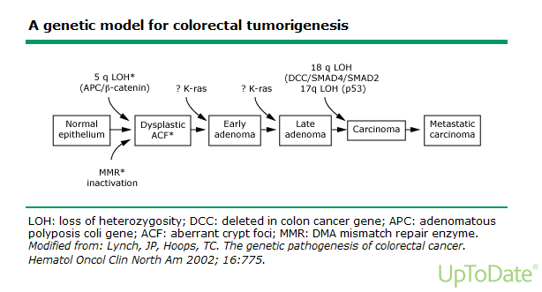
Genetics of Colon Cancer

Slide 12
Colon Cancer Screening
Tests that offer early detection:
Fecal Occult Blood testing (FOBT)
Fecal Immunochemical Testing (FIT)
Stool DNA-based tests
Tests that offer prevention:
Flexible sigmoidoscopy
Colonoscopy
CT Colonography
Colon Capsule

Slide 13
Current Guidelines for CRC Screening
The US Multi-Society Task Force Recommends that starting at age 50 years continuing to age 75 years. African American males should start screening at age 45:
- For detection of polyps and cancer:
Colonoscopy every 10 years- Gold Standard. Sensitivity of colonoscopy for the detection of polyps greater than or equal to 1 cm and tumors is greater than 95%.

Slide 14
Current Guidelines for CRC Screening
Flexible Sigmoidoscopy every 5 years- unable to see right sided or transverse colon lesions.
CT Colonography every 5 years. Highly sensitive for polyps greater than 1 cm.
Double Contrast Barium Enema (DCBE) every 5 years- The sensitivity ranges from 39–90%. Replaced by CT colonography.

Slide 15
Current Guidelines for CRC Screening
Tests to detect cancer:
-Annual Fecal Occult Blood Test (FOBT) – Sensitivity ranges from 30–92% with a specificity of 98%. Now replaced by FIT.
- Annual FIT testing
- Annual stool DNA testing (Cologuard)

Slide 16
CRC Screening Tests
Stool DNA testing: FDA approval in 8/14. Detects hemoglobin and gene mutations associated with CRC. Study of 10,000 patients found Cologuard detected 92% of CRC and 42% of advanced adenomas compared to FIT which detected 74% of CRC and 24% of adenomas.

Slide 17
Patients with Family Hx of CRC
Single first-degree relative with CRC or advanced adenoma diagnosed at age >=60 years:
Recommended screening: same as average risk.
Single first-degree with CRC or advanced adenoma diagnosed at age <60 years or two first-degree relatives with CRC or advanced adenomas.
- Recommended screening: colonoscopy every 5 years beginning at age 40 years or 10 years younger than age at diagnosis of the youngest affected relative.

Slide 18
High Risk Populations
HNPCC/Lynch Syndrome: Affected patients should undergo screening starting at age 20-25 years, until 40 years and then annually.
Familial Adenomatous Polyposis (FAP): Affected patients undergo annual sigmoidoscopy or colonoscopy until colectomy is deemed as the appropriate treatment.

