Slide 1
First, Do No Pharm
Tom Finucane 31 January 2014

Slide 2
No conflict of interest

Slide 3
Objective
I would like to persuade you that we are in general “enslaved in a plausible pseudoscience”.

Slide 4
Are these distinctive disease entities?
Heartburn
Upset stomach
Stomachache
GERD
Pyrosis
Dyspepsia
Indigestion

Slide 5
The besetting malady of this country is dyspepsia.
From it about half of the income
of doctors is derived, and at least two-thirds
of that of the patent medicine vendors.
Osler 1900

Slide 6
Bellyache v.i. to grumble or
complain, esp in a whining manner.
Merriam Webster
Merriam Webster 2020
GERD v.i. (see ‘bellyache’)

Slide 7
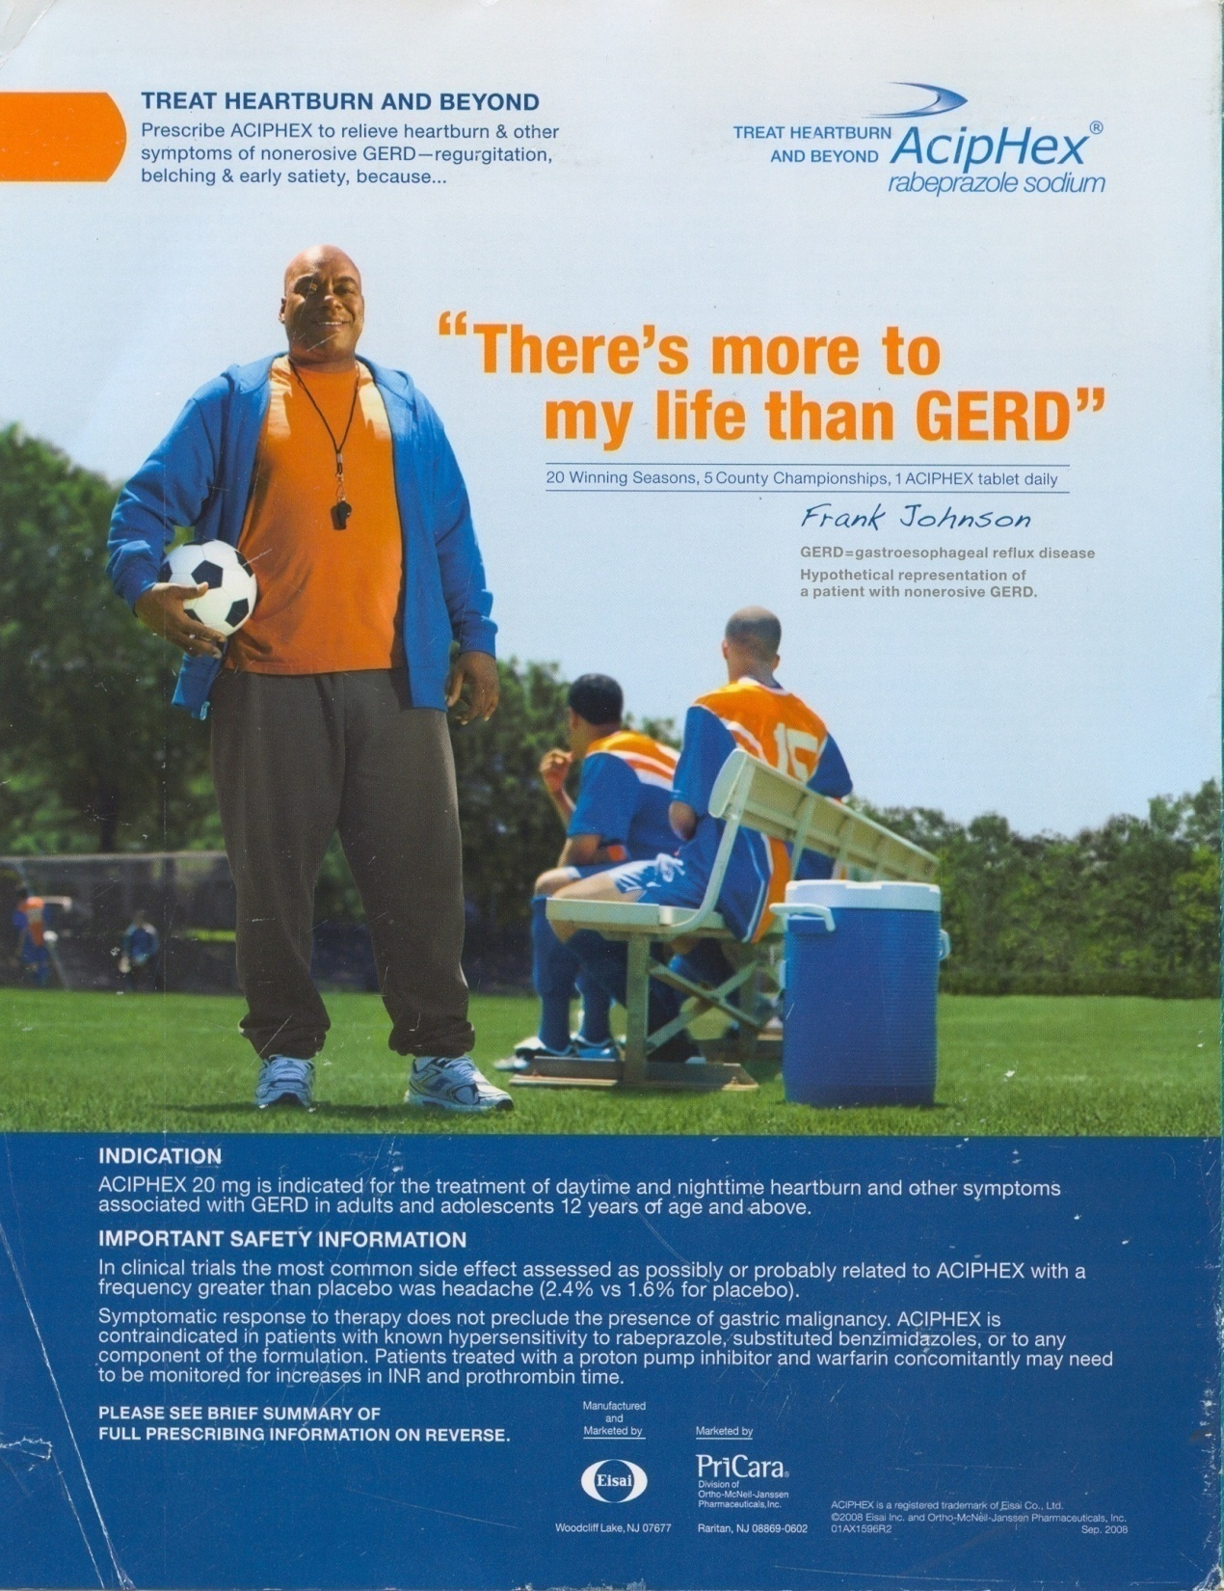

Slide 8
CANCER?

Slide 9
GERD, Barrett’s, Cancer?
For patients with Barrett’s esophagus, the goal of pharmacologic acid suppression with agents such as the proton pump inhibitors is to control reflux symptoms.
ACG Guidelines on Barrett’s 2008
The incidence of esophageal adenocarcinoma has been increasing steadily since 1980.
(Squamous CA has been falling.)
Pennathur Lancet 2013

Slide 10
Gastric secretion of hydrochloric acid appears to be unique to vertebrates and is almost ubiquitous in all fishes, amphibians, reptiles, birds and mammals.
Koelz HR.
Scand J Gastroenterol 1992.

Slide 11
Comparative anatomy and physiology suggest that gastric acid has evolved approx 350 million years ago. The similarity of the acid-secreting mechanism implies a major advantage for selection …

Slide 12
Proton pump inhibitors
Relative risk of
Pneumonia
1.9 Laheij JAMA 2004
1.5 Eurich Am J Med 2010, etc
c. diff diarrhea
2.9 Dial JAMA 2005, etc
hip fracture
2.7 Yang JAMA 2006
FDA Drug Safety Comm, 2010

Slide 13
Hospital-acquired pneumonia
Cohort study
64,000 admissions.
27,000 got PPIs. 8,000 got H2 blkrs. Some got both
Taking a PPI is associated with a 30% increase in HAP.
Herzig JAMA 2009

Slide 14
What do we want from drug treatment for Alzheimer Disease?

Slide 15
What is Alzheimer Disease?
Have you ever heard a clinician apply the diagnosis “dementia of unknown cause”?
That is actually called “Alzheimer’s”
Highly variable clinical expression and clinical course.
Worldwide shifts in incidence over the recent decades.
Major effect of age.

Slide 16
Risk factors for ‘AD’?
Aging
Vascular risk factors
Educational level
Down syndrome
Head circumference
Apolipoprotein pattern
Family history
Head trauma
Vascular risk factors

Slide 17
What is the biological plausibility that modifying a neurotransmitter using a systemic medication will produce meaningful benefit in a patient with Alzheimer Disease?

Slide 18
What do we want?
Changes in mental status testing?
Changes that patient or companions can notice?
Changes that improve the life of patient or companion?
Stabilization of disease?

Slide 19
Changes in mental status testing?
A consistently positive finding.
On MMSE and ADAS-cog, donepezil produced statistically significant benefit.
MMSE: improved in 7 of 9 studies. No study showed a 2-point improvement
ADAS – cog. No study showed a 4-point improvement. (Scale is 70 points.)
This is proof of principle.

Slide 20
Changes that patient or companions can notice?

Slide 21
The average difference on the CIBIC-plus was about 0.33 points.
A score of “Minimally improved” was 1.0.
This point is not airtight because we are using ordinal categorical data.
It may be that a few people do better than placebo.

Slide 22
Changes that improve the life of patient or companion?

Slide 23
Quality of life of (mild-moderate) patients is measured in 2 trials. There is no consistent difference.
A third trial used the Patient Global Assessment Scale where patients rate their impression of change. “No significant differences” were observed.

Slide 24
No significant differences were seen between donepezil and placebo in behavioural and psychological symptoms, carer psychopathology, formal care costs, unpaid caregiver time, adverse events or deaths, or between 5mg and 10 mg donepezil. Courtney
Lancet 2004

Slide 25
Stabilization?
No significant benefits were seen with donepezil compared with placebo in institutionalisations (42% vs. 44% at 3 years; p=0.4) or progression of disability (58% vs. 59% at 3 years; p=0.4).
Courtney
Lancet 2004

Slide 26
Evidence is insufficient to support the use of pharmaceutical agents or dietary supplements to prevent cognitive decline or Alzheimer’s disease.
“Preventing AD and cognitive decline”
http://consensus.nih.gov/2010/docs/alz/ALZ_Final_Statement.pdf

Slide 27
Despite intensive laboratory and clinical research over three decades, an effective treatment to delay the onset and progression of Alzheimer's disease is not at hand.
Selkoe, DJ
Preventing AD
Science; Sept 2012

Slide 28
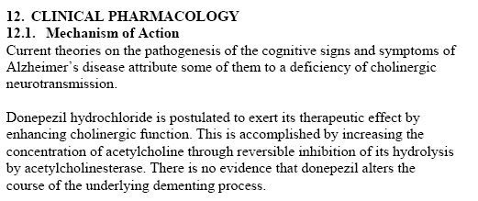
The Package Insert….

Slide 29
Cholinesterase inhibitors
Changes in mental status testing?
Changes that patient or companions can notice?
Changes that improve the life of patient or companion?
Stabilization of disease?

Slide 30
Adverse effects
Dropout rates averaged 30% in the cholinesterase groups and 18% in placebo groups in the RCTs reviewed by Birks in Cochrane
Anorexia, weight loss, nausea, vomiting, tremor in Cochrane
In cohort studies, bradycardia, pacemaker placement, falls, hip fracture

Slide 31
What is proper treatment if, after best conservative efforts, a daughter asks for help with her Dad who has dementia, has moved in with her, and is sundowning in a way that destabilizes her family?

Slide 32
“Second-generation” or “atypical” antipsychotics?

Slide 33
First, the time has come to abandon the terms first-generation and second-generation antipsychotics, as they do not merit this distinction. The only second-generation antipsychotic that is obviously better than other drugs is clozapine, and this is a very old drug indeed.
Tyrer Lancet 2009

Slide 34
Second-generation antipsychotics are now used more commonly than first-generation drugs, even though controlled trials have failed to demonstrate a clear advantage in efficacy with the newer drugs, except for clozapine and possibly olanzapine Med Letter 6.13

Slide 35
Antipsychotic drugs differ in many propeties and can therefore not be categorised in first-generation and second-generation groupings.
Leucht. Lancet. 2013

Slide 36
How about …
“Expensive antipsychotics”

Slide 37
Why choose them?
Reduction in extrapyramidal symptoms.

Slide 38
Tardive dyskinesia
5.2% with second-generation antipsychotics versus 5.2% with first-generation antipsychotics (P = 0.865) in the elderly
Medical Letter 6.13
(weak evidence)

Slide 39
Safety?

Slide 40
WARNING: INCREASED MORTALITY IN ELDERLY PATIENTS WITH DEMENTIA-RELATED PSYCHOSIS
See full prescribing information for complete boxed warning.
Elderly patients with dementia-related psychosis treated with antipsychotic drugs are at an increased risk of death. ZYPREXA is not approved for the treatment of patients with dementia-related psychosis.

Slide 41
Efficacy?

Slide 42
Atypicals in Alzheimer’s
AD plus:
agitation, aggression, psychosis
Randomized to:
quetiapine olanzapine
risperidone placebo
Schneider NEJ, 2006

Slide 43
Main outcomes
“The main outcomes were the time from initial treatment to the discontinuation of treatment for any reason and
the number of patients with at least minimal improvement on the Clinical Global Impression of Change (CGIC) scale at 12 weeks.”

Slide 44
Lilly assessed penalties totaling $1.415 billion for off-label marketing of its drug, Zyprexa.
One portion of that sum is a $515 million criminal fine, the largest criminal fine ever imposed upon an individual US corporation.
usdoj.gov 1/15/09

Slide 45
Total Zyprexa Sales
Since 1996: $39 billion
1st 6 months of 2008: $3.5 billion

Slide 46
“Abbott to pay $1.6 billion for illegally marketing drug”
“Abbott directed its sales force to get Depakote widely used in nursing homes, principally to neutralize older patients …
“Abbott essentially preyed on … the most helpless patient populations.”
An attorney
Wash Post 5.8.12

Slide 47
GlaxoSmith Kline
July 2012 GlaxoSmith Kline agreed to pay a fine of $3 billion to resolve civil and criminal liabilities regarding its promotion of drugs, as well as its failure to report safety data. This is the largest health care fraud settlement in the United States to date.

Slide 48
J&J
$2.2 billion
‘alleged kickbacks to doctors and pharmacies to promote the antipsychotic drugs Risperdal ….’
WashPost 11/4/2013

Slide 49
Utilization?

Slide 50
FOR decades, antipsychotic drugs were a niche product. Today, they’re the top-selling class of pharmaceuticals in America, generating annual revenue of about $14.6 billion and surpassing sales of even blockbusters like heart-protective statins.
D. Wilson NYT 10/2/10

Slide 51
Egas Moniz wins Nobel Prize in 1949 for the development of a procedure
Frontal lobotomy

Slide 52
Chronic Sedentary Feasting, Aging, and the Tight Control of DM2

Slide 53
“The precise drugs used and their exact sequence may not be as important as achieving and maintaining glycemic targets safely.”
ADA guidelines 2011

Slide 54
A worldwide epidemic …
Chronic Sedentary
Feasting

Slide 55
What drugs have been shown in RCTs to reduce the risk of micro or macrovascular disease or death?

Slide 56
Mean age of subjects (yrs)
ADVANCE 66
ACCORD 62
VADT 60
UKPDS 53
UGDP 52
Steno 2 55
UGDP 52

Slide 57
Survival as a function of HbA1C in people with Type 2 DM: a retrospective cohort study.
Currie CJ
Lancet 6 Feb. 10
(Mean age 64)

Slide 58
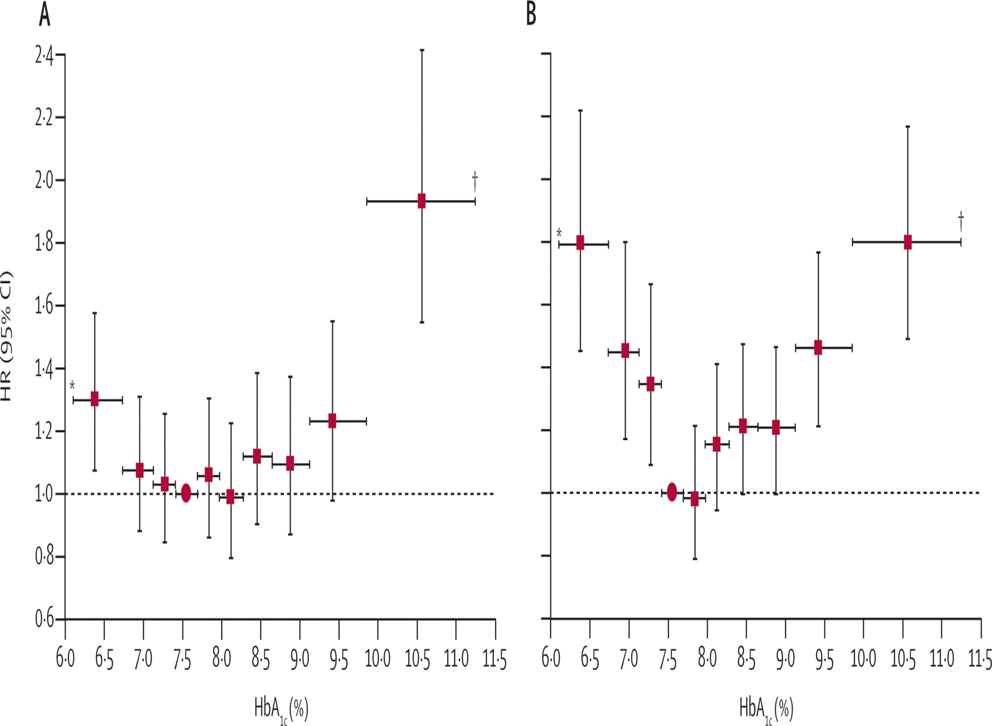

Slide 59
A Professor of Medicine and diabetologist at UTHSCSA reviewed a 2007 paper for the NEJ that raised a question of cardiovascular risk from rosiglitazone.
Before submitting his review, he faxed a copy of it to GSK, from whom he received emoluments.
Nature 451;2008:509.

Slide 60
Today the A.D.A.’s treasurer is the director of investor relations for Johnson and Johnson
New York Times, 11/25/06

Slide 61
“The precise drugs used and their exact sequence may not be as important as achieving and maintaining glycemic targets safely.”
ADA guidelines 2011

Slide 62
Evidence from RCTs
Except for ACCORD and for metformin in UKPDS 34, no RCT of tight control in DM2 has shown a reduction in
*MI * Renal failure
*CVA * Blindness
*Amputation * Neuropathy
* Death

Slide 63
For GERD, AD, dementia-related behavioral disturbance, chronic sedentary feasting:
First do no Pharm.
Or as Olser said, “ .. “

Slide 65
As compared with standard therapy, the use of intensive therapy to target normal glycated hemoglobin levels for 3.5 years increased mortality and did not significantly reduce major cardiovascular events. These findings identify a previously unrecognized harm of intensive glucose lowering in high-risk patients with type 2 diabetes.
ACCORD NEJM

Slide 66
 Intensive glucose control in patients with poorly controlled type 2 diabetes had no significant effect on the rates of major cardiovascular events, death, or microvascular complications with the exception of progression of albuminuria (P = 0.01)
VADT
NEJM

Slide 67
A strategy of intensive glucose control, involving gliclazide (modified release) and other drugs as required, that lowered the glycated hemoglobin value to 6.5% yielded a 10% relative reduction in the combined outcome of major macrovascular and microvascular events, primarily as a consequence of a 21% relative reduction in nephropathy
ADVANCE
NEJM

Slide 68
ADVANCE
Combined endpoint; 5 yrs: 18.1 vs 20%
Microvascular: 9.4 vs 10.9
(Nephropathy: 4.1 vs 5.2)
No difference in
Major macrovascular events
Death from cardiovascular causes
Death from any cause

Slide 69
The main benefit conferred by the ADVANCE treatment regimen was a one-fifth reduction in renal complications.
[From 5 to 4 per 100 over 5 years.
Chance of not having macroalbuminuria: 95 ->96%]
The component of new or worsening nephropathy most clearly reduced through intensive glucose control was the development of macroalbuminuria.
ADVANCE
NEJM

