Slide 1
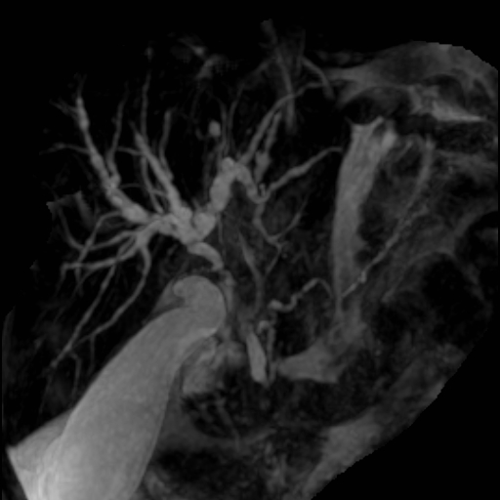
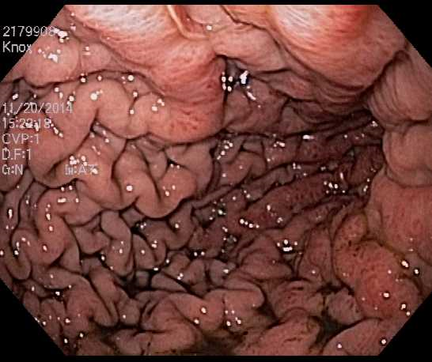
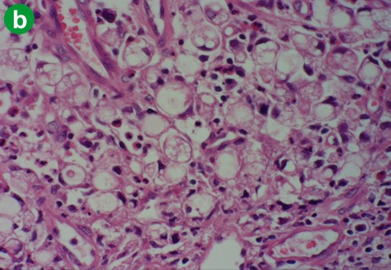
Things are Not Always What they Seem
(An Unusual Presentation of Gastric Cancer)
Adebukola Owolabi, MD. Chude Anagor, MD. Folake Kofo-Idowu, MD. Hawwa Alao, MD.
CASE PRESENTATION: 61 yr old woman with two day history of left lower quadrant abdominal pain, nausea, and intractable vomiting productive of bilious and ground coffee material. PE: Dehydrated, tachycardic, cachectic and lethargic. Abd: mildly distended & diffusely tender. LABS: ALP: 434, Cr: 3.01, LIPASE: 171, AMYLASE:115 normal AST, ALT, Bilirubin ANA +ve ASMA, IgG4, p-ANCA, and AMA were all negative. Refused ERCP. Paracentesis: negative cytology on 2 occasions AXR; distended small bowel, no point of obstruction. Upper GI series: gastric wall thickening and luminal narrowing of 3rd & 4th part of duodenum. Staging laparoscopy: serosal and greater omentum involvement, nodal in gastrohepatic ligament. 2 admissions in last 6 months. 8/2014: Right nephroureteral stent for hydronephrosis Pyelonephritis, AKI and pancreatitis MRCP showed multiple segmental strictures suggestive of primary sclerosing cholangitis Normal LFT’s refused ERCP 9/2014 : Bilateral nephroureteral stents a/c progressive hydronephrosis despite stenting of ureters Recurring AKI pancreaticobiliary distortion seen on CT.
DISCUSSION: The patient was managed for obstructive uropathy without clear cause Diagnosis was prompted by coffee ground vomiting Cholangiopancreatographic findings with normal liver functions could not be attributed to PSC but rather thought to result from obstructive duodenal infiltration Though histological evidence was lacking, it is plausible that distant metastatic infiltrations causing luminal obstruction may be the basis of biliary beaded picture and obstructive uropathy.²
CONCLUSION: The rarity & predominantly late presentation of gastric cancers pose a diagnostic challenge, as metatstatic disease may be similar to other clinical conditions.
REFERENCES: Some specific radiological findings and consideration of linitis plastica of the gastrointestinal tract. [Review] [35 refs] Raskin MM. CRC Critical Reviews in Clinical Radiology & Nuclear Medicine. 8(1):87-106, 1976. Obstructive uropathy. An unusual presentation of primary linitis plastica of the colon. Greenfield SM; Seedor JW; Nack SL; Sohn M. Digestive Diseases & Sciences. 30(7):689-96, 1985 Jul.
MRCP suggestive of PSC
UPPER GI ENDOSCOPY
AXR:Patent Duodenal stent, B/L ureteral stents.
STOMACH Diffuse inflammation
LA grade D reflux esophagitis
Descending duodenum stenosis
HISTOLOGY: STOMACH BIOPSY
Invasive diffuse-type gastric carcinoma with signet ring features

