Slide 1
Lyme Disease and Post-treatment Lyme Disease Syndrome
John N. Aucott, M.D.
Assistant Professor, Department of Medicine
Johns Hopkins Hospital
Lyme Disease Research Foundation
Park Medical, L.L.C.
10755 Falls Road, Suite 200
Lutherville, MD
www.LymeMD.org

Slide 2
No Relevant Financial Relationships with Commercial Interests
We will not reference an unlabeled or unapproved use of a drug or product in my presentation.
John N. Aucott, MD
Disclosures

Slide 3
Learning Objectives
Recognize the increasing incidence of Lyme disease
Learn about new tick-born pathogens that expand the DDx of Lyme disease
Be aware of the heterogeneity and complexity in patients presenting with a concern of Chronic Lyme disease
Understand the clinical features of Post-Treatment Lyme Disease Syndrome (PTLDS)
Learn about data from the SLICE Study on immune signatures in Lyme disease and PTLDS

Slide 4

Lyme Disease a Leading World Wide Infectious Disease
Iceman from Italian Alps 5,300 years ago with Lyme disease
1902-1922 European Tick-borne disease described
  Erythema chronicum Migrans (ECM)
  Meningopolyneuritits (Bannwarth’s Syn.)
  1975 – Connecticut cluster of arthritis cases in children
  Link of prior tick bite and rash to arthritis
  Discovery of bacterial pathogenesis
Worldwide expanding infectious disease
  Climate change and northern expansion of Lyme disease into Canada
Notes:
Poleward Expansion of the White-Footed Mouse (Peromyscus leucopus) under Climate Change: Implications for the Spread of Lyme Disease. Roy-Dufresne E et al. PLOSONE November 18, 2013

Slide 5
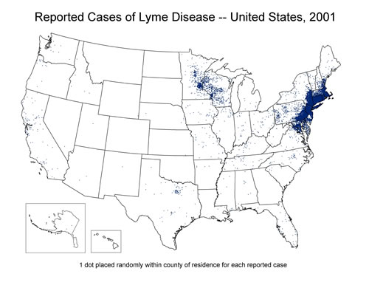
Geographic Spread of Lyme Disease

Slide 6
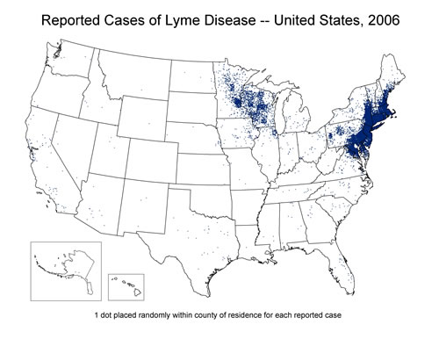
Geographic Spread of Lyme Disease

Slide 7
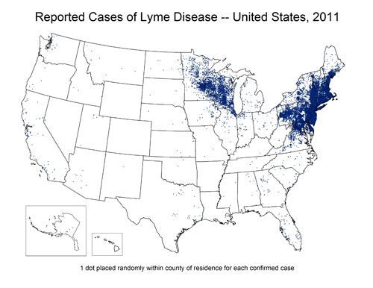
Geographic Spread of Lyme Disease

Slide 8
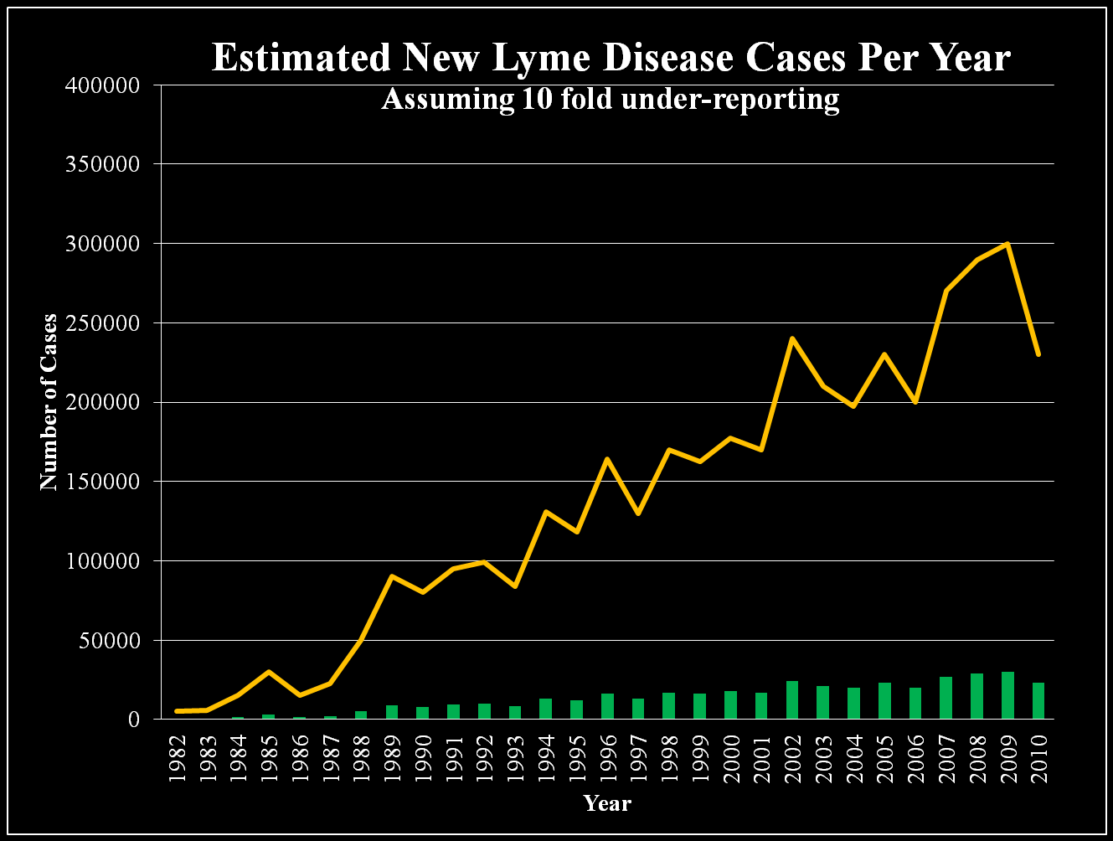
300,000 CASES A YEAR
Notes:
CDC Estimates 300,000 US Cases of Lyme Disease Annually. Kuehn BM. JAMA. 2013 Sep 18;310 (11): 1110. Doi: 10.1001/jama.2013.278331

Slide 9
Ten Most Commonly Reported
Notifiable Diseases, Maryland, 2011
Disease | Rate Per 100,000
1. Chlamydia | 466.9
2. Gonorrhea | 110.8
3. Lyme disease | 23.2
4. HIV/AIDS | 20.1
5. Salmonellosis | 17.3
6. Campylobacteriosis | 10.6
7. Strep. Group B, invasive | 10.4
8. Strep. pneumoniae, invasive | 10.1
9. Meningitis, aseptic | 9.0
10. Syphilis, Primary & Secondary | 7.8
Notes:
in 2011, it was the 6th most common Nationally Notifiable disease. However this disease does not occur nationwide and is concentrated heavily in the northeast and upper Midwest.

Slide 10
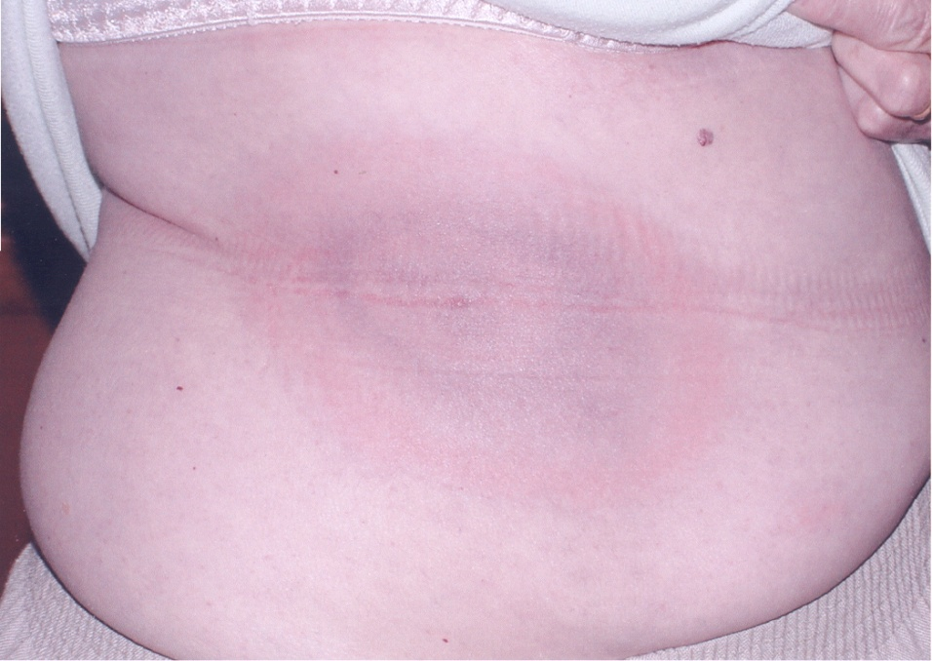
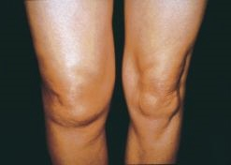
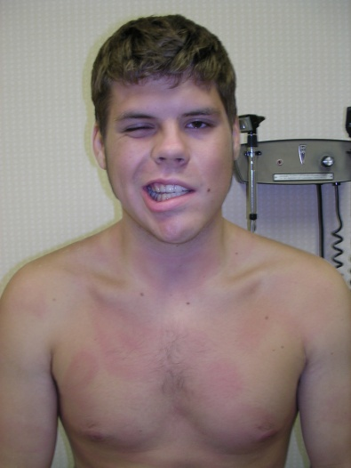
Stages of Lyme Disease are Defined by the Signs of Infection

Slide 11
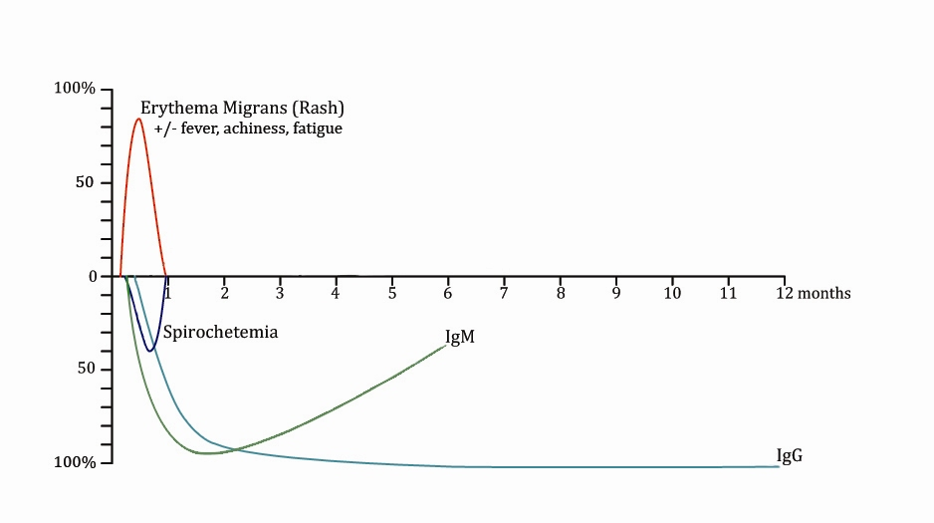
Early Diagnosis and Treatment is Key to Preventing Long-term Complications

Slide 12
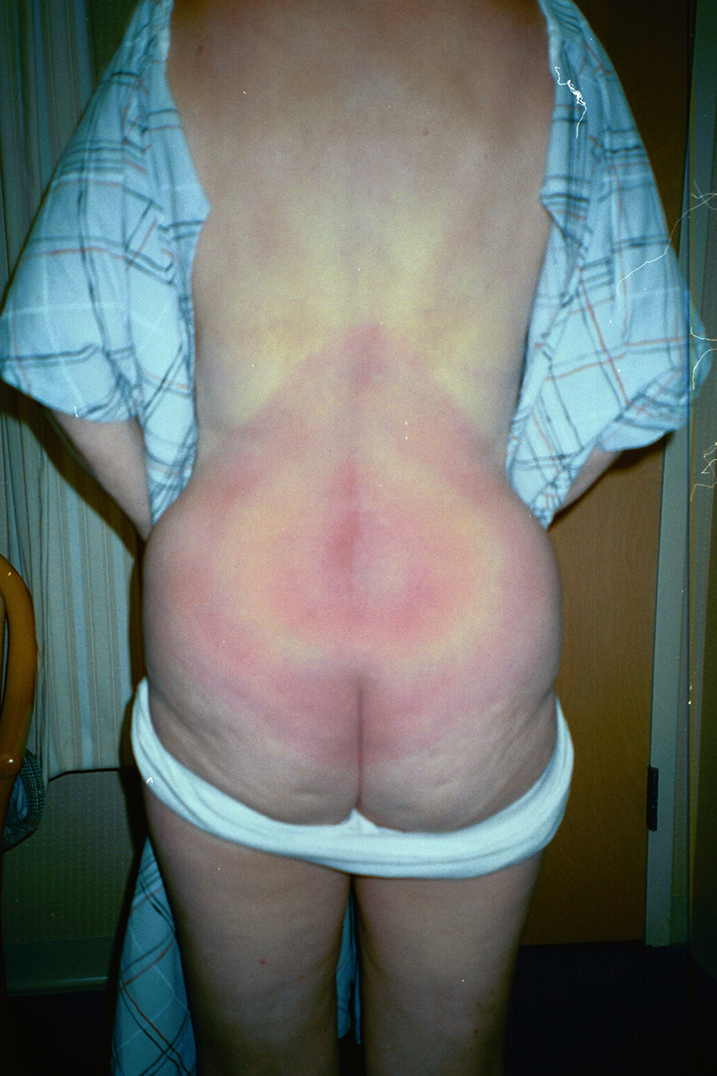
Erythema Migrans (EM) is the Classic Early Manifestation of Lyme Disease
Onset 3-30 days after tick bite
Skin lesion can be unnoticed by patients and physicians
  Minimal pain and pruritis
  May mimic spider bites
Resolve without therapy over weeks

Slide 13

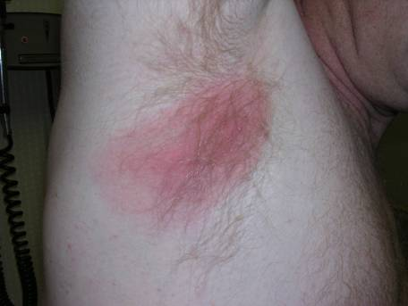
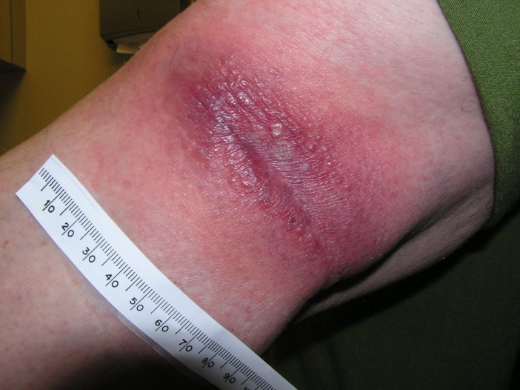
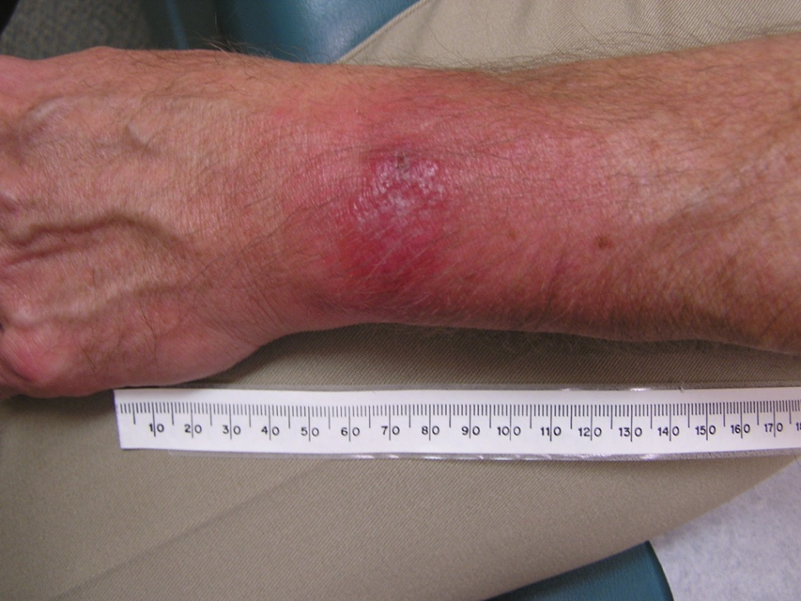
Only 20-30% of EM are Classic Target Lesions
Notes:
20% of pts have bulls eye
The most common rash of early Lyme disease is not the classic bulls eye, but the uniformly red round/oval lesion of EM
That is large, > 5 cm, last weeks when untreated
2% with vesiculopustular: Commonly middiag shingles, spider bites, MRSA

Slide 14
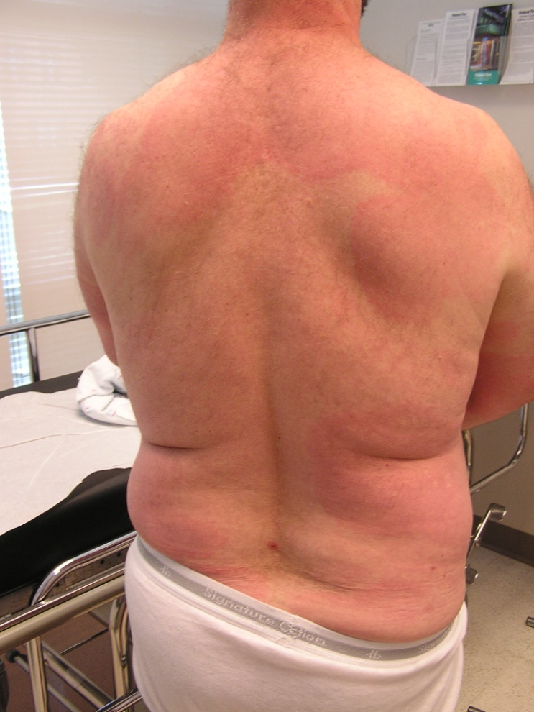
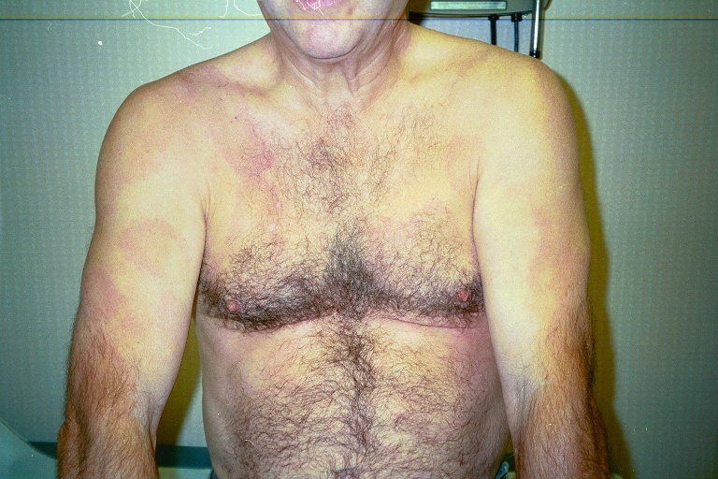
Disseminated Rash of Lyme Disease is Atypical in Appearance
Notes:
14

Slide 15
Atypical Presentations of Early Lyme Disease Without EM Rash
“Viral-like” presentations of Lyme disease overlap with other acute infectious diseases
  Enterovirus, west nile, even influenza
  Tick-borne illnesses: Anaplasma, Ehrlichia, Babesia
Tick-borne Illness look similar when there is no rash
  Fever, headache, malaise,
  Absence of typical rhinitis of viral URI

Slide 16
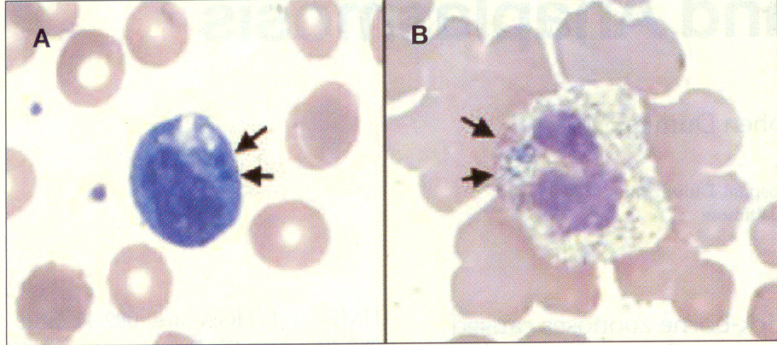
Anaplamsa, Ehrlichia, and B. miyamotoi
Ehrlichia/Anaplasma
  Leukopenia
  Thrombocytopenia
  Higher fever
  Elevation AST/ALT
  Dx: smear, PCR,
  Acute/conv. serology
B. miyamotoi
  Symptoms similar to other tick-borne diseases: myalgia, headache, fever
  Rash uncommon
  Test (-) on Lyme serology
Notes:
Tick-Borne Pathogens other than Lyme Disease
Borrelia miyamotoi Infection Presenting as Human Granulocytic Anaplasmosis: A case report. Chowdri HR et al.. Annals of Internal Medicine 2013 Jul 2;159 (1):21-7
Background: While Borrelia burgdorferi, the agent of Lyme disease, accounts for the vast majority of tick-borne infection, other borrelia species and other bacterial, viral and protozoal pathogens can cause tick-borne infection as well. In Europe the closely related species B. garinii and B. afzelii cause a significant percentage of Lyme disease cases. A newly identified human pathogen Borrelia miyamotoi causes a Lyme-like illness in Eurasia and N. America. It is known that all of the different tick-borne infections can present with nonspecific infectious symptoms such as myalgia, headache, and fever.
Findings: A new cause of tick-borne infectious disease called B. miyamotoi presents with an illness that is indistinguishable from other common tick-borne infections. This case report describes two patients initially suspected of having have Anaplasmosis who were diagnosed using research laboratory PCR testing to have infection with B. miyamotoi instead.
What is Borrelia miyamotoi?
Borrelia miyamotoi are spiral-shaped bacteria that are closely related to bacteria that cause tick-borne relapsing fever (TBRF). They are more distantly related to the bacteria that cause Lyme disease. First identified in 1995 in ticks from Japan, the bacteria have since been detected in two species of North American ticks, the black-legged or “deer” tick (Ixodes scapularis) and the western black-legged tick (Ixodes pacificus). These ticks are already known to transmit several diseases, including Lyme disease, anaplasmosis, and babesiosis.
What type of illness does B. miyamotoi cause?
Human infections with B. miyamotoi were first described in 2011 in a report from Russia. Most of the patients had fever, headache, and muscle aches--symptoms typical of TBRF. Symptoms similar to those of Lyme disease, such as the erythema migrans rash (bull’s-eye rash), arthritis, or facial palsy, were uncommon.
Recently, three cases of human infection with B. miyamotoi were identified in the United States.One patient was an elderly, immunocompromised woman with confusion and an unsteady gait. The bacteria were seen in samples of the patient’s spinal fluid, and she recovered when treated with antibiotics. The two other patients had fever, chills, and muscle aches, similar to the symptoms of the patients in Russia.
How do doctors diagnose B. miyamotoi?
Diagnosis currently relies on the use of tests to detect DNA of the organism, called polymerase chain reaction (PCR) tests. These tests are under development and not widely available. North American strains of B. miyamotoi have not yet been successfully grown in culture, a common method for identifying bacterial diseases. Blood tests based on detection of antibodies require further validation. Blood tests for Lyme disease are unlikely to be helpful in diagnosis of B. miyamotoi infections

Slide 17
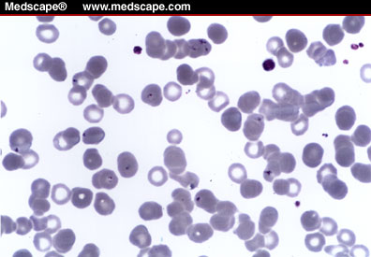
Babesia microti and Co-Infections
Babesiosis:
  First case in Maryland
  Anemia
  Splenomegally
  Risk splenectomy for
  severe disease
  Dx: smear, PCR, serology
Coinfection
  Lyme disease, Anaplasma, Babesia

Slide 18
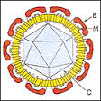
Tick-borne Viruses
Flaviviruses
  Powassan Virus
    Transmitted by Ixodes ticks
    10% fatality
    50% permanent neurologic sequela
  Tick Borne Encephalitis (Eurasia only)
Heartland Virus; Midwest US
  Transmitted by lone star ticks
  Fever, fatigue, thrombocytopenia, leukopenia
Notes:
Changing epidemiology of Powassan encephalitis in North America suggests the emergence of the deer tick virus subtype. Khoury MY, Cargo J, Wormser G.; Expert Rev. Anti Infect Ther. 11 (10), 983-985. (2013)
Background: Different tick species occur across North America that are responsible for transmitting different tick-borne diseases. In general, tick-pathogen relationships are specific with the majority of any one disease causing pathogen being transmitted by only one tick species. For example, Anaplasma is transmitted by the deer tick, Ixodes scapularis, and Ehrlichia by the Lone Star Tick, Amblyomma americanum. However, one species of tick may transmit more than one co-infectious pathogen in a single bite (For example, a single deer tick bite can transmit Bb, Anaplasma, and Babesia.) The encephalitis causing Powassan virus is a pathogen known to be transmitted by Ixodes cookie ticks.

Slide 19
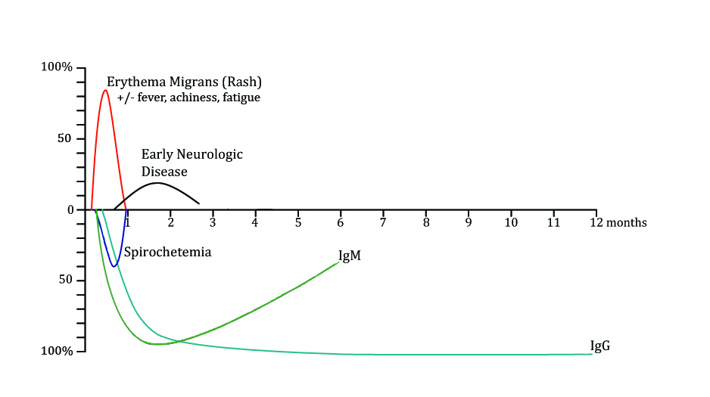
Natural History of Untreated Lyme disease – Early Disseminated Infection
Early Disseminated Infection: Cranial nerves, meningitis, radiculitis, carditis

Slide 20
Three Sudden Cardiac Deaths Associated with Lyme Carditis – United States, November 2012 – July 2013.
CDC MMWR 2013 Weekly/Vol. 62/No. 49. 993-996
Lyme Carditis
  Only 40% patients with Lyme carditis report having erythema migrans rash, as compared with 70%-80% of patients overall.
  Prompt recognition and early, appropriate therapy for Lyme disease is essential. Healthcare providers should:
    Ask patients with suspected Lyme disease about cardiac symptoms, including palpitations, chest pain, lightheadedness, fainting, and shortness of breath, and obtain an ECG if indicated;
    Ask patients with unexplained heart block about possible exposure to infected ticks; and.
Notes:
Three Sudden Cardiac Deaths Associated with Lyme Carditis – United States, November 2012 – July 2013. CDC MMWR 2013 Weekly/Vol. 62/No. 49. 993-996
Background: Lyme disease is a systemic, multi-system infection in which cardiac involvement may occur, typically 3 weeks into infection. Patient reported symptoms of cardiac illness are nonspecific and include lightheadedness, palpitations and rarely passing out. Cardiac illness may also be asymptomatic.
Findings: Three cases of sudden death due to cardiac Lyme disease were reported to the CDC. None of the cases had an EM skin lesion, but two of the three cases had nonspecific symptoms including musculoskeletal pain, malaise, shortness of breath and anxiety 1-2 weeks before death. Examination of heart tissues at CDC demonstrated diffuse mixed perivascular lymphocytic pancarditis. ELISA and IgM Western blot serology was positive for all three cases. No case had a (+) IgG Western Blot. Two of the cases were discovered by the tissue bank pathologist prior to organ donation.
Cautions: Results from case reports cannot be used to calculate the overall frequency of disease and so it is not known if this report represents a trend or emergence of more virulent strains of Bb.
Implications: Clinical series can provide important clues into disease manifestations. In this case the take home point is that nonspecific symptoms can be the presenting manifestation of a serious illness and that they need to be taken seriously and properly evaluated understanding the unique circumstances and risk factor present in the given case, including added vigilance in Lyme endemic regions.
The nonspecific nature of Lyme disease symptoms may lead to underdiagnosis of blood-borne disseminated infection. Infection of blood and tissues may represent a public health challenge for transfusion and organ donation. Unrecognized cardiac disease may result in sudden death of individuals eligible for organ donation.

Slide 21
General Principles in the
Diagnosis of Lyme Disease
Diagnosis starts with risk factors and clinical signs and symptoms (pre-test probability)
Supportive labs have significant limitations
  No direct test for presence of pathogen (except PCR in synovial fluid)
  PCR not sensitive for low # organisms in blood/ CSF
  Validated Culture not available
Serology (ELISA/Western Blot)
  Sensitivity limited by biologic delay in seroconversion
    Early disease there is risk of false negative test
  Specificity limited by persistence of antibody from remote exposure
    Late disease can’t easily distinguish past exposure from active infection

Slide 22
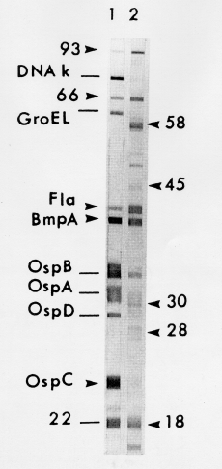
Antibody testing is used for confirming exposure
2 step testing
  Elisa screening, Western blot for (+) Elisa
Criteria for (+) blot
  Weeks 1-4: IgM 2/3 bands
  > 4 weeks: IgG 5/10 bands
High specificity designed for surveillance
Gaps in sensitivity as currently defined by 2-tier surveillance testing
  40% sensitive for early EM
  Convalescent post-treatment IgG is often negative
Notes:
Serology (ELISA/Western Blot)
Sensitivity limited by biologic delay in seroconversion
Early disease there is risk of false negative test
Specificity limited by persistence of antibody from remote exposure
Late disease can’t easily distinguish past exposure from active infection
Describe osp proteins, heat shock protein, flagellar,

Slide 23
Treatment
Oral doxycycline preferred for adults and children over age of 12
  Oral amoxicillin in those allergic to doxycycline
    Must consider risk of co-infection with anaplasma
  IV antibiotics indicated for neurologic involvement or refractory arthritis
Borrelia NOT sensitive to 1st generation cephalosporins, quinolones

Slide 24
Prognosis
Prognosis depends on stage of infection at which treatment is given
Treatment of early disease speeds resolution of EM rash and prevents development of later objective finding of disease (meningitis, arthritis)
No biomarker for establishing eradication of infection.
  Serology does not act as test of cure
  “no PSA test for Lyme disease”
Treatment of late Lyme arthritis is 90% effective
  10% develop post treatment antibiotic refractory arthritis
Do symptoms persist or recur after treatment??

Slide 25
Post-treatment Symptoms are Real,
But What Should we Name Them?
Minor late symptoms –Steere 1983
Lyme disease associated with Fibromyalgia – Dinerman & Steere 1992
Post-infectious Syndrome – Asch &Weinstein 1994
Chronic Lyme disease – Donta 1997
Post-Lyme Syndrome – IDSA Guidelines - 2006
Post-Treatment Lyme disease Syndrome –
                CDC website - 2012
PTLDS/CLD
  Name reflects the audience
  Controversy over pathophysiology and treatment

Slide 26
Does Chronic Lyme Disease Exist?
Chronic Lyme disease is a legitimate patient concern and the “chief complaint” they may present with.
Does everyone with a chief complain of Chronic Lyme have an illness related to Lyme disease or PTLDS ??
  No (think chest pain and Coronary disease)
Incidence and severity depend on risk factors:
  Low risk patients with early, adequate treatment
    10-20% incidence
    Often mild/intermittent symptoms
  High Risk with late diagnosis or initial misdiagnosis
    Severe/persistent
    Z- pack, quinolone phenomenon
Notes:
Difference between older retrospective studies and recent prospective studies in patient selection and risk factors explains differences in literature regarding PTLDS

Slide 27
Categorization of patients presenting for evaluation of Lyme disease
with symptoms ≥ 12 weeks duration (n = 235)
Aucott JN, Seifter A, Rebman AW. (2012). Probable late lyme disease: a variant
manifestation of untreated Borrelia burgdorferi Infection. BMC Inf Dis, 12:173.
Notes:
Transition: Pt hears MUS, they hear it is all in yu

Slide 28
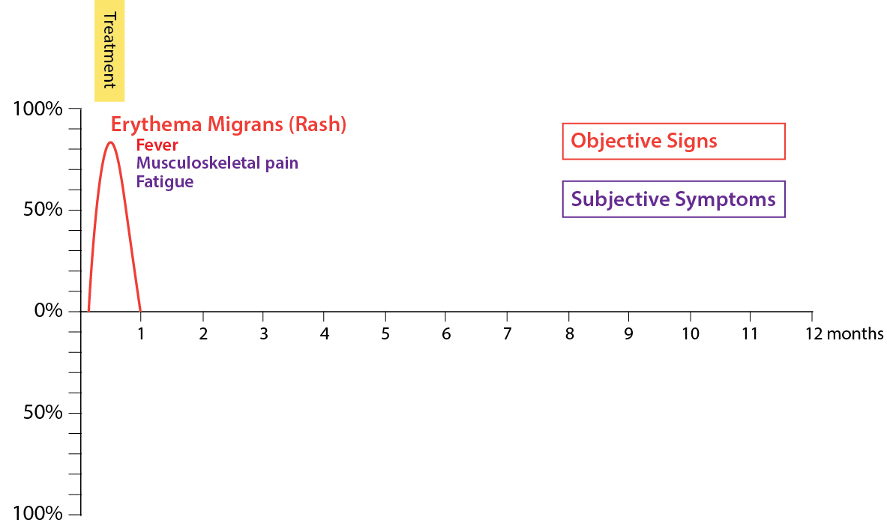
Model for
Post Treatment Lyme Disease Syndrome

Slide 29
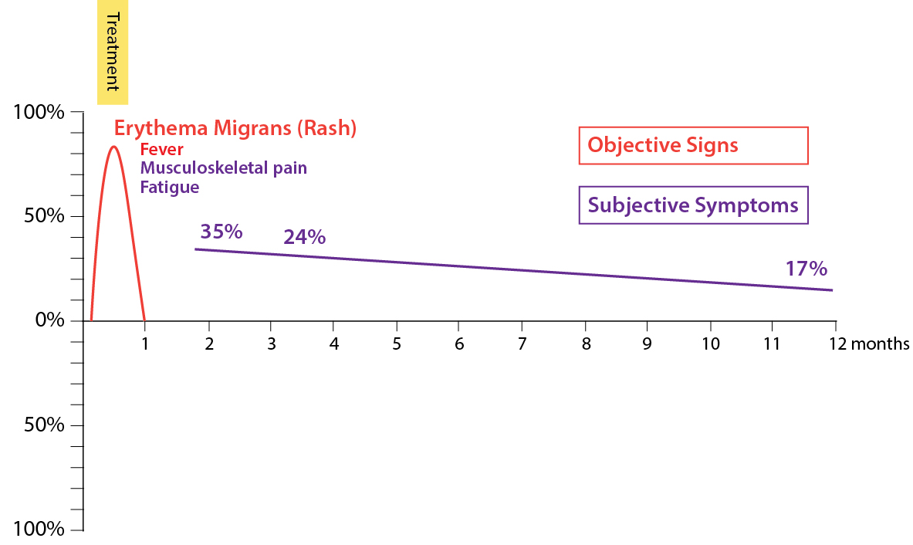
Model for
Post Treatment Lyme Disease Syndrome

Slide 30
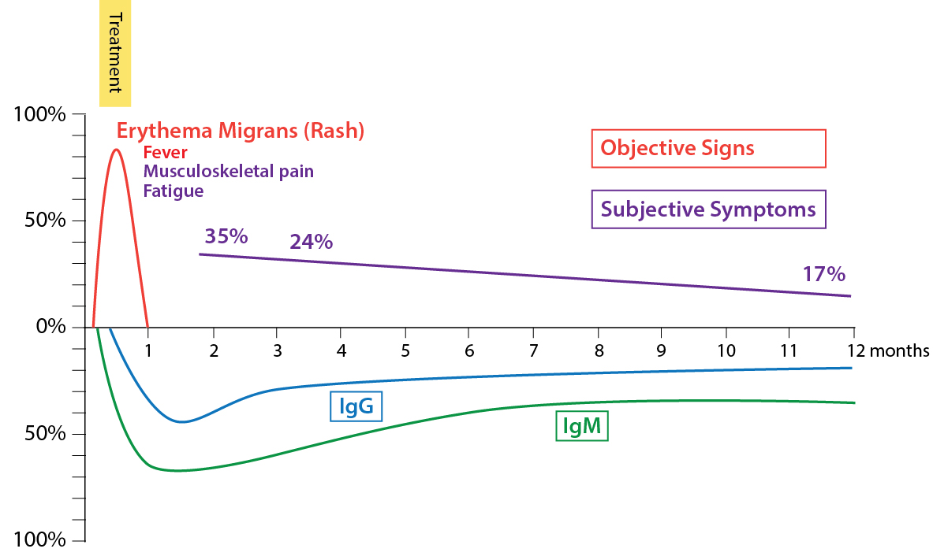
Model for
Post Treatment Lyme Disease Syndrome
PTLDS/CLD
Notes:
Development of a Foundation for a Case-definition of Post-Treatment Lyme Disease Syndrome. Aucott JN, Crowder LA, Kortte KB; Int J of Infectious Dis. 2013 June; 17 (6): e443-e449
Background: As experienced in community-based healthcare settings, Chronic Lyme disease (CLD) is a heterogeneous group of illnesses, some triggered by tick-borne illness and others not. Post-antibiotic Treatment Lyme Disease Syndrome (PTLDS) refers to a narrowly defined group of patients in research seen in research settings. The great difficulty in understanding CLD comes from the lack of definitions and controlled studies of PTLDS.
Findings: In a research setting, PTLDS can be defined and identified in a low risk group with ideally diagnosed and treated early Lyme disease. This group of patients is distinct with decreased health related function that is different from other treated Lyme patients and controls. An intermediate group of patients have persistent symptoms after treatment of Lyme disease, but maintain normal health related function.

Slide 31
Excluding re-infection in Patients with Persistent or Recurrent Symptoms
Prior Lyme disease does not prevent future new infection
New episode best diagnosed by new EM rash
If no rash, symptoms alone do not mean new infection, could be symptoms of PTLDS or other illness
Serology more difficult to interpret in context of previous infection
    (+) IgM more likely to represent old infection than new episode. IgM persists for long periods after treatment
    (+) IgG, especially if with more bands or higher ELISA titer support diagnosis of new episode of infection
Patients with prolonged symptoms and no physical findings and only IgM (+) are more likely to have PTLDS than a new episode of Lyme disease

Slide 32
Hypothesis for Pathophysiology of PTLDS
“Hum” of general population
Triggered anxiety or depression
  Susceptibility from traumatic life events
Autoimmune
  Anti-neural antibodies
  Dependent or independent on bacterial products
Post-infectious syndromes of arthritis, fatigue
  Persistent damage
  Campylobacter-triggered reactive arthritis, post-infectious fatigue
Persistent post-treatment infection
  Q fever, brucellosis

Slide 33

SLICE Study
First prospective cohort study with non-Lyme affected controls for comparison
  5 year prospective cohort with 2 year follow up
  At enrollment all patients have documented EM Pretreatment and 6 post treatment visits
Validated symptom/severity of illness measures
Unique opportunity to study disease process
  At onset and over time
Biorepository for future studies
  Frozen Blood, DNA, RNA, serum, urine
Notes:
Clearly we need better markers of disease activity and reliable markers of exposure. to better understand the events in Lyme disease that may lead to chronic illness. And to find better tests. In order to do so

Slide 34

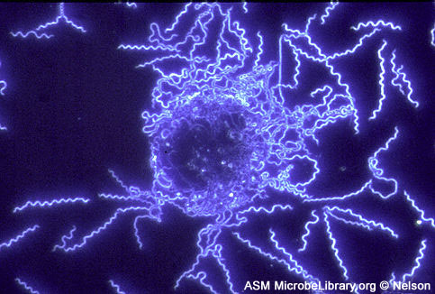
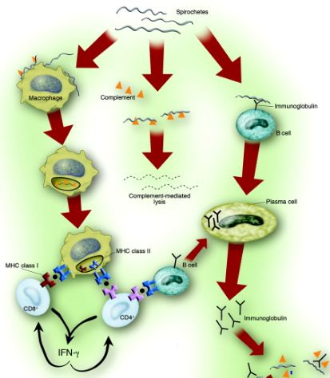
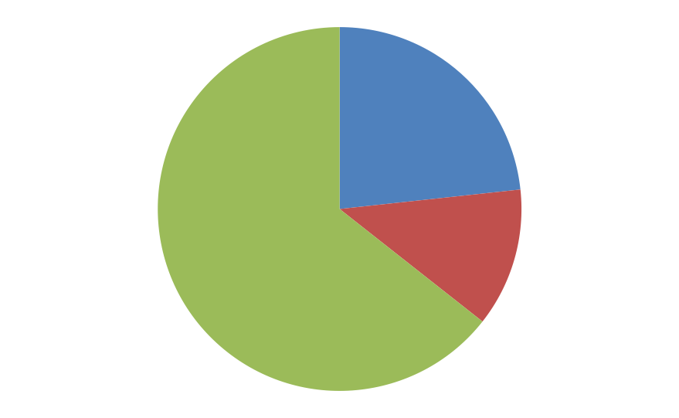
Beyond the Mouse and Test Tube
Human Disease Based Research
24%
n=18
65%
n=48
11%
n=8
Clinical outcomes of Lyme patientsª (n=74)
Returned to pre-Lyme health status
Post-Treatment Lyme Disease Syndrome
Persistent symptoms with
normal functioning
ª Determined at visit 5 (six months following the end of treatment)
Notes:
No differences in demographics (age, income, education) in those with PLS
And those without at 6 months using our broad definition. The PLS rate is slightly
Higher among women (46% of females and 29% of males) although this difference
Was not statistically significant (p=0.17).
No differences in clinical characteristics, including rashsize,
seropositivity, lymphopenia, or elevated liver function tests. The PLS rate was
Slightly higher among those with disseminated lesions (50% vs. 31%) although
This difference was also not significant (p=0.15). Those with PLS also had a longer
Mean duration of illness (10.5 days vs. 7.5 days) but this was also not
significant (p=0.20).

Slide 35
Blood Cytokine and Chemokine levels in
Acute Lyme Disease vs. Uninfected Controls
Lyme Patients Visit 1
Controls
CXCL10
CXCL9
PTLDS Status
Notes:
Elevated Levels of IL-23 in a Subset of Patients with Post-Lyme Disease Symptoms Following Erythema Migrans. StrleK, StupicaD, Drouin EE, Steere AC, Strle F, Clin Infect Dis 2013 Dec 4
Background: As experienced in community-based healthcare settings, Chronic Lyme disease is a heterogeneous group of illnesses, some triggered by tick-borne illness and others not. Post-antibiotic Treatment Lyme Disease Syndrome (PTLDS) refers to a narrowly defined group of patients seen in research settings. The causation of chronic Lyme disease and PTLDS remains controversial. Studies of PTLDS may begin to elucidate some of the pathophysiology involved in the heterogeneous diseases that make up CLD and syndromes such as fibromyalgia and chronic fatigue whose symptoms overlap with PTLDS.
Findings: PTLDS may be associated with immune system abnormalities that perpetuate symptoms after antibiotic therapy. Elevated IL-23 cytokine levels and certain autoantibodies were associated with PTLDS.
One way to use the data is to look at group differences. This slide shows early Lyme disease patients, in red, and controls, in black, at the first visit (acute disease, pre-treatment for cases). Just looking at this at a glance, you can see that there is a difference in intensity of analytes between cases on the left and controls on the right. Look at all the reds and oranges on the left. This specific heat map shows the 18 analytes that are significantly different between cases and controls at the first study visit.

Slide 36
Take-Home Points
Post-treatment Lyme Disease Syndrome is a potential long term complication of Lyme disease.
Patients who are self-identified as having Chronic Lyme Disease need a thorough diagnostic evaluation including a detailed history to identify those with PTLDS
There is evidence that depression is not the “cause” of symptom persistence in PTLDS
After an extensive evaluation many patients will have Medically Unexplained Symptoms or may fit a syndrome such as fibromyalgia or Chronic Fatigue
  PTLDS presents opportunity to model symptom based syndromes
  models incorporate both biologic and behavioral variables that interact to determine patient’s phenotype
Biomarkers for diagnosis and monitoring of Post Treatment Lyme Syndrome are urgently needed

Slide 37
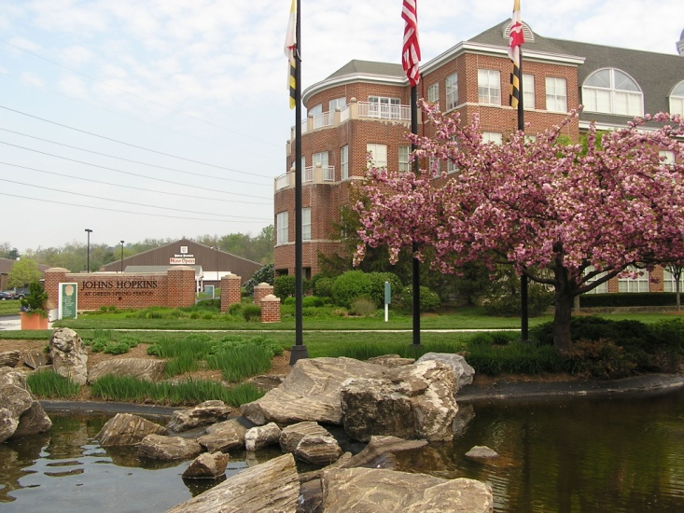

SLICE Study: Understanding the Impact of Lyme disease on human health and immune function
Lyme Disease Research Group
Hopkins Green Spring Station
  Alison Rebman, MPH
Johns Hopkins Schools of Medicine
  Mark J. Soloski, Ph.D., Immunology
  Kate Kortee, Ph.D., Neuropsychology
Stanford U. School of Medicine
  William Robinson, MD
Abbott; Ibis Biosciences division
Mark W. Eshoo, Ph.D.
Chris C. Crowder, Ph.D.

Slide 38
McHugh’s four perspectives
The perspective of disease: what is wrong with the structure of the brain itself? Multiple Sclerosis or Depression from the disease perspective.
  Genetics, environmental exposure, organ pathophysiology
The perspective of dimension: in what way does an individual's character cause him trouble
  Extraversion/introversion, stoic vs. catastrophizer
The perspective of behavior: what actions persist because they have been reinforced, or are driven by biological means
  Conversion disorder, Addiction
The perspective of life-story: what has happened to a person which leads him to experience life (Health) as he does?
  Grief, loss, betrayal, lack of validation

Slide 39
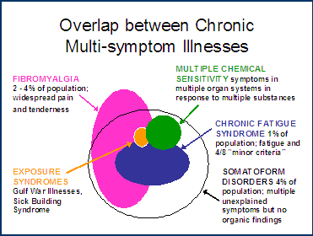
How is PTLDS distinguished from other Symptom based syndromes
Notes:
DO we believe syndromes are real illness, or are they all in the patients head
Patients may be told and fear that “ it is all in my head”: Psychosomatic, Somatization, Somatoform disorders, Hypochondrias
Somatization = HUMAN BEING Reaction to “Hit”, no a causation. One piece to puzzle of why people recover to differing degrees. Model: TBI.

