Slide 1
Adult Immunization and Quality Improvement for Residents Module 2 – Quality Improvement in Adult Immunization
Updated November 2018

Slide 2
Disclosures
[insert your disclosures here]

Slide 3
Overview
Module 1 – Science of Adult Immunization
Module 2 – Quality Improvement in Adult Immunization
Standards for Adult Immunization Practice
Strategies to Increase Adult Immunization
What is Quality Improvement?
Example Quality Improvement Projects
Additional Resources

Slide 4
What is ACP’s Approach to Quality Improvement?
Simple Core Concepts
Establish the What and Why for Change
Identify How to Measure
Change
Plan for Change and Identify Solutions
Implement and Sustain Change
Pillars of ACP’s QI Approach
Clinician Engagement
Team-based Care
Maximize Efficiency and Minimize Burden
Patient and Family Partnerships
Step-by-step Guidance – How will we get there?
Establish Reason
Sustained Change/Improvement
Provide the Tools
Project Management
Template
Process Map
Build Your Team
Cause Analysis
Action-Priority Matrix
PDSA Worksheet

Slide 5
Plan-Do-Study-Act
Many models for QI exist, PDSA is 1 simple method:
Plan
Do
Study
Act
This presentation will use the PDSA model to review how you might improve immunization in your setting…
Notes:
This module will focus on using PDSA methodology to improve immunization rates

Slide 6
Opportunity and Reward
Immunization rates are far below HP2020 goal
Common measure of quality preventive care
Inpatient, outpatient
Adult, obstetric, pediatric
Primary, specialty care
Many elements in process which can be improved
Patient acceptance/demand
Front desk
Nursing/MA
Physician
Checkout

Slide 7
PDSA: 4 step process to improve quality
1. PLAN: Establish a team
Agree on background knowledge
What does our data show?
Analyze your current process…
Design a change

Slide 8
PLAN:
Step 1a: Assemble your team to improve immunization…
Step 1b: Gather background information
What standards apply to vaccination?
What are our national and/or state immunization rates and goals?
…and what about those rates in our community?
Step 1c: Assess your own immunization rates
No need for comprehensive data
Take a Biopsy: Brief audit of 20-30 random charts will suffice
Step 1d: Analyze your immunization process, specify goal
Step 1e: Design 1st change in process
the team will implement to change ‘X’ in immunization process…
Notes:
TEAM work is important in any QI endeavor.
The most successful teams incorporate at least 1 member of all relevant constituencies for the project (although patients are not always included in QI teams, there is a rationale for this and some have done this very successfully).
In assembling the team, it is important that 1 member serve as the team lead; and it is often useful for new teams to include a facilitator who is familiar with QI concepts and processes to help move the project forward.
Once the team is assembled and agrees on a topic of focus, the remaining planning steps can move forward…

Slide 9
BACKGROUND
What are the immunization rules?
Is there a set of national immunization standards?
What are the rates?
Are these static or improving?
Are there other specific factors we need to consider?
Notes:
Background information will help your team to know the rules and to set reasonable goals for your project while identifying potential barriers and ‘quick wins’ which you may be able to achieve…
These are some background questions your team might ask before starting an immunization project…

Slide 10
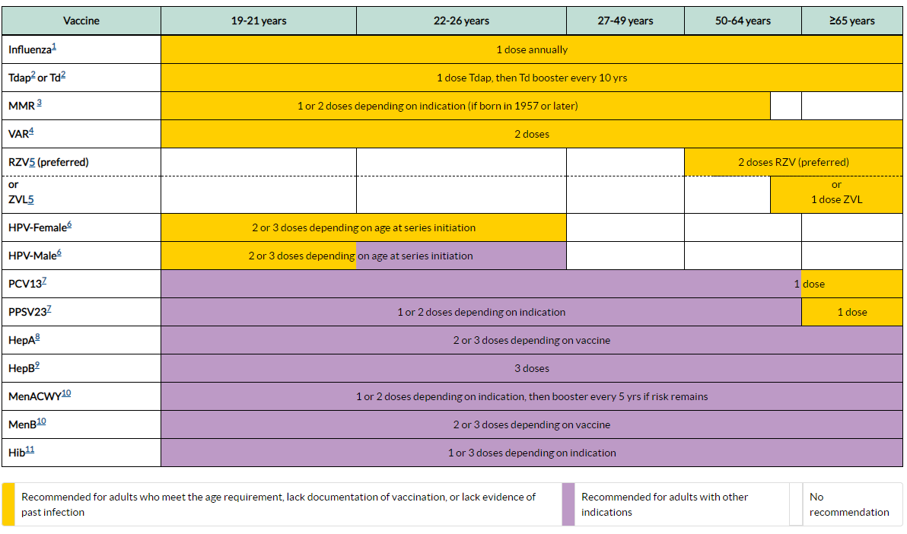
KNOW THE RECOMMENDATIONS …
ACIP Adult Schedule- should be updated annually so the slide set remains current. See source link below.
https://www.cdc.gov/vaccines/schedules/downloads/adult/adult-combined-schedule.pdf
Notes:
This is the AGE BASED ACIP Immunization schedule (and is accompanied by a MEDICAL INDICATION BASED ACIP schedule).
These schedules are updated every year with the most current immunization guidance for US adults.
Travel-based immunization recommendations are not included in this schedule, but are available from CDC Weblinks.

Slide 11
Standards for Adult Immunization Practice
ALL providers should incorporate an immunization needs assessment into every clinical encounter with a strong recommendation to vaccinate!
ASSESS immunization status
Strongly RECOMMEND needed vaccines
ADMINISTER needed vaccines
(or, if unable, REFER patients -> vaccinating provider)
4. DOCUMENT received vaccines
http://www.cdc.gov/vaccines/hcp/patient-ed/adults/for-practice/standards/index.html

Slide 12
Adult Vaccination Rates = POOR!
Vaccine [Population] | 2013 | 2016
Influenza
Influenza – All Adults | 42.7 % | 43.5 %
[All] 19 – 49 years | 30.4 % | 32.1 %
[All] 50 – 64 years | 48.0 % | 46.4 %
> 65 years | 71.7% | 70.4 %
HCW [All] | 75.2 % | (no data)
PPS23 & PCV13
High risk 19 – 49 years | 21.2 % | 24.0 %
> 65 years | 59.7 % | 66.9 %
Tetanus [19 – 49 years, received past 10 years] | 62.9 % | 62.8 %
Tetanus/Pertussis [19+, received in past 10 years] | 17.2 % | 26.6 %
Shingles – Zoster [Age 60+] (2016: above HP 2020 goal!) | 24.3 % | 33.4 %
Hepatitis B Vaccine [High risk 19 – 49 years] | 32.6 % | 32.9 %
HPV Vaccine [Women 19-26 >1 dose] | 36.8% | 48.5%
HPV Vaccine [Men 19-21, >1 dose] | 5.9% | 21.2%
MMWR Feb 5, 2016/ Vol 65(1). http://www.cdc.gov/mmwr/preview/mmwrhtml/mm6436a1.htm
https://www.cdc.gov/vaccines/imz-managers/coverage/adultvaxview/pubs-resources/NHIS-2016.html
Data: NHIS 2013, 2016
Notes:
NHIS – National Interview Survey
The HCW stats are from 2013-2014 season and 2014 – 2015 season

Slide 13
Little Improvement in Most Rates Since 2010
https://www.cdc.gov/vaccines/imz-managers/coverage/adultvaxview/pubs-resources/NHIS-2016.html

Slide 14
Adult Vaccination Rate Disparities: Race
Vaccine [Population] | Rate
Pneumococcal [>65 years]
All Adults | 66.9 %
Hispanic | 48.6 %
White | 71.0 %
Black | 55.5 %
Asian | 52.6 %
“…there are, unfortunately, similar disparities for most adult vaccines and we have not improved these disparities in the past 5 years. This is absolutely unacceptable in the United States in 2018!!” -RHH, MD 9/18/2018
https://www.cdc.gov/vaccines/imz-managers/coverage/adultvaxview/pubs-resources/NHIS-2016.html
Data: NHIS 2016
Notes:
Unlike childhood vaccination rates, we see large ethnic and racial disparities in adult vaccination rates.

Slide 15
Adult Vaccination Rate Disparities: Economic
 | With health insurance |  |  |  |  |  |  | Without health insurance
 | Overall |  | Public |  | Private
Vaccination, age group, increased-risk status | % | (95% CI) | % | (95% CI) | % | (95% CI) |  | % | (95% CI)
Influenza vaccination (2015-16 season)§
≥19 yrs | 46.7 | (45.5-47.9)¶ | 52.0 | (49.7-54.4)¶** | 44.6 | (43.3-46.0)¶ |  | 14.8 | (12.6-17.5)
19-49 yrs | 35.2 | (33.4-37.0)¶ | 35.4 | (31.3-39.9)¶ | 35.1 | (33.2-37.0)¶ |  | 13.5 | (11.1-16.5)
50-64 yrs | 48.8 | (46.8-50.9)¶†† | 52.3 | (47.5-57.3)¶†† | 47.9 | (45.7-50.2)¶†† |  | 19.3 | (14.5-25.6)
≥65 yrs | 70.7 | (68.9-72.5)†† | 68.0 | (65.3-70.6)**†† | 73.4 | (71.0-75.8)†† |  | --¶¶ | --
Pneumococcal vaccination, ever§§
19-64 yrs, increased risk | 25.6 | (24.3-27.0)¶ | 31.3 | (28.9-33.9)¶** | 22.9 | (21.4-24.4)¶ |  | 14.3 | (11.5-17.5)
≥65 yrs | 67.2 | (65.6-68.8)¶†† | 63.3 | (61.0-65.6)¶**†† | 71.4 | (69.5-73.2)¶†† |  | -- | --
Tetanus vaccination, past 10 years***
≥19 yrs | 63.9 | (62.7-65.0)¶ | 58.4 | (56.5-60.3)¶** | 65.9 | (64.7-67.1)¶ |  | 47.5 | (44.6-50.3)
19-49 yrs | 65.3 | (64.0-66.7)¶ | 60.6 | (57.7-63.5)¶** | 66.6 | (65.2-68.0)¶ |  | 47.1 | (43.9-50.3)
50-64 yrs | 65.7 | (63.8-67.5)¶ | 61.6 | (58.3-64.9)¶** | 66.7 | (64.6-68.7)¶ |  | 49.4 | (44.1-54.7)
≥65 yrs | 58.1 | (56.4-59.8)¶†† | 54.7 | (52.4-56.9)**†† | 61.8 | (59.6-63.8)¶†† |  | 37.2 | (20.5-57.5)
Herpes zoster (shingles) vaccination, ever††††
≥60 yrs | 34.1 | (32.7-35.5)¶ | 30.3 | (28.4-32.1)¶** | 36.9 | (35.1-38.8)¶ |  | 7.1 | (4.0-12.3)
60-64 years | 25.2 | (22.9-27.6)¶ | 20.6 | (16.9-24.8)¶** | 26.5 | (23.9-29.3)¶ |  | -- | --
≥65 yrs | 37.6 | (36.0-39.1)¶†† | 32.0 | (29.9-34.1)¶**†† | 43.4 | (41.4-45.5)¶†† |  | -- | --
HPV vaccination among females (at least 1 dose), ever§§§§
19-26 yrs | 50.0 | (46.5-53.6)¶ | 42.6 | (36.4-48.9)** | 53.3 | (49.1-57.5)¶ |  | 34.1 | (26.0-43.4)
HPV vaccination among males (at least 1 dose), ever§§§§
19-26 yrs | 13.5 | (11.4-15.9) | 17.6 | (11.7-25.6) | 12.5 | (10.3-15.1) |  | 13.4 | (7.9-22.0)
Lack of health insurance is a powerful predictor of lack of immunization…
https://www.cdc.gov/vaccines/imz-managers/coverage/adultvaxview/pubs-resources/NHIS-2016.html

Slide 16
What are your local immunization rates?
State or Local Health Department
IIS (Immunization Information System) Data
NHIS Survey data for your location (sample size??)
Your institution
EMR QI/Immunization Dashboard?
Useful for baseline data but changes from small scale project(s) may not be visible for some time…
Chart audit
Need not be extensive to give a ‘sense’ of status
20-30 Randomly selected charts can be an adequate ‘biopsy’
Focus on 1 or 2 elements to maximize value/time equation
Notes:
State and local data may be available but will require a little more ‘digging.’ All states and some smaller jurisdictions have an immunization registry. Registries (IIS) were initially developed to track childhood immunization but many now include some adult data and can be classified as ‘LIFESPAN IMMUNIZATION REGISTRIES.’ Unfortunately, the quantity of adult data and what data sources feed these registries (EMR’s, Pharmacies, clinics, schools, others) are variable across the nation.
The National Health Information Survey is a telephone based survey which is done every 1-2 years and asks questions from randomly selected households about immunization and then attempts to correlate this data with that from providers. The data is available by state but the sample size can be too small to make conclusions in many areas…

Slide 17
What are ‘the gaps’ in your immunization process??
Is there DEMAND for vaccine from patients?
Are there BARRIERS to vaccinating patients?
Is your STAFF knowledgeable and supportive of immunization as a quality goal?
Do you WALK THE WALK as well as talk the talk?
Notes:
So… thinking about your own immunization process… These are some potential ideas to help you to think about the immunization process in your setting. Are there other elements you think we should consider for improvement???

Slide 18
IMMUNIZATION PROJECT IDEAS…
If you and your team have already developed a question (or set of questions) you wish to address, great! If not the next few slides outline some evidence and ideas that may help you make a plan for improvement…

Slide 19
Evidence-Based Strategies to Increase Adult Immunization
Provider Recommendation & Communication
Reminder – Recall
Chart/Provider Reminders
Standing Orders
Immunization Information Systems

Slide 20
1. Provider Recommendation
Physicians who consistently offer vaccines and provide vaccine recommendations have significantly higher uptake of immunization by patients.
Making physician assessment and vaccine recommendation routine is key to improving coverage
Physician recommendation can help reduce racial and ethnic disparities in vaccine coverage
Physician engagement of staff is important in alignment in entire team’s message
Hurley, et al. Annals of Internal Medicine, 2014.
www.thecommunityguide.org/vaccines/index.html
www.cdc.gov/mmwr/preview/mmwrhtml/mm6305a4.htm

Slide 21
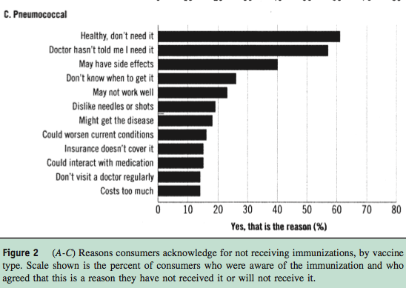

Slide 22
Who Most Influences Adults’ Decisions to Get Immunized?
 | Ages 18-26 | Age 65 and Older | All Adults
Personal physician | 47% | 82% | 69%
Family member | 33% | 6% | 19%
Celebrity physician, public figure, other | 11% | 4% | 7%
None of the above | 7% | 6% | 4%
No answer | 2% | 1% | 1%
NFID. 2009 National Adult Immunization Consumer Survey: Fact Sheet. http://www.adultvaccination.com/doc/Survey_Fact_Sheet.pdf
AMA. American Medical News. Physicians asked to persuade adults to get immunized.
http://www.ama-assn.org/amednews/2009/08/03/prsc0803.htm

Slide 23
Clinician Recommendation Translates Into Higher Vaccination Rates
(Even for Patients With Negative Attitudes)
Vaccination Rate (%)
*High-risk patients were those ages 65 and older or those having heart disease, lung disease, diabetes, or other serious illness.
Nichol KL, et al. J Gen Intern Med. 1996;11(11):673-677.

Slide 24
Patient Barriers
Patient Issue | Solution
Fear and misconception | Educate patients Use written materials (i.e., vaccine information statements) Discuss Pain of vaccination Safety of vaccines—thimerosal/autism Danger of illnesses caused by vaccines
Lack of Recommendation | Recommend vaccination to all patients
Lack of Access | Make it easier for patients Express vaccinations, extended hours Extended vaccination season Vaccination in nontraditional settings Target hospitalized patients
Lack of Awareness | Communicate with patients Telephone, letters/postcards, e-mail alerts “No one ever told me that.” – stress the importance of vaccination in the context of underlying disease
Inability to Pay | Discuss options with patient
Language Barrier | Use translated educational materials
Nichol KL. Cleve Clin J Med. 2006;73:1009-1015.

Slide 25
SHARE Mnemonic for helping vaccine hesitant patients/families
Share the reasons why the recommended vaccines are right for the patient given age, health status, lifestyle, job, or other risk factors.
Highlight your own experiences with vaccination to reinforce benefits and strengthen confidence.
Address patient questions and any concerns about vaccines, including side effects, safety, and vaccine effectiveness, in plain and understandable language.
Remind patients that many vaccine-preventable diseases are common in the U.S. and can be serious for them.
Explain the potential costs of getting VPDs, including serious health effects, time lost (such as missing work or family obligations), and financial costs.
VPDs= Vaccine Preventable Diseases

Slide 26
If patients remain hesitant or are not ready to get vaccinated
Emphasize benefits of getting vaccinated TODAY
Vaccination today will provide protection sooner
Provide education materials or trusted websites
Send reminders about needed vaccines
Document the conversation in the patient record
Offer ‘drop in vaccination’ or ‘shot only’ opportunity
Note reason for refusal/delay, leverage this at future visit
Plan to continue the conversation or vaccinate at next visit, specify this in your documentation
‘Close the deal’ by following up and vaccinating as planned!

Slide 27
2. Reminder – Recall
Strategy to remind patients that vaccines are
due (reminder) or
late (recall)
Multiple potential delivery methods
(telephone, letter, email, text)
Include materials targeted to patient-specific risks (asthma, diabetes, HIV, smokers,...)
Shown to increase in vaccination coverage 12 – 20%
Guide to Community Preventive Services http://www.thecommunityguide.org/vaccines/clientreminder.html
Notes:
Here are some possible questions you may receive from the audience:
What time of year do you start projects like these?
What staff makes the patient lists for the QI project?
What are the EHR considerations such as basic reporting functions of patient records?

Slide 28
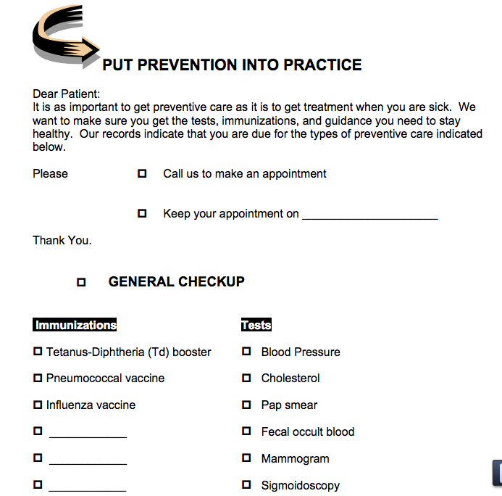
Sample Reminder Notice
Notes:
This is an example reminder notice and if you use this strategy, modify to meet your practice/patient needs.

Slide 29
3. Chart/Provider Reminders
Effective strategy to alerting provider/team that patients are due for vaccines
Can be accomplished via
Review conducted in advance [part of pre-visit planning]
EMR alert at the point of care
Sticker or flag (on the front of a paper chart)
Shown to increase vaccination 12 – 16% overall
EHR based alerts have been shown to result in up to 50% increase in influenza and pneumococcal vaccinations.
http://archinte.jamanetwork.com/article.aspx?articleid=1105941
http://www.thecommunityguide.org/vaccines/providerreminder.html
Notes:
If there are questions on who will remind the provider, explain it could be the medical assistant, nurse, or a reminder in the EHR depending on clinic workflow.

Slide 30
4. Standing Orders Protocol (SOPs)
Strategy to avoid missed vaccination opportunities by allowing non – physician providers to administer vaccines without direct physician involvement
Require education and team-based care
Often coupled with pre-visit planning, reminder-recall
Recommended by many groups, including:
CDC Advisory Committee on Immunization Practices (ACIP)
U.S. Preventive Services Task Force
Endorsed by CMS specifically for use in Immunization

Slide 31
Benefits of Standing Orders
Improve immunization rates
Empower non-physician staff
Free up physician time for other important pt. care
Help meet quality metrics
Can be implemented in inpatient and outpatient settings
Approved by CMS Specifically for Vaccination

Slide 32
Basic Procedure under Standing Order
Recommend vaccination
“Your doctor strongly recommends flu vaccines and wants you to have it – may I give it to you now?”
If patient has concerns, may defer to provider
Screen for contraindications and precautions
Provide appropriate Vaccine Information Statement (VIS)
Administer vaccine
Document vaccine administration
Route to provider for order signature

Slide 33
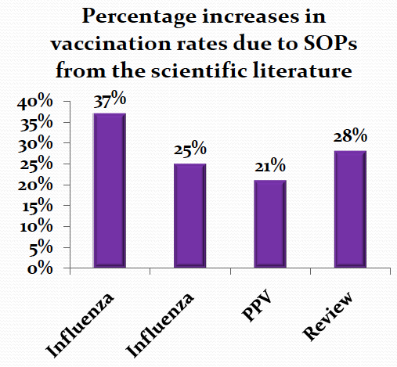
Standing Orders Protocols are Effective
Pharmacotherapy2007;27:729-733
Journal of American Geriatric Society2005;53:1008-1010
American Journal of Kidney Diseases2009;54:6-9
American Journal of Preventive Medicine2000;18(1S):92-6

Slide 34
Standing Orders Resources
ACP’s I Raise the Rates Webinar-Standing Orders-A Model to Fit Your Practice https://www.acponline.org/sites/default/files/documents/clinical_information/resources/adult_immunization/final_nov_2015_standing_orders_webinar.pptx
Toolkit with sample protocols, best practices, and useful resources
www.immunizationed.org/standingorders
Other examples of SOPs
www.immunize.org/standingorders/
www.mass.gov/Eeohhs2/docs/dph/cdc/immunization/mso_protocols_general.pdf
www.nyc.gov/html/doh/html/imm/flu-ptk6.shtml

Slide 35
Inpatient Protocol Examples
Pre-printed admissions order forms including vaccine/immunization order
Nursing – based
Nurse screens for eligibility and either vaccinates by standing order or puts preprinted order on chart for physician
Pharmacy – based
Pharmacist screens for eligibility using age, medications, or diagnoses with computer facilitation
Computer – enabled
Physician order entry screens or pharmacy as above

Slide 36
5. Immunization Information Systems (IIS): State Lifespan Registries
IIS (registries) are confidential, population-based, computerized databases that record all immunization doses administered by participating providers in a given area
IIS capabilities vary by state and locality
Generally have robust vaccinations records for children; adult data is more variable
Due to the mobility of the U.S. population, IIS will be critical to easily access complete vaccine histories
Multiple vaccine providers and locations for adults
Need for systematic reporting to IIS
Interoperability/data sharing between IIS systems= needed!
http://www.cdc.gov/vaccines/programs/iis/contacts-registry-staff.html
Notes:
The CDC has a contact list of state IIS staff: http://www.cdc.gov/vaccines/programs/iis/contacts-registry-staff.html

Slide 37
IIS Goals and Submitting Data
Goals:
Ensure appropriate delivery of immunizations to a population
Support delivery of clinical immunization services at the point of immunization administration
Maintain data quality to avoid unnecessary or duplicative dosing
Submitting Data:
Requires EHR integration with IIS via Secure File Transfer Protocol (SFTP) interface
Provider enters immunization data into EHR
IIS sends an receipt email upon successful upload
EHR automatically uploads to IIS

Slide 38
IIS Effectiveness
Recommended by Community Preventive Services Task Force with strong evidence of effectiveness
IIS successful in:
Supporting reminder-recall systems & provider reminders
Identifying patient vaccination status, missed opportunities, invalid dosing, disparities in vaccination coverage
Guiding public health response to outbreaks of vaccine-preventable disease

Slide 39
PDSA: 4 step process to improve quality
DO: Implement your process change Collect data

Slide 40
Do:
Implement your chosen project
Usually best to do a small scale/short interval project in first cycle to ‘prove concept’
Assure all who may be ‘touched’ by this are aware
Specify project parameters:
E.g. 1 provider, 1 week, 1 clinic (what works for you??)
Include a data collection plan in your project!
‘Simple spreadsheet’
Run chart can help demonstrate effects of change

Slide 41
PDSA Process
Plan
Design a process change: Identify gap in care, champions and stakeholders, process for change (with measurable outcome and timeframe)
Do
Put the process change into place
Study
Review the data
Act
Abandon, adapt, adopt, or repeat again

Slide 42
Use of PDSA in Adult Immunization: 1 example…
Plan
Documentation of zoster vaccination among elderly is 15%. For each Medicare visit, record zoster vaccination status.
Do
Over 3 months, document vaccination status: received vaccine, contraindicated, declined (with reason for decline), were not offered
Study
After 3 months, documentation has increased to 50%
Act
Continue documentation, consider implementing standing orders

Slide 43
QI Starter – Example #1
You have done a quick audit of 30 randomly selected patients in your continuity clinic panel and see that only 40% of your patients received an influenza vaccine and had it documented in the EMR in the 2017 – 18 season.
What elements can you identify that might play into this low vaccination rate?
What simple intervention can be implemented to address this issue?
What other team members do you want to engage in this project to improve your likelihood of success?
What is the specific goal that you aim to reach?
Notes:
Elements: Recommendation? Vaccination? Record keeping? Missed opportunities? Reach out to patients for external vaccinations/record in EMR?
IDEAS:
Precharting: Identify immunization gaps [may be useful to implement prechart and/or standing orders to close these gaps]
Registration: Opportunity to assess immunization status [use an immunization questionnaire at registration]
Start recommendations for vaccination at checkin desk or by patient information materials in waiting room
Rooming: Implement standing orders to vaccinate willing patients before the provider sees patient, provider can intervene with patients who have questions
Providers: Assure all are on the same page and have knowledge/skills to effectively encourage vaccines, order vaccines, refer for vaccination…
Team: QI facilitator with some background in principles and experience in at least 1-2 projects.
Team lead (Physician, nurse or resident who will set agenda and be accountable for timelines)
Nurse, MA
Others??
Choose a project, set a goal…

Slide 44
PDSA: 4 step process to improve quality
Study: Assess impact of change
Collect +
Review +
Analyze data
What did we learn?
Identify refinements

Slide 45
Study: Assess impact of change
Collect data [if not done live-time during Do step]
Review data and compare with baseline
Answer 3 questions:
Did this change make an impact? (did impact meet goal?)
Was the change efficient? (Was impact/effort >1?)
What is the next step?
Continue same project for another cycle (insufficient data)
Modify and repeat small scale (impact or efficiency low)
Disseminate (Expand to more providers/sites) (success- generalize?)
Drop this project/do something different next time (poor/no result)
Add a second small change onto initial change (success < goal)

Slide 46
QI Starter – Example #2
You have performed an audit of 30 randomly selected inpatients cared for on the Internal Medicine service in the past year for CHF. You can find no documentation that any of them received Pneumococcal vaccination while hospitalized.
What is your analysis of this situation?
What simple interventions might be implemented to try to improve this care quality issue?
Whom should you engage in your team to make this happen?
What is the specific goal you hope to achieve?
Notes:
Analysis: Were patients ASKED about prior vaccine?
Was vaccine offered (who asks, what is the process, how is it documented)?
Was vaccine given (who, when, does this require a specific order, is there a standing order in place)?
Was given vaccine not recorded (do we have a working vaccine registry in EMR, does it communicate with IIS)?
For any of these elements- brainstorm about potential changes and focus on simplicity…
Who should be on QI team?
Set a specific goal…

Slide 47
Sample QI Projects
Strategy Utilized | Vaccine | Population | Details
Patient Communication | Hepatitis B | Diabetics | Generate list of all diabetic patients <60 years old, at next visit recommend vaccination against Hepatitis B
Reminder – Recall | Influenza | All adults | At the start of flu season, send patient communication to remind patients to receive vaccine. After 2 months, identify patients not yet vaccinated and resend reminder
Chart Reminder | HPV | Female patients 19 – 26 & Male patients 19 – 21 | Query EHR to identify eligible patients who have not received HPV vaccine. Program an alert in patient charts to discuss and administer vaccine at next visit
Standing Orders | Tdap | Pregnant women, 27 – 36 weeks gestation | Set up, educate re: Standing Order. For each pregnant patient, staff will offer/administer/document in record
Immunization Information Systems | Pneumo | Patients over 65 | For each visit with patients 65+, assess pneumo vaccination status in EMR from IIS, vaccinate if not in record.

Slide 48
PDSA: 4 step process to improve quality
Act: Evaluate lessons learned and
Systematize and/or refine 1st change
Develop process to sustain improvements
Initiate next improvement cycle

Slide 49
Act:
Put results of Study of 1st change into action
Unsuccessful project:
What was missed in 1st cycle? Did we start with correct target?
Design/implement new intervention based on this analysis
Partially-Successful project:
Efficient: Modify and disseminate or Modify and repeat
NOT Efficient: Can we make process/project efficient? YES NO
Successful project
Assess efficiency, resources needed to sustain project to determine how to proceed (see partial success)
Implement next cycle of improvement (based on above)

Slide 50
Additional Resources
ACP Adult Immunization Resource Hub
http://acponline.org/ai
CDC Patient Education Materials http://www.cdc.gov/vaccines/hcp/patient-ed/adults/index.html
Adult Vaccinations Resource Library http://www.immunize.org/adult-vaccination/resources.asp
What Works to Increase Adult Vaccination Rates http://www2a.cdc.gov/vaccines/ed/whatworks/index.html
Quick Guide to Adult Vaccine Messaging http://www.izsummitpartners.org/wp-content/uploads/2014/05/AdultVaccineMessaging.pdf
October 2014

Slide 51
Backup Slides

Slide 52
State Lifespan Registries
Population Level
Aggregates data on vaccinations for surveillance and guiding public health action
Point-of-Care
Provides consolidated immunization histories for use by vaccination provider

Slide 53
Sample: Influenza Standing order

Slide 54
Sample EHR Reminders (Epic EMR)

Slide 55
Establishing your QI Team Resources
https://www.acponline.org/system/files/documents/clinical_information/resources/adult_immunization/building_your_team_worksheet.pdf
https://www.ahrq.gov/professionals/prevention-chronic-care/improve/system/pfhandbook/mod14.html
https://www.aafp.org/fpm/1999/0400/p25.html
http://www.ihi.org/resources/Pages/HowtoImprove/ScienceofImprovementFormingtheTeam.aspx
http://www.ihi.org/communities/blogs/make-patients-on-the-qi-team-the-norm-not-the-exception
https://www.go2itech.org/2017/07/involving-patients-in-qi-the-caribbean-collaborative-careqic/

