Slide 1
Adult Immunization and Quality Improvement for Residents Module 1 – Science of Adult Immunization
Updated September 2019

Slide 2
Overview
Module 1 – Science of Adult Immunization
Adult Immunization Rates
ACIP Recommended Adult Vaccine Schedule
Vaccination Among Special Populations:
Diabetics
Healthcare workers
Pregnant women
The elderly
Module 2 – Quality Improvement in Adult Immunization

Slide 3
Disclosures
[insert your disclosures here]

Slide 4
Opportunity and Reward
Immunization rates are far below HP2020 goals
Common measure of quality preventive care
Inpatient, outpatient
Adult, obstetric, pediatric
Primary, specialty care
Many elements in process which can be improved
Front desk
Nursing/MA
Physician
Checkout
HP2020 = Healthy People 2020
www.healthypeople.gov

Slide 5
Adult Vaccination Rates = POOR!
Vaccine [Population] | 2013 | 2017
Influenza
Influenza – All Adults | 42.7 % | 45.4 %
[All] 19 – 49 years | 30.4 %
[All] 50 – 64 years | 48.0 %
> 65 years | 71.7%
HCW [All] | 75.2 %
PPS23 & PCV13
High risk 19 – 49 years | 21.2 % | 24.5 %
> 65 years | 59.7 % | 69.0 %
Tetanus [19 – 49 years, received past 10 years] | 62.9 % | 63.4%
Tetanus/Pertussis [19+, received in past 10 years] | 17.2 % | 31.7%
Shingles – Zoster [Age 60+] | 24.3 % | 34.9%
Hepatitis B Vaccine [High risk 19 – 49 years] | 32.6 % | 32.9 %
HPV Vaccine [Women 19-26 >1 dose] | 36.8%
HPV Vaccine [Men 19-21, >1 dose] | 5.9%
MMWR Feb 5, 2016/ Vol 65(1). http://www.cdc.gov/mmwr/preview/mmwrhtml/mm6436a1.htm
https://www.cdc.gov/vaccines/imz-managers/coverage/adultvaxview/pubs-resources/NHIS-2017.html
Data: NHIS 2013, 2017
Notes:
NHIS – National Interview Survey
The HCW stats are from 2013-2014 season and 2014 – 2015 season

Slide 6
Little Improvement in Most Rates Since 2010
https://www.cdc.gov/vaccines/imz-managers/coverage/adultvaxview/pubs-resources/NHIS-2017.html#trends-coverage

Slide 7
Adult Vaccination Rate Disparities: Race
Vaccine [Population] | Rate
Pneumococcal [>65 years]
All Adults | 69.0
White | 73.2
Black | 57.3
Hispanic | 51.0
Asian | 55.6
“…there are, unfortunately, similar disparities for most adult vaccines and we have not improved these disparities in the past 5 years. This is absolutely unacceptable in the United States in 2018!!” -RHH, MD 9/18/2018
https://www.cdc.gov/vaccines/imz-managers/coverage/adultvaxview/pubs-resources/NHIS-2017.html#flu
Data: NHIS 2017
Notes:
Unlike childhood vaccination rates, we see large ethnic and racial disparities in adult vaccination rates.

Slide 8
Adult Vaccination Rate Disparities: Economic
 | With health insurance |  |  |  |  |  |  | Without health insurance
 | Overall |  | Public |  | Private
Vaccination, age group, increased-risk status | % | (95% CI) | % | (95% CI) | % | (95% CI) |  | % | (95% CI)
Influenza vaccination (2015-16 season)§
≥19 yrs | 46.7 | (45.5-47.9)¶ | 52.0 | (49.7-54.4)¶** | 44.6 | (43.3-46.0)¶ |  | 14.8 | (12.6-17.5)
19-49 yrs | 35.2 | (33.4-37.0)¶ | 35.4 | (31.3-39.9)¶ | 35.1 | (33.2-37.0)¶ |  | 13.5 | (11.1-16.5)
50-64 yrs | 48.8 | (46.8-50.9)¶†† | 52.3 | (47.5-57.3)¶†† | 47.9 | (45.7-50.2)¶†† |  | 19.3 | (14.5-25.6)
≥65 yrs | 70.7 | (68.9-72.5)†† | 68.0 | (65.3-70.6)**†† | 73.4 | (71.0-75.8)†† |  | --¶¶ | --
Pneumococcal vaccination, ever§§
19-64 yrs, increased risk | 25.6 | (24.3-27.0)¶ | 31.3 | (28.9-33.9)¶** | 22.9 | (21.4-24.4)¶ |  | 14.3 | (11.5-17.5)
≥65 yrs | 67.2 | (65.6-68.8)¶†† | 63.3 | (61.0-65.6)¶**†† | 71.4 | (69.5-73.2)¶†† |  | -- | --
Tetanus vaccination, past 10 years***
≥19 yrs | 63.9 | (62.7-65.0)¶ | 58.4 | (56.5-60.3)¶** | 65.9 | (64.7-67.1)¶ |  | 47.5 | (44.6-50.3)
19-49 yrs | 65.3 | (64.0-66.7)¶ | 60.6 | (57.7-63.5)¶** | 66.6 | (65.2-68.0)¶ |  | 47.1 | (43.9-50.3)
50-64 yrs | 65.7 | (63.8-67.5)¶ | 61.6 | (58.3-64.9)¶** | 66.7 | (64.6-68.7)¶ |  | 49.4 | (44.1-54.7)
≥65 yrs | 58.1 | (56.4-59.8)¶†† | 54.7 | (52.4-56.9)**†† | 61.8 | (59.6-63.8)¶†† |  | 37.2 | (20.5-57.5)
Herpes zoster (shingles) vaccination, ever††††
≥60 yrs | 34.1 | (32.7-35.5)¶ | 30.3 | (28.4-32.1)¶** | 36.9 | (35.1-38.8)¶ |  | 7.1 | (4.0-12.3)
60-64 years | 25.2 | (22.9-27.6)¶ | 20.6 | (16.9-24.8)¶** | 26.5 | (23.9-29.3)¶ |  | -- | --
≥65 yrs | 37.6 | (36.0-39.1)¶†† | 32.0 | (29.9-34.1)¶**†† | 43.4 | (41.4-45.5)¶†† |  | -- | --
HPV vaccination among females (at least 1 dose), ever§§§§
19-26 yrs | 50.0 | (46.5-53.6)¶ | 42.6 | (36.4-48.9)** | 53.3 | (49.1-57.5)¶ |  | 34.1 | (26.0-43.4)
HPV vaccination among males (at least 1 dose), ever§§§§
19-26 yrs | 13.5 | (11.4-15.9) | 17.6 | (11.7-25.6) | 12.5 | (10.3-15.1) |  | 13.4 | (7.9-22.0)
Lack of health insurance is a powerful predictor of lack of immunization…
https://www.cdc.gov/vaccines/imz-managers/coverage/adultvaxview/pubs-resources/NHIS-2016.html

Slide 9
Vaccination Rates Are Inadequate: Messages for Doubters…
Vaccine preventable diseases kill more Americans annually than traffic accidents, breast cancer, or HIV/AIDS
YET…
Only ~1/5 of eligible adults (18 – 64) received Tdap in past 2 years
~1/3 of adults > 60 have had a shingles vaccine
Lifetime risk of shingles is 1/3, increasing with age!
~ 1/5 % of eligible women received HPV vaccine series [far less men!]
HPV causes a majority of cervical and a number of other cancers
~ 40 % of all adults are vaccinated annually for influenza
And influenza caused about 80,000 deaths in US in 2017-18 season…
~ 60% of patients > 65 have received any pneumococcal vaccine
http://healthyamericans.org/assets/files/TFAH2010AdultImmnzBrief13.pdf

Slide 10
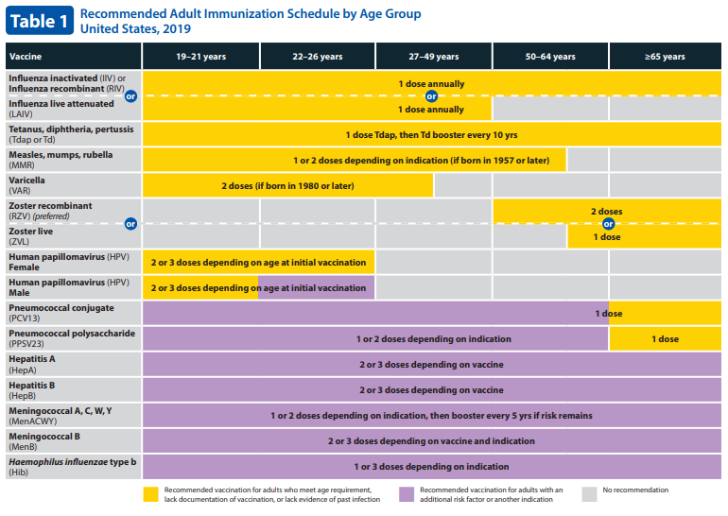
Adult Immunization Schedule: Age
http://www.cdc.gov/vaccines/schedules/hcp/imz/adult-conditions.html

Slide 11
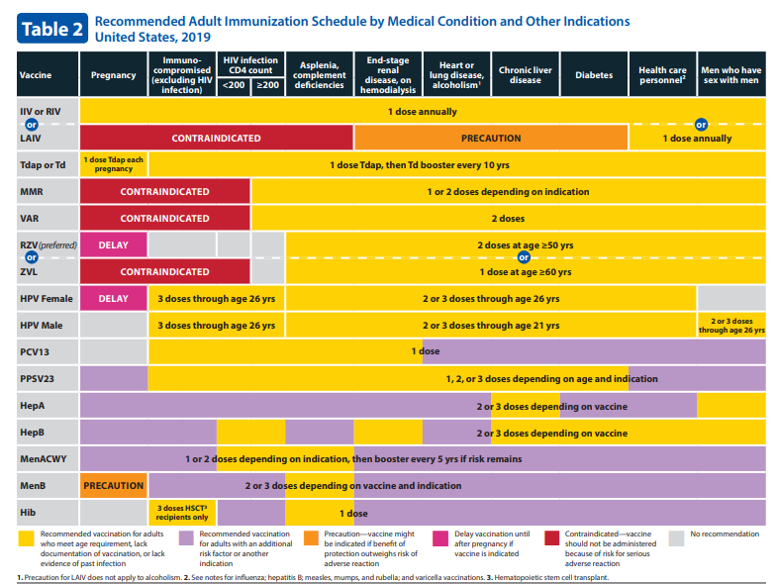
Adult Immunization Schedule – Medical Indications
http://www.cdc.gov/vaccines/schedules/hcp/imz/adult-conditions.html

Slide 12
Vaccine Groups
“All Adults | “Risk-Based”
Influenza | HPV
Pneumococcal [PCV13, PPSV23] | MMR
Tdap | Varicella
Zoster | Meningococcal Quad [MCV4, MPSV4] MenB
 | Hepatitis A
 | Hepatitis B
Notes:
Multiple specific vaccines with different indications are available for a number of these diseases and these are specified in this table.
Maria needs (unless previously vaccinated):
Annual Influenza vaccine [in season]
Tdap
HPV series
MMR
Varicella
Hepatitis B series

Slide 13
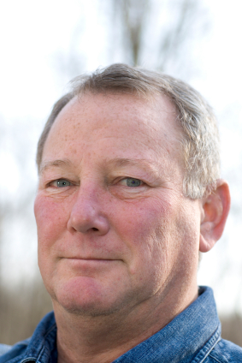
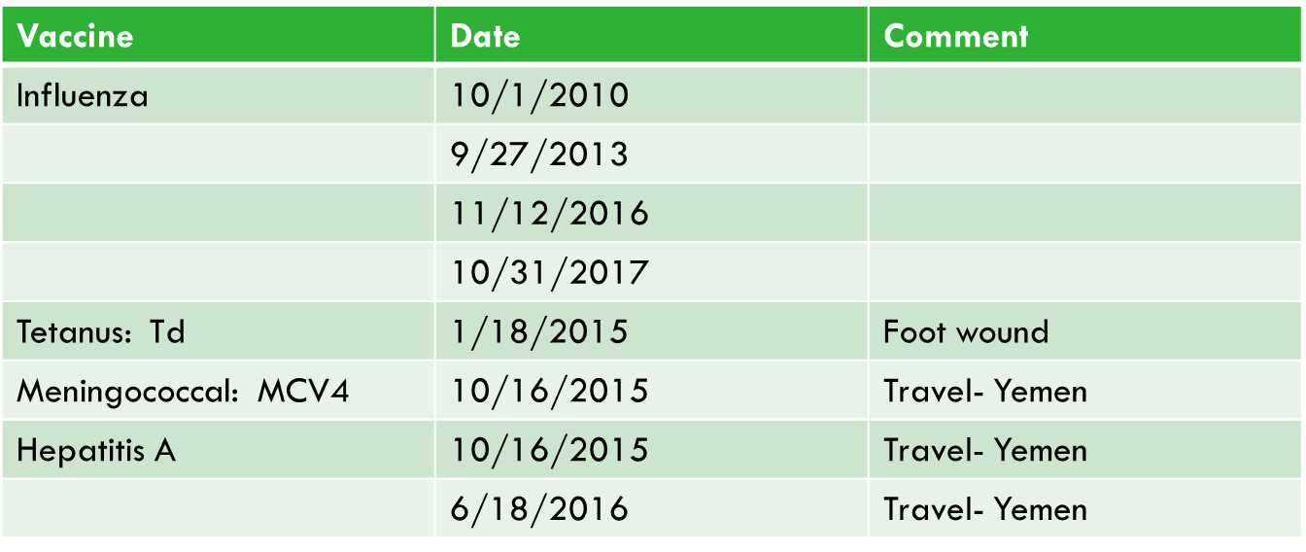
Case 1
John Francis is a 42 year old man with diabetes and hypertension seen for a ‘routine follow-up’ of his diabetes.
His immunization record is shown.
Which vaccines should you strongly recommend that he receive today?
Click here to reveal the correct answer
Influenza, Pneumococcal (PPSV23), Tdap, Hepatitis B
Notes:
Look at the last booster dose for the vaccines?
Vaccines reviewed:
- Influenza
- Tdap
- Pneumo
- Hep B

Slide 14
Clinical Vaccinology: Part 1
Influenza
Pneumococcal (PCV13, PPSV23)
Tdap and Td

Slide 15
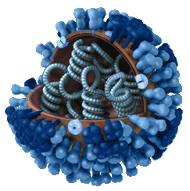
Influenza
Influenza: Orthomyxoviridae family [enveloped RNA virus]
3 types based on surface Ag [HA, NA] + internal structure
A: Multiple hosts – Birds, Mammals [Man]. Many HA, NA types
B: Humans (only)
C: Humans (only) Mild illness ‘URI’
Vaccinate from ‘Vaccine available’ thru ‘no disease in community’
Up to 50,000 deaths annually in US from Influenza
200K+ assoc. hospitalizations, chronic illnesses exacerbations
> 90% seasonal influenza M&M occurs in adults > 65 years
H3N2 strains cause greatest morbidity/mortality in adults
Vaccination= MOST effective intervention vs. illness, death
http://www.cdc.gov/flu/avian/gen-info/flu-viruses.htm
Notes:
Influenza vaccines administered in US Contain 2 A strains [H1N1 and H3N2] and 1-2 B strains.
The strains to be included in annual Northern Hemisphere (including USA) influenza vaccine are chosen in February of each calendar year for that fall’s flu season based on the circulating strains in the Southern Hemisphere. Goal is for vaccine strains to match the virus strains which will circulate in the Northern Hemisphere. Predictions are usually, but not always, accurate. This can occur for 2 reasons: Viral reassortment can result in circulating strain drift from the chosen strain or the vaccine virus match with circulating strains may not be as strong as expected.

Slide 16
US Influenza Vaccines => AAAA
Vaccinate ALL ADULTS AND kids 6+ months old ANNUALLY!!
IIV: ‘Inactivated influenza vaccines’
Administered IM to “All comers” 6+ months old
Multiple flu vaccines approved each year
Differ: age(s) for whom approved, production method, +/- adjuvant in formulation,…
Some are TRI-valent, others QUAD-rivalent
NO published trials of comparative efficacy of TRI vs. QUAD
Take home message (from ACIP… and from me):
IMMUNIZE with a vaccine approved for (your) patient!
# Falsey, et.al. J ID 2009, June9 [Epub]; C. Bridges CDC Personal Comm. 3/2013
http://www.nejm.org/doi/full/10.1056/NEJMoa1315727 http://www.fda.gov/NewsEvents/Newsroom/PressAnnouncements/ucm474295.htm
Notes:
IIV= Current abbreviation for ‘Inactivated Influenza Vaccine’ recognizing that there are many vaccine variations: Quadrivalent, Cell culture based, High-Dose, Recombinant, Adjuvanted…

Slide 17
US Influenza Vaccines => AAAA (continued)
Is there evidence to support a specific vaccine for my patient?
SENIORS:
High-Dose IIV, Adjuvanted IIV (TRI) are at least equivalent to standard vaccine
ANAPHYLACTIC Egg Hypersensitivity/Allergy: Use egg-free vaccine
Recombinant HA vaccine: egg-free, all HA no NA (QUAD)
Cell culture vaccine: essentially egg-free (femtograms of egg protein) (TRI)
Egg allergy is NOT a contraindication to Influenza vaccination
If sensitivity is NOT anaphylactic, can use any vaccine.
‘NEEDLE-PHOBIC’+ AGE 2-49 YEARS:
LAIV: Live-attenuated, cold-adapted nasal (QUAD)
Take home: DON’T DELAY waiting on specific product: Vaccinate!
# Falsey, et.al. J ID 2009, June9 [Epub]; C. Bridges CDC Personal Comm. 3/2013
http://www.nejm.org/doi/full/10.1056/NEJMoa1315727 http://www.fda.gov/NewsEvents/Newsroom/PressAnnouncements/ucm474295.htm

Slide 18
Influenza Vaccine Priorities
ALL 6 MONTHS AND OLDER + DON’T WANT THE FLU
HEALTHCARE WORKERS
High risk for disease (symptomatic and asymptomatic)
High risk for transmission
If sick, not available to provide healthcare…
PATIENTS AT HIGHEST RISK (Spread +/- SEVERE ILLNESS)
Pregnant women
Newborns and children < 2 years
Ade 65+ years
“Medical Comorbidities” (including BMI 40+ kg/m²)
Immunecompromise
Household contacts of high-risk
Long-term care, institutionalized, crowded living conditions
http://www.cdc.gov/vaccines/pubs/vis/downloads/vis-flu.pdf

Slide 19
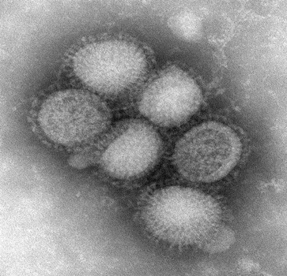
Influenza ‘Nuts and Bolts’
IIV: 1 dose for adults (and children 9+ years)
Regardless of vaccine selected
LAIV may be safely used in MOST HC settings as alternative to TIV
Kids < 9 years, 1st vaccine season: 2 doses 4+ weeks apart
Vaccine effectiveness is multifactorial
Match between ‘disease’ and ‘vaccine’ strains
~2 weeks following vaccine to develop immunity
Cited efficacy may not reflect all benefits
reduction in severe illness, deaths, hospitalization
Patient ‘substrate’ estimates:
‘Healthy young < 65’ at ~60 – 80% v. ‘Sick older > 65’ at 30-40%
What does the future hold???
Influenza Pandemics (shift or reassortment with avian, porcine virus)
Universal Influenza vaccine
Novel vaccine delivery systems
http://www.cdc.gov/vaccines/pubs/vis/downloads/vis-flu.pdf
http://www.premierinc.com/all/safety/safety-share/12-05-downloads/03-shea-hcw-flu-position-paper.pdf . DiazGranados, et.al. NEJM 371(7), August 14, 2014.
https://cc.readytalk.com/cc/s/meetingArchive?eventId=rtv7rz2szhrw
Notes:
ACIP makes no statement about the preference for 1 influenza vaccine over another.
Future: We have already seen a number of small outbreaks of human disease with ‘avian’ or ‘porcine’ influenza- reassortant forms of Influenza A which can then be transmitted to humans and between humans from animal reservoirs. Examples: H5N1, H7N3… Ongoing surveillance and development of candidate vaccines to protect humans from these threats will be needed to minimize the risk for a widespread pandemic…
There is a great deal of interest and study ongoing to develop candidates for ‘universal influenza vaccines [vaccines that protect against multiple strains and which can provide immunity over a number of seasons] in addition to novel vaccine delivery systems. One intriguing example is a vaccine patch which delivers vaccine to the dermis using a device which looks like a simple cloth bandage…

Slide 20
Influenza TEST YOUR KNOWLEDGE Q1
You are seeing a 72 year old man with diabetes and coronary disease in clinic for follow-up. He has a history of egg allergy (anaphylaxis). Which of the following is correct re: influenza vaccination in this man?
Administer any influenza vaccine, the risk is negligible
Administer LAIV [nasal vaccine]
You should administer hdIIV
You should administer RIV
Do NOT administer influenza vaccine, it is contraindicated in severe egg allergy.
Click here to reveal the correct answer
NO
NO
NO
CORRECT
NO
Notes:
Anaphylactic egg hypersensitivity is one situation where egg allergy should alter the choice of influenza vaccine used. The correct answer is d (RIV). Recombinant influenza vaccine is produced in a bioengineering facility and the vaccine contains no egg protein.

Slide 21
Influenza TEST YOUR KNOWLEDGE Q2
A 75 year old man with multiple medical issues comes into your clinic. He tells you that he is spending much of his time in the Nursing Home with his wife. What vaccine do you recommend to protect him (and her) from influenza?
Standard Influenza vaccine
High-Dose Influenza vaccine
Recombinant Influenza vaccine
Doesn’t matter which vaccine, just get flu vaccine into his arm!
Vaccinate early in season and revaccinate late in season to assure adequate protection through season
Click here to reveal the correct answer
OK
Best
OK
OK
NO
Notes:
The best answer is B (high dose vaccine); although it would be reasonable to use any influenza vaccine product (a, c, d) if you did not have high dose vaccine available.
There is no indication for more than 1 dose of influenza vaccine in a season in an adult patient.

Slide 22
Influenza TEST YOUR KNOWLEDGE Q3
Which influenza strain causes the highest morbidity and mortality in seniors?
B
A: H1N1
A: H2N2
A: H3N2
A: H5N1
Click here to reveal the correct answer
NO
NO
NO
d. Correct
e. NO
Notes:
H3N2 influenza (d) causes the greatest morbidity and mortality in seniors. The 2017-18 season was an H3N2 predominant year and had the highest rate if influenza-related deaths in the US in recorded history.

Slide 23
Influenza TEST YOUR KNOWLEDGE Q4
When should you start and when can you stop vaccinating for influenza each year?
Sept 1, Jan 1
Sept 1, March 1
August 1, February 1
August 1, April 1
Vaccine available, Disease is gone
Click here to reveal the correct answer
NO
NO
NO
NO
Correct
Notes:
E is the correct response. Generally this means that influenza vaccination should start in August or September and we should aim to vaccinate most of our patients before 11/1 as disease commonly begins to occur in US communities in the fall and it takes ~2 weeks for immunity to develop after vaccination.

Slide 24
High Value Care + Adult Influenza Vaccination
DO NOT: give partial dose influenza vaccine or multiple doses in 1 season
There is no evidence for either of these practices!
DO NOT: delay vaccination awaiting arrival of a different vaccine
Missed opportunities to vaccinate are major cause for under-vaccination.
DO: give influenza vaccine (separate needle/site) with other indicated immunizations
It is safe to give influenza vaccination with any other indicated adult vaccine
DO: vaccinate all healthcare workers to minimize transmission
To patients, healthcare team, families and community
DO: vaccinate all patients in hospitals, LTC facilities, crowded living situations.
Other than acute febrile illness, which may reduce vaccine effectiveness, there is no reason to delay for fear of ‘making current illness worse’ or ‘worsened surgical outcomes…’

Slide 25
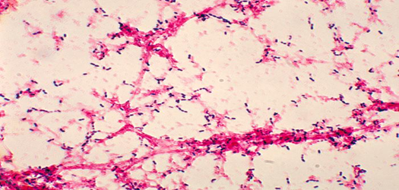
Pneumococcal Disease: Pathophysiology
Cough…Sneeze…
Produce Airborne Droplets
Nasopharyngeal
Colonization
Asymptomatic Colonization
Auto-
Inoculation
Hematogenous Spread
Sinusitis
Otitis
Media
Aspiration
Pneumonia
Meningitis
Blood
Brain
Barrier
Community Immunity reduces colonization, Personal immunity impairs infection…
Bacteremia/Septicemia
Result: >2000 Adults 65⁺ die annually from invasive pneumococcal disease (IPD): Bacteremia, sepsis, meningitis
Henriques-Normark B, Tuomanen EI. Cold Spring Harb Perspect Med. 2013;3(7). pii: a010215; van der Pol T, Opal SM. Lancet. 2009;374(9700):1543-1556.

Slide 26
Pneumococcal Vaccines
PPSV23 = ‘adult standard’ = purified capsule polysaccharide
23 types → cause ~ 88 % invasive disease
Immunity lasts at least 5 years following 1 dose
Local reactions – only common AE
All who live to 65+ need at least 1 dose. Revaccinate only those who require and receive vaccine before 65 years.
PCV13=‘pediatric standard’ vaccine = conjugated to protein
13 types → ~50% IPD in immunocompromised adults
1 dose in adult life (sole exception is ‘immune system reset’)
No published efficacy studies in adults [PCV7 data in HIV, reports, etc.]
ACIP recommends combined strategy [PCV13 + PPSV23] in adults at highest risk

Slide 27
PPS 23 Vaccine Effectiveness
7 Meta-Analyses of RCT [Most recent Cochrane, 1/2013]
Conclusions inconsistent re: cause specific outcomes
Agreement: REDUCTION in IPD
NO reduction ALL CAUSE mortality, pneumonia
3 Meta-Analyses of Observational Studies
Consistent results: vaccine is effective for prevention of IPD
RCT Results
Invasive PNC Dz: Odds ratio [consistent] 0.26 (CI 0.25-0.46)
Pneumonia: Odds ratio [signif. heterogeneity] 0.71 (CI 0.52-0.97)
Mortality: Odds ratio 0.87 (CI 0.69-1.10)
Summary
Data = PPS prevents IPD
There is not compelling data for VV all-cause Pneumonia, Mortality
Fine, et.al. ArchivesIM 1994(154): 2666. Hutchinson et.al. CanJFP 1999(45): 2381. Watson, et.al. Vaccine 2002(20): 2166. Conaty, et.al. Vaccine 2004(22): 3214. Dear, et.al. Cochrane DB Syst Rev 2004, Issue 3. Moberley , et.al. Cochrane DB Syst Rev 2008, Issue 1. Moberly, et.al. Cochrane DB Syst Rev 2013, Issue 1.

Slide 28
PCV13 Adult Vaccine Effectiveness
CAPiTA
PC RCT PCV13 unimmunized adults 65+ years, Netherlands
PCV7 in Dutch infants since 6/2006 -> PCV10 in March 2011
84,000+ participants PCV13 v. Placebo
Enrolled 9/2008-1/2010, follow-up ended 8/2013
PCV13 reduces bacteremic CAP with vaccine–type PNC (Primary)
PCV13 reduces nonbacteremic CAP, other IPD (Secondary)
Serologic and urinary Ag used to identify PNC infection
Considered by ACIP in making current Pneumococcal recs.
http://www.nejm.org/doi/full/10.1056/NEJMoa1408544
Notes:
CAPITA met its primary and secondary endpoints of reduction in bacteremic and non-bacteremic community acquired pneumonia due to Pneumococci.

Slide 29
Adult Pneumococcal Vaccine: By The Numbers
Two vaccines
PCV13
PPSV23
Three intervals
8 weeks when PCV13 before PPSV23 for highest risk medical conditions
1 year between PCV13 and PPSV23:
When PPSV23 is given before PCV13
AND when both vaccines are given after age 65 years
5 years minimum between doses of PPSV23
Maximum doses in adult lifetime
1 PCV13 [with only 1 uncommon and specific exception]
3 PPSV23 [If highest risk medical condition and first dose before 59 yr]

Slide 30
Pneumococcal Immunization
HIGHEST Risk
Immune compromised [IC], ‘Anatomic Risk’
Adults 65+ [Shared decision making 2019]
INCREASED Risk
Smokers, Chronic Medical Conditions – Not Immunocompromised
AVERAGE Risk
Young [< 65], No Chronic Medical Conditions
PCV 13 + PPSV23
NO
PPSV23 ONLY
NO
NO PNEUMOCOCCAL VACCINE

Slide 31
Pneumococcal Immunization I
PPSV23 ALONE for INCREASED RISK
All cigarette smokers ≥ 19 years old
Chronic conditions ≥19 years old Diabetes Lung disease: asthma, COPD Cardiovascular disease Liver disease Kidney disease (EXCEPT ESRD, nephrotic syndrome: PCV13 + PPSV23 recommended)
After this 1 dose, no further Pneumococcal vaccine is recommended until patient becomes Highest Risk by AGE 65+ or develops a HIGHEST RISK medical CONDITION.
Immunity lasts at least 5 years following 1 dose
REVACCINATION ONCE after 65 years [AND >5 years after initial dose] for those vaccinated prior to age 65
http://www.cdc.gov/mmwr/preview/mmwrhtml/mm5934a3.htm http://www.cdc.gov/mmwr/preview/mmwrhtml/mm6140a4.htm

Slide 32
Pneumococcal Immunization II
PCV13 then PPSV23 for HIGHEST RISK CONDITIONS
Disease: CANCER (systemic Tx): solid tumors, hematologic malignancies, myeloma, etc. HIV Immune deficiency: inherited and other (CVID, etc.) End-stage kidney disease ESRD, nephrotic syndrome Iatrogenic: MEDS: Steroids (20 mg/d or greater), biologic immunomodulators, XRT, others TRANSPLANTS: solid organ, bone marrow, stem cell Asplenia: ANATOMIC: splenectomy (best if immunized prior to) FUNCTIONAL: hemoglobinopathy, sickle cell, other - - - - - - - - - - - - - - - - - - - - - - - - - - - - - - - - - - - - - - - - - - - - - 4. Anatomic: (Loss of blood-brain barrier protection) CSF leak, cochlear implant
See table for details…
http://www.cdc.gov/mmwr/preview/mmwrhtml/mm6140a4.htm http://www.cdc.gov/mmwr/preview/mmwrhtml/mm6337a4.htm
Notes:
Divide adults at highest risk for Pneumococcal Infections further into those with highest risk due to AGE ALONE and those with MEDICAL INDICATIONS.
The unifying themes for these medical indications are Immune compromise (groups 1-3) and Anatomic Risk (group 4: loss of the blood-brain barrier protection against meningitis).

Slide 33
Pneumococcal Immunization III
PPSV23 + Shared-Decision Making re: PCV13 for 65 years+
All adults 65+ should receive PPSV23
Shared decision making, grade ‘B’ recommendation for PCV13 in adults 65+ years without other indications for PCV13 Wait 1 year between PCV13 and PPSV23 vaccines ACIP voted to change rec. based on reduction in risk of invasive pneumococcal infections identified in surveillance presented at June 2019 meeting.
Shared Decision Making
Discussion between provider and patient about potential benefits and risks of vaccine vs. not vaccinating.
NO additional/booster doses of PCV13 or PPSV23 recommended after age 65 years
http://www.cdc.gov/mmwr/preview/mmwrhtml/mm5934a3.htm http://www.cdc.gov/mmwr/preview/mmwrhtml/mm6140a4.htm

Slide 34
ADULT PNEUMOCOCCAL VACCINE: Risk Groups and Recommendations 2019
Adults 19-64 years
WITHOUT RISK conditions:
DO NOT need Pneumococcal vaccination until they develop one or more risk medical condition or age > 65 years.
Adults 19-64 years with
INCREASED RISK MEDICAL conditions:
Alcoholism
Cigarette Smokers
Diabetes Mellitus
Heart Disease
[Incl. CAD, CHF; NOT Isolated HTN]
Liver Disease
Lung Disease
[Incl. Asthma, COPD]
Adults 19 years and older with
HIGHEST RISK MEDICAL conditions:
1. IMMUNE COMPROMISE:
Medications
(Prednisone >20 mg/d x 2 wk, Biologics, ...)
Cancer Treatment
Transplants [Organ, BMT, Stem Cell]
Inherited/Acquired Immune Deficiency
Sickle Cell, Splenectomy
Renal failure, Nephrotic Syndrome
2. ANATOMIC RISKS:
CSF Leaks, Cochlear Implants
Adults 65+ years
AT HIGH RISK due to AGE
Lifetime Maximum # Adult Doses of
Pneumococcal Vaccines:
PCV13 1
PPSV23 3
Today: You should administer…
No indication for Pneumococcal vaccine. Assess for other adult vaccines due.
PPSV23 Vaccine
Polysaccharide
*NEW* Shared Decision Making
PCV13 Vaccine
Conjugate
PCV13 Vaccine Conjugate
Next Pneumococcal Vaccination: 8 weeks later 1 year later
No further Pneumococcal vaccine unless develop highest risk condition or age 65 years
PPSV23 Vaccine
Polysaccharide
PPSV23 Vaccine
Polysaccharide
Notes:
*Booster dose PPSV23 (second dose) is only indicated in patients with highest risk medical conditions:
-ANATOMIC RISK (after age 65 + 5 years from prior dose before age 65)
-IMMUNE COMPROMISE (5 years after 1st dose PPSV23)
Second Booster dose PPSV23 (3rd dose) only indicated in IMMUNE COMPROMISED who received 2nd dose before age 65 years and at least 5 years prior to 3rd dose.
Next Vaccine: 5 years later*
ANATOMIC RISK: No further Pneumococcal vaccine unless PPSV23 given before age 65 yr. and now 65+ and 5 years since last PPSV23 [2 adult doses]
PPSV23 Vaccine
Polysaccharide
No further Pneumococcal vaccine after age 65 years.
Next Vaccine: 65+ and 5 years later*
PPSV23 Vaccine
Polysaccharide
https://www.cdc.gov/vaccines/schedules/downloads/adult/adult-combined-schedule.pdf
R. Hopkins, MD. UAMS COM. 7/29/19.
Developed for educational purposes.

Slide 35
Pneumococcal TEST YOUR KNOWLEDGE Q1
Which of the following would be medical indications for PCV13 vaccine in adult patients?
Type 1 diabetes mellitus
NASH cirrhosis
Cigarette smokers
Pregnant women
Heart transplant recipients
Click here to reveal the correct answer
NO
NO
NO
NO
CORRECT
Notes:
PCV13 is indicated for Pneumococcal vaccination of highest risk adults. Of the patients listed, only the heart transplant patient is at highest risk for invasive pneumococcal disease. Persons with diabetes, cirrhosis, cigarette smokers are all at increased risk but not highest risk- they warrant PPSV23 vaccination. Pregnant women are not are not at increased risk and do not have an indication for pneumococcal vaccination.

Slide 36
Pneumococcal TEST YOUR KNOWLEDGE Q2
Which of the following is most correct about the use of PCV13 and PPSV23 vaccines in adults?
a. PCV13 should not be administered to adults who received the
vaccine as a child except if they have a bone marrow/stem cell transplant.
b. Only 1 dose of PCV13 is recommended in adults (1 exception).
c. PCV13 should be given AFTER PPSV23 if at all possible
d. PCV13 and PPSV23 should be separated by ~6 months in adults 65+
e. PPSV23 booster doses should be given every 5 years after 1st dose
Click here to reveal the correct answer
NO b. CORRECT c. NO d. NO. NO
Notes:
PCV13 vaccine is recommended in all adults at highest risk for invasive pneumococcal disease; and only 1 dose is recommended in adults with the sole exception of patients who require bone marrow or stem cell transplantation
[the correct answer is B]. Patients with bone marrow or stem cell transplants essentially need a complete immune system reset and vaccination in these persons is more similar to the vaccination of neonates and small children than to other adults.
PCV13 should be given BEFORE PPSV23 if possible; if given after PPSV23,
PCV13 should be given at least 12 months after the polysaccharide vaccine.
Only selected patients at highest risk require any PPSV23 boosters.

Slide 37
Pneumococcal TEST YOUR KNOWLEDGE Q3
William is 63. He required splenectomy for abdominal trauma in his 40’s. He received PPSV23 prior to surgery; but did not receive any subsequent pneumococcal vaccinations. He was admitted to your hospital service through ED with bacteremic Pneumococcal pneumonia 8 days ago and is now ready to be discharged. Do you recommend he receive Pneumococcal immunization at this time? If so, what is your specific recommendation?
PCV13 today followed by PPSV23 in 8 weeks and
final PPSV23 5 years after that dose (at age 68).
Click here to reveal the correct answer
Notes:
This is a situation of a patient with incomplete initial Pneumococcal vaccination for a highest risk condition [splenectomy].
As this patient received PPSV23 first for a highest risk condition, he needs PCV13 (at least 1 year after dose of PPSV23) now, a second dose of PPSV23 8 weeks after this dose of PCV13 (must also be 5 years from prior dose PPSV23) and final dose PPSV23 5 years after this second dose PPSV23 (this is his final dose as given after age 65).
Patients with splenectomy are also at highest risk for other gram negative infections- in addition to pneumococcal vaccination, they require vaccination against Haemophilus influenza type B (HiB) and Meningococcal infections (MCV4 and MenB vaccination).

Slide 38
Pneumococcal ‘Nuts and Bolts’ PCV13 [1 dose in adults] PPSV23 [1 – 3 doses based on risk]
Increased Risk Patients:
Pneumococcal polysaccharide (PPSV23) – NOW
No further Pneumococcal vaccination until/unless
AGE >65 YEARS OR
Develops HIGHEST RISK MEDICAL CONDITION
Highest Risk Medical Condition Patients:
Pneumococcal (PPSV23) vaccine-naive patients (ideal situation):
PCV13 followed by PPSV23 at least 8 weeks later
Booster PPSV23 in 5 years (AND final PPSV23 at 5+ years/65+ years)
Previously PPSV23 – vaccinated patients:
PCV13 at least 1 year after prior dose PPSV23
Booster PPSV23 at least 5 years after prior PPSV23
(AND must be 8+ weeks after PCV13)
Final PPSV23 after 65+ years and at least 5 years after last dose
http://www.cdc.gov/mmwr/preview/mmwrhtml/mm6140a4.htm http://www.cdc.gov/mmwr/preview/mmwrhtml/mm6337a4.htm

Slide 39
Pneumococcal ‘Nuts and Bolts’-continued PCV13 [1 dose in adults] PPSV23 [1 – 3 doses based on risk]
Patients 65 and older (High Risk):
All adults should receive 1 dose PPSV23 after age 65 years
If PRIOR PPSV23, should also be at least 5 years since (last dose) PPSV23
IF PRIOR dose PCV13, should also be at least 1 year since PCV13
Shared decision Making: Grade B Recommendation for PCV13 vaccine
ACIP June 2019: voted to change Grade A recommendation for all 65+ to receive PCV13
Pneumococcal infections declining in 65+ population, due to ‘herd immunity’
In general, PCV13 should be administered prior to PPSV23
PCV13 must be given at least 1 year after last PPSV23
CMS [M’CARE] will only pay if > 11+ months between PCV13/PPSV23
No additional/booster PPSV23 if sole indication is age > 65 years
http://www.cdc.gov/mmwr/preview/mmwrhtml/mm6140a4.htm http://www.cdc.gov/mmwr/preview/mmwrhtml/mm6337a4.htm
Notes:
The next slide depicts this in a more visual/flow chart which may be sufficient for some presenters to delete this slide from the deck.

Slide 40
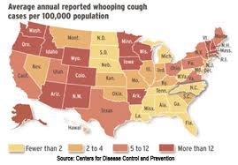
Tetanus, Diphtheria and Pertussis
Diphtheria:
Rare in US [<5 cases in past 10 years]
Still causes disease internationally, >50 % mortality w/o Tx
Tetanus:
Uncommon in US [~200 cases/16 deaths US 2009-15]
Most deaths in elderly
Pertussis:
Endemic, most disease adolescent/adult
2016 U.S.: 17,972 cases, six infant deaths
‘100 days cough’= Hi Morbidity…
Mortality highest in infants
https://www2.cdc.gov/vaccines/ed/surveillance/

Slide 41
Td -- Tdap
Pertussis incidence increasing since 1970’s [to 40K cases/yr]
Passive reporting likely underestimates true disease burden
Community outbreaks: Most in fall, winter and in all ages
Nosocomial Disease: Academic, Community
[Med/Surg, OR, L&D, NICU, Oncology]
Residential Care
Adults don’t usually have ‘classic’ triphasic disease
Most have persistent Cough: Median 4 months [6 studies]
20-40 % ‘Whoop’, 40 – 55 % Posttussive emesis
12-32 % Lymphocytosis
~10% develop complications [Pneumonia most common]
http://www.cdc.gov/vaccines/vpd-vac/pertussis/
http://www.cdc.gov/vaccines/vpd-vac/combo-vaccines/DTaP-Td-DT/Tdap.htm

Slide 42
Impact of Pertussis Vaccination
Pertussis reporting is passive/not mandatory- rates are likely significantly higher…
www.cdc.gov/pertussis/outbreaks.html

Slide 43
Td -- Tdap
All adults need a primary tetanus, diphtheria vaccine series
3 doses: initial, 1 m. later, 6 m. later [protective Ab ~ all for 10 years+]
Many > 60 y. never received primary series, ½ adults have no protection…
Booster Td every 10 yrs needed after primary series [many do not receive]
Most boosters given are ‘episodic trauma-related’
Replace 1 dose Td with Tdap [primary series or as ‘booster’]
Interval from last Td is unimportant
No harm if > 1 dose Tdap, but not ACIP recommended
Td/Tdap contraindications
Severe allergy to vaccine or Arthus reaction after T vax.
[Tdap] encephalopathy < 7 days after pertussis containing vaccine
[Tdap] unstable neurologic disease, moderate – severe acute illness
http://www.cdc.gov/vaccines/vpd-vac/combo-vaccines/DTaP-Td-DT/Tdap.htm

Slide 44
Td -- Tdap
Tdap Recommendation: All Adults
1 dose to replace one dose Td [booster or primary]
Subsequent Td q10yr
May give any time following last Td
Special emphasis:
Parents, childcare, other adults with close infant contact
HEALTHCARE
Tdap intrapartum all women, every pregnancy
Regardless of interval/prior Tdap [best @ 27 – 36 weeks gestation]
Focus: Protect infants [Highest M&M group] by passive immunity
No specific recommendation for ‘ring vaccination’ of family (is reasonable)
http://www.cdc.gov/vaccines/vpd-vac/combo-vaccines/DTaP-Td-DT/Tdap.htm

Slide 45
Td and Tdap TEST YOUR KNOWLEDGE Q1
Select the best answer:
Which of the following patients needs Tdap vaccination today?
65 year old man: Td at age 64, last dose ‘20 years ago’
75 year old man: dirty wound, unknown Tetanus vax status
60 year-old going to visit daughter, new grandson [Tdap 2012]
65 year-old Internist in for checkup, last Tdap at age 55
Patients a and b above.
NO
NO
NO
d. NO
e. CORRECT
Click here to reveal the correct answer
Notes:
Correct answer is e.
First patient has never had Tdap so needs Tdap for pertussis protection, regardless of Td a year ago
Second patient needs tetanus-containing vaccine for wound protection and Tdap provides that as well as pertussis protection.
The 60 year old is already ‘up to date’ on Pertussis immunization
The internist had Tdap at 55 so needs Td now.

Slide 46
Td and Tdap TEST YOUR KNOWLEDGE Q2
Which of the following is most correct re: Tdap vaccination in pregnancy?
Tdap is recommended in 1st pregnancy only
Tdap is recommended before 27 weeks gestation each pregnancy
Tdap is recommended at 27-35 weeks each pregnancy
Tdap is recommended at 35 weeks or later each pregnancy
Tdap is contraindicated in pregnancy
Click here to reveal the correct answer
a. NO b. NO c. CORRECT d. NO e. NO
Notes:
Correct answer is c.
Tdap is recommended at 27-35 weeks of every pregnancy to provide passive Pertussis antibody transfer to infants (who are at highest risk for Pertussis-associated morbidity and mortality).

Slide 47
System-Based Practice re: Td, Tdap
Insurance Coverage
All ACA-Compliant Private plans: Covered, no copay
Medicare:
Injury/wound related - covered under part B [link Dx/CPT]
Preventively: covered under part D (Drug benefit)
Medicaid: (rules differ by state program)
Usually covered in pregnancy ‘bundle’,
Other situations: check with your state Medicaid program.
Tdap | Td
Once in all adults | Every 10 years
Every pregnant woman/pregnancy at 27-35 weeks | None

Slide 48
Vaccine Groups
“All Adults | “Risk-Based”
Influenza | HPV
Pneumococcal [PCV13, PPSV23] | MMR
Tdap | Varicella
Zoster | Meningococcal Quad [MCV4, MPSV4] MenB
 | Hepatitis A
 | Hepatitis B
Notes:
Multiple specific vaccines with different indications are available for a number of these diseases and these are specified in this table.
Maria needs (unless previously vaccinated):
Annual Influenza vaccine [in season]
Tdap
HPV series
MMR
Varicella
Hepatitis B series

Slide 49
Case 2
Maria Alvarez is a 24 year old medical student with no significant past medical history. She is here today for an ‘annual preventive exam.’
Which vaccines should you make sure she receives? As a healthcare worker in training, what vaccines should she receive?
Click here to reveal the correct answer(s)
Influenza (Annually)
Hepatitis B, MMR, Varicella
HPV
Tdap
Notes:
Vaccines reviewed:
HPV
Hepatitis B

Slide 50
Clinical Vaccinology: Part 2
HPV
Hepatitis B
Healthcare Provider Vaccination

Slide 51
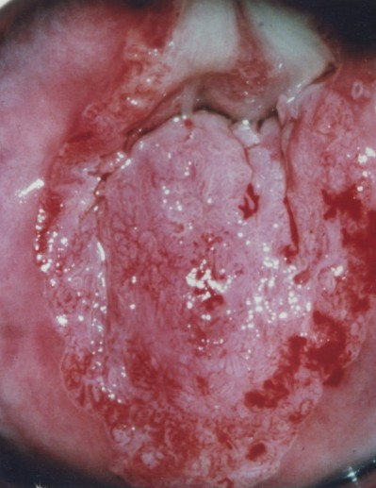
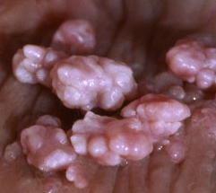
Cervical Cancer
Genital Warts
Notes:
Why are HPV vaccines needed?
Certain human papillomavirus (HPV) types cause cancer, including: cervical, vulvar, vaginal, penile, anal, and oropharyngeal (base of the tongue, tonsils and back of throat) cancers. Certain HPV types also cause most cases of genital warts in men and women.
HPV is a common virus that is easily spread by skin-to-skin contact during sexual activity with another person. It is possible to have HPV without knowing it, so it is possible to unknowingly spread HPV to another person.
HPV vaccine is a strong weapon in prevention. These safe, effective vaccines are available to protect females and males against some of the most common HPV types and the health problems that the virus can cause.
How common are the health problems caused by HPV?
HPV is the main cause of cervical cancer in women. There are about 12,000 new cervical cancer cases each year in the United States. Cervical cancer causes about 4,000 deaths in women each year in the United States.
There are about 15,000 HPV-associated cancers in the United States that may be prevented by vaccines each year in women, including cervical, anal, vaginal, vulvar and oropharyngeal cancers.
About 7,000 HPV-associated cancers in the United States that may be prevented by vaccine each year in men, and oropharyngeal cancers are the most common.
About 1 in 100 sexually active adults in the United States have genital warts at any given time.
RIVERSIDE LIBRARY

Slide 52
HPV
HPV is common –and vaccine preventable- cause for Cancer(s)
Cervical CA is second most common cause CA death in women
US: ~10 women die every day of cervical cancer
Anal CA and penile CA in men definitively linked to HPV
HPV causes many oropharyngeal (and other CA)
~20 million current HPV infections
By age 50, 80% SA women will have acquired genital HPV
Many clear spontaneously but no way to identify which will do so…
6.2 million new genital HPV infections/year in US
74% in women 15 – 24 years of age
70% Cervical CA worldwide due to HPV serotypes 16 [54%], 18 [13%]
Additional 15% due to HPV serotypes 31, 33, 45, 52, 58
>90% Genital warts due to HPV serotypes 6, 11
http://www.cdc.gov/mmwr/preview/mmwrhtml/rr5602a1.htm

Slide 53
HPV Vaccine
NOTE: This is a CANCER PREVENTION vaccine, not a sex vaccine!
HPV9 Vaccine:
Contains types 6, 11, 16, 18, 31, 33, 45, 52, 58
3 doses over 6+ months for adults
2 dose Series for those who start series before 15 years of age
No need to start over if completion delayed
Effective >8 yrs, only for types patient has NOT previously acquired
Women, Men: vaccinate between ages 9 and 26
Vaccine licensed to age 45: [June 2019 ACIP] Grade B ‘SDM’
Contraindications/Cautions:
Local reaction, bronchospasm reported
Not recommended in pregnancy – no proven AE [administer after delivery]
Immunosuppression can reduce efficacy
VAX DOESN’T CHANGE CERVICAL CA SCREENING RECOMMENDATIONS!!
http://www.cdc.gov/mmwr/preview/mmwrhtml/rr5602a1.htm

Slide 54
HPV TEST YOUR KNOWLEDGE Q1
You are seeing James, a 23 year-old man, in STD clinic. He has been healthy other than a 1 week history of urethral discomfort. He was referred to you by his girlfriend who was recently found to have PID. He does not know his immunization history.
Which of the following do you recommend today re: Vax?
Urethral swab for HPV, vaccinate if test positive
Urethral swab for HPV, vaccinate if test negative
No test, give HPV9 vaccine today, final dose in 6 months
No test, HPV9 today, dose 2 in 1 month, dose 3 in 6 mo.
HPV vaccine only recommended in men to age 21 yr.
Click here to reveal the correct
answer
NO
NO
NO
CORRECT
NO
Notes:
James is at high risk for HPV based on the fact he is being seen in STD clinic and that his girlfriend was recently diagnosed with PID. High risk Men are recommended to have HOV vaccination to age 26. It is likely he has been exposed to at least some strains of HPV but strains he has not been exposed to will be less likely once he is vaccinated. A 3 dose series of HPV vaccine is recommended in persons vaccinated with a series begun at or after age 15 years.

Slide 55
HPV TEST YOUR KNOWLEDGE Q2
MA is a healthy 19 year old woman who has come in on 3/1/2019 for a ‘checkup’ prior to moving into a dorm at a local college. She provides you with the immunization record shown. What vaccines do you recommend she receive today?
Vaccine | Date | Other MAW, DOB 9/1/1999
Influenza | 10/3/2016, 11/4/2017, 9/2/2018 | IIV4
Tdap | 9/11/2011, 9/2/2018 | [Primary series complete 2005]
HPV | 1/12/2015, 10/21/2016 | HPV4
MCV4 | 10/12/2012, 9/2/2018
MenB | 9/2/2018
MMR, VAR | 12/12/2000, 6/11/2013
Answer: HPV9, Bonus answer: MenB dose #2
Click here to reveal the correct answer
Notes:
MAW started her HPV series after age 15, so she needs a 3rd dose of HPV vaccine to complete the series.
MAW also needs final dose of MenB vaccine to complete this series and provide time limited protection against Meningocococcal serogroup B disease.
[I know this has not been covered in this slide set– that is why it is a BONUS!!]

Slide 56
Hepatitis B: Underused Risk-based Adult vaccine
Behavioral and social:
>1 sex partner in 6 months
Household contacts and sex partners of HBsAg+ people
MSM
IVDU
Inmates in long-term correctional facilities
Occupational
Health care, public safety workers, staff working with developmentally disabled
Medical
Persons with Diabetes mellitus under 60 years of age [MD discretion at 60+ yr]
Persons with (any) chronic liver disease
Persons living with HIV
People seeking STD evaluation or treatment
Hemodialysis patients and ESRD patients awaiting dialysis
Travel: risk destination or activity
All adults who want to be protected from hepatitis B
Notes:
Hepatitis B vaccination recommendation in adults is based on risk. Risk groups make up ~60% adults…

Slide 57
Hepatitis B and Diabetes
ACIP recommends Hepatitis B vaccine in unimmunized diabetic patients (October 2011)
ALL diabetic patients aged 19-59 years
Age 60+ at discretion of the treating physician
Risk is likely greatest: injectable meds, glucose checks, sharing supplies…
HBV immunization is a common gap in Diabetes care practice!
Why?
Patients with DM have 2.1 fold higher risk for acute HBV v. non-DM
NASH is common in patients with diabetes
NASH, as one type chronic liver disease, ^^^ HBV–associated Morbidity/mortality
NHANES: Seroprevalence for HBV [Anti – HBVc IgG] is 60% higher in DM
http://www.cdc.gov/mmwr/pdf/wk/mm6050.pdf
Notes:
NHANES - National Health and Nutrition Examination Survey

Slide 58
Challenges in Hepatitis B vaccination
Response to standard Hepatitis B vaccines lower in patients with:
Obesity
Diabetes Mellitus [more so with longer duration of disease]
Renal failure
Increasing age
Immune compromising conditions
>90 % response rate for vaccination in adults < 40 years
~75% response rate for vaccination of adults at 60 years
ACIP does not recommend a specific vaccine product for HBV immunization except in immune compromise and hemodialysis
https://www.cdc.gov/mmwr/volumes/67/rr/rr6701a1.htm

Slide 59
Hepatitis B Vaccines
Formulations/Route: IM
Standard vaccines: standard schedule is 3 doses over 6+ months
Multiple alternate schedules demonstrated effective (3-4 doses)
Combination Hepatitis A/B vaccine for those needing protection from HAV, HBV
High dose vaccine, specific schedule for Dialysis, Immune compromised patients
TLR-Adjuvanted HBV Vaccine (approved 2017) 2 doses over 1 month
If series delayed, do not restart. Complete series w/ same vax as prior dose(s)
Currently best method to assess HBV immunity is to measure HBsAb BUT primary immunity induced by vaccine is cell-mediated
Many will mount anamnestic response without prior measureable antibody
http://www.cdc.gov/vaccines/hcp/acip-recs/vacc-specific/hepb.html

Slide 60
Hepatitis B TEST YOUR KNOWLEDGE Q1
For which of the following patients is the ACIP recommendation for Hepatitis B vaccine ‘at the individual physician’s discretion (level B)?
28 year-old Peace Corps volunteer posted to work in SE Asia
38 year-old woman with chronic HCV
42 year-old man with newly diagnosed DM2 on oral meds
62 year-old man with uncontrolled DM2 on insulin
70 year-old woman caring for her son with chronic active HBV
Click here to reveal the correct answer
a. NO b. NO c. NO d. CORRECT e. NO
Notes:
‘Travel to an endemic area’ is a Level A indication for HBV immunization
Chronic liver disease is a level A indication for HBV immunization
Diabetes mellitus in adults <60 years is a level A indication for HBV immunization
Diabetes mellitus in adults 60 and older is a level B indication for HBV immunization (at physician discretion)
Household contacts and sexual partners of patients with HBV have a level A indication for HBV immunization

Slide 61
Hepatitis B TEST YOUR KNOWLEDGE Q2
Which of the following patients is least likely to develop immunity following hepatitis B vaccination?
A 25 year-old medical student
A 40 year-old nurse
A 55 year-old with chronic HTN and newly diagnosed DM 2
A 70 year-old with CKD stage 4 and DM2 x 20 years
Click here to reveal the correct answer
a. NO b. NO c. NO d. CORRECT
Notes:
The response to Hepatitis B immunization is reduced with increasing age at the time of vaccination, obesity, DM (and lesser response with longer duration of disease), renal failure and immune compromise.

Slide 62
Healthcare Workers
Key in implementation of Adult Immunization
Education: Multiple studies show that…
STRONG PRESUMPTIVE MD recommendation → Increases vaccine uptake
“You need _ _ _ vaccine today because _ _ _. “
HCW need preventive benefits for ‘themselves’
Potential source for disease transmission to
Patients
Other staff
Communities
Their own Families
Potential for Vax Preventable Illness to impair patient care
Adverse effects on efficiency and/or
Absent: Prevents HCW from taking care of patients
http://www.cdc.gov/mmwr/preview/mmwrhtml/00050577.htm

Slide 63
Healthcare Worker Vaccination
Annual influenza immunization!!
Tdap: All should receive 1 adult dose
Then Td every 10 years (sooner if ‘risky wounds’)
MMR: Proof of immunity and/or 2 vaccine doses
Varicella: Proof of immunity and/or 2 vaccine doses
HBV: 3 dose series
Titer 1 month after series
Repeat entire series x 1 if titer < 10 IU
No recommendation to screen/recheck titer otherwise

Slide 64
HCP TEST YOUR KNOWLEDGE Q1
John is a 27 year old who is in your office for a screening evaluation prior to starting residency. The most recent sections of his immunization record is shown. Based on this data, which vaccines do you recommend for him today?
Vaccine | Date J. R. Johns DOB 4/6/1991
Influenza (IIV) | 9/14/2016, 1/12/2017, 10/14/2018
MMR | 11/1/1993, 3/2/1999
VAR | 11/1/1993
Tdap | 11/2/1999, 2/14/2008
Hepatitis B | 10/4/1995, 12/6/1995, 6/6/1996
MCV4 | 6/1/2009, 8/18/2009
Remove cover for correct answer(s)
Tdap, Varicella,
(If 2019 or later influenza season= Influenza)
Notes:
Influenza vaccine is recommended annually for all HCP. 2 doses of MMR and Varicella vaccine or proof of immunity is recommended for all HCP. 1 dose Tdap is recommended for all adults followed by Td every 10 years or as needed for wound prophylaxis. A complete 3 dose series of Hepatitis B vaccine or evidence of immunity is recommended for all HCP.

Slide 65
HCP TEST YOUR KNOWLEDGE Q2
One of your interns sticks his head into the work room and tells you that he stepped on a hypodermic needle (which then punctured his foot) in the parking lot when walking to his car last night after he ‘got off short call.’ He cleaned the wound and denies any symptoms today. You insist that he be evaluated immediately by employee health.
He received Tdap ~10 years ago; completed HBV immunization (and had + confirmatory HBsAb titer early this year).
What do you recommend re: immunization?
Click here to reveal the correct answer
Td vaccination
Notes:
Since he has had 1 dose of Tdap as an adult, recommend Td vaccination.
If you did not have recent confirmation of HBsAb at a protective level, would need to consider HBV prophylaxis.

Slide 66
Adult Vaccine Groups
“All Adults | “Risk-Based”
Influenza | HPV
Pneumococcal [PCV13, PPSV23] | MMR
Tdap | Varicella
Zoster | Meningococcal Quad [MCV4, MPSV4] MenB
 | Hepatitis A
 | Hepatitis B
Notes:
Multiple specific vaccines with different indications are available for a number of these diseases and these are specified in this table.
Christine needs:
Influenza [in season]
Tdap
Hepatitis B [if not immune]
Live virus vaccines [MMR, Varicella and Zoster] are contraindicated in pregnancy.

Slide 67
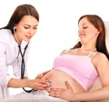
Case 3
Christine Pulaski is a 32 year old pregnant woman with no significant past medical history who presents for a prenatal visit in her first trimester.
Which vaccinations should she receive during pregnancy? Which vaccinations are contraindicated?
Receive: Influenza (NOW), Hepatitis A, B (if not immune, other risk conditions present), Tdap (27-35 weeks)
Contraindicated: Live virus vaccines (LAIV, MMR, VAR, ZVL =Live Zoster)
Click here to reveal the correct answer
Notes:
Vaccines reviewed:
(Indicated)
- Inactivated influenza
- Hep a, b
- Tdap
(contraindicated)
- Live influenza
- MMR
- Varicella
- Zoster (live vaccine)

Slide 68
Clinical Vaccinology: Part 3
Vaccination of Pregnant Women
Zoster

Slide 69
Pregnancy and Vaccination
Pregnant women at very high risk for Influenza M&M
Prenatal Tdap vaccine
Passive antibody transfer to fetus, highest 3d trimester
Protect highest risk population: Infants
No demonstrated risk to mother or infant
Inactivated vaccines safe, effective in pregnancy
Although HPV not recommended, no evidence of harm
HAV, HBV vaccines can be admin. if needed
Live virus vaccines contraindicated [MMR, VAR, ZVL, LAIV]

Slide 70
Vaccinate Pregnant Women
Influenza vaccine recommended in all pregnant women, every pregnancy: FluVax4Mom4Baby!!
Inactivated vaccine only
Safe/Can be given any trimester of each pregnancy
Tdap vaccine is recommended in all pregnant women, every pregnancy: Tdap at 27-36wk4Baby!
Passive Ab transfer maximized at this time
Protect infant until can begin active immunization (2m)
Recommend assess Tdap status of all household contacts and bring up to date all ‘deficient’ contacts

Slide 71
Pregnancy TEST YOUR KNOWLEDGE Q1
Jill is a 29 year old G3P2 woman who is in your office for followup of her chronic HTN on November 1. She is currently ~30 weeks pregnant with her 3rd child. Received Influenza vax. in 1st pregnancy and Tdap vaccine in both prior pregnancies [2017, 2016] but had arm soreness each time. What do you advise re: vaccines today?
Give influenza, hold off Tdap since had reaction
Give both vaccines together (Same syringe/injection) today
Give both vaccines, separate sites
Give Tdap today, wait 2 weeks and then Influenza
Click here to reveal the correct answer
a. NO b. NO c. CORRECT d. NO
Notes:
Case as presented is a common scenario- it is very common to have a sore arm after any vaccination, but particularly after Tdap or other adjuvanted vaccines.
She should receive both vaccines today in separate syringes and separate sites. The deltoid muscle of the arm is the best location to administer each of these IM injections.
Different vaccines should never be mixed and administered together- there is no biologic reason to suspect this would be a superior technique and there is the potential for unintended consequences.
If it were not influenza season and there was no influenza in the community or region, choice ‘d’ would be a consideration; however, delaying any vaccine increases the likelihood it will not be given at all (missed opportunity for vaccination).
The best answer is ‘c’, give both vaccines in separate sites.

Slide 72
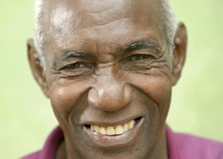
Case 4
Christopher Watkins is a 68 year old man with a prior 10 – week history of a persistent cough presenting for his annual Medicare wellness visit.
Mr. Watkins lives with his daughter and his 2 young grandchildren (ages 6 months and 2 years). Which vaccines should Mr. Watkins receive?
Influenza, Tdap, Zoster (RZV), Pneumococcal (PCV13- 1 adult dose and PPSV23- 1 dose after age 65)
Click here to reveal the correct answer
Notes:
Vaccines reviewed:
- Tdap (pertussis focus)
- Zoster

Slide 73
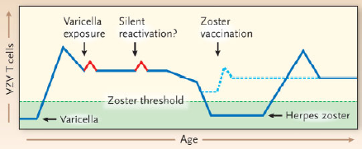
Zoster Pathophysiology: Epidemiology
Most who have varicella will have measureable Ab for life
Zoster occurs when CMI ‘surveillance’ declines
Reactivation or Varicella exposure re-stimulates CMI
[Cycle can repeat serially… shingles can recur!]
Lifetime risk of Zoster ~33% [~ 99.5% adults sero + prior Varicella]
At 85 – lifetime risk ~ 50%
PHN = most common AE
Up to 1/3 pt with Zoster
More common
>70 years with Zoster
Immunocompromised
Vaccination stimulates CMI
Arvin A. NEJM 2005;352:2266-77.
http://www.cdc.gov/mmwr/preview/mmwrhtml/rr5705a1.htm

Slide 74
Zoster vaccines
RZV (Shingrix) Adjuvanted Subunit vaccine
Available since 2017
Refrigerated- must be reconstituted/2 doses, given IM
FDA Licensed/ACIP Recommended in adults 50+
ACIP PREFERRED over ZVL (~90% efficacy vs. 60%)
ZVL (Zostavax) Live-attenuated vaccine
Available since 2006
Frozen- must be reconstituted/given SQ within 1 hr
ACIP Recommended in adults 60+ [FDA licensed 50+]
Contraindicated in Immune compromise, Pregnancy

Slide 75
Zoster: RZV (Preferred)
Vaccinate adults 50+
2 doses IM
Adjuvanted vaccine- can cause arm pain, low grade fever
Local AE with 1st dose does not predict AE with second dose
Regardless of prior episode(s) of Zoster
Regardless of whether/not received ZVL
At least 2 months after ZVL
No need to test and/or vaccinate vs. Varicella first
No need to defer for ‘at risk contacts’– no transmission risk
No booster.

Slide 76
Implementing Zoster Vaccination
RZV has a preferential recommendation
ZVL can be given to 60+ adults w/o immune compromise
Current vaccine shortage is improving
Manufacturer has ‘vaccine finder’ on Website
Private Insurance ACA-Conforming plans
RZV covered 100% without copay
Medicare and Medicaid
Medicare Coverage under Part D (Drug plan)
Medicaid Coverage determination is state by state…

Slide 77
Zoster TEST YOUR KNOWLEDGE Q1
A 62 year old family physician requests Shingles vaccine. Which of the following is most correct about this vaccine?
Zostavax [ZVL] is a live virus vaccine, it should not be given as he may spread the virus after vaccination.
Shingrix [RZV] is a subunit vaccine. A single dose should be given to prevent shingles in this person.
ZVL is recommended 5 years later in all adults who received RZV
RZV is recommended in all adults who previously received ZVL
ACIP recommendations and FDA licensure for ZVL and RZV are similar with the exception that ZVL should not be given in immune compromised adults.
Click here to reveal the correct answer
a. NO b. NO c. NO d. CORRECT e. NO
Notes:
ZVL is a live virus vaccine; but the risk of any transmission of the attenuated OKA strain virus is vanishingly small. Unless this provider worked routinely with the most highly immune-suppressed patients, ZVL could be administered.
BUT, the current recommendation is preferential for the use of RZV vaccine. RZV has higher efficacy but requires completion of a 2 dose series to achieve the 90%+ level of protection. There is no recommendation for a booster dose of any zoster vaccine after completion of the 2 dose series of RZV. RZV is recommended in patients who previously received ZVL [this is the correct response]. ACIP and FDA are in accord about a number of things; but their statements on these 2 vaccines are quite different.

Slide 78
Zoster TEST YOUR KNOWLEDGE Q2
Which of the following is correct about the new subunit Zoster vaccine [RZV]?
Must be stored in 2 vials and frozen
Must be given within 2 hours of reconstitution
Must be given IM
Reactions after first dose preclude completion of series
If diluent misplaced can be reconstituted with saline
Click here to reveal the correct answer
a. NO b. NO c. CORRECT d. NO e. NO
Notes:
The correct answer is C
The recombinant Zoster vaccine must be stored in 2 vials [lyophilized powdered vaccine and specific diluent which must be used to reconstitute the vaccine] but CANNOT be frozen [it should be refrigerated] and should be maintained in cool conditions until vaccination
Must be given within 6 hours of reconstitution
CORRECT ANSWER
As it is an adjuvanted vaccine, low grade fever and local reactions are common after vaccinations; but a mild reaction after the first dose neither predicts a reaction after the second dose nor precludes completion of the 2 dose series.

Slide 79
Summary
Current vaccination rates are well below targets
Vaccines can prevent morbidity and mortality associated with vaccine preventable disease
Adult immunization is complex, rapidly changing
Physician recommendation is key to patient uptake!
Next steps:
[Add PROGRAM SPECIFIC INFO]
Module 2 will be [add date]
Strategies to increase adult immunization in practice!

