Slide 1
Positive Psychology Strategies in Times of Crisis: Supporting Each Other
ACP Webinar
March 2020
Kerri Palamara, MD

Slide 2
CME Accreditation
The American College of Physicians is accredited by the Accreditation Council for Continuing Medical Education to provide continuing medical education for physicians.
The American College of Physicians designates this Other activity (ACP Physician Well-being Champions Program) for a maximum of 25 AMA PRA Category 1 CreditsTM. Physicians should claim only the credit commensurate with the extent of their participation in the activity.
(This webinar is worth 1 AMA PRA Category 1 CreditTM.)

Slide 3
ABIM MOC Statement
Successful completion of this CME activity (ACP Physician Well-being Champions Program), which includes participation in the evaluation component, enables the participant to earn up to 25 practice assessment MOC points in the American Board of Internal Medicine’s (ABIM) Maintenance of Certification (MOC) program. Participants will earn MOC points equivalent to the amount of CME credits claimed for the activity. It is the CME activity provider’s responsibility to submit participant completion information to ACCME for the purpose of granting ABIM MOC credit.
(This webinar is worth 1 ABIM practice assessment MOC point.)

Slide 4
Disclosure
The individuals in control of content for this ACP Physician Well-being Champions CME activity have nothing to disclose.

Slide 5
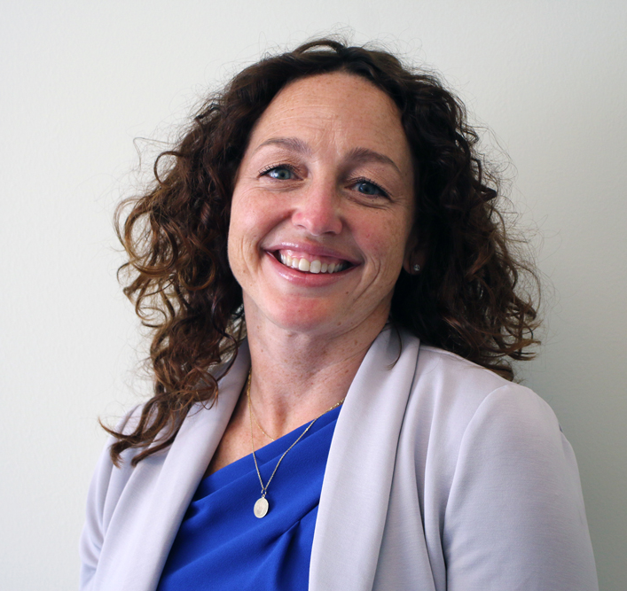
Meet Our Faculty
Kerri Palamara, MD, FACP
Director, Center for Physician Well-being, Massachusetts General Hospital
Lead, Physician Coaching Services, American College of Physicians

Slide 6
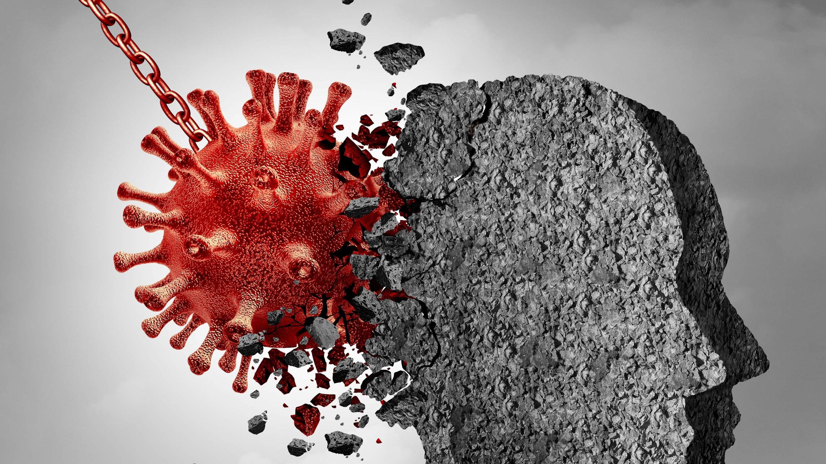
Agenda
Checking in with you & where we are today
Overview of Positive Psychology Exercises
How to Make These Happen
Questions!
https://pinerivertimes.com/articles/131560-mental-health-professionals-share-insight-into-coping-with-covid19

Slide 7
Checking in with you & where we are at today

Slide 8
What I’m Hearing
Uncertainty about screening and frequently changing PPE recommendations/supply leave people feeling exposed and underprepared.
The uncertainty of clinical presentation of patients with COVID-19.
The lack of testing capability leaves us with the onus of messaging why we can’t test more people, despite their angst.
The fear of working in healthcare if you are worried about your own health or the health of someone in your home.
The anxiety about who we may expose or infect if we become ill.
Worrying about loved one’s, financially and medically.
Fear that we or our colleagues will die.
Feeling useless at home when we can’t be at work.
Working in new roles outside of comfort zone.
Worrying about daycare and home schooling, and the general status of our homes/family.
I miss people, and physical connection.
My world feels so foreign to me.

Slide 9
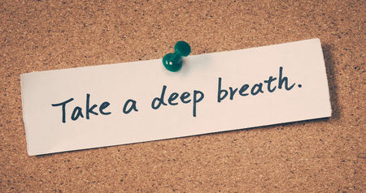
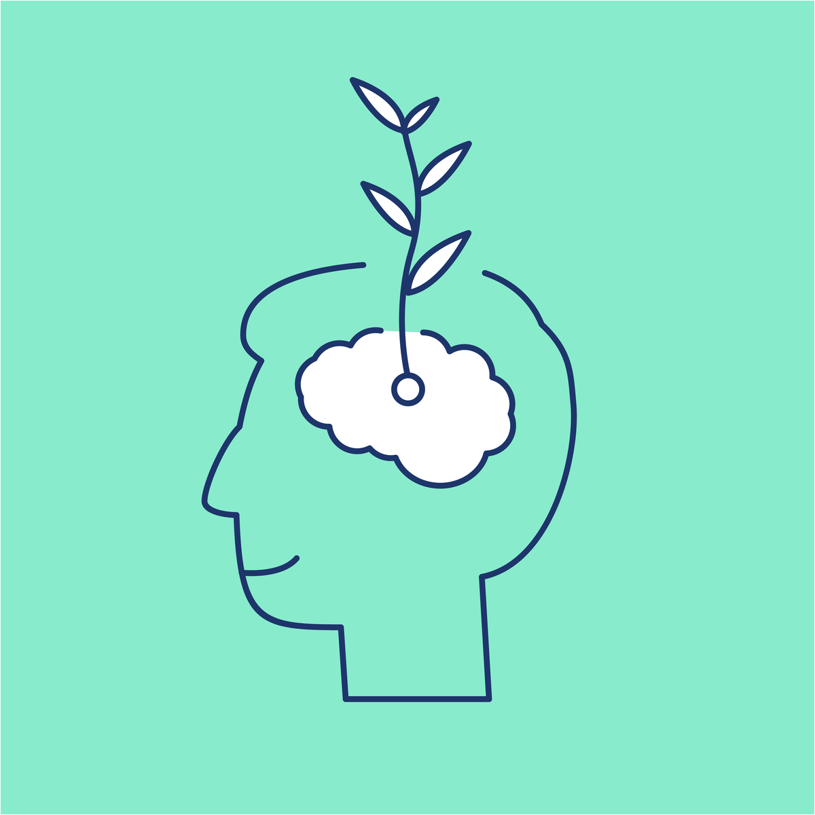
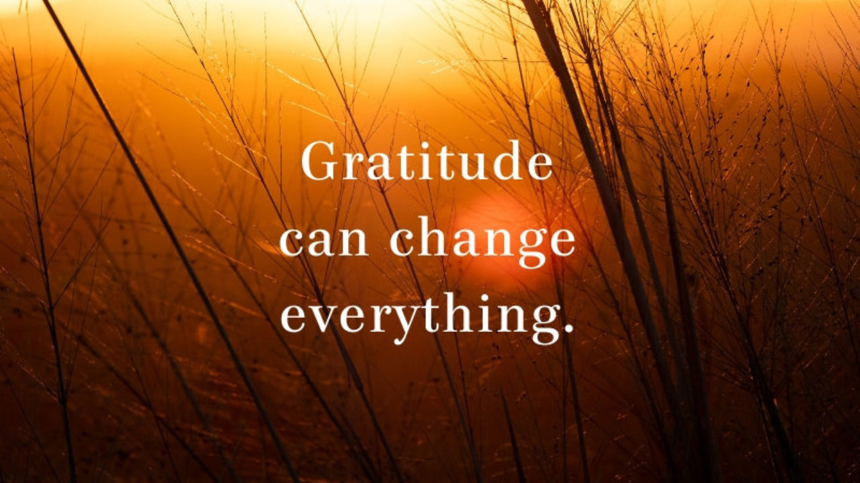
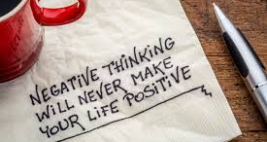
How Positive Psychology Can Help

Slide 10
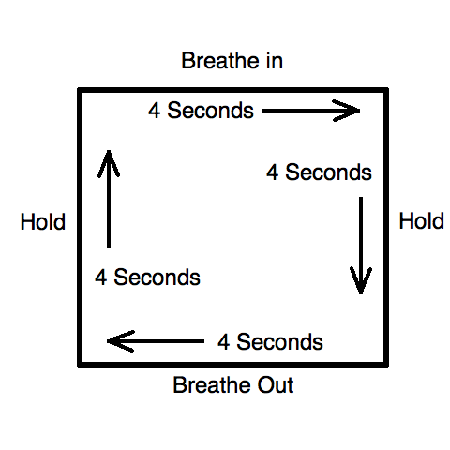
Take a Deep Breath
Photo Credit: https://medium.com/@mikenseer/the-life-hack-you-can-take-anywhere-breathing-20f0627d0f73
Ma et al, Front Psychol. 2017; 8: 874.

Slide 11
Power of Laughter
Try laughing – at yourself or something funny.
Laughter is contagious, and data shows that even if it is not authentic, it still makes you feel better!
Helps with coping, resiliency, health
Check out this CocaCola commercial for a happiness booster or a laugh! https://www.youtube.com/watch?v=1veWbLpGa78
Kuiper, N. Europe's Journal of Psychology, 2012, Vol. 8(3), 475–491,

Slide 12
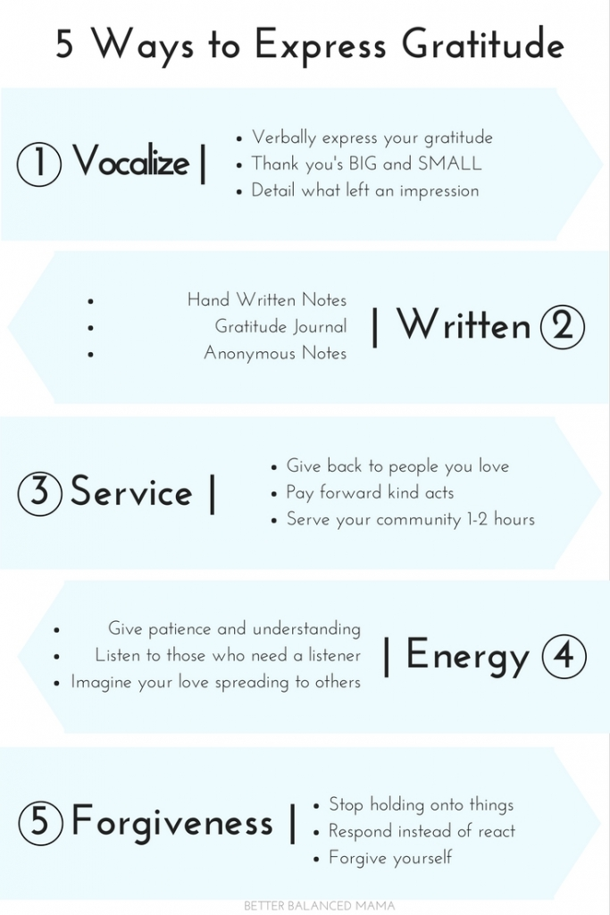
Practice Gratitude!
Deliver authentic praise for a job well done or positive feedback
This strengthens connections between us, sparks motivations in both individuals, and boosts our happiness.
This is easy, can be done in person or by email, and can make someone’s day! Be specific - give thanks and express your appreciation
Other ways – gratitude journal, give back in service to someone, send positive energy to others, meditate, forgive
Photo Credit: https://www.betterbalancedmama.com/five-ways-express-gratitude/
Kaplan et al Journal of Business and Psychology volume 29, pages367–380(2014); chopik et al J Posit Psychol. 2019; 14(3): 292–302. , Di Fabio et al Front Psychol. 2017; 8: 2025.

Slide 13
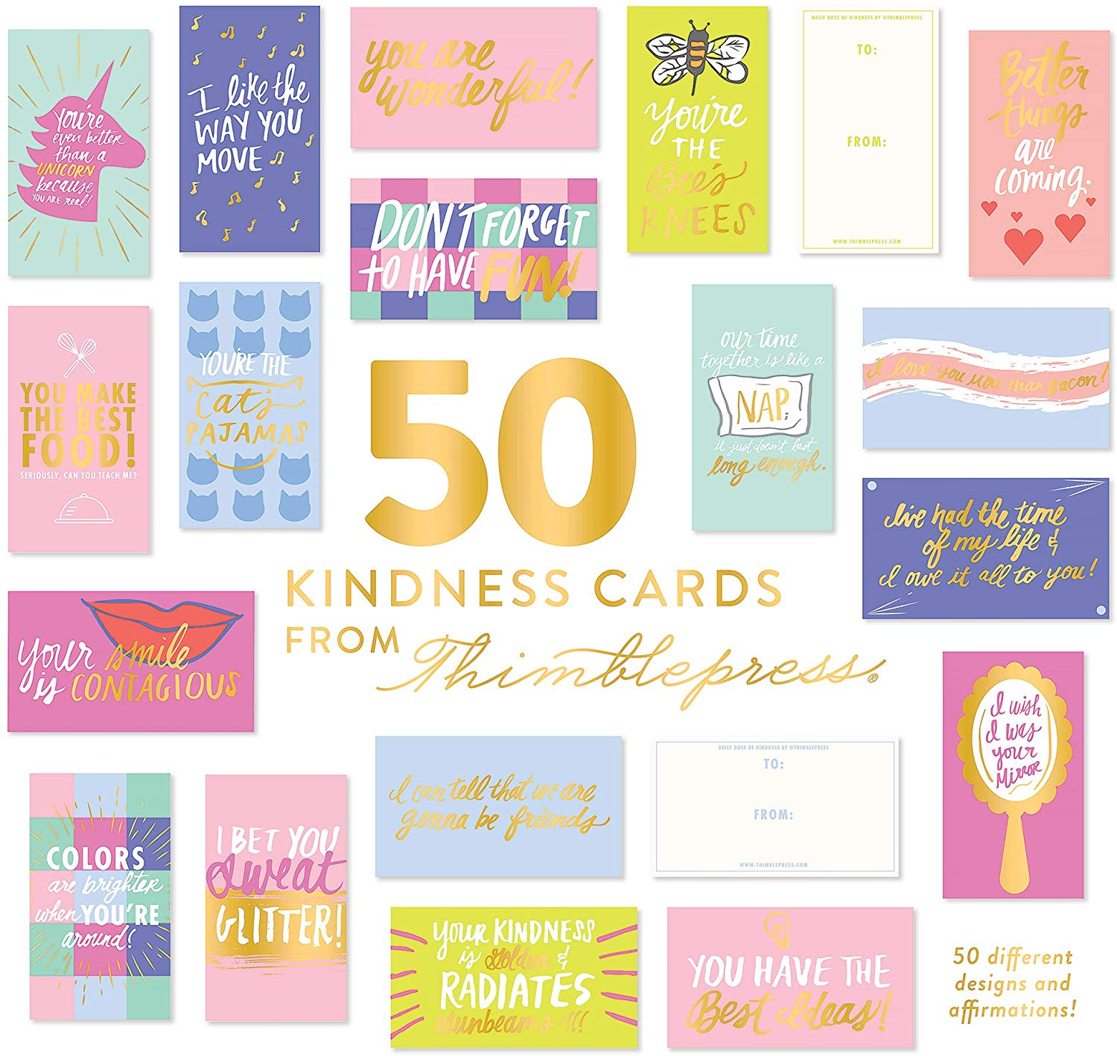
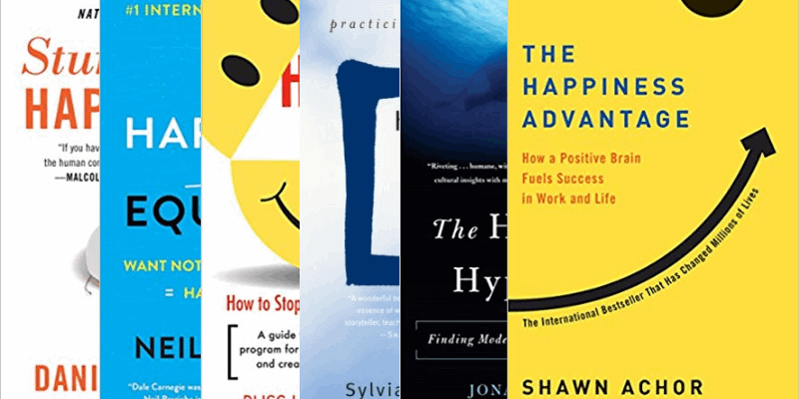
A Few Unique Ways to Express Your Gratitude Today

Slide 14
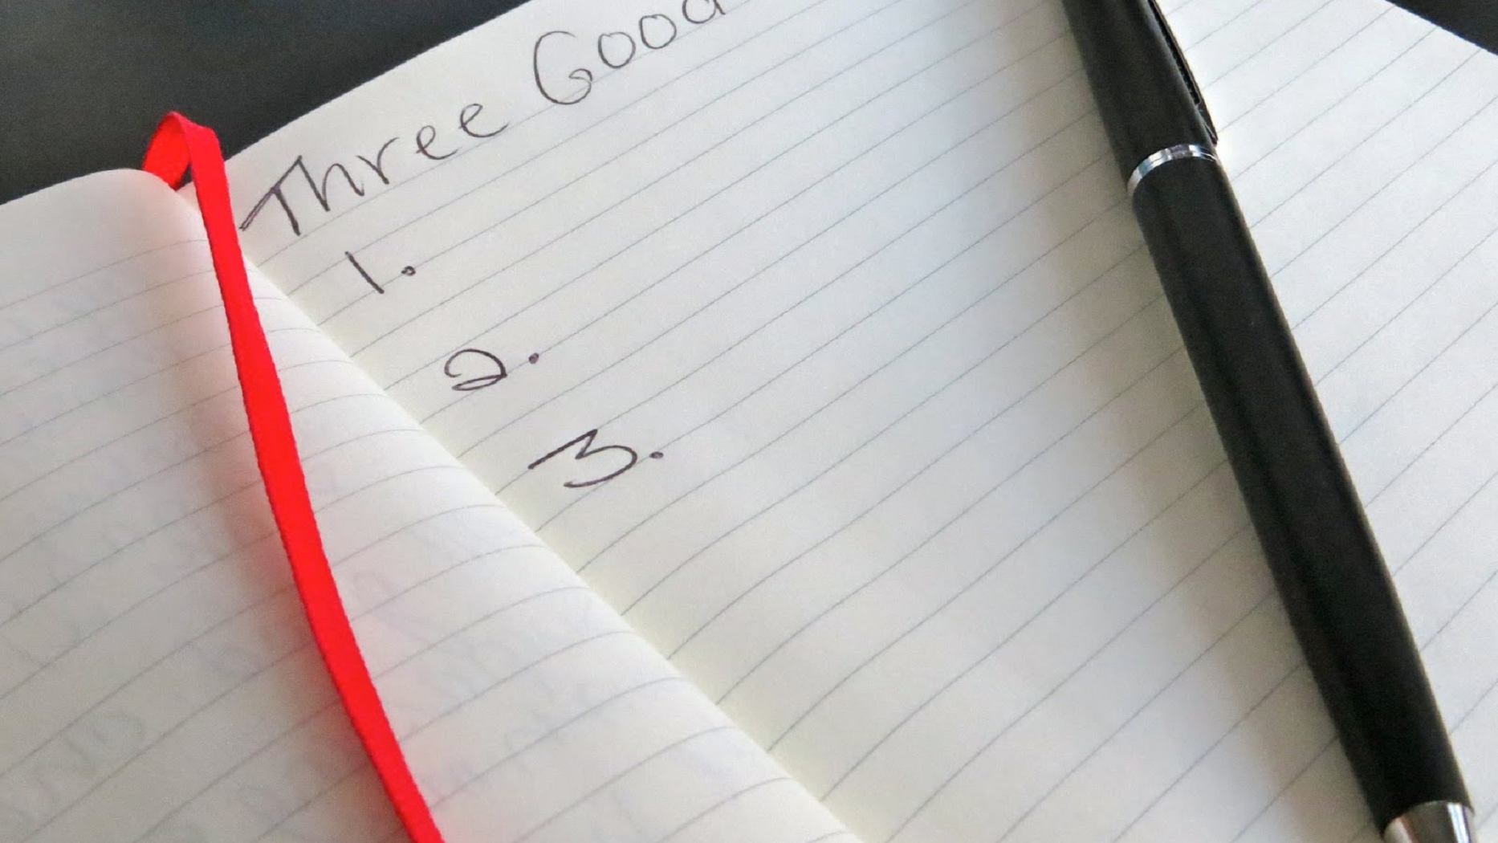
Practice 3 Good Things
Sexton and Adair; BMJ Open. 2019; 9(3): e022695.

Slide 15
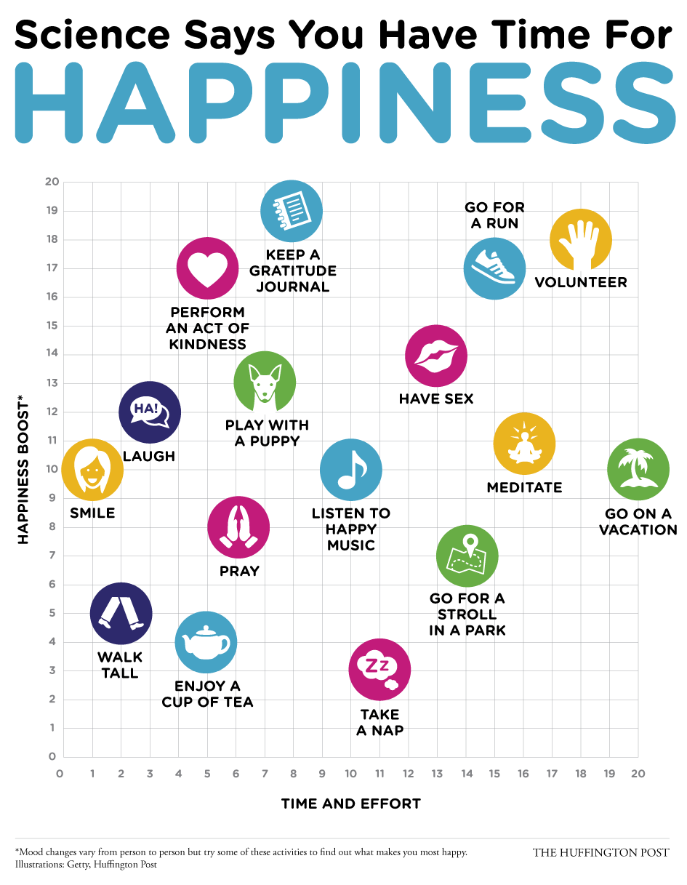
Happiness Boosters
Reach for it when you need an infusion or energy or enthusiasm…or sooner
Rewire your brain in small steps toward a happier state of being
Be more productive, creative, efficient
Know the feeling that tells you when you need it

Slide 16
Examples
3 Good Things
Practice Gratitude
Have a belief mindset
Have something to look forward to
Be a positive role model
Connect with others
Random acts of kindness
Mindfulness – music, photos, brief pauses, breathing, reflective writing, laughter
Exercise
Dance moment
Photo credit: www.haraldlepisk.com

Slide 17
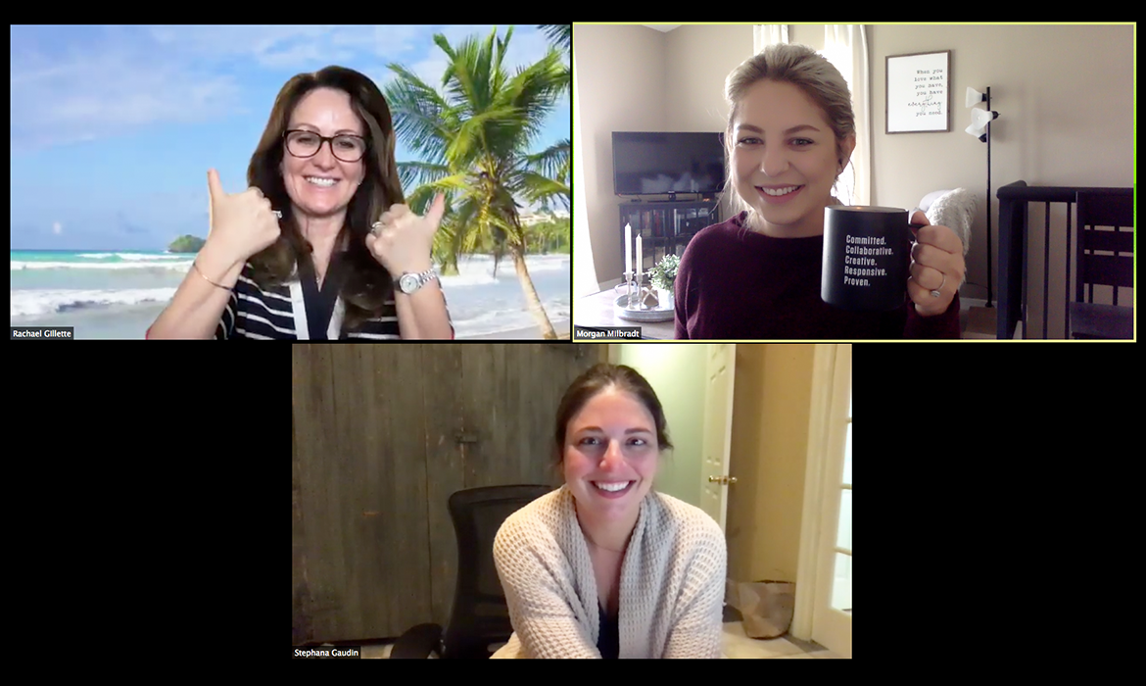
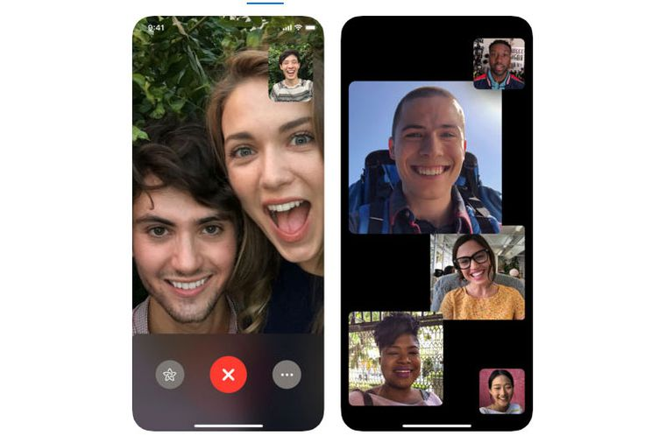
Physical Distance ≠ Social Isolation!!
Share a good story!
This connects us while boosting happiness, creativity, and open-mindedness in both parties.
Allows you to re-live the experience and unpackage what was great about it.
The listener gets a chance to experience your positivity and are also reminded of their own positive experiences.
Reach out and talk to someone!
The next time you are busy or overwhelmed at work, consider talking to someone about something non-medical for just a few moments, rather than burying yourself further in your work.
This actually INCREASES efficiency and productivity!
Soler-Gonzalez et al Front Psychol. 2017; 8: 1475.

Slide 18
Have a positive mindset!
It is ok to be afraid, in fact, we should be! The trick is in the mindset!
When you aren’t sure how to act or what to do, ask yourself, “what would my positive role model do”?
When you are really overwhelmed, focus on the baby steps and put one foot in front of the other. Ask yourself, “what is the next thing I need to do?”
Consider this quote from Mark Twain – “Courage is not the absence of fear, it is acting in spite of it.”

Slide 19
Finally, when talking with someone (or yourself)… 1) Consider the need behind the feeling first 2) then focus on how that need can best be addressed

Slide 20
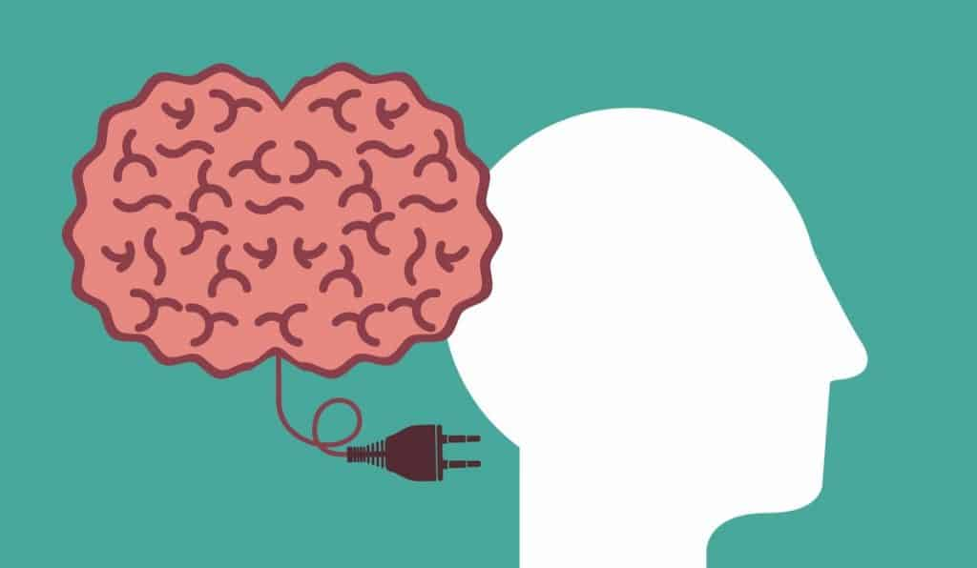
How to Make These Happen
Commit to 1-2 of these practices today.
Find a reliable time to do it, and hold yourself to that.
Share these with others!
Connect! Bring people together via Zoom for a non-business meeting!
Notice your feelings and your mood – reach for these tools when you can most use them!

Slide 22
There are so many helpful references and resources for this. Here are a few that support the evidence behind many of these theories, but there are many more beyond this.
Square breathing - Ma et al, Front Psychol. 2017; 8: 874.
Laughter - Kuiper, N. Europe's Journal of Psychology, 2012, Vol. 8(3), 475–491,
Gratitude - Kaplan et al Journal of Business and Psychology volume 29, pages367–380(2014); Chopik et al J Posit Psychol. 2019; 14(3): 292–302. , Di Fabio et al Front Psychol. 2017; 8: 2025.
3 Good Things - Sexton and Adair; BMJ Open. 2019; 9(3): e022695.
Happiness Boosters – Scott et al https://doi.org/10.5465/amj.2011.59215086; Wildschut et al, Current Directions in Psychological Science 17(5) · October 2008
Social Isolation/Loneliness in the Workplace - Soler-Gonzalez et al Front Psychol. 2017; 8: 1475.
Wheel of Needs – Manske http://radicalcompassion.com
Helpful Books on Happiness:
Authentic Happiness by Martin Seligman
Stumbling on Happiness by Daniel Gilbert
The Happiness Advantage by Shawn Achor
Happiness Is an Inside Job: Practicing for a Joyful Life by Sylvia Boorstein
The Happiness Project by Gretchen Rubin
The Happiness Hypothesis by Jonathan Haidt (+ Summary)
The Happiness Equation by Neil Pasricha
Happiness by Design: Finding Pleasure and Purpose in Everyday Life by Paul Dolan
The Happiness Factor: How to Be Happy No Matter What! by Kirk Wilkinson
The How of Happiness by Sonja Lyubomirsky
Solve for Happy by Mo Gadwat
Happiness: Lessons from a New Science by Richard Layard and Baron Layard

Slide 23
Questions! kpalamara@partners.org

