Slide 1
American College of Physicians
Thank you for joining us for today’s webinar
Addressing and Supporting Physician Mental Health during Challenging Times
Presented by the ACP Leadership Academy and the ACP Well-being and Professional Fulfillment program
The webinar will begin promptly at 3:00 p.m. ET
A recording of this presentation will be available at
acponline.org/leadershipacademy

Slide 2
Addressing and Supporting Physician Mental Health during Challenging Times
Kerri Palamara, MD, FACP
Joshua C. Morganstein, MD

Slide 3
CME and Disclosure Information
The American College of Physicians (ACP) is accredited by the Accreditation Council for Continuing Medical Education (ACCME) to provide continuing medical education for physicians.
The ACP designates this other activity (blended) for a maximum of 1 AMA PRA Category 1 Credit(s)™. Physicians should claim only the credit commensurate with the extent of their participation in the activity.
To claim CME credit, please go to:
https://www.acponline.org/wellbeing-webinars-cme
The individuals in control of content for this activity have nothing to disclose.

Slide 4
Disclaimer
The ideas, attitudes, and opinions expressed herein are my own and do not necessarily reflect those of the Uniformed Services University, the U.S. Public Health Service, the Department of Defense, or other branches of the U.S. government. I am not endorsing any of the entities or resources mentioned in this presentation and have no relevant disclosures or conflicts of interest to report.

Slide 5
Shultz, J. M., Espinola, M., Rechkemmer, A., & Cohen, M. A. (2016). Prevention of Disaster Impact and Outcome Cascades. In The Cambridge Handbook of International Prevention Science (pp. 492–519).

Slide 6
Psychological & Behavioral Responses to Pandemics/Disaster
Sleep difficulties
Decreased Sense of Safety
Physical (Somatic) Symptoms
Irritability, Anger
Distraction, Isolation
Distress Reactions
Psychiatric Disorders
Depression
PTSD
Anxiety
Complex Grief
Resilience
Health
Risk
Behaviors
Alcohol, Tobacco, Rx meds
Family Distress
Interpersonal Conflict/Violence
Disrupted Work/Life Balance
Restricted Activities/Travel
Ursano, R., Fullerton, C., Weisaeth, L., & Raphael, B. (2017). Individual and Community Responses to Disasters. In R. Ursano, C. Fullerton, L. Weisaeth, & B. Raphael (Eds.), Textbook of Disaster Psychiatry (pp. 1-26). Cambridge: Cambridge University Press.

Slide 7
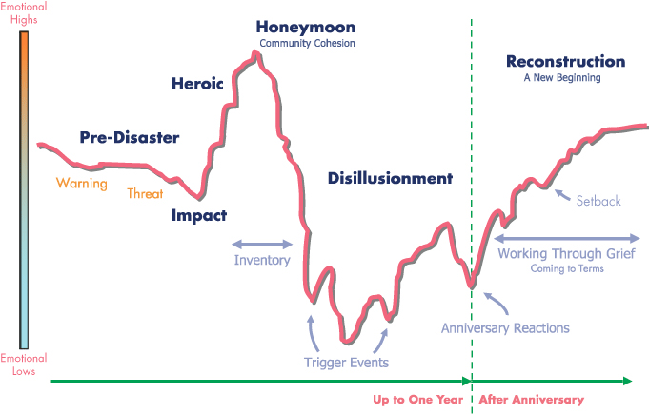
Community Phases of Disasters
DeWolfe, D. J. (2000). Training manual for mental health and human service workers in major disasters. (D. J. Nordboe, Ed.) (2nd ed.). SAMHSA. Retrieved from https://files.eric.ed.gov/fulltext/ED459383.pdf
Gladwell, M. (2000). The Tipping Point: How Little Things Can Make a Big Difference. Little Brown & Company. New York, NY.

Slide 8
Risk Factors for Healthcare Workers
PRE
POST
DISASTER
PRE-EVENT
Socioeconomic Status
Social Support
Training Status
Work Environment
Underlying Health Conditions
Help-Seeking Behaviors
RECOVERY
Job Loss, Financial Hardship
Social support Loss
Low Organizational Support
Lack of Rest & Recovery
EVENT
Duration & Severity of Exposure
Psychological Identification
Illness
Bereavement
Moral injury
Morganstein, J. C., West, J. C., & Ursano, R. J. (2017). Work-Associated Trauma. In K. A. Brower & M. B. Riba (Eds.), Physician mental health and well-being: research and practice (pp. 34–60).
Norris, F. H., Friedman, M. J., Watson, P. J., Byrne, C. M., Diaz, E., & Kaniasty, K. (2002). 60,000 disaster victims speak: Part I. An empirical review of the empirical literature, 1981-2001. Psychiatry, 65(3), 207–239.
Somasundaram and van de Put (2006). Management of Trauma in Special Populations after a Disaster. J Clin Psychiatry;67(suppl 2):64-73

Slide 9
Psychological First Aid (PFA)
The Five Elements:
Safety
Calming
Self/Community Efficacy
Connectedness
Hope/Optimism
Analogous to “First Aid”
Population-based “framework”
“Do no harm” approach
Resilience-focused
NOT a cure/tx for illness
MAY mitigate illness/dz
Hobfoll, S. E., Watson, P., Bell, C. C., Bryant, R. A., Brymer, M. J., Friedman, M. J., et al. (2007). Five essential elements of immediate and mid-term mass trauma intervention: empirical evidence. Psychiatry, 70(4), 283–315– discussion 316–69.

Slide 10
Resources: Education Tools
CSTS COVID-19 Response page
https://www.cstsonline.org/resources/resource-master-list/coronavirus-and-emerging-infectious-disease-outbreaks-response
Pandemics: Health Care Emergencies
(FREE from Cambridge Press)
https://www.cambridge.org/core/services/aop-cambridge-core/content/view/478824C480288A8935798FBF151D96FA/9781316481424c18_p270-284_CBO.pdf/pandemics_health_care_emergencies.pdf

Slide 11
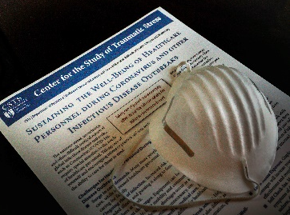
Sustainment of Healthcare Workers
ORGANIZATIONS
INDIVIDUALS
Self-care
Take Breaks
Peer (Battle) Buddy
Stay Connected
Do Self Check-ins
Honor Service
Speak Up
LEADERS
Presence
Communication
Encouragement
Be an example
Normalizing
Hope/optimism
Grief
Training
Equipment
Education
Policies
Procedures
Resources
Brooks, S. K., Dunn, R., Amlôt, R., Rubin, G. J., & Greenberg, N. (2018). A Systematic, Thematic Review of Social and Occupational Factors Associated With Psychological Outcomes in Healthcare Employees During an Infectious Disease Outbreak. Journal of Occupational and Environmental Medicine / American College of Occupational and Environmental Medicine, 60(3), 248–257.
Birkeland, M. S., Nielsen, M. B., Knardahl, S., & Heir, T. (2015). Time-lagged relationships between leadership behaviors and psychological distress after a workplace terrorist attack. International Archives of Occupational and Environmental Health.
Wood, M. D., Walker, T., Adler, A. B., Science, C. C. O. H., & Jahangiri, K. (2020). Post-Traumatic Growth Leadership: Mitigating Stress in a High-Risk Occupation. Occupational Health Science.

Slide 12
SAFETY
Training
Equipment
Information
Protect Family
”Buddy Up”
CALMING
Ensure Sleep & Meals
Use Media Wisely
Provide Information
Normalize Reactions
Breaks, Rest Cycles
Listen to People
HOPE
Restore Normal Activities
Encourage Problem-Solving
Leverage Opportunities
Focus on Strength/Growth
EFFICACY
HCW-derived Activities
Recognize Service
Helping Resources
Buddy Checks
CONNECTEDNESS
Team Huddles
Buddy Checks
Camaraderie Activities
Technology

Slide 13
“Buddy Up”
Buddy systems (swim buddy, high risk work “buddy checks”, 12-step pgms)
Safety, social support, efficacy
Formal (vs ad hoc) peer support
Collaborative selection process
Daily check-ins: self-care, emotional health, camaraderie
Ramsberger, P. F., Mills, L., & Legree, P. (2002). Evaluation of the Buddy Team Assignment Program (p. 60). United States Army Research Institute for the Behavioral and Social Sciences.

Slide 16
Questions?

Slide 17
Additional Resources American College of Physicians

Slide 18
Additional Resources
COVID-19 ACP Physician's Guide Clinician Well-being Resources
Features resources dedicated to personal resilience, crisis lines and counseling support, institutional and team well-being, grief management, and more
CME-eligible ACP Well-being webinars
COVID-19: Practical Support from Internists on the Front Lines
Mini But Mighty Skills for Well-being
Positive Psychology in Times of Crisis
COVID-19 Administrative and Regulatory Relief Advocacy
Advocating for administrative and regulatory relief to remove unnecessary burden on physicians so they are able to focus their efforts on addressing the COVID-19 crisis
Asking HHS to make a targeted allocation from the Provider Relief fund to primary care physicians and other clinicians to help them weather the COVID-19 pandemic and help remove financial strains on primary care practices
Created a Chapter Advocacy Toolkit that features resources and calls to action that ACP chapters can use to advance policies at the state level
Please contact acpwellbeing@acponline.org for any questions, comments, or suggestions

Slide 19
Additional Resources
Visit ACP’s COVID-19 Resource Hub: www.acponline.org/covid19
Register for Upcoming Programming: Innovations in the Care of Outpatients with COVID-19 Wednesday, June 24, 2020 5:00 p.m. - 6:00 p.m. ET
www.acponline.org/leadershipacademy

Slide 20
Thank you!

