Slide 1

Medical Practice-based Economics of Adult Immunization
John H. O’Neill, Jr., D.O., FACP
Bayview Internal Medicine, Inc., Middletown, DE
Immunization Technical Advisory Committee, ACP
May 16, 2015 New Orleans, LA

Slide 2
Disclosure
Dr. John O’Neill has no financial relationships with any entity producing, marketing, re-selling, or distributing health care goods or services, consumed by, or used on, patients.

Slide 3
Objectives
Review medical practice strategies for ordering, storing and administering vaccines safely, at reduced costs.
Discuss evaluating the financial impact of adult immunization on your medical practice.
Discuss billing codes and reimbursement for vaccines under Medicare and private carriers to maximize value to your practice.

Slide 4
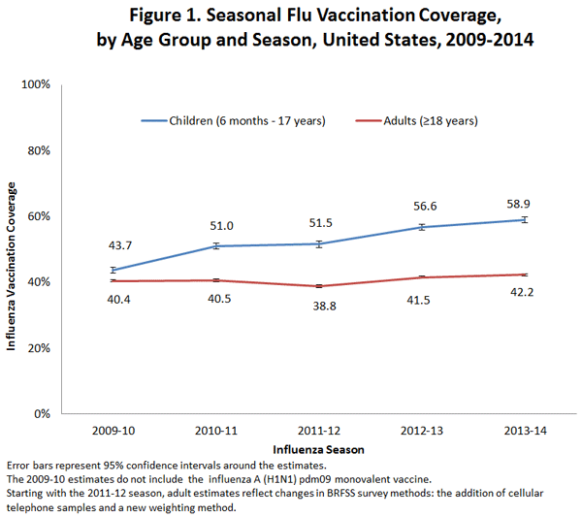
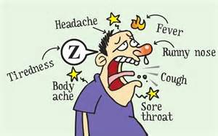
US Adult Immunization Rates are Unacceptably Low!
Source:
www.cdc.gov/flu/fluvaxview

Slide 5
NHIS 2013, Non-Flu Immunization
Immunization | Age range | % Received
Pneumococcal | 19-64 >65 | 21.2 59.7
Tetanus | 19-64 >65 | 63 56
Tetanus/Pertussis | 19-64 >65 | 18.4 (+2.9%) 11.9
Hepatitis B | 19-49 With hx DM | 32.6 26.3
Zoster | >60 | 24.2 (+4.1%)
HPV (female) | 19-26 female 19-21 male | 36.9 7.7 (+5.3%)
Source:
cdc.gov/mmwr/preview
2/6/15

Slide 6
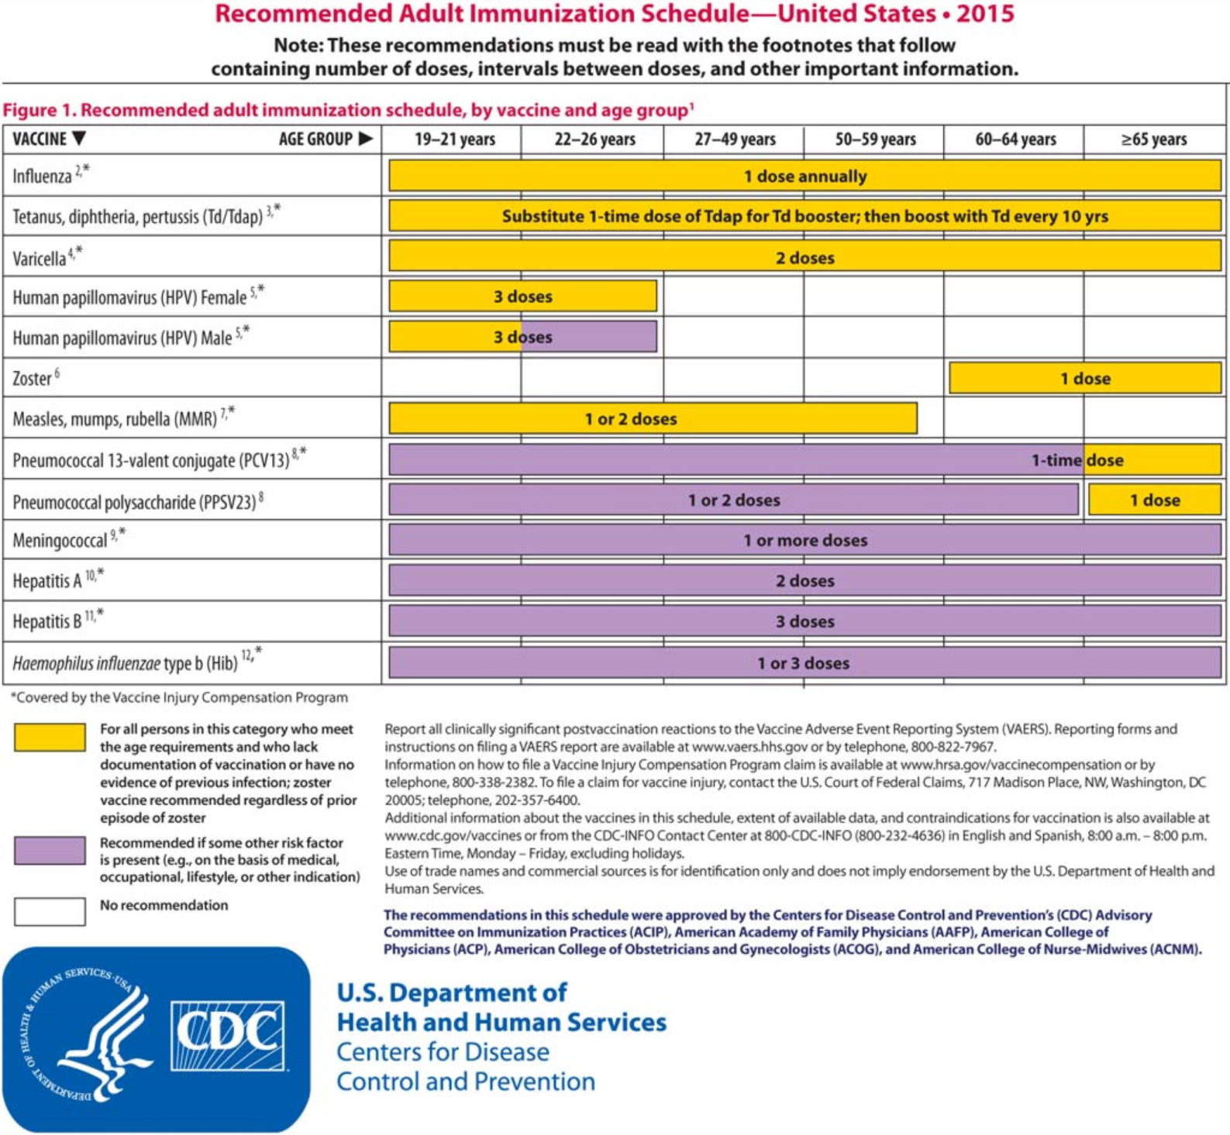
ACIP
Source:
Annals of IM
3 February 2015

Slide 7
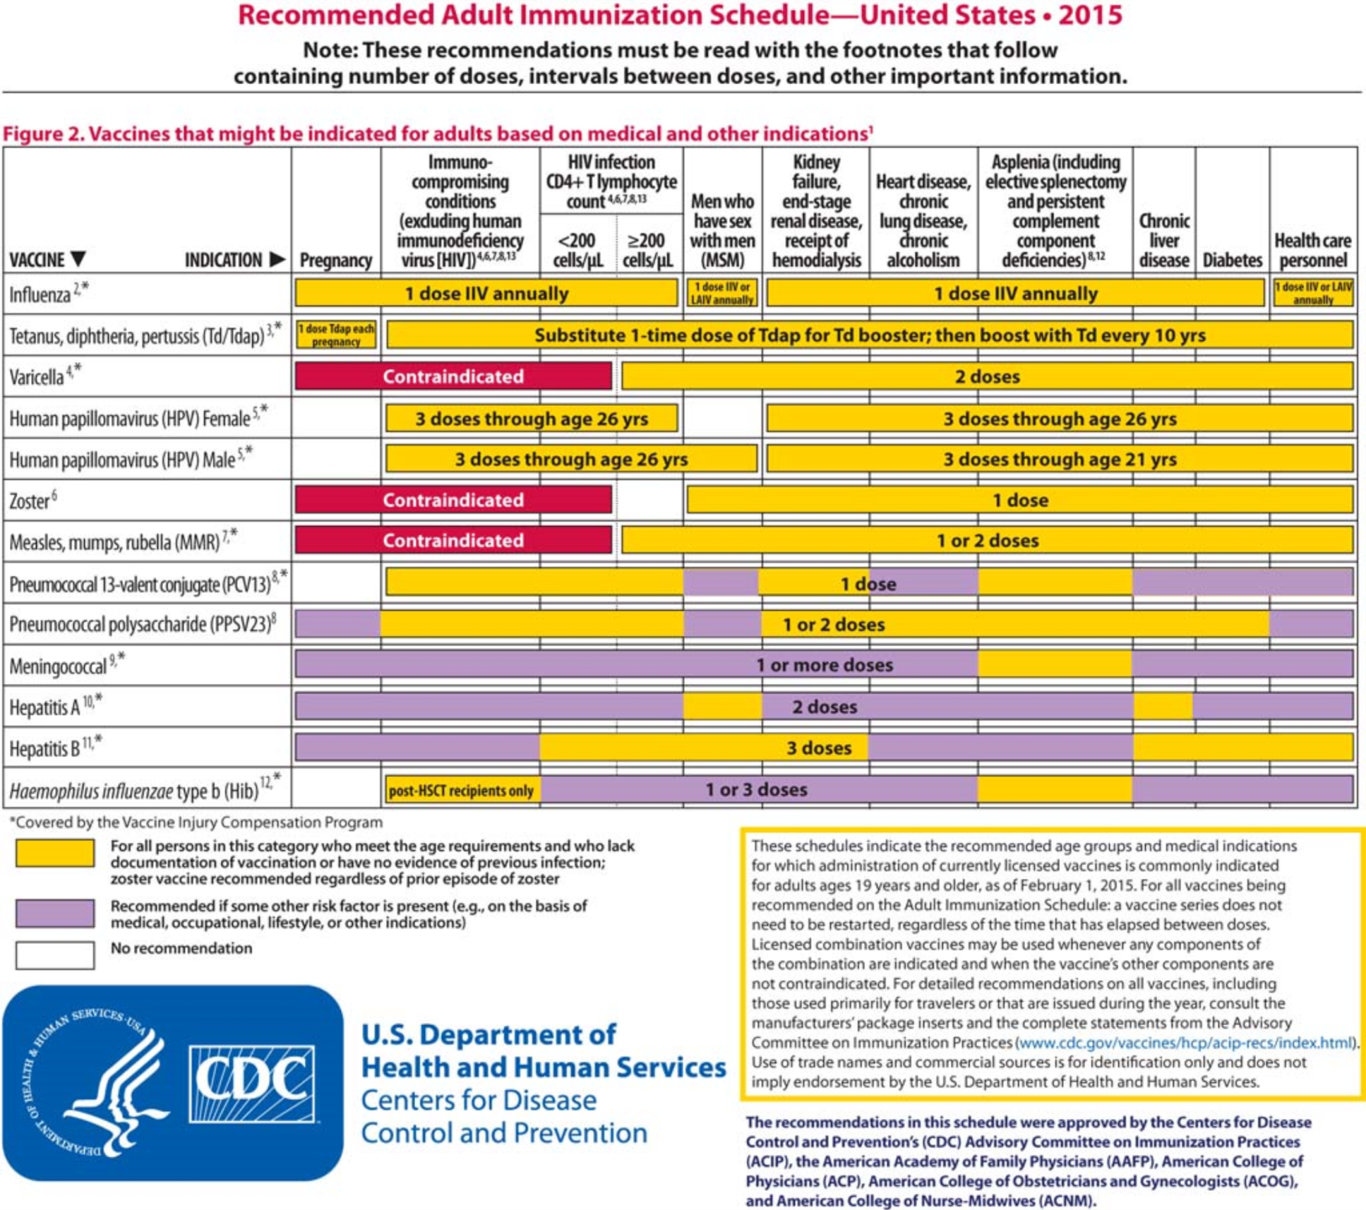
ACIP
Source:
Annals of IM
3 February 2015

Slide 8
“The Big Five” for Adults
Influenza
Td/Tdap
PCV13 (conjugated pneumococcal)
PPSV23 (pneumococcal polysaccharide)
Zoster (VZV)

Slide 9
“The Other Seven” for Adults: individual circumstances
HPV4
Meningococcal
Hepatitis B
Hepatitis A
MMR
Varicella
Hib

Slide 10
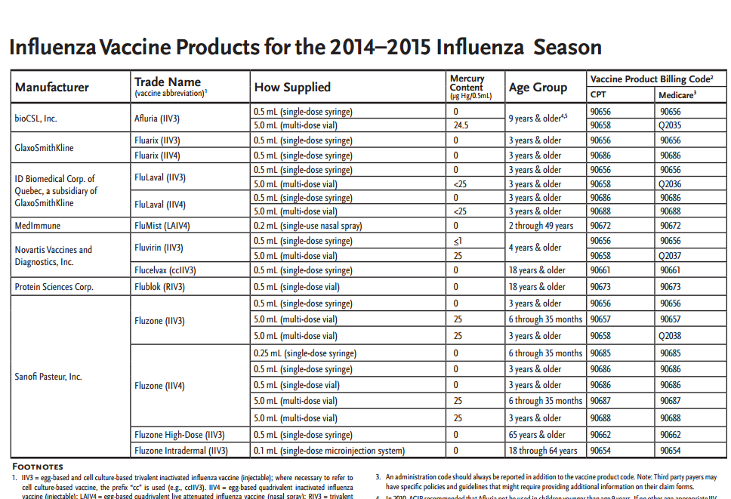
www.immunize.org (IAC)
www.immunize.org (IAC)

Slide 11
Types of Adult Flu Vaccines: ’14-’15
CPT code | MCR Q code | Vax Type | Brand Name
90654 (18-64 y/o) |  | IIV3 | Fluzone intraderm
90656 (preservative free) |  | IIV3 (pf) | Fluzone, Fluvirin, Fluarix, Afluria
90658* | Q2034 | IIV3 | Agriflu
90658* | Q2035 | IIV3 | Afluria
90658* | Q2036 | IIV3 | FluLaval
90658* | Q2037 | IIV3 | Fluvirin
90658* | Q2038 | IIV3 | Fluzone
90661 cell culture, no egg |  | ccIIV3 | Flucelvax
90662 (preservative free) |  | IIV3hd | Fluzone-HiDose
90672 (2-49 y/o) |  | LAIV4 | FluMist
90673* (18 y/o and up) | Q2033 | RIV3 | FluBlok
90686 (quadriv, pres free) |  | IIV4 (pf) | FluZone
90688 (quadriv) |  | IIV4 | FluLaval

Slide 12
Vaccines, Cost and Reimbursement
See also www.icd10data.com
vaccine | cpt | Icd9 Icd10: *Z23 | Approx. Cost* (*VCF 4/1/15) | Est. Private Sector reimb. | Mcr (de ) reimb.
Influenza (IIV3 PF) | 90656 | V04.81 | 12.49 | 14-20 | 14.09
Influenza (IIV3) | 90658 | V04.81 | 10.69-13.63 | 12-16 | 12.04
Influenza (hi dose ag) | 90662 | V04.81 | 28-30 | 32-34 | 33.37
Influenza quadrivalent | 90688 | V04.81 | 16.15 |  | 16.84
PPSV23 | 90732 | V03.82 | 72.38 | 69-78 | 77.84
Tdap | 90715 | V06.5 | 37.55-42.61 | 40-47
Herpes Zoster | 90736 | V05.9, V04.89 | 187.89 | 190-197
PCV13 | 90670 | V03.82 | 152.01-166 | 148-151 | 153.96
Hepatitis B | 90746 | V05.3 | 52-61 | 56-59 | 59.70
Meningococcal (conj.) | 90734 | V03.89 | 112.93 | 120-123
HPV (4 valent) | 90649 | V05.9, V04.89 | 147.01 | 150-154

Slide 13
Cost Information on Vaccines (VFC)
http://www.cdc.gov/vaccines/programs/vfc/awardees/vaccine-management/price-list/index.html
Other very useful references:
Immunization Action Coalition (IAC):
http://www.immunize.org/
ACP Immunization Portal: http://immunization.acponline.org/

Slide 14
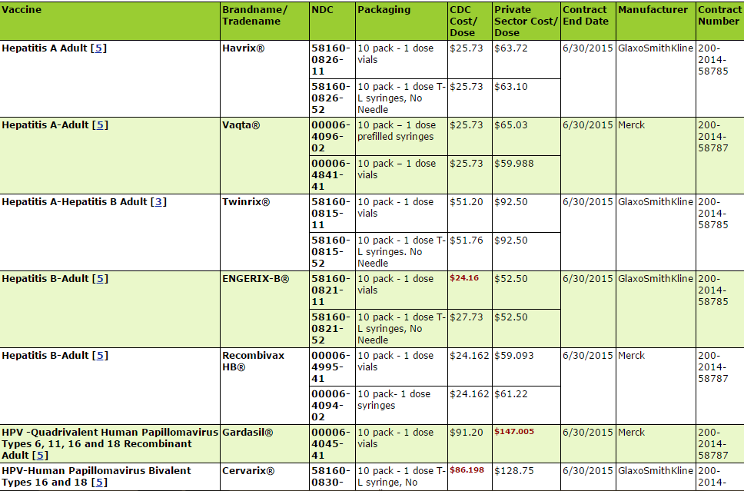
Adult Vaccine Price List

Slide 15

ACP Immunization Portal
Electronic Access to ACP’s Guide to Adult Immunization , with 4 pdf’s downloadable modules to help with practice-based quality improvement processes, recommended adult vaccines and their dosing/indication, and special circumstances: (immunocompromised, pregnancy)
Free for ACP Members!
http://immunization.acponline.org

Slide 16

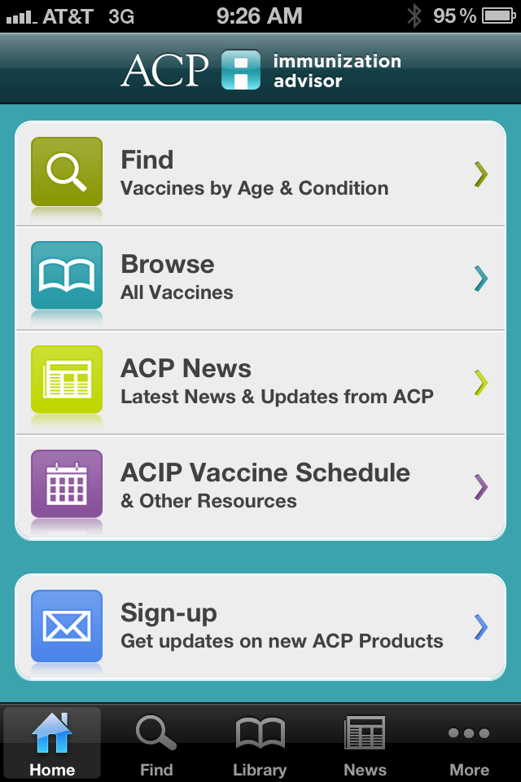
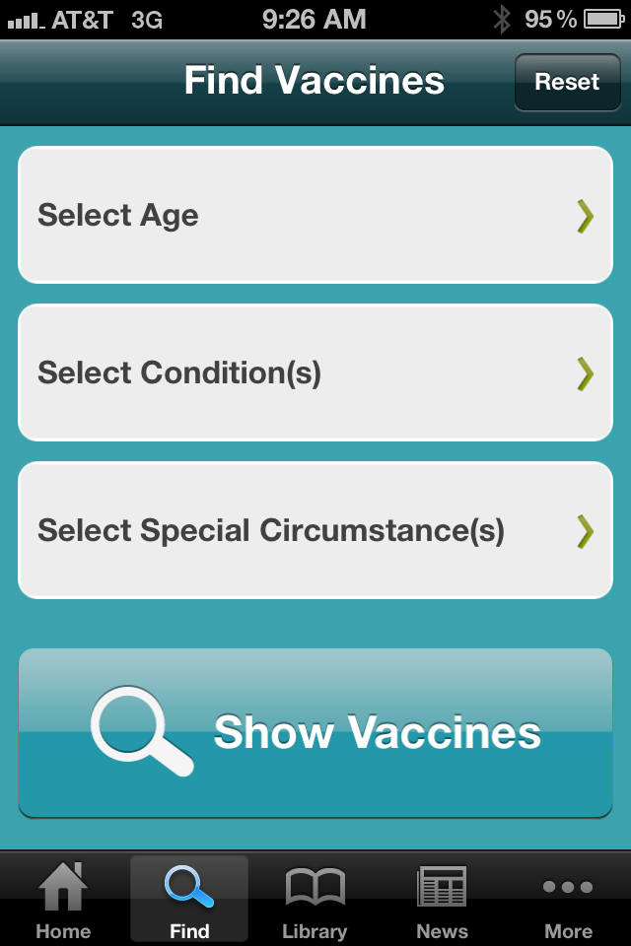

Slide 17
Vaccine Administration
Vaccine | MCR (HCPCS) | MCR Pmt (DE ) PAR | Non-MCR CPT | Private Sector reimburse
Influenza | G0008 | 25.81 | 90471 | 10-12.80
Pneumococcal | G0009 | 25.81 | 90471 | 10-12.80
Hepatitis B | G0010 | 25.81 | 90471 | 10-12.80
Second Vax Admin per day | (use icd9 V06.6 if flu vax and PPSV23 given same day) | 12.85 | 90472
Administer Vax <age 18, with counseling |  |  | 90460, 90461 | 10-12.80

Slide 18
BVIM Vaccination Jan 1- Dec 31/14
CPT admin | #procedures
90460 | 1
90471 | 315
90472 | 7
G0008 | 288
G0009 | 47
G0010 | 0
Vaccine | #procedures
HPV4 | 4
influenza | 449
PCV13 | 23
Tdap | 96
Varicella | 0
PPSV23 | 65
Meningococcal | 7
Zostavax | 6
Hepatitis B | 5

Slide 19
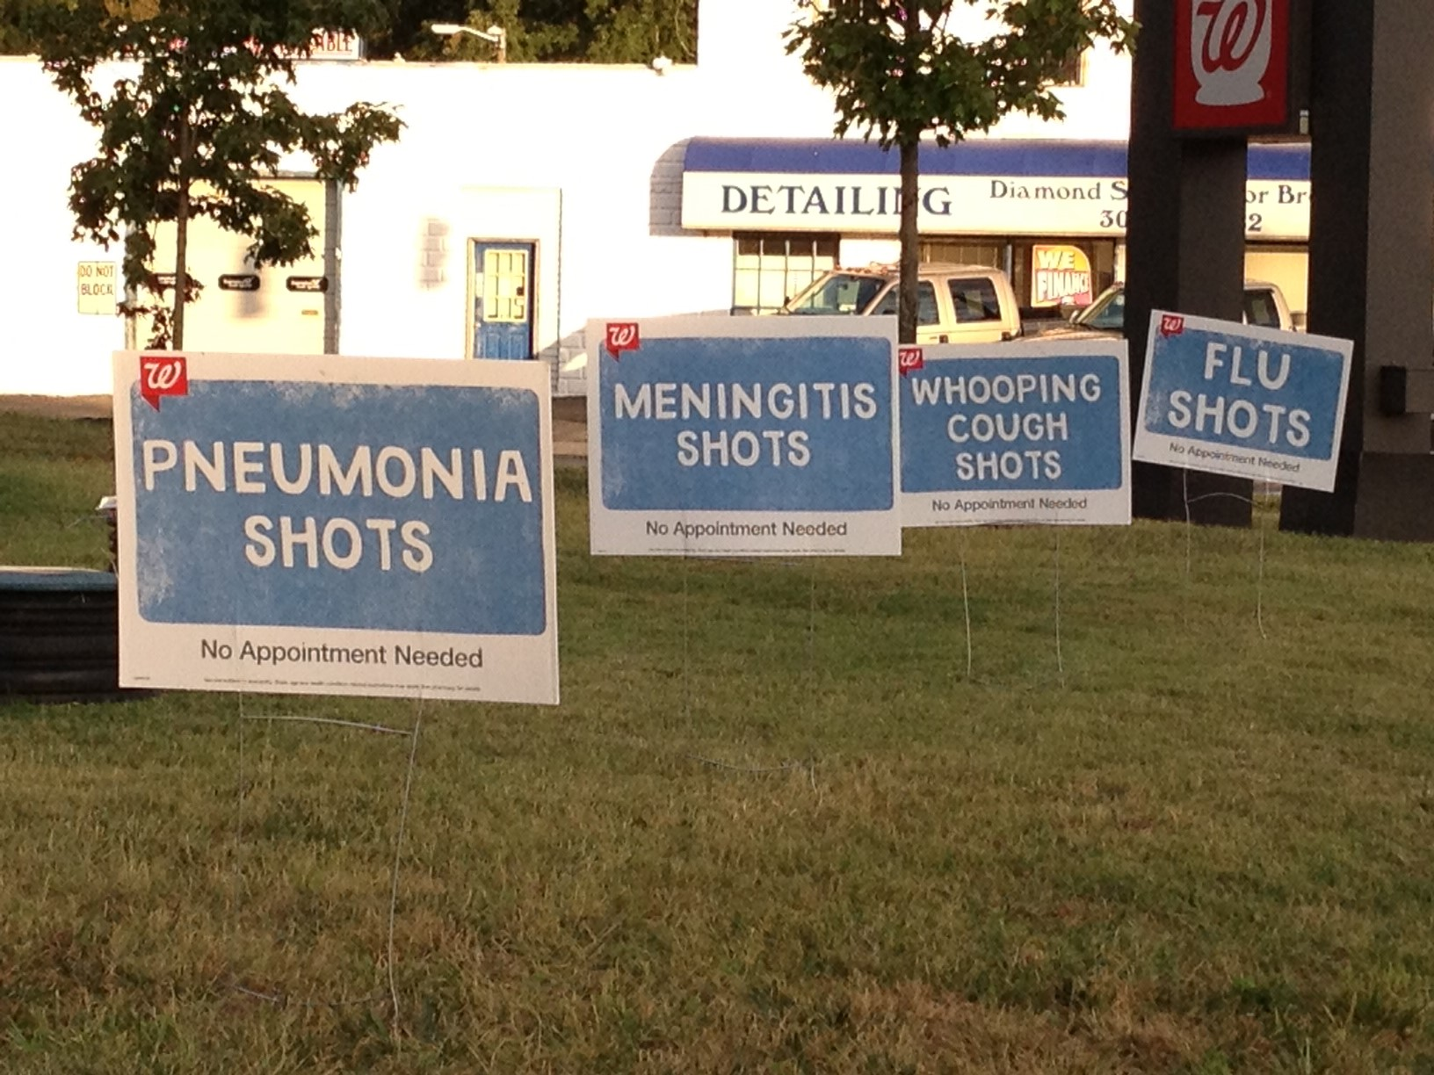

Slide 20
Other cost considerations:
Staff: they are there anyway!!
Needles, syringes, alcohol swabs, bandaids
Storage and handling of vaccines:
http://www.cdc.gov/vaccines/recs/storage/toolkit/storage-handling-toolkit.pdf
Vaccine Discount Suppliers: buying vaccines for less $$$

Slide 21


Slide 22
Vaccine Ordering and Discounts
NDVA: National Discount Vaccine Alliance, Inc.
http://www.nationaldiscountvaccinealliance.com/
AHP: Atlantic Health Partners, LLC
http://www.atlantichealthpartners.com/
VaxServe.com
https://www.vaxserve.com/index.cfm?fa=anon.homepage
AAP: Group Purchasing vs Physician Buying Groups
http://www2.aap.org/immunization/pediatricians/GPO.html
ACP Webinar: Efficient Vaccine Ordering
http://www.acponline.org/multimedia/?bclid=782543304001&bctid=1733749311001

Slide 23
Logging Vaccines: Simple Procedure
Source:
Immunization Action Coalition (IAC)
Immunize.org
Maintain a vaccine inventory log that is used to document the following:
a. Vaccine name and # of doses rec’d
b. Date we received the vaccine
c. Condition of vaccine when received
d. Vaccine manufacturer, lot number
e. Vaccine expiration date
f. Dates administered

Slide 24
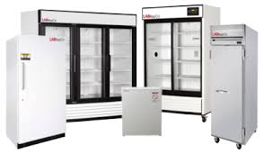
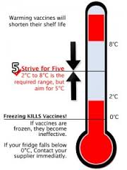
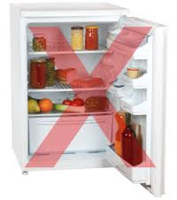
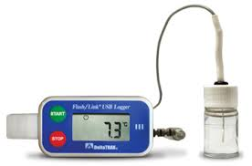
Vaccine Storage

Slide 25
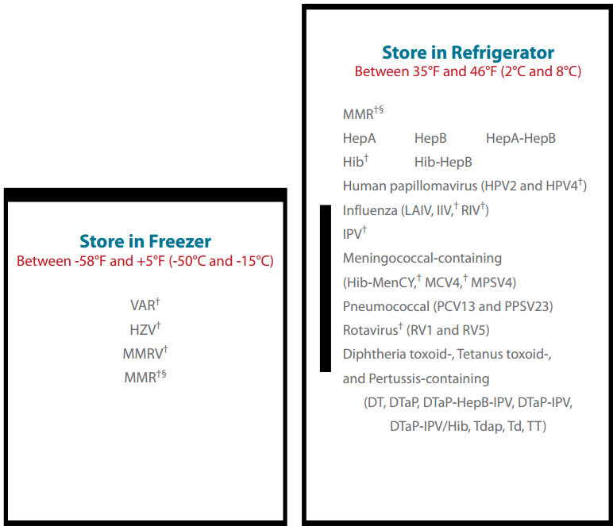

Slide 26
Vax Refrigeration/Storage
Source: (fridges)
public.health.oregon.gov
(Oregon VFC guide)
Re: Digital Logging Thermometers -
See: http://www.vfcdataloggers.com/
Vaccine Refrigerator Manufacturers to Consider:
Panasonic Biomedical www.sanyobiomedical.com
Follett: www.follettice.com
Helmer: www.helmerinc.com
Thermo Scientific: www.thermo.com
Lab Research Products: www.labresprod.com
Gem Scientific: www.gemref.com
Fisher Scientific: www.fishersci.com
Sun Frost (efficient): www.sunfrost.com

Slide 27
Standing orders for Vaccines
Advocated for by ACIP, particularly for influenza, pneumococcal, Tdap and hepatitis B vaccines
Administration of vaccines by nurses, pharmacists, medical assistants and other qualified personal, under physician established protocol, without examination by physician
Substantially improves immunization rates
http://www.cdc.gov/mmwr/preview/mmwrhtml/rr4901a2.htm
http://www.immunize.org/standing-orders/ (IAC)

Slide 28
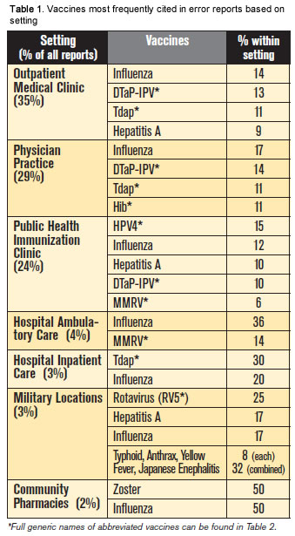
VERP: Vaccine Safety
1st VERP 11/28/2013, 433 reports (ISMP)
In the office setting, errors involving influenza vaccines, Tdap and combination vaccines, HPV vaccines, and zoster vs varicella vaccines were common.
Simple Practice-based patient safety protocols should improve vaccination procedures and patient outcomes: verification of patient identity and immunization record, verification of proper vaccine and administration
Source: https://www.ismp.org/Newsletters/acutecare/showarticle.aspx?id=64

Slide 29
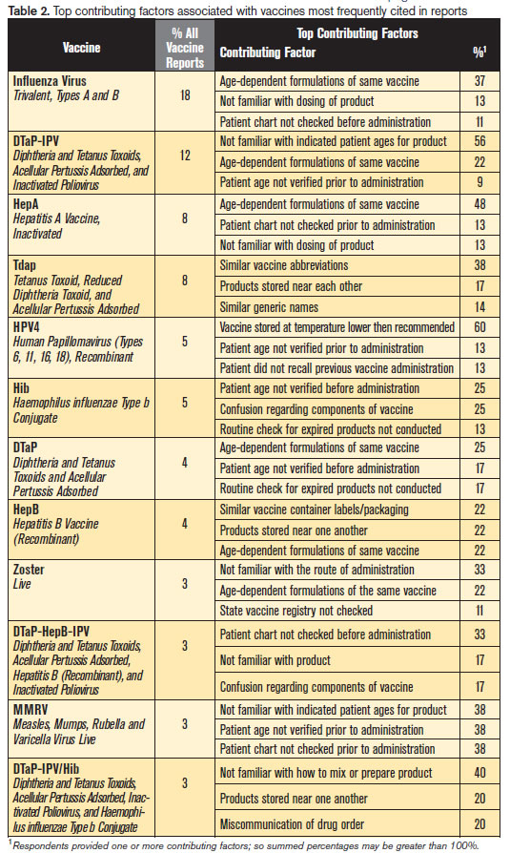
VERP (2013)
Common contributing factors to errors in vaccine administration:
Age dependent formulations
Indicated patient age for immunization
Similar vaccine abbreviations
Similar vaccine packaging
Lack of familiarity with proper mixing or preparation of product, and route of administration
Source: https://www.ismp.org/Newsletters/acutecare/showarticle.aspx?id=64

Slide 30
Plan-Do-Study-Act (PDSA Cycle)
[the Chronic Care Model , see 1st module, ACP Immunization Portal]
Preparation
PDSA
Identify practice gap
Set aim/goal
Identify process measures that ultimately can lead to improved clinical outcome
Plan the change, in small steps
Do: carry out the plan
Study: plot data on run chart
Act: adopt, adapt or abandon

Slide 31
PDSA: improving Tdap Admin in BVIM >65 y/o
Gap: low Tdap rates for >65 y/o
Goal: improve monthly Tdap in > 65 y/o by 100%
Process: MA identifies eligible pt and gives Tdap VIS to read while waiting in office
Start: March 2012
Adopt!

Slide 32

Take Home Points: Economics of Practice-based Adult Immunization (drjho7@verizon.net)
Know your vaccine cost per dose, and reimbursement for vaccines by each of your payers (VFC reference)
Assess the immunization status of your practice by PM/IT reporting and/or PDSA cycles
Use Standing orders for most commonly given vaccines; give VIS to all vaccine recipients (IAC website)
Catalog and Store your vaccines per CDC guidelines (CDC toolkit reference)
Implement vaccine patient safety protocols in your practice

