Slide 1
How to Build an Immunization Neighborhood
Laura Lee Hall, PhD
Eric Crumbaugh, PharmD
Angela Duck, MSN, RN
Maria Lanzi, MS, MPH, ANP, COHN-S
I Raise the Rates Champion Training
May 15 – 17, 2015
New Orleans, LA

Slide 2
Rationale for Immunization Neighborhood
Not all practices find it realistic to stock all vaccines
Need for patient-centered coordination – referring patients to providers who are:
  Convenient,
  Provides financial access,
  Stocks requested vaccines, and
  Feeds back data to practice

Slide 3
I Raise the Rate Immunization Neighborhood Project
Working in partnership with APhA to develop tools to be used by practices and pharmacies/other vaccinating providers
Includes: tools for identifying trusted partner for referral, referral forms, data feedback forms,
Timeline for development suggests availability for participants in October 2015

Slide 4

The Immunization Neighborhood
Eric Crumbaugh, PharmD

Slide 5
Place of Influenza Vaccination Among Children and Adults
Early 2012-13 Flu Season
National Immunization Survey and National Internet Flu Survey
www.cdc.gov/flu/fluvaxview/nifs-estimates-nov2012.htm
Notes:
This graph shows place of vaccination among children and adults as of November 2012 for the 2012-13 flu season. The most common place of vaccination among both adults (34.5%) and children (64.8%) was a doctor’s office. These results are similar to results from the early 2011-12 season when 31.6% of adults and 63.3% of children were vaccinated in doctor’s offices.
Other common places of flu vaccination reported by adults during early November of the 2012-13 season included medical places other than doctor’s offices (21.5%), pharmacies or stores (18.4%), and workplaces (17.0%). The next most common places of flu vaccination for children were medically related places other than doctor’s offices (25.3%) and schools (5.5%).

Slide 6


Ultimate Goal
“Immunization Neighborhood”
Purpose:
  Collaboration, coordination, and communication among immunization stakeholders dedicated to meeting the immunization needs of the patient and protecting the community from vaccine-preventable diseases.

Slide 7
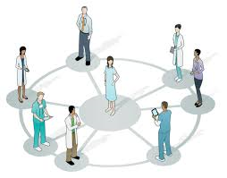
Immunization Neighborhood
Where are You?
Strategy to address Pediatric, Adolescent, and Adult Immunization Needs
Meeting specific needs of targeted populations
Collaboration * Coordination * Communication *
Physicians
Hospitals / Institutions
Payers
Immunization Stakeholders
Community leaders & influencers
Pharmacists
Nurses
Physician Assistants
Public Health
Supporting the Neighborhood
HIT
Documentation
Standards / Guidelines
Consistent Messaging
Scope of Authority
Referral mechanisms

Slide 8
Coordination
Guided by established standards and recommendations
Assess patient immunization status
  Patient history (oral and record cards)
  Electronic health records / IIS
Administer vaccines or refer patient to immunizer
Referral of patients for other services / entry or re-entry into system

Slide 9
Collaboration
Agreement between stakeholders: meet patient needs, protect patients from vaccine-preventable diseases, and increase patient access to recommended vaccinations
  Depending upon state requirements
    Scope of vaccine offerings
    Protocols or standing orders
    Common messaging

Slide 10
Communication (Documentation)
Documentation to electronic health record and IIS
  Completeness of health records
  Reporting for quality measures
Provision of documentation to patient
Patient reminders and recall
  Completion of series (HPV, Hep B, etc)
Billing for vaccinations

Slide 11
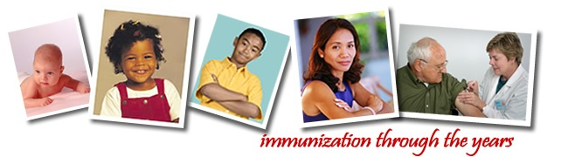
Roles of Pharmacists in Immunization Advocacy
Pharmacist as advocate
  Educating and motivating patients
Pharmacist as facilitator
  Hosting others who vaccinate
Pharmacist as immunizer
  Administering vaccinations
Supports multi-faceted role of pharmacists across the life cycle.
1996, APhA House of Delegates

Slide 12
Pharmacists’ Administration of Influenza Vaccine: 2010‒11
CDC estimates that pharmacists administered almost 20% of the influenza vaccinations provided to adults in the U.S. in the 2010‒11 season
Estimated number of vaccines administered by pharmacists was 17 million to 25 million doses
CDC. MMWR Morb Mortal Wkly Rep. 2011;60:781–5.
Skelton JB; APhA, AMCP. J Am Pharm Assoc. 2011;51:704-12.
Notes:
During the 2010 to 2011 influenza season, it is estimated that pharmacists administered almost 20% of all influenza vaccines provided to adults in the United States. The estimated number of influenza vaccine doses administered by pharmacists during the season was between 17 million and 25 million.
References
Centers for Disease Control and Prevention. Place of influenza vaccination among adults: United States, 2010–11 influenza season. MMWR Morb Mortal Wkly Rep. 2011;60:781–5.
Skelton JB; American Pharmacists Association; Academy of Managed Care Pharmacy. Pharmacist-provided immunization compensation and recognition: white paper summarizing APhA/AMCP stakeholder meeting. J Am Pharm Assoc. 2011;51:704-12.

Slide 13
Source of Referral to Pharmacy Vaccination Services
APhA Annual Immunization Surveys
Notes:
This slide presents the source of referrals to pharmacy immunization services, as reported by respondents to APhA’s annual immunization surveys. Physicians are the leading source of referrals, however many other practitioners and groups represent important sources of referrals.

Slide 14
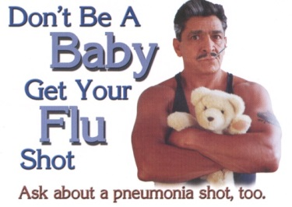
Pharmacy’s Unique Contribution
Improving medication use…Advancing patient care
Access, proximity, extended hours
  especially when others are closed
  equivalent of US population enters a pharmacy each week (1)
Ability to identify high-risk patients easily based upon their medications
Public’s trust-Gallup Poll/enthusiastic acceptance
Message dissemination vehicles
Practice guided by nationally adopted guidelines
Support completion of multi-dose vaccines (ie: HPV, etc)
Knowledgeable vaccine resource
- Education/training
Ability to handle storage issues
(1) Doucette W, McDonough R. Beyond the 4 P's: using relationship marketing to build value and demand for pharmacy services. Journal of the American Pharmacists Association. 2002;42:183-189.

Slide 15

Education and training
Across the lifespan…
Nationally recognized 20-hour certificate training program and continuing education programs (www.pharmacist.com/education)
  High percentage of learners (43% ) self-reported a change in performance following the program; 79% indicated that the number of immunizations delivered in their practice has increased following the program. (1)
Immunization education integrated into student pharmacist curricula
APhA provides a biweekly immunizing pharmacist listserve and an e-community for immunizing pharmacists
APhA provides a webinar after each ACIP meeting to update pharmacists on changes in recommendations
Website, periodicals, publications
(1) CE Meas. 2010;4:4-9. doi:10.1532/CEM08.09115

Slide 16
Supporting the “Immunization Neighborhood”
Increase access points
Enhanced and consistent communications/education
Documentation/Quality Measures (outcomes)
  Interface between primary care, public health and pharmacists
  Documentation processes and use of technology
    Goal: documentation back to the medical record
    Assist in achieving quality measures
Collaboration/impact of state laws/regs
  Address challenges in obtaining protocol agreements
    Consensus on components and definitions
    Integration of immunizations with other patient care activities
      Diabetes management, Tdap, HPV
Who is paying pharmacists?
  Network inclusion
  Standard and simplified processes

Slide 17
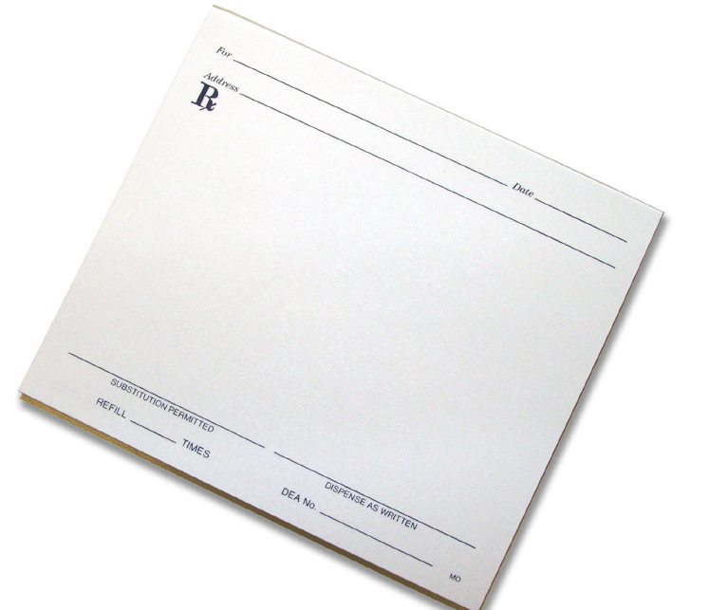
Rx to our nation’s immunization initiative
Today we have
* good vaccines
* access points
We need collaboration focused on improving public health
Every patient encounter provides an opportunity to educate and advance immunization status…

Slide 18
The Immunization Neighborhood
Maria Lanzi, MS, MPH, ANP, COHN-S

Slide 19
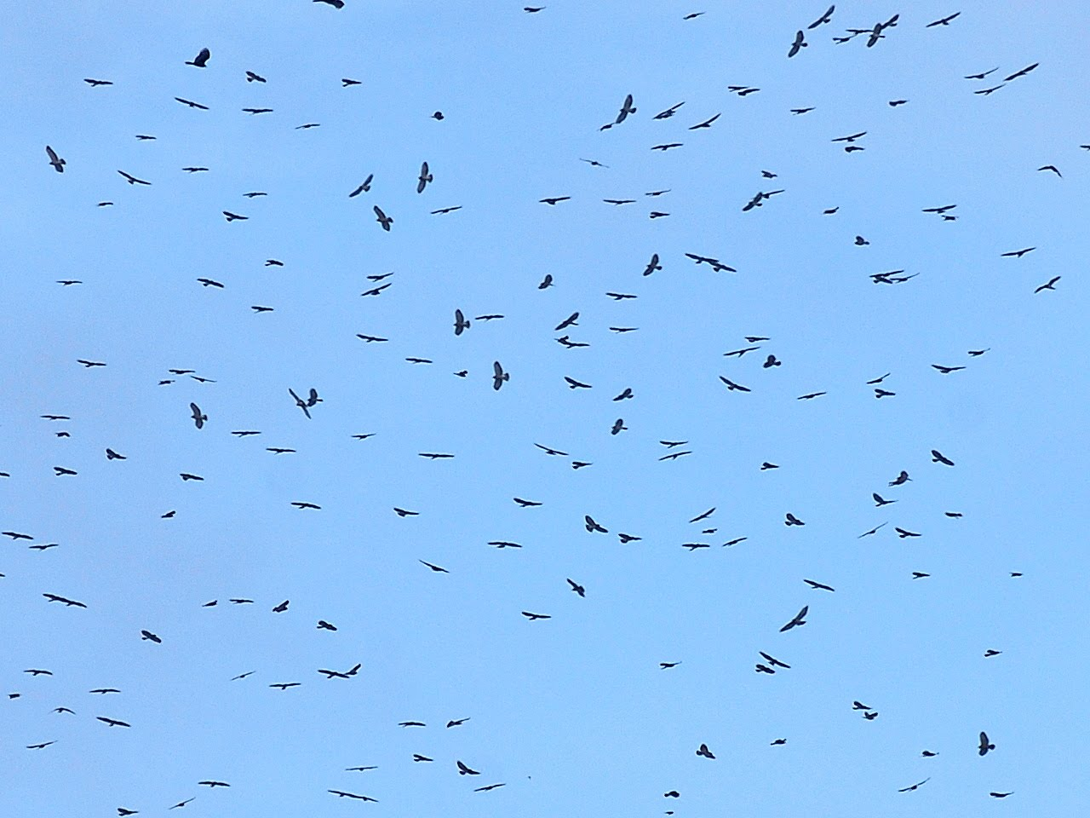

Slide 20
New Jersey Immunization Network
Seminal Event
Common Ground
Passionate
Committed

Slide 21
New Jersey Immunization Network
Members
  Community relationships
  Knowledge
  Competencies
  Resources

Slide 22
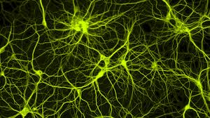
New Jersey Immunization Network

Slide 23
New Jersey Immunization Network
  Infrastructure that interconnects various groups
  Provides a system for exchange of information
  Unites groups in shared vision and common goals
Notes:
Together: greater capacity for change than individual parts alone

Slide 24
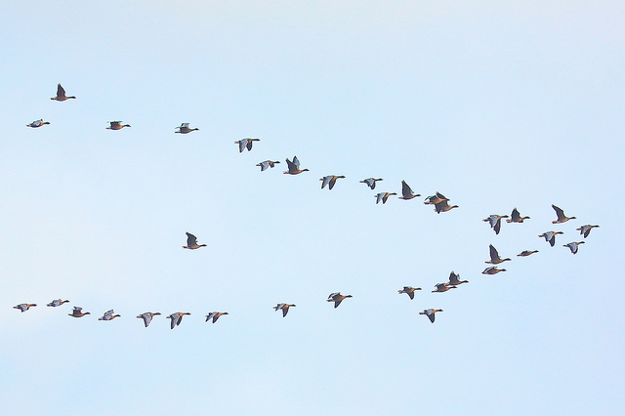
New Jersey Immunization Network

Slide 25
Nurses In The Immunization
Neighborhood
Angela Duck, MSN, RN

Slide 26
Nurses in the Immunization Neighborhood
ROLES OF NURSES | DISCIPLINARY LOCATIONS
Advocate | Primary Care
Immunizer | Acute Care
Caregiver | Long Term Care
Facilitator | Public Health
Educator | Schools/School-Based Clinics
 | Education
Notes:
Because nurses are often the ones administering vaccines, it makes their expertise, knowledge, and advice vital in creating a safe and trusted environment for discussing childhood immunizations,” said Dr. Anne Schuchat, Assistant Surgeon General of the U.S. Public Health Service and CDC’s Director of the National Center for Immunization and Respiratory Diseases.

Slide 27
Primary Care
Improving Access to Preventive Care
  Telemedicine
  Disease Management Initiatives
  Immunization Assessments
  Shot Clinics-Non physician visits
  Order Sets & Protocols
  Best Practice Advisories
  Education and Documentation
  Immunization Registries
  Performance Improvement Monitoring
Medical Home
  Model or philosophy of primary care that is patient-centered, comprehensive, team-based, coordinated, accessible, and focused on quality and safety.
http://www.pcmh.ahrq.gov/page/defining-pcmh

Slide 28
Acute Care & Long Term Care
Immunization assessment and screening
Discharge Planning
  Discharge Orders
  Order Sets & Protocols
  Best Practice Advisories
  Referrals
Education
  Patient and/or caregiver
  Documentation
Communicate with medical home
Immunization Registries
Employee Health
Infection Prevention & Control Nurse
Performance Improvement Monitors/CMS Measures
Notes:
In a hospital setting, having an immunized population can be vital to containing infectious diseases and keeping sick patients from getting sicker. Health care providers working at hospitals are at the front lines and are instrumental in fighting the spread of disease.
But there's a lot going on with hospitalized patients, and there medical needs are often very complicated and extensive. Or, they might only be in the hospital briefly, so there isn't a lot of time to health teaching on every single topic. But, with these patient hand outs and other resources, nurses in hospitals can quickly and easily include vaccines into their discharge planning and teaching.
Besides the patients, it's important for hospital staff to be up to date on their immunizations. This page also includes resources for what vaccines hospital employees are normally recommended to get. Don't have a vaccine program at your hospital? Use some of these resources to make the case for vaccines, and help get a program started!

Slide 29
Public Health
Enhance the Health of Community Through Education and Service
Disease Surveillance
Community Health Assessments
School Based Clinics
Provide Education and Training to Healthcare Providers
Provide Education to Teachers and Healthcare Workers
Immunization registries

Slide 30
Education & Research
Provide information every nurse needs to know related to immunizations
Work with clients across the lifespan
Communicate effectively regarding immunizations and maintain safety of vaccines.
American Nurses Association-Bringing Immunity to Every Community
National Association of School Nurses
NIP-IT (A Nursing Initiative Promoting Immunization Training)
  Features an innovative and creative web-based curriculum about immunizations and vaccine preventable diseases
Evidence generated from research changes practice, education, and policy (Burns & Grove, 2011)
http://www.anaimmunize.org/

