Slide 1
Dollars and Cents of Immunization in Your Practice Dr. Jason Goldman Dr. C. Michael Soppet February 28, 2016 I Raise the Rates Champion Training
Notes:
I would change the title to “Dollars and SENSE of immunization in your practice”. This is not rocket science.
Thank you for the opportunity. I have learned and I am more inspired than ever. I thank my small group, Marty Derrow of Ft Myers, Kristen Hager of Weston, Cindy Miller of Clearwater, and Rick Waks from Maitland, Florida. I thank Pfizer for their sponsorship and my enduring thanks to Laura Lee, Rebecca and our governors for their hard work.

Slide 2
Charles M Soppet, MD, FACP Internal Medicine Associates of Dothan
General Internal Medicine Practice, Alabama
Medical Practice Quality Committee, ACP
Immunization Technical Advisory Committee, ACP
Disclosures:
I have a consulting contract with Pfizer. No other conflicts of interest to disclose
msoppet@comcast.net
Notes:
Marie Brown said yesterday in her talk that a speaker should tell you something about himself, that the audience was interested in knowing who he was. So, I will tell you.
Strictly speaking, I am an ordinary infantry soldier in our medical army. My career path has been one of traditional inpatient and outpatient primary care internal medicine, in 7-10 person practices, in rural and small city settings.
Following six years as a US Air Force Internist, I practiced in Selma, Alabama for 21 years and Dothan Alabama for the past 13 years. If you add those up, it comes to 40 years of diamonds and rust.

Slide 3
Fields of Interest
Improving efficiency of Primary Care Practices
Improving Financial Performance of Primary Care Practice
Increasing the Prevalence of High Functioning PCMH’s and PCMH Neighbors
Notes:
These have been and remain my interests. On January 1st, I became an amateur, which the dictionary defines as a person who engages in a study, sport, or other activity for pleasure rather than for financial benefit or professional reasons.

Slide 4
BARRIERS TO IMMUNIZATION
ACA DID NOT FIX ALL VACCINE COVERAGE PROBLEMS FOR THE INSURED
PARTIALLY INSURED POPULATIONS
PHYSICIAN/ CLINICIAN KNOWLEDGE
PHYSICIAN AND STAFF ENGAGEMENT
EMR problems
Notes:
Let’s summarize Friday and Saturday. This weekend has been about recognizing, addressing and removing or lowering barriers. I have listened carefully to your comments and this is what I have heard.

Slide 5
BARRIERS TO IMMUNIZATION
Patients often say “No thank you”
Physicians and other clinicians say “No thank you”
Risk aversion = fear of loss outweighs hope of gain
“Model Dependant Realism”
Stephen Hawking in “The Grand Design”
Notes:
These last two are examples of what Stephen Hawking has called in physics “model dependent realism”. Marie and Bob have reminded us that belief trumps data. Our Tuskeegee betrayal lives still. Personal Experience forms belief. True of patients. Also true of physicians. Jason and I this morning are tasked with addressing the financial elephant in the room. So what have we learned so far? Walgreens is doing very nicely, and payment for vaccine administration fees has come a long way. While dutifully reminded that “belief trumps data”, Jason and I are stubbornly going to present some data anyway.

Slide 6
HISTORY OF THE VACCINE ADMINISTRATION PAYMENT (CODES 90471 AND G0008)
 | Medicare Administrative Contractor Region
YEAR | ALABAMA | FT LAUDERDALE | MIAMI | REST OF FLORIDA
1999 | $2.00
2000 | $2.00
2002 | $3.44 | $4.36 | $4.72 | $3.88
2003 | $6.70 | $8.18 | $8.67 | $7.43
2004 | $7.11 | $8.65 | $9.14 | $7.89
2005 | $16.81 | $18.87 | $19.68 | $17.97
2009 | $18.62 | $21.63 | $22.70 | $20.30
2011 | $21.71 | $24.18 | $25 | $22.91
2013 | $22.71 | $25.41 | $27.54 | $27.20
2014 | $22.71 | $26.14 | $26.49 | $24.56
2016 | $23.12 | $26.25 | $26.52 | $24.77
Notes:
In the next twenty minutes I am going to try to convince you that 1 plus 1 =2. Except when it doesn’t.
Our starting point for our work this morning is what we have learned about vaccine administration fees.
Common Sense: Vaccine Administration Should be profitable

Slide 7
MEDICARE VACCINE PROFIT
Vaccine Cost
Vaccine Administration Fee
Vaccine Reimbursement exceeds vaccine cost by $6-$25 per dose
Administration fee reimbursement
$24.85 on east coast *
$25.34 on west coast *
* 90471 or G008
Return on Investment is 19% to 207%
Notes:
Here are the cliff notes version of Traditional Medicare profitability. This is actual data from my practice an others from 2014 and 2015.
PCV: Medicare pays you for your cost of vaccine plus a small handling fee of about 13% or $18.25
Zostavax: plus a small handling fee of about 15% or $24.96
PPS-23: plus a small handling fee of about 17% or $11.31
Influenza: plus a small handling fee of about $6 for influenza

Slide 8
PLEASE REPEAT AFTER ME !
1 + 1 = 2
“At least on paper, PURCHASE AND ADMINISTRATION OF VACCINES FOR MEDICARE PATIENTS Seems to BE PROFITABLE”
Notes:
Audience Participation. Please repeat after me.

Slide 9
COMMERCIAL VACCINE PROFIT
Vaccine Cost
Vaccine Administration Fee
Vaccine Reimbursement exceeds vaccine cost by $6-$18 per dose
Averages $24.85 per dose on east coast
Averages $39.25 per dose on west coast
Return on Investment range 20% to 233%
Notes:
Cliff Notes for an Average Commercial Carrier in Alabama. Each commercial insurer will pay differently and this is updated yearly so you have to keep up.

Slide 10
PLEASE REPEAT AFTER ME !
1 + 1 = 2
“At least on paper, PURCHASE AND ADMINISTRATION OF VACCINES FOR the average COMMERCIAL PATIENT SEEMS TO BE PROFITABLE”
Notes:
Audience Participation. Please repeat after me. GOOD. However, Medical People are trained to be skeptical, and that is a good thing. So, you require more proof. Also Good. Next please turn to page 2 of the handout distributed this morning and find the table marked by the single black circle. Before your eyes glaze over, let me assure you this is not for you. This is a slide to take home to your practice administrator.

Slide 11
Details for Medicare Vaccines
 | number of | Vaccine | Disposables | nursing | total | Medicare | Medicare | Total |  | profit | RATE OF | alternate
 | Doses | cost/dose | cost/dose | cost/dose | cost/dose | reimbursement | payment for | Medicare | BILLING | per | RETURN | administration
Vaccine Diagnosis code |  |  | ** | $20/hr |  | for vaccine | administration | payment | COST | dose |  | code
is Z23 | administered |  |  | 5-6 min | (J+K+L) |  | Code=90471 | (N + O) | (-7.25%)
INFLUENZA TRI (Q2037) | 4030 | $9.40 | $ 0.16 | $ 1.66 | $ 11.22 | $ 15.40 | $ 21.79 | $ 37.19 | $ (2.70) | $ 23.27 | 207% | G0008
2014 Zostavax (90736) | 200 | $162.38 | $ 0.16 | $ 1.66 | $ 164.20 | $ 187.79 | $ 22.71 | $ 210.50 | $ (15.27) | $ 31.03 | 19%
2015 Zostavax (90736) |  | $170.50 | $ 0.16 | $ 1.66 | $ 172.32 | $ 187.79 | $ 22.71 | $ 210.50 | $ - | $ 38.18 | 22%
Prolia | 134 |  | $ 0.16 | $ 1.66
2014 Prevnar 13 (90670) | 220 | $135.81 | $ 0.16 | $ 1.66 | $ 137.63 | $ 153.96 | $ 22.71 | $ 176.67 | $ (12.81) | $ 39.04 | 28%
2015 Prevnar 13 (90670) |  | $152.01 | $ 0.16 | $ 1.66 | $ 153.83
Pneumovax 23 (90732) | 350 | $66.23 | $ 0.16 | $ 1.66 | $ 68.05 | $ 77.84 | $ 21.79 | $ 99.63 | $ (7.22) | $ 24.36 | 36% | G0009
Tetanus Toxoid (90703) | 37 | $25.17 | $ 0.16 | $ 1.66 | $ 26.99 | $ 21.96 | $ 22.71 | $ 44.67 | $ (3.24) | $ 14.44 | 54%
Hepatitis B (90746) | 176 | $40.37 | $ 0.16 | $ 1.66 | $ 42.19 | $ 53.38 | $ 22.71 | $ 76.09 | $ (5.52) | $ 28.38 | 67%
TdaP (90715) | 167 | $31.30 | $ 0.16 | $ 1.66 | $ 33.12 | $ 33.31 | $ 22.71 | $ 56.02 | $ (4.06) | $ 18.84 | 57%
Hepatitis A |  |  | $ 0.16 | $ 1.66 |  |  | $ 22.71
total vaccine doses 2014 | 5314
** Disposables | per box | per dose
Alcohol Wipes-box 200 | $1.67/box | $ 0.00
3 cc syringe/22 gauge needle | $7.95/box | $ 0.08
23 gauge needle-box 100 | $4.69/box | $ 0.05
Bandaids-box 100 | $2.75/box | $ 0.03
sharps containers
Notes:
Tailor the data to your own state situation. It will save you or your office manager a lot of work and if you put it on a spreadsheet it is reusable year after year as prices and costs change.

Slide 12
Details for Commercial Insurance- Example
VACCINE/CODE | cost per dose | cost of | nursing | TOTAL | commercial | commercial | TOTAL | Billing | PROFIT | ROI
 |  | disposables | cost | REAL | PAYMENT | PAYMENT FOR | COMMERCIAL | Cost | per
Admin diagnosis= Z23 |  |  | $20/hr | COST | for vaccine | administration | PAYMENT | 7.25% | dose
 |  |  | 5-6 min |  |  | Code=90471
INFLUENZA -Q2037 | $9.40 | 0.16 | $ 1.66 | $ 11.22 | $ 15.40 | $ 24.85 | $ 40.25 | (2.92) | $ 26.11 | 233%
 |  | 0.16
2014 Zostavax-90736 | $162.38 | 0.16 | $ 1.66 | $ 164.20 | $ 187.79 | $ 24.85 | $ 212.64 | (15.42) | $ 33.02 | 20%
2015 Zostavax | $170.50 | 0.16 | $ 1.66 | $ 172.32
Prolia |  | 0.16 | $ 1.66
2014 Prevnar 13-90670 | $135.81 | 0.16 | $ 1.66 | $ 137.63 | $ 153.97 | $ 24.85 | $ 178.82 | (12.96) | $ 28.23 | 21%
2015 Prevnar 13 | $152.01 | 0.16 | $ 1.66 | $ 153.83
Pneumovax 23-90732 | $66.23 | 0.16 | $ 1.66 | $ 68.05 | $ 75.00 | $ 24.85 | $ 99.85 | (7.24) | $ 24.56 | 36%
Tetanus Toxoid-90703 | $25.17 | 0.16 | $ 1.66 | $ 26.99 | $ 23.83 | $ 24.85 | $ 48.68 | (3.53) | $ 18.16 | 67%
Hepatitis B-90746 | $40.37 | 0.16 | $ 1.66 | $ 42.19 | $ 58.74 | $ 24.85 | $ 83.59 | (6.06) | $ 37.87 | 90%
TdaP-90715 | $31.30 | 0.16 | $ 1.66 | $ 33.12 | $ 43.91 | $ 24.85 | $ 68.76 | (4.99) | $ 30.65 | 93%
Notes:
Okay, turn the page and you see the same formatted spreadsheet for a typical commercial payer in our area. In January of each year, it will be necessary for your practice administrator to fill in the precise information for each commercial carrier with whom you deal. They will orbit around certain averages that you can then employ to populate a form for your “average” commercial insurer profile.

Slide 13
PDSA -What to expect
Instant Improvement in rates
Improved Personal Satisfaction
Improved staff satisfaction
Fun through teamwork and success
Profit through utilization of your sunk costs
Notes:
Laura Lee told us Friday night that the three things on the minds of you all were:
Interest in Team building
Achieving skill in Quality Improvement Cycles
Patient engagement with shared decision making
Sunk costs are things you are paying for already-nursing time with attendant benefits, malpractice insurance, rent, etc, that have to be offset by profits but for which no
Extra costs are incurred for the vaccinating activity. As I recall from the informal poll Friday night, we had 6 believers in vaccine profitability and 6 believers in vaccine non profitability. Jason stated that in his practice, vaccines were definitely profitable if done the right way. I believe all these physicians are correct. The key is doing it the right way.

Slide 14
Please repeat after me
“1 + 1 really should add up to 2”
“VACCINE ADMINISTRATION FOR THE VAST MAJORITY OF PATIENTS SHOULD BE PROFITABLE”
Notes:
Altogether now

Slide 15
UNTIL IT DOESN’T
1 + 1 = 1.5
Notes:
EXPERIENCE FORMS BELIEF. IF THIS IS AND HAS BEEN YOUR EXPERIENCE, YOUR BELIEF WILL BE DIFFERENT. HOWEVER, YOU DESERVE TO KNOW WHAT HAPPENED ?

Slide 16
METHODS OF LOSING MONEY
INVENTORY SHRINK- (UNINTENDED)
FAILURE TO DOCUMENT/CHARGE
THEFT BY DIVERSION
POCKETING COPAYMENTS FOR PART D DRUGS
FAILURE TO COLLECT COPAYMENTS FOR PART D
Notes:
In Retail business, loss of inventory is called the inventory shrinkage rate (Shrink for short). Walgreens “loses” inventory by human error, inside theft, shoplifting, product spoilage, etc. In your practice, think of shrink as unaccounted for vaccine inventory. We will discuss this later. Average retail shrink about 1.45% annually.

Slide 17
STEPS TO IMMUNIZE
Order inventory
Receive and maintain inventory
Distribute to intermediate user
Physician standing order for immunization
Administer vaccine to end user (the patient)
Document administration in EMR
Generate 2 charges, bill 2 charges, collect 2 charges
Reconcile inventory and re-order.
Notes:
We have discovered occasional glitches in each of these. The most common errors for us were failure by the nurse to document the administration in the EMR which then failed to generate a charge for the vaccine cost and also failed to generate an appropriate code for the vaccine administration.

Slide 18
Logging Vaccines: Simple Procedure
Source:
Immunization Action Coalition (IAC)
Immunize.org
Maintain a vaccine inventory log that is used to document the following:
a. Vaccine name and # of doses rec’d
b. Date we received the vaccine
c. Condition of vaccine when received
d. Vaccine manufacturer, lot number
e. Vaccine expiration date
f. Dates administered
Notes:
Who Does this? Maranda. In fact, she keeps track of inventories, maintains an adequate stock on hand, and orders all vaccines directly. She reconciles the packing invoice against her order invoice and records all these things.

Slide 19
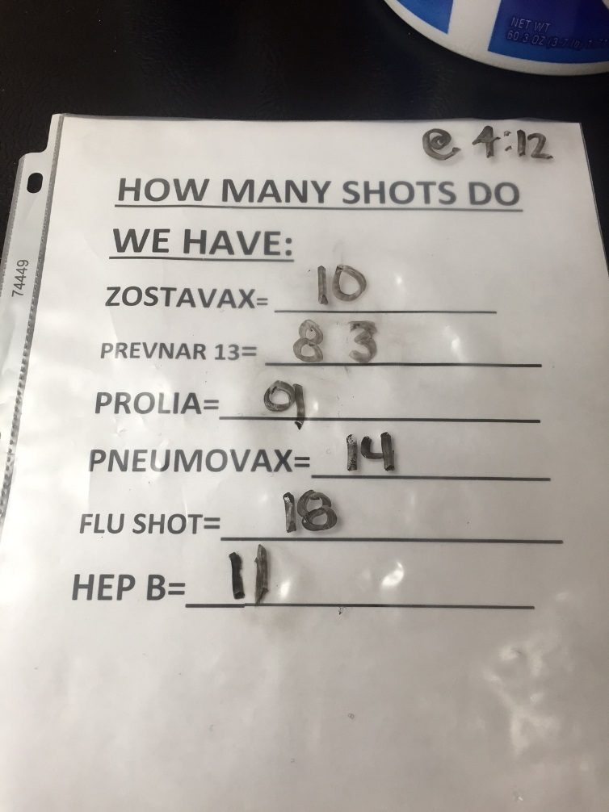
LOW TECH INVENTORY CONTROL
Notes:
Maranda’s low tech inventory control. She does these at least twice per day (first thing in am and last thing in pm) and as she has time through the day. She reconciles vaccine doses administered and documented with those checked out daily. That is, she balances her vaccine drawer in her refrigerator, maintains proper temperatures etc. This is just a printed sheet contained in a plastic holder that she writes upon with a sharpie !

Slide 20
Vax Refrigeration/Storage
Source: (fridges)
public.health.oregon.gov
(Oregon VFC guide)
Re: Digital Logging Thermometers -
See: http://www.vfcdataloggers.com/
Vaccine Refrigerator Manufacturers to Consider:
Panasonic Biomedical www.sanyobiomedical.com
Follett: www.follettice.com
Helmer: www.helmerinc.com
Thermo Scientific: www.thermo.com
Lab Research Products: www.labresprod.com
Gem Scientific: www.gemref.com
Fisher Scientific: www.fishersci.com
Sun Frost (efficient): www.sunfrost.com
Notes:
Where do you store your vaccine? Proper storage and proper temperatures improve shelf life and efficacy. Here are some websites to look for vaccine refrigerators and digital logging thermometers with pricing. We have a Zostavax freezer and a separate vaccine refrigerator for all other vaccines plus a small refrigerator at the two nurses stations for the daily allotment of each nurses vaccine. The nurses “check-out” their vaccines at the beginning of each day. Larger practices could use a Pyxis system. We prefer the old fashioned way.

Slide 21
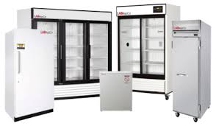
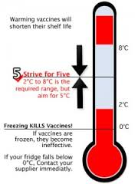
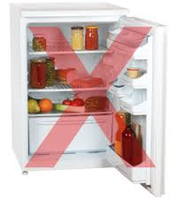
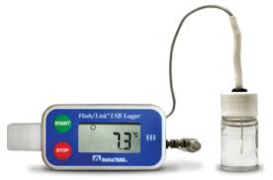
Vaccine Storage

Slide 22
How to Charge and Code for Vaccines
60 y/o Diabetic patient presents for annual visit:
She receives annual care + influenza + PCV-13 vaccines: You code for office visit +vaccines
ICD-10 Description/Vaccine Admin
Code Code Code
E11.40 (DM/neuropathy) 99213
Z-23 Q2037 90471
Z-23 90670 90472
Notes:
Basics of Coding for the Vaccine. On your insurance claim you will also need the NDC number for the vaccine which is also included in your take-home or you can simply obtain it from the packing information you receive with your vaccine. Maranda keeps this up to date and transmits that information to your billing people.

Slide 23
Plan-Do-Study-Act (PDSA Cycle) [the Chronic Care Model , see 1st module, ACP Immunization Portal]
Preparation
PDSA
Identify practice gap
Set aim/goal
Identify process measures that ultimately can lead to improved clinical outcome
Plan the change, in small steps
Do: carry out the plan
Study: plot data on run chart
Act: adopt, adapt or abandon
Notes:
Vaccination is actually a perfect starting point for those who are not familiar with Quality Improvement. First, set your aim or goal. I suggest something simple, such as a 10% improvement in vaccination rates for a single vaccination and don’t choose a seasonal one such as influenza. My prediction is that within a month or two you will easily expand this to all adult vaccinations.

Slide 24
Plan: Profit on Pneumococcal Polysaccharide Vaccine 23 (You and your patient)
Plan: Measure Baseline Rate and set goal
How many doses to order
How to store doses
Plan: How many doses to order
How to retrieve doses
How to administer, document, and charge
How to account for payment
How to reorder for next cycle
Notes:
Set a plan for a modest number of days to collect data, say two weeks worth. Many methods available but this is how we do it.

Slide 25
Do: Administer the Vaccine
Empower your nurses
Education Session Friday afternoon
Handouts to nurses
Pre-printed order sets
Standing orders
Keep track of number given each day
“check-out” ten doses per nurse per day
“return” un-used doses to central location at end of day
“reconcile administration record with “check out” number
“bill” at end of each day

Slide 26
Standing orders for Vaccines
Advocated for by ACIP, particularly for influenza, pneumococcal, Tdap and hepatitis B vaccines
Administration of vaccines by nurses, pharmacists, medical assistants and other qualified personal, under physician established protocol, without examination by physician
Substantially improves immunization rates
http://www.cdc.gov/mmwr/preview/mmwrhtml/rr4901a2.htm
http://www.immunize.org/standing-orders/ (IAC)
Notes:
We use them for everything but Zostavax. Now you have them. You can use them to empower your nurses.

Slide 27
PDSA DAILY WORKSHEET FOR VACCINES
DAILY PLANNING WORKSHEET AND RECONCILIATION SHEET FOR IMMUNIZATION PDSA
6-Mar-16 | Monday
DATE | WEEKDAY
 |  |  | VACCINE TYPE
 | Influenza | PPS-23 | PCV-13 | Tdap | Td | Zostavax | Hep B | HPV | Hep A | Hib | Meningococcal
Mary Smith
John Doe
George Will
Babe Ruth
Ty Cobb
 |  |  |  |  |  |  |  |  |  |  | LEGEND
 |  |  |  |  |  |  |  |  |  |  | n/a=Not needed
 |  |  |  |  |  |  |  |  |  |  | x=previously given
 |  |  |  |  |  |  |  |  |  |  | ?= ask them today
 |  |  |  |  |  |  |  |  |  |  | D=declined today
 |  |  |  |  |  |  |  |  |  |  | checkmark=given today
Notes:
CVO: Friday afternoons to educate and to explore. Welcome break from clinical duties and fun. Teach your nurses and others what to do so you can hand these duties off to them. Plan to make your nurses and others your Chief Vaccinating Officers (CVO’s)

Slide 28
Study: Reconcile
Old rates with new rates of immunization after one month
Number of doses ordered-number of doses on hand = number of vaccine doses administered
Number of doses billed=number doses given ?
Total Payments for vaccine and vaccine administration fees received= total $
Notes:
Medconcert has a nice tool for this. Part of this can be done simultaneously by your practice administrator. The payments and billed parts.

Slide 29
STUDY: How did we do?
Improvement in administration rate?
Loss rate ?
Billed rate ?
What are we doing wrong to create loss rate
What are we doing wrong to create lost billings
What is our return on investment ?

Slide 30
Plan: what to change
Identify gaps in performance
ie missing doses ?
ie payments below expected ?

Slide 31
How to predict number of doses needed
Zostavax
Number of patients in your practice 60 and over?
Very expensive and not a good way to learn
How about starting with 10?
Part D adjudication through https://www.mytransactrx.com
Commercial: www.checkcoveragenow.com
Notes:
Special Cases of Zostavax and tdap for Medicare since these are Part D Drugs. You have to adjudicate the claim in the office before you give it to ascertain and collect copay and confirm that their particular Part D plan will pay for these two vaccinations. I will show you how in small group sessions. TransactRx is a Part D adjudication website: www://TransactRx.com

Slide 32
WINNING ATTITUDE
“I HAVE A GOAL”
“I WILL CONTROL WHAT I CAN CONTROL AND MOVE ON”
“SO WHAT, NOW WHAT ?”
Notes:
You are Champions. A Champion is a person who fights or argues for a cause, or on behalf of someone else. You are doing both, and that is why you can call yourselves Champions. Champions also have a winning attitude. Have a plan, work your plan, allow for and plan for contingencies. Put another way, we want you to go home this afternoon and when you hit the clinic tomorrow, have these three things in mind. This is your Mantra. Know your specific goal, plan the timeline and intermediate steps, and when you hit the inevitable roadblocks, seek aggressively to remove them.

Slide 33
ALTOGETHER NOW !
“VACCINE ADMINISTRATION WILL BE PROFITABLE FOR MY PRACTICE”

Slide 34
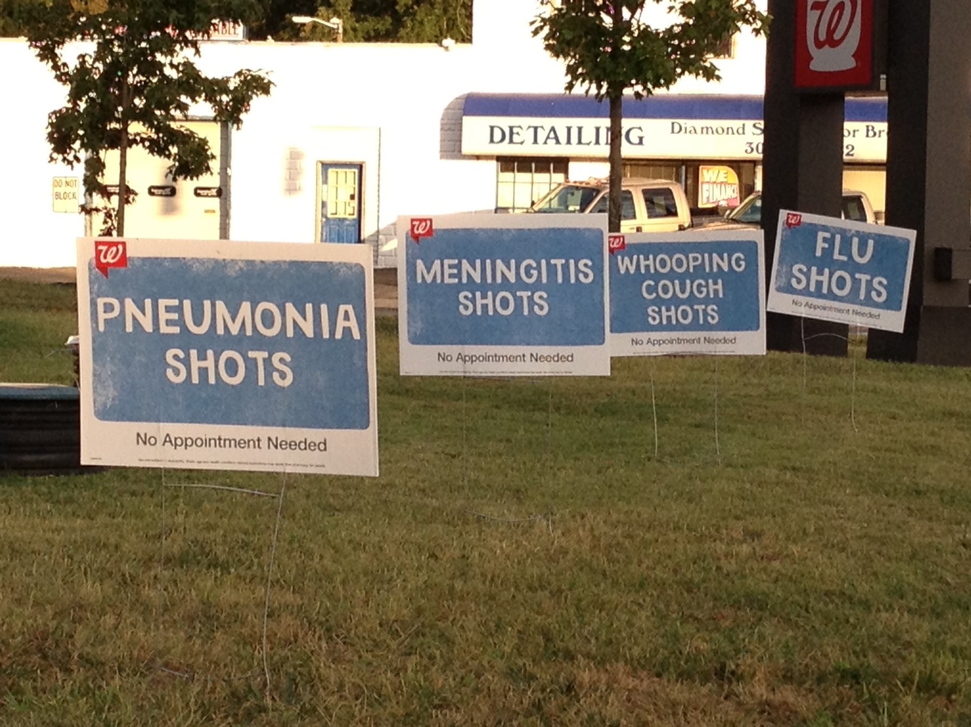
Notes:
Remember, Confidence !

Slide 35
Tomato example of compounded Return on investment
Borrow $10
Purchase a bag of tomato seeds for $10
Plant the seeds and sell the tomatoes for $30
Pay back the borrowed $10
Save $10 of profit in the bank
Buy a new bag of tomato seeds for $10
Plant the seeds and sell the tomatoes for $30
Save the $20 profit in the bank and buy another bag of tomato seeds for $10
Notes:
This is your business model.

Slide 36
Concept of Return on Investment
Set aside(or borrow) seed money at end of each year to buy your vaccine for beginning of the new year
Separate account for vaccine revenue and purchase
Do not steal from this account through the year
Purchase replacement vaccine doses with revenues deposited in this account
Write yourself a nice bonus check at year’s end
Notes:
Fun Exercise. Try it.

Slide 37
Vaccine Reimbursement Tips Dr. Jason Goldman, MD, FACP February 28, 2016 I Raise the Rates Champion Training

Slide 38
Supply side
Buy direct from manufacturer
Group purchasing organization
e.g. Atlantic Health Partners
Buy multiple vaccines for discount
Defer paying invoice usually several months
Pay promptly on due date for further discounts
Order what is needed to avoid vaccine loss from expiration
Many manufactures will take back unused vaccines and credit account

Slide 39
Manufacturers
Pfizer: www.pfizerpro.com
Merck: www.merckvaccines.com
Sanofi Aventis: www.vaccineshoppe.com
GlaxoSmithKline: www.gskdirect.com

Slide 40
Medicare Part D
www.MytransactRX.com
Allows to check coverage of patients, print out proof, submit claim all through portal and then direct deposit to account
Check for Zostavax and Tdap
Limited if patient is not covered or information not up-to-date
Can also check for several other vaccines

Slide 41
Zostavax Commercial Payers
www.checkcoveragenow.com
Similar to TransactRX
Can look at benefits and show to patient
Submit through normal claims process
Can also check several other vaccines

Slide 42
Reimbursement Tips
Dx code for all vaccines Z23
Know the CPT for each vaccines, check with manufacturer
Medicare vaccines for Flu (G0008), PPSV 23 (G0009), and Hepatitis B (G0010), use G code as first dose
Second administration is 90472 then number of units for each vaccine
Modifier 25 on EM code with modifier 59 for vaccines

Slide 43
Billing Examples
Patient comes in only for high dose flu shot – Medicare or Medicare advantage
No physician visit
Bill 90662 and G0008
If seen by physician for visit then bill:
E/M code appropriate level such as 99213-25, G0008-59 and 90662-59
**Do not use 99211 and vaccines unless patient is specifically having a separate service such as blood pressure adjustment, etc.**

Slide 44
More Examples
Patient comes in for flu, Hep B, and Pneumonia with Medicare, then bill:
G0008, 90662, G0009, 90732, G0010, 90746
If commercial, then bill:
90471, 90686 (quadravalent), 90472 for 2 units, 90732, 90746
Again if with E/M then modifier 25 on E/M and modifier 59 on each administration and each vaccine

Slide 45
More Examples
Flu, pneumonia and hep B with other vaccines
Patient with pneumonia and zostavax
Medicare G0009, 90732, 90472, 90736
Commercial 90471, 90472, 90732, 90736
Flu, pneumonia and zostavax
Medicare G0008, 90662, G0009, 90732, 90472, 90736
Commercial 90471,90472 2 units, 90732, 90736, 90685
Tdap 90715, 90471

