Slide 1
Creating a Team of Champions
Maria C. Lanzi, MS, MPH, ANP-BC
Sara Wallach MD, FACP
February 28, 2016
I Raise the Rates Champion Training

Slide 2
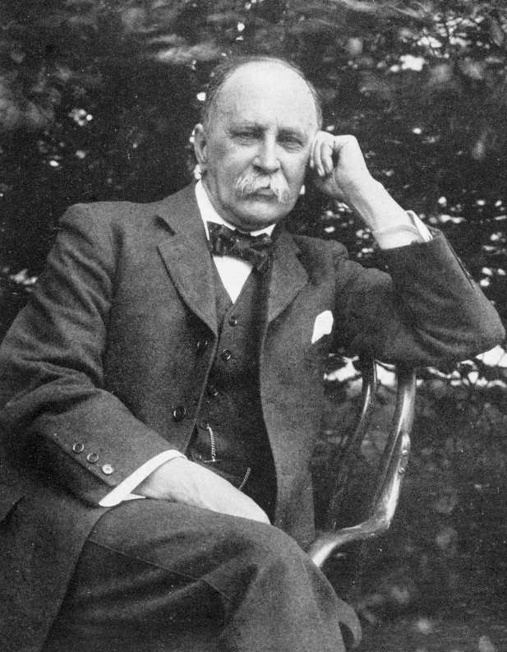
Sir William Osler
July 12, 1849 – December 29, 1919
“In the gradual division of labor, by which civilization has emerged from barbarism, the doctor and nurse have been evolved.”
“The trained nurse has become one of the great blessings of humanity, taking a place beside the physician and the priest, and not inferior to either in her mission.”
Notes:
Aequanimitas, and Other Addresses (1905)

Slide 3
Historical Perspective
Patriarchal, Traditional Male-Female Roles
  Only physicians (usually male) were responsible for decisions on diagnosis and treatment
Healthcare Hierarchy
  Scope and Degrees of Authority
  Centralized power in decision making
  Worked autonomously

Slide 4
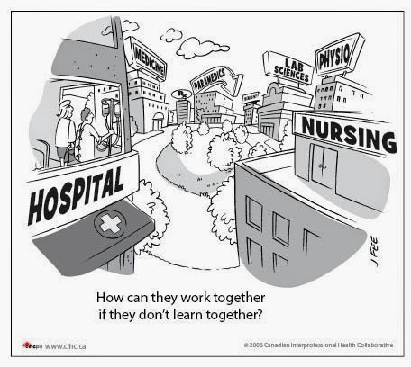
Reinforcing the Divide
Distinct higher institutions of learning
    Cultural bias and differences
    Preconceived notions
      Level of education
      Training
      Practice
    Ineffective communication

Slide 5
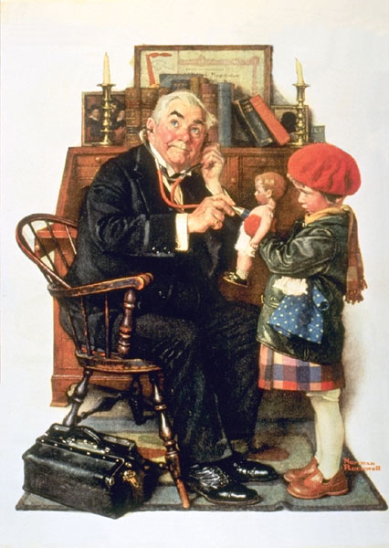
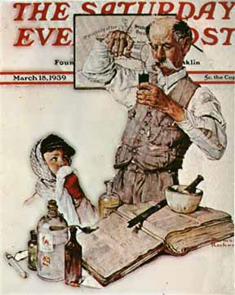
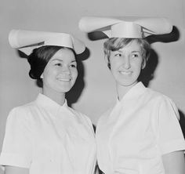
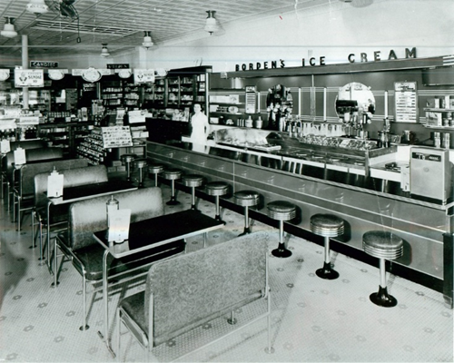
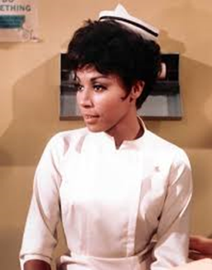
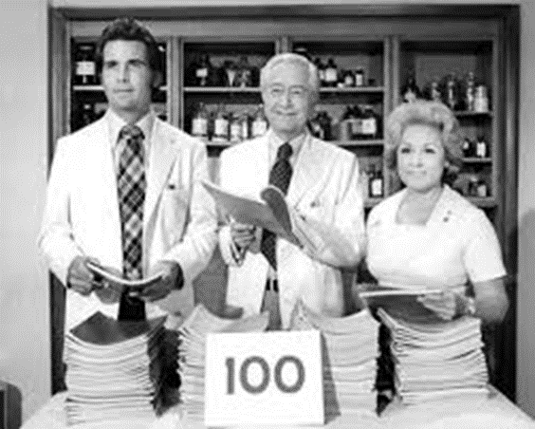
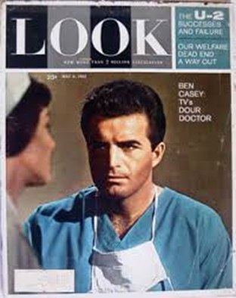
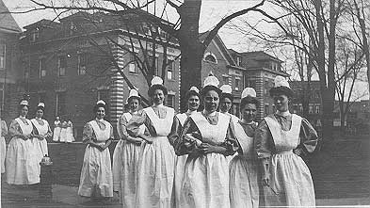
The Good Old Days

Slide 6
Life in Primary Care before ACA
Average visit: 15 minutes as far back as the 1950’s
Pre- 1992: Medicare Usual and customary
1992 Medicare changes to RVU and documentation increases
1992-1998 face to face time: 55% of timed visit
“Time constraints limit the ability of physicians to comply with preventive services recommendations.”

Slide 7

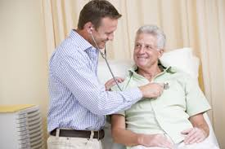

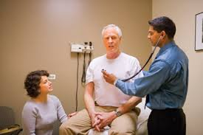
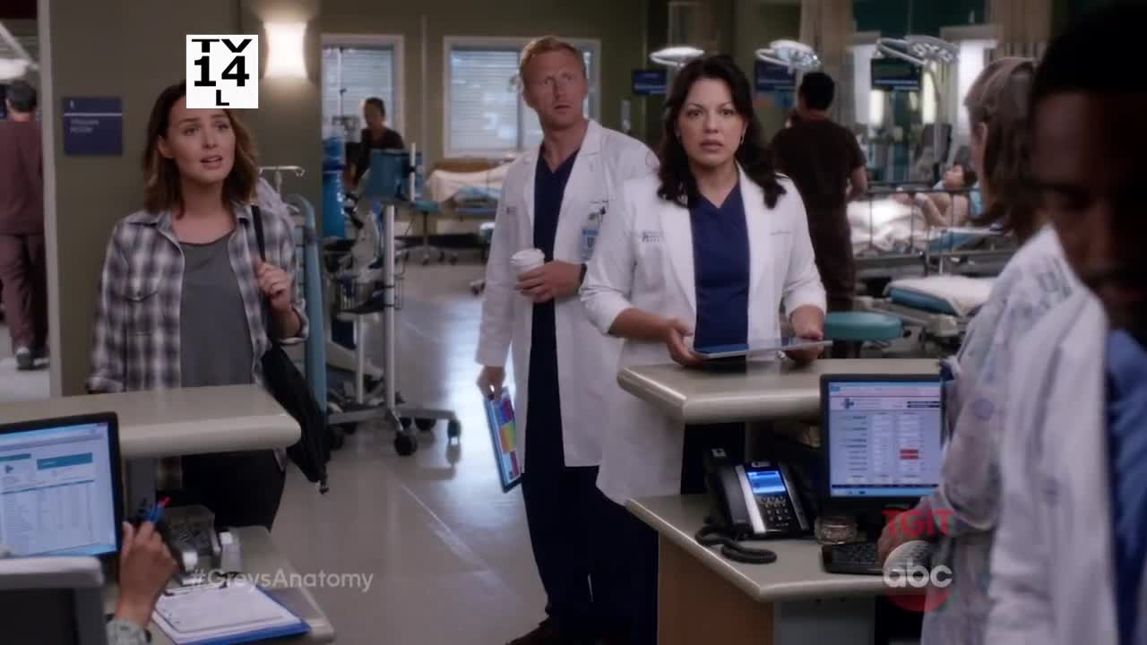
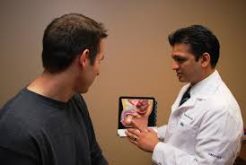
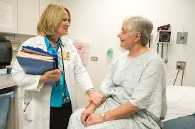



Fantasy Island

Slide 8


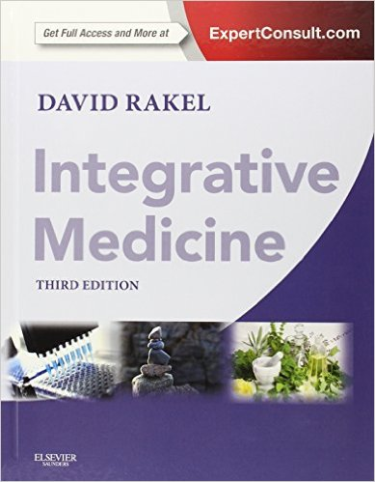

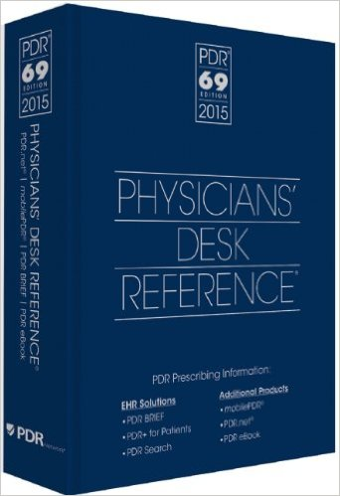



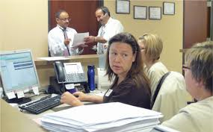
Information Overload

Slide 9
Life in Primary Care after ACA
Increase in chronic disease management
  75% of primary care visits -multiple chronic diseases
  Average primary care visit - 18 minutes
  Average number of issues/visit- 7.1
  2.5 – 3 minutes per issue
Increase in non clinical work load
  Ever-changing regulations, quality metrics, and practice requirements
Medical Economics, August 9, 2013

Slide 10
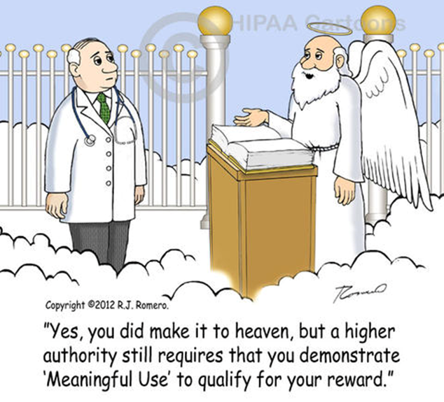
The Reality

Slide 11



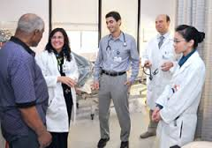
Birth of the Healthcare Team

Slide 12
The Healthcare Team
Multidisciplinary Cooperative Approach
  Includes physicians, nurses, pharmacists, et al
  Ensure that critical elements of care are competently performed, including:
    Population management
    Protocol based regulation of medication
    Self management support
    Intensive follow up
Patient-Centric

Slide 13
The Healthcare Team
Partnership, not hierarchal
Interdependent
  Roles are dynamic, context dependent, processual, and interactional (Contadriopoulos)
  Make the most of all interactions (Lindeke)
  Utilize the best knowledge and abilities of all health team members
  Produce positive patient outcomes

Slide 14
Goal: I Raise the Rates
  Improve Immunization Rates
  But how?

Slide 15
Nurses
Trusted healthcare professionals
Largest segment of healthcare professionals
Work in all aspects of healthcare delivery
  Hospitals, Offices, Schools, Public Health, homes
Continuum of services
  Direct patient care, health promotion, patient education and coordination of care
Patient Care, leadership, research, policy
Notes:
Nurses, NPs, PHN

Slide 16
Nurse Practitioners
Additional Advanced Education (Master’s) and Advanced Clinical Training
Diagnose, Treat and Prescribe (state dependent)
Disease prevention and health management
High Quality Cost-Effective Care
IOM Report 2012: quality, patient-centered, accessible, and affordable care
Notes:
Minimal Masters and Advanced Clinical Training
Emphasis on disease prevention and health management

Slide 17






Recognizing a Champion
Notes:
Lou Gehrig: ALS Arthur Ashe: HIV Jackie Robinson: DM Roger Staubach: concussions; Jackie Joyner Kersee: Asthma; Pat Summitt: Alzhiemers

Slide 18
Identifying a Practice Champion
Believes in the project (Immunization)
Trusted and Respected
Accepts role and responsibility
  Directly influences patient care
  Accountable for outcome (increasing rates)
Good communicator
Resilient & Persistent
Transformational Leader

Slide 19
Empowering The Champion
Designated Leader of Team Project
  Clear to practice and team
Empowered to make decisions
    Assess, Recommend, Administer, Document
      Use of Standing orders
      Chart/Clinician Reminder and Recall strategies
      Addressing “missed opportunities”

Slide 20
Responsibilities of the Champion
Act as the Role Model – Best Practices
Peer to Peer and Staff Education
Use ACP tools
  Baseline data and Specific target goal
  Standing Orders Protocol
  Specific Communication Techniques
  CECity MedConcert Platform
Communicates Progress Back to Team
Notes:
Baseline data (vaccine, age, diagnosis)
CE City: View performance, identify patient outliers and address gaps, improvement tools, documentation/ reporting

Slide 21
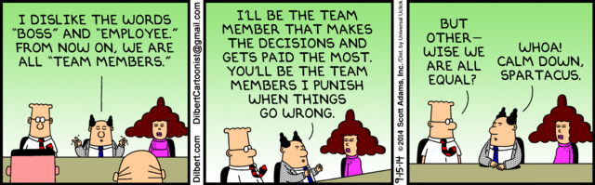

Slide 22
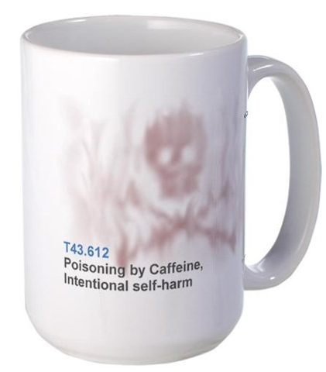
Thank you

Slide 23
Principles Supporting Dynamic Clinical Care Teams: An American College of Physicians Position Paper Doherty R and Crowley R, for ACP’s Health and Public Policy Committee Ann Intern Med. 2013;159(9):620-626
Responsibilities for a patient's care within a collaborative and multidisciplinary team should be based on what is in the patient's best interest.
ACP reaffirms the importance of patients having access to a personal physician
Teams must have the flexibility “to determine the roles and responsibilities expected of them based on shared goals and the needs of the patient.”
Well-functioning teams will assign responsibilities to advanced practice nurses, other registered nurses, physician assistants, clinical pharmacists, and other health care professionals for specific dimensions of care.
A cooperative approach by physicians, advanced practice nurses, other registered nurses, physician assistants, clinical pharmacists, and other health care professionals in collaborative team models will be needed to address physician shortages.
A unique strength of multidisciplinary teams is that clinicians from different disciplines and specialties bring distinct training, skills, knowledge bases, competencies, and patient care experiences to the team.

Slide 24
References
Contandriopoulos et el. A Process-based Framework to Guide Nurse Practitioners Integration into Primary Healthcare Teams: Results From a Logic Analysis. BMC Health Services Research (2015) 15:78
Mitchell et al. Core Principles & Values of Effective Team-Based Health Care. Institute of Medicine. October 2012
Team-Based Competencies: Building a Shared Foundation for Education and Clinical Practice. Conference proceedings, February 2011. Health Resources and Services Administration, Josiah Macy Jr. Foundation, the Robert Wood Johnson Foundation, the ABIM Foundation and the Interprofessional Education Collaborative.
Wagner, E. H. (2000). The role of patient care teams in chronic disease management. BMJ : British Medical Journal, 320(7234), 569–572.
Lindeke, Linda L, PhD, RN, CNP and Sieckert, Ann M, BAN. Nurse-Physician Workplace Collaboration. Online Journal of Issues in Nursing. 2005;10(1)
Principles Supporting Dynamic Clinical Care Teams: An American College of Physicians Position Paper Doherty R and Crowley R, for ACP’s Health and Public Policy Committee Ann Intern Med. 2013;159(9):620-626
Gottschalk, BS and Flocke, Susan A. Phd. Time Spent in Face-to-Face Patient Care and Work Outside the Examination Room. Annals of Family Medicine, March 25, 2005.
Institute of Medicine Report: The Future of Nursing: Leading the Change, Advancing Health. 2010
Institute of Medicine Report: Best Practice Innovation Collaborative. 2012.
Principles Supporting Dynamic Clinical Care Teams: An American College of Physicians Position Paper Doherty R and Crowley R, for ACP’s Health and Public Policy Committee Ann Intern Med. 2013;159(9):620-626

Slide 25
Creating a Team of Champions
Maria C. Lanzi, MS, MPH, ANP, COHN-S
Sara Wallach MD, FACP
February 27, 2016
I Raise the Rates Champion Training

Slide 26
I Raise the Rates
Leveraging with Graduate Medical Education

Slide 27
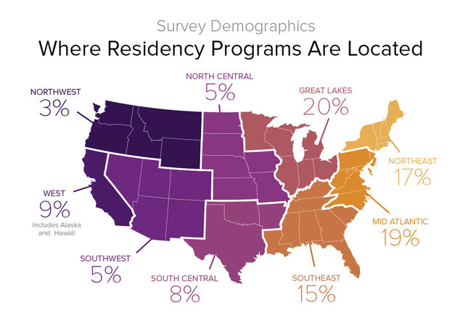
National Residency Programs Locations

Slide 28
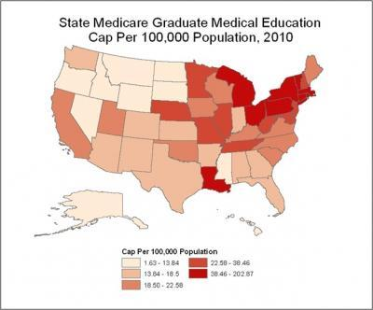
State Medicare Funding

Slide 29
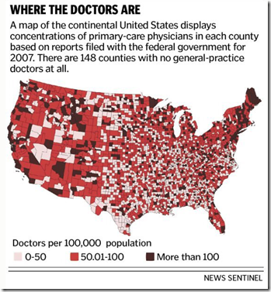

Slide 30
History of Graduate Medical Education
1919 Flexner Report
1970s Safety Net Hospitals
1981 Accreditation Council for GME
1989 Bell Commission-”Night Floats”
2011 16 hour work shifts for PGY1s
2015 Institute of Medicine GME Recommendations
2016 Merger of ACGME and AOA accreditation requirements

Slide 31

Accreditation Council for Graduate
Medical Education
Formulated in 1981
Standardized Training Requirements for Institutions and Programs
Mandates Ambulatory Training for Primary Care Programs

Slide 32

Objectives in 1981
Program structure
Amount and quality of formal teaching
Balance between service and education
Promoted resident evaluation and feedback
Required financial and benefit support for trainees
Adapted Nasca ,TJ N Engl J Med 2012; 366:1051-1056 March 15, 2012

Slide 33
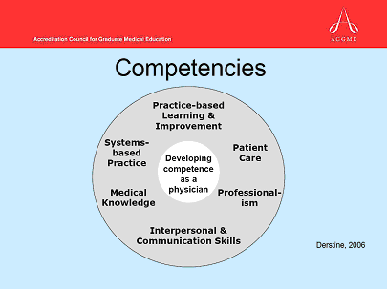
General Competencies, 1996
Notes:
Use word clinician physician assistant

Slide 34
ACGME New Accreditation System, 2013
Annual data collection – extends accreditation length to 10 years; site visit every 10 years
Milestones, ACGME resident and faculty surveys, operative and case-log data
Self-study before the 10-year site visit

Slide 36
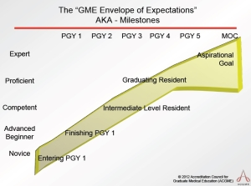
The New Accreditation System
Development Driven
Observation Based
Multi-source
Promotes Standardization
Eliminates Grade Inflation

Slide 37


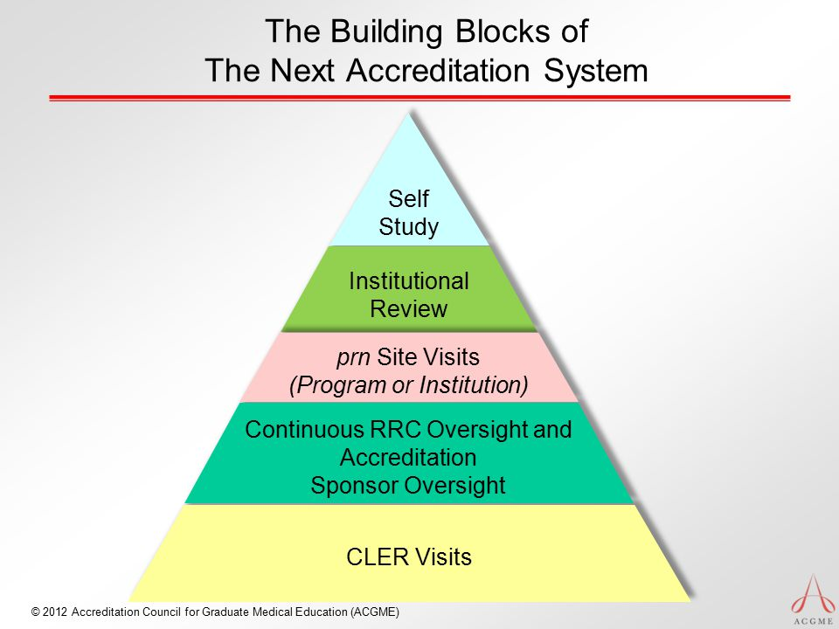

Clinical Learning Environment
Notes:
Patient centered care

Slide 38

Institutional based-Representative Hospital
C-suite
Focuses on Institutional Environment
Resident Well being
Resident Training in Quality, Patient Safety, Health Care Disparities

Slide 39

CLER Performance Improvement Standards
1) Resident/fellow and faculty member education on reducing health care disparities (Pathway 5)
2) Residents/fellows are engaged in QI activities addressing health care disparities for the vulnerable populations served by the clinical site (Pathway 6)

Slide 40

IOM Recommendations, Triple AAIM
Encourage production of a physician workforce better prepared to work in, help lead, and continually improve an evolving health care delivery system that can provide better individual care, better population health, and lower cost.

Slide 41
Why Graduate Medical Education
Resident physicians are the future of medicine
Technologically Savvy
ACGME requirements-Clinical Learning Environment Standards
Address Institute of Medicine Concerns
Twenty-six core and subspecialty programs

Slide 42
How to Engage Residents
Champions
Evaluate performance on Quality Improvement Projects
Publications and Presentations
Authentic Leaders; Validation
Acquire Team building Skills

Slide 43


Slide 44
Challenges to Implementation
Target Population is vulnerable with significant health care disparities
Connectivity of Electronic Health Records
Time management
Changing resident rotations and training requirements
Resident well care and priorities

Slide 45

Common Goals

