Slide 1
Presenting
iRaise the Rates
Champions Training Program
MedConcert Platform
CECity | ACP | QHC | Pfizer
Presentation and Discussion
The Leader in Performance Management for Pay for Value, Professionalism and Performance Improvement
Confidential – Not for Distribution

Slide 2
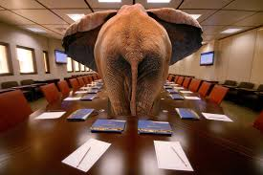
The Elephant in the Room: Data

Slide 3
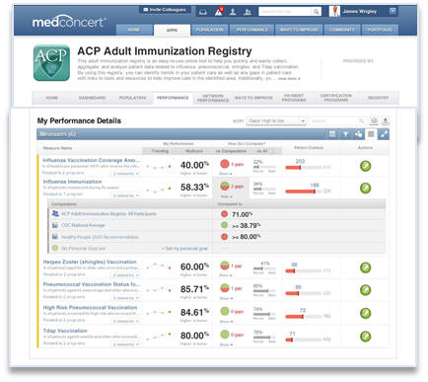
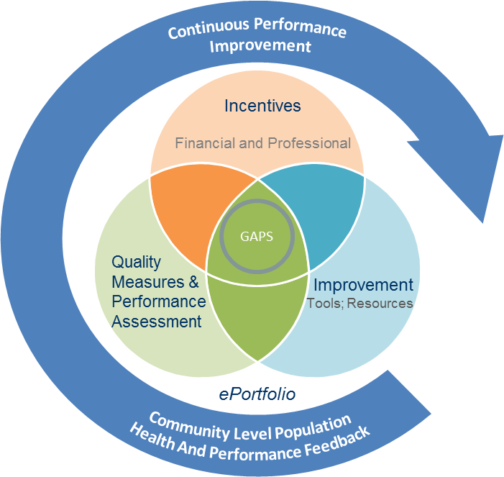
Data Sources, Submission, Feedback
Data Partners
Value
Science and Informatics
Online Web Forms for Data Entry or Data File Upload
CECity Platform
MedConcert Portal
Practices
without
EMRs
Online Tools for Data File Upload
Practices
with access
to EMRs
Feed Data Forward
Feed Info Back
Patient-Clinical Partnerships
LSU Drilling Platform
HIEs
Incentives
Payors
RAPID FEEDBACK LOOPS
Aggregate Data Feeds, Outcomes Research Reports
National Benchmarking Reports, Clinical Guidance and Decision Support Tools, Population Health Studies
Shared Lessons Learned & New Evidence
(SSO or Data Feed Option for Presentation in 3rd Party Systems)
Patient Reported
Culture
State Registry, Others
Confidential – Not for Distribution

Slide 4
Don Berwick, MD Founder Institute for Healthcare Improvement
“ I am not interested in Measurement Per se, I am obsessed with improvement and the role that measurement has in that process “

Slide 5
Measure Selection: Standardized Definitions based on ACIP Guidelines
Measure Title | Description | Denominator Description | Numerator Description
Influenza Vaccination | Percentage of patients aged 6 months or older seen during a visit between October 1 and March 31 who received an influenza vaccination OR who reported previous receipt of an influenza vaccination. | Patients aged 6 months or older seen for a visit between October 1 and March 31 with a valid patient encounter code. | Patients who received an influenza vaccination OR reported previous receipt of an influenza vaccination.
Pneumonia Vaccination Status for Older Adults | Percentage of patients aged 65 or older who ever received a pneumococcal vaccination. | Patients aged 65 or older with a valid patient encounter code. | Patients who have ever received a pneumococcal vaccination.
High Risk Pneumococcal Vaccination | The percentage of patients aged 19 through 64 with a high risk condition, who either received a pneumococcal vaccination (reported separately) OR had a contraindication to pneumococcal vaccination (reported separately). | Patient aged 19 through 64 with a high risk condition (e.g., diabetes, heart failure, COPD, end-stage kidney disease, nephritic syndrome, chronic kidney disease, chronic dialysis, asplenia, malignancy, solid organ transplant, on immunosuppressive medications, HIV) and a valid patient encounter code. | 1. Patients who received a pneumococcal vaccination OR 2. Patients who have a contraindication to pneumococcal vaccination.
Herpes Zoster (Shingles) Vaccination | Percentage of patients aged 60 or older who received a herpes zoster vaccination OR who reported previous receipt of a herpes zoster vaccination. | Patients aged 60 or older with a valid patient encounter code. | Patients who received a herpes zoster vaccination OR who reported previous receipt of herpes zoster vaccination.
Tdap (Tetanus, Diphtheria, Acellular Pertussis) Vaccination | Percentage of patients aged 19 or older who received a primary vaccine series of tetanus/diphtheria/acellular pertussis (tdap) vaccine OR who reported previous receipt of Tdap vaccination. | Patients aged 19 or older with a valid patient encounter code. | Patients who received Tdap vaccination OR who reported previous receipt of Tdap vaccination.

Slide 6
Measure Requirements
Required
Influenza Vaccination
Pneumonia Vaccination for Older Adults
Pneumonia Vaccination for High Risk Individuals
Optional
Herpes Zoster (Shingles Vaccination)
Tetanus, Diphtheria, Acellular, Pertusis (tdap) vaccination
Notes:
The I Raise the Rates Platform allows you to assess your performance across five immunization
measures, including:
Required Measures:
Influenza Vaccination
Pneumococcal Vaccination for Adults 65 and Over
Pneumococcal for High Risk Individuals
Optional Measures:
Tdap (Tetanus, Diphtheria and Pertussis)
Herpes Zoster
Overview:
Enter data for a minimum of 25 patients to assess your baseline immunization rates and identify gaps in your performance.
Link to tools and resources on the platform to develop and implement an action plan to increase your rates.
Enter data for an additional 25 patients to see your improvement.
The following timelines are recommended for your baseline and follow-up data collection:
Baseline data collection: Random sample of 25 patients, age 19 and up, seen from July 2014 to June 2015
Follow-up data collection: Random sample of 25 patients, age 19 and up, seen from July 2015 to June 2016
More frequent data entry can be conducted if desired.

Slide 7
Data Methods/Sources
Electronic data feeds
Louisiana
LSU/HCSD
UAMS (EHR/Epic)
Arkansas Department of Health Immunization Registry (supplemental data)
UAMS Aging Institute: 3 Geriatric clinics
Manual Chart Forms/Upload
Individual/Group practices

Slide 8
Sampling
Manual/upload input
Electronic Data Feed
Minimum 25 randomly selected patient records for each review periods
100% eligible patient population
Frequency of data feed to be determined by source – monthly recommended

Slide 9
Review Periods
Baseline
July 2014 – June 2015
Follow-up (post intervention)
July 2015 – June 2016

Slide 10
Benchmarks/Peer Comparators
Benchmarks
CDC National Average
Healthy people 2020
Individual provider – personal goals
Peer Comparators
Participants
vs. All participants in platform
vs. participants in practice
vs. state participants

Slide 11
Medconcert: Multitenant, cloud-based platform for continuous improvement

Slide 12
ACP Adult
Immunization Platform and Performance Improvement Program
HOME PAGE
Confidential – Not for Distribution

Slide 13
ACP Adult
Immunization Platform and Performance Improvement Program
HOME PAGE

Slide 14
Data Collection Methods:
Manual
Data Upload
Data Integration/feed
Data Upload Excel Spreadsheet
Manual data entry using online chart tool

Slide 15
Manual Chart Entry Form
Patient Demographics
Measure Questions driven by age and encounter

Slide 16
Pneumonia Vaccination Status for Older Adults
Description:
Percentage of patients aged 65 or older who ever received a pneumococcal vaccination.
Instructions:
This measure is used to assess the percentage of older adults 65 years and older who have ever received a pneumococcal vaccination.
Denominator:
Patients aged 65 or older with a valid patient encounter code.
DENOMINATOR Criteria (Eligible Cases):
Patients aged ≥ 65 years on date of encounter
AND
Valid patient encounter codes (CPT or HCPCS): 90945, 90947, 90951, 90952, 90953, 90954, 90955, 90956, 90957, 90958, 90959, 90960, 90961, 90962, 90963, 90964, 90965, 90966, 90967, 90968, 90969, 90970, 99201, 99202, 99203, 99204, 99205, 99211, 99212, 99213, 99214, 99215, 99304, 99305, 99306, 99307, 99308, 99309, 99310, 99315, 99316, 99324, 99325, 99326, 99327, 99328, 99334, 99335, 99336, 99337, 99341, 99342, 99343, 99344, 99345, 99347, 99348, 99349, 99350, 99356, 99357, G0402, G0438, G0439
NUMERATOR:
Patients who have ever received a pneumococcal vaccination.
Performance Met:
CPT II: 4040F
HCPCS: G8864
CPT: 90732
CVX: 33, 100, 109, 133
RxNorm: 287523, 1182409
OR
Performance Not Met:
CPT II: 4040F-8P
HCPCS: G8867
Rationale:
Pneumonia is common cause of illness and death in the elderly and persons with certain underlying conditions such as heart failure, diabetes, cystic fibrosis, asthma, sickle cell anemia or COPD.

Slide 17
How Do We Improve?

Slide 18
My Performance Dashboard

Slide 19
Improvement
System/Practice-based Interventions, Tools, Resources
Patient Education and Engagement Tools and Resources
Culture of Quality Improvement Learning and other tools
Confidential – Not for Distribution

Slide 20
Population Health Management

Slide 21
Performance Monitor – Organizations
Network Performance Dashboards for Provider Network
Provider and Enterprise Population Health Management and Analytics
Drill down to locations, providers and patient populations

Slide 22
Building a Learning Health System Community…
Communication and Collaboration Tools for Sharing, Scaling and Spreading Improvement
Confidential – Not for Distribution

Slide 23
Next Steps
Finalize Platform (In final testing stages)
Onboard participants
Provide Registration information
Support multiple data source submissions
Platform training
Group webinars
One-on-one

Slide 24
Partnering for Quality
Improving Quality Through Plan-Pharmacy Collaboration
Enabled by EQuIPP
David Nau, PhD, RPh, FAPhA
President
DNau@PharmacyQuality.com

Slide 25
EQuIPP Performance Measurement and Assessment for Pharmacy & Health Plans
Pharmacy
Health Plans
How do we compare vs. peers?
How do we compare vs. state?
How can we compete to participate in value-based, shared-risk or tiered networks?
How is my network performing?
How do we compare as a plan?
How can we create networks to properly share value based on high performance?
Overview |  | PQS is a Joint Venture (for profit) between CECity and Pharmacy Quality Alliance (non-profit), trusted licensor of medication-use quality measures CECity platform leveraged to present unbiased performance at provider, organization, state, national and payor network level Includes core “measures that matter” – Medicare Stars (Part D) Major health plans and Chain Pharmacies are all in

Slide 26
What is EQuIPP ?
EQuIPP is a multi-plan, multi-pharmacy, collaborative to:
Support collaboration of health plans, PBMs and pharmacies for Quality Improvement related to medication use
Allow consistent, standardized assessment of community pharmacy performance on Part D stars and other quality measures
Enable faster, more-refined, benchmarking of Part D stars performance in key market areas
EQuIPP provides a neutral assessment of quality for trusted performance assessment and benchmarking by all parties.
EQuIPP lays the foundation for performance-based contracts and payment systems for pharmacy networks

Slide 27
Participants
Pharmacies
Chains:
CVS
Rite Aid
Kroger
Safeway
ThriftyWhite
Kinney
Tops Markets
Independents:
Health Mart
Med Shoppe
LeaderNET
APNS
CIPN
CARE Coop
PPOK
Walmart
Walgreens
Target
Meijer
Giant Eagle
BI-LO
Albertsons
SUPERVALU
AccessHealth
Good Neighbor
APSC
SPC
United Drugs
EPIC Network
PBA/Trinet
Health Plans / PBMs
Humana
Coventry
Wellcare
Cigna – HealthSpring
Caremark - Silverscript
Inland Empire Health Plan (CA)
UPMC Health Plan (PA)
Gateway Health Plan (PA)
Healthfirst of NYC
Express Scripts (2015)
Prime Therapeutics (2015)
EQuIPP Statistics:
Over 15 million lives in dataset
Over 54,000 participating pharmacies
Notes:
n the United States, a pharmacy benefit manager (PBM) is most often a third party administrator (TPA) of prescription drug programs but sometimes can be a service inside of an integrated healthcare system (e.g.: Kaiser or VA). They are primarily responsible for processing and paying prescription drug claims.

Slide 28
Data Flow for EQuIPP
Health Plan
Dashboards
PBM
Data
EQuIPP
Results
Clinical / MTM Platforms
Pharmacy
P4P reports
ACO
(Future)

Slide 29
EQuIPP Core Measures
EQuIPP core measures are from PQA:
3 measures of medication safety
High risk medications in the elderly
Appropriate treatment of blood pressure in persons with diabetes
Drug-drug interactions
3 measures of medication adherence
Oral diabetes medications
Cholesterol medication (statins)
Blood pressure (renin-angiotensin system antagonists)
Additional quality measures can be added to align with CMS, NCQA, URAC or other initiatives

Slide 30
EQuIPP – Basic Services
Health plans & PBMs:
Access to performance dashboards that display their performance and relevant benchmarks on quality metrics across lines of business and across geographic regions
Visibility into the performance of their pharmacy network
Neutral intermediary for performance-based contracts with pharmacies
Insights Report provided once each quarter
analyzes performance patterns and identifies outliers
Pharmacies:
Access to performance dashboards that report their scores and relevant benchmarks across the same key quality measures
EQuIPP supports multi-tier views of a pharmacy organization’s performance – from the individual store, through districts/regions, to the corporate rollup
Insights Report provided once each quarter
analyzes performance patterns and identifies competitive position

Slide 31
Patient Outlier Capability
Outliers are patients who represent improvement opportunities
Outliers can be identified from a standard EQuIPP data feed or based on supplemental file provided by clients
Include a brief documentation function to allow pharmacists to track outreach
Outlier documentation can be provided to clients to help determine future interventions

Slide 32
Marketplace/Exchange Plan Support
Background
Quality Rating System (QRS) has announced that the 3 PDC measures will be part of the 2015 Beta Test Set
Plans will directly submit PDC rates to CMS along with HEDIS rates, and all measure rates must pass NCQA audit parameters
CMS will publicly report performance scores beginning in the 2016 open enrollment period for the 2017 coverage year
New Role for PQS
PQS can perform the PDC calculations for your plan to optimize the likelihood that they will pass the NCQA audit
PQA “software certification” processes for vendors is in development
PQS will distribute PDC measure performance to pharmacies in EQuIPP ™ network
Marketplace/Exchange plans should start on 2014 on performance improvement; 2014-2015 claims data will drive the scores made public in 2016

