Slide 1
Overcoming Barriers to High Value Care
2015-2016 • Presentation 5 of 6

Slide 2
Learning Objectives
Describe the barriers to high value care in clinical practice and explore ways to overcome these barriers
Weigh the efficacy and safety of medical interventions to avoid inappropriate use and harm
Practice negotiating a care plan with patients that incorporates their values and addresses their concerns
Explain the importance of local culture in your practice decisions

Slide 3
Potential Barriers to High Value Care
Lack of guidelines driven by lack of evidence
Poor familiarity with guidelines
Lack of knowledge of costs, including the impact of setting on cost
Defensive medicine
Time pressure (emphasis on shorter LOS and productivity)
Explaining to patients why tests/treatments are not indicated takes time
Discomfort with diagnostic uncertainty
Local culture
Misaligned financial incentives
Lack of appreciation of harms
Patient expectations
Lack of centrally available information on prior tests

Slide 4
Potential Barriers to High Value Care
Lack of guidelines driven by lack of evidence
Poor familiarity with guidelines
Lack of knowledge of costs, including the impact of setting on cost
Defensive medicine
Time pressure (emphasis on shorter LOS and productivity)
Explaining to patients why tests/treatments are not indicated takes time
Discomfort with diagnostic uncertainty
Local culture
Misaligned financial incentives
Lack of appreciation of harms
Patient expectations
Lack of centrally available information on prior tests
Notes:
The highlighted barriers are those that will be focused on today

Slide 5
Barrier 1: Defensive Medicine
“Defensive medicine occurs when doctors order tests, procedures, or visits… primarily to reduce their exposure to malpractice liability.”
(Congressional OTA 1994)
Defensive medicine is very common: 93% of physicians in Pennsylvania report practicing defensive medicine¹
Notes:
Ask residents: Raise your hand if you have ever practiced defensive medicine or seen it practiced

Slide 6
Defensive Medicine Does NOT Protect Against Malpractice²
Malpractice claims can be arbitrary and hard to prevent: 40% of malpractice claims do not involve medical errors
More care is not better care, as tests and treatments have associated harms that may lead to malpractice
Lack of follow up of abnormal test results often leads to malpractice litigation—don’t order the test if you don’t plan on following it up and acting on the results

Slide 7
Tips to Avoid Malpractice
Listen to your patients and carefully document decision-making, including discussion of side effects and risks of all tests and treatments
If a mistake occurs, open communication is key³
The primary factor in a patient’s decision to pursue a malpractice case is lack of communication from the provider after an unexpected outcome or undesirable result
7 years after implementation of a disclosure policy, the VA in Lexington, KY had among the lowest payouts of any VA hospital
After 5 years with open disclosure policy at the University of Michigan, annual litigation expenses declined from $3 million to $1 million and number of claims declined by 50%

Slide 8
Case 1: Patient Request for Testing
Chief complaint: “I want to see if I have osteoporosis.”
58-year-old woman presents for an annual physical. Her 60-year-old sister, who smokes and drinks alcohol, recently had a DEXA scan revealing osteoporosis. She is concerned that she could have it, too.
The patient does not smoke or drink alcohol, and has no family history of hip fracture.
She read about DEXA scans online and states “I am really afraid of getting a hip fracture, so I want to know where I stand so I can start medication now if I need it.”

Slide 9
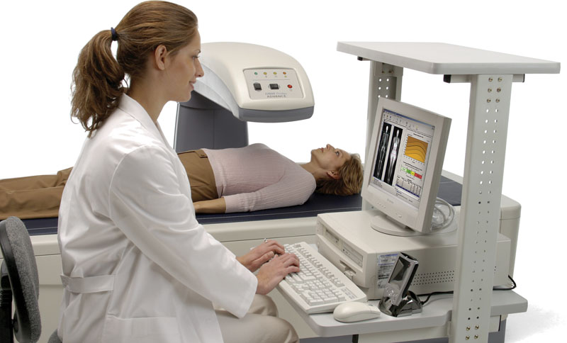
Large Group Questions
Do you think a DEXA would benefit this patient?
Would you order a DEXA?
Notes:
Photo credit: https://www.manchestermemorial.org/care-services/imaging/dexa-scan

Slide 10
Case 1: DEXA

Slide 11
What Do Physicians Do?⁴
One study reviewed 3568 DEXA scans completed between 2010 and 2012
48% were completed on patients less than 65 years old
15% were repeated in the same patients within a 2-year period
These data suggest inappropriate ordering according to the USPSTF guidelines

Slide 12
Barrier 2: Patient Expectations⁵
Patients often think that more testing is better
Physicians have legitimate concerns about patient satisfaction, which may be tied to reimbursement
Patients want a clear diagnosis, shared decision-making, and acknowledgment that their symptoms are real and concerns are valid
Effective communication may contribute more to satisfaction than the specific management plan

Slide 13
Talking to Patients about NOT Doing Things
What are some principles of patient-centered discussions?
Notes:
Ask the group- what are some of the principles of patient-centered discussions? How would you approach issues like this with a patient?
Photo credit: http://www.forces4quality.org

Slide 14
Tool: High Value Care Conversation Guide
Set up an effective conversation with patients
Explain in plain language why requested tests are unnecessary
Customize the plan to match patients’ values
Screen for logistic and financial barriers to care
Notes:
Hand out the HVC Conversation Guide in preparation for the attendees to apply it to the next case

Slide 15
Case 2: Patient Request for Treatment
Chief complaint: “I need antibiotics”
A 67-year-old woman visits the clinic asking for a prescription for penicillin. She has an appointment for a dental procedure next week and states “I’ve always had antibiotics before dental work because of the rheumatic fever I had as a child.”
You explain that she does not need antibiotics and she becomes upset, stating “But I’m afraid of getting a heart infection – that’s why I’ve always needed it before. My dentist wants me to take it, too.”
Notes:
Photo credit: www.umalert.com

Slide 16
The Conflict
The patient has been given antibiotics before dental appointments in the past. She feels that her dentist requires it.
She wants an antibiotic prescribed as she is concerned about the risk of developing endocarditis, which has been explained to her in the past.
Guidelines currently do not recommend dental prophylaxis unless the patient has a prosthetic cardiac valve or other prosthetic cardiac materials, h/o endocarditis, cyanotic congenital heart disease, or cardiac transplant with valvulopathy.⁵

Slide 17
Small Group Work
Break into small groups to discuss:
How would you resolve the conflict between what the patient wants and what you feel is medically indicated?
Practice using the HVC Conversation Guide.
How much should you accommodate patient wishes for treatments with little or no prospect of benefit and the possibility of harm?

Slide 18
Report Back: What Did You Decide to Do?
Prescribe antibiotics (it’s just penicillin anyway)
No antibiotics, provide education and reassurance
Notes:
Have the small groups vote.

Slide 19
Case 3: Local Culture
You are an intern on the general medicine service. You admit a patient for cellulitis of the leg. On hospital day 2, the patient has worsening pain. The leg looks worse, with intense tenderness and erythema, and the patient has worsening leukocytosis and new acute kidney injury.
You are concerned that the patient may be developing necrotizing fasciitis, so you call the surgery resident and ask for a consult for “worsening cellulitis, possible necrotizing fasciitis.”
She says, “Order a CT and we will see her later.”
You don’t think that is appropriate….

Slide 20
Small Group Work
Break into small groups to discuss the following:
What went wrong?
How could you better frame a question for the consultant?

Slide 21
What went wrong?
Framing a question for your consultant:
Be specific: what question do you want them to answer?
What are you concerned about? How concerned are you?
What can they do that you can’t?
Include important relevant information (exam/history)
“Speak the same language” via risk stratification tools and subspecialty guidelines when able
Suggest a time frame: Emergent/urgent/routine?
Notes:
Give information on worsening clinical symptoms
Include your physical exam findings and key laboratory data
Are you worried about subcutaneous air?
Are you concerned for necrotizing fasciitis even without imaging? (LRINEC Score)
Can the patient be seen later? Or is this an urgent consult?
Do you feel this patient may need to go to the OR today?

Slide 22
Case 3: Follow up
The resident called the surgery team and relayed the concerning physical findings as well as the laboratory changes
Calculated the LRINEC score, which was elevated and suggested necrotizing fasciitis
The surgical team evaluated the patient at bedside without imaging and the patient went to the OR that day

Slide 23
Barrier 3: Local Culture/Hidden Curriculum⁷
Local Culture: What is the problem?
The art of medicine sometimes outweighs the evidence
Deeply ingrained; difficult to change (but not impossible)
A clinical example:
Jin, et al. evaluated the rate of blood transfusions in cardiac surgeries within a health care system
The variance of red blood cell transfusions among hospitals (0.82) was more than double that among surgeons in the same hospital (0.32)
The hospital a surgeon practiced at was more powerful than an individual surgeon’s preference

Slide 24
Barrier 3: Local Culture/Hidden Curriculum⁸
Hidden Curriculum: What is it?
Non-verbal messages transmitted “on the job” through practices, habits, and hierarchy
Actions of senior physicians (often unspoken) influence the behavior of students, regardless of what is formally taught
In medical school, students are taught that the history and physical exam are key to diagnosis; some consultants request imaging before evaluating a patient at the bedside
Fear of disapproval outweighs fear of uncertainty
Notes:
Applying to the case example:
Waiting for imaging may delay treatment of a life threatening disease

Slide 25
Barrier 3: Local Culture/Hidden Curriculum
Potential Solutions
Search for the best available evidence to assist in decision making
Identify respected clinical experts to support practice change
Use comparative data to identify practice variation and motivate clinicians to change
Notes:
Applying to the case example:
Waiting for imaging may delay treatment of a life threatening disease

Slide 26
Summary
Key barriers to high value care include defensive medicine, addressing patient expectations, and local culture
Good communication with patients and proper documentation are the best ways to defend your medical decisions
Take time to negotiate a care plan with patients that incorporates their values and addresses their concerns
Local culture affects your practice decisions; be clear in your consult questions in order to get the best answer for your patients

Slide 27
References
Studdert DM, Mello MM, Sage WM, et al. Defensive medicine among high-risk specialist physicians in a volatile malpractice environment. JAMA. 2005 Jun 1;293(21):2609-17. [PMID: 15928282]
Studdert DM, Mello MM, Gawande AA, et al. Claims, errors, and compensation payments in medical malpractice litigation. N Engl J Med. 2006 May 11;354(19):2024-33. [PMID: 16687715]
Gallagher TH, Studdert DM, Levinson W. Disclosing harmful medical errors to patients. N Engl J Med. 2007 Jun 28;356(26):2713-9. [PMID: 17596606]
Lee F. An approach using retrospective data to guide the design of a targeted clinical decision support intervention to reduce inappropriately ordered DXA scans [thesis]. New York, NY: Weill Medical College Of Cornell University; 2014. Publication no. 1525999.
Ong S, Nakase J, Moran GJ, et al. Antibiotic use for emergency department patients with upper respiratory infections: prescribing practices, patient expectations, and patient satisfaction. Ann Emerg Med. 2007 Sep;50(3):213-20. [PMID: 17467120]

Slide 28
References
Wilson W, Taubert KA, Gewitz M, et al. Prevention of infective endocarditis: guidelines from the American Heart Association: a guideline from the American Heart Association Rheumatic Fever, Endocarditis, and Kawasaki Disease Committee, Council on Cardiovascular Disease in the Young, and the Council on Clinical Cardiology, Council on Cardiovascular Surgery and Anesthesia, and the Quality of Care and Outcomes Research Interdisciplinary Working Group. Circulation. 2007 Oct 9;116(15):1736-54. [PMID: 17446442]
Jin R, Zelinka ES, McDonald J, et al. Effect of hospital culture on blood transfusion in cardiac procedures. Ann Thorac Surg. 2013 Apr;95(4):1269-74. [PMID: 23040823]
Liao JM, Thomas EJ, Bell SK. Speaking up about the dangers of the hidden curriculum. Health Aff (Millwood). 2014 Jan;33(1):168-71. [PMID: 24395948]
Lee T, Pappius EM, Goldman L. Impact of inter-physician communication on the effectiveness of medical consultations. Am J Med. 1983 Jan;74(1):106-12. [PMID: 6849320]

