Slide 1
High Value Diagnostic Testing and Cancer Screening
2015-2016 • Presentation 3 of 6

Slide 2
Learning Objectives
Review sensitivity, specificity, and predictive value and their applicability to high value care.
Practice applying these concepts to support high value care decisions when considering diagnostic and screening tests.
Explore the benefits and harms (including cost) of routine screening.
Develop an approach to customize screening recommendations to an individual patient and his/her unique risk factors, values, and concerns.

Slide 3
Brief Review of Biostatistical Concepts¹
Sensitivity—The ability to detect people who do have disease
Specificity—The ability to detect people who do not have disease
Positive Predictive Value (PPV)—The likelihood that a person with a positive test result actually has disease
Negative Predictive Value (NPV)—The likelihood that a person with a negative test result truly does not have disease
Notes:
Needed in order to interpret diagnostic tests and especially screening.

Slide 4
Sensitivity “Be sensitive to those who have disease”
 | Disease Positive | Disease Negative
Test Positive | True Positive | False Positive
Test Negative | False Negative | True Negative
True Positive
True Positive + False Negative
Notes:
Very sensitive tests required in situations where consequences of false negative would be very bad (screening donated blood for HIV)

Slide 5
Specificity “Negative people get specific”
 | Disease Positive | Disease Negative
Test Positive | True Positive | False Positive
Test Negative | False Negative | True Negative
True Negative
True Negative + False Positive
Notes:
Needed in situations where false positive would be very bad (i.e. cancer)

Slide 6
PPV
 | Disease Positive | Disease Negative
Test Positive | True Positive | False Positive
Test Negative | False Negative | True Negative
True Positive
True Positive + False Positive

Slide 7
NPV
 | Disease Positive | Disease Negative
Test Positive | True Positive | False Positive
Test Negative | False Negative | True Negative
True Negative
True Negative + False Negative

Slide 8
Diagnostic Testing
Pretest Probability
Diagnostic Test
Posttest Probability
Disease prevalence
Sensitivity, specificity
PPV, NPV

Slide 9
Role of Diagnostic Tests
To reduce uncertainty regarding a specific patient’s diagnosis
Generally most appropriate for patients you feel have an intermediate (10%-90%) pretest probability of a disease
Test characteristics (such as likelihood ratios) should be considered before ordering a test to help determine whether a given test would significantly alter your posttest probability (and thus affect management).
Notes:
Emphasize that unique pt presentations/symptoms and the pt demographics are essential to formulating clinical judgment regarding the pretest probability of a specific disease.
Should be applied in a sequential fashion until clinician’s can reach a “threshold” after which our posttest probability is high enough that we are confident that a patient either has or does not have a disease

Slide 10
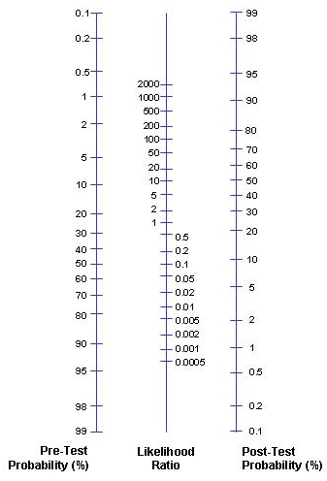
Likelihood Ratios
Using likelihood ratios:
Use the estimated pretest probability of disease as an anchor on the left side of the graph.
Draw a straight line through the known likelihood ratio, either (+) or (-).
Where this line intersects the graph on the right represents the posttest probability of disease.
Notes:
A LR ratio of 2 increases post-test probability by approximately 15%, a LR of 5 increases post-test probability by approximately 30% and a LR of 10 increases the post-test probability by approximately 45%.

Slide 11
Positive Likelihood Ratio of Common Physical Exam Maneuvers²
Fluid wave for ascites:
Valgus laxity for MCL injury:
Homan’s sign for DVT:
Nuchal rigidity for meningitis:
5.0
146.5
1.1
3.0

Slide 12
Diagnostic Testing
Likelihood Ratio
Pretest Probability
Diagnostic Test
Posttest Probability
Disease prevalence
Sensitivity, specificity
PPV, NPV

Slide 13
Approach To PE: Small Group Exercise
Break into 3 small groups.
Each group will work through a different case of a patient with possible pulmonary embolism.
Focus on the diagnostic process:
Estimate the pretest probability of disease in your patient.
Evaluate how D-dimer testing or CTA in your patient would influence your posttest probability of disease and assess whether these test would be helpful in your patient.

Slide 14
Role of Screening Tests
To detect asymptomatic and early-stage disease
Should be highly sensitive and highly specific to pick up most cases of true disease and avoid false positives
Targeted toward populations with a higher disease prevalence (high positive predictive value)
Should be relatively safe and cost-effective
Should screen for diseases in which early identification and treatment have been demonstrated to improve clinical outcomes
Notes:
Goal is for high sensitivity and specificity, but there is no free lunch so usually sacrifice one at the expense of the other

Slide 15
Common Harms Associated with Screening
False positive results
Primary goal of screening: find cancer → maximize sensitivity at cost of specificity → False positives
Can lead to incorrect labeling, inconvenience, expense, and physical harm in follow-up tests
Notes:
As mentioned before, no free lunch.

Slide 16
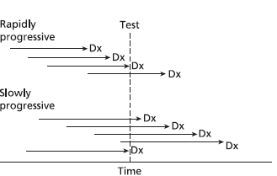
Common Harms Associated with Screening
Lead-Time Bias: Make diagnosis of cancer, but no mortality benefit
Length-Time Bias: “Overdiagnosis” and “Pseudodisease”
Notes:
Lead time bias-Survival determined by time from diagnosis to death. With screening, can increase survival time, even though patient ends up dying at the exact same time they would have without the test. Seems like they lived longer, but actually just knew about disease longer
“Overdiagnosis”: Will finding a disease help the patient? Some diseases are so slow growing, or may even regress. Therefore they may not cause any trouble and in fact may not be a “disease” at all. This is an example of “length-time bias”. Cancer incidence increases with earlier screening. How do we know which ones will be invasive, and which will not be a problem? By nature, screening tests tend to pick up cancers that are more indolent and have better prognosis

Slide 17
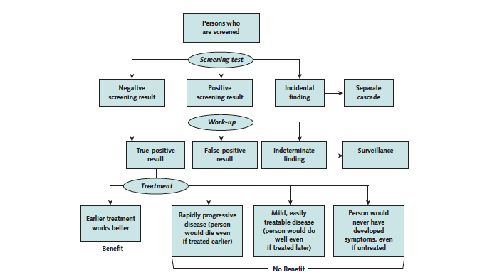
Screening Cascade³

Slide 18
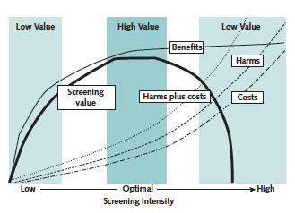
Value Framework³

Slide 19
Screening Value Cases
Discuss the following screening cases, and use handout to guide your decisions:
45-year-old woman asking about mammography
70-year-old man with ESRD on HD, CAD, COPD, and uncontrolled DM asking for colonoscopy
35-year-old woman, new patient, had a negative Pap smear 2 years ago, now asks for a repeat Pap test because “that’s what she’s always had”

Slide 20
Screening Smarter
Screen less frequently.
Don’t screen patients with a life expectancy less than 10 years.
Discuss potential downstream testing with patient before ordering initial screening test.
Use higher threshold for positive result.
Understand basic test characteristics and limitations as well as an individual patient’s goals and values.
Notes:
Bullet point two: As many as 50% of people over 75 report physician recommends continued screening
10% of women with advanced non-breast cancer underwent mammography, 15% of men with advanced non-prostate cancer underwent PSA testing
Bullet point three: Make sure patient would consider transrectal biopsy before ordering PSA

Slide 21
Cost-effectiveness⁴
“Cost-saving”
Reduces cost, Costs money, Costs money,
Improves health Improves health Worsens health
Measures that cost money but improve health can be further categorized by their cost, often measured in dollars per QALY (quality-adjusted life-year).
QALYs incorporate an estimate of the quantity of life gained by the intervention, coupled with a more subjective assessment of the quality of that life affected by the intervention.
Historically, payers have considered any intervention that has a cost-effectiveness ratio of <$100K per QALY as acceptable.
Notes:
Should also take into account cost-effectiveness

Slide 22
Cost Effectiveness of Selected Treatments^{5,6}
Cost-saving (ratio of <$0): Aspirin for at-risk patients, childhood immunizations
0 to $13,999/QALY: Chlamydia screening, colorectal screening for all adults >50
$14,000 to $34,999/QALY: Cervical cancer screening, hypertension screening (all adults)
>$35,000/QALY: Mammography
Notes:
IOM Roundtable on Evidence Based Medicine: Lowering costs and improving outcomes
EXAMPLES OF relative cost-effectiveness of different preventive measures.
Colonoscopy for avg risk patients costs $1000-3000 but provides a 20-30% absolute mortality reduction (USPSTF grade A)
Mammography for avg risk women ages 40-49 prevents only one death for every 1000 women screened annually for 10 yrs (USPSTF grade B)
**notably the mortality benefit of screening mammography increases with age owing to the higher incidence of breast cancer in older women

Slide 23
Lung Cancer Screening and QALY⁷
Recent study from Nov. 2014 NEJM examined the QALY for low-dose CT screening for lung cancer.
Study found that screening for lung cancer with low-dose CT would cost $81,000 per QALY gained, below the $100K cut-off.
Some concern that outside study, costs will go up (different institutions with different prices for CT, increased follow-up testing, etc.)

Slide 24
Summary
Diagnostic tests should only be used if the result is likely to significantly affect your certainty of a disease (posttest probability) and should rely on likelihood ratios for a given test when available.
The goals of screening are to detect treatable, asymptomatic, or early stage disease.
The limitations (lack of sensitivity/specificity) and cost-effectiveness of screening tests, as well as patients’ goals, should be taken into account before ordering.
Recommendations are not prescriptive, but rather the beginning of an open dialogue with patients to create (as a team) a prioritized plan of preventive health maintenance.

Slide 25
References
Glaser AN. High-Yield Biostatistics. 3rd ed. Philadelphia: Lippincott Williams and Wilkins; 2004.
McGee S. Evidence-Based Physical Diagnosis. Philadelphia: Elsevier Saunders; 2012.
Harris RP, Wilt TJ, Qaseem A; High Value Care Task Force of the American College of Physicians. A value framework for cancer screening: advice for high-value care from the American College of Physicians. Ann Intern Med. 2015 May 19; 162:712-7. [PMID: 25984846]
Owens, D, Qaseem A, Chou R, Shekelle P; Clinical Guidelines Committee of the American College of Physicians. High-value, cost-conscious health care: concepts for clinicians to evaluate the benefits, harms, and costs of medical interventions. Ann Intern Med. 2011 Feb 1;154(3):174-80. [PMID: 21282697]
Cohen JT, Neumann PJ, Cohen JT, Neumann PJ, Weinstein MC. Does preventive care save money? Health economics and the presidential candidates. N Engl J Med. 2008 Feb 14;358(7):661-3. [PMID: 18272889]
Institute of Medicine. The Healthcare Imperative: Lowering Costs and Improving Outcomes: Workshop Series Summary. Washington DC: National Academics Press; 2010

Slide 26
References
Pinsky, Paul F. Cost-effectiveness of CT screening in the National Lung Screening Trial. New Engl J Med. 2015 Jan 22;372(4):387.
Moynihan R, et al. Preventing overdiagnosis: how to stop harming the healthy. BMJ. 2012;344: e3502. [PMID: ]
Wilt TJ, Harris RP, Qaseem A; High Value Care Task Force of the American College of Physicians. Screening for cancer: advice for high-value care from the American College of Physicians. Ann Intern Med. 2015 May 19;162(10):718-25. [PMID: 25984847]
Welch HG, Schwartz L, Woloshin S. Overdiagnosed: Making People Sick in the Pursuit of Health. Boston, MA: Beacon Press; 2011.
Moriates C, Arora V, Shah, N. Understanding Value-Based Healthcare. New York: McGraw-Hill Education; 2015.

