Slide 1
Health Care Costs and Payment Models
2015 - 2016 • Presentation 2 of 7

Slide 2
Learning Objectives
Explain the basics of health insurance and coverage.
Demonstrate the complexity of health care costs and the large variation in out-of-pocket costs based on insurance status.
Weigh the impact of insurance coverage and out-of-pocket costs with the ability to adhere to treatment recommendations.
Explore how provider reimbursement models can affect delivery of high value care.
Encourage physicians to not practice “one size fits all” medicine.

Slide 3
An uninsured patient’s perspective: Mr. M
A 28-year-old man with severe abdominal pain, ED diagnosis of a ruptured appendix, treated with IV antibiotics for 4 days, followed by surgery
Patient: “I grew up in a family without health insurance my whole life, and our policy was basically ‘Give it a couple of weeks’… so I didn't want to call 911 or go to an emergency room.”

Slide 4
An Uninsured Patient’s Perspective¹
Julian McCullough, comedian
Recorded at “Told,” a storytelling show in New York City
As heard on This American Life (NPR) (#439)
“How much? No health insurance, 7 days in the hospital, … appendectomy:”
$45,000
Notes:
Open slide in slide show for audio file- it’s 2 minutes long
Here mention statistic that medical bills are the leading cause for personal bankruptcy, and that 78% of those who file for this reason HAD insurance at start of their illness
it is important to realize that uninsured patients are billed the full charge except in certain states (for example, New York), where state law sets the maximum amount that uninsured patients can be billed at 17% above Medicare rates.

Slide 5
Definitions²
Cost: dollar amount that it costs for a provider to deliver a health care service
Charges: the financial amount a health care provider asks for a service
often much higher than cost and reimbursement
only uninsured patients are billed charges
Reimbursement: amount a third party payer (i.e., insurance) negotiates as payment to the provider
may drive charge inflation
Price: the amount a patient pays out of pocket for a service
hardest number to estimate, but this matters most to patients
Notes:
Source: Understanding Value Based Healthcare book

Slide 6
Sources of Health Insurance (2013)^{3,4}
Military 5%
Uninsured
13%
Medicare and Medicaid Spending
Medicaid 17%
39% of national health spending
23% of federal budget
43% of hospital revenues
Employment Based 54%
Medicare 16%
Individual Private Insurance 11%
Notes:
Health coverage is not mutually exclusive so adds up to >100% - bottom line, most of health insurance is employment based
Here discuss:
Uninsured rates peaked at 15.5% in 2010 and have been dropping
1 in 3 Americans are covered by Medicare or Medicaid – the spending in this group is higher than the percent covered – why?
10% of the medicare population accounts for 59% of Medicare spending

Slide 7
Individual Private Insurance
Individual policies involve an individual person paying a premium directly to a “health plan” or insurance company, which reimburses providers.
Individual policies provide health insurance for approx. 11% of U.S. population.
Notes:
Individual private insurance. A third party, the insurance plan (health plan), is added, dividing payment into a financing component and a reimbursement component

Slide 8
Employment-Based Private Insurance
Employers usually pay all or part of the premium that purchases health insurance for their employees.
This is a tax-deductible business expense and the government does not treat the health insurance fringe benefit as taxable income to the employee.
Therefore, the government is in essence subsidizing employer-sponsored health insurance.
This subsidy was estimated at $260B/year in 2009.
Notes:
Employers get a direct subsidy for providing health insurance but ALSO enjoy tax-free status of their contributions to health insurance benefits
- This is the largest tax expenditure by the federal government

Slide 9
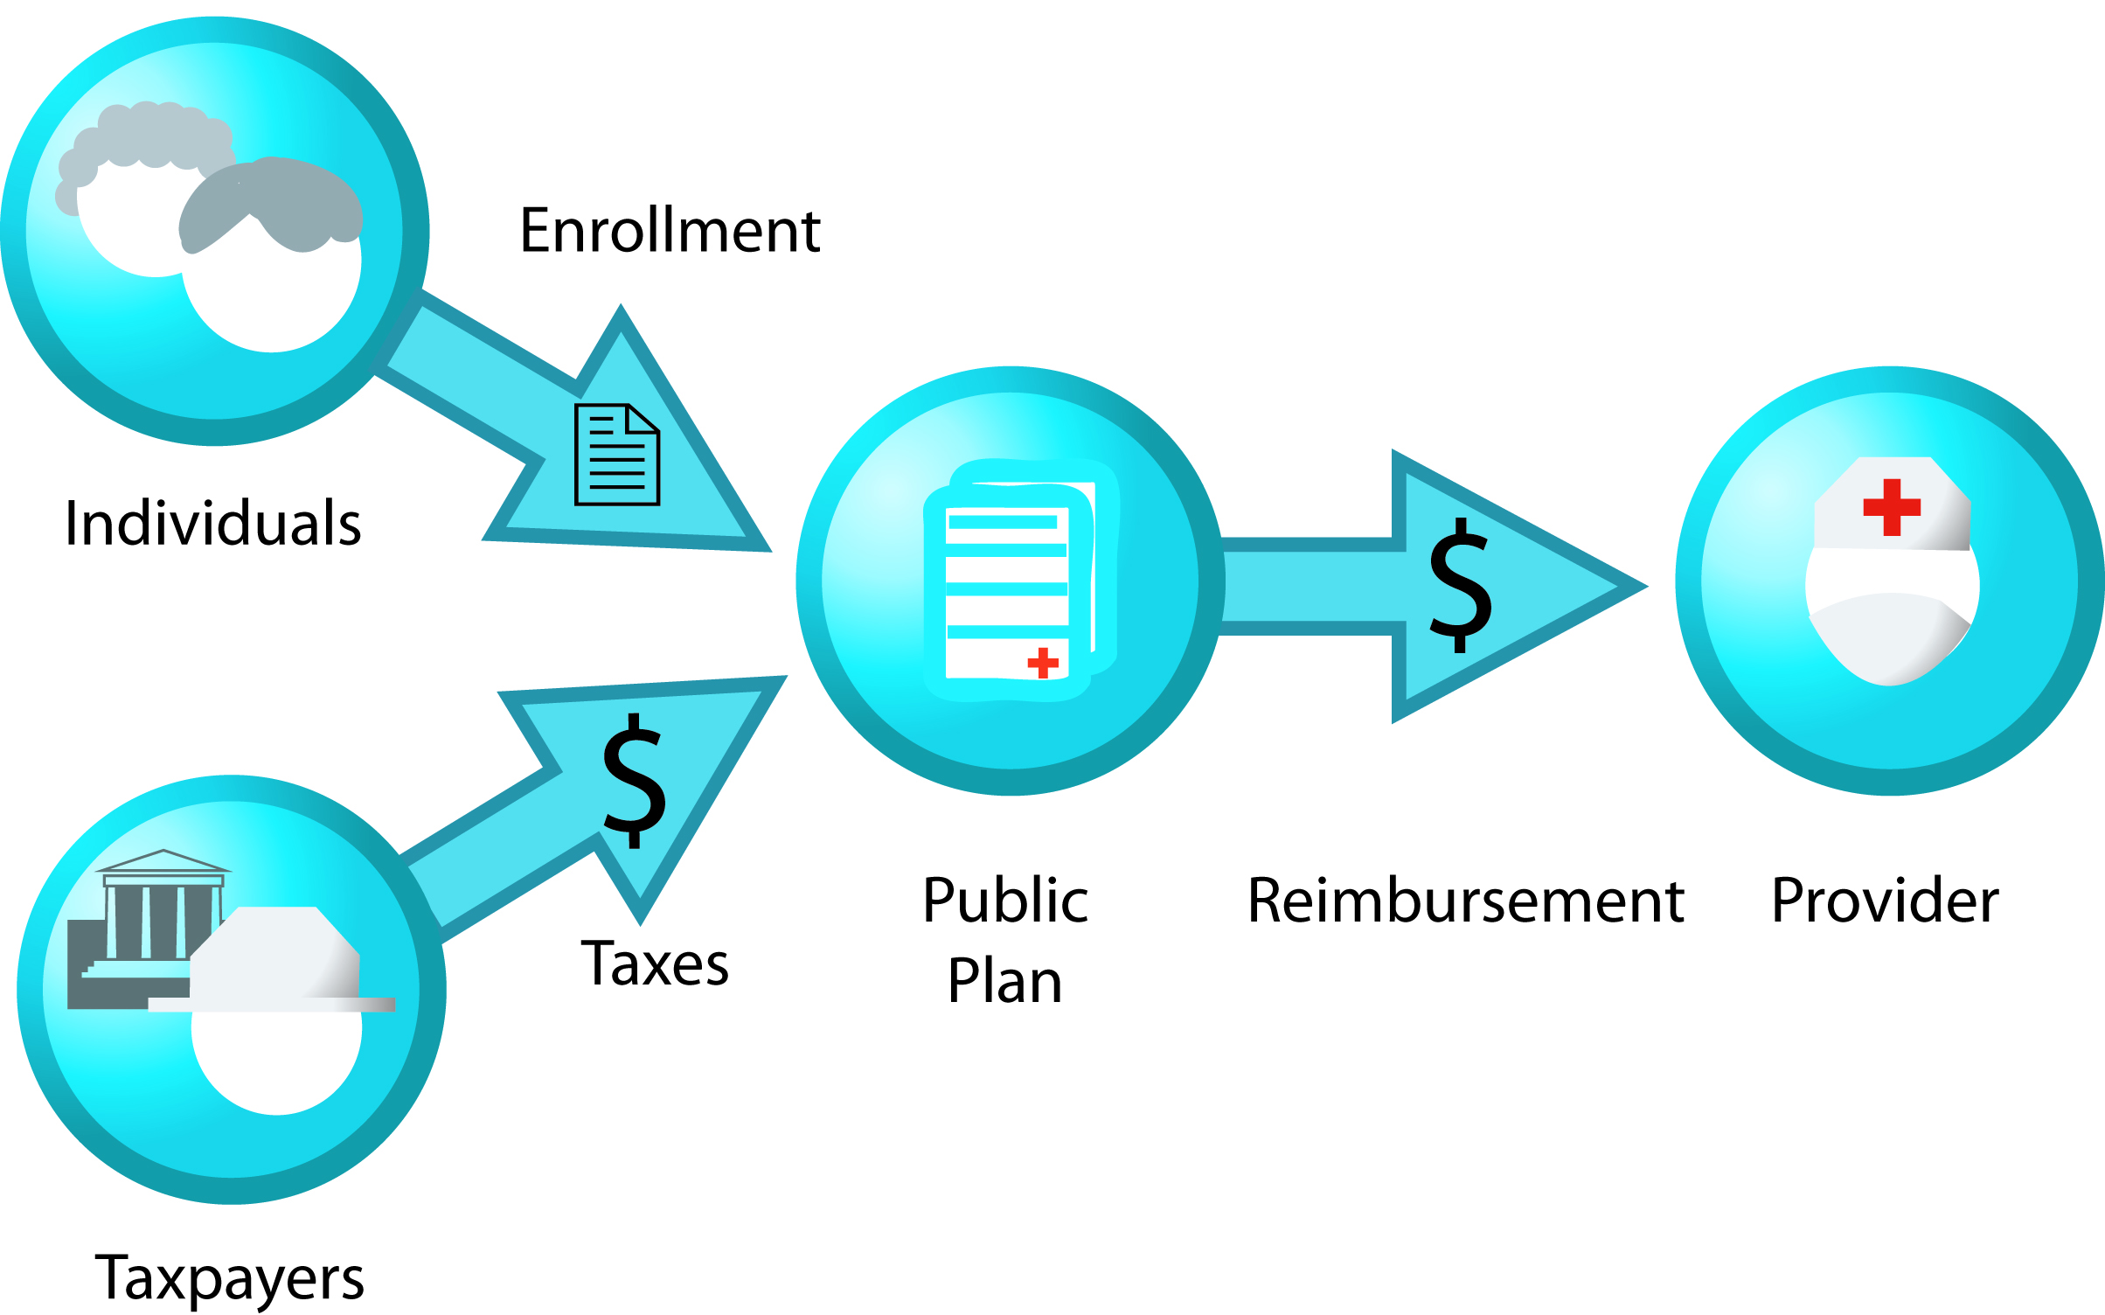
Government-Financed Insurance
In the late 1950s, less than 15% of the elderly had health insurance.
In 1965, Medicare (for the elderly) and Medicaid (for the poor) was enacted
First tax-financed govt. insurance
Notes:
For Medicare, must pay taxes to qualify, for Medicaid, eligibility not linked to taxes paid

Slide 10
Medicare⁵
Medicare Part A
Hospital insurance plan for the elderly
Financed through social security taxes
At age 65, pts who have paid >10 yrs into SSI automatically enrolled.
Those <65 totally and permanently disabled may enroll after 24 mos of disability.
Those with ESRD on HD usually enrolled without wait period.
Medicare Part B
Insures the elderly for physicians’ services
Financed by federal taxes and monthly premiums from beneficiaries
Available to those eligible for Medicare Part A who elect to pay the Medicare Part B premium of $104.90/mo (2015)

Slide 11
Medicare Prescription Coverage⁵
Medicare Part D
Voluntary prescription coverage that is added to original Medicare
Plans have monthly premiums in addition to that paid for Part B.
Deductibles vary but may not exceed $360 per year (2016).
Beneficiaries may owe a late enrollment penalty if they are without drug coverage for >63 days.
Medicare Advantage Plan
Beneficiaries can enroll in a private health plan to receive Medicare covered benefits.
Plans cover Medicare parts A and B and usually D.
One MUST have Medicare parts A and B to sign up.
Notes:
There are 2 ways for Medicare beneficiaries to obtain prescription coverage: part D and the Medicare Advantage Plan
- About one third of Medicare beneficiaries are enrolled in the Medicare Advantage Plan

Slide 12
Medicaid⁶
Federal program administered by the states, with the federal government paying between 50% and 76% of total Medicaid costs
The federal government requires that a broad set of services be covered under Medicaid, including hospital, physician, laboratory, x-ray, prenatal, preventive, nursing home, and home health services.
Pharmacy coverage is optional but currently is provided in all states.
Covered groups: nonelderly low income persons and the disabled

Slide 13
Pre-ACA: Who were the Uninsured?⁷
Adults without dependent children
Low or moderate income families (<400% poverty level)
Working families without access to employer sponsored insurance coverage
Undocumented persons
Notes:
Uninsured Minorities: 26% of Hispanics and 17% of Black Americans were uninsured in 2013 compared to 12% of non-Hispanic whites.

Slide 14
The Affordable Care Act of 2010⁷
Aims: To decrease the number of uninsured Americans and reduce health care costs
Expansion of coverage:
Medicaid expansion: sets the Medicaid minimum income eligibility across the US to <138% of the federal poverty level
Health insurance exchanges: competitive markets with clear information to assist persons in purchasing insurance; subsidized for families <400% poverty limit
Notes:
With the ACA changes, 55% of uninsured non-elderly are eligible for financial assistance to obtain coverage
Early estimates note that the uninsured rate dropped by 1 percentage point in early 2014
Medicaid enrollment has grown 14%
Discuss: Who is still uninsured in 2015?
Undocumented
Those who are eligible for Medicaid but have not enrolled
Those without other coverage who still feel that insurance is too expensive but opt to pay the penalty instead
Those who live in states that did not expand Medicaid and do not qualify
http://kff.org/uninsured/report/the-uninsured-a-primer/

Slide 15
Access to Health Care
Notes:
http://kff.org/uninsured/report/the-uninsured-a-primer/

Slide 16
Does Health Insurance Make a Difference?
A patient story:
Mr. O is a 58 year-old man who does not have insurance and has not seen a physician in 10 years. He works as a landscaper. He presented to the ED with chest pain and weakness and was found to have both an NSTEMI and an acute MCA infarct in the setting of uncontrolled diabetes and hyperlipidemia.
What do you think happened to this uninsured patient with acute illness?
Why did this happen?
Notes:
Answer:
Cardiac cath revealed diffuse triple vessel disease most appropriate for CABG
CABG is not appropriate in the setting of acute stroke; therefore, the patient was managed medically with aspirin, clopidogrel, beta blocker, ACEi, and statin as well as treatment for diabetes
Pt was discharged with the intent to have CBG performed in the future to allow time for healing from the acute stroke
One year later, the patient has still not obtained CABG

Slide 17
Does Health Insurance Make a Difference?^{7,8}
Uninsured
Fewer regular medical visits and preventive health screenings
In 2013, 33% of uninsured reported a preventive health visit compared with 74% of those with employer-based coverage and 67% with Medicaid.
Lower survival rates for breast and colorectal cancer
Increased mortality (likely owing to greater morbidity from undiagnosed medical conditions, such as diabetes, HTN, and cardiovascular disease)
Less care during hospitalization
Less likely to receive a costly test or procedure
Higher in-hospital mortality rates
Notes:
Insurance helps: gaining Medicaid coverage results in 35% increase in likelihood of having an outpatient visit

Slide 18
Clinical Case #2 & Group Activity: Weekend Warrior
A 55 year-old man presented to his PCP with knee pain after twisting his knee during a skiing accident. He attempted rest, ice, and NSAIDs at home for 5 days without improvement.
Knee exam findings revealed joint instability, effusion, and tenderness.
The PCP ordered an MRI and referred the patient to orthopedics.
Notes:
Have residents break into small groups and provide estimates – charges referred to what is billed, reimbursement is what is ultimately paid to either the facility (for an MRI) or to the MD group (office visit)
Photo credit: http://www.mensfitness.co.uk/exercises/sport-workouts/2183/how-avoid-knee-pain-when-skiing

Slide 19
How Much Does the Patient Pay?
 | Ortho Office Visit |  | MRI
 | Facility Charge | Professional Charge | Facility Charge | Professional Charge
Charges
Out-of-Pocket Cost: Insurance with copay
Out-of-Pocket Cost: High deductible plan or uninsured
Out-of-Pocket Cost: Medicare
*Includes discount for patients who do not have insurance

Slide 20
Resource: Dartmouth Calculator
http://www.dartmouth-hitchcock.org/billing-charges/out_of_pocket_estimator_dhmc.html
Work in groups to complete the chart using the Dartmouth Calculator
How do out of pocket costs affect adherence to the treatment plan?
Notes:
http://www.dartmouth-hitchcock.org/billing-charges/out_of_pocket_estimator_dhmc.html

Slide 21
How Much Does the Patient Pay?
 | Ortho Office Visit |  | MRI
 | Facility Charge | Professional Charge | Facility Charge | Professional Charge
Charges | $336 | $151 | $4,023 | $806
Out-of-Pocket Cost: Insurance with copay | $25 |  | $25
Out-of-Pocket Cost: High deductible plan or uninsured | $341* |  | $3,380*
Out-of-Pocket Cost: Medicare | $227 |  | $1,095
*Includes discount for patients who do not have insurance
Notes:
The patient had the high deductible plan so did not follow up. Cost- particularly out of pocket cost- impacts the adherence of all patients (even those with the best education and insurance)
The Medicare out of pocket costs do not include co-insurance (such as the Medicare advantage plan)
How do out of pocket costs affect adherence to the treatment plan?

Slide 22
Methods of Payment (Health Provider Reimbursement Models)
Diagnosis-related groups (DRGs)
Physician or hospital is paid one sum for all services delivered during one illness; there is a different set case-price for each of approximately 750 distinct DRGs (Medicare).
Per Diem
The hospital is paid for all services delivered to a patient during one day (private insurance, PPOs/HMOs).
Fee-For-Service
The physician or hospital is paid a fee for each service (e.g., medication, IV fluids, ECG, surgical procedure) provided (uninsured, some private insurance).
Capitation
One payment is made for each patient’s treatment during a month or year (has now virtually disappeared; previously, largely HMOs).
Notes:
Ask trainees whether they think these methods encourage or discourage high value cost-conscious practices?
Highlight the pitfalls of traditional FFS → no disincentive to delivering unnecessary services (more is better if payer just keeps paying regardless of health benefit to patient)
Medicaid varies by state, and uses per diem, FFS, and DRGs depending on the state

Slide 23
Methods of payment: ACOs
Accountable Care Organizations (ACOs)
In 2010, a portion of the ACA authorized CMS to create an ACO program to service Medicare and Medicaid patients.
Realign value with payment incentives (“pay-for-performance”)

Slide 24
Accountable Care Organizations (ACO)⁹
Definition: Doctors, hospitals, and other health care providers who come together to coordinate high quality care for Medicare patients
Goal: Ensure that patients get the right care at the right time without duplication of services or errors
Benefit: ACOs who provide high-quality care with lower costs will share the savings with Medicare.
Notes:
Discuss the definition of ACOs per CMS.
Discuss how/whether your organization is participating as an ACO with CMS or other large payers (FAQ background/pre-work)

Slide 25
Steps Toward High Value Care¹⁰
Step one: Understand the benefits, harms, and relative costs of the interventions that you are considering.
Step two: Decrease or eliminate the use of interventions that provide no benefits and/or may be harmful.
Step three: Choose interventions and care settings that maximize benefits, minimize harms, and reduce costs (using comparative-effectiveness and cost-effectiveness data).
Step four: Customize a care plan with patients that incorporates their values and addresses their concerns.
Step five: Identify system-level opportunities to improve outcomes, minimize harms, and reduce health care waste.
Notes:
Refer to step 4 in the curriculum framework and highlight the fact that the residents just practiced step 4 in their small group activity. High value care is not “one size fits all medicine” and care plans must be individualized to reflect the values, concerns and support systems of individual patients.

Slide 26
Summary
Insurance status and type of coverage (public, private, HMO/PPO, or high-deductible plan) affects adherence to recommended treatment plans.
Given large differences in coverage/affordability, we must all seek to individualize patient care to improve quality and safety and decrease unnecessary costs.

Slide 27
References
Clip courtesy of This American Life from WBEZ Chicago.
Moriates C, Arora V, Shah N. Understanding Value-Based Healthcare. New York, NY: McGraw-Hill; 2015.
US Census Bureau. www.census.gov . Accessed December 16, 2015.
Altman D, Frist W. Medicare and Medicaid at 50 years: perspectives of beneficiaries, health care professionals and institutions, and policy makers. JAMA. 2015;314(4):384-95. [PMID: 26219056]
Department of Health and Human Services. www.medicare.gov. Accessed December 16, 2015.
Department of Health and Human Services. www.medicaid.gov. Accessed December 16, 2015.
Majerol M, Newkirk V, Garfield R. The Uninsured: A Primer — Key Facts about Health Insurance and the Uninsured in the Era of Health Reform. The Henry J Kaiser Family Foundation Web site. http://kff.org/uninsured/report/the-uninsured-a-primer/. Published Nov 13, 2015. Accessed December 16, 2015.
McWilliams J. Health consequences of uninsurance among adults in the United States: recent evidence and implications. Milbank Q. 2009 June; 87(2):443-94. [PMID: 19523125]
Centers for Medicare and Medicaid Services. www.cms.gov . Accessed December 16, 2015.
Adapted from Owens, D, Qaseem A, Chou R, Shekelle P; Clinical Guidelines Committee of the American College of Physicians. High-value, cost-conscious health care: concepts for clinicians to evaluate the benefits, harms, and costs of medical interventions. Ann Intern Med. 2011 Feb 1;154(3):174-80. [PMID: 21282697]
Dartmouth-Hitchcock Out-of-Pocket Estimator. http://www.dartmouth-hitchcock.org/billing-charges/out_of_pocket_estimator_dhmc.html. Accessed December 16, 2015.

