Slide 1

Connecting Care
Ensuring Quality Referrals and Effective Care Coordination
the Medical Neighborhood
Action Step # 4:
Create a Care Coordination Agreement
ACP SAN special project
for implementing
High Value Care Coordination
Carol Greenlee MD FACP & Beth Neuhalfen

Slide 2

The ACP SAN
High Value Care Coordination curriculum
Action Steps to Connected Care
Look at your internal referral process (get your own house in order)
Ensure the specialty practice gets what is needed for a high value referral
Ensure the others (patients, the requesting practice and any secondary care) get what they need
Develop Care Coordination Agreement(s) (compact) with appropriate referring practice(s)

Slide 3



Putting it all together-Connecting Care
Building the bridge
abutments –getting your
own house in order
Securing the
connecting pieces:
the referral request
the referral response
Establishing the bridge: a Care Coordination Agreement for the
Referral process

Slide 4

As you listen…
Think about helping the practice(s) develop a care coordination agreement
  With which other practice(s) would it be beneficial to develop a CCA
  What might be needed & desired in a care coordination agreement to improve the referral process for
    Patients
    Clinicians and practices
    Reducing waste and improving cost effectiveness
  How could this improve access to care

Slide 5

Ideally…
Patient-Centered High Value Care Coordination would be standard of care…
… with every clinical team doing what is needed to coordinate, connect and share the care for
our patients whenever and wherever
that care may take them

Slide 6



To help us get there…
Care Coordination Agreements provide
A starting point
And
A roadmap

Slide 7
What is a Care Coordination Agreement?
An invitation to work together better…
Provides a platform that everyone agrees to work from:
  Standardized definitions
  Agreed upon expectations regarding communication and clinical responsibilities.
Can be formal or informal
Internal practice policies and procedures should be aligned to support the agreement
Also called Care Coordination Compact or Collaborative Care Agreement / Compact

Slide 8


Who and How?
Practices worked with frequently
  Including multispecialty groups in same organization
Practices that need to provide “more”
  PCP needing timely referral response notes
  Specialty group needing more than ICD code with referrals
  PCP needing colonoscopy reports from GI group
  Surgeon needing pre-op prep or post-op assistance
Practices that need to provide “less”
  Chart dump with referrals
  40 page referral response notes (with every order, etc. in it)

Slide 9

Models for Establishing Agreements
“One-on-One” Compacts with selected medical neighbors
  PCP practice with specialist / specialty to specialty
  ACO with a specialty
System-wide adoption (all players within system)
  Closed or integrated systems (VA, ACO, IPA, AMC)
Unilateral approach
  Medical Center / Specialty Practice (“This is how we agree to work with those who refer to our center/practice and this is what we would like from you when you refer a patient ”)

Slide 10
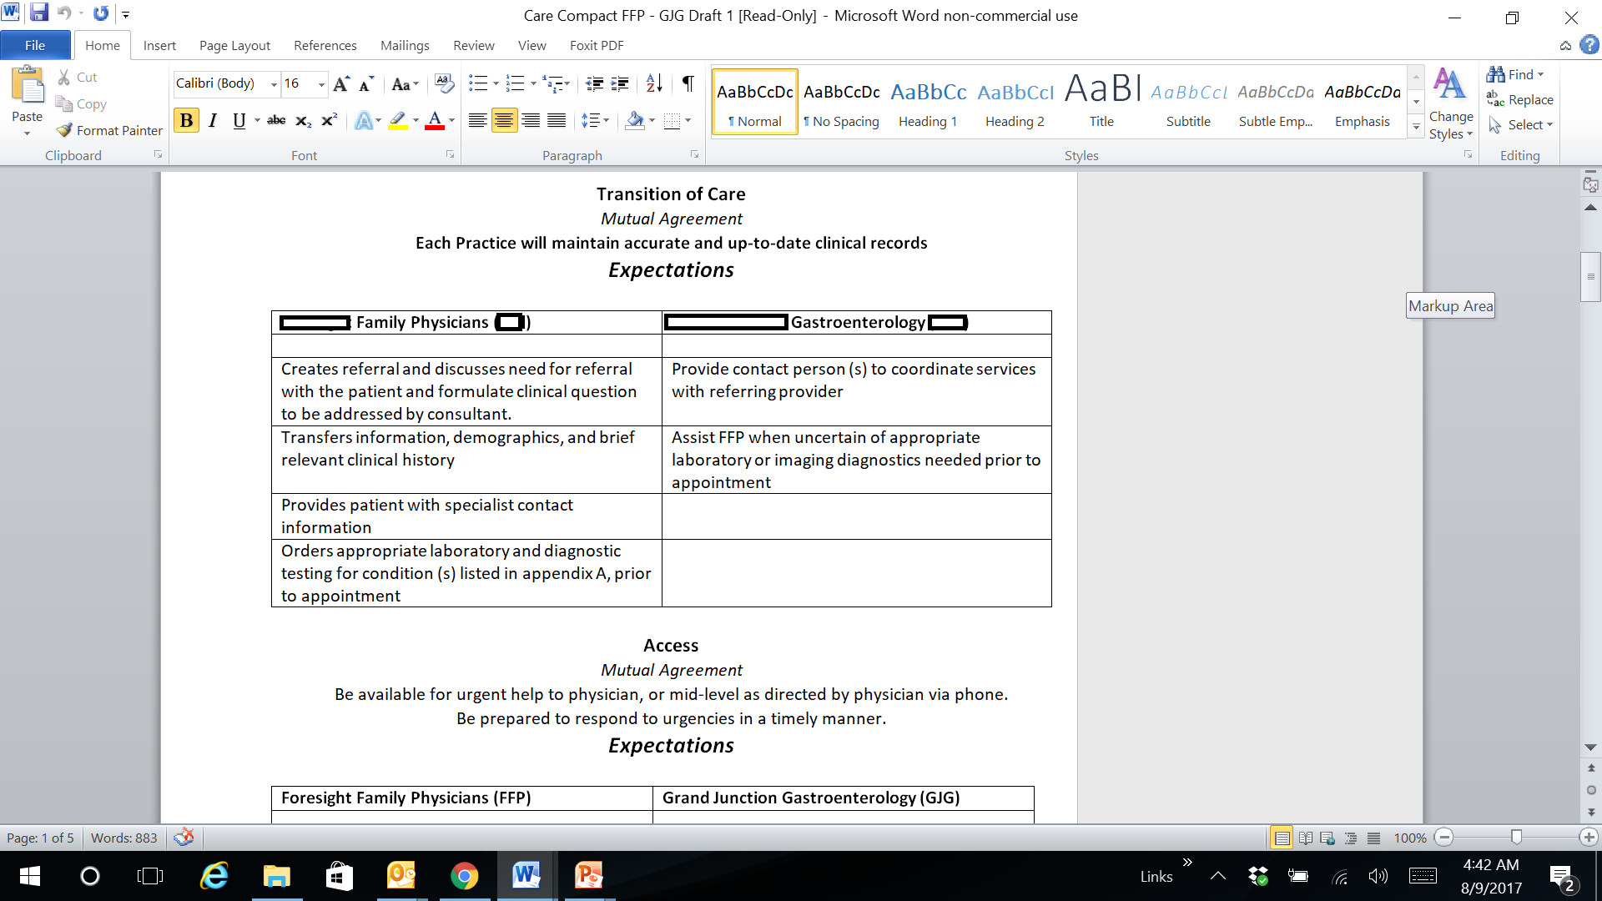
Example of Formal 1-on-1 CCA
(PCP with Specialty)

Slide 11
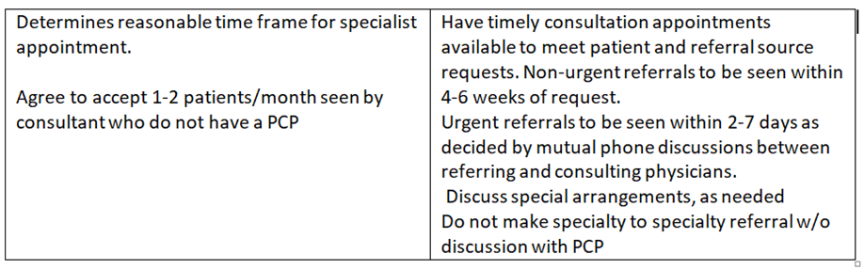
Example of Formal 1-on-1 CCA
(PCP with Specialty)

Slide 12
Example of Informal 1-on-1 CCA
(Specialty to Specialty – collaborative care)
Endocrinology with Endocrine Surgeon
  Work closely together for surgical cases involving parathyroid/thyroid/adrenal issues
  Evolved & continuously evolving understanding of information, communication & collaboration needs
    Clear clinical questions/ reason for referral
    Detailed summary / discussions-calls
    Defined expectations around roles & responsibilities
    Defined expectations around shared information, communication and care collaboration

Slide 13
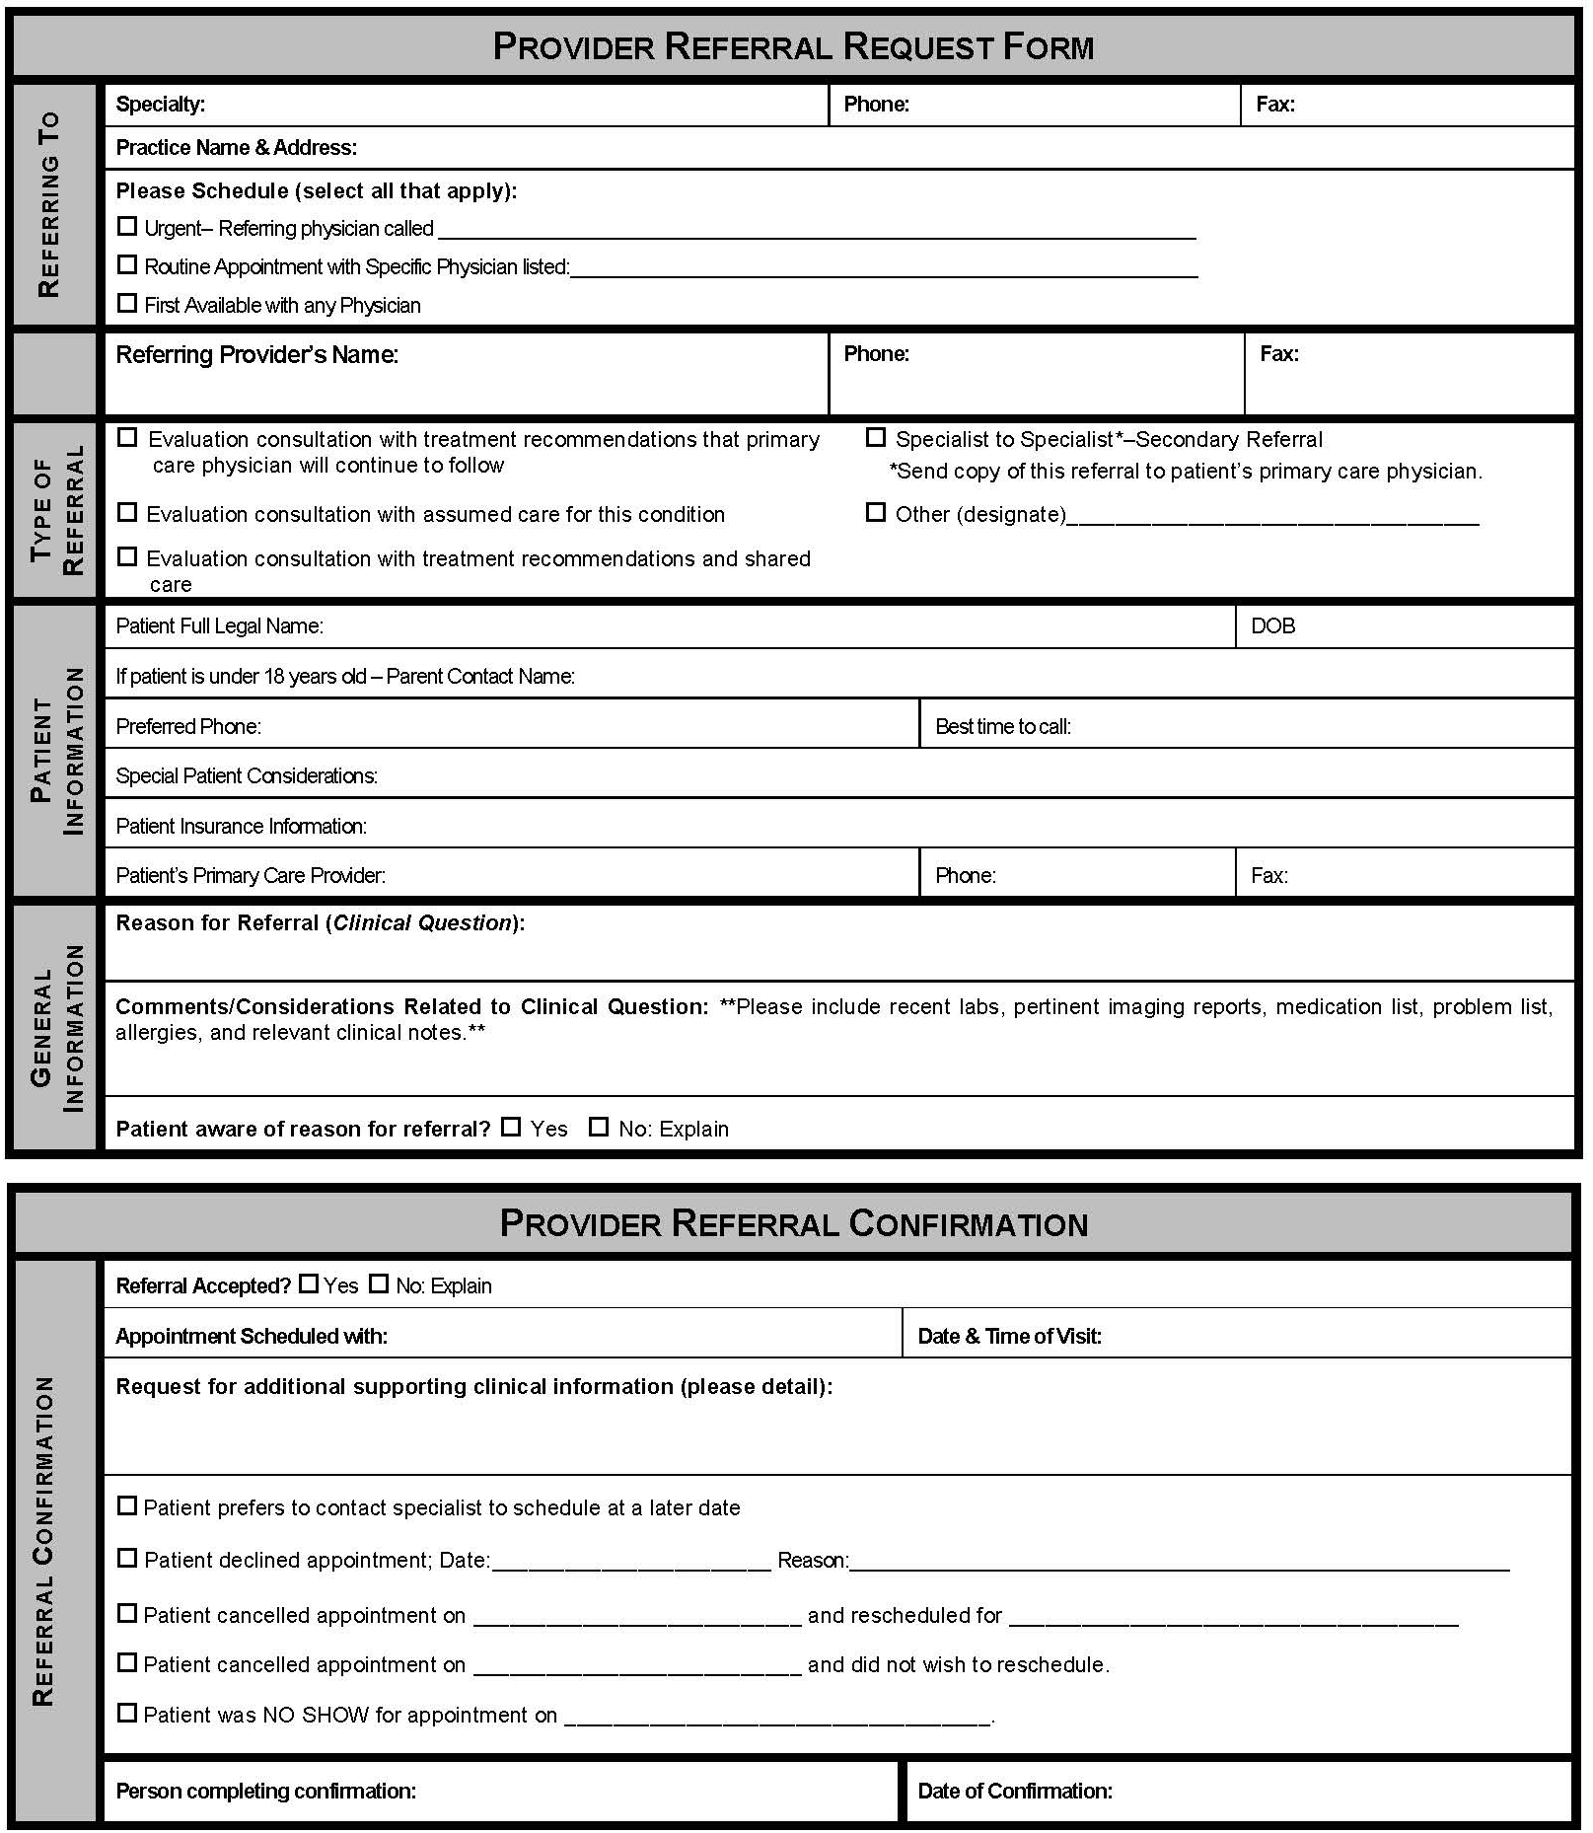
Example of System-wide CCA for IPA
(Independent Physicians Association)
    Focus on Referral Process :
    Referral Request
      Clinical question
      Supporting data
    Prepared Patient
    Referral Response
      Address clinical question
    Referral Tracking
    Confirmation of appointment or decline (redirect) referral
    Notification of No Show or Cancellation

Slide 14
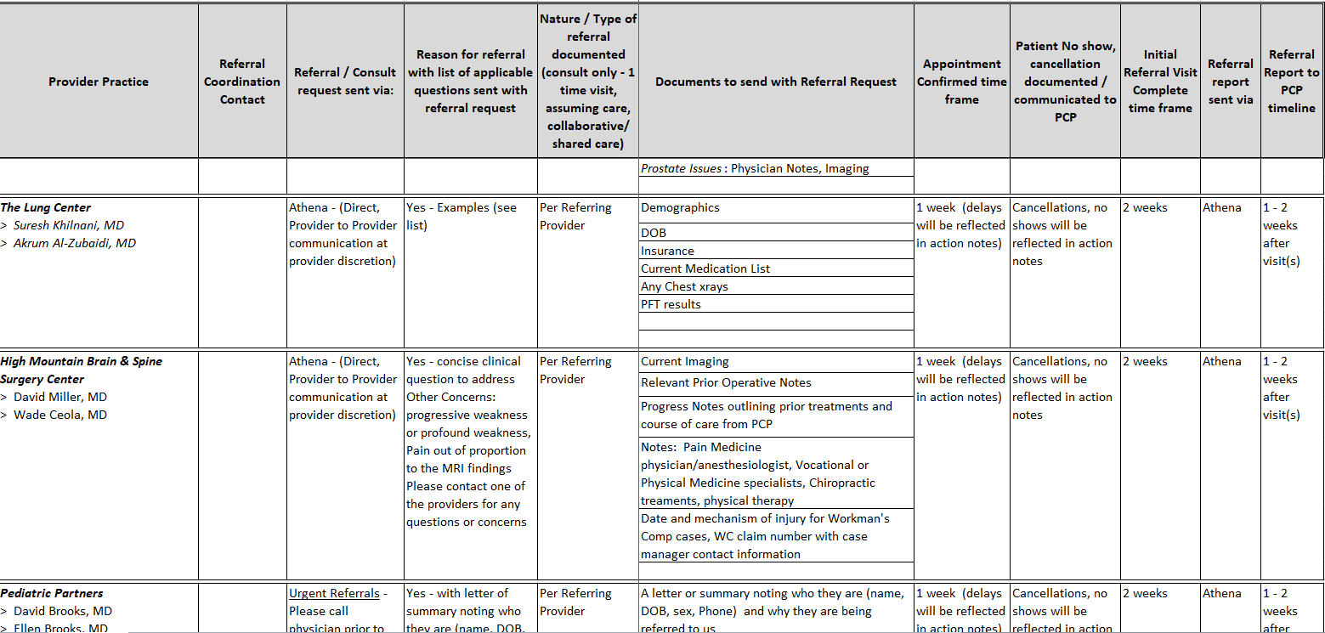

Example of System-wide CCA for Employed Multi-Specialty Physicians group

Slide 15
Wide Specialty Referral Base
Most specialists have a wide geographic referral base
Large institutions & Academic Medical Centers
  Many, if not most, referrals come from outside the “system” or institution
Private practice or smaller institutions
  Patients come from distant locations & a variety of referral sources
  Consider a Unilateral Care Coordination Agreement

Slide 16
Example of Unilateral CCA
PLEASE SHARE THIS WITH YOUR PHYSICIANS AND ADVANCED PRACTICE PROVIDERS
We want to provide you with value-added and appropriate assistance with your ENDOCRINOLOGY referrals. Please note the requested information. Feel free to use your own referral form but please do include as much of the information as possible to help us expedite your patient’s referral.
Providing a summary of the issues necessitating referral or a clinical question will help us ensure that we address the appropriate concerns and also will help us triage the referral.
Every referral request is reviewed by the staff and our physician upon receipt.
We may ask that you do some additional testing prior to referral to prevent delay or to further define the process for your patient.
We want to be sure that you and your patient get the advice and assistance to care that is requested. We are working to align our referral response to meet those aims. We will do our best to tie into any CARE PLAN that has been established for the patient and to outline any endocrine care plan or action plan items. As we all know, this is a work in progress for all of us and please feel free to let us know if there are additional items or a different format that would be of more help to you in coordinating the care of our common patients.
Sincerely and Thank You,
Carol Greenlee MD and the staff of Western Slope Endocrinology

Slide 17
Demographics
Full Legal Name: _______________________________________________DOB: ______________________
Home Phone: _____________________ Cell: _____________________ Work: ________________________
Referring Provider: ____________________________________________ Phone: _____________________
Referral Information
Clinical Question or Reason for referral (summary is helpful):
Type of Referral requested:
___Medical Consultation: Evaluate and advise with recommendations for management sent back to me
___Co-management: I prefer to share the care for the referred condition (PCP lead)
___Co-management: Please assume principal care for the referred condition (Specialist assumes care)
___Have Specialist determine which is most appropriate after their assessment of the patient
Is this routine____ or urgent____? ⁭
If urgent please indicate why and consider calling Dr. Greenlee to help us expedite care.
Is the patient aware that they have been referred to us and why? ___________________
Are there any special needs such as issues with mental competence, language or physical issues?
Is the patient the contact person? ______ If not, who is? __________________________________
Please include clinical data that is pertinent to the referral:
The patient’s core medical information (Demographics, Medication list, Allergy list, Problem list, etc)
Labs
Radiology reports
Clinical notes
Any additional medical history that is useful
If you have a CARE PLAN on this patient, please attach

Slide 18
Western Slope Endocrinology Referral Form (“CCA”)
We will call the patient to schedule the appointment if appropriate and will notify you of the appointment date and time.
We will also notify you if we determine that the referral is not appropriate for our practice or if we are unable to schedule the patient.
We will send a referral response note usually within 2-3 days of seeing the patient. We most often send this by fax from our EMR.

Slide 19
Referral Request Elements Before & After Unilateral WSE CCA Referral Form
Basic Data
Clinical Question/RfR
Pertinent Data
Notes:
WSE = Western Slope Endocrinology (private solo endocrinology practice)

Slide 20
Primary Care Unilateral CCA
Wrap it into the referral request (spell it out)
38 yo female with suppressed TSH confirmed on repeat testing along with elevated fT4 (see attached), please evaluate for cause of hyperthyroidism and help with selection of most appropriate treatment option
Patient is in care management, she has unreliable phone & transportation services, please contact her care manager Ginger Rogers at 123-456-7890 for help with scheduling any tests or imaging
Please contact us before any secondary referrals
  Patient is under controlled substance agreement
  She is in CO Medicaid Prime plan (Value Based-Shared Savings plan)

Slide 21
Take a minute …
Does the practice already have some form of formal or informal care coordination or referral agreements with another practice now?
  If so, would it benefit further by adding referral tracking, pre-consultation or secondary referral guide
With which other practice(s) would establishing a care coordination or referral agreement be beneficial?
  What type of agreements (one-on-one or system-wide) might be best to start with in your situation?

Slide 22

Getting Started
Decide what to include in the Care Coordination Agreement
  Start with basics (elements of good referral process)
  Include critical issues that need to be addressed
Have a conversation
  “we really enjoy seeing your patients/we so appreciate your help with our patients…it would help us if…” or
  “we want to be sure you are getting what you need…”
Decide on forms
  Serves as checklist, helps with team care around referral

Slide 23


Basics that Benefit
Having a conversation
  Defining needs
    Many misperceptions
  Benefit of discussing issues/working together
“Forms”- “Formal” Agreement
  Defines the elements (reference, enduring, modifiable)
  Reinforces/encourages completeness (“compliance”)
    “Hard stop” for clinical questions
    “Patient informed” check box
    Enhances tracking & team roles

Slide 24
What is Included in the Care Compact ? (start with the basics)
Preparation of the patient / pre-consultation
Type of referral /role of the specialist
Provide a clinical question with all referrals
Core data set to accompany all referral.
Pertinent supporting data for the referral
Communication protocol
Critical elements of the referral response
Protocol for making appointments
“Closing the Loop” protocol
.

Slide 25

Connecting the Agreement Pieces
The Referral Request checklist elements
  Scheduling protocol
  Close the loop referral tracking
The Referral Response checklist elements
Referral Guidelines
  List of urgent-intermediate-routine referral conditions
  Pertinent data sets / referral guidelines for what information is needed for specific conditions
Agreement on how to handle secondary diagnoses
Specifications on making secondary referrals

Slide 26
Template Care Coordination Agreement
PCP / Requesting
Neighbor / Responding
Prepare patient
  Use of referral guidelines where available
  Patient/family aware of and in agreement with reason for referral, type of referral, and selection of specialist
  Expectations for events and outcomes of referral
Provide appropriate and adequate information*
  Demographic and insurance information
  Reason for referral, details
  Core Medical Data on patient
  Clinical data pertinent to reason for referral
  -- Any special needs of patient.
Indicate type of referral requested:
  Pre-visit Preparation/Assistance
  Consultation (Evaluate and Advise)
  Procedure
  Co-management with Shared Care
  Co-management with Principal Care
  Full responsibility for all patient care
* See provided model check list of suggested areas to address.
Review Referral Requests and Triage According to Urgency
  Reserve spaces in schedule to allow for urgent care
  Notify referring provider of recognized referral guidelines and inappropriate referrals
  Work with referring provider to expedite care in urgent cases
  Verify insurance status
  Anticipate special needs of patient/family
  -- Agree to engage in pre-referral consult if requested.
  _ Provide PCP with number for direct contact for urgent/immediate matters.
Provide appropriate and adequate information in a timely manner*
  To include specific response to referral question; verify type role; any changes to diagnosis; medication; equipment; testing; procedures; education; referrals; follow up recommendations or needed actions
* See provided model check list of suggested areas to address.
12

Slide 27
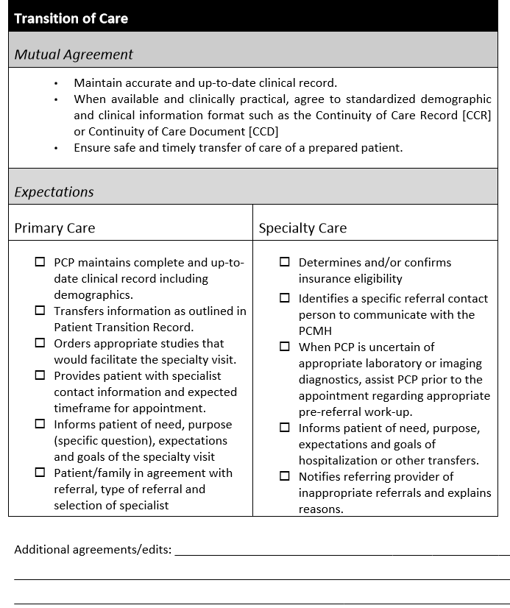
Example Guide for Care Coordination Agreement
The Mutual Agreement section of the tables reflect the core elements of the PCMH
and Medical Neighborhood
and outline expectations from
both primary care and
specialty care providers.

Slide 28
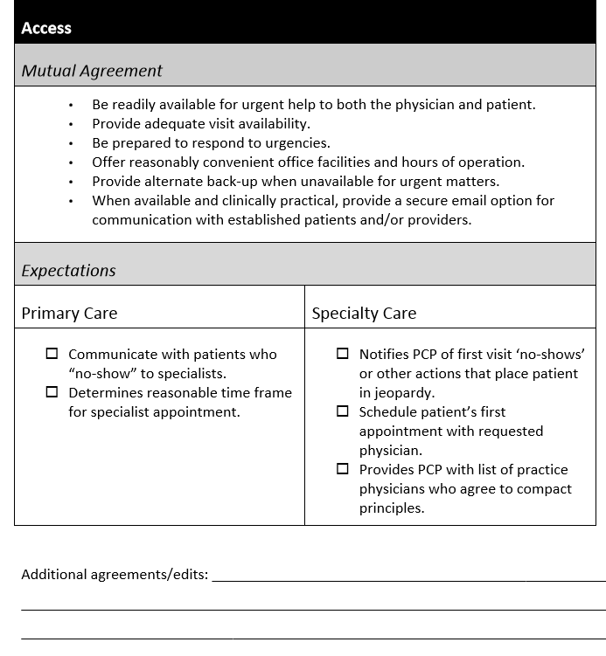

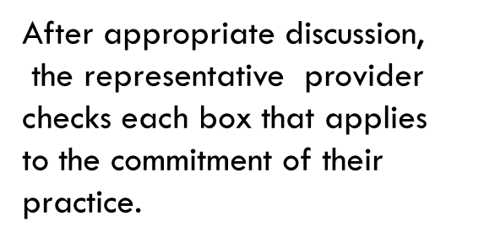
Example Guide for Care Coordination Agreement
The Expectations section of the table provides flexibility to choose what services can be provided depending on the nature of your practice and the working arrangement with PCP or specialist
Provides an area to add, delete
or modify expectations

Slide 29

Put it in action….
Identify another practice or practices that would be good to establish a care coordination agreement with
Have prepared offers & requests of what the practice can provide and what they would like the other practice to provide
  Include what might be made available through EHR
Set up meeting with the practice teams or representatives from both practices
Mutually discuss and determine what needs to go into the agreement

Slide 30
As you listen …
Think about how having care coordination agreements and improving the referral process can improve access to specialty care
  Consider ways this might help access to the practice or clinic you are working with
Think about which patients might be able to “graduate” from specialty care back to primary care
  Help the practice identify and develop a process

Slide 31

Defining “Access” to Health Care
Defined by IOM in 1993:
Access to health care = having "the timely use of personal health services to achieve the best health outcomes"

Slide 32
Timeliness
The health care system's ability to provide health care quickly after a need is recognized.
Measures of timeliness include:
  Availability of appointments and care for illness or injury when it is needed
  Time spent waiting in doctors' offices and emergency departments (Eds)
The delay in time between identifying a need for a specific test or treatment and actually receiving those services can negatively impact health and costs of care.

Slide 33

Some issues with “Access” to Health Care
IOM 2001 Crossing the Quality Chasm
“A highly fragmented delivery system…[with] long waiting times and delays…”

Slide 34
The Current State – Wait Times
Average wait time for new patient appointment:
  24.1 days (32.2 days for a dermatologist)
    based on the Merritt Hawkins 2017 survey (a 30% increase from 18.5 days in 2014)
Not the experience for many systems and communities:
  One system had wait times of 11 months for gastroenterology, 10 months for nephrology and 7 months for endocrinology
  One community had an average wait time for a new specialty care appointment of 19 weeks (> 4 months) –
    with 30% waiting >6 months and 6% waiting > 1 year

Slide 35
Effects of Delay
Worsening of referred condition
  Use of more medication & ED services
  Treatable conditions no longer treatable
  Higher mortality rates
Need to repeat testing due to delay (outdated results)
  38% of all patients; 50% if waited > 6 months
Patient-reported aspects (while waiting):
  50% worried about undiagnosed condition
  30% had symptoms interfere with activities
  24% had to miss work or school

Slide 36
Improved Referral Process → Improved Access
Fewer inappropriate referrals (8% of referrals -average 43/specialist/year)
  Pre-consultation request & review processes
  Adequate referral information
Fewer No Shows
  Prepared patient- participant in care
Fewer extra (additional) follow up appointments needed (60-70% of referrals to specialist lack information)
  High Value Referral Request with clinical question & data
  Referral guidelines (pertinent data sets)
  Pre-consultation request & review processes

Slide 37
Reduction in Delay by Reducing Unnecessary Care
Using pre-consultation review & care coordination agreements, my solo specialty care practice:
  Reduced inappropriate referrals into my practice from ~20% to 0%
  Reduced insufficient information at the time of the referral appointment from 70% to <5%
    Reduced need for an additional follow-up appointment
  Reduced wait time for routine new referral appointments by over 2 months (~4.5 months to ~ 2months)

Slide 38
Improved Referral Process- Improved Access
Just by improving the referral process(including pre-consultation request & review process) for high value referrals- improve access
If able to add in use of “e-consults” (virtual clinician-to-clinician assistance)- even further improvement to access

Slide 39
E-consult vs Pre-consult
E-consult = a referral that would have needed to be face-to-face if e-consult had not been available but was no longer needed because of advice received through the e-consult process
Pre-consult = referral not medically necessary (no further assessment or management needed) or very straight-forward help (reassure) or needs a different specialty type (redirect) or preparation for face-to-face

Slide 40
Examples from Dermatology (“tele-derm”)
Pre-consultation
E-consultation
  Referral asking “how soon do you need to see this patient?” with photo of skin lesion to “r/o Melanoma”: Review by dermatology identifies it as benign (e.g. seborrheic keratosis);
    requesting practice notified & patient receives reassurance (no dermatology appointment needed)
a skin eruption with which the referring clinician may not be familiar but which dermatology clinician recognizes (e.g. nummular eczema)
  able to provide adequate suggestions for treatment; the patient is started on the correct treatment and responds, a visit to Dermatology is avoided

Slide 41

Non-Face-to-Face Consultation
(Virtual -including e-Consultations)
Reduce unnecessary specialty visits
Streamline patient care decisions
Educational function
Key Elements
    Answer clinical question, and tailor to specific patient characteristics
    Non-binding…convert eConsult to standard visit if too complex
    Compensated time and effort
    Exchange records and responses
      Documentation: “Based on the information I received, I recommend…” (can ask for more info- iterative process)

Slide 42
Formal Consultation
Cognitive consultation (advice)
  To obtain specialist’s opinion on a patient’s diagnosis, abnormal lab or imaging study result(s), treatment or prognosis
  Limited to one or a few visits that focus on answering a discrete question.
    e-Consultation: provide advice/recommendations without an office visit (clinician to clinician) - virtual
  Reduces wait time (delay) for both the patients receiving the e-consult advice & the patients needing face-to-face referral appointment

Slide 43
Wait Times for Specialty Appointments at SFGH: before & after Pre- & E-consultations
Courtesy
E. Murphy SFGH
Notes:
Required components of a good referral process, including a clinical question

Slide 44
SFGH – e-Referrals & Referral Disposition
Scheduled immediately for face-to-face appointment
  60% (50-82%) by surgical and women’s health reviewers
    Vs 48.6% (27-76%) by medical sub-specialties
      Highest Neurology & rheumatology;
      Lowest Endocrine, Allergy, Hematology & Hepatology
  66% by NP reviewers
    Vs 50.9% by Physician reviewers
Scheduled after Pre-consultation exchange: 7-35%
Pure e-consultation: 7.7-59.3%
Reviewers “paid” 10% FTE or 4 hours/week: including Pre & E-consult work
Notes:
Tuot DS,et al. Leveraging an electronic referral system to build a medical neighborhood. Healthcare (2015), http://dx.doi.org/10.1016/j.hjdsi.2015.04.001i

Slide 45
Ottawa Hospital- Factors for Success for e-Consults
% avoided face-to-face referral
  Specialty Type
    Dermatology 49.5% / Hematology 46.5%/ Endocrinology 45%
    Vs Rheumatology 24.1% / OB GYN 28.2% / Neurology 30.8%
  Clinical Question Type
    What should I do / what would you do? - 44%
    Specific issues desired to be addressed - 30 to 47%
    Vs Does this patient need a referral ? - 25%
    Reviewers paid $200/hour pro-rated; includes e-consult work
Notes:
Telemedicine and e-health March 2016, vol. 22, no.3 Impact of Question Content on e-Consultation Outcomes

Slide 46
E-Consult project at UCSF
72 hour expectation
Specialist can convert to a scheduled visit for case complexity
Fielded by mid/senior-level specialist
0.5 wRVU payment to Specialist
0.5 wRVU credit for PCP (toward productivity)

Slide 47
E-Consult Drivers
Patient Perspective
I have a problem today
Another appointment can be a challenge:
  Missed work / arrange child care
  Out of pocket costs:
    Co-pay
    travel
    parking
        = $50+

Slide 48
E-Consult Drivers
PCP Perspective
Quick access to specialty guidance
A new specialist = more care coordination
I know the patient and scope of the question
Sometimes I want to own the problem
I know the family / I speak the language
Physician visits are a hardship
The patient may not follow through with a specialty visit

Slide 49
Clinician Surveys
Specialist Survey
  65% “strongly agreed” that the e-Consult question was clear
  61% “strongly agreed” that the question was of “optimal complexity”
    14% converted by specialist to in-office visit
Primary Care Survey
  83% “strongly agreed” that the e-Consult response influenced their care plan

Slide 50
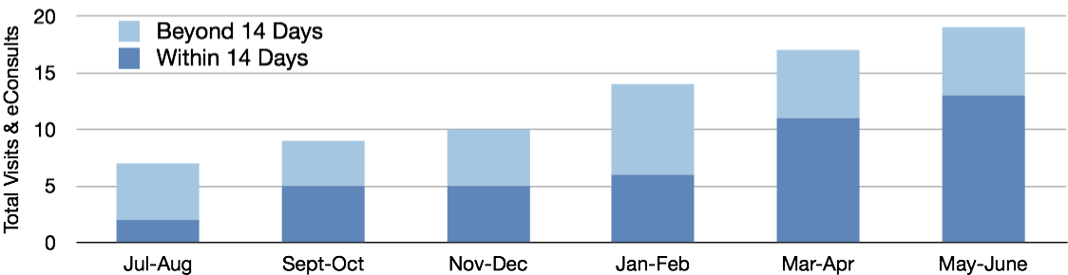
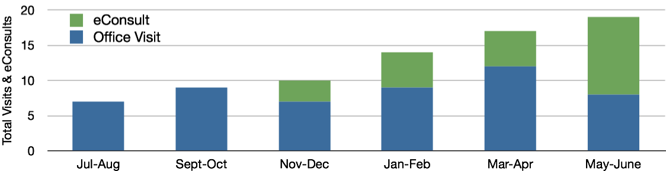
Access to Care: Infectious Diseases
Care Provided by UCSF I.D. for Core Population:
eConsults & New Patient Visits
Care Provided by UCSF I.D. for Core Population with 14-Day Target
(Office Visit + eConsult)

Slide 51

Consider …
Just by improving the referral process(including pre-consultation request & review) for high value referrals → improve access
What other opportunities are there to open up access for patients needing specialty expertise and care?

Slide 52
Among Referred Patients, Type of Work Done by Specialists in the US (Data are from the 2002-2004 NAMCS)

Slide 53


Opening Access through “Graduation”
Transition back to primary care for management
Patients with minor or resolved issues
  Especially if based on new approach, those issues could have been handled by pre- or e-consultation
Patients who were referred with an unstable condition that are now stable and are appropriate for management by their primary care team
Patients for whom additional specialty testing and treatment are no longer indicated (e.g. appropriate for move to palliative care or hospice)
Roles are fluid based on changes in the patient or the condition
Notes:
Patients often get ‘stuck” in specialty care and that contributes to reduced access: can graduate to shared care or back to management by PCP

Slide 54
Put it in action….
Look at the wait time for routine new patient appointments or follow up appointments to the practice or clinic
Ensure use of Pre-consultation review to sort out referrals that are inappropriate & to be sure referred patients see are prepared (high value)
Consider which patients / conditions are suitable for “graduation” (transition from specialty care to primary care management of the condition)

Slide 55

Leave in action….
Develop a Care Coordination Agreement
  Work with at least one referring or referred to practice
  Develop expectations & agreement of the elements to be included in a Referral Request & Referral Response for all referrals
  Consider including referral guidelines for specific conditions
Utilize the High Value Care Coordination referral processes to maximize access to the clinic or practice
  Monitor to be sure that efforts are sustained
  Follow wait times & track referrals

Slide 56
Materials for Action Step 4
Sample / model templates for Care Coordination Agreements
www.acponline.org/hvcc-training

