Slide 1
Connecting Care Ensuring Quality Referrals and Effective Care Coordination
the Medical Neighborhood
Action Step #2
Ensure the Specialty Practice Gets What is Need for a High Value Referral
ACP SAN special project
for implementing
High Value Care Coordination
Carol Greenlee MD FACP and Beth Neuhalfen

Slide 2
The ACP SAN High Value Care Coordination curriculum
Action Steps to Connected Care
Look at your internal referral process (get your own house in order)
Ensure the specialty practice gets what is needed for a high value referral
Ensure the others (patients, the requesting practice and any secondary care) get what they need
Develop Care Coordination Agreement(s) (compact) with appropriate referring practice(s)

Slide 3
As you listen…
Think about what is needed with a referral request to provide the most appropriate care for the referred patient, including:
Appropriate urgency of the referral appointment
Addressing the referral problem & patient’s goals
Reducing waste or unnecessary resource use for the patient, the practice and the health care system

Slide 4
The Referral Request
Patient in exam room with cc/o “fatigue” (or “lungs” or “heart” or “anemia” or “pain”…)
Not sure what testing was done or treatments tried before referral
Start over or
Ask front desk staff to call the referring practice to get
records faxed/sent…

Slide 5
Try to get patient records at time of specialty care referral appointment …
Interrupt specialty staff, ask them to call primary care & keep calling (specialty staff time diverted)
If get through, ask PC staff to stop everything they are doing to send records
Often requires use of fax (even if fax to EMR) and if fax machine is busy on either side, adds delay
Specialty Care clinician looks through records while trying to talk to patient & do exam
If records arrive after the appointment -> back end work, missed critical elements, wrong pathway, etc.

Slide 6
Surveys show this scenario is all too common
68% of specialists reported receiving no information from the primary care provider prior to referral visits;… and if they received info… 43% of specialists were dissatisfied with the information they received Gandi et. al. J Gen. Int. Med. 2000
Only 34.8% of specialists received notification of a patient's history and reason for consultation before the referral appointment (65.2% did not) O’Malley, AS, Reschovsky JD. Arch Intern Med. 2011;171(1):56-65
In Colorado, 37% of specialists receive necessary information (63% do not) Systems of Care survey, Colorado Medical Society

Slide 7
Ensure the specialty practice gets what is needed for a high value referral
Three (3) Action Items:
Basic Elements of a Referral Request
Referral Criteria
Risk Stratify Urgency
Pertinent Data Set (referral guidelines)
Pre-consultation /Pre-visit review process

Slide 8
1st Define the Basic Elements of the Referral Request
Check list for a high value Referral Request
Patient Demographics & Scheduling Information
Referral Information
Patient’s Core Data Set
Care Coordination/Referral Tracking

Slide 9
Patient Demographics and Scheduling Information
Name, demographics, contact info, surrogates
Special considerations (impaired hearing, vision, cognition, etc..)
Insurance information
Referring clinician/practice name, contact info (including direct contact for urgent matters)
Indicate that patient/surrogate understands and agrees with the purpose of (and type of) referral
Educational material for patient (on disorder or specialty)
Information about the specialty practice (logistics, contact info, etc.)
Indicate whether
Patient should call to schedule
Specialty practice should contact the patient

Slide 10
Incomplete Referrals - “too little, too late”
20 year old male comes in with parents asking for help with drug & alcohol use disorder
Referral sent to Behavioral Health
Behavioral Health has policy that patient himself must call to schedule appointment
After 5 weeks with no appointment patient was hospitalized with severe head trauma after a roll-over accident while driving under the influence …
Up to 50% of referrals are never completed
Never scheduled
No Show / Cancellations
Poor referral tracking leads to inappropriate re-referrals, inefficient care, worse patient satisfaction, and malpractice lawsuits
20% of malpractice claims for diagnosis error involve referral communication deficits
Notes:
Gandhi 2006

Slide 11
Define the protocol for making appointments
The expected protocol:
The patient will call to schedule an appointment (if opt for this, still need a protocol)
The specialty practice should contact the patient
Allows for Pre-visit assessment/referral disposition
Allows for tracking of referrals / accountability

Slide 12
Referral Information
What is the specific clinical question (reason for referral)
A brief Summary of case details pertinent to the referral, include relevant co-morbidities (alarm signs or symptoms)
Urgency (referral status or referral priority)
Referral Type (anticipated, pending specialist’s evaluation) (Referral Definition or Role in care requested of the specialist)
Pertinent data set: Clinical information directly relevant to the specific referral question (office notes, test results, etc.) (Supporting data for the referral)

Slide 13
Provide a Clinical Question (or summary of reason for referral) with all referrals
“eyes” “gallbladder” “diabetes”
68 year old female with intermittent double vision. Is ophthalmopathy assessment the correct starting point?
39 year old female with severe RUQ pain, abnormal US and known diabetes, does she need surgery?
20 yo female with T1DM since age 8 on insulin pump therapy, transferring from pediatric to adult care

Slide 14
Summary of Case Pertinent to the Referral
Clinical question or reason for referral & summary: & “
Help introduce the patient’s story
“Please help determine which next treatment option is best suited for a 62 yo first grade teacher who has had diabetes for past 10 years. She was allergic to SU; had diarrhea with metformin, edema with Pioglitazone and is now on Long Acting insulin 60 units once daily with widely fluctuating glucose levels and A1c of 10.2%. She is reluctant to check her BG or take injections during the work day due to working with children and the demands of school teacher.” ( note: this also “turns the patient into a person”)

Slide 15
Referral Type (What is the suggested role of the specialist)
____ Pre-visit Advice / Pre-consultation
____ Non Face-to-Face (e-) consultation
____ Consultation (Evaluate and Advise, with the goal of managing the problem remaining with the referring clinician)
____ Procedural Consultation
____Co-Management with Shared Care (Referring clinician (e.g. PCP) maintains first call for the referral disorder)
____ Co-Management with Principal Care (Referred to subspecialist/specialist assumes first call for the referral disorder)
____ Please assume Full Responsibility for Complete Transfer of all Patient Care (e.g .Pediatric to Adult care transition)

Slide 16
Formal Consultation
Cognitive consultation (advice)
To obtain specialist’s opinion on a patient’s diagnosis, abnormal lab or imaging study result(s), treatment or prognosis
Limited to one or a few visits that focus on answering a discrete question
e-Consultation: provide advice/recommendations without an office visit (clinician to clinician)
Procedural consultation
To obtain a technical procedure for diagnostic, therapeutic or palliative purposes
Include detailed report back to referring physician
Examples: MRSA infection with recurrent carbuncles, Surgery, Colonoscopy, Bone Marrow Biopsy,

Slide 17
Non-Face-to-Face Consultation (including e-Consultations)
A referral that would be needed as a
face-to-face consult if e-consult was not
available but no longer needed when advice
received through the e-consult process
Key Elements
Exchange records and responses
Documentation: “Based on the information I received, I recommend…”
Answer clinical question, and tailor to specific patient characteristics
Convert eConsult to standard visit if too complex
Compensated time and effort

Slide 18
E-consult Dermatology (“tele-derm”) example:
A straightforward problem that can be addressed so the referring provider is able to treat or reassure the patient without a subsequent appointment to Dermatology. Example:
Skin eruption with which the referring clinician may not be familiar but which dermatology clinician recognizes (e.g. nummular eczema)
Can provide adequate suggestions for treatment; the patient is started on the correct treatment and responds, a visit to Dermatology is avoided

Slide 19
Co-Management (ONGOING management of a patient’s medical condition)
Shared Care for the disease
(PCP responsible for Elements of Care, takes ‘first call’)
Principal care for the disease.
(Specialist responsible for Elements of Care for that disorder or set of disorders, takes ‘first call’ for the disorder)
Principal care of the patient for a consuming illness for a limited period of time
(Specialist serves as first contact but patient maintains PCP as medical home/ hub of care)

Slide 20
Patient’s Core (general) Data Set
Active problem list
Past medical and surgical history
Medication list
Medical allergies
Preventive care (e.g., vaccines and diagnostic tests)
Family history
Habits/social history
List of providers (care team) (other specialists caring for patient).
Advance directive;
Overall current care plan and goals of care
Pain Contracts
Care Management
Behavior Health

Slide 21
Referral Tracking “Closing the Loop” protocol
Referral request sent, logged and tracked & acted on
Referral request received and reviewed
Referral accepted with confirmation of appointment date sent back to referring practitioner
Referral declined due to inappropriate referral (wrong specialist, etc) and referring practice notified
Patient defers making appt or cannot be reached and referring practice notified
Referral response sent (must address clinical question/reason for referral)
Referral Note sent to referring clinician and PCP in timely manner
Notification of No Show or Cancellation (with reason, if known)

Slide 22
The Referral Request Elements
Applies to ALL referral requests- whenever a patient is referred to another clinician or service:
Primary Care to Specialty Care (including Behavioral Health, Radiology, Pathology and Hospital Medicine)
Specialty to Specialty (“Secondary Referrals”)
Specialty to Primary Care
ED to Primary or Specialty Care
Primary or Specialty Care to Ancillary & other services (Diabetes Ed, Physical Therapy, Nutrition, etc..)
Agree to supply what is needed for High Value Care

Slide 23
Ideal: “Synoptic” Referral Request
Clinical question or reason for referral: Please help determine which next treatment option is best suited for a 62 yo first grade teacher who has had diabetes for past 10 years. She was allergic to SU; had diarrhea with metformin, edema with Pioglitazone and is now on Long Acting insulin 60 units once daily with widely fluctuating glucose levels and A1c of 10.2%. She is reluctant to check her BG or take injections during the work day due to working with children and the demands of school teacher.”
Urgency: intermediate
Type of Referral: Shared co-management
Core Data: attached
Pertinent Data: lab flow sheet attached
Patient considerations: Please call after 3 PM due to work hours
Contact for more info: back line number is 123-456-8901

Slide 24
Put it into action….
For Primary Care
Use this checklist to ensure the referral requests provide the information needed for high value care coordination
For Specialty Care
Use this checklist to ensure they are getting what they need from others (as part of your Pre-consultation review)
When/if they send “secondary referrals”, use this checklist to ensure they provide the needed information with the referral the request
The Referral Request checklist will be part of the Care Coordination Agreement that they will develop

Slide 25
2nd Establish Referral Criteria / Guidelines
Timing of the referral request and appointment
urgency or priority for scheduling expectations - urgent, intermediate/move up and routine (“risk stratification of the referral needs”)
Supporting data needed for the particular referral condition
“pertinent data sets” / referral guidelines for referral conditions

Slide 26
A large specialty clinic…
Patients are booked on an “as come” (first call, first booked) basis
If patient is urgent & requesting clinician is concerned, s/he calls the specialist who tries to work(squeeze, cram) the patient in over lunch break …

Slide 27
Prioritize / Risk Stratify the Referral Needs
What is the Urgency or Priority for the referred condition : (Referral status)
Specialty Care practice - determine urgency of referral needs for commonly referred conditions or patient types
Create list of Urgent-Intermediate-Routine conditions for the specialty care practice referral care team
does not need to be all inclusive- this is a guide to assist with team care & the referral process – a starting point
can be modified based on individual patient context
Include: “if not sure, ask”

Slide 28
Examples from my practice:
Urgent conditions
Move Up (Intermediate)
Pregnancy & diabetes
Pregnancy & thyroid
Hyperthyroidism
New thyroid cancer
New onset T1DM
DM with frequent/severe hypoglycemia
New dx Addison’s disease
Pituitary mass with vision loss
Diabetes out of control
Hypercalcemia
Pituitary
Adrenal
PCOS
Weight gain
Low T
Hypothyroid not feeling well
Routine

Slide 29
Risk Stratify the Referral Needs
Specialty Care practices could consider sharing the list with referring practice(s) as part of their Care Coordination Agreement
The requesting practice is asked to communicate regarding the perceived urgency of the referred condition;
Other clinicians often have different perceptions of urgency than the specialty practice (e.g. Hyperthyroidism as routine referral request vs urgent referral needs)
Helps avoid use of “urgent” to get patient in sooner for non-urgent needs

Slide 30
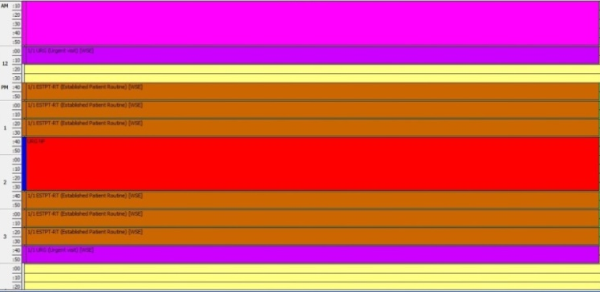
Schedule Based on the Referral Needs
Specialty care practices need to have a mechanism to schedule patients in accordance with their referral needs / risk status
Reserved Urgent spots (“work the referral; work the schedule”)
On-call clinician to see patients with urgent referral needs
Other options
Urgent

Slide 31
Triage (Risk Stratification) and Tracking
Urgent
Move up
Routine
Short Call

Slide 32
Working the Schedule
91% of patients would come on short notice if contacted
Notes:
Study out of UK showed that 91% of patients would come on short notice / cancellation if given the opportunity & called(texted, emailed)

Slide 33
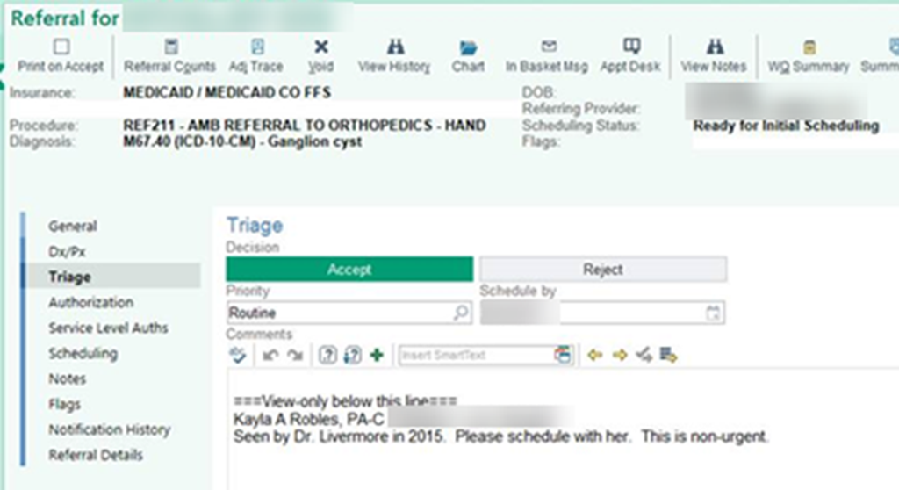
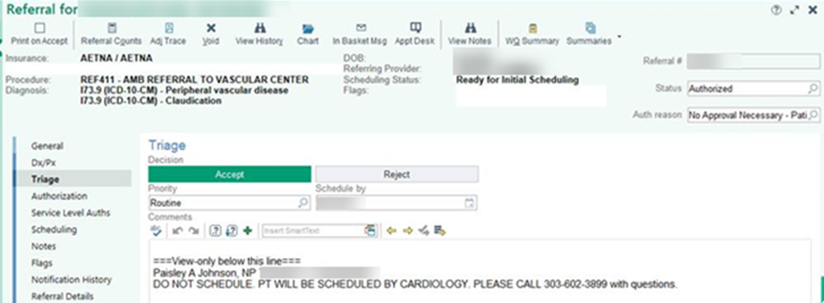

Slide 34
Put it into action …
Attach “risk stratification” referral urgency list as supplement to the Care Coordination Agreement as guide for referral requests
Specialty care teams can use the list for guidance on urgency of referral needs (priority) as part of the Pre-consultation review process for appropriate scheduling

Slide 35
“Backwards” care Inappropriate Care Two Cases from an Academic Medical Center
Patient comes for “uncontrolled” T2DM,
no A1C available (did not have POC A1C at AMC)
spent visit discussing insulin
subsequent A1C 7.1%
called patient to tell her to ignore everything we talked about and just adjust current oral regimen
Patient drove 3 hours for appointment to get FNA of thyroid nodule ,
no TSH available
Patient insisted the biopsy be done that day
biopsy done
TSH obtained
found to have suppressed TSH due to “hot” nodule (FNA not indicated)
Information Void – Value Void
Low Value Care (No Benefit/ Cost)

Slide 36
Supporting Data (Pertinent Data Set) for the referred condition
Pertinent to the clinical question or reason for referral (not data dump)
Adequate enough to address the issues (reduce duplication)
To allow the specialty practice to
determine if the referral is to the appropriate specialty
effectively triage urgency
effectively address the referral (enough info to do something)

Slide 37
Parameters for Pertinent Data Sets
The Pertinent Data Set / referral guideline should not create a significant burden for the requesting physician or practice
Should be a “minimal data set” for the condition
Process can be iterative –
use of pre-consultation process with pre-visit assistance to ask for more information or addition testing or therapeutic trial when indicated and appropriate based on individual case

Slide 41
Available Pertinent Data Sets

Slide 42
Develop Pertinent Data Sets for Referred Conditions
Identify 1 to 4 referral conditions
most common
most critical
most problematic (do not get needed info or get a lot of unnecessary info or get too late or too early)
Determine “pertinent data sets” for those conditions
What supporting data is critical
What is helpful but optional (attach results if already done but not necessary to do)
What is unnecessary or should not be done

Slide 43
Put it into action….
Use the Pertinent Data Sets / Referral Guidelines as part of Care Coordination Agreement with a requesting practice to improve the referral process
Specialty care practices can use their Pertinent Data Sets / Referral Guidelines for their practice team to help with Pre-consultation/ Pre-visit review to ensure needed information is received so to maximize the value of the referral appointment

Slide 44
As you listen…
Think about how investing in a Pre-consultation (Pre-visit review and assistance) process could help make the referral process
more patient-centered &
also save time & effort (resources) for the practice (reduce chaos at time of appointment & the back-end burden)

Slide 45
Antithesis of High Value Coordinated Care:
Common scenario #1:
60 yo woman was referred to surgeon Dr. Z by another specialist for a procedure. After a 3 month wait for the appointment, Surgeon Z. read her records as he walked in the room saying “I don’t do that procedure. You will need to go to XXX Clinic to get that done”.
Waste:
Delay: Progression of condition, harm
Non-value-added appointment for all in involved

Slide 46
Antithesis of High Value Coordinated Care:
Common scenario #2:
70 year old woman does not know why she was referred, PCP staff just told her to make appt, no records, only get into voice mail at PCP office
Waste:
Resources (duplicated testing, visit costs, time)
Access “jammed up” (delay of care…downstream effects)

Slide 47
Pre-consultation to the rescue !

Slide 48
What is Pre-consultation? (Intended to expedite & prioritize care)
A request for pre-visit advice and/ or assistance
Should not require in-depth analysis of the case
Can result in no need for further assessment or management
Can “evolve” into an e-consult or face-to-face appointment
A process of pre-visit review
To ensure appropriateness of the referral
To ensure adequacy of the referral information
To provide advice or assistance as needed for preparation for the referral appointment and interim care
Additional testing
Therapeutic trial
Interim care to stabilize while waiting for specialty care
Notes:
So just what is Pre-consultation? It is intended to expedite & prioritize care and there are essentially two forms of Pre-consultation. One is a Pre-consultation REQUEST which is a type of a referral request….

Slide 49
Pre-consultation Request for Pre-visit Advice and/or Assistance
Pre-visit preparation or assistance can take place before any type of formal referral & can include:
Request for guidance regarding whether referral is appropriate and/or necessary
Request for guidance on the urgency of the referral
Request for guidance for pre-visit work-up.
Through these interactions, patient care is optimized and cooperation & an educational process around that care occurs between the practices

Slide 50
I am referring this patient for:
___Pre-consultation/ pre-visit assistance/preparation
___Medical Consultation: Evaluate and advise with recommendations for management and send back to me
___Procedural Consultation: Specialist to confirm need for and perform requested procedure if deemed appropriate.
___Co-management: I prefer to share the care for the referred condition (PCP lead, first call)
___Co-management: Please assume principal care for the referred condition: (Specialist assumes care, first call)
___Please assume full responsibility for the care of this patient (Complete transfer of care)
Notes:
It is helpful to have Pre-consultation on the referral form in order to be clear that a Pre-consultation is being asked for with a referral request

Slide 51
Examples of Pre-consultation requests:
Are these slightly abnormal thyroid function studies of concern? Do they need further evaluation?
If so, what additional testing do you want before the appointment
For referral to Nephrology for new patient evaluation for renal dysfunction, patient has had an Abdominal CT scan,
Does patient still need Renal US before you will schedule?
Receive photo of skin lesion with referral asking how urgently patient needs to be seen to “r/o melanoma”
Review by dermatology identifies it as benign (e.g. seborrheic keratosis); requesting practice notified & patient receives reassurance

Slide 52
Response to a Pre-consultation Request
Clinician involvement is critical
Can indicate
No need for further assessment or treatment
Need for a different specialty type
Need for additional testing or therapeutic trial prior to referral
Need for formal face-to-face appointment
Simple issues amenable to recommendations per “e-consult” (virtual consultation clinician-to-clinician)
Can send response by faxed note (or even phone call) if shared or interoperable EMR is not available

Slide 53
Pre-consultation Review (“working the referral”)
Recommended for all referral requests
Review prior to scheduling patient
To ensure appropriate referral
Determine urgency of the referral
Ensure adequate information for high value referral
Can be a team process (with clinician oversight & availability)
Use of referral request checklist
Use of lists of urgent-intermediate-routine conditions
Use of referral guidelines/ pertinent data sets
Clinician review of outlier or complex cases

Slide 54
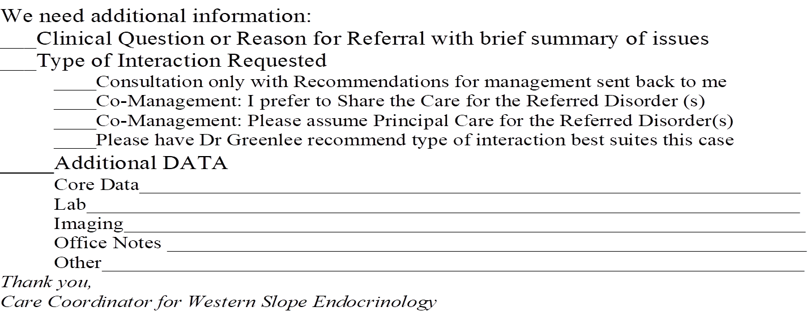
How do you request missing information?
Phone call to referring practice
Forms
Tracking system to ensure receive
It’s worth the investment in
time & effort up front to
prevent the chaos & disruption
and back-end mess & burden

Slide 55
Pre-consultation/ Pre-visit Review Check-list
Identify if referral is to appropriate specialty
If referred condition is better managed by a different specialty:
what process do you use to redirect the referral?
Who notifies the patient?
Identify if referral appointment is needed (indicated)
If further evaluation or management is not indicated
Explain why not indicated (e.g. “thyroid nodule guidelines” or ….)
Answer simple question that does not require formal consultation (e.g. “this does not require any treatment”)
Who notifies & explains to patient?
Need to know that referring practice has process for handling

Slide 56
Pre-consultation/ Pre-visit Review Check-list
Are the referral request elements complete?
Is the clinical question clear
Is there adequate & pertinent supporting data (pertinent date set)
Is the Core Medical Data set included
What is the urgency (risk stratification) of the referral needs?
Is the patient scheduled according to those needs

Slide 57
Recommendations for “Neighborly” Response to Pre-consultation Request or Review
“It appears this patient was referred for Lupus and would benefit more from referral to Rheumatology rather than Endocrinology. However, if there are endocrine issues that I failed to recognize and that need to be addressed, please let me know and we will schedule …otherwise we will defer scheduling at this time…”
“It appears that this referral is regarding a 4 mm thyroid nodule noted on thyroid ultrasound. Current ATA thyroid nodule guidelines indicate that no further evaluation is needed. If there are additional concerns that I missed, please let me know…otherwise, we will defer scheduling at this time” (consider “here is what the current guideline states [copy &paste]”)
Consider a call to clarify (and build the relationship and the process)
Avoid “deferred”, “not appropriate”, “reject”

Slide 58
Pre-consultation/ Pre-visit Review
Improves value of appointment for patients
Creates more time for interaction with the patient around the reason for referral or the clinical question
Improves resource utilization by both requesting & responding practices
Reduces stress and increases cooperation around caring for the patient
Improves access
Improves safety
Reduces waste

Slide 59
Put it into action….
For Primary Care
Consider a Pre-consultation Request for patients they need guidance on preparation for referral or if not sure about need for referral, type of specialty or timing
For Specialty Care
As they develop their Pre-consultation Review process
Use the Referral Request checklist
Use the urgency / priority lists
Use the Pertinent Data Sets / Referral guidelines

Slide 60
Leave in action….
Specialty Care Practices:
Create lists of conditions that are usually urgent, intermediate (move-up) or routine in priority (i.e. how urgent is the referral?)
Ensure the practice has capacity to schedule & see patients based on the urgency needs
Develop Pertinent Data Set / referral guidelines for at least one (1-4) conditions commonly referred to your practice (may use the Pertinent Data Sets on the ACP High Value Care website if applicable)
Develop a Pre-consultation process

Slide 61
Leave in action….
Primary Care Practices:
Utilize urgency guides created by specialty care practices to help direct timing of referral request
Provide direct contact (call) with the specialty care clinician regarding urgent cases
Utilize Pertinent Data Sets / referral guidelines to help ensure high value referral requests for your patients(may use the Pertinent Data Sets on the ACP High Value Care website if applicable)
Utilize Pre-consultation request when need clarity regarding the referral request

Slide 62
www.acponline.org/hvcc-training
Materials for Action Step 2
Outpatient Referral Request Checklist
HVCC Checklist for Developing Pertinent Data Sets / Referral Guidelines
Pertinent Data Sets developed by specialty societies
HVCC Pre-consultation Review Checklist

Slide 63
QIA checklist
If practices are already in process on Medical Neighbor efforts
Ensure that the practice truly has the process or element in place – check off
Fill in the missing elements or processes with the curriculum and tools
For difficult to engage practices- “create demand”
Are you having trouble getting what you need from a certain practice ? – let’s create a CCA / compact
Work backwards to create the CCA and then implement it in the practice

Slide 64
Recorded “Segments” of Action Steps
Action step 2
Action step 3
Action step 4
The Referral Request checklist
Referral Criteria
Urgency/priority of referral need
Pertinent data sets/ referral guidelines
Pre-consultation Request & Review process
Ensure the patient’s needs are met
Patient-centered referral process
Ensure the requesting practice needs are met
Referral Response Checklist
Referral Tracking-Close-the-Loop
Ensure High Value Secondary Referrals
Create a Care Coordination Agreement
Improve Access

