Slide 1
Connecting Care Ensuring Quality Referrals and Effective Care Coordination
the Medical Neighborhood
Action Step #2: segment 2
Establish Referral Criteria
ACP SAN special project
for implementing
High Value Care Coordination
Carol Greenlee MD FACP

Slide 2
As you listen…
Think about how to “risk stratify” the conditions referred to you as regards the urgency of the referral needs.
Consider whether or not your practice has a process to schedule patients in accordance with the urgency of their referral needs.
Think about which conditions referred to you could benefit from having defined referral guidelines of when to refer & what information to send with the referral (defined Pertinent Data Sets)

Slide 3
A large specialty clinic…
Patients booked on an “as come” (first come, first booked) basis
If patient is urgent and requesting clinician is concerned, s/he calls the specialist who tries to work them in over lunch break

Slide 4
Risk Stratify the Referral Needs
What is the Urgency or Priority for the referred condition : (Referral status)
Determine Urgency of referral needs for commonly referred conditions or patient types
Create list of Urgent-Intermediate-Routine conditions for your practice care team
does not need to be all inclusive- this is a guide to assist with team care & the referral process
can be modified based on individual patient context
Include: “if not sure, ask”

Slide 5
Examples from my practice:
Urgent conditions
Move Up (Intermediate)
Pregnancy & diabetes
Pregnancy & thyroid
Hyperthyroidism
New thyroid cancer
New onset T1DM
DM with frequent/severe hypoglycemia
New dx Addison’s disease
Pituitary mass with vision loss
Diabetes out of control
Hypercalcemia
Pituitary
Adrenal
PCOS
Weight gain
Low T
Hypothyroid not feeling well
Routine

Slide 6
Risk Stratify the Referral Needs
Consider sharing the list with referring practice(s) as part of your Care Coordination Agreement
The requesting practice is asked to communicate regarding the perceived urgency of the referred condition;
Other clinicians often have different perceptions of urgency than the specialty practice (e.g. Hyperthyroidism as routine referral request vs urgent referral needs)
Helps avoid use of “urgent” to get patient in sooner for non-urgent needs

Slide 7
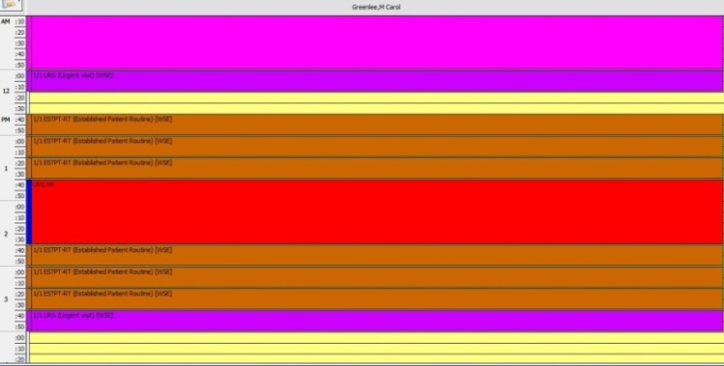
Schedule Based on the Referral Needs
Have a mechanism to schedule patients in accordance with their referral needs / risk status
Reserved Urgent spots (“work the referral; work the schedule”)
On-call clinician to see patients with urgent referral needs
Other options
Urgent

Slide 8
Triage (Risk Stratification) and Tracking
Urgent
Move up
Routine
Short Call

Slide 9
Working the Schedule
91% of patients would come on short notice if contacted
Notes:
Study out of UK showed that 91% of patients would come on short notice / cancellation if given the opportunity & called(texted, emailed)

Slide 10
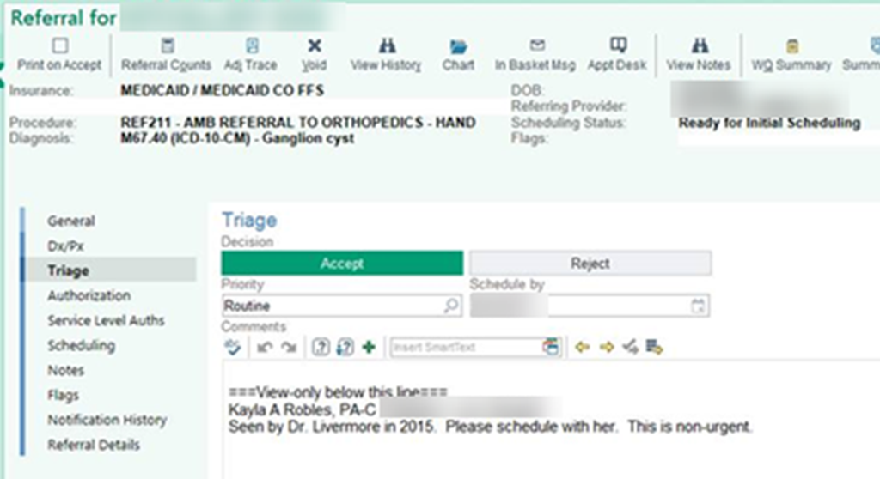
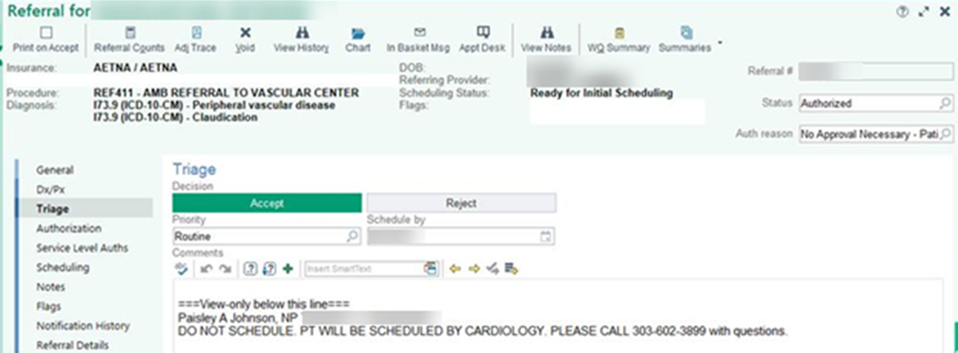

Slide 11
Put it into action …
Use the risk stratification list for urgency of referral needs (priority)
as part of the Care Coordination Agreement as guide for referral requests
as part of the Pre-consultation review process

Slide 12
Information Void Value Void Two Cases from an Academic Medical Center
Patient comes for “uncontrolled” T2DM,
no A1C available (did not have POC A1C at AMC)
spent visit discussing insulin
subsequent A1C 7.1%
called patient to tell her to ignore everything we talked about and just adjust current oral regimen
Patient drove 3 hours for appointment to get FNA of thyroid nodule ,
no TSH available
Patient insisted the biopsy be done that day
biopsy done
TSH obtained
found to have suppressed TSH due to “hot” nodule (FNA not indicated)
Disconnected / Uncoordinated Care
“Backwards” care…Inappropriate care
Low value care (no benefit /cost)

Slide 13
Develop Pertinent Data sets for Referred Conditions
Identify 1 to 4 referral conditions
most common
most critical
most problematic (do not get needed info or get a lot of unnecessary info or get too late or too early)
Determine “pertinent data sets” for those conditions
What supporting data is critical
What is helpful but optional (attach results if already done but not necessary to do)
What is unnecessary or should not be done
31

Slide 14
Pertinent Data set /Supporting Data for the Referred Condition
Pertinent (not data dump)
Attach the Abnormal labs or Imaging reports that may have triggered the referral
Attach past test results that might indicate change or progression (or put in brief summary)
Notes regarding symptoms, signs, discussions
Clinical information requested by the referred to specialty/subspecialty practice prior to a consultation regarding the specific condition(e.g. specific lab tests)
Adequate (reduce duplication)
Additional test results that may be needed and will prevent the specialist from unnecessarily repeating the test (e.g. a Creatinine level for referral for diabetes management)

Slide 15
Parameters for Pertinent Data Sets
Intended to provide information needed to allow the referred to physician/ practice to be able to:
Determine if the referral is to the appropriate specialty
Effectively triage urgency
Need Clinical Information (“alarm signs or symptoms”)
Need Referral Guidelines (when to refer not just what to send when refer) (“pre-visit advice”)
Effectively address the referral (enough info to do something)
“address” may include providing a non face-to-face consultation(e.g. answer a simple question, provide advice to requesting clinician) or
engage in the requested care during a typical face-to-face visit.
effective use of appointment time; need-to-know information

Slide 16
Parameters for Pertinent Data Sets
The Pertinent Data Set / referral guideline should not represent a significant burden to the referring physician
Should be a “minimal data set” for the condition
Process can be iterative, ask for more information based on individual case
Use of Pre-consultation with pre-visit assistance to ask for more information or addition testing or therapeutic trial when indicated and appropriate

Slide 20
Available Pertinent Data Sets

Slide 21
Check list for Pertinent Data Sets/ Referral Guidelines
For a condition or set of conditions:
Essential Information (pertinent & adequate)
Additional Information to send if already done (available) but don’t need to do
Tests or procedures to avoid
Alarm symptoms, signs, conditions (urgency)
Common ‘rule-outs’ to consider before referral
Relevant Choosing Wisely elements
Resources for Health Care Professionals
Resources for Patients

Slide 22
Put it into action….
Use your practice Pertinent Data Sets / Referral Guidelines as part of Care Coordination Agreement with a referring practice to improve the referral process
Use your Pertinent Data Sets / Referral Guidelines for your practice team to help with Pre-consultation/ Pre-visit review to ensure needed information is received so to maximize the value of the referral appointment

Slide 23
Leave in action….
Create lists of conditions that are usually urgent, intermediate (move-up) or routine in priority (i.e. how urgent is the referral?)
Ensure the practice has capacity to schedule & see patients based on the urgency needs
Develop Pertinent Data Set / referral guidelines for at least one (1-4) conditions commonly referred to your practice (may use the Pertinent Data Sets on the ACP High Value Care website if applicable)

