Slide 1

Connecting Care
Ensuring Quality Referrals and Effective Care Coordination
the Medical Neighborhood
Action Step #1
Get Your Own House in Order
ACP SAN special project
for implementing
High Value Care Coordination
Carol Greenlee MD FACP & Beth Neuhalfen

Slide 2
As you listen…
Think about how things work now in your clinic & how improving the referral process might help
  Reduce chaos & frustration in the clinic
  Improve satisfaction & outcomes for your patients
  Reduce waste & unnecessary resource use

Slide 3

Outline
Why: The need for better coordinated & connected care
What: Recommendations and best practices for high value care coordination based on physician derived & developed principles and tool kits
How: Action steps to get you moving from disconnected to connected care
Working together is BETTER …for everyone

Slide 4

IOM 2001 Crossing the Quality Chasm
“A highly fragmented delivery system”
[with]…“ poorly designed care processes characterized by unnecessary duplication of services and long waiting times and delays…
…physician groups, hospitals, and other health care organizations operate as silos,
often providing care without … complete information”
a ‘non-system’
disconnected care

Slide 5

Case 1 (“Playing Charades”)
70 year old woman from town
2 hours away, doesn’t know why she was referred
No records
Only voice mail at referring practice
What to do?
Glipizide, metformin, Levothyroxine on med list
Discussed diabetes and thyroid
Ordered A1c and TSH
Oops!
  A1c and TSH results done 2 weeks prior were identical
  Left adrenal mass on abdominal CT
60-70% of specialists reported receiving no information on referred patients
43% of specialists dissatisfied with the information they do receive

Slide 6
Case 2 (“wasted days & wasted nights”)
28 year old female had routine consultation appt booked with us by her PCP front office staff with cc/o “fatigue”
No records sent
3 month wait
Oops!
Referral was for suspected Lupus , she needed a Rheumatology consult, I’m an Endocrinologist….
Now a 5 month wait….
8% of Referrals are Inappropriate – to the wrong specialty or not necessary
(average 43 per specialist per year)

Slide 7

Case 3 (“Where’s the Beef?”)
  59 yo man with T2DM, HTN, Hyperlipidemia & Obesity
referred to cardiology with unexplained DOE & question “is this ischemic?”
28 page note from the cardiologist
  only ICD codes for impression
  no indication of what the cardiologist thinks or is going to do or
  what s/he recommends the PCP do or
  what s/he told the patient to do…
  More questions than answers
25-50% of Primary Care clinicians
receive no information back after the referral appointment
~50% don’t know if patient ever saw the specialist
20 - 40% of referral incomplete
28% are dissatisfied with the information they do receive

Slide 8
Consequences of Disconnected Care
Waste, Safety & Satisfaction issues
  Misdiagnosis
  Delayed diagnosis and treatment
  Duplicate tests
  Unnecessary tests
  Additional visits
  Access backlog / workforce needs
  Confusion, errors
  Increased stress, burden, dissatisfaction
  Not very patient centered
  Not very cost effective
  Not very satisfying & often burdensome on the back end

Slide 9


We need a System instead of Silos
“Once we get to interoperability….”

Slide 10
Case 4 (“TMI-Overload”)
74 year old woman with cognitive impairment from Skilled Nursing Facility brought in by transport person
No records except MAR
SNF physician on the road
Look in the HIE….
94 pages of reports
Diabetes
Pituitary mass
Osteoporosis
But what’s the question?

Slide 11
Shared EHR does not solve all the referral/ care coordination problems
Care Coordination requires:
Information sharing (can even be done without EMR)
  Adequate
  Pertinent
Communication
  With patient & family and the medical home team
  With extended care team (e.g., clinical question)
Collaboration/Working Together (mindset – culture)
  Standardization & expectations of referral procedures
  Clarity in roles and responsibilities
Patient-centered approach (common goal - meeting patient needs)
  Contextual care: considering patient’s needs & circumstances
  Shared goals and decision making

Slide 12
We need a SYSTEM of Connected Care…
Notes:
We need that system, we need a grid for c and cc

Slide 13
Outline
Why: The need for better coordinated & connected care
What: Recommendations and best practices for high value care coordination based on physician derived & developed principles and tool kits
How: Action steps to get you moving from disconnected to connected care
Working together is BETTER …for everyone

Slide 14

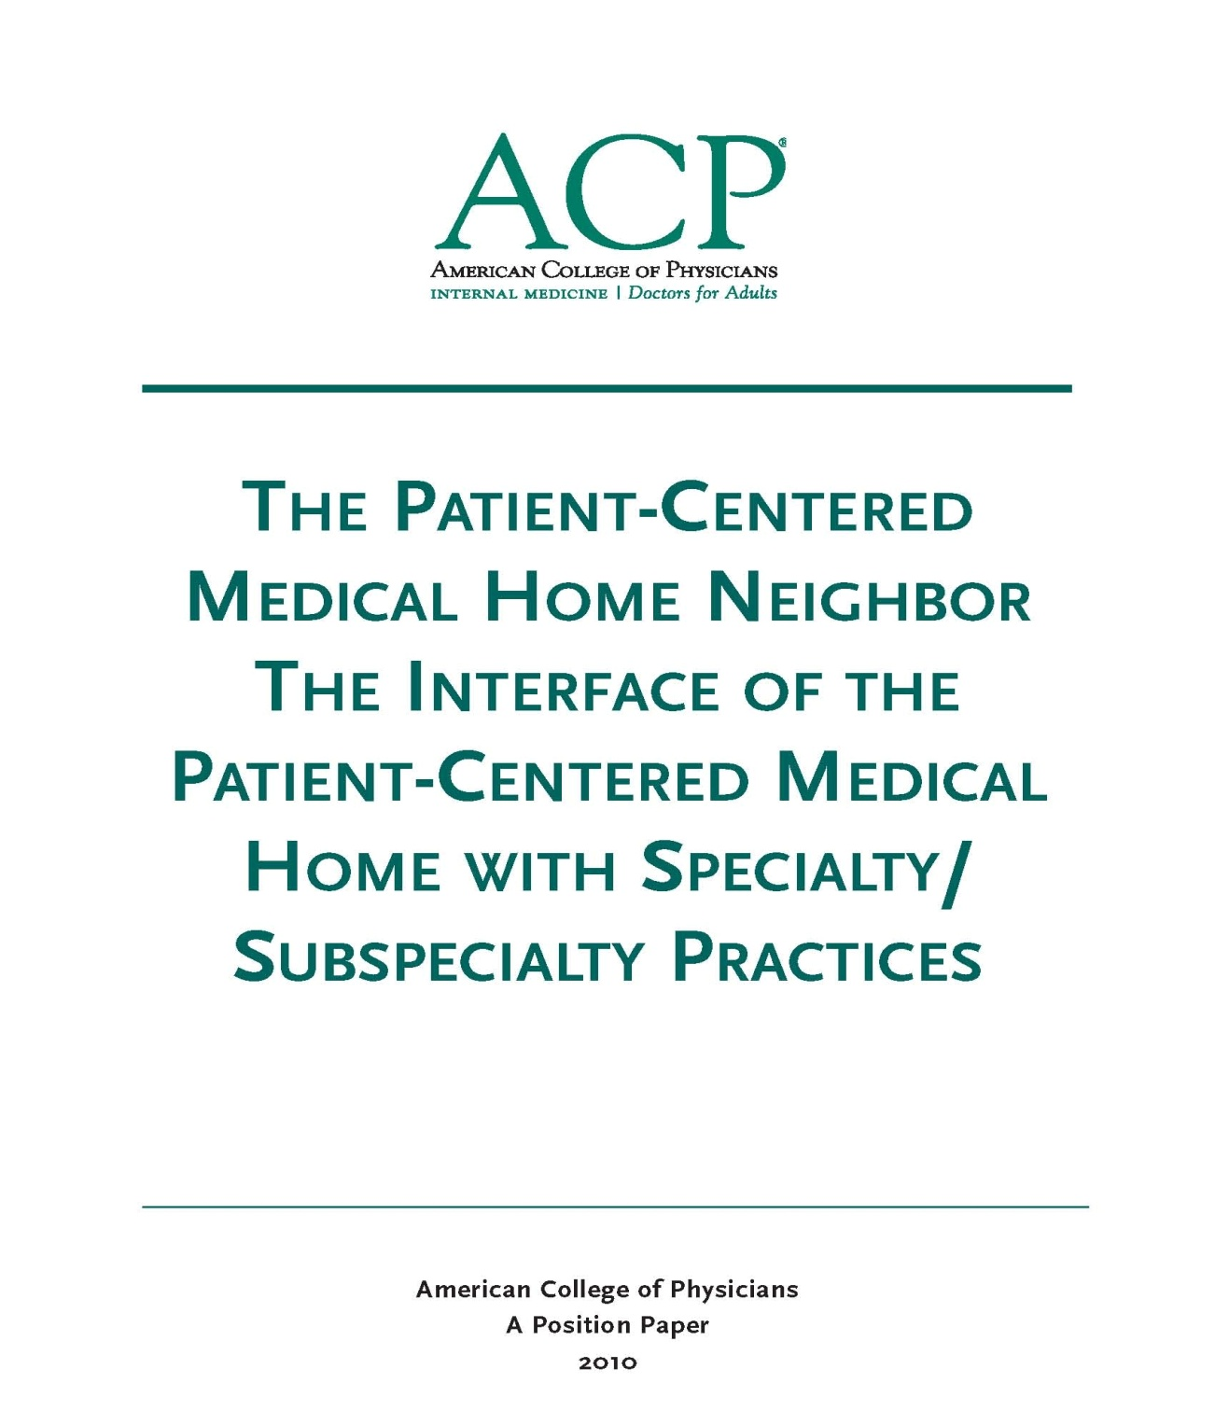
The Medical Neighborhood
October 2010
Medical Neighbor defined:
Communicates, collaborates & integrates
Appropriate & timely consultations
Effective flow of information
Responsible co-managing
Patient-centered care
Support medical home as hub of care
2010

Slide 15

Anticipated roles to meet patient needs
Pre-consultation/ pre-visit assistance
Cognitive Consultation
  E-consult (virtual clinician-to-clinician)
Procedural Consultation
Shared care Co-management
  virtual co-management
Principal Co-management

Slide 16
Pre-visit Advice / Pre-consultation
  Intended to expedite/prioritize care
  Previsit Advice
    Does the patient need a referral
    Which specialty is most appropriate
    Recommendations for what preparation or when to refer
  Previsit Review
    Is the clinical question clear
    Is the necessary data attached
    Triage urgency (risk stratify the patient’s referral needs)
  Urgent Cases
    Expedite care
    Improved hand-offs with less delay and improved safety

Slide 17
Take a minute …
How could having a “pre-consultation” process improve things for both the patient and the involved practices ?

Slide 18
We need a system for care coordination
The “Medical Neighborhood”
  An approach to care coordination
    It’s about working together better
    Promotes connected care wherever that care may be needed
High Value Care Coordination Tool Kit
  Defining what is needed & expected for high value referrals and care coordination
Notes:
The MN is not a place, it is an approach to how we work together to connect the care for patients where ever that care may take them

Slide 19

What do you need to connect the care?
High Value Care Coordination
  Information Sharing
  Communication
  Collaboration
Start with Check Lists for:
High Value Referral Request
High Value Referral Response
Notes:
So how do you get the care to be connected…we need

Slide 20
Expectations for High Value Referrals
Referral Request
Referral Response
Prepared Patient
Type of referral
Clinical question
Urgency
Core Data Set
Pertinent Data set
Answer the clinical question
What the specialist is going to do
What the patient is instructed to do
What does the referring physician need to do & when
What follow up is needed & with whom

Slide 21
Prepared Patient
Patient as partner in care
  Patient included in the process
  The patient’s needs & goals considered
Patient understand role of specialist and who to call for what
  Pre-visit patient education regarding
    the referral condition and/or
    the type of and role of the specialist
Appropriate (patient-centered) “handoff”
  Specialty practice alerted of any special needs of the patient
  Appropriate specialist at appropriate time to meet the patient’s needs
  Appropriate preparation with testing or therapeutic trials prior to referral
Notes:
The pt needs to be part of pt centered care

Slide 22
Take a minute …
How often are the patients prepared for the referral now (from perspective of both the requesting or receiving practices…and the patients)?

Slide 23

A referral is part of taking care of the patient…meeting the needs of the patient
Collaboration is Critical
How do you get to collaboration ?

Slide 24
Make an Agreement….
Care Coordination Agreement
(Collaborative Care Agreement/Care Compacts)
Platform that everyone agrees to work from:
  Standardized Definitions
  Agreed upon expectations regarding communication and clinical responsibilities.
Can be formal or informal
Your policies and procedures should be aligned to support the agreement
Notes:
How you handle the referral in your practice plays a critical role in successfully connecting care, it goes beyond the agreement, it operationalizing the agreement

Slide 25
What’s in the Care Compact ?
(start with the basics)
Critical elements of the referral request
Critical elements of the referral response
Protocol for scheduling appointments
“Closing the Loop” referral tracking protocol
Notes:
Agree to xxxx

Slide 26
  Define the protocol for scheduling appointments
  the expected protocol:
    the patient will call to schedule an appointment
    the specialty practice should contact the patient
      Allows for Pre-visit assessment/referral disposition
      Allows for tracking of referrals / accountability

Slide 27
Referral Tracking “Closing the Loop” protocol
Referral request sent
Referral request received and reviewed
  Referral accepted with confirmation of appointment date sent back to referring practitioner
  Referral declined due to inappropriate referral (wrong specialist, etc) and referring practice notified
  Patient defers making appt or cannot be reached and referring practice notified
Referral response sent (must address clinical question/reason for referral)
  Referral Note sent to referring clinician and PCP in timely manner
  Notification of No Show or Cancellation (with reason, if known)
Referrals made from one specialty to another (e.g. secondary referrals) include notification of the patient’s primary care clinician

Slide 28
Template Care Coordination Agreement
PCP/ Requesting
Neighbor/ Responding
Prepare patient
  Use of referral guidelines where available
  Patient/family aware of and in agreement with reason for referral, type of referral, and selection of specialist
  Expectations for events and outcomes of referral
Provide appropriate and adequate information. (Optimally adopt mutually agreed upon referral form with neighbor*)
  Demographic and insurance information
  Reason for referral, details
  Core Medical Data on patient
  Clinical data pertinent to reason for referral
  -- Any special needs of patient.
Indicate type of referral requested:
  Pre-visit Preparation/Assistance
  Consultation (Evaluate and Advise)
  Procedure
  Co-management with Shared Care
  Co-management with Principal Care
  Full responsibility for all patient care
* See provided model check list of suggested areas to address.
Review Referral Requests and Triage According to Urgency
  Reserve spaces in schedule to allow for urgent care
  Notify referring provider of recognized referral guidelines and inappropriate referrals
  Work with referring provider to expedite care in urgent cases
  Verify insurance status
  Anticipate special needs of patient/family
  -- Agree to engage in pre-referral consult if requested.
  _ Provide PCP with number for direct contact for urgent/immediate matters.
Provide appropriate and adequate information in a timely manner. (Optimally adopt mutually agreed upon referral response form with PCP*)
  To include specific response to referral question and any provision of or changes in type of recommended interaction; diagnosis; medication; equipment; testing; procedures; education; referrals; follow up recommendations or needed actions
* See provided model check list of suggested areas to address.
12

Slide 29
Take a minute …
How would having care coordination agreements help improve the referral process for your patients ? For your practice?

Slide 30
Apply to All Referral Situations
Primary Care to Specialty Care (Radiology, Pathology and Hospital Medicine)
Specialty to Specialty
Specialty to Primary Care
Ancillary & other services (Diabetes Ed, Physical Therapy, Nutrition, etc.)
Agree to work together in the care of mutual patients

Slide 31
Outline
Why: The need for better coordinated & connected care
What: Recommendations and best practices for high value care coordination based on physician derived & developed principles and tool kits
How: Action steps to get you moving from disconnected to connected care
Working together is BETTER …for everyone

Slide 32

The ACP Support & Alignment Network
High Value Care Coordination curriculum
Action Steps to Connected Care
Look at your internal referral process (get your own house in order) – presented in Launch Webinar
Ensure you get what you need for a high value referral
Ensure the others gets what they need
Develop Care Coordination Agreement(s) (compact) with appropriate referring practice(s)

Slide 33
Action Step 1

Slide 34
What’s happening in your practice?
True Tales from the Trenches
“We had to fax the same records to the specialist 6 times”
“ I referred the patient for a shoulder injury but received a note back about his old knee injury”
“We sent the records, the front desk received the records but the specialist (physician) never saw them and had no idea why the patient was referred/prior work up
“The specialist said they didn’t have time to look at the records my PCP sent”
“We have no idea if the patient was ever seen or not”

Slide 35
To have connected care between practices, need to have connected care within practices
We often have silos within our silos
Need to develop Patient-centered team care (entire staff) around the referral process
  Make it part of taking care of the patient
  Work as a team to design improvements, test and implement
Intentional internal processes (Policy & Procedures)
Track the referrals and the process

Slide 36

Action Steps to Connected Care
Look at your internal referral process (get your own house in order)
  Perform a Walk-through / Process Map of the referral process within the practice
    Identify any gaps in critical elements
    Develop an Improvement Plan to close the gaps
  Define who the team members are for the practice referral process
  Develop a Policy & Procedures document for your practice team’s internal referral process (will be a work in progress)

Slide 37

Start with One Step at a time….
Get your own “house” in order
  Start with a Process Map
    Make it a team approach
    Look for gaps (“opportunities”)in the referral process

Slide 38
Tips to Help you Process Map
Requesting a Referral
Responding to a Referral
Process Start and End
  Start = Decision to refer
  End = Referral reconciled
Referral reconciled means:
  Referral response received and recommendations are incorporated into the patient’s care in partnership with patient OR
  Referral incomplete and next steps have been made in partnership with patient
Process Start and End
  Start = Receipt of referral request
  End = Referral Response sent
Referral Response can be :
  Redirection to more appropriate specialist
  Referral not needed or Answer to simple question without appointment
  Notice of No Show or Cancel
  Completed Referral with note

Slide 39
Tips to Help you Process Map
Map your process “as is”
  resist the tendency to “fix” as you map
Include those who actually “do” this process
  Different people may vary in how they do the job
With complex processes such as this one, consider multiple passes, allow time to revisit & tweak
  Include:
    Who? Include handoff details, Patient involvement
    What? Time parameters? Documentation and notification parameters?

Slide 40
Develop a P&P (Policy & Procedures)
Set a practice policy for referrals
    Example primary care policy: “Our policy is to provide standardized referrals with a clear reason or question stated and attach the appropriate information so that our patients get the care they need efficiently, effectively and safely”
    Example specialty policy: “Our policy is to provide high value, patient-centered referrals appropriate to the needs of the patient”
Design the Procedures the way you want it to work
    See if it works
    Make improvements/changes as needed to get it working well

Slide 41

Leave in action….
Perform a referral process walk-through (Process Map)
Identify gaps in “Critical Elements”
  Subsequent Action Steps will provide assistance with filling gaps
Identify needed team members, roles & responsibilities for your practice referral process
Develop a Policy & Procedure document (can be added to & tweaked as progress through the additional steps)

Slide 42
www.acponline.org/hvcc-training
Primary care checklist for referral process assessment and critical elements
Specialty care checklist for referral process assessment and critical elements
ACP SAN HVCC policy examples for referral process
Sample policy & procedures for referral content

Slide 43
Delivery Structure

Slide 44
Go at your own pace for the next Action Steps
For the next 3 Action Steps
  Practices go at their own pace via
    short video clips of “action segments”
    supporting checklists & other materials
  Complete the Action Items for each segment & move to the next

Slide 45
Action “Segment” video-clips
Action step 2
Action step 3
Action step 4
The Referral Request checklist
Referral Criteria
  Urgency/priority of referral need
  Pertinent data sets/ referral guidelines
Pre-consultation Request & Review process
Ensure the patient’s needs are met
  Patient-centered referral process
Ensure the requesting practice needs are met
  Referral Response Checklist
  Referral Tracking-Close-the-Loop
Ensure High Value Secondary Referrals
Create a Care Coordination Agreement
Improve Access

Slide 46
Office Hours and Peer to Peer Interaction
Scheduled “office hours” with a SME to discuss challenges and celebrate your accomplishments.
Peer to peer interaction to learn best practices.

Slide 47
Program Metrics

Slide 48
Impact on TCPi Aims and Milestones
Contributes to reaching TCPI aims:
  Improve health outcomes
  Reduce unnecessary testing
  Achieve cost savings
  Reduce clinician & practice burden
Help practices achieve many of the TCPi milestones, particularly…

Slide 49

Key Milestones Impacted
Milestones
2
6
9
10
19
22
Reduce Unnecessary Testing & Visits
Team Care
Care Coordination Agreements
Communication with Primary Care Hub of Care
Joy in Work/ Reduced Chaos & Burden
Work Processes
Patient & Family Engagement
Notes:
Will measure using PAT milestone data pre and post training for several assessments.
Also, possibly use TIA tool as interim measurement.

Slide 50
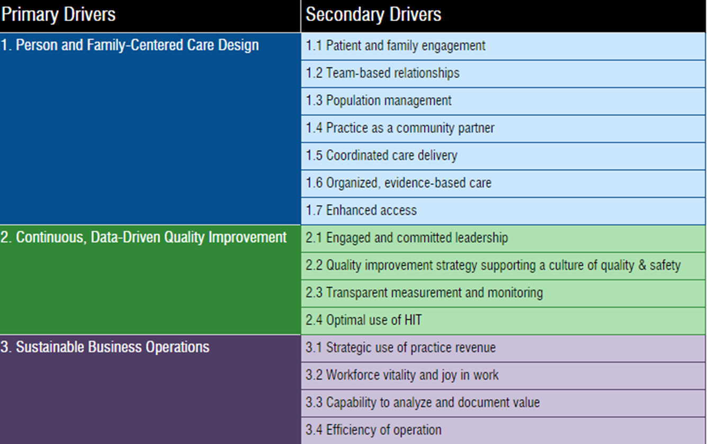



Notes:
Incorporates shared decision making; teach back, awareness of health literacy, patient participation in the referral process
Focus on team care, defining roles & responsibilities
Medical Neighbor approach to improving care coordination (main focus)
Provides referral guidelines for appropriate specialty type, timing, testing
Improving referral processes improves access
Reducing chaos and burden helps reduce job dissatisfaction and increase satisfaction/joy
Reduces internal waste/ inefficiency as well as waste to patient and system

Slide 51
WHERE ARE THE MATERIALS?
All the materials for the course, including video clips and supporting documents, can be found at:
www.acponline.org/hvcc-training

