Slide 1

Connecting Care
Ensuring Quality Referrals and Effective Care Coordination
the Medical Neighborhood
Action Step #1
Get Your Own House in Order
ACP SAN special project
for implementing
High Value Care Coordination
Carol Greenlee MD FACP & Beth Neuhalfen

Slide 2
As you listen…
Think about how you can help your practices begin to look at & improve their referral processes to….
  Reduce chaos & frustration in the clinic
  Improve satisfaction & outcomes for patients
  Reduce waste & unnecessary resource use

Slide 3

Outline
Why: The need for better coordinated & connected care
What: The critical elements for a high value referral experience
How: Action steps to get practices moving from disconnected to connected care
Working together is BETTER …for everyone

Slide 4

Pain Points
S
a
t
i
s
f
a
c
t
i
o
n
Referral Process
A
c
c
e
s
s
Often Creates:
Chaos
Extra burden
Frustration
Confusion
Waste

Slide 5


It’s not working well for the clinicians…
“ Most of the time I don’t know what the referring doc wants me to do for the patient”
“They had testing done but we don’t have the results, since the patient is here now for a consultation, we’ll just repeat the testing.
“I don’t know if my patient saw the specialist or not”
“Why didn’t someone let me know they were referring my patient to a surgeon”
“I just dug through a 48 page note from the specialist and still have no idea what they think or what they did with my patient”

Slide 6



…and then there is the
Patient Experience
“My doctor told me why he sent me to see you but I was so upset about the news he gave me that I don’t remember what he said.”
“I was supposed to call to schedule with that specialist? I thought her office was supposed to contact me.”
“I understood I was here to have the procedure today, not just to talk about my stomach pain!”
“I had that MRI last month. You mean I was supposed to bring the report and the films with me to this visit? I assumed you had that information.”
“I waited 3 months for the appointment, took the day off of work & after I was in the exam room learned I needed a different type of specialist”

Slide 7
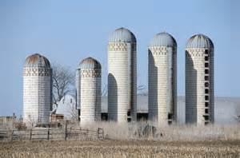
IOM 2001 Crossing the Quality Chasm
“A highly fragmented delivery system”
…physician groups, hospitals, and other health care organizations operate as silos
a “non-system”
disconnected care

Slide 8

Case 1 (“Playing Charades”)
70 year old woman from town
2 hours away, doesn’t know why she was referred
No records
Only voice mail at referring practice
What to do?
Glipizide, metformin, Levothyroxine on med list
Discussed diabetes and thyroid
Ordered A1c and TSH
Oops!
  A1c and TSH results done 2 weeks prior were identical
  Left adrenal mass on abdominal CT
60-70% of specialists reported receiving no information on referred patients
43% of specialists dissatisfied with the information they do receive

Slide 9
Case 2 (“wasted days & wasted nights”)
28 year old female had routine consultation appt booked with us by her PCP front office staff with cc/o “fatigue”
No records sent
3 month wait
Oops!
Referral was for suspected Lupus , she needed a Rheumatology consult, I’m an Endocrinologist….
Now a 5 month wait….
8% of Referrals are Inappropriate – to the wrong specialty or not necessary
(average 43 per specialist per year)

Slide 10

Case 3 (“Where’s the Beef?”)
  59 yo man with T2DM, HTN, Hyperlipidemia & Obesity
referred to cardiology with unexplained DOE & question “is this ischemic?”
28 page note from the cardiologist
  only ICD codes for impression
  no indication of what the cardiologist thinks or is going to do or
  what s/he recommends the PCP do or
  what s/he told the patient to do…
  More questions than answers
25-50% of Primary Care clinicians
receive no information back after the referral appointment
~50% don’t know if patient ever saw the specialist
20 - 40% of referral incomplete
28% are dissatisfied with the information they do receive

Slide 11
Consequences of Disconnected Care
Waste, Safety & Satisfaction issues
  Misdiagnosis
  Delayed diagnosis and treatment
  Duplicate tests
  Unnecessary tests
  Additional visits
  Access backlog / workforce needs
  Confusion, errors
  Increased stress, burden, dissatisfaction
  Not very patient centered
  Not very cost effective
  Not very satisfying & often burdensome on the back end

Slide 12


We need a System instead of Silos
“Once we get to interoperability….”

Slide 13
Case 4 (“TMI-Overload”)
74 year old woman with cognitive impairment from Skilled Nursing Facility brought in by transport person
No records except MAR
SNF physician on the road
Look in the HIE….
94 pages of reports
Diabetes
Pituitary mass
Osteoporosis
But what’s the question?

Slide 14
Shared EHR does not solve all the referral/ care coordination problems
Care Coordination requires:
Information sharing (can even be done without EMR)
  Adequate
  Pertinent
Communication
  With patient & family and the medical home team
  With extended care team (e.g., clinical question)
Collaboration/Working Together (mindset – culture)
  Standardization & expectations of referral procedures
  Clarity in roles and responsibilities
Patient-centered approach (common goal - meeting patient needs)
  Contextual care: considering patient’s needs & circumstances
  Shared goals and decision making

Slide 15
From Disconnected Care →
High Value, Connected Care
Start with the END in mind:
Goal of Care Coordination: To Benefit the Patient
  Ensure appropriate, continuous connected care
  Enhance the Quality of Care (6 domains)
    Patient Centered Care
    Safety
    Effectiveness
    Efficiency
    Timeliness
    Equity
Notes:
ALLYSON

Slide 16
From Disconnected Care →
High Value, Connected Care
Start with the END in mind:
Goal of Care Coordination: To Benefit the Physician and Clinical Team
  Working together/Cooperation/Cohesion
    Increase effectiveness and safety
    Increase satisfaction
    Reduce stress, chaos and burden
    Increase connectedness and part in the bigger picture
    More enjoyment (JOY) in the work
  …Connecting the Care, Sharing the Care
Notes:
ALLYSON

Slide 17
Outline
Why: The need for better coordinated & connected care
What: The critical elements for a high value referral experience
How: Action steps to get practices moving from disconnected to connected care
Working together is BETTER …for everyone

Slide 18

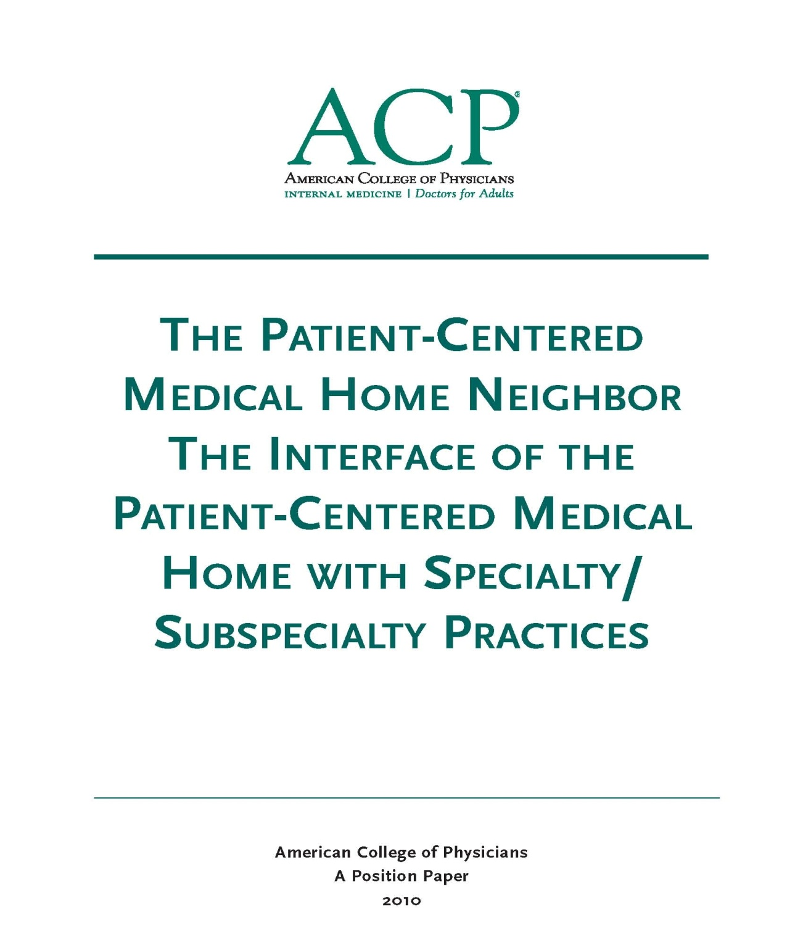
The Medical Neighborhood
October 2010
Medical Neighbor defined:
Communicates, collaborates & integrates
Appropriate & timely consultations
Effective flow of information
Responsible co-managing
Patient-centered care
Support medical home as hub of care
2010

Slide 19
We need a system for care coordination
The “Medical Neighborhood”
  An approach to care coordination
    It’s about working together better
    Promotes connected care wherever that care may be needed
High Value Care Coordination Tool Kit
  Defining what is needed & expected for high value referrals and care coordination
Notes:
The MN is not a place, it is an approach to how we work together to connect the care for patients where ever that care may take them

Slide 20

Patient-Centered Connected Care- the patient’s medical neighborhood
The Patient is the center of care
Primary Care is the
necessary hub of care
Specialty/ancillary care is an extension of care
  Helping with care to meet patient needs

Slide 21

What do you need to connect the care?
High Value Care Coordination
  Information Sharing
  Communication
  Collaboration
Start with Check Lists for:
High Value Referral Request
High Value Referral Response
Notes:
So how do you get the care to be connected…we need

Slide 22
Expectations for High Value Referrals
Referral Request
Referral Response
Prepared Patient
Type of referral
Clinical question
Urgency
Core Data Set
Pertinent Data set
Answer the clinical question
What the specialist is going to do
What the patient is instructed to do
What does the referring physician need to do & when
What follow up is needed & with whom

Slide 23
Prepared Patient
Patient as partner in care
  Patient included in the process
  The patient’s needs & goals considered
Patient understand role of specialist and who to call for what
Pre-visit patient education regarding
    The referral condition and/or
    The type of and role of the specialist
    Info on the specialty practice (parking, contact info, other logistics)*
Appropriate (patient-centered) “handoff”
  Specialty practice alerted of any special needs of the patient
  Appropriate specialist at appropriate time to meet the patient’s needs
  Appropriate preparation with testing or therapeutic trials prior to referral
Notes:
The pt needs to be part of pt centered care

Slide 24
Define the specialty role to most appropriately meet patient needs
___Pre-consultation/ pre-visit assistance/preparation
___Medical Consultation: Evaluate and advise with recommendations for management and send back to me
___Procedural Consultation: Specialist to confirm need for and perform requested procedure if deemed appropriate.
___Shared Care Co-management: I prefer to share the care for the referred condition (PCP lead, first call)
___Principal Care Co-management: Please assume principal care for the referred condition: (Specialist assumes care, first call)
___Please assume full responsibility for the care of this patient (Complete transfer of care)(e.g. Pediatric to Adult Care transition)

Slide 25
Provide a Clinical Question
(or summary of reason for referral)
“eyes” “gallbladder” “diabetes”
68 year old female with intermittent double vision. Is ophthalmopathy assessment the correct starting point?
39 year old female with severe RUQ pain, abnormal US and known diabetes, does she need surgery?
20 yo female with T1DM since age 8 on insulin pump therapy, transferring from pediatric to adult care

Slide 26
Provide Supporting Data (pertinent data set) for the referred conditions
Pertinent (not data dump)
Adequate (reduce duplication)
To allow the specialty practice to
  determine if the referral is to the appropriate specialty
  effectively triage urgency
  effectively address the referral (enough info to do something)

Slide 27
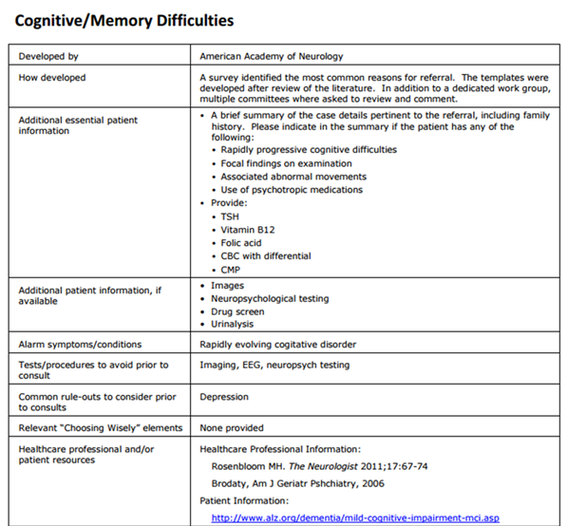
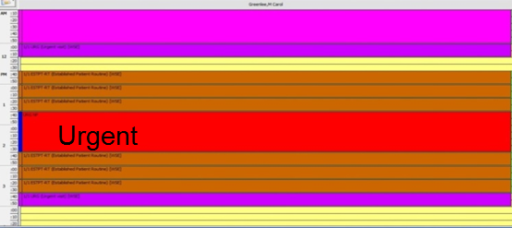
Establish referral guidelines (Pertinent Data Sets) for a High Value specialty consultation
Define:
  Testing needed
  Therapeutic trials
  What not to do
  Alarm signs & symptoms
  Urgency
Create:
  Capability to schedule based on needs

Slide 28

Pre-consultation Request & Review
  Intended to expedite/prioritize care
  Pre-visit Request for Advice
    Does the patient need a referral
    Which specialty is most appropriate
    Recommendations for what preparation or when to refer
  Pre-visit Review of all Referrals
    Is the clinical question clear
    Is the necessary data attached
    Triage urgency (risk stratify the patient’s referral needs)
  Urgent Cases
    Expedite care
    Improved hand-offs with less delay and improved safety

Slide 29
Take a minute …
Ask the practice if the referral request provides the information needed for the first appointment to be “high value” (add benefit).
What makes the referral process painful for the clinicians and/or the staff at the practice level?
What does the practice team feel they are currently doing well with their referral process?
Are the patients satisfied with the referral process?

Slide 30

Provide a High Value Referral Response
Answer the clinical question/address the reason for referral-Summary (include some thought process)
Agree with or Recommend type of referral / role of specialist
Confirm existing, new or changed diagnoses; include “ruled out”
Medication /Equipment changes
Testing results, testing pending, scheduled or recommended (including how/who to order)
Procedures completed, scheduled or recommend
Education completed, scheduled or recommended
Any “secondary” referrals made (confer with and/or copy PCP on all)
Any recommended services or actions to be done by the PCMH
Follow up scheduled or recommended
Clear indication of
What the specialist is going to do
What the patient is instructed to do
What the referring physician needs to do & when
Easy to find & refer to in the response note

Slide 31

A referral is part of taking care of the patient…meeting the needs of the patient
Collaboration is Critical
How do you get to collaboration ?

Slide 32

Make an Agreement….
Care Coordination Agreement
(Collaborative Care Agreement/Care Compacts)
Platform that everyone agrees to work from:
  Standardized Definitions
  Agreed upon expectations regarding communication and clinical responsibilities.
Can be formal or informal
Your policies and procedures should be aligned to support the agreement
Notes:
How you handle the referral in your practice plays a critical role in successfully connecting care, it goes beyond the agreement, it operationalizing the agreement

Slide 33
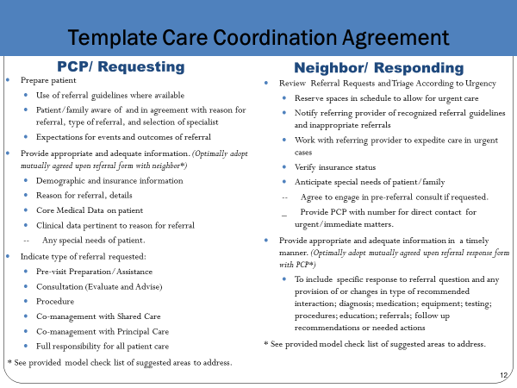
What’s in the Care Compact ?
(start with the basics)
Critical elements of the referral request
Critical elements of the referral response
Protocol for scheduling appointments
Closing the Loop-referral tracking protocol
Notes:
Agree to xxxx

Slide 34
  Define the Protocol for
  Scheduling Appointments
What is the expected protocol:
    the patient will call to schedule an appointment
    the specialty practice should contact the patient
      Allows for Pre-visit assessment/referral disposition
      Allows for tracking of referrals / accountability

Slide 35
Referral Tracking “Closing the Loop” protocol
Referral request sent, logged and tracked
Referral request received and reviewed
  Referral accepted with confirmation of appointment date sent back to referring practitioner
  Referral declined due to inappropriate referral (wrong specialist, etc) and referring practice notified
  Patient defers making appt or cannot be reached and referring practice notified
Referral response sent (must address clinical question/reason for referral)
  Referral Note sent to referring clinician and PCP in timely manner
  Notification of No Show or Cancellation (with reason, if known)
Referrals made from one specialty to another (e.g. secondary referrals) include notification of the patient’s primary care clinician

Slide 36
Apply to All Referral Situations
Primary Care to Specialty Care (Radiology, Pathology and Hospital Medicine)
Specialty to Specialty
Specialty to Primary Care
Ancillary & other services (Diabetes Ed, Physical Therapy, Nutrition, etc.)
Agree to work together in the care of mutual patients

Slide 37
Take a minute …
Ask the practice if they know the % of loops closed (notes sent back to requesting clinician by the responding clinician).
Does the practice know where the referral went and what is the current status of the referral?
Do patients leave the requesting practice with a clear idea of how the appointment with the specialist is to be made?
Does the patient know what the next steps are after seeing the specialist?

Slide 38
Outline
Why: The need for better coordinated & connected care
What: The critical elements for a high value referral experience
How: Action steps to get practices moving from disconnected to connected care
Working together is BETTER …for everyone

Slide 39
Action Step 1

Slide 40
What’s happening inside the practice?
True Tales from the Trenches
“We had to fax the same records to the specialist 6 times”
“ I referred the patient for a shoulder injury but received a note back about his old knee injury”
“We sent the records, the front desk received the records but the specialist (physician) never saw them and had no idea why the patient was referred/prior work up
“The specialist said they didn’t have time to look at the records my PCP sent”
“We have no idea if the patient was ever seen or not”

Slide 41

To have connected care between practices, need to have connected care within practices
We often have silos within our silos
Need to develop Patient-centered team care (entire staff) around the referral process
  Make it part of taking care of the patient
  Work as a team to design improvements, test and implement
Intentional internal processes (Policy & Procedures)
Track the referrals and the process

Slide 42

Action Steps to Connected Care
Look at your internal referral process (get your own house in order)
  Perform a Walk-through / Process Map of the referral process within the practice
    Identify any gaps in critical elements
    Develop an Improvement Plan to close the gaps
  Define who the team members are for the practice referral process
  Develop a Policy & Procedures document for your practice team’s internal referral process (will be a work in progress)

Slide 43

Start with One Step at a time….
Get your own “house” in order
  Start with a Process Map
    Make it a team approach
    Look for gaps (“opportunities”)in the referral process

Slide 44
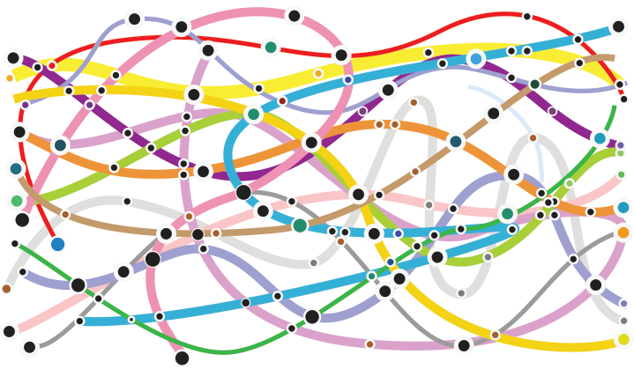






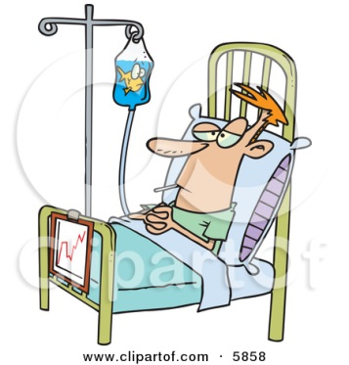
Process Map (Mess)

Slide 45
Tips to Help with Internal Referral Process
Process Map
Requesting a Referral
Responding to a Referral
Process Start and End
  Start = Decision to refer
  End = Referral reconciled
Referral reconciled means:
  Referral response received and recommendations are incorporated into the patient’s care in partnership with patient OR
  Referral incomplete and next steps have been made in partnership with patient
Process Start and End
  Start = Receipt of referral request
  End = Referral Response sent
Referral Response can be :
  Redirection to more appropriate specialist
  Referral not needed or Answer to simple question without appointment
  Notice of No Show or Cancel
  Completed Referral with note

Slide 46
Tips to Help with Internal Referral Process Process Map
Map your process “as is”
  resist the tendency to “fix” as you map
Include those who actually “do” this process
  Different people may vary in how they do the job
With complex processes such as this one, consider multiple passes, allow time to revisit & tweak
  Include:
    Who? Include handoff details, Patient involvement
    What? Time parameters? Documentation and notification parameters?

Slide 47
Develop a P&P (Policy & Procedures)
Set a practice policy for referrals
    Example primary care policy: “Our policy is to provide standardized referrals with a clear reason or question stated and attach the appropriate information so that our patients get the care they need efficiently, effectively and safely”
    Example specialty policy: “Our policy is to provide high value, patient-centered referrals appropriate to the needs of the patient”
Design the Procedures the way you want it to work
    See if it works
    Make improvements/changes as needed to get it working well

Slide 48
www.acponline.org/hvcc-training
Primary care/ Requesting practice checklist for referral process assessment and critical elements
Specialty care/Responding practice checklist for referral process assessment and critical elements
ACP SAN HVCC policy examples for referral process
Sample policy & procedures for referral content
QIA checklist
  If practices are already in process on Medical Neighbor efforts: Ensure that the practice truly has the process or element in place – check off
  Fill in the missing elements or processes with the curriculum and tools

Slide 49
Take a minute …
What is the ideal state of referrals for patients and clinicians/practice teams?
Does the practice have a “why” to doing this work?
How will you know when you are successful in high value care coordination?

Slide 50

Leave in action….
Perform a referral process walk-through (Process Map)
Identify gaps in “Critical Elements”
  Subsequent Action Steps will provide assistance with filling gaps
Identify needed team members, roles & responsibilities for your practice referral process
Develop a Policy & Procedure document (can be added to & tweaked as progress through the additional steps)

Slide 51

Idea Sharing
Anyone already working on the referral process-Medical Neighborhood with practices?
Has anyone done a process map of a practice referral process?
  What did you learn?
Has anyone worked with a practice on putting a care coordination agreement (compact) in place?

Slide 52
WHERE ARE THE MATERIALS?
All the materials for the course, including video clips and supporting documents, can be found at:
www.acponline.org/hvcc-training

