Slide 1
Connecting Care: Ensuring Quality Referrals and Effective Care Coordination Office Hours
An Invitation to start building
The Medical Neighborhood
ACP SAN special project
for implementing
High Value Care Coordination
April 22, 2019

Slide 2
Scope - Over 100 Million Referrals per Year
The ideal referral involves:
Minimal wait time & efficient use of resources
Referral accuracy: ensures that the referral is:
medically necessary
directed to the correct specialty
complete with relevant history and workup
aligned with patient goals
defined to appropriately meet the needs of the patient
Timely appointment scheduling & completion
Accountable information exchange
Direct communication with relevant information transfer before & after referral visit by specialty care

Slide 3
Current State for the Referral Process
60-70% of specialists reported receiving no information
25-50% of primary care providers received no information
~50% did not even know if their patient ever saw the specialist
28 % of primary care and 43% of specialists are dissatisfied with the information they receive
8% of referrals are inappropriate (wrong specialist or are unnecessary) (average 43 referrals /specialist/year)
Up to 50% of referrals are never completed } delayed/missed diagnosis and/or treatment
Notes:
Gandi et. al. J Gen. Int. Med. 2000
O’Malley, AS, Reschovsky JD. Arch Intern Med. 2011;171(1):56-65
Colorado Medical Society Systems of Care grant
CRICO IHI NPSF: closing the loop

Slide 4
What do you need to connect the care?
Interoperability is a tool – Improving the referral process requires us:
High Value Care Coordination
Information Sharing
Communication
Collaboration
Start with the Referral Process
Notes:
Interoperability is only a tool – connecting & coordinating care requires us – currently there are two misperceptions: 1) we can’t have coordinated referrals without interoperability and the follow on misperception 2) once we get interoperability then all the care coordination & communication issues will be resolved

Slide 5
The ACP SAN High Value Care Coordination curriculum
Action Steps to Connected Care
Look at your internal referral process (get your own house in order)
Ensure the specialty practice gets what is needed for a high value referral
Ensure the others (patients, the requesting practice and any secondary care) get what they need
Develop Care Coordination Agreement(s) (compact) with appropriate referring practice(s)

Slide 6
Action Steps to Connected Care – INTERNAL PROCESS
Look at your internal referral process (get your own house in order)
Perform a Process Map of the referral process within the practice
Identify any gaps in critical elements, log jams, duplicated efforts, etc.
Develop an Improvement Plan to close the gaps (next Action Steps)
Define who the team members are for the practice referral process
Start developing a Policy & Procedures document for your practice team’s internal referral process (will be a work in progress)

Slide 7
What we all learned….
Major log jam around the referral loop:
No established process for closing the loop
not consistently done
PC has to call repeatedly to get referral response notes – large work burden
Variation in the way referral requests come in
Not using agreed upon referral hubs
Duplication in referral requests for same patient/condition (PCPs send multiple referral requests because they do not receive confirmation that referral request was received; specialties have a hard time managing duplicates) or due to PA
Prior authorization issues with referrals
PCPs are having issues getting the prior authorizations until an appt is scheduled with provider identified, specialists have to cancel appts if prior authorization not in place, which results in a lot of back and forth and repeated phone calls & need to cancel appointments for some patients if PA not received
Notes:
PC staff spend so much time trying to figure out if referral request received, booked , getting prior auth and then trying to get referral response note that they mainly only track high risk referrals and don’t know what happened to the other referrals – if this was remedied would have more time to ensure attachments correct and also track more referrals
SC wastes a lot of time on entering same patient info that came in duplicate ways (different staff working on), if remedied they would have more manpower and time to better help close the loop

Slide 8
Proposed Solutions
Task force of PC and SC staff reps to work on the process together
Can’t be fixed by any practice by itself
Perhaps CTC clinical strategy team assistance
? interface with payers to improve the process around PA
Action Step 3 - details on closing the referral loop
Implementing close the loop steps & processes will help
Opportunity to do it in a collaborative standardized way to reduce the burden on everyone

Slide 9
What we all learned….
Need to clarify/better define the information that needs to be sent with the referral request – identified need for:
a clinical question or reason for referral and not just an ICD code
SC often does not know why patient referred or what concern is
PC using the ICD code & its definition wording, not actual clinical question/ reason
pertinent supporting data set for the referred condition
SC often does not have the info they need with the referral
PC feels their staff know what to attach with their referral requests
indication of the role desired of SC (e.g., consult, co-management, etc.) & an indication if PC is comfortable resuming management of the condition once stable or not
SC access reduced by ongoing SC management for patients that could be managed by PC/other SC

Slide 10
What we all learned….
Need to clarify/better define the information that needs to be sent with the referral request :
Epic (? also other EMR) doesn’t allow adding the needed info – unable to customize the referral request
Can only enter “number of visits” and “type of referral”, unable to add info on the patient or the problem
Need assistance with what is possible (see examples from Denver Health)
Reduce Inappropriate referrals – issues that could be handled by PC
Internal process needed to improve APP discussing with physician before referring

Slide 11
Proposed Solutions
Use of common referral request check list
Include specification of desired SC role
Previous efforts to define roles did not go any where – need to resurrect
Referral guidelines from SC for what they need with referral for specific conditions
University GI working w University Surgical
Consider other dyad efforts (e.g. PC w Cardiology, etc.) to develop – then share across all practices
Action Step 2 goal = ensure SC gets the info needed for a high value referral

Slide 12
Action Steps to Connected Care – GIVE the SPECIALTY PRACTICE WHAT IT NEEDs
Ensure the specialty practice gets what is needed for a high value referral
Define basic referral request elements
Establish referral guidelines
Urgency
Pertinent Data Sets/ supporting information
Ensure Pre-consultation / Pre-visit review & request

Slide 13
1st Define the Basic Elements of the Referral Request
Check list for a high value Referral Request
Patient Demographics & Scheduling Information
Referral Information
Patient’s Core Data Set
Care Coordination/Referral Tracking

Slide 14
Referral Information
What is the specific clinical question (reason for referral)
A brief Summary of case details pertinent to the referral, include relevant co-morbidities (alarm signs or symptoms)
Urgency (referral status or referral priority)
Referral Type (anticipated, pending specialist’s evaluation) (Definition of care or Role in care requested of the specialist)
Pertinent data set: Clinical information directly relevant to the specific referral question (office notes, test results, etc.) (Supporting data for the referral)

Slide 15
Provide a Clinical Question (or summary of reason for referral) with all referrals
“eyes” “gallbladder” “diabetes”
68 year old female with intermittent double vision. Is ophthalmopathy assessment the correct starting point?
39 year old female with severe RUQ pain, abnormal US and known diabetes, does she need surgery?
20 yo female with T1DM since age 8 on insulin pump therapy, transferring from pediatric to adult care

Slide 16
Referral Type (What is the suggested role of the specialist)
____ Consultation (cognitive) (Evaluate and Advise, with the goal of managing the problem remaining with the referring clinician)
____ Procedural Consultation
____Co-Management with Shared Care (Referring clinician (e.g. PCP) maintains first call for the referral disorder)
____ Co-Management with Principal Care (Referred to subspecialist/specialist assumes first call for the referral disorder)
__I prefer to manage this condition once stable on care plan
__I prefer that you (specialty care) manage this condition on on-going basis
____ Please assume Full Responsibility for Complete Transfer of all Patient Care (e.g .Pediatric to Adult care transition or a move)

Slide 17
Ideal: “Synoptic” Referral Request
Clinical question or reason for referral: Please help determine which next treatment option is best suited for this 62 yo first grade teacher who has had diabetes for past 10 years and has been intolerant to all oral meds, now on basal insulin w A1c of 10.2%
Urgency: intermediate
Type of Referral: Shared co-management
Core Data: attached
Pertinent Data: lab flow sheet attached
Patient considerations: Please call after 3 PM due to work hours
Contact for more info: back line number is 123-456-8901

Slide 18
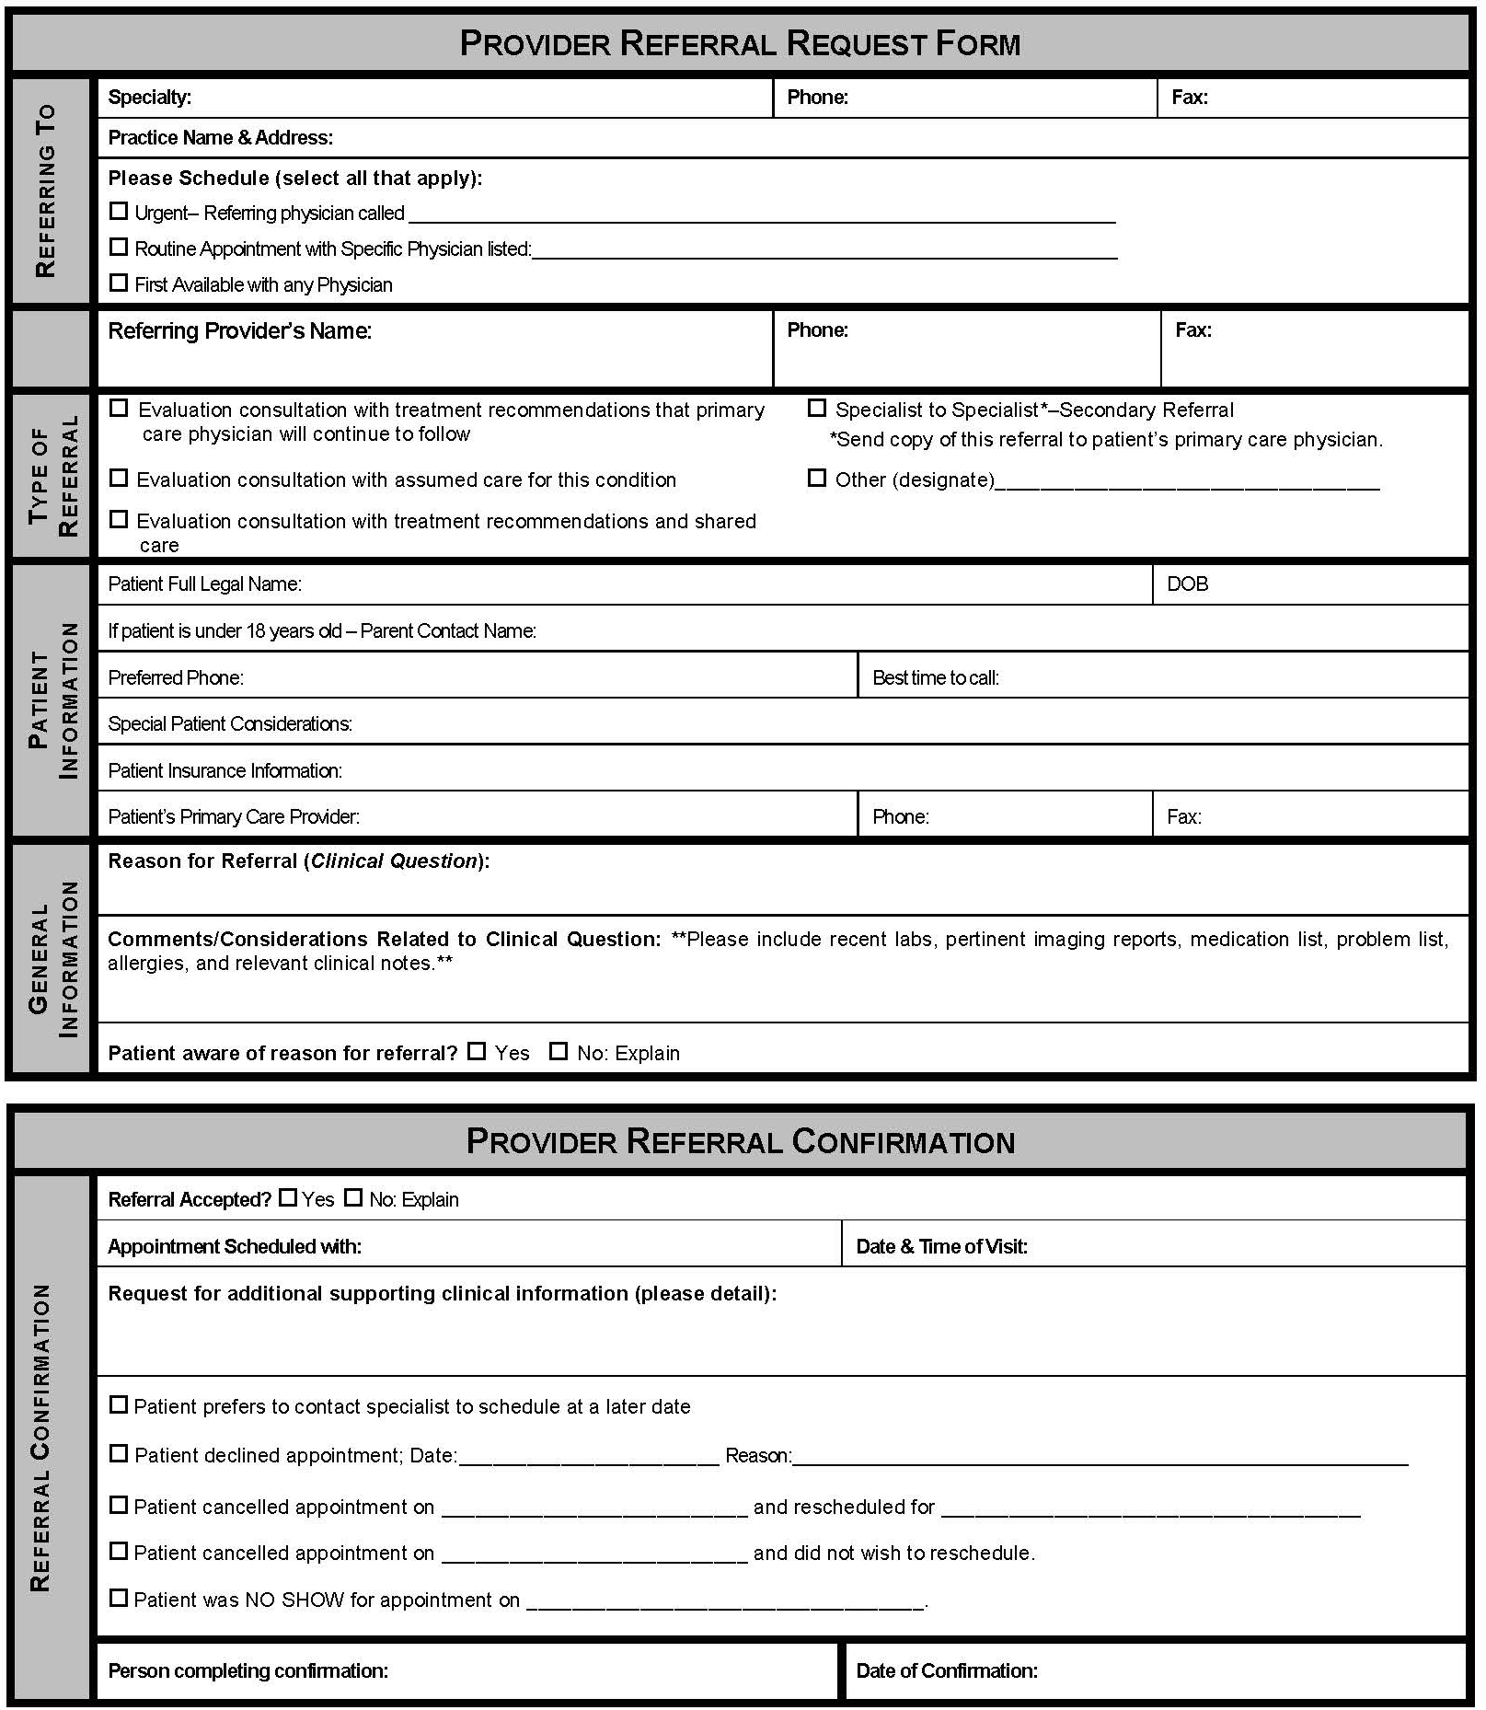
System-wide CCA for Mesa County Physicians IPA (Independent Physicians Association)
Referral Process :
Referral Request
Clinical question
Supporting data
Prepared Patient
Referral Response
Address clinical question
Referral Tracking
Confirm or decline referral
Inform of no shows/ cancellations
Download this form!
Notes:
This was very basic as first step –

Slide 19
Demographics
Full Legal Name: _______________________________________________DOB: ______________________
Home Phone: _____________________ Cell: _____________________ Work: ________________________
Referring Provider: ____________________________________________ Phone: _____________________
Referral Information
Clinical Question or Reason for referral (summary is helpful): _________________________________
Type of Referral requested:
___Medical Consultation: Evaluate and advise with recommendations for management sent back to me
___Co-management: I prefer to share the care for the referred condition (PCP lead)
___Co-management: Please assume principal care for the referred condition (Specialist assumes care)
___Have specialty care physician determine which is most appropriate after their assessment of the patient
Is this routine____ or urgent____? ⁭
If urgent please indicate why and consider calling Dr. Greenlee to help us expedite care.
Is the patient aware that they have been referred to us and why? ___________________
Are there any special needs such as issues with mental competence, language or physical issues?
Is the patient the contact person? ______ If not, who is? __________________________________
Please include clinical data that is pertinent to the referral:
The patient’s core medical information (Demographics, Medication list, Allergy list, Problem list, etc)
Labs
Radiology reports
Clinical notes
Any additional medical history that is useful
If you have a CARE PLAN on this patient, please attach
Notes:
My ask/ request of them

Slide 20
2nd Establish Referral Criteria / Guidelines
Timing of the referral request and appointment
urgency or priority for scheduling expectations –
Recommend creating lists of conditions that are usually urgent, intermediate/move up and routine (“risk stratification of the referral needs”)
Supporting data needed for the particular referral condition
“pertinent data sets” / referral guidelines for referral conditions

Slide 21
Specialty Care Clinicians can Develop Pertinent Data Sets for Referred Conditions
Identify which conditions need referral guidelines (greatest ROI)
most common
most critical
most problematic (do not get needed info or get a lot of unnecessary info or get too late or too early)
Determine “pertinent data sets” for those conditions
What supporting data is critical
What is helpful but optional (attach results if already done but not necessary to do)
What is unnecessary or should not be done
Can utilize/adapt existing set(s) if appropriate
Recommend vetting with primary care or requesting SC

Slide 23
Available Pertinent Data Sets

Slide 24
Critical Elements – Define Urgency of the Condition & Role & Clinical Question for Specialty Care

Slide 25
Critical Elements- Pertinent Data Clinical Referral Guideline Panels
© 2019 Epic Systems Corporation. Confidential.

Slide 26
Need a mechanism for Pre-consultation (Intended to expedite & prioritize care) (triage – “to sort out”)
A request for pre-visit advice and/ or assistance
Should not require in-depth analysis of the case
Can result in no need for further assessment or management
Can “evolve” into a face-to-face appointment (or “e-consult”)
A process of pre-visit review
To ensure appropriateness of the referral
To ensure adequacy of the referral information
To provide advice or assistance as needed for preparation for the referral appointment and interim care
Additional testing
Therapeutic trial
Interim care to stabilize while waiting for specialty care
Notes:
So just what is Pre-consultation? It is intended to expedite & prioritize care and there are essentially two forms of Pre-consultation. One is a Pre-consultation REQUEST which is a type of a referral request….

Slide 27
Leave in action…. Where to start? – menu of options
Clinical question/detailed reason for referral with every referral
Provided with every referral request
Addressed by every referral response
Agree on use of definitions of care/ roles for specialty care
Primary care request desired specialty care role
Specialty care acknowledge (agree with or suggest another option) & indicate role on patient chart
Referral guidelines for common or critical referral conditions
Specialty care develop – vetted with primary care
Primary care determine how to incorporate into referral process
Could be aided by
use of common
referral request
form or checklist
Agreement on
definitions for SC roles
Requesting practices
need to know what
is needed for specific
conditions
Option – work in Dyads
to develop

Slide 28
www.acponline.org/hvcc-training
Materials for Action Step 2
Outpatient Referral Request Checklist
HVCC Checklist for Developing Pertinent Data Sets / Referral Guidelines
Pertinent Data Sets developed by specialty societies (search “ACP Pertinent data sets”)
HVCC Pre-consultation Review Checklist

