Slide 1

Connecting Care
Ensuring Quality Referrals and Effective Care Coordination
the Medical Neighborhood
Action Step # 4:
Create a Care Coordination Agreement
ACP SAN special project
for implementing
High Value Care Coordination
Carol Greenlee MD FACP & Beth Neuhalfen

Slide 2

The ACP Support & Alignment Network
High Value Care Coordination pilot project
Action Steps to Connected Care
Look at your internal referral process (get your own house in order)
Ensure you get what you need for a high value referral
Ensure the others gets what they need
Develop Care Coordination Agreement(s) (compact) with appropriate referring practice(s)

Slide 3

As you listen…
Think about developing a care coordination agreement
  With which practice(s) would it be beneficial to develop a CCA
  What do you need & want in a care coordination agreement to improve the referral process for
    Patients
    Clinicians and practices
    Reducing waste and improving cost effectiveness
  How could this improve access to care

Slide 4



Putting it all together-Connecting Care
Building the bridge
abutments –getting your
own house in order
Securing the
connecting pieces:
the referral request
the referral response
Establishing the bridge: a Care Coordination Agreement for the
Referral process

Slide 5

Ideally…
Patient-Centered High Value Care Coordination would be standard of care…
… with every clinical team doing what is needed to coordinate, connect and share the care for
our patients whenever and wherever
that care may take them

Slide 6



To help us get there…
Care Coordination Agreements provide
A starting point
And
A roadmap

Slide 7
What is a Care Coordination Agreement?
Platform that everyone agrees to work from:
  Standardized definitions
  Agreed upon expectations regarding communication and clinical responsibilities.
Can be formal or informal
Also called Care Coordination Compact or Collaborative Care Agreement / Compact

Slide 8


Who and How?
Practices you work with frequently
  Including multispecialty groups in same organization
Practices you need “more” from
  PCP needing timely referral response notes
  Specialty group needing more than ICD code with referrals
  PCP needing colonoscopy reports from GI group
  Surgeon needing pre-op prep assistance
Practices you need “less” from
  Chart dump with referrals
  40 page referral response notes (with every order, etc. in it)

Slide 9

Models for Establishing Agreements
“One-on-One” Compacts with selected medical neighbors
  PCP practice with specialist / specialty to specialty
  ACO with a specialty
System-wide adoption (all players within system)
  Closed or integrated systems (VA, ACO, IPA)
Unilateral approach
  Medical Center / Specialty Practice (“This is how we agree to work with those who refer to our center/practice and this is what we would like from you when you refer a patient ”)

Slide 10
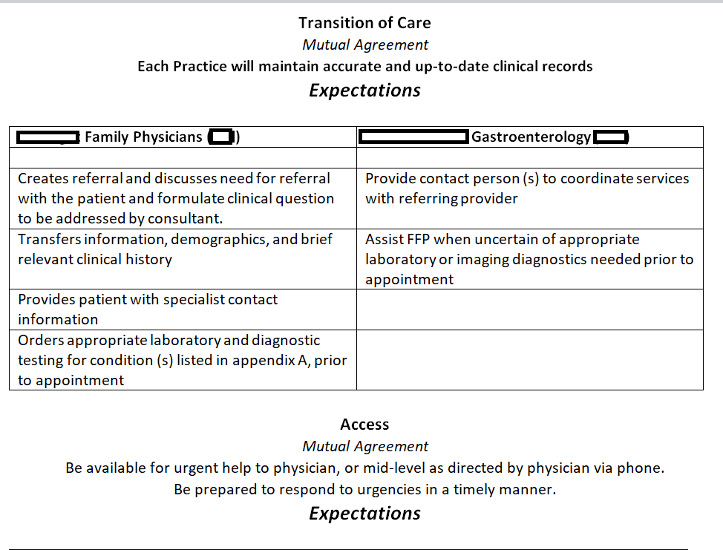
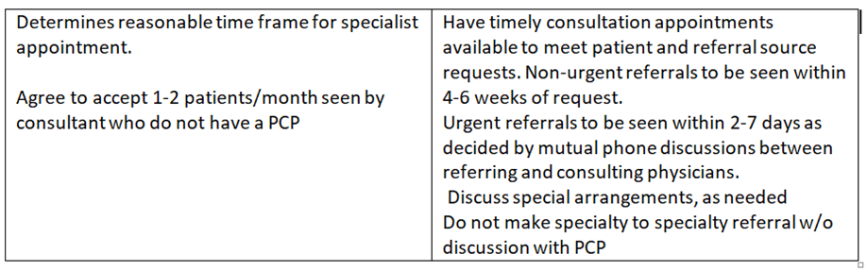
Example of Formal 1-on-1 CCA
(PCP with Specialty)

Slide 11
Example of Informal 1-on-1 CCA
(Specialty to Specialty)
Endocrinology with Endocrine Surgeon
  Work closely together for surgical cases involving parathyroid/thyroid/adrenal issues
  Evolved & continuously evolving understanding of information, communication & collaboration needs
    Clear clinical questions/ reason for referral
    Detailed summary / discussions-calls
    Defined expectations around roles & responsibilities
    Defined expectations around shared information, communication and care collaboration

Slide 12
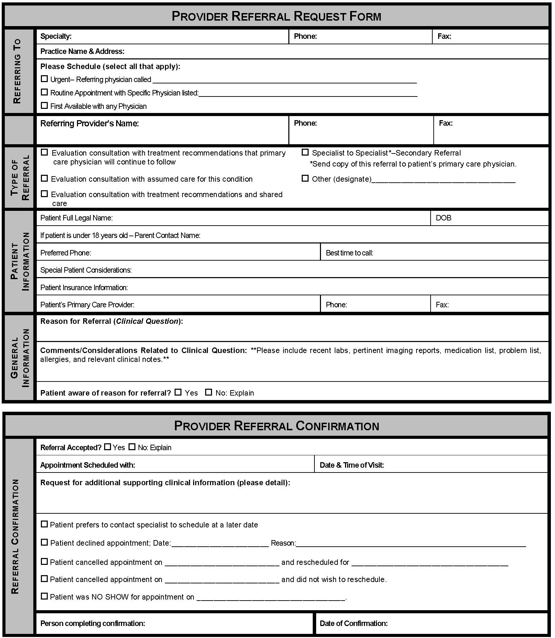
Example of System-wide CCA for IPA
(Independent Physicians Association)
    Focus on Referral Process :
    Referral Request
      Clinical question
      Supporting data
    Prepared Patient
    Referral Response
      Address clinical question
    Referral Tracking
    Confirmation of appointment or decline (redirect) referral
    Notification of No Show or Cancellation

Slide 13
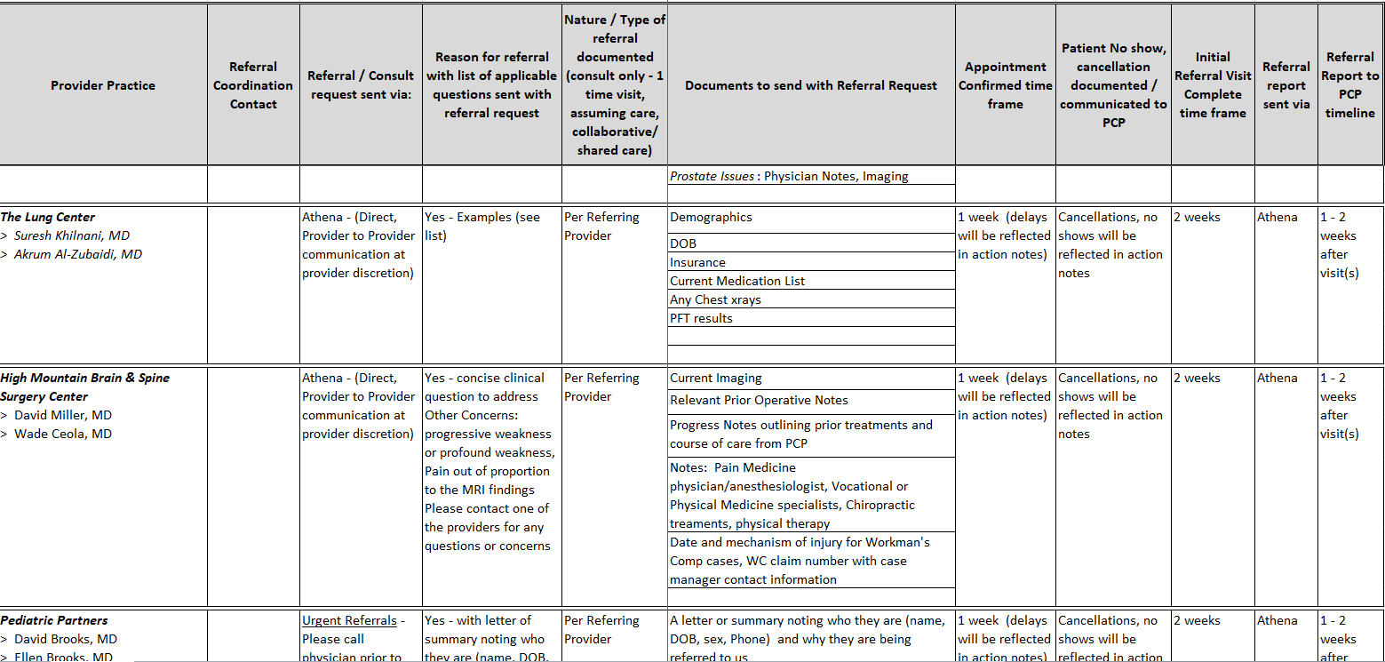

Example of System-wide CCA for Employed Multi-Specialty Physicians group

Slide 14
Wide Specialty Referral Base
Most specialists have a wide geographic referral base
Large institutions & Academic Medical Centers
  Many, if not most, referrals come from outside the “system” or institution
Private practice or smaller institutions
  Patients come from distant locations & a variety of referral sources
  Consider a Unilateral Care Coordination Agreement

Slide 15



Serving the entire referral base…
Mesa County Physicians IPA -295 physicians
Group CCA
In Western CO there are 2000+ Physicians, NPs, PAs, CNMW
In Eastern Utah ~ 100 clinicians

Slide 16
Example of Unilateral CCA
PLEASE SHARE THIS WITH YOUR PHYSICIANS AND ADVANCED PRACTICE PROVIDERS
We want to provide you with value-added and appropriate assistance with your ENDOCRINOLOGY referrals. Please note the requested information. Feel free to use your own referral form but please do include as much of the information as possible to help us expedite your patient’s referral.
Providing a summary of the issues necessitating referral or a clinical question will help us ensure that we address the appropriate concerns and also will help us triage the referral.
Every referral request is reviewed by the staff and our physician upon receipt.
We may ask that you do some additional testing prior to referral to prevent delay or to further define the process for your patient.
We want to be sure that you and your patient get the advice and assistance to care that is requested. We are working to align our referral response to meet those aims. We will do our best to tie into any CARE PLAN that has been established for the patient and to outline any endocrine care plan or action plan items. As we all know, this is a work in progress for all of us and please feel free to let us know if there are additional items or a different format that would be of more help to you in coordinating the care of our common patients.
Sincerely and Thank You,
Carol Greenlee MD and the staff of Western Slope Endocrinology

Slide 17
Western Slope Endocrinology Referral Form (“CCA”)
We will call the patient to schedule the appointment if appropriate and will notify you of the appointment date and time.
We will also notify you if we determine that the referral is not appropriate for our practice or if we are unable to schedule the patient.
We will send a referral response note usually within 2-3 days of seeing the patient. We most often send this by fax from our EMR.

Slide 18
Demographics
Full Legal Name: _______________________________________________DOB: ______________________
Home Phone: _____________________ Cell: _____________________ Work: ________________________
Referring Provider: ____________________________________________ Phone: _____________________
Referral Information
Clinical Question or Reason for referral (summary is helpful):
Type of Referral requested:
___Medical Consultation: Evaluate and advise with recommendations for management sent back to me
___Co-management: I prefer to share the care for the referred condition (PCP lead)
___Co-management: Please assume principal care for the referred condition (Specialist assumes care)
___Have Specialist determine which is most appropriate after their assessment of the patient
Is this routine____ or urgent____? ⁭
If urgent please indicate why and consider calling Dr. Greenlee to help us expedite care.
Is the patient aware that they have been referred to us and why? ___________________
Are there any special needs such as issues with mental competence, language or physical issues?
Is the patient the contact person? ______ If not, who is? __________________________________
Please include clinical data that is pertinent to the referral:
The patient’s core medical information (Demographics, Medication list, Allergy list, Problem list, etc)
Labs
Radiology reports
Clinical notes
Any additional medical history that is useful
If you have a CARE PLAN on this patient, please attach

Slide 19
WSE Unilateral CCA
Secondary Referrals
If you are referring the patient for a condition that may need endocrine surgery such as thyroid cancer, large multi-nodular goiter, hyperparathyroidism or a large pituitary adenoma please indicate if you and the patient have a preference for the surgeon. Otherwise, we will work with the patient and their needs and preferences to match the best surgeon for their situation. We will also help manage any needed perioperative endocrine care.
If a patient using an insulin pump develops a site infection, we will refer to an appropriate and available surgeon if I&D is needed or may call on the local PCP to help with assessment and appropriate referral as needed.
Occasionally endocrine patients need urgent ophthalmologic assessment for Graves’ Ophthalmopathy, optic nerve compression or retinal hemorrhage. Dr. Greenlee will refer to the most appropriate and available ophthalmologist in these situations.

Slide 20
Referral Request Elements Before & After Unilateral WSE CCA Referral Form
Basic Data
Clinical Question/RfR
Pertinent Data
Notes:
WSE = Western Slope Endocrinology (private solo endocrinology practice)

Slide 21
Primary Care Unilateral CCA
Wrap it into the referral request (spell it out)
38 yo female with suppressed TSH confirmed on repeat testing along with elevated fT4 (see attached), please evaluate for cause of hyperthyroidism and help with selection of most appropriate treatment option
Patient is in care management, she has unreliable phone & transportation services, please contact her care manager Ginger Rogers at 123-456-7890 for help with scheduling any tests or imaging
Please contact us before any secondary referrals
  Patient is under controlled substance agreement
  She is in CO Medicaid Prime plan (Value Based-Shared Savings plan)

Slide 22
Take a minute …
Do you have formal or informal care coordination or referral agreements with another practice now?
With which practice or practices would you most like to work out a care coordination or referral agreement ?
  What type of agreements (one-on-one or system-wide) might be best to start with in your situation?

Slide 23

Getting Started
Decide what to include in the Care Coordination Agreement
  Start with basics (elements of good referral process)
    Add in co-management elements if & when ready / needed
  Include critical issues that need to be addressed
Have a conversation
  “we really enjoy seeing your patients/we so appreciate your help with our patients…it would help us if…” or
  “we want to be sure you are getting what you need…”
Decide on forms
  Serves as checklist, helps with team care around referral

Slide 24


Basics that Benefit
Having a conversation
  Defining needs
    Many misperceptions
  Benefit of discussing issues/working together
“Forms”- “Formal” Agreement
  Defines the elements (reference, enduring, modifiable)
  Reinforces/encourages completeness (“compliance”)
    “Hard stop” for clinical questions
    “Patient informed” check box
    Enhances tracking & team roles

Slide 25
What is Included in the Care Compact ? (start with the basics)
Preparation of the patient
Type of referral /role of the specialist
Provide a clinical question with all referrals
Core data set to accompany all referral.
Pertinent supporting data for the referral
Communication protocol
Critical elements of the referral response
Protocol for making appointments
“Closing the Loop” protocol
.

Slide 26

Connecting the Agreement Pieces
The Referral Request checklist elements
  Scheduling protocol
  Close the loop referral tracking
The Referral Response checklist elements
Referral Guidelines
  List of urgent-intermediate-routine referral conditions
  Pertinent data sets / referral guidelines for specific conditions
Agreement on how to handle secondary diagnoses
Specifications on making secondary referrals

Slide 27
Template Care Coordination Agreement
PCP / Requesting
Neighbor / Responding
Prepare patient
  Use of referral guidelines where available
  Patient/family aware of and in agreement with reason for referral, type of referral, and selection of specialist
  Expectations for events and outcomes of referral
Provide appropriate and adequate information*
  Demographic and insurance information
  Reason for referral, details
  Core Medical Data on patient
  Clinical data pertinent to reason for referral
  -- Any special needs of patient.
Indicate type of referral requested:
  Pre-visit Preparation/Assistance
  Consultation (Evaluate and Advise)
  Procedure
  Co-management with Shared Care
  Co-management with Principal Care
  Full responsibility for all patient care
* See provided model check list of suggested areas to address.
Review Referral Requests and Triage According to Urgency
  Reserve spaces in schedule to allow for urgent care
  Notify referring provider of recognized referral guidelines and inappropriate referrals
  Work with referring provider to expedite care in urgent cases
  Verify insurance status
  Anticipate special needs of patient/family
  -- Agree to engage in pre-referral consult if requested.
  _ Provide PCP with number for direct contact for urgent/immediate matters.
Provide appropriate and adequate information in a timely manner*
  To include specific response to referral question; verify type role; any changes to diagnosis; medication; equipment; testing; procedures; education; referrals; follow up recommendations or needed actions
* See provided model check list of suggested areas to address.
12

Slide 28
Template Care Coordination Agreement
PCP / Requesting
Neighbor / Responding
Indication of urgency - Direct contact with specialist for urgent cases
Provide Neighbor with number for direct contact for additional information or urgent matters
  Needs to be answered by responsible contact Review secondary diagnoses or suggested referrals identified by Neighbor/specialist.
If co-managing with Neighbor, provide them with any changes in patient’s clinical status relevant to the condition being addressed by the Neighbor.
Contact the patient, if deemed appropriate, when notified by Neighbor of failure to keep appointment.
Indicate acceptance of referral category or suggest alternate option and reasoning for change.
Refer follow-up of any secondary diagnoses (additional disorders identified or suspected) back to the PCP for handling unless directly related to the referred problem.
  If secondary diagnosis is followed up by Neighbor, notify PCP.
Information regarding any secondary referrals made by Neighbor needs to be communicated to PCP.
Notify Referring Provider of No Shows and Cancellations.
If patient is self-referred or referred by another specialist/Neighbor, the PCP provider needs to be copied on the referral response upon obtaining appropriate patient permission.
13

Slide 29
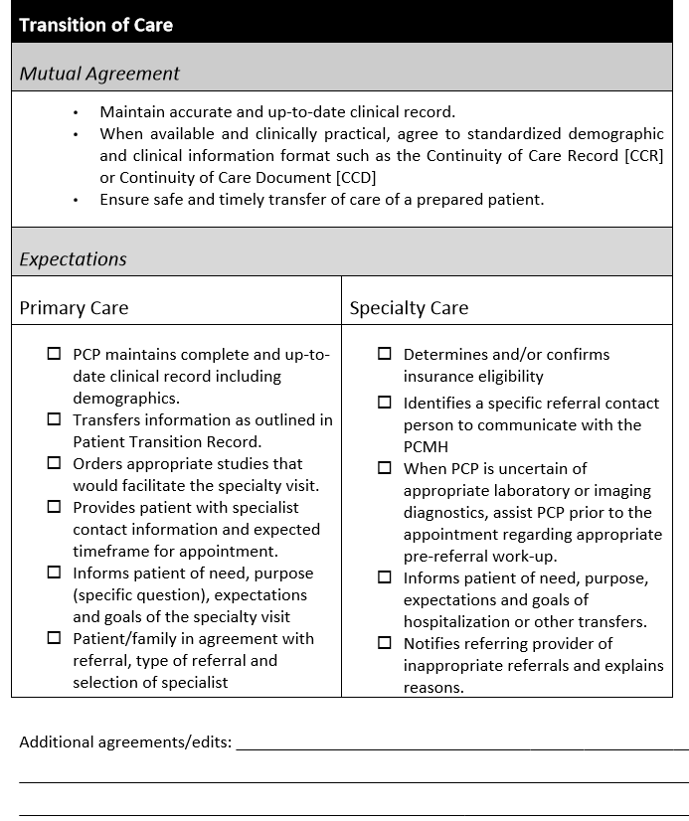
Example Guide for Care Coordination Agreement
The Mutual Agreement section of the tables reflect the core elements of the PCMH
and Medical Neighborhood
and outline expectations from
both primary care and
specialty care providers.
(When patients self-refer to
specialty care, processes should be
in place to determine the patient’s
overall needs and reintegrate
further care with the PCMH,
as appropriate.)

Slide 30
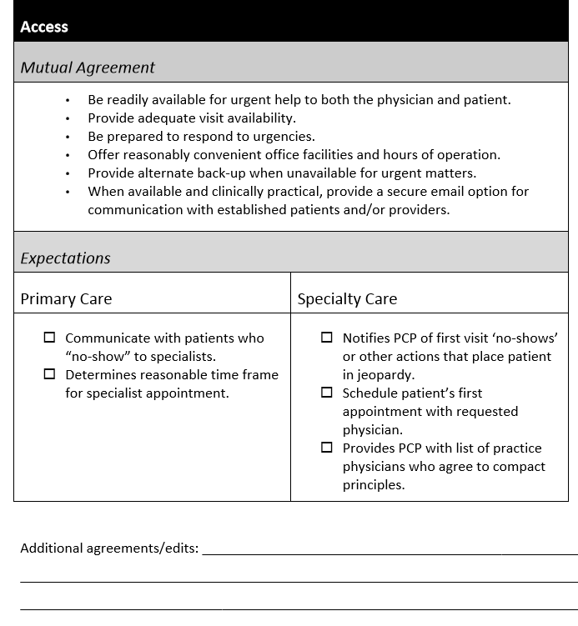

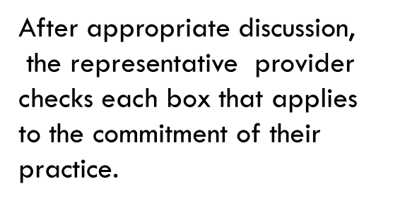
Example Guide for Care Coordination Agreement
The Expectations section of the table provides flexibility to choose what services can be provided depending on the nature of your practice and the working arrangement with PCP or specialist
Provides an area to add, delete
or modify expectations

Slide 31

Put it in action….
Identify another practice or practices that would be good to establish a care coordination agreement with
Have prepared offers & requests of what you can provide and what you would like them to provide
  Include what might be made available through EHR
Set up meeting with the practice teams or representatives from both practices
Mutually discuss and determine what needs to go into the agreement

Slide 32
Take a minute …
Think about how having a care coordination agreement to improve the referral process can improve access to specialty care
  List some ways this might help access to your practice or clinic

Slide 33
Improved Referral Process- Improved Access
Fewer inappropriate referrals (8% of referrals -average 43/specialist/year)
  Pre-consultation request & review processes
Fewer No Shows
  Prepared patient- participant in care
Fewer extra (additional) follow up appointments needed (60-70% of referrals to specialist lack information)
  High Value Referral Request
  Referral guidelines (pertinent data sets)
  Pre-consultation request & review processes

Slide 34
Improved Referral Process- Improved Access
Just by improving the referral process(including pre-consultation request & review process) for high value referrals- improve access
If able to add in use of “e-consults” (virtual clinician-to-clinician assistance)- even further improvement to access

Slide 35
E-consult vs Pre-consult
E-consult = a referral that would have needed to be face-to-face if e-consult had not been available but was no longer needed because of advice received through the e-consult process
Pre-consult = does not need a referral (no further assessment or management needed) or very straight-forward help or needs a different specialty type or preparation for face-to-face

Slide 36
Examples of Pre- and E-consultations
Pre-consultation
E-consultation
  “Are these slightly abnormal thyroid function studies of concern? Do they need further evaluation?”
    The response might be
      No concern, no further evaluation needed
      Recommend this additional testing …
      These are concerning, recommend formal…
A “tele-derm” photo of a skin eruption with which the referring clinician may not be familiar but which dermatology clinician recognizes (e.g. nummular eczema)
  able to provide adequate suggestions for treatment; the patient is started on the correct treatment and responds, a visit to Dermatology is avoided

Slide 37
Impact on Wait Times of Pre & E-consultations SFGH
Courtesy
E. Murphy SFGH

Slide 38
SFGH - Referral Disposition
Scheduled immediately for face-to-face appointment
  Ave 50-82% (ave ~60%) by surgical and women’s health reviewers
    Vs 27-76% (ave 48.6%) by medical sub-specialties
      Highest Neurology & rheumatology;
      Lowest Endocrine, Allergy, Hematology & Hepatology
  66% by NP reviewers
    Vs 50.9% by Physician reviewers
Scheduled after Pre-consultation exchange: 7-35%
Pure e-consultation: 7.7-59.3%
Reviewers “paid” 10% FTE or 4 hours/week: including Pre & E-consult work
Notes:
Tuot DS,et al. Leveraging an electronic referral system to build a medical neighborhood. Healthcare (2015), http://dx.doi.org/10.1016/j.hjdsi.2015.04.001i

Slide 39
Ottawa Hospital- Factors for Success for e-Consults
% avoided face-to-face referral
  Specialty Type
    Dermatology 49.5% / Hematology 46.5%/ Endocrinology 45%
    Vs Rheumatology 24.1% / OB GYN 28.2% / Neurology 30.8%
  Clinical Question Type
    What should I do / what would you do? - 44%
    Specific issues desired to be addressed - 30 to 47%
    Vs Does this patient need a referral ? - 25%
    Reviewers paid $200/hour pro-rated; includes e-consult work
Notes:
Telemedicine and e-health March 2016, vol. 22, no.3 Impact of Question Content on e-Consultation Outcomes

Slide 40
E-Consult project at UCSF
72 hour expectation
Specialist can convert to a scheduled visit for case complexity
Fielded by mid/senior-level specialist
0.5 wRVU payment to Specialist
0.5 wRVU credit for PCP (toward productivity)

Slide 41
E-Consult Drivers
Patient Perspective
I have a problem today
Another appointment can be a challenge:
  Missed work / arrange child care
  Out of pocket costs:
    Co-pay
    travel
    parking
        = $50+

Slide 42
E-Consult Drivers
PCP Perspective
Quick access to specialty guidance
A new specialist = more care coordination
I know the patient and scope of the question
Sometimes I want to own the problem
I know the family / I speak the language
Physician visits are a hardship
The patient may not follow through with a specialty visit

Slide 43
Examples of E-Consult Cases
Incidental lung nodule
Coronary Ca in LAD noted on chest CT obtained for cough. further work-up?
Bisphosphonate for 10 years. Should she continue in light of new evidence?'
"Irregular Z-line" on upper endoscopy in 2006. Does she need surveillance for GERD?
Is this Patient a candidate for HCV treatment?
PPD Conversion, breast feeding, should I start treatment?

Slide 44
Process Measures
14% were converted by specialists to in-office visits.
77% were completed within 72 hours
Time spent responding to each e-Consult
    <10 min = 56%
    10-20 min = 36%
    >20 min = 8%

Slide 45
Provider Surveys
Specialist Survey
  65% “strongly agreed” that the e-Consult question was clear
  61% “strongly agreed” that the question was of “optimal complexity”
Primary Care Survey
  83% “strongly agreed” that the e-Consult response influenced their care plan

Slide 46
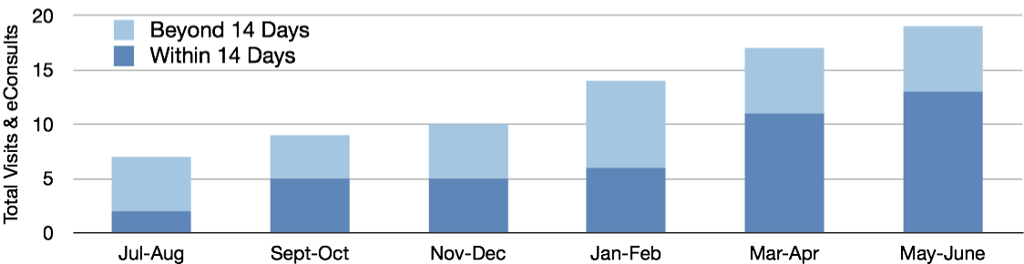
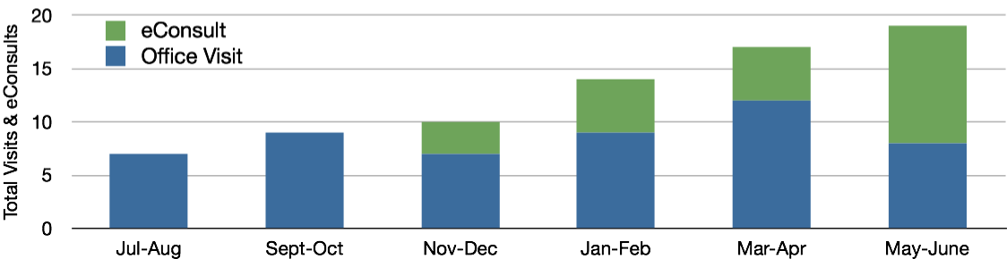
Access to Care: Infectious Diseases
Care Provided by UCSF I.D. for Core Population:
eConsults & New Patient Visits
Care Provided by UCSF I.D. for Core Population with 14-Day Target
(Office Visit + eConsult)

Slide 47
Take a minute …
Is there a place yet for E-consults in your practice or system?

Slide 48
Put it in action….
Look at the wait time for routine new patient appointments or follow up appointments to your practice or clinic
Ensure use of Pre-consultation review to sort out referrals that are inappropriate & to be sure referrals you see are prepared (high value)
Identify referral conditions or questions that might be able to be handle by e-consults (virtual clinician-to-clinician consultation)

Slide 49

Leave in action….
Develop a Care Coordination Agreement
  Work with at least one referring or referred to practice
  Develop expectations & agreement of the elements to be included in a Referral Request & Referral Response for all referrals
  Consider including referral guidelines for specific conditions
Utilize the High Value Care Coordination referral processes to maximize access to your clinic or practice
  Monitor to be sure you efforts are sustained
  Follow wait times & track referrals

