Slide 1

Connecting Care
Ensuring Quality Referrals and Effective Care Coordination
the Medical Neighborhood
Action Step #3
Ensure Others Get What They Need
ACP SAN special project
for implementing
High Value Care Coordination
Carol Greenlee MD FACP

Slide 2

Action Steps to Connected Care
Look at your internal referral process (get your own house in order)
Ensure you get what you need for a high value referral
Ensure others get what they need
Develop Care Coordination Agreement(s) (compact) with appropriate referring practice(s)
Three (3) Action Items to Establish:
Basic Elements of a Referral Request
Referral Criteria/ Guidelines
  Risk Stratify Urgency
  Pertinent Data Set (Referral Guidelines)
Pre-consultation/ Pre-visit review process

Slide 3
Recommendations for “Neighborly” Response to Pre-consultation Request or Review
“It appears this patient was referred for Lupus and would benefit more from referral to Rheumatology rather than Endocrinology. However, if there are endocrine issues that I failed to recognize and that need to be addressed, please let me know and we will schedule …otherwise we will defer scheduling at this time…”
“It appears that this referral is regarding a 4 mm thyroid nodule noted on thyroid ultrasound. Current ATA thyroid nodule guidelines indicate that no further evaluation is needed. If there are additional concerns that I missed, please let me know…otherwise, we will defer scheduling at this time” (consider “here is what the current guideline states [copy &paste]”)
Consider a call to clarify (and build the relationship and the process)
Avoid “deferred”, “not appropriate”, “reject”

Slide 4
Action Steps to Connected Care
Look at your internal referral process (get your own house in order)
Ensure you get what you need for a high value referral
Ensure others get what they need
Develop Care Coordination Agreement(s) (compact) with appropriate referring practice(s)

Slide 5

As you listen…
Be focused and engaged
Be open to envisioning ways to ensure others get what they need from the referral, including
  The patient
    Needs, goals, understanding, participation
  The referring clinician and practice
    A high value referral response report/note
    Close-the-loop referral tracking processes
  The recipients of any secondary referrals that you request (other specialists, ancillary services)
    A high value referral request sent & tracked and reconciled

Slide 6
Case: Non-Patient-Centered Referral Experience
Pt is given a paper for an intermediate referral for worsening XXX but doesn’t really understand why he is being sent.
  Waits to hear from someone to schedule for 2 weeks but doesn’t hear and decides to call his PCP.
Specialist office finally calls the patient to schedule in a month but didn’t know it was an intermediate referral.
  When the pt. arrives, the specialist doesn’t know why the patient was sent and proceeds to order labs and tests.
The patient leaves confused and not sure if he will return because he didn’t feel listened to and didn’t understand the reason for seeing a specialist to begin with.
3 months later when the patient visits his PCP, the PCP finds out he never went back to specialist ; he did go to the ED with complaints of his condition but his care team was not notified by the ED of the visit.

Slide 7
Case: Patient-Centered Referral Experience
Patient is referred by his PCP for an intermediate referral for worsening XXX after discussing the goals of the referral and how the appointment will be scheduled
The specialist office calls the patient the next day to schedule.
  The patient is seen within two weeks and when he arrives, the specialist seems to know all about his case.
  The specialist even knows that his goal is to be active and play with his grandchildren again.
They review the labs and tests that were completed prior to the appointment and discuss next steps which involve his PCP.
The patient leaves with an understanding of next steps and the specialist sends a report including the plan of care to the PCP.
  Patient makes his next appointment and feels confidence in his healthcare team.

Slide 8
The Patient Experience in the Referral Process
“My doctor told me why he sent me to see you but I was so upset about the news he gave me that I don’t remember what he said.”
“I was supposed to call to schedule with that specialist? I thought her office was supposed to contact me.”
“I understood I was here to have the procedure today, not just to talk about my stomach pain!”
“I had that MRI last month. You mean I was supposed to bring the report and the films with me to this visit? I assumed you had that information.”
“I took the day off of work, drove 2 hours to get here and now you tell me this is not the right doctor for my problem?”

Slide 9
Meeting the Patient’s Needs in the Referral Process
A referral is part of taking care of the patient,
by both the requesting & receiving practices
It is an extension of care meant to help meet the needs of the patient
  in the most appropriate way, including
    Urgency
    Role of the specialist
  in a patient-centered way

Slide 10




Patient-Centered Care is more than caring
Caring about the patient is central & crucial
but
Patient (Person & Family)-Centered care also requires
delivering care in a Patient-Centered way
What does that mean?

Slide 11
IOM (Institute of Medicine)
Definition of Patient Centered Care
“Providing care that is
respectful of and responsive to
individual patient preferences, needs and values, and ensuring that patient values
guide all clinical decisions.”
Notes:
IOM now National academy of Medicine

Slide 12
Core Concepts of Patient-Centered Care
Dignity and Respect.
  Health care practitioners listen to and honor patient and family perspectives and choices.
  Patient and family knowledge, values, beliefs, and cultural backgrounds as well as literacy capabilities are incorporated into the planning and delivery of care.
Information Sharing.
  Health care practitioners communicate and share complete and unbiased information with patients and families in ways that are affirming and useful.
  Patients and families receive timely, complete, and accurate information in order to effectively participate in care and decision-making.
Participation.
  Patients and families are encouraged and supported in participating in care and decision-making at the level they choose.
Collaboration.
  Patients, families, health care practitioners, and health care leaders collaborate in policy and program development, implementation, and evaluation; in facility design; in professional education; and in research, as well as in the delivery of care.

Slide 13
What matters to the patient…
…the first step in understanding patient-centered care is an understanding of our patients’ perceptions of their care–
what is important to them,
how well we are delivering care,
what factors in our patient care improve outcomes
We need to attempt to move from “what’s the matter” with our patients to “what matters” to our patients.

Slide 14
The Referral Request - Prepared Patient
Patient aware of and in agreement with referral with appropriate expectations (opportunity for Shared Decision Making)
  Is patient willing to participate in the referral
  Does patient understand & agree with the reason for referral and understand what additional expertise is needed
    Are patient’s expectations realistic
  Is patient willing to accept Pre-consultation advice or assistance from specialty care,
    Including if “ no appointment required”
    Is “e-consult” (virtual consult) advice an option patient accepts
  Does patient have concerns about the referral or the specialty practice
21
Notes:
The pt needs to be part of pt centered care

Slide 15
The Referral Request - Prepared Patient
Consideration of what matters to the patient
  Patient specific goals
    What the patient hopes to gain medically (e.g. avoid surgery vs undergo surgery; ensure diagnosis or Rx is correct/optimal, etc.)
    Goals for life (be able to care for grandkids, travel, etc.)
  Reading material or other preparation for patient prior to appointment
    Explaining type of specialist or procedure
    Information on referral condition or concerns
    Flyer from specialty practice about the practice
  Logistics / “Burden”
    Location/ hours/transportation/appropriate wait time
21
Notes:
The pt needs to be part of pt centered care

Slide 16
The Referral Request - Prepared Patient
Alert specialty practice of any special needs or considerations for patient / family
  Impaired vision, hearing, cognition, ambulation, etc.
    Need to be aware for scheduling, forms, rooming needs
  Caregiver status
    Does spouse, adult offspring, case manager, etc. need to be involved in scheduling , in the visit and/or care plan/self-management
  Transportation
    Will PCP/Requesting practice help arrange if needed
    Distance or other considerations (time of appointment, hotel needs)
  Pain Management Agreement, Advanced Directives, Behavioral Health or Care Management arrangements and contacts
21
Notes:
The pt needs to be part of pt centered care

Slide 17
The Referral Request - Prepared Patient
Use of Referral Guidelines (specific to the patient/condition)
  Appropriate specialist at appropriate time
  Appropriate preparation with testing or therapeutic trials prior to referral
Patient understands role of specialist and who to call for what
  Consultation for Advice (PCP to manage)
  Consultation for Procedure
  Co-management help from specialist
    Shared Care (PCP first call)
    Principal Care (Specialist first call for the condition)
Over time the role of specialist may be fluid (change) as disease/ patient changes
21
Notes:
The pt needs to be part of pt centered care

Slide 18
  High Value Care Coordination Toolkit April 2014 http://hvc.acponline.org/physres_hvcc_project.html
An outline of recommendations to physicians on preparing a patient for a referral in a patient-centered manner.

Slide 19
The Referral Response: Ensure the Patient’s Needs are Met
Patient scheduled according to urgency or priority of referral needs
  Coordination with requesting practice (contact with specialist for urgent referrals with interim assistance)
  Pre-consultation review with risk stratification of referral needs
  Capability to schedule according to urgency of referral needs
Pre-visit preparation for the appointment
  Ensure needed information received & referral appropriate
  Review of clinical question & supporting data as pre-visit prep by clinician
21
Notes:
The pt needs to be part of pt centered care

Slide 20

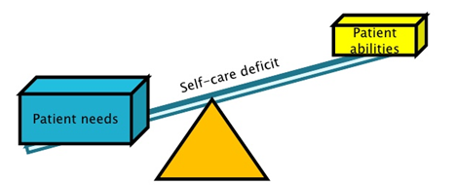
The Referral Response: Ensure the Patient’s Needs are Met
Consideration of what matters to the patient
  Patient concerns voiced & listened to
    The patient’s story
  Patient specific goals
    Medical aspects as well as for their life activities
Shared Decision Making for diagnostic or management options
  The best clinical evidence adapted to
    the patient’s values & preferences
    the burden of care and patient capacity
    the patient’s needs & circumstances (contextual care)
21
Notes:
The pt needs to be part of pt centered care

Slide 21


Take Context into Consideration
Context = the patient’s needs and circumstances
Consider
  Patient goals, values, priorities, concerns, fears
  Cost / affordability
  Patient’s schedule vs the treatment schedule
  Patient literacy , numeracy and self-efficacy
  Transportation needs and availability
21
Notes:
The pt needs to be part of pt centered care

Slide 22


Take Context into Consideration cont.
Context = the patient’s needs and circumstances
Consider
  Caregiver status
  Any impairments (visual, hearing, cognition, ambulation)
  Food or housing insecurity
  Mental or behavioral health needs
  Medical comorbidities
21
Notes:
The pt needs to be part of pt centered care

Slide 23


The Referral Response: Ensure Patients’
Needs Are Met
  Explanation of test results and implications
Clarity around medication changes & instructions
Clarity around care plan instructions & self-management goals
Clarity regarding alarm symptoms & who /when to call
  Clear instructions and expectations with teach back
21
Notes:
The pt needs to be part of pt centered care

Slide 24




Embrace the Importance of Relationships
In Connected Care
  Caring
“The secret of the care of the patient is in caring for the patient” Peabody
  Curiosity & Compassion
“Do we meet each person curious about the miracle of a human being that we are about to connect with?” Senge
  Connection, Cooperation & Camaraderie
“… being part of a great team… most striking is the meaningfulness of the experience… being part of something larger than themselves, … being connected… being generative” Senge

Slide 25

Put it into action….
Identify at least one way your practice can deliver more patient-centered care around the referral process
Commit to implement the new approach … and to implement additional improvements over time (culture of continuous improvement)
Consider doing a patient experience survey about the referral process

Slide 26
Meeting the Needs of Requesting
Clinician and Practice
A high value referral response report or note
  Perform an audit of specialist’s referral response
    Ensure presence of critical elements & clarity
    Ensure critical information easy to access (location)
    Develop improvement plan for any identified gaps
Close-the-loop referral tracking processes
  Create the process & any needed forms
  Assign roles & responsibilities
  Track the process

Slide 27
Antithesis of High Value Coordinated Care:
Case 1:
  59 yo man with T2DM, HTN, Hyperlipidemia & obesity
    referred to cardiology with unexplained DOE.
    28 page note from the cardiologist
      only ICD codes for impression
      no indication of what the cardiologist thinks or is going to do or what s/he recommends the PCP do
  Disconnected Care
    More questions than answers
    Safety concerns

Slide 28
High Value Referral Response
Answer the clinical question/address the reason for referral
  Summary or Synopsis (include some thought process)
Agree with or Recommend type of referral / role of specialist
Confirm existing, new or changed diagnoses; include “ruled out”
Medication /Equipment changes
Testing results, testing pending, scheduled or recommended (including how/who to order)
Procedures completed, scheduled or recommend
Education completed, scheduled or recommended
Any “secondary” referrals made (confer with and/or copy PCP on all)
Any recommended services or actions to be done by the PCMH
Follow up scheduled or recommended

Slide 29
Antithesis of High Value Coordinated Care:
Case 2:
  54 yo male with thyroid nodule evaluated by endocrinologist with report to PCP indicating “FNA shows Papillary Thyroid Cancer. Needs surgery.”
    F/u appt with PCP a year later shows thyroid intact and nodule still palpable…
  Risk:
    Delayed care: potential harm to patient
    Liability concerns

Slide 30
Referral Response: Critical Elements
Answer the clinical question/ address the reason for referral
  Summary or Synopsis (include some thought process)
Clear indication of diagnosis/evaluation &/or the treatment plan
  What is the specialist going to do
  What is the patient instructed to do
  What does the referring physician need to do & when
What follow up is needed and with whom

Slide 31
High Value Referral Response
Make your referral response easy for the referring practice to review & utilize (“user friendly”)
  Do not want to contribute to “data dump” problem (send multiple page report where the referring physician cannot easily access critical information)
  If possible, develop synoptic summary of referral response (checklist format for data elements)
  Set up protocol with referring physician that critical elements will be placed in a specific part of or location in the referral response report e.g. Under “Assessment and Planning”

Slide 32
“Synoptic” Referral Response
Answer to clinical question: Based on her need for mealtime insulin but reluctance/inability to administer injections during work day as first grade teacher, we have opted for her to try Premixed insulin before breakfast and dinnerastand dinner.
Type of referral: agree with Shared Co-management
Diagnosis: no change
Testing: pocA1c 9.6%
Medication changes:
  Stop Lantus insulin
  Start Humalog mix 75/25 as 20 units before meals twice daily
Equipment changes: none
Self management:
  Titration sheet for insulin adjustments
  Patient to measure BG before lunch and at bedtime and FBS
F/U: 2 weeks with endocrine and then in another 4 weeks with PCP
34

Slide 33
Example: Nephrology referral response for evaluation of 36yo male with Type 1 diabetes with Cr 1.9 and K+ 5.7
Impression: Stage 3 CKD
Plan: Recommend change from ACEI to CCB
Why ?
Who does what ?
What is plan for f/u and which provider ?
Impression: Stage 3 CKD due to type 1 diabetes and HTN with no evidence of additional autoimmune renal disease
Plan: Shared Care with annual f/u
Recommend change from ACEI to CCB due to persistent significant hyperkalemia due to type IV RTA & to delay renal replacement
I have provided script for amlodipine 5 mg qd with refills x11
He is to see you for BP check and Renal Panel in 1 month to recheck K+ and Cr
Please feel free to contact me if K+ still elevated or BP not controlled
Provided handouts on CKD to patient
Notes:
In this case the referring physician asked if this patient’s declining renal function was due only to his diabetes or was there perhaps another autoimmune process going on and asked for recommendations for management: the response left more questions than answers…if the responder had included the expected elements for the referral response then the handoff would have been much more satisfying and the physician picking back up the care would be more in alignement with the overall plan of care

Slide 34

Put it into action…
Audit at least 5 Referral Response notes (notes or reports sent back in response to an initial referral request), and/or:
Ask one of your practice partners or a referring clinician to audit your Referral Response notes
Check for the critical elements
Is critical information easy to find in the note
Create an improvement plan for any identified gaps

Slide 35

Open Loop – Open Ended
53 year old man had skin lesion resected by PCP
  Pathology showed melanoma
  Referred to Dermatology for the needed further management
  Patient was No Show for Dermatology appointment
  …and neither clinician was aware…
Notes:
Patient could have been unclear for reason, thought already resected why need to see derm; could be fearful, could have co-pay/cost concerns, could have had car trouble, could have forgotten

Slide 36
REASONS FOR NO-SHOWS
Overscheduling/forgetting about appointment
Feeling that condition has worsened and opting to go to the emergency room instead
Not understanding why appointment is necessary
A limited relationship with their physician making them less concerned about skipping an appointment
A language barrier that causes them to misunderstand when appointment is scheduled
Socio-economic factors
Worries about receiving bad news and hoping to avoid the situation
Some patients may simply feel better and not need the appointment, but fail to notify the office.
Annals of Family Medicine
Usually not defiance or
being a contrarian

Slide 37
Referral Tracking “Closing the Loop”
Referral request sent & logged
Referral request received and reviewed – referring practitioner notified:
  Referral accepted with confirmation of appointment date & time (note if patient on a move up list)
    If request is a secondary referral, include PCP in notification (e.g. patient referred by endocrinology, GI, cardiology to surgery)
    Notify if appointment is moved up or re-scheduled
    Ask for additional information if missing critical items or special request to aid & expedite assessment or management
    Need process to track to ensure that all missing/ special request information is received

Slide 38
Referral Tracking “Closing the Loop”
Referral request received and reviewed – referring practitioner notified, continued:
  Referral declined due to inappropriate referral (wrong specialist, further assessment &/or management not indicated )
    How is this communicated to the requesting practice?
      Who sends referral request to the appropriate specialty
    How is this communicated to the patient ?
  Patient defers making appt or cannot be reached
    If unable to contact patient, confirm correct contact information
    Establish time frame for notifying requesting practice based on urgency of the referred condition

Slide 39
Referral Tracking “Closing the Loop”
Referral response sent -
  Referral Note (report) sent to requesting clinician &/or PCP
    Ensure Addresses clinic question or reason for referral
    Sent in timely manner (usually considered within 1 week of visit)
    Process for notifying requesting practice and/or PCP of test results that come back after the referral response note sent
  Notification of No Show or Cancellation
    If patient cancelled, include reason for cancellation if known
    Notice of NO SHOW and any policy on rescheduling

Slide 41
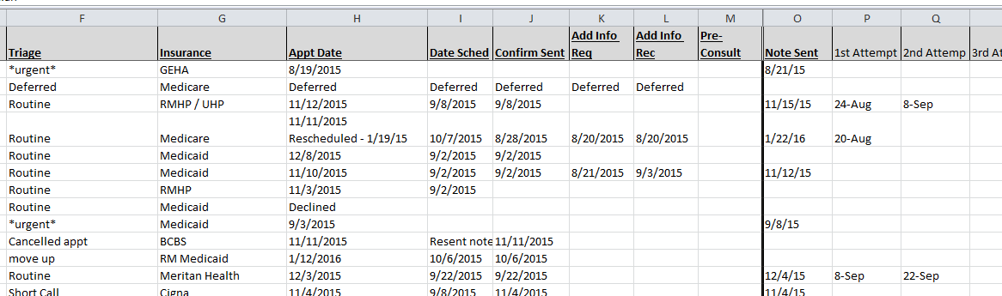
Close the Loop Referral Tracking

Slide 42
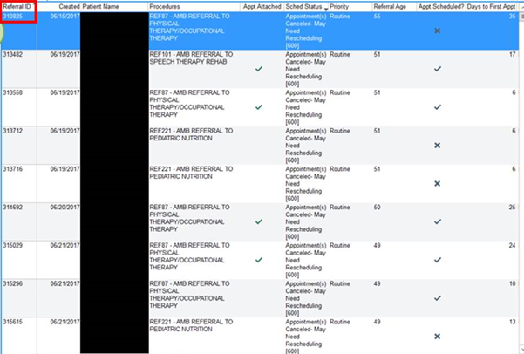
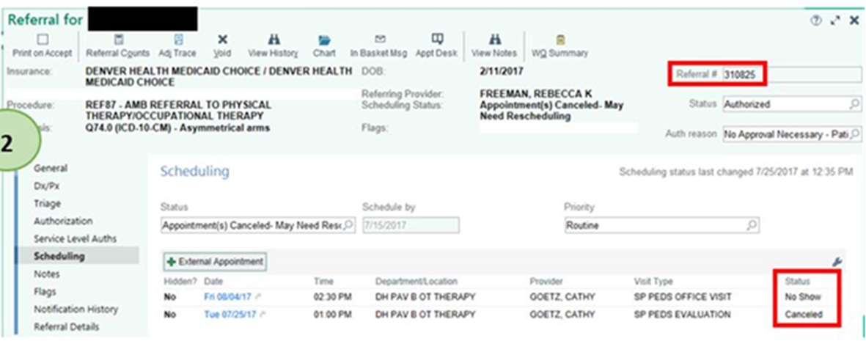
Referral Tracking at Denver Health (EPIC)
Notes:
DH through epic reports is able to work the queue daily in reconciling appointments made, cancellations that need to be rescheduled, and no-show appointments that may need a navigator to call the patient to ensure there aren’t any barriers to attending the appointment. The clinic sending the referral is responsible for tracking their patient referrals….from the time of referral initiation to close the loop. Each patient is accounted for in the referral process. In this example the scheduling status shows what needs to happen with the patient and the care team can take action in providing a high valued referral.

Slide 43
Referral Tracking “Closing the Loop”
Self-referred patient
Referral request received and reviewed
  Handle c/w practice policy
  Clarify reason for referral / clinical question
  Ensure appropriate specialty
  Attempt to get records in advance
Referral response sent -
  Referral Note (report) sent to PCP and appropriate other clinicians (unless patient has strong objections despite reassurance)

Slide 44
Put it in action….
Identify team member(s) for the role & responsibility of closing-the-loop for referral requests to & from your practice
Create any needed forms for the close-the-loop process
Determine how you will track the close-the-loop process
Make it part of the referral process for your practice

Slide 45
The Referral Black Hole
84 yo man with upper extremity radicular pain referred by his PCP/ PCMH to Neurosurgery for possible spinal stenosis
  MRI shows Cervical DJD & a large thyroid mass
  Neurosurgeon notes MNG with 4 cm thyroid nodules
Refers to Endocrinology
  Does FNA of thyroid nodules
  Cytology benign but surgery discussed
Refers to ENT
  Schedules surgery for thyroid
ENT refers to another Primary Care practice for pre-op clearance
Patient’s PCP learns of planned procedure from a hallway conversation-arranges follow-up with patient
Patient asks PCP if thyroidectomy will relieve his neck and shoulder pain

Slide 46
Secondary Diagnoses
Another disorder related to or unrelated to the reason for referral
  Can be diagnosed during evaluation of referral condition
    Can be related to the specialty area or not
  Can be brought up by patient complaint or history
    Can be related to the specialty area or not
50

Slide 47
Secondary Diagnoses
Another disorder related to or unrelated to the reason for referral
Suspected Sleep Apnea in a patient referred for cardiac disease
Celiac disease in a patient referred for severe osteoporosis
Hemochromatosis in a patient referred for diabetes with hypogonadism
Hepatitis C in a patient referred for Sjogren’s
GERD in patient referred for hoarseness
Rash in a patient seen by General Surgery re gallbladder
Headaches in patient seen by GI for diarrhea or constipation
GERD symptoms in patient seen for hyperthyroidism
Heart palpitations in patient seen by ortho for knee pain
Knee pain in patient seen by cardiology for heart palpitations

Slide 48
Recommendations: Handling Secondary Diagnoses Pending Care Coordination Agreements
Secondary diagnosis discovered as part of the evaluation of the referred condition & related to the referred condition & in specialist’s field of expertise
  Specialist assumes management (e.g. Cushing’s Syndrome discovered during evaluation of severe osteoporosis by endocrinology)
All other Secondary Diagnoses are best handled by deferring to or at least first conferring with the Primary Care team. (even if it is something that falls under the specialty sphere).

Slide 49
Secondary Referrals
OB GYN to Perinatology or GYN Oncology
Rheumatology to Hand Surgeon or Physical Therapy
Endocrinology to Nuclear Medicine or Ophthalmologist
GI/Endocrine/Cardiology/Oncology to Surgery
Appropriate Secondary referrals (related to principal condition) can expedite care (if allowed by insurance plan policy)
Inappropriate Secondary referrals waste resources (e.g. referral to a non-related specialty vs back to Primary Care)
51

Slide 50


Avoid the Black Hole
Connecting the care with communication, cooperation
& collaboration is the best approach

Slide 51
Meeting the Needs of Those You Refer To
Ensure appropriate & high value secondary referrals
  Secondary referrals arise from a referral request to another specialty/ subspecialty practice for consultation, procedures, or co-management by a specialty practice (by one specialty practice to another specialty practice)
  In some instances, the referral for special services may require some specialty knowledge and may best be managed by the specialty/subspecialty practice
    E.g. endocrinology referring to endocrine surgery for pheochromocytoma; cardiology referring to cardiothoracic surgery for valvular heart disease; GI referring to surgery for bowel resection for refractory Inflammatory Bowel Disease

Slide 52
Meeting the Needs of Those You Refer To
Ensure appropriate & high value secondary referrals
  There needs to be clear expectations for when the PCP wishes (or is required by insurance plan) to be involved in secondary referrals & when it is preferable for the specialty/subspecialty practice to proceed without conferring with PCP (if allowed by insurance plan)
  In all cases, the PCP needs to be included in the communication regarding the secondary referral & the outcomes of that referral and a process for ensuring this communication connection needs to be established

Slide 53
Consider establishing agreement for secondary referrals that expedite care (example from WSE CCA)
If you are referring the patient for a condition that may need endocrine surgery such as thyroid cancer, large multi-nodular goiter, hyperparathyroidism or a large pituitary adenoma please indicate if you and the patient have a preference for the surgeon. Otherwise, we will work with the patient and their needs and preferences to match the best surgeon for their situation. We will also help manage any needed perioperative endocrine care.
If a patient using an insulin pump develops a site infection, we will refer to an appropriate and available surgeon if I&D is needed or may call on the local PCP to help with assessment and appropriate referral as needed.
Occasionally endocrine patients need urgent ophthalmologic assessment for Graves’ Ophthalmopathy, optic nerve compression or retinal hemorrhage. Dr. Greenlee will refer to the most appropriate and available ophthalmologist in these situations.

Slide 54
If You Do Make a Secondary Referral Request
Be sure to
  Include the Patient’s PCP/ PCMH in the decision or at least cc on the referral request
  Include critical elements of a high value referral request:
    Prepared Patient
    Type of referral
    Clinical question
    Urgency
    Core Data Set
    Pertinent Data set
  Track the referral request until reconciled

Slide 55
Put it into action….
Identify which secondary diagnoses you should handle for patients referred to you
  Or when handling these secondary diagnoses expedites care
Identify when a secondary referral request from your practice is appropriate (requires specialty expertise and expedites care) (and how to know when insurance plan requires PCP to refer)
Ensure PCP is included in the communications involving the Secondary Diagnoses & Referrals

Slide 56
Leave in action….
Identify at least one way to better partner with patients around the referral process
Audit referral response notes with improvement plan for any identified gaps
Put in place a close-the-loop tracking process
Clarify & Define expectations around how to handle secondary diagnoses & secondary referrals
Materials for Action Step 3
Recommendations for a Patient-Centered Referral
Patient Experience Surveys
Outpatient Referral Response Checklist
Referral Response Audit tools
www.acponline.org/hvcc-training

