Slide 1
Connecting Care Ensuring Quality Referrals and Effective Care Coordination
the Medical Neighborhood
Action Step #2, webinar 1
The Referral Request &
Referral Criteria
ACP SAN special project
for implementing
High Value Care Coordination
Carol Greenlee MD FACP

Slide 2
As you listen…
Think about what is needed with a referral request to provide the most appropriate care for the referred patient including
Appropriate timing (urgency) of the referral appointment
Addressing the referral problem & patient’s goals
Reducing waste or unnecessary resource use for the patient, the practice and the health care system

Slide 3
The Referral Request
Patient in exam room with cc/o “fatigue” (or “lungs” or “heart” or “anemia” or “pain”…)
Not sure what testing was done or treatments tried before referral
Asked front desk staff to call the referring practice to get records faxed/sent…

Slide 4
Surveys show this scenario is all too common
68% of specialists reported receiving no information from the primary care provider prior to referral visits;… and if they received info… 43% of specialists were dissatisfied with the information they received Gandi et. al. J Gen. Int. Med. 2000
Only 34.8% of specialist received notification of a patient's history and reason for consultation before the referral appointment (65.2% did not) O’Malley, AS, Reschovsky JD. Arch Intern Med. 2011;171(1):56-65
In Colorado, 37% of specialists receive necessary information (63% do not) Systems of Care survey, Colorado Medical Society
This is not good for the patient
Not good for the clinician or practice
Not good for the system

Slide 5
Action Steps to Connected Care
Look at your internal referral process (get your own house in order)
Ensure you get what you need for a high value referral
Ensure others get what they need
Develop Care Coordination Agreement(s) (compact) with appropriate referring practice(s)
Three (3) Action Items to Establish:
Basic Elements of a Referral Request
Referral Criteria/ Guidelines
Risk Stratify Urgency
Pertinent Data Set (Referral Guidelines)

Slide 6
1st Define the Basic Elements of the Referral Request
Check list for a high value Referral Request
Patient Demographics & Scheduling Information
Referral Information
Patient’s Core Data Set
Care Coordination/Referral Tracking

Slide 7
Patient Demographics & Scheduling Information
Name, demographics, contact info, surrogates
Special considerations (impaired hearing, vision, cognition, etc..)
Insurance information
Referring clinician/practice name, contact info (including direct contact for urgent matters)
Indicate that patient/surrogate understands and agrees with the purpose of (and type of) referral
Indicate whether
Patient should call to schedule
Specialty practice should contact the patient

Slide 8
Patient Demographics and Scheduling Information
Name, demographics, contact info, surrogates
Special considerations (impaired hearing, vision, cognition, etc..)
Insurance information
Referring clinician/practice name, contact info (including direct contact for urgent matters)
Indicate that patient/surrogate understands and agrees with the purpose of (and type of) referral
Educational material for patient (on disorder or specialty)
Indicate whether
Patient should call to schedule
Specialty practice should contact the patient

Slide 9
Prepared Patient
Patient as partner in care
Patient included in the process & in agreement with referral
Is the patient willing / intending to go to the referral appointment ?
The patient’s needs & goals considered- what matters to the patient
Specialty practice alerted of any special needs of the patient
Visual, hearing, cognitive impairment, ambulation issues
Transportation, travel / distance considerations
Challenges with phone service
Caretaker considerations
Care Management arrangements-assistance
Notes:
The pt needs to be part of pt centered care

Slide 10
Define the protocol for making appointments
Set parameters around time limit for waiting to receive that call
establish a process for what to do if patient has not called
e.g. if patient has not called to schedule within a week of us (specialty practice) receiving the referral request, we will call the patient (or we will notify PCP)
the expected protocol:
the patient will call to schedule an appointment
the specialty practice should contact the patient
Allows for Pre-visit assessment/referral disposition
Allows for tracking of referrals / accountability

Slide 11
Referral Information
What is the specific clinical question (reason for referral)
A brief Summary of case details pertinent to the referral, include relevant co-morbidities (alarm signs or symptoms)
Urgency (referral status or referral priority)
Referral Type (anticipated, pending specialist’s evaluation) (Referral Definition or Role in care requested of the specialist)
Pertinent data set: Clinical information directly relevant to the specific referral question (office notes, test results, etc.) (Supporting data for the referral)

Slide 12
Provide a Clinical Question (or summary of reason for referral) with all referrals
“eyes” “gallbladder” “diabetes”
68 year old female with intermittent double vision. Is ophthalmopathy assessment the correct starting point?
39 year old female with severe RUQ pain, abnormal US and known diabetes, does she need surgery?
20 yo female with T1DM since age 8 on insulin pump therapy, transferring from pediatric to adult care

Slide 13
Summary of Case pertinent to the referral
Clinical question or reason for referral & summary: & “
Help introduce the patient’s story
“Please help determine which next treatment option is best suited for a 62 yo first grade teacher who has had diabetes for past 10 years. She was allergic to SU; had diarrhea with metformin, edema with Pioglitazone and is now on Long Acting insulin 60 units once daily with widely fluctuating glucose levels and A1c of 10.2%. She is reluctant to check her BG or take injections during the work day due to working with children and the demands of school teacher.” ( note: this also “turns the patient into a person”)

Slide 14
Take a minute …
How would having a clinical question help your practice handle referral requests more effectively?

Slide 15
Referral Type (what is the suggested role of the specialist)
____ Pre-visit Advice / Pre-consultation
____ Consultation (Evaluate and Advise, with the goal of managing the problem remaining with the referring clinician)
____ Procedural Consultation
____Co-Management with Shared Care (Referring clinician (e.g. PCP) maintains first call for the referral disorder)
____ Co-Management with Principal Care (Referred to subspecialist/specialist assumes first call for the referral disorder)
____ Please assume Full Responsibility for Complete Transfer of all Patient Care (e.g .Pediatric to Adult care transition)

Slide 16
Pre-consultation Request & Review
Intended to expedite/prioritize care
Previsit Request for Advice & Assistance
Does the patient need a referral
Which specialty is most appropriate
Recommendations for what preparation or when to refer
Previsit Review
Is the clinical question clear
Is the necessary data attached
Triage urgency (risk stratify the patient’s referral needs)
Urgent Cases
Expedite care
Improved hand-offs with less delay and improved safety

Slide 17
Formal Consultation
Cognitive consultation (advice)
To obtain specialist’s opinion on a patient’s diagnosis, abnormal lab or imaging study result(s), treatment or prognosis
Limited to one or a few visits that focus on answering a discrete question.
Procedural consultation
To obtain a technical procedure for diagnostic, therapeutic or palliative purposes
Include detailed report back to referring physician
Examples: Colonoscopy, Bone Marrow Biopsy, MRSA infection with recurrent carbuncles

Slide 18
Co-Management (ONGOING management of a patient’s medical condition)
Shared Care for the disease
(PCP responsible for Elements of Care, takes ‘first call’)
Principal care for the disease.
(Specialist responsible for Elements of Care for that disorder or set of disorders, takes ‘first call’ for the disorder)
Principal care of the patient for a consuming illness for a limited period of time
(specialist serves as first contact but patient maintains PCP as medical home/ hub of care)

Slide 19
Co-Management Oncology examples:
Shared Care for the Disease
CLL
Principal Care of the Disease
Ductal carcinoma in situ (non-invasive breast cancer – DCIS)
Principal Care of the Patient
Metastatic colon cancer with adjuvant chemotherapy
25
Notes:
Oncology examples of comanagement

Slide 20
Take a minute …
How can defining the type of referral (role of the specialist) add to the value of the care ?
How can that role be communicated so that the patient as well as all involved clinicians are aware ?

Slide 21
Patient’s Core (general) Data Set
Active problem list
Past medical and surgical history
Medication list
Medical allergies
Preventive care (e.g., vaccines and diagnostic tests)
Family history
Habits/social history
List of providers (care team) (other specialists caring for patient).
Advance directive;
Overall current care plan and goals of care
Also Need Shared Information on:
Global Risk Stratification
Is patient in Care Management or working with Behavioral Health services
How are SDoH needs being met (e.g. transportation services)
Is the Patient under a Pain Contract or Controlled Substance Agreement

Slide 22
Referral Tracking “Closing the Loop” protocol
Track what you requested:
Deferred
F/u with patient or redirect referral
Confirmed appointment
No Show / Cancellation notice
Referral Response note & results
Referral request sent
Referral request received and reviewed
Referral accepted with confirmation of appointment date sent back to referring practitioner
Referral declined due to inappropriate referral (wrong specialist, etc) and referring practice notified
Patient defers making appt or cannot be reached and referring practice notified
Referral response sent (must address clinical question/reason for referral)
Referral Note sent to referring clinician and PCP in timely manner
Notification of No Show or Cancellation (with reason, if known)

Slide 23
The Referral Request Elements
Applies to ALL referral requests- whenever a patient is referred to another clinician or service:
Primary Care to Specialty Care (including Radiology, Pathology and Hospital Medicine)
Specialty to Specialty (“Secondary Referrals”)
Specialty to Primary Care
Primary or Specialty Care to Ancillary & other services (Diabetes Ed, Physical Therapy, Nutrition, etc..)
Agree to supply what is needed for High Value Care

Slide 24
Ideal: “Synoptic” Referral Request
Clinical question or reason for referral:”Please help determine which next treatment option is best suited for a 62 yo first grade teacher who has had diabetes for past 10 years. She was allergic to SU; had diarrhea with metformin, edema with Pioglitazone and is now on Long Acting insulin 60 units once daily with widely fluctuating glucose levels and A1c of 10.2%. She is reluctant to check her BG or take injections during the work day due to working with children and the demands of school teacher.”
Urgency: intermediate
Type of Referral: Shared co-management
Core Data: attached
Pertinent Data: lab flow sheet attached
Patient considerations: Please call after 3 PM due to work hours
Contact for more info: back line number is 123-456-8901

Slide 25
Put it into action….
For Primary Care
Use this checklist to ensure your referral requests provide the information needed for high value care coordination
For Specialty Care
Use this checklist to ensure you are getting what you need from others (as part of your Pre-consultation review)
When/if you send “secondary referrals”, use this checklist to ensure you provide the needed information with the referral you request
The Referral Request checklist will be part of the Care Coordination Agreement that you will develop

Slide 26
2nd Establish Referral Criteria / Guidelines
Timing of the referral request and appointment
urgency or priority for scheduling expectations - urgent, intermediate/move up and routine (“risk stratification of the referral needs”)
Supporting data needed for the particular referral condition
“pertinent data sets” / referral guidelines for referral conditions

Slide 27
A large specialty clinic…
Patients are booked on an “as come” (first call, first booked) basis
If patient is urgent & requesting clinician is concerned, s/he calls the specialist who tries to work(squeeze, cram) the patient in over lunch break …

Slide 28
Prioritize / Risk Stratify the Referral Needs
What is the Urgency or Priority for the referred condition : (Referral status)
Determine Urgency of referral needs for commonly referred conditions or patient types
Create list of Urgent-Intermediate-Routine conditions for your practice referral care team
does not need to be all inclusive- this is a guide to assist with team care & the referral process
can be modified based on individual patient context
Include: “if not sure, ask”

Slide 29
Examples from my practice:
Urgent conditions
Move Up (Intermediate)
Pregnancy & diabetes
Pregnancy & thyroid
Hyperthyroidism
New thyroid cancer
New onset T1DM
DM with frequent/severe hypoglycemia
New dx Addison’s disease
Pituitary mass with vision loss
Diabetes out of control
Hypercalcemia
Pituitary
Adrenal
PCOS
Weight gain
Low T
Hypothyroid not feeling well
Routine

Slide 30
Risk Stratify the Referral Needs
Consider sharing the list with referring practice(s) as part of your Care Coordination Agreement
The requesting practice is asked to communicate regarding the perceived urgency of the referred condition;
Other clinicians often have different perceptions of urgency than the specialty practice (e.g. Hyperthyroidism as routine referral request vs urgent referral needs)
Helps avoid use of “urgent” to get patient in sooner for non-urgent needs

Slide 31
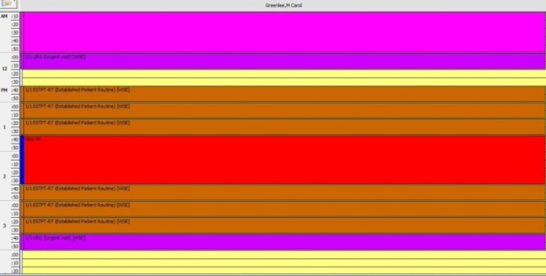
Schedule Based on the Referral Needs
Have a mechanism to schedule patients in accordance with their referral needs / risk status
Reserved Urgent spots (“work the referral; work the schedule”)
On-call clinician to see patients with urgent referral needs
Other options
Urgent

Slide 32
Triage (Risk Stratification) and Tracking
Urgent
Move up
Routine
Short Call

Slide 33
Working the Schedule
91% of patients would come on short notice if contacted
Notes:
Study out of UK showed that 91% of patients would come on short notice / cancellation if given the opportunity & called(texted, emailed)

Slide 34
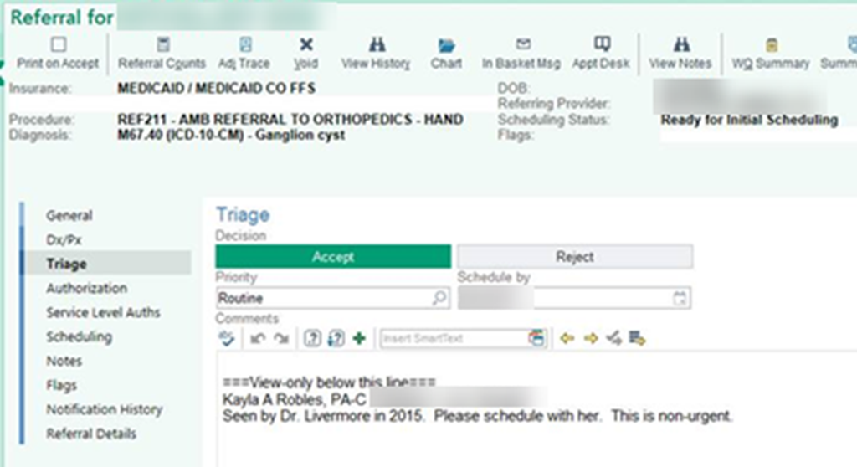
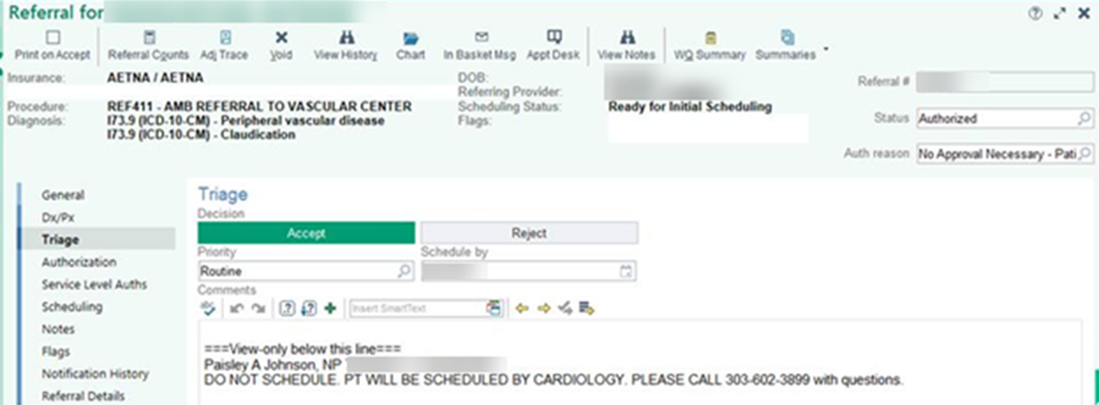

Slide 35
Put it into action …
Use the lists for stratification of urgency of referral needs (priority) as part of the Pre-consultation review process for appropriate scheduling
Attach urgency stratification lists as supplement to the Care Coordination Agreement as guide for referral requests

Slide 36
“Backwards” care Inappropriate Care Two Cases from an Academic Medical Center
Patient comes for “uncontrolled” T2DM,
no A1C available (did not have POC A1C at AMC)
spent visit discussing insulin
subsequent A1C 7.1%
called patient to tell her to ignore everything we talked about and just adjust current oral regimen
Patient drove 3 hours for appointment to get FNA of thyroid nodule ,
no TSH available
Patient insisted the biopsy be done that day
biopsy done
TSH obtained
found to have suppressed TSH due to “hot” nodule (FNA not indicated)
Information Void – Value Void
Low Value Care (No Benefit/ Cost)

Slide 37
Supporting Data (Pertinent Data Set) for the referred condition
Pertinent to the clinical question or reason for referral (not data dump)
Adequate enough to address the issues (reduce duplication)
To allow the specialty practice to
determine if the referral is to the appropriate specialty
effectively triage urgency
effectively address the referral (enough info to do something)

Slide 38
Parameters for Pertinent Data Sets
The Pertinent Data Set / referral guideline should not create a significant burden for the referring physician
Should be a “minimal data set” for the condition
Process can be iterative –
use of pre-consultation process with pre-visit assistance to ask for more information or addition testing or therapeutic trial when indicated and appropriate based on individual case

Slide 42
Available Pertinent Data Sets

Slide 43
Develop Pertinent Data sets for Referred Conditions
Identify 1 to 4 referral conditions
most common
most critical
most problematic (do not get needed info or get a lot of unnecessary info or get too late or too early)
determine “pertinent data sets” for those referrals
what supporting data is critical
What is optional (attach results if already done but not necessary to do)
what is unnecessary or should not be done
31

Slide 44
Put it into action….
For Primary Care
Ask for & use Pertinent Data Set / Referral Guidelines from specialty care for the most common and/or complex conditions that you refer
For Specialty Care
Use your Pertinent Data Sets / Referral Guidelines for your practice team to help with Pre-consultation/ Pre-visit review to ensure needed information is received so to maximize the value of the referral appointment
Include Pertinent Data Sets / Referral Guidelines as part of Care Coordination Agreement

Slide 45
Leave in action….
For Primary Care
Ensure high value referrals by use of Referral Request checklist
For Specialty Care
Create lists of conditions that are usually urgent, intermediate (move-up) or routine in priority (i.e. how urgent is the referral?)
Ensure the practice has capacity to schedule & see patients based on the urgency needs
Develop Pertinent Data Set / referral guidelines for at least one (1-4) conditions commonly referred to your practice (may use the Pertinent Data Sets on the ACP High Value Care website if applicable)

Slide 46
www.acponline.org/hvcc-training
Outpatient Referral Request Checklist
Pertinent Data Set resources
Checklist for creating Pertinent Data Set

